Slide 1
Climate-smart soils
Author: K. Paustian, J. Lehmann, S. Ogle, D. Reay, G. Robertson & P. Smith
(Nature, 2016)
Discentes: Caio M. Gomes, Ícaro M. Galvão e Jorge L. Locatelli
Docente: Carlos E. P. Cerri
Piracicaba, 2020

Slide 2
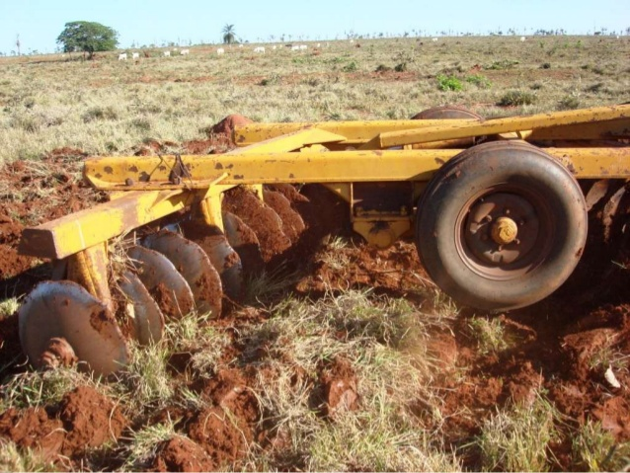
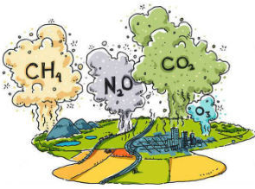
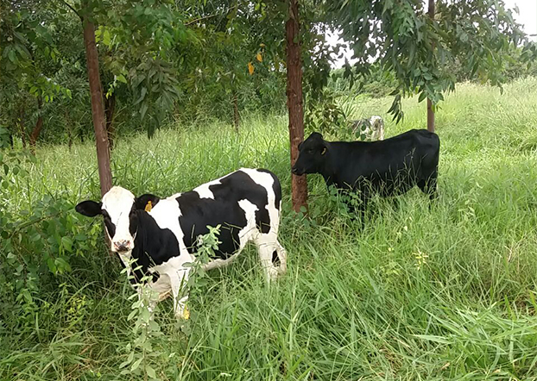
Introdução
A agricultura como fonte de emissões de GEE
O uso da terra contribui com ~ 25% do total das emissões antropogênicas globais de GEE
Principais GEE biogênicos:
Dióxido de carbono (CO₂)
Metano (CH₄)
Óxido nitroso (N₂O)

Slide 3
Introdução
A inclusão de projetos de mitigação centrados no solo indicam um papel crescente na mitigação agrícola de GEE
A implementação de estratégias de mitigação de GEE baseados no solo em larga escala exigirá a capacidade de medir e monitorar as reduções de GEE com precisão aceitável, incerteza quantificável e a um custo relativamente baixo

Slide 4
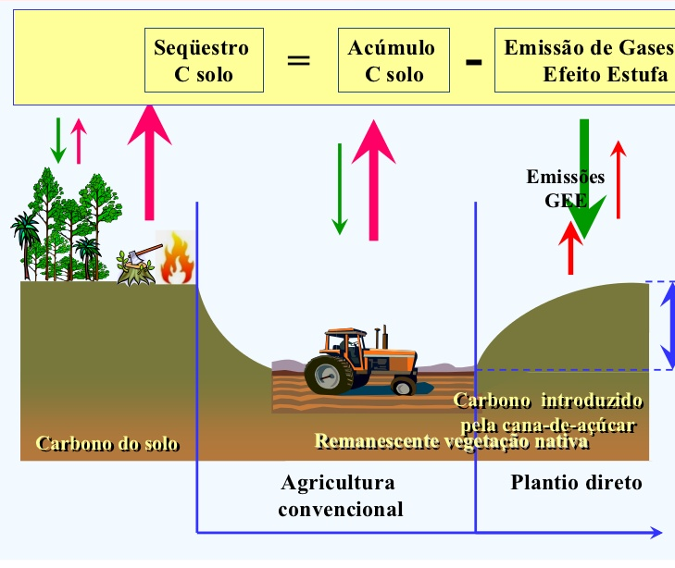
Manejo dos sistemas e sequestro de C
Os solos constituem o maior pool de C orgânico terrestre
Assim, aumentar em até alguns % o armazenamento líquido de C no solo representa um potencial sumidouro de C
Evitar a conversão e a degradação de ecossistemas nativos é uma forte alternativa de mitigação

Slide 5
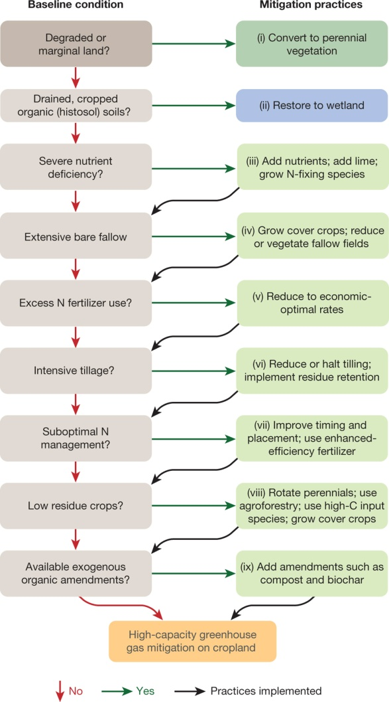

Slide 6
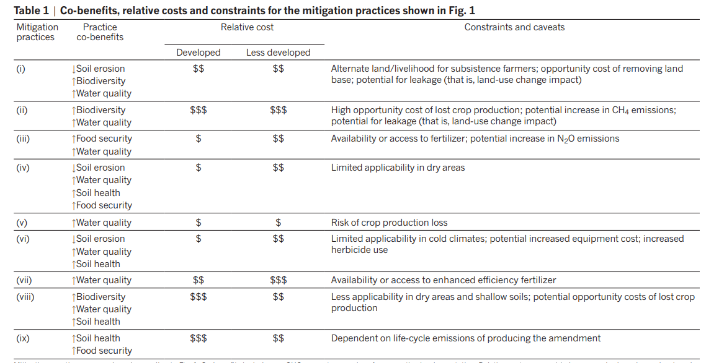

Slide 7
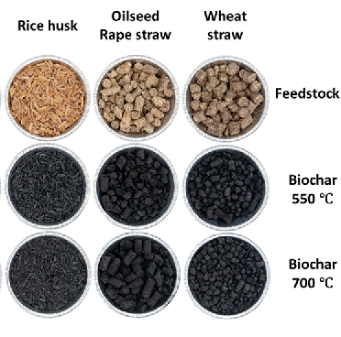
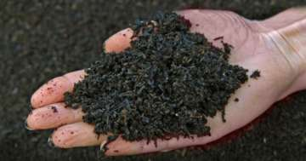
Sequestro de C via adição de C externo
A adição de C derivado de fontes externas, como compostos ou biocarvão (biochar), pode aumentar os estoques de C do solo
Elevado tempo médio de residência
Os tempos de permanência no solo variam dependendo do tipo de biochar, teor de nutrientes e condições do solo

Slide 8
N₂O – Manejo e emissões
8,1 Tg ano⁻¹
4,2 Tg ano⁻¹
Notes:
Arable soils emit more N2O to the atmosphere than any other anthropogenic source2,19; some 4.2 teragrams (Tg) of a global anthropogenic flux of 8.1TgN2O-Nyr−1 . Reducing this flux represents a substantial mitigation opportunity, particularly since N2O is often the major source of radiative forcing in intensively managed cropland. Better N management to reduce emissions would also ameliorate other environmental problems such as nitrate pollution of ground and surface waters caused by excess reactive N in agroecosystems (Fig. 1, Table 1).

Slide 9
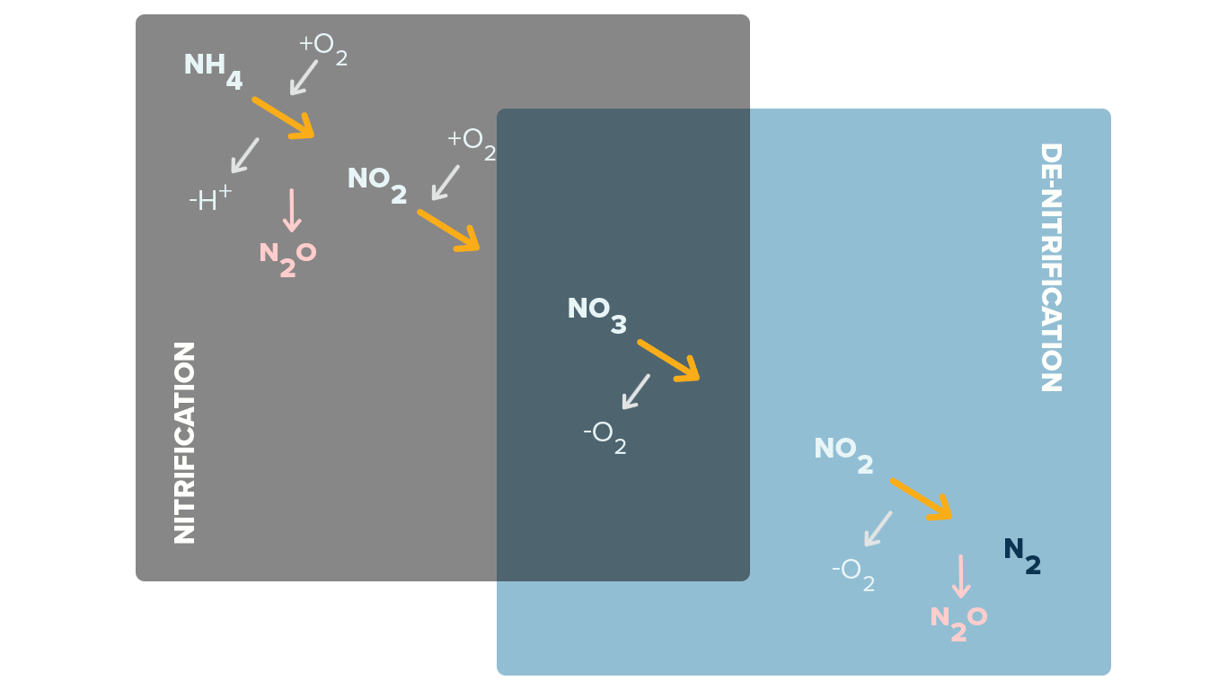
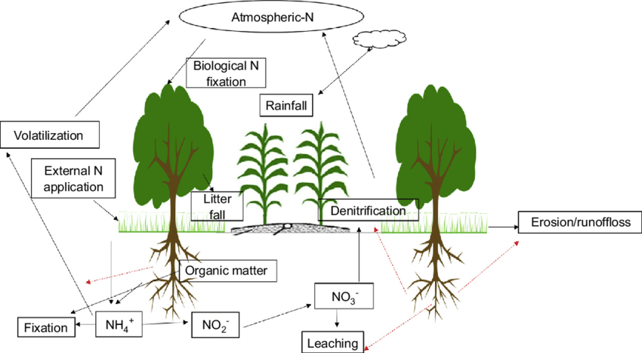
N₂O – Manejo e emissões
Notes:
N2O is produced in soils by microbial activity—mainly nitrification and denitrification—which occurs readily when stimulated by the abundant N that cycles rapidly in virtually all agroecosystems. During nitrification, ammonium added as fertilizer, fixed from the atmosphere by legumes, or mineralized from soil organic matter, crop residue, or other inputs is oxidized to nitrite and eventually to nitrate in a series of reactions that can also produce N2O. Likewise, when denitrifiers use nitrate as an electron acceptor when soil oxygen is low, N2O is an intermediate product that can readily escape to the atmosphere.

Slide 10
N₂O – Manejo e emissões
1% N₂O
N
Competição
Notes:
Arable soils managed to support high crop productivity have the capacity to produce large quantities of N2O, and fluxes are directly related to N inputs. On average, about 1% of the N applied to cropland is directly emitted as N2O (ref. 49), which is the basis for estimating emissions using default Intergovernmental Panel on Climate Change methods18. However, recent evidence suggests that this value is too high for crops that are under-fertilized and too low for crops that are fertilized liberally28. When crops compete with microbes for available N, N2O fluxes are lower. In addition to direct in-field emissions, high N applications cause N losses from leaching and volatilization that contribute to ‘indirect’ N2O emissions, downstream or downwind from the field50.

Slide 11
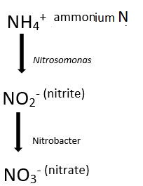
NBPT
N₂O – Manejo e emissões
DCD e Nitrapirina
Ajuste da dose aplicada
Aplicação em taxa variável
Sincronizar a aplicação de acordo com a demanda
Notes:
Since N2O has no significant terrestrial sink, abatement is best achieved by attenuating known sources of N2O emissions, by altering the environmental factors that affect N2O production (soil N, oxygen, and C) or by biochemically inhibiting conversion pathways using soil additives. For example, nitrification can be inhibited with commercial additives such as nitrapyrin and dicyandiamide, which slow ammonium oxidation, and field experiments suggest that inhibitors can reduce N2O fluxes by up to 40% in some soils, although other soils show little reduction and more research is needed to understand variable site-level responses51. Likewise, tillage and water management can affect N2O fluxes by altering the soil microenvironment52,53
Another means of reducing N2O emissions from arable soils is more precise N management to minimize excess N not used by the crop, while maintaining sustainable high yields. Fertilized crops typically take up less than 50% of the N applied; the remainder is available for loss. According to one recent study54, corn farmers in the midwestern states of the USA could reduce N2O loss by 50% with more conservative fertilizer practices. Nitrogen conservation can be achieved by: (1) better matching application rates of N to crop needs using advanced statistical and quantitative modelling; (2) applying fertilizer at variable rates across a field based on natural patterns of soil fertility, or within the root zone rather than broadcast on the soil surface; and (3) applying fertilizer close to when the crop can use it, such as several weeks after planting, or adding it earlier but using slow-release coatings to delay its dissolution (Fig. 1, Table 1) 50
High temporal and spatial variability make predictions of changes in N2O fluxes in response to management surprisingly difficult. Particularly lacking are empirical data for multi-intervention strategies that may interact in unexpected ways. Aligned to this paucity are gaps in our understanding of how N cycling and net N2O flux in managed soils will respond to future climate change55. The limited number of field manipulation studies to date indicate that changing temperature and precipitation patterns may have large and strongly coupled effects on net N2O emissions56, yet our understanding of the processes that underpin these effects and their robust representation in models is far from complete.

Slide 12
CH₄ – Manejo e emissões
177-284 Tg ano⁻¹
33-40 Tg ano⁻¹
~30 Tg ano⁻¹
Solo anaeróbico
Solo aerado

Slide 13
CH₄ – Manejo e emissões
Notes:
More than one-third (>200Tg yr−1 ) 9 of global methane (CH4) emissions occur through the microbial breakdown of organic compounds in soils under anaerobic conditions57. As such, wetlands (177–284Tgyr−1 ) and rice cultivation (33–40Tgyr−1 ) 9 represent the largest soil-mediated sources of CH4 globally. In contrast, well aerated soils act as sinks for CH4 (estimated at ~30Tgyr−1 ) from the atmosphere via CH4 oxidation, the bulk of this net sink being in unmanaged upland and forest soils58.

Slide 14
CH₄ – Manejo e emissões
Temperatura
Aeração do meio
Manejo
Disponibilidade de substrato
-25% ou 7,6 Tg ano⁻¹
Adição de N
~30 Tg ano⁻¹
Notes:
https://link.springer.com/content/pdf/10.1023/A:1005929032764.pdf
Key determinants of soil CH4 fluxes include aeration, substrate availability, temperature and N inputs59; therefore, soil management can radically alter CH4 fluxes. For example, in most soils, conversion to agriculture severely restricts CH4 oxidation, related to the suppression of methanotrophs by accelerated N cycling60. In flooded rice, alterations in drainage regimes and organic residue incorporation could reduce emissions by ~25% or 7.6TgCH4 yr−1 globally19, although cycles of wetting and drying of soils may also enhance N2O production61 and soil C mineralization62, thereby reducing the net mitigation effect.
With global rice production projected to expand by ~40% between 2000 and 2023 (ref. 63), the potential for further GHG mitigation via soil management appears to be large, although the global distribution and diverse nature of rice production systems—including irrigated, rain-fed and deep-water—present challenges to developing effective mitigation strategies. For longer-term (>20 year) projections, climate change and land–atmosphere interactions become increasingly important, with changes in N inputs, temperature, precipitation and atmospheric CO2 concentration all likely to affect net CH4 fluxes from soils64.
This uncertainty highlights important gaps in understanding key processes and their underlying controls. The restoration of soil CH4 uptake following agricultural conversion, for example, appears related to methanotroph community diversity65, about which we know too little. Likewise the abatement of CH4 generation in rice rhizospheres is related to C compounds exuded by roots, such that CH4 mitigation might be achieved through further rice breeding and genetics66.

Slide 15
Potencial global de mitigação
5,3 Pg CO₂(eq) ano⁻¹ (Sem restrições financeiras)
1,5 Pg CO₂(eq) ano⁻¹ (US$ 20 por Mg CO₂(eq)
~8 Pg CO₂(eq) ano⁻¹
Notes:
How important, in total, is this large, varied set of land-use and management practices as a GHG mitigation strategy? One of the challenges in answering this question is to distinguish between what is technically feasible and what might be achieved given economic, social and policy constraints. A comprehensive global analysis of agricultural practices19 combined climate-stratified modelling of emission reductions and soil C sequestration with economic and land-use change models to estimate mitigation potential as a function of varying ‘C prices’ (reflecting a social incentive to pay for mitigation). They estimated total soil GHG mitigation potential ranging from 5.3PgCO2(eq) yr−1 (without economic constraints) to 1.5 PgCO2(eq) yr−1 at the lowest specified C price (US$20 per Mg of CO2(eq)). Average rates for the majority of management interventions are modest,
A more unconventional intervention that has been proposed is the development of crops with larger, deeper root systems, hence increasing plant C inputs and soil C sinks22,68. Increasing root biomass and selecting for root architectures that store more C in soils has not previouslybeen an objective for crop breeders, although most crops have sufficient genetic plasticity to alter root characteristics substantially69 and selection aimed at improved root adaptation to soil acidity, hypoxia and nutrient limitations could yield greater root C inputs as well as increased crop yields68. Greater root C input is well recognized as a main reason for the higher soil C stocks maintained under perennial grasses compared to annual crops16. Although there are no published estimates of the global C sink potential for ‘root enhancement’ of annual crop species, as a first-order estimate, a sustained increase in root C inputs might add ~1PgCO2(eq) yr−1 or more if applied over a large portion of global cropland area (Fig. 2).
Thus, the overall mitigation potential of existing (and potential future) soil management practices could be as high as ~8PgCO2(eq) yr−1 . How much is achievable will depend heavily on the effectiveness of implementation strategies and socioeconomic and policy constraints. A key strength is that a variety of practices can often be implemented on the same land area, to leverage synergies, while avoiding offsetting effects for different gases (Fig. 1). But regardless of which combination of management interventions are pursued, effective policies, that incentivize land managers to adopt them, will be needed. A common thread across implementation strategies is the role for strong science-based metrics with which to measure and monitor performance.

Slide 16
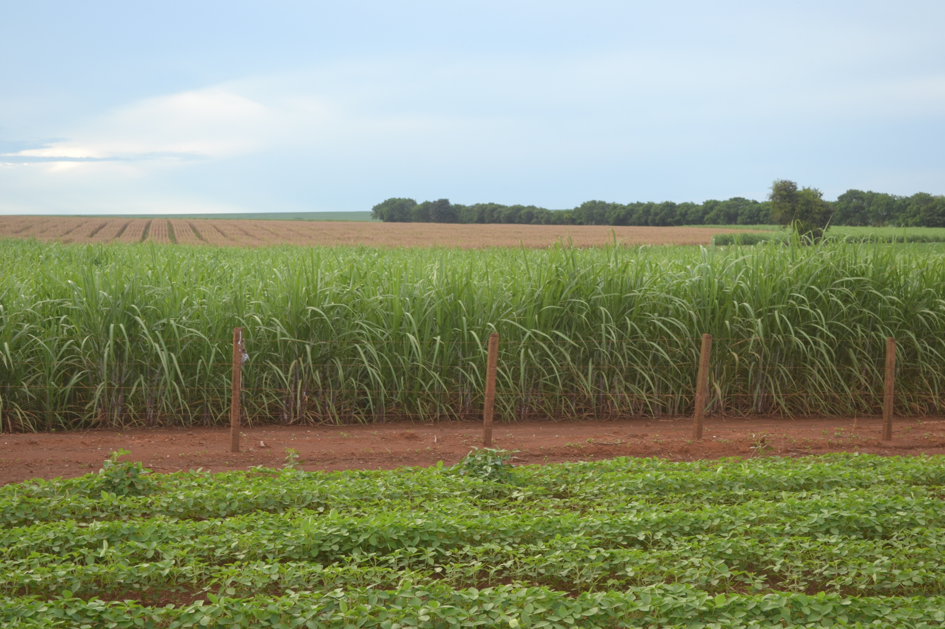
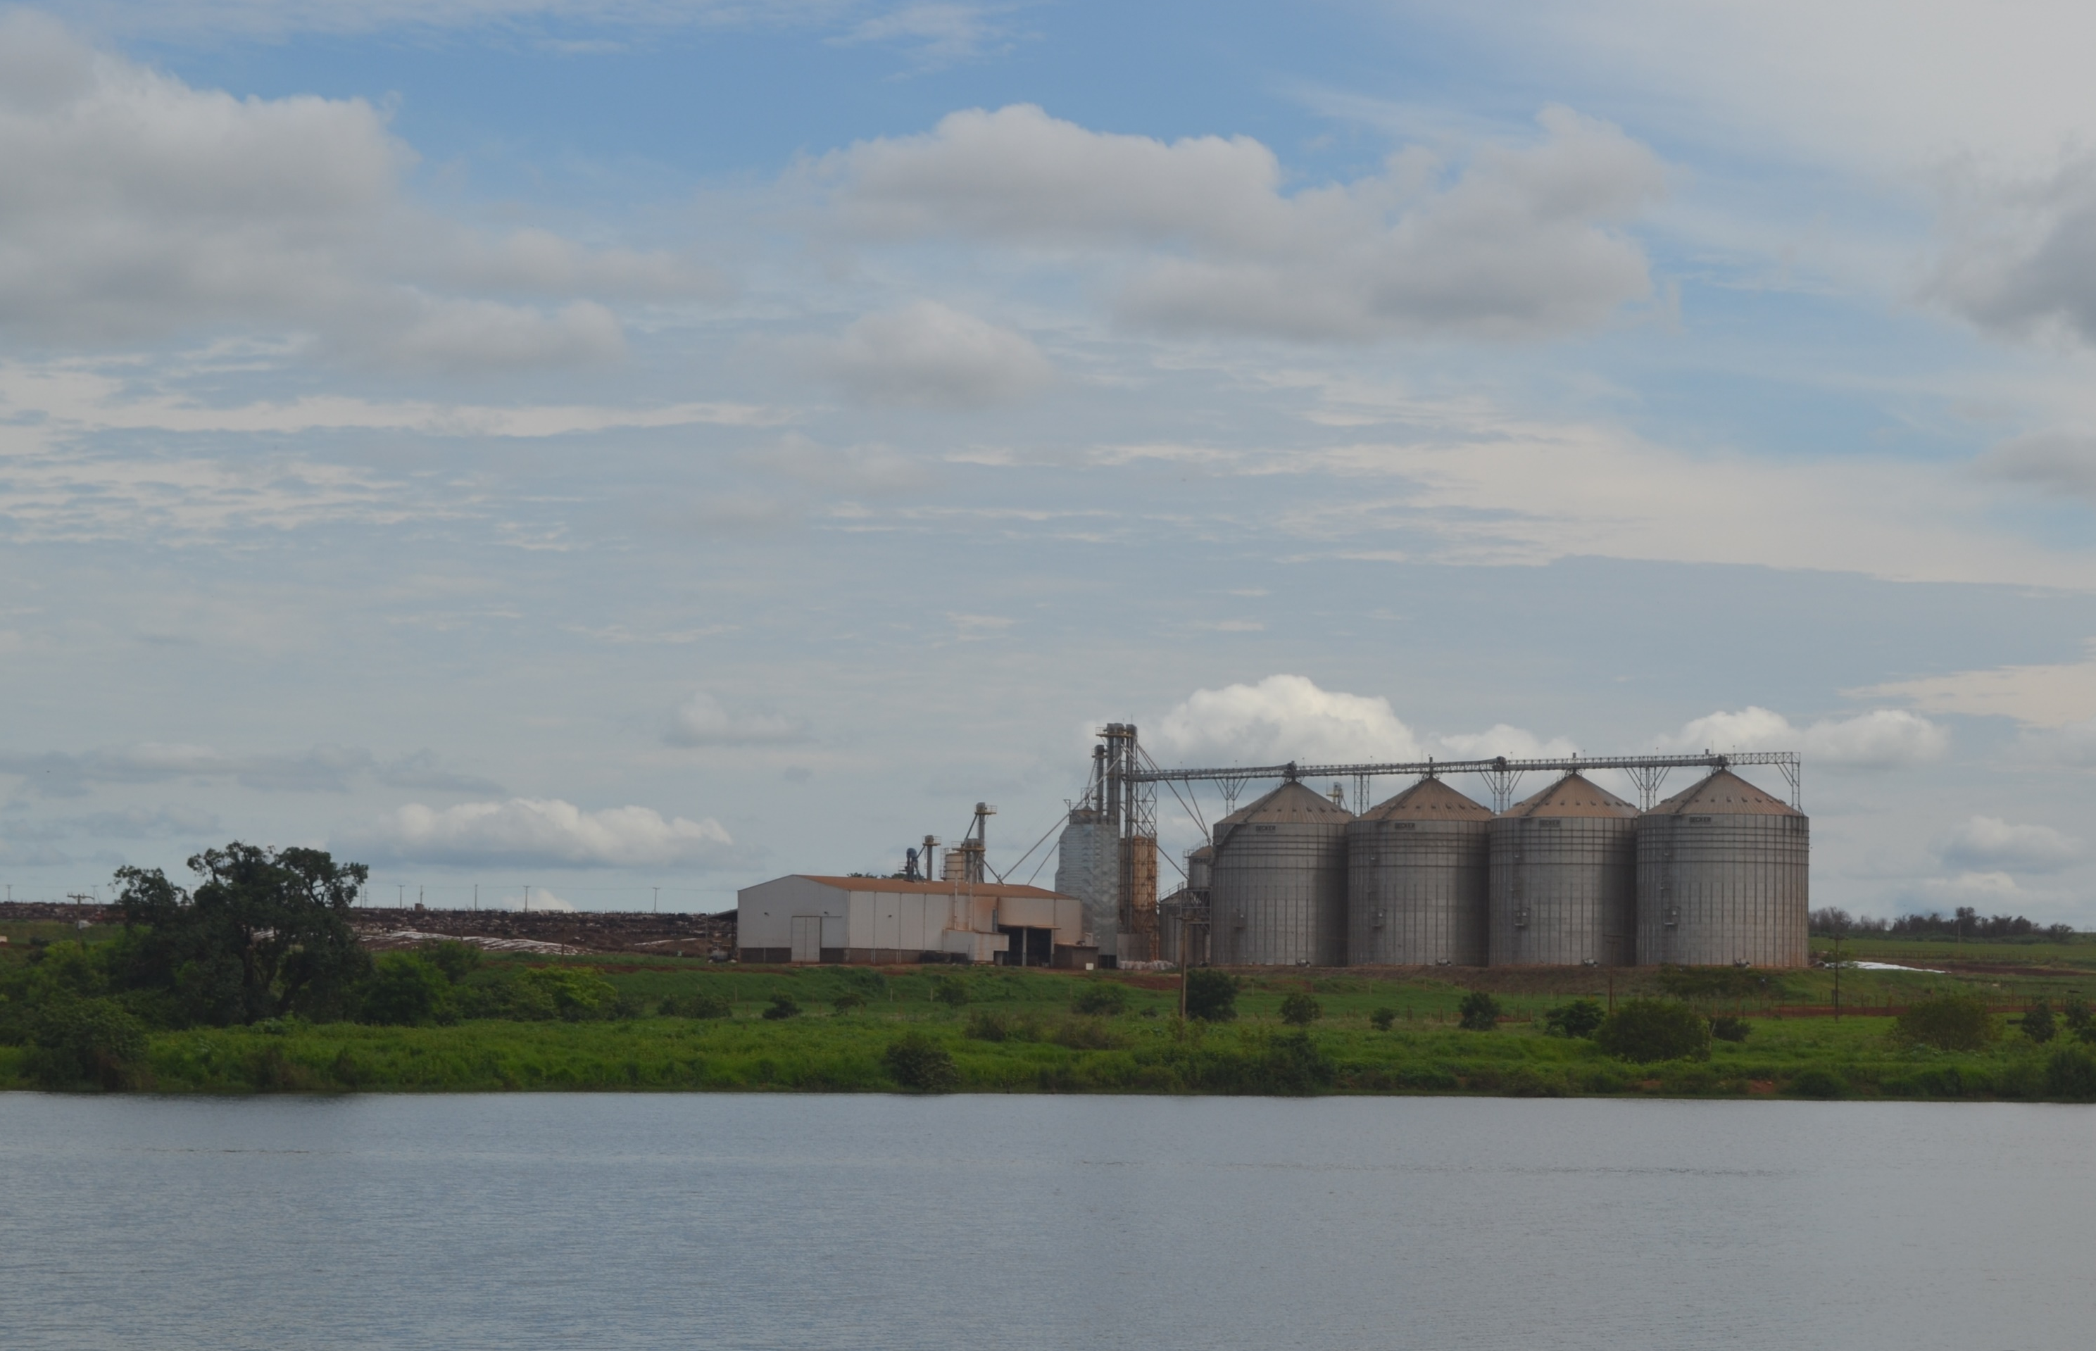
Implementação de práticas “mitigadoras”
Agropecuária = Escala global
Políticas de mitigação:
Cap-and-trade
Green labelling
Taxação
Subsídios
Monitoramento: avaliações diretas vs modelos

Slide 17
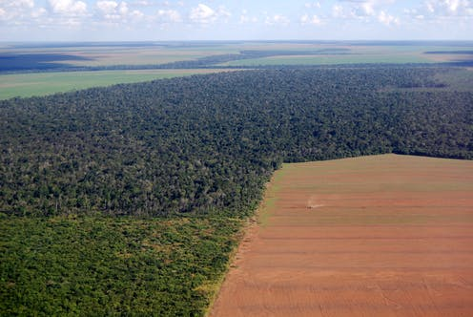
Implementação de práticas “mitigadoras”
Modelos: quantificação das emissões f(localidade; condições ambientais; manejo)
Empíricos vs mecanicistas (process-based)
Projetos:
Conversão no uso da terra
Projetos mais complexos do uso da terra (agropecuária)
Precisão do monitoramento
Muitas interações entre fatores (culturas, manejo, clima,
solo, etc.)
Fonte de dados para input no modelo = produtor
Produção, quantidade de fertilizante, defensivos,
combustível, etc.
Alternativas para engajar produtores: Cool farm tool/
COMET-Farm tool
Projetos mais abrangentes: sensoriamento remoto
E.g.: mudança no uso do solo via imagens de satélite
∆C / ha
∆C/ha

Slide 18
Quantificação de incertezas
Erros de Modelos process-based
Falta de compreensão do processo
Parametrização inadequada
Erros de Modelos empíricos
Própria mensuração para gerar fatores de emissão
Falta de representação de interações
Sistemas de monitoramento, reporte
Desconto do “prêmio” ~ nível de incerteza do dado
Integração de propriedades = Incerteza
Verificação independente
Mensurações diretas na propriedade
Julgamento de especialistas
Observações atmosféricas: inverse modelling
Mitigação CO₂ eq
Fazenda A
Fazenda B

Slide 19
Conclusões e recomendações
“All of the above” approach

Slide 20
Conclusões e recomendações
Limitação à implementação: quantificação e verificação de forma “barata-efetiva”
Inclusão do solo em políticas de compliance e mercado de C voluntário
Reduzir custos de governos que forneçam subsídios baseados em boas práticas
Atender a demanda por produtos “low carbon”
Redução de incertezas
Melhorar previsões dos modelos e monitoramento
Como?
Suporte à pesquisa em fluxos de GEE e Mensuração de C no solo em campos experimentais e “on-farm”
Protocolos de pesquisa consistentes e integrados
Suporte à pesquisas em escalas menores (estabilização da MOS, microbiologia, interações químicas, etc.)
Modelos estilo open-source, community-development
Contexto político econômico cultural e social = Quem vai ou não emitir/sequestrar/mitigar GEE são produtores

Slide 21
Obrigado!

