Slide 1
Chapter 6 Organizational Structure & Management Systems: The Fundamentals of Strategy Implementation
Prof. Luciano Thomé e Castro

Slide 2
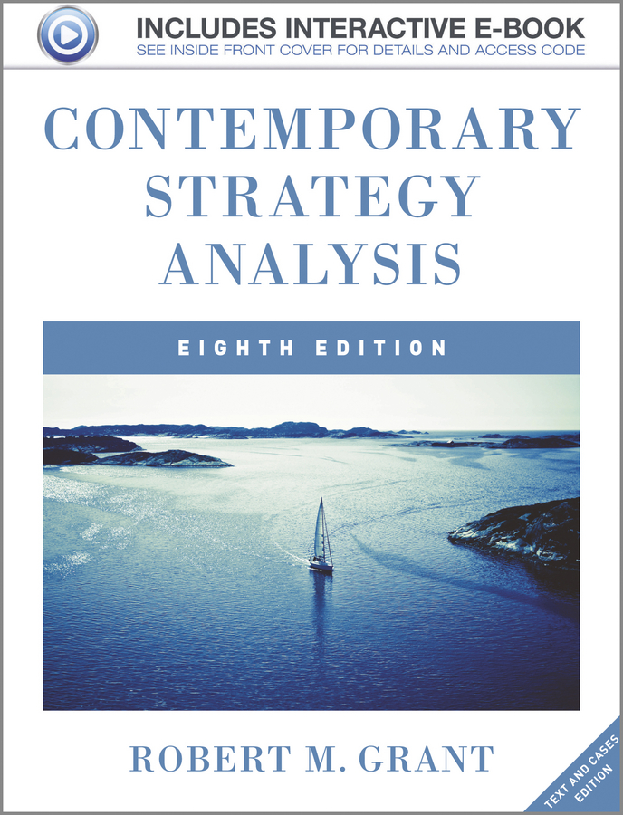
© 2013 Robert M. Grant
www.contemporarystrategyanalysis.com

Slide 3
Organizational Structure & Management Systems: The Fundamentals of Strategy Implementation
OUTLINE
From strategy to implementation: Strategic planning systems
Organizational design
Specialization and division of labour
The cooperation problem
The coordination problem
Hierarchy in organizational design
Contingency approaches to organizational design
Organizational design: Choosing the right structure
Defining organizational units
Alternative structural forms
Trends in organizational design
© 2013 Robert M. Grant
www.contemporarystrategyanalysis.com

Slide 4
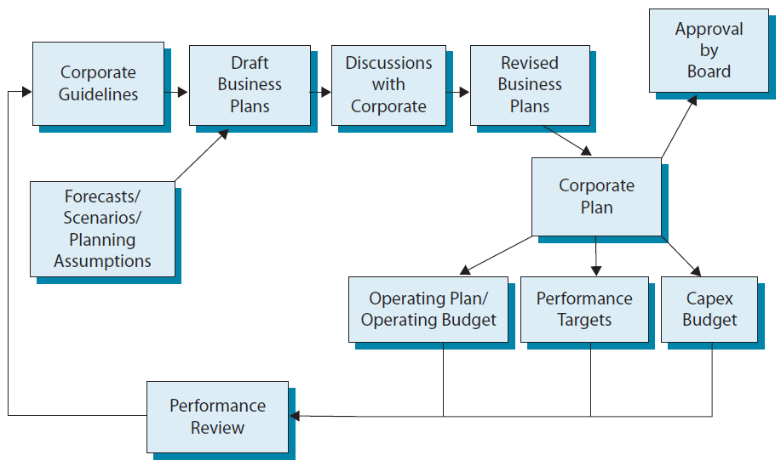
From Strategy to Execution:
The Strategic Planning Cycle
© 2013 Robert M. Grant
www.contemporarystrategyanalysis.com

Slide 5
What’s in a Strategic Plan?
Component of Strategic Plan | Illustration: Royal Dutch Shell Strategic Plan, 2011-14
Corporate priorities Strategic (e.g. market leadership competitive repositioning, new business development) Financial (e.g. sales growth, profitability, debt reduction) | Goals: reinforce industry leadership; provide competitive shareholder return; help meet global energy demand in a responsible way. Key differentiators: technology, project delivery capability, and operational excellence. Medium term focus: growth through upstream investment
Business strategies priorities in terms of primary basis for competitive advantage (e.g. cost reduction initiatives, innovation goals) | Upstream: Focuses on exploration for new reserves with projects where technology and know-how add value, especially in Gulf of Mexico, North American tight gas, and Australian LNG. Also, selective acquisitions and exit from non-core petroleum assets Downstream: Sustained cash generation by focusing on most profitable and growing businesses and exiting non-core refining capacity and selected retail positions
Strategic milestones: Target dates for initiating or completing projects or attaining goals | Examples of project start-ups for 2012-13: Qatar gas-to-liquids plant, 2nd phase of BC-10 Brazilian oilfield, Gamusut Kakap Malaysian oilfield
Resource commitments | Annual organic capital expenditure $25-30 billion 2011-14; >80% in upstream. Downstream investment to focus on marketing, especially in China, Brazil & SE Asia
Performance targets and financial projections | Production: Grow up to 3.7m barrel/day by 2014 Cash flow: $43 billion by 2012 (assuming $80/barrel oil) Safety: Reduce injuries from 1.3 per million hours to zero
© 2013 Robert M. Grant
www.contemporarystrategyanalysis.com

Slide 6
Emergence of the Modern Corporation
 | The Business Environment | Strategic Changes | Organizational Changes
Early 19th Century | Poor transports: Markets local Limited mechanization | Firms specialized and serve local markets | Small firms Simple management structures
Late 19th Century | Introduction of railroads, telegraph industrialization | Geographical and vertical expansion | Line/staff separation Functional structure Accounting systems
Early 20th Century | Development of road transport, telephone, financial markets & world trade | Product diversification & multinational growth | The multidivisional corporation
Late 20th Century | Rapid innovation – IT especially Globalization Turbulence | Quest for competitive advantage Outsourcing | Matrix structures Decentralization Alliances and networks
© 2013 Robert M. Grant
www.contemporarystrategyanalysis.com

Slide 7
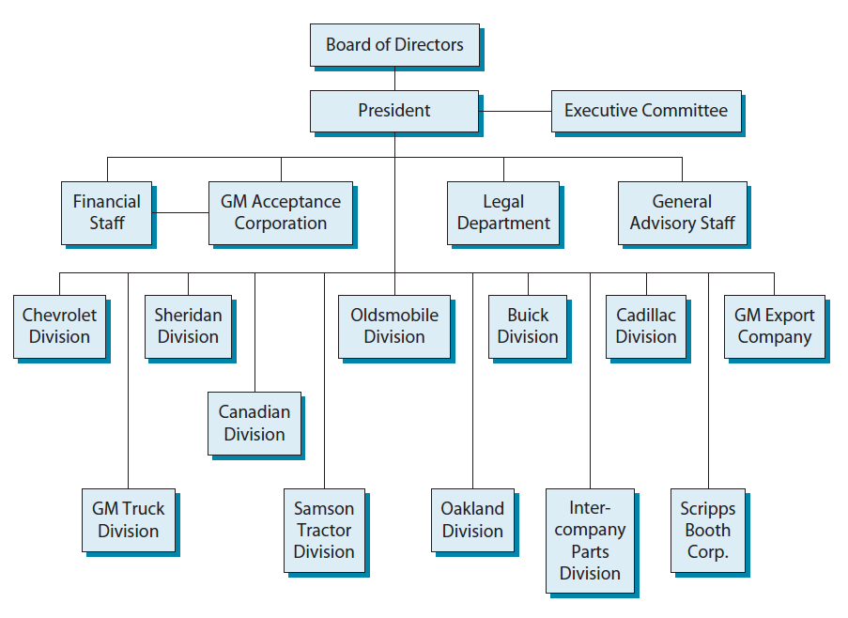
General Motor’s Organization Structure, 1921
© 2013 Robert M. Grant
www.contemporarystrategyanalysis.com

Slide 8
Implication of Specialization:
The Basic Tasks of Organization
High productivity requires specialization
The effects of specialized individuals need to be integrated. This creates two problems:
The need for cooperation
The Agency problem:
Employee’s goals ≠ Owner’s goals
The need for coordination
Managing interdependency
Organizational solutions
Control mechanisms e.g. hierarchical supervision
Performance incentives that align individual & firm goals
Shared values that create common purpose
Organizational solutions
Rules and directives
Organizational routines
Mutual adjustment
© 2013 Robert M. Grant
www.contemporarystrategyanalysis.com

Slide 9
Hierarchy as Control:
Weber’s Principles of Bureaucracy
Rational-legal authority
Specialization of labor
Hierarchical structure
Coordination and control through rules and standard operating procedures
Standardization of employment practices
Separation of positions and people: authority assigned to a position, not a person
Formalization of administrative acts, decisions and rules
© 2013 Robert M. Grant
www.contemporarystrategyanalysis.com

Slide 10
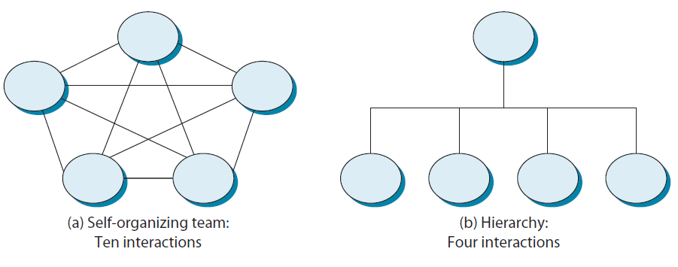
Hierarchy as Control:
Weber’s Principles of Bureaucracy
But what about effectiveness of coordination?
- Depends upon the organization’s task
© 2013 Robert M. Grant
www.contemporarystrategyanalysis.com

Slide 11
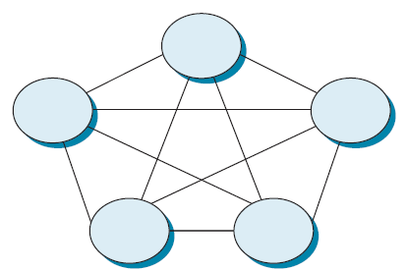
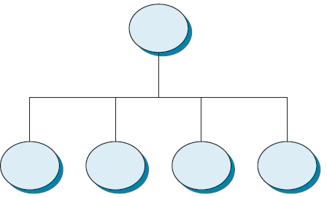
Hierarchy of Loosely-Coupled Modules Allows Decentralized Adaptation
Tightly coupled integration system:
Change in any part of the system requires system-wide adaptation
Loose-coupled, modular hierarchy:
Partially-autonomous modules linked by standardized interfaces permits decentralized adaptation and innovation
© 2013 Robert M. Grant
www.contemporarystrategyanalysis.com

Slide 12
Contingency Approaches to Organizational Design: Mechanistic and Organic Forms
© 2013 Robert M. Grant
www.contemporarystrategyanalysis.com

Slide 13
Designing the Hierarchy
Defining Organizational Units
Top level
Units may be defined on the basis of tasks, products, geographical proximity, or process/function
Critical issue: Intensity of coordination — Those with the greatest inter-dependence should be in the same organizational unit
Additional criteria: economies of scale, economies of utilization, learning, standardization of control systems
2nd level
2nd level
1st level
1st level
1st level
1st level
1st level
© 2013 Robert M. Grant
www.contemporarystrategyanalysis.com

Slide 14
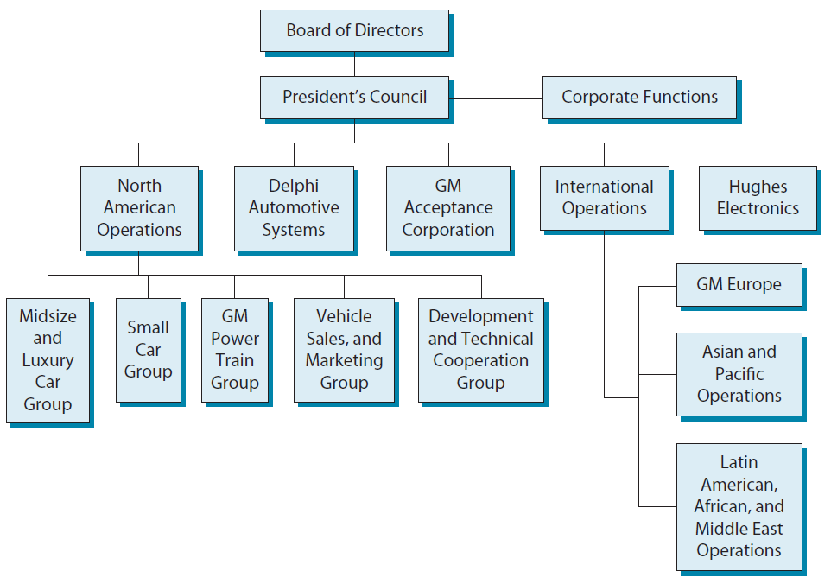
General Motor’s Organization Structure, 1997
© 2013 Robert M. Grant
www.contemporarystrategyanalysis.com

Slide 15
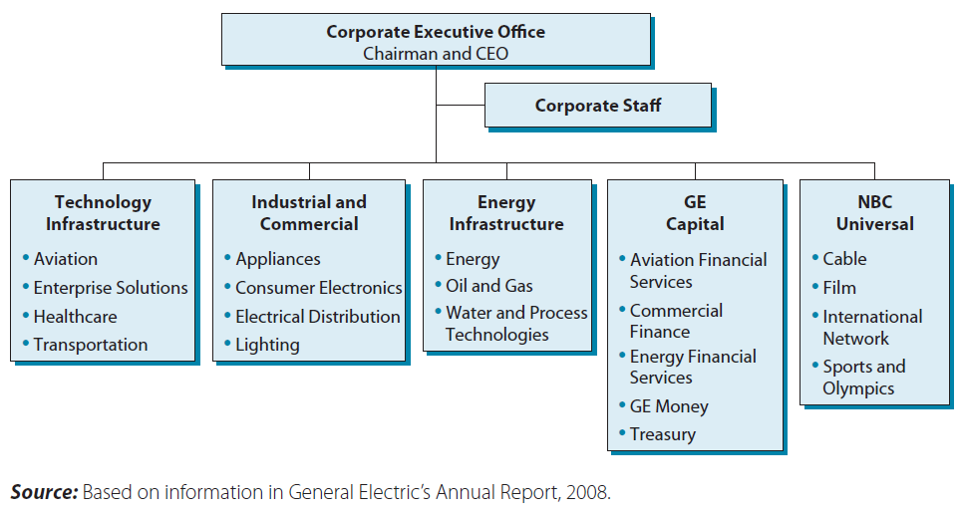
General Motor’s Organizational Structure, January 2009
© 2013 Robert M. Grant
www.contemporarystrategyanalysis.com

Slide 16
Mobil Corporation, 1997: A Mixed Structure (divisions defined by business, function and geography)
Board of Directors
CEO
Executive Office
Corporate Center
Support Services
North America
New Exploration
Worldwide LNG & IPP
Technology
Asia/ Pacific
Europe & CIS
Africa & Middle East
South America
North America M&R
Worldwide Chemicals
Shipping
© 2013 Robert M. Grant
www.contemporarystrategyanalysis.com

Slide 17
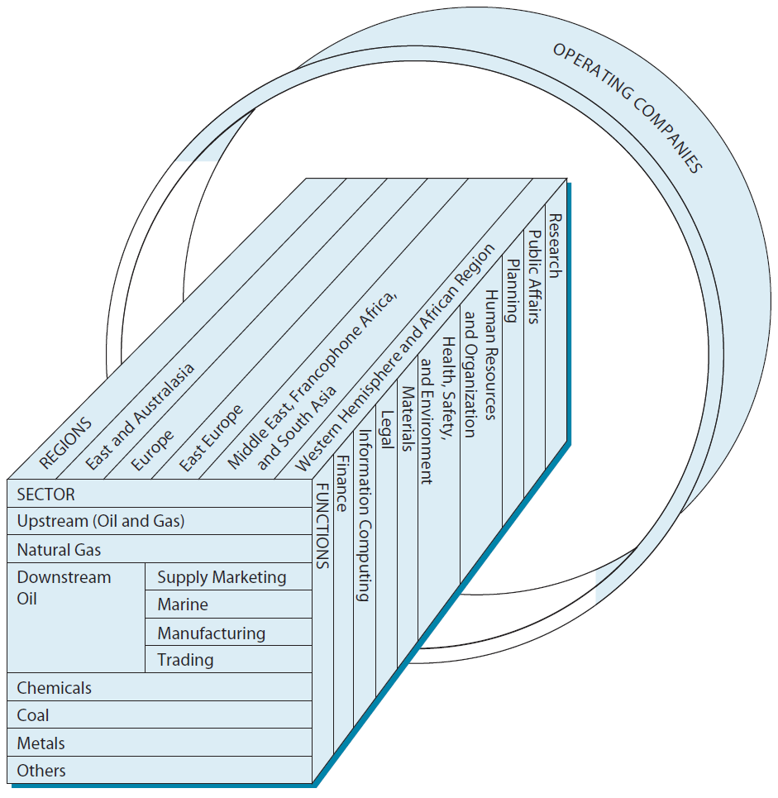
Royal Dutch/Shell Group, 1994:
A Matrix Structure
© 2013 Robert M. Grant
www.contemporarystrategyanalysis.com

Slide 18
Recent Trends in Organizational Design
Limited evidence of a “revolution in organizational design” – basic features of organizations (e.g. hierarchy, financial control mechanisms, strategic planning) are still present
Major trends of the past two decades:
Delayering – Organizational hierarchies becoming flatter
Adhocracy and team-based organization – emphasis on shared values, high participation, flexible roles and communication, lack of authority
Project-based organizations – Dynamic structures with time-limited project teams
Network structures – Organizations and groups of organizations where coordination is based upon informal social links
© 2013 Robert M. Grant
www.contemporarystrategyanalysis.com

