Slide 1
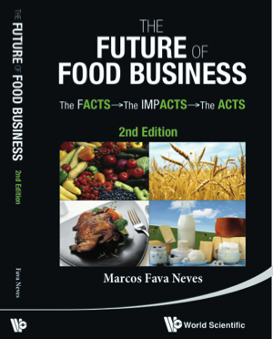
Supply Chains
RAD2402 - Strategies in Agribusiness
Chapter 41
Prof. Dr. Marcos Fava Neves
Faculdade de Administraçao (FEA/RP) – Universidade de São Paulo, desde 1995
Escola de Administração de Empresas (EAESP/FGV), desde 2018
Center for Agricultural Business - Purdue University (Indiana/USA), desde 2013
PAA – FAUBA – Universidade de Buenos Aires, desde 2006
Criador da Markestrat (www.markestrat.com.br) em 2004
Especialista em planejamento estratégico no agronegócio
www.doutoragro.com

Slide 2
The world is worried with sustainability of supply chains?

Slide 3
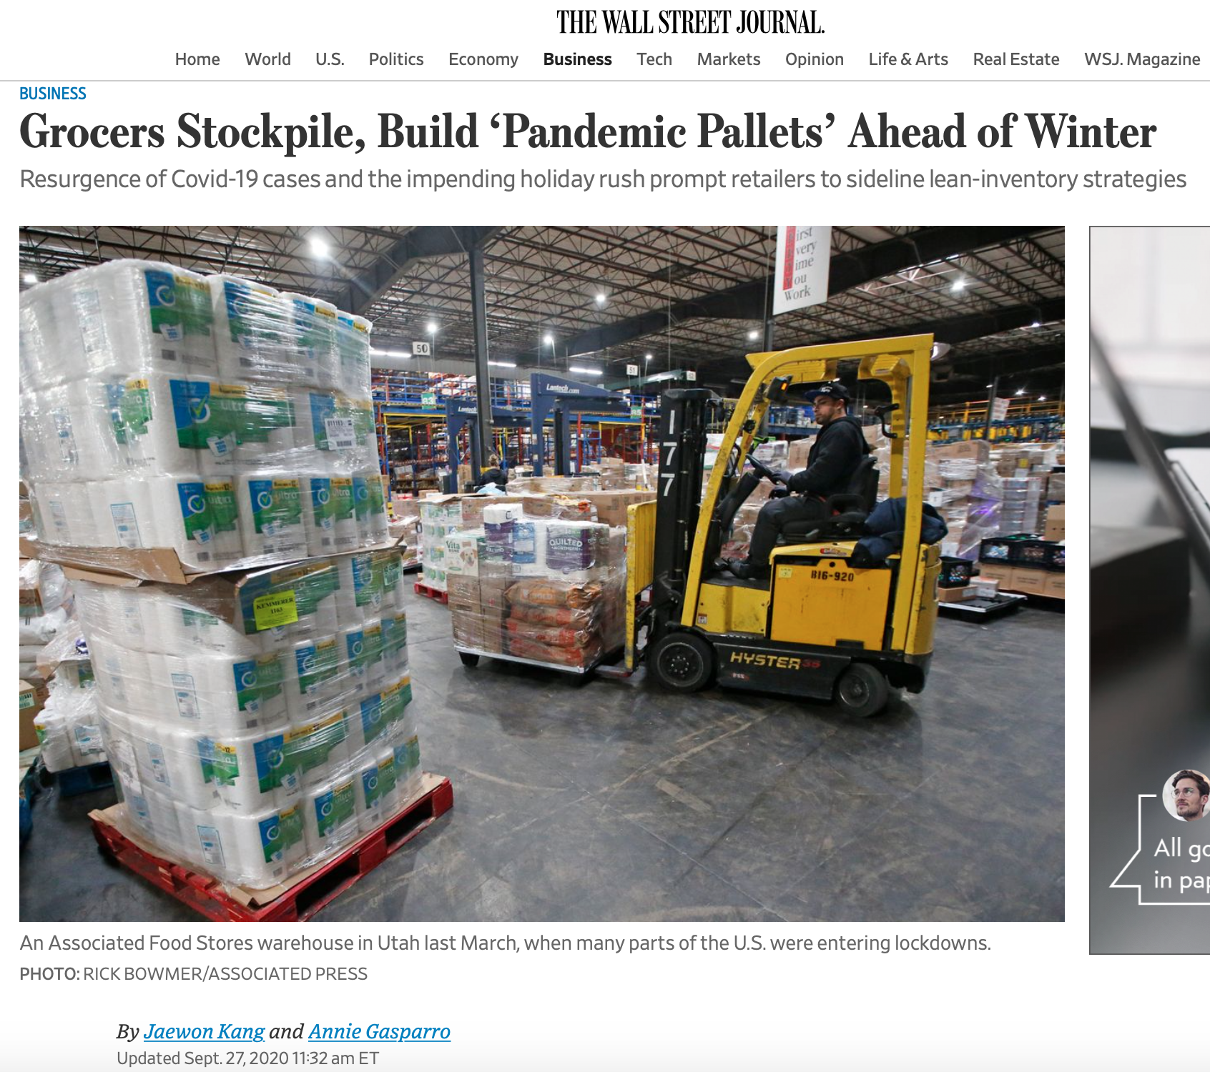

Slide 4
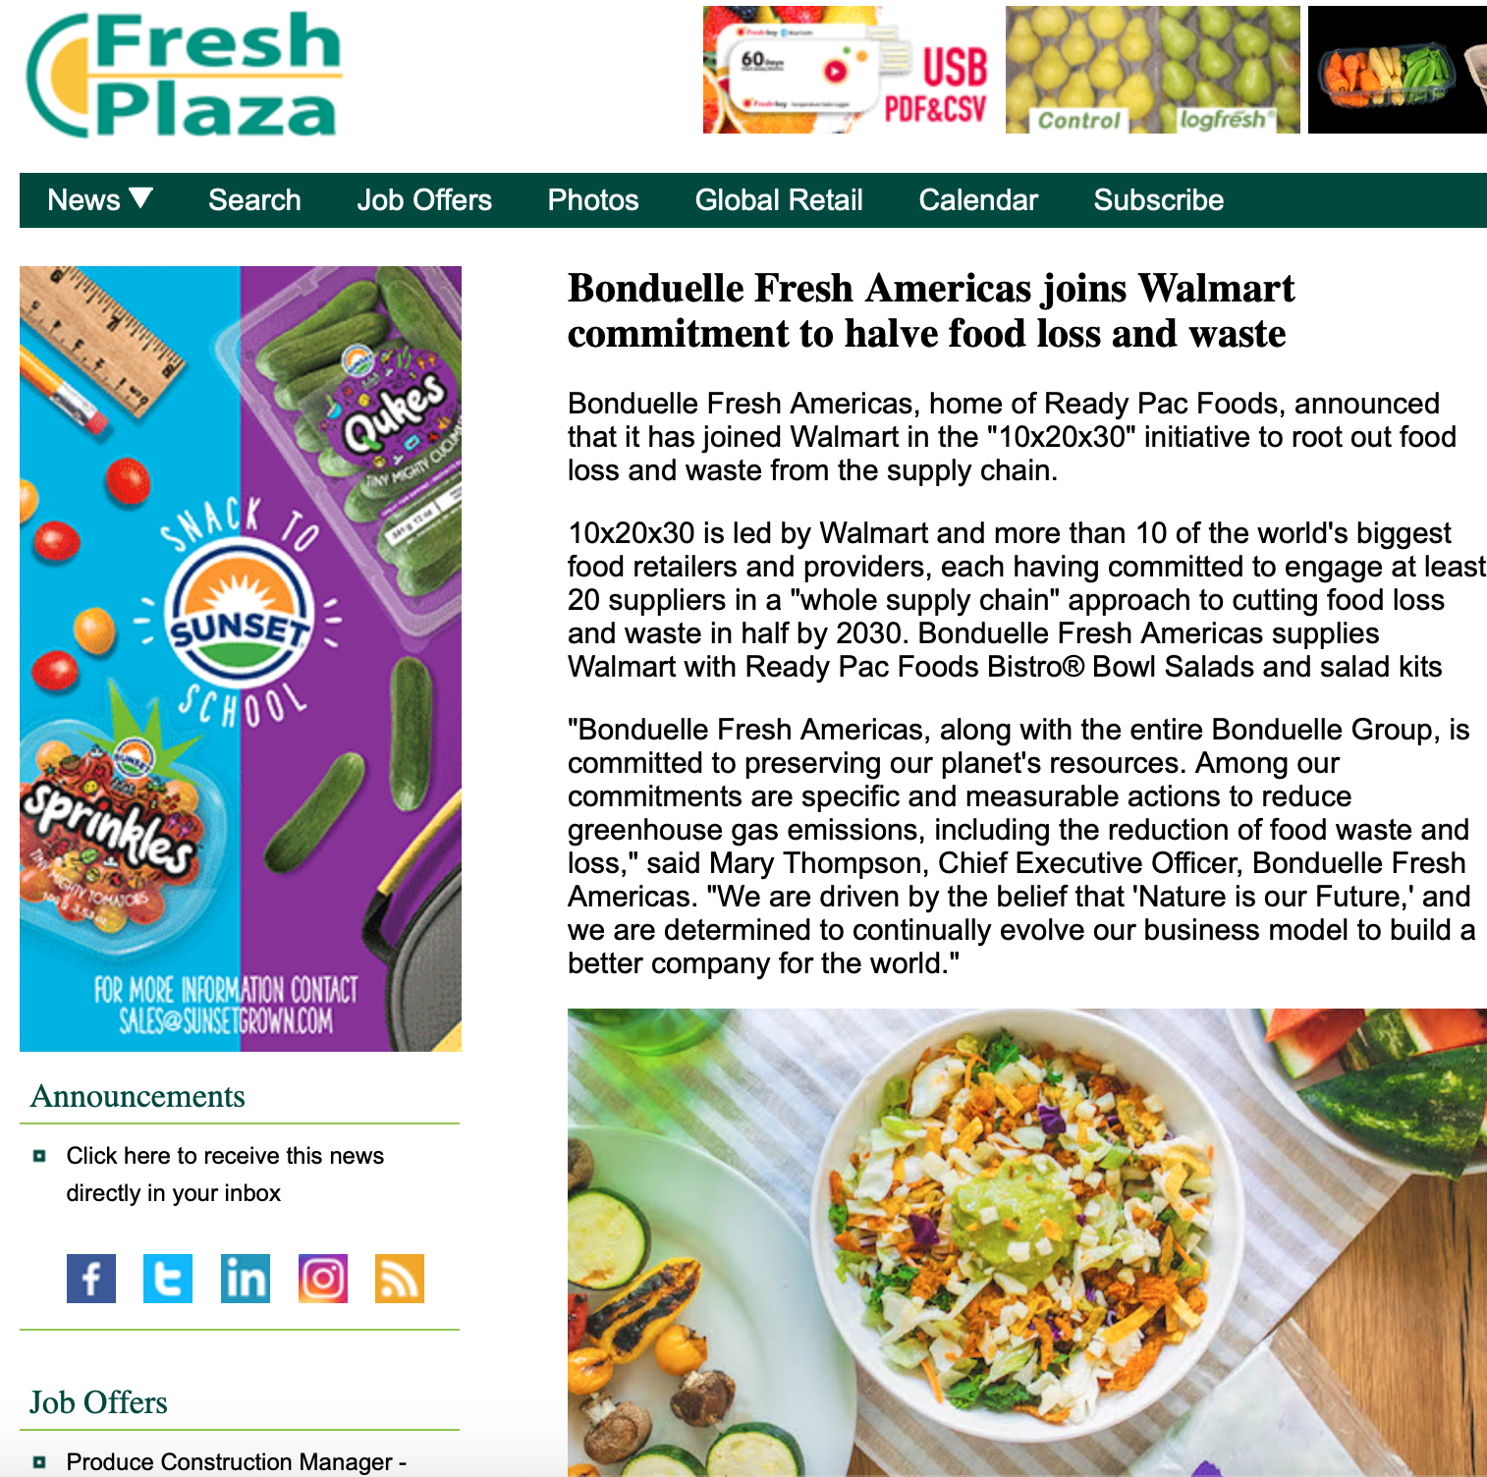

Slide 6
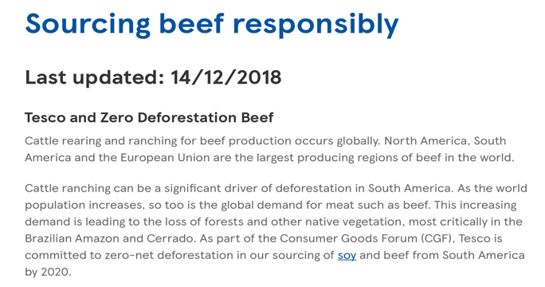
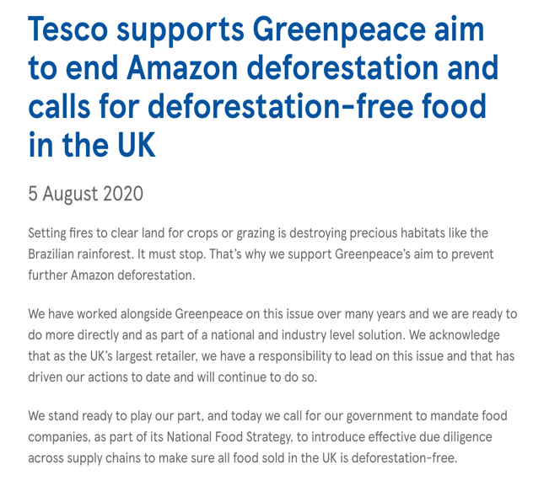
Source: https://www.tescoplc.com/updates/2020/tesco-supports-greenpeace-aim-to-end-amazon-deforestation-and-calls-for-deforestation-free-food-in-the-uk/

Slide 7
What are the leaders doing?

Slide 9
Lets warm up with a case in the vegetable industry?

Slide 10
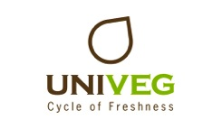
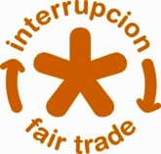

Slide 11
Key facts & figures
Turnover: EUR 3.3 billion in 2009
Workforce: 9,500 people worldwide
Presence: the UNIVEG group serves a global customer
base in 25 countries, across 4 continents

Slide 12
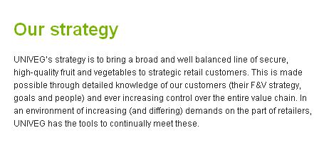
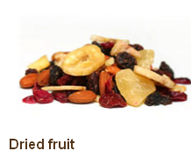
FRUIT & VEGETABLES

Slide 13
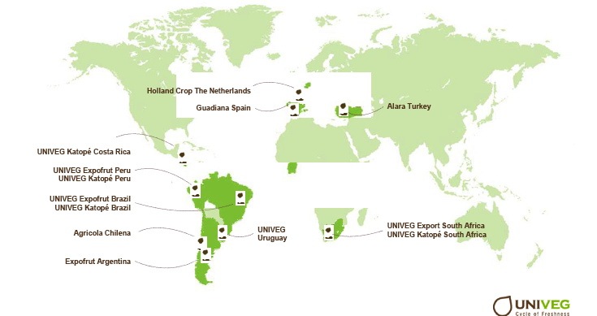
Univeg - Growing Areas

Slide 14
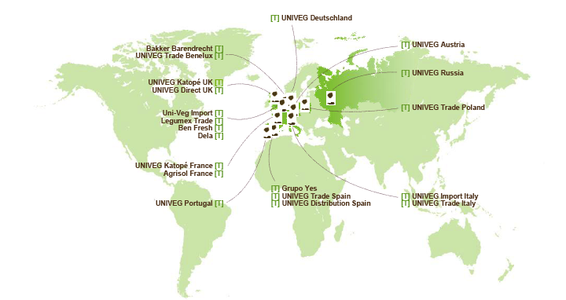
Univeg: Trading and Service

Slide 15
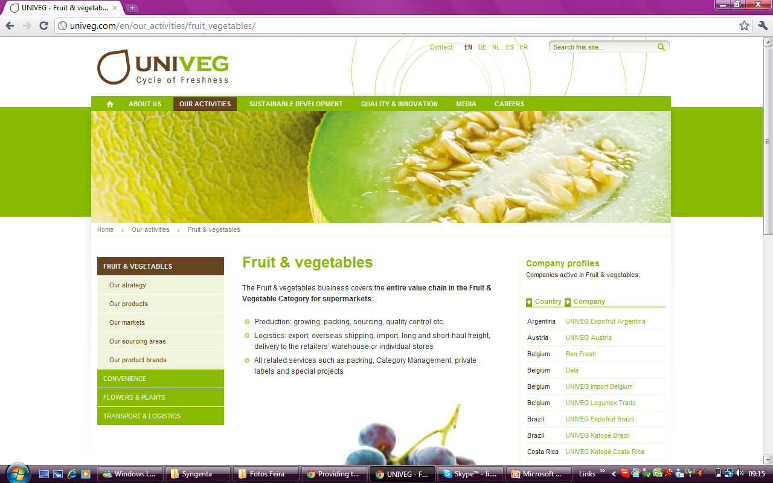

Slide 16
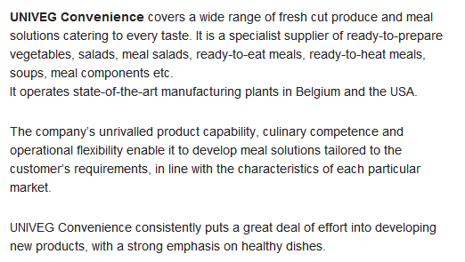
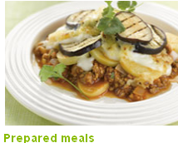
CONVENIENCE
Brands

Slide 17
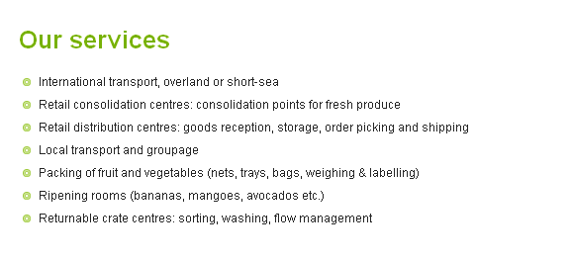
TRANSPORT & LOGISTICS

Slide 18
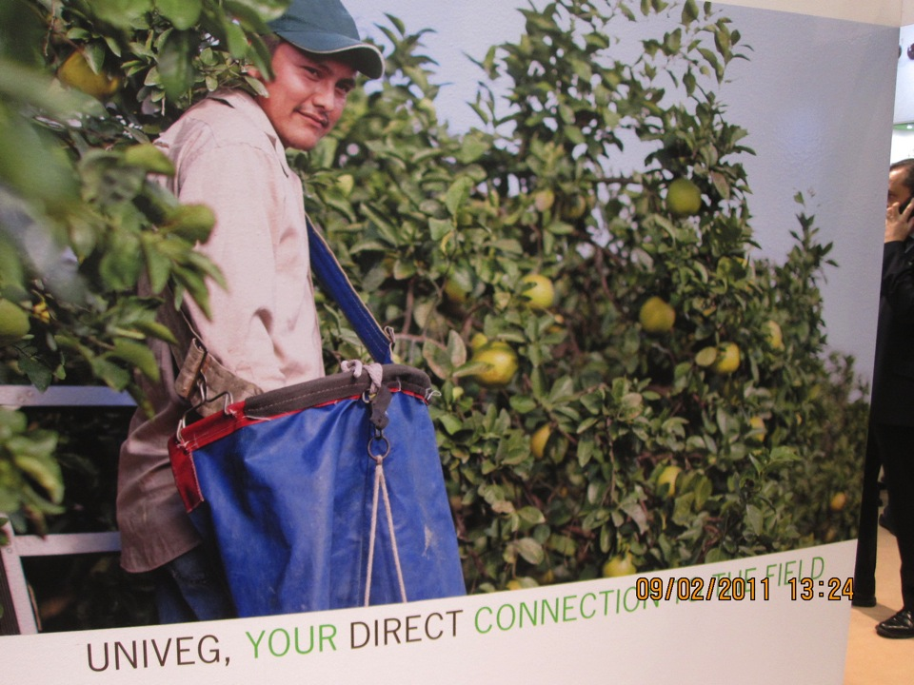

Slide 19
Developing the Supply Chain

Slide 20
In What Should We “Think About” When Developing Our Supply Chain?
COST | RELATIONSHIPS | OTHER DIFFERENTIALS
Knowledge/technology Global sourcing Scale in buying Efficiency of suppliers Innovation Competition of suppliers Avoid supplier concentration dependence Quality/security Inbound logistics | Collaboration and Coordination (flexibility and responsiveness) Transaction costs Information Flow Simplicity, control/predictability Year round supply Look at the best (brands of suppliers) Fairness Ethics and behavior of suppliers (supplier code of conduct) Stimulate benchmarking Building committees and trust | Stimulating inclusion Certifications Direct connection Buying local Environmental issues (energy, water, carbon, waist) Social issues of suppliers (treating employees, community, etc.)
Source: Marcos Fava Neves: The Future of Food Business,
^{World Scientific, 2014}

Slide 21
Method to Plan and Develop the Supply Chain of the Company
1
4
Understand the Company´s Integrated Supply Chain Structure
Major inputs (products or services) purchased or internally produced;
Costs involved (procurement costs, handling, transaction costs, stocks);
Way that the transactions are done (governance forms, like contracts, markets and other forms).
Proposal of a Governance Structure for Each Input
Analyze economics and margins and value capture possibilities;
Specialization gains;
Reversibility if needed (technology switch) and adaptability;
Building entry barriers for competitors;
Promote development and inclusions and with this accessing public credit lines
2
5
Market Analysis of Major Inputs
Number of suppliers, products, brands, channels, prices;
Concentration of suppliers;
Selling behavior of suppliers (transactions);
Services offered by suppliers;
Locations;
Major macro-environmental risks.
Building the Contract (Relationship)
Negotiation and how to consider macro-environmental changes;
Regulation of products, services, communications, payment and information flows;
Analysis of specific investments needed and the risks associated to these investments
How to promote incentives and share results of competitiveness gains.
3
6
Diagnosis of Each Input of Company´s Integrated Supply Chain
Company acquires x market characteristics;
Resources given x benefits;
Single supplier x multiple suppliers
Degree of sophistication of the relationships;
Vulnerabilities and risks;
Degree of dependence on specific suppliers;
Priority list for interventions;
Long term goals of the Company and traditions;
Internal resistance to change (cultural aspects and barriers).
Management of the Relationship
Governance forms, with boards and external evaluation committees;
Search for continuous transactions costs reductions;
Sharing benefits of experience curve and innovation gains and sharing;
Continuous benchmark process and evaluation of alternatives;
Bringing motivation and avoiding the risk of accommodation;
Sharing open communication platforms;
Flexibility and responsiveness improving services and support;
Promoting networking and cooperation for learning and benchmarking;
Permanently increasing trust.
Source: Marcos Fava Neves: The Future of Food Business, World Scientific, 2014

Slide 22
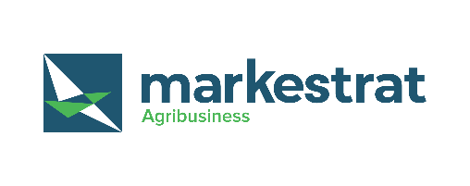
Marcos Fava Neves is an international expert on global agribusiness issues and a part-time professor of planning and strategy at the School of Business (FEARP) of the University of São Paulo (USP) and FGV Business School, both in Brazil. He graduated as an agronomic engineer from ESALQ/USP - Piracicaba in 1991. He earned his master’s degree in 1995 and his doctorate in management in 1999 from the FEA/USP School of Economics and Business – São Paulo. Marcos completed postgraduate studies in European agribusiness at ESSEC-IGIA in France in 1995 and in chains/networks at Wageningen University, in the Netherlands (1998-1999). In 2013 he spent the year as a visiting international professor at Purdue University (Indiana, USA) where he maintains the linkage as a permanent International Adjunct Professor. Since 2006 he is an international professor at the University of Buenos Aires, Argentina.
He has specialized in strategic-planning processes for companies and food chains and works as a board member of both public and private organizations, being member of mor than 10 international boards since 2004. Also in 2004, he created the Markestrat think tank with other partners, today employing around 60 people and doing international projects, studies and research in strategic planning and management for more than 250 agri-food business organizations. Some of these projects were very important in suggesting public policies for food chains that were implemented in Brazil with economic and social impacts.
Also as an experience in the private sector, from 1992 to 1993 he worked in citrus juice exporter and from 1994 to 1995 in a veterinarian company. In 2008, he became CEO of Brazil’s second-largest biofuel holding company, a position he occupied until 2009, when he returned to the University of São Paulo (USP) and Markestrat.
At the academic side, since 1995 (when he was hired by USP), Marcos has advised more than 30 doctorate dissertations and master’s theses and helped to form around 1200 Bachelors in Business Administration in Brazil with around 120 courses taught to undergraduates at USP.
His writings are strongly focused on supplying simple and effective methods for business. He has published more than 100 articles in international journals and has been author and editor of 63 books by 10 different publishers in Brazil, Uruguay, Argentina, South Africa, Singapore, Netherlands, China, the United Kingdom and the United States. He is also a regular contributor for China Daily Newspaper and has written two case studies for Harvard Business School (2009/2010), one for Purdue (2013) and five for Pensa/USP in the nineties. Recognized as the Brazilian academic with the largest number of international publications about orange juice and sugar cane chain and one of the top 3 most cited Brazilian authors in the area of food and agribusiness. He has reached more than 4000 citations in Google Scholar index.
Marcos is one of the most active Brazilian speakers, having done more than 1050 lectures and presentations in 25 countries. He received around 150 recognitions from Brazilian and international organizations, and is considered a “Fellow” of the IFAMA (International Food and Agribusiness Management Association), title received in Minneapolis - 2015.
Coming from a family of farmers, he is a worldwide defender of agriculture and farmer’s role in the development of the society. In the social side, together with his parents, Marcos is one of the creators and maintainers of Mucapp, a NGO that in 20 years has built more than 450 houses for families in Brazil that face very unfavorable conditions.

