Slide 1
Descriptive and Causal Inferences
Descriptive - what happened?
Explanatory - what made this happen?
Predictive - what will happen?
Normative - what should happen?
Interpretative - why this happened?

Slide 2
Inference and Simplification I
Inference is the process of using the facts we know to learn about facts we do not know.
The facts we do not know are the subjects of our research questions, theories, and hypotheses.
The facts we do know form our (quantitative or qualitative) data or observations.
Scientific simplification involves the productive choice of a theory (or hypothesis) to evaluate; the theory then guides us to the selection of those facts that are implications of theory.
With this criterion for the selection of facts, we can quickly recognize that more observations of the implications of a theory will only help in evaluating the theory in question.
Since more information of this sort cannot hurt, such data are never discarded, and the process of research improves.

Slide 3
Inference and Simplification II
Simplification - One of the first and most difficult tasks of research in the social sciences is this act of simplification.
It is a task that makes us vulnerable to the criticism of oversimplification and of omitting significant aspects of the situation. Nevertheless, such simplification is inevitable for all researchers.
The difference between the amount of complexity in the world and that in the thickest of descriptions is still vastly larger than the difference between this thickest of descriptions and the most abstract quantitative or formal analysis.

Slide 4
Inference and Simplification III
Modeling - All models range between restrictive and unrestrictive versions.
Restrictive models are clearer, more parsimonious, and more abstract, but they are also less realistic (unless the world really is parsimonious).
Unrestrictive models are detailed, contextual, and more realistic, but they are also less clear and harder to estimate with precision.
We model data with variables, units, and observations
KKV believe that, where possible, social science research should be both general and specific: it should tell something about classes of events as well as about specific events at particular places.
The study should be timeless and timebound at the same time.

Slide 5
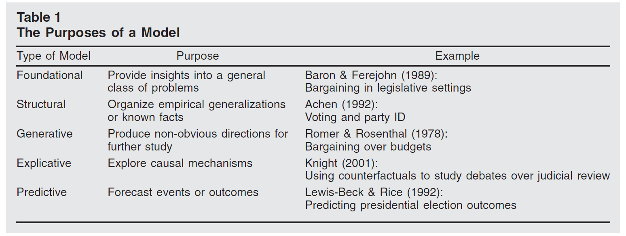
Inference and Simplification IV

Slide 6
Inference and Simplification V
Uniqueness - Some qualitatively oriented researchers would reject the position that general knowledge is either necessary or useful (perhaps even possible) as the basis for understanding a particular event.
Explanation, according to their position, is limited to that unique event or unit: not why revolutions happen, but why the French Revolution happened.
Researchers in this tradition believe that they would lose their ability to explain the specific if they attempted to deal with the general—with revolutions or democratization.
Uniqueness, however, is a misleading concept. The real question that the issue of uniqueness raises is the problem of complexity. The point is not whether events are inherently unique, but whether the key features of social reality that we want to understand can be abstracted from a mass of facts.

Slide 7
Descriptive Inference and Causal Inference
Social science research, whether quantitative or qualitative, involves the dual goals of describing and explaining. Some scholars set out to describe the world; others to explain. Each one is essential.
One cannot construct meaningful causal explanations without good description; description, in turn, loses most of its interest unless linked to some causal relationships.
Description often comes first; it is hard to develop explanations before we know something about the world and what needs to be explained on the basis of what characteristics.
But the relationship between description and explanation is interactive.

Slide 8
Descriptive Inference I
Descriptive inference is the process of understanding an unobserved phenomenon on the basis of a set of observations.
In descriptive inference, we seek to understand the degree to which our observations reflect either typical phenomena or outliers.
Good description is better than bad explanation (KKV, pp 45).

Slide 9
Descriptive Inference II
It can be conceptualized from two separate factors: systematic and nonsystematic differences.
One of the fundamental goals of inference is to distinguish the systematic component from the nonsystematic component of the phenomena under study.
Systematic factors are persistent and have consistent consequences when the factors take a particular value.
But this does not mean that systematic factors represent constants.
Nonsystematic factors are transitory: we cannot predict their impact.

Slide 10
Descriptive Inference III
Data collection - we need not have a complete theory before collecting data nor must our theory remain fixed throughout. Theory and data interact.
Data collection - we should always try to continue to collect data even after the reorganization in order to test the new theory and thus avoid using the same data to evaluate the theory that we used to develop it.
Each time we develop a new theory or hypothesis, it is productive to list all implications of the theory that could, in principle, be observed.
If collecting one additional datum will help provide one additional way to evaluate a theory, then it is worth doing.

Slide 11
Descriptive Inference IV
Data collection - As part of the simplification process accomplished by organizing our data into observable implications of a theory, we need to systematize the data.
We can think about converting the raw material of real world phenomena into “classes” that are made up of “units” or “cases” which are, in turn, made up of “attributes” or “variables” or “parameters”.

Slide 12
Descriptive Inference V
It is therefore essential to distinguish between the number of cases and the number of observations.
The former may be of some interest for some purposes, but only the latter is of importance in judging the amount of information a study brings to bear on a theoretical question.
A wide range of methods, including observation, participant observation, intensive interviews, largescale sample surveys, history recorded from secondary sources, randomized experiments, ethnography, content analyses, and any other method of collecting reliable evidence.
The most important rule for all data collection is to report how the data were created and how we came to possess them.

Slide 13
Causal Inference I
Probabilistic and Deterministic causalities
Another key ontological distinction is between probabilistic and deterministic understandings of causality.
Probabilistic causality means that the researcher believes that we are dealing with a world in which there are random (stochastic) properties.
While we might assume that the world is inherently deterministic, the social world contains nonlinear associations, feedback, and other complex features that make it appear as if there are stochastic elements.

Slide 14
Causal Inference II
KKV experimental logic for causality - the approach to causality advanced in KKV emphasizes that a definition of causality requires (a) the careful description of a counterfactual condition (what would have happened if the cause had been absent?) and (b) a comparison of what did happen with what would have happened had the cause been absent.
For KKV the “dependent variable” is sometimes called the “outcome variable.” “Explanatory variables” are often referred to as “independent variables.”
KKV divide the explanatory variables into the “key causal variable” (also called the “cause” or the “treatment variable”) and the “control variables.”
The key causal variable always takes on two or more values, which are often denoted by “treatment group” and “control group”.

Slide 15
Causal Inference III
The fundamental problem of probabilistic causality:

Slide 16
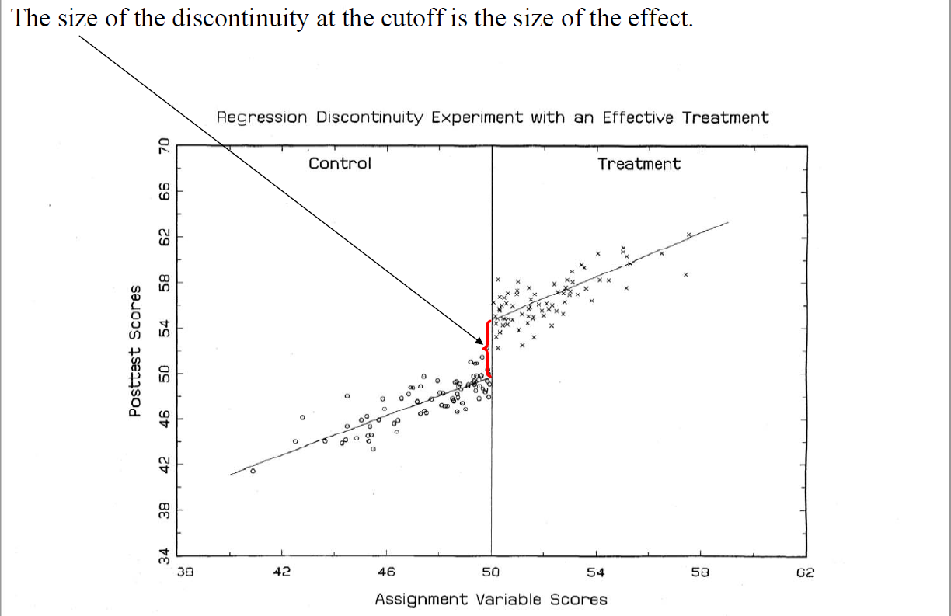
Causal Inference IV

Slide 17
Causal Inference V
Deterministic causal relationships can be studied at the population level but are more often associated with small-n case study research.
For qualitative scholars, the term deterministic is used primarily to refer to discussions of necessary and sufficient causes in individual cases or combinations of these types of conditions.
It is means that what we are examining is not whether a given X tends to covary with Y in a population but whether X is either a necessary and/or sufficient cause of Y in an individual case.
A condition is necessary if the absence of it prevents an outcome, regardless of the values of other variables, whereas if a sufficient condition is present, the outcome will always take place.

Slide 18
Causal Inference VI
A long list of terms directly or indirectly indicates that the researcher is formulating hypotheses using the resources of logic.
To express the causal idea that X is necessary for Y, scholars use terms and expressions such as "only if," "is essential, indispensable, requisite, necessary for," "blocks, vetos, prevents," "is sine qua non of," and "enables, permits, allows." Some of these expressions are quite explicit and direct about using logic to express.
Analogously, various terms suggest that the scholar understands X to be sufficient for Y.
The scholar uses words and expressions such as "ensures, guarantees," "is always followed by," "inevitably leads to," and "yields, generates, produces." Again, some of these terms more directly suggest a sufficiency relationship (e.g., "X is always followed by Y") than others ("X yields Y").

Slide 19
Causal Inference VII
Causal Mechanism
When we speak of a causal relationship between X and Y, what is the nature of causality in the relationship?
The ontological position in social science is a mechanistic understanding of causality, a position that underlies process-tracing methods.
The defining feature of a mechanistic ontology of causation is that we are interested in the theoretical process whereby X produces Y and in particular in the transmission of what can be termed causal forces from X to Y.
A mechanistic understanding of causality does not necessarily imply regular association.
Indeed, a mechanism can be infrequent. What is necessary is that X actually produces Y through a causal mechanism linking the two.

Slide 20
Causal Inference VIII
Causal mechanism
Andrew Bennett has defined causal mechanisms as “processes through which agents with causal capacities operate in specific contexts to transfer energy, information or matter to other entities.
David Waldner has defined a mechanism as “an agent or entity that has the capacity to alter its environment because it possesses an invariant property that, in specific contexts, transmits either a physical force or information that influences the behavior of other agents or entities”.
Mechanisms operate at an analytical level below that of a more encompassing theory; they increase the theory’s credibility by rendering more fine-grained explanations.

Slide 21
Causal Inference IX
A causal mechanism can be defined as “a complex system, which produces an outcome by the interaction of a number of parts”. Causal mechanisms “attempts to identify the intervening causal process - the causal chain and causal mechanism - between an independent variable (or variables) and the outcome of the dependent variable”.
Investigating causal mechanisms enables us to go a step further when studying causal relationships, allowing us to peer into the box of causality to locate the intermediate factors lying between some structural cause and its purported effect.
dominos example George and Bennet

Slide 22
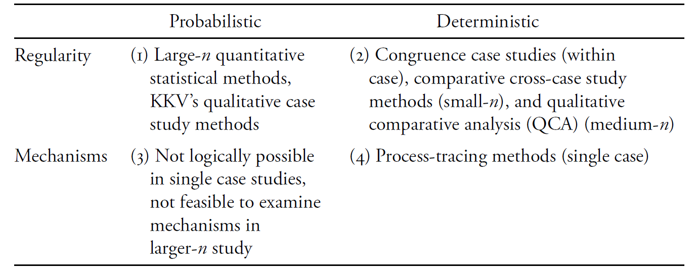
Causal Inference X
Summarizing approaches and methods for causal inference

