Slide 1
MAC5784 – AI in videogames
Flavio Soares Correa da Silva
2nd semester 2020

Slide 2
Course plan
All interactive systems
 | Interactive systems | Games | Complex networks
Individualistic agents
Strategic agents
Social agents
Empathic agents
All agents

Slide 3
Interactive systems
Interactive systems = designed systems
Design (following Artigas): sketch + plan
Plan: goal, purpose + building plan

Slide 4
Interactive systems
Interactive systems = conversational systems
other users
user
designer

Slide 5
Interactive systems
Interactive systems = conversational systems
other users
user
designer

Slide 6
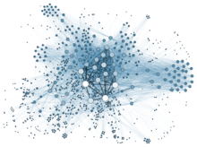
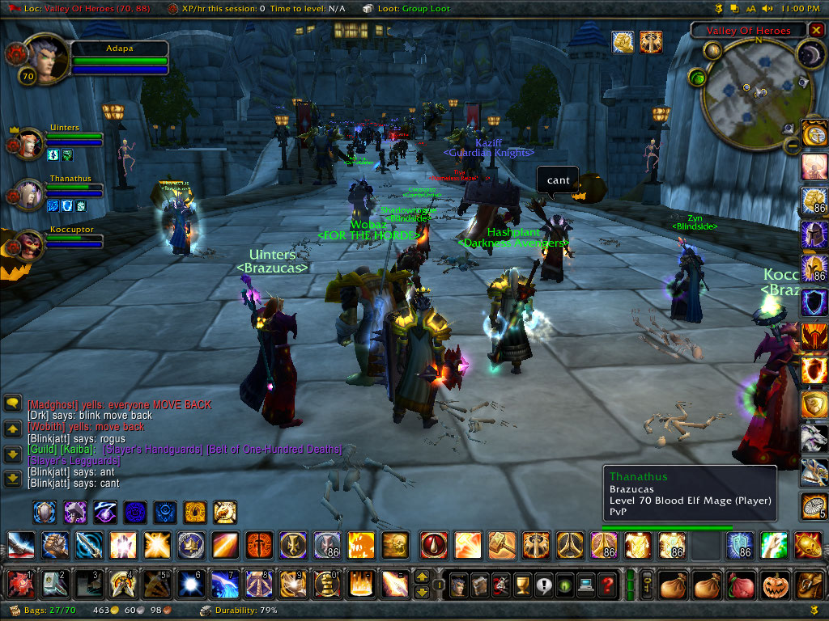
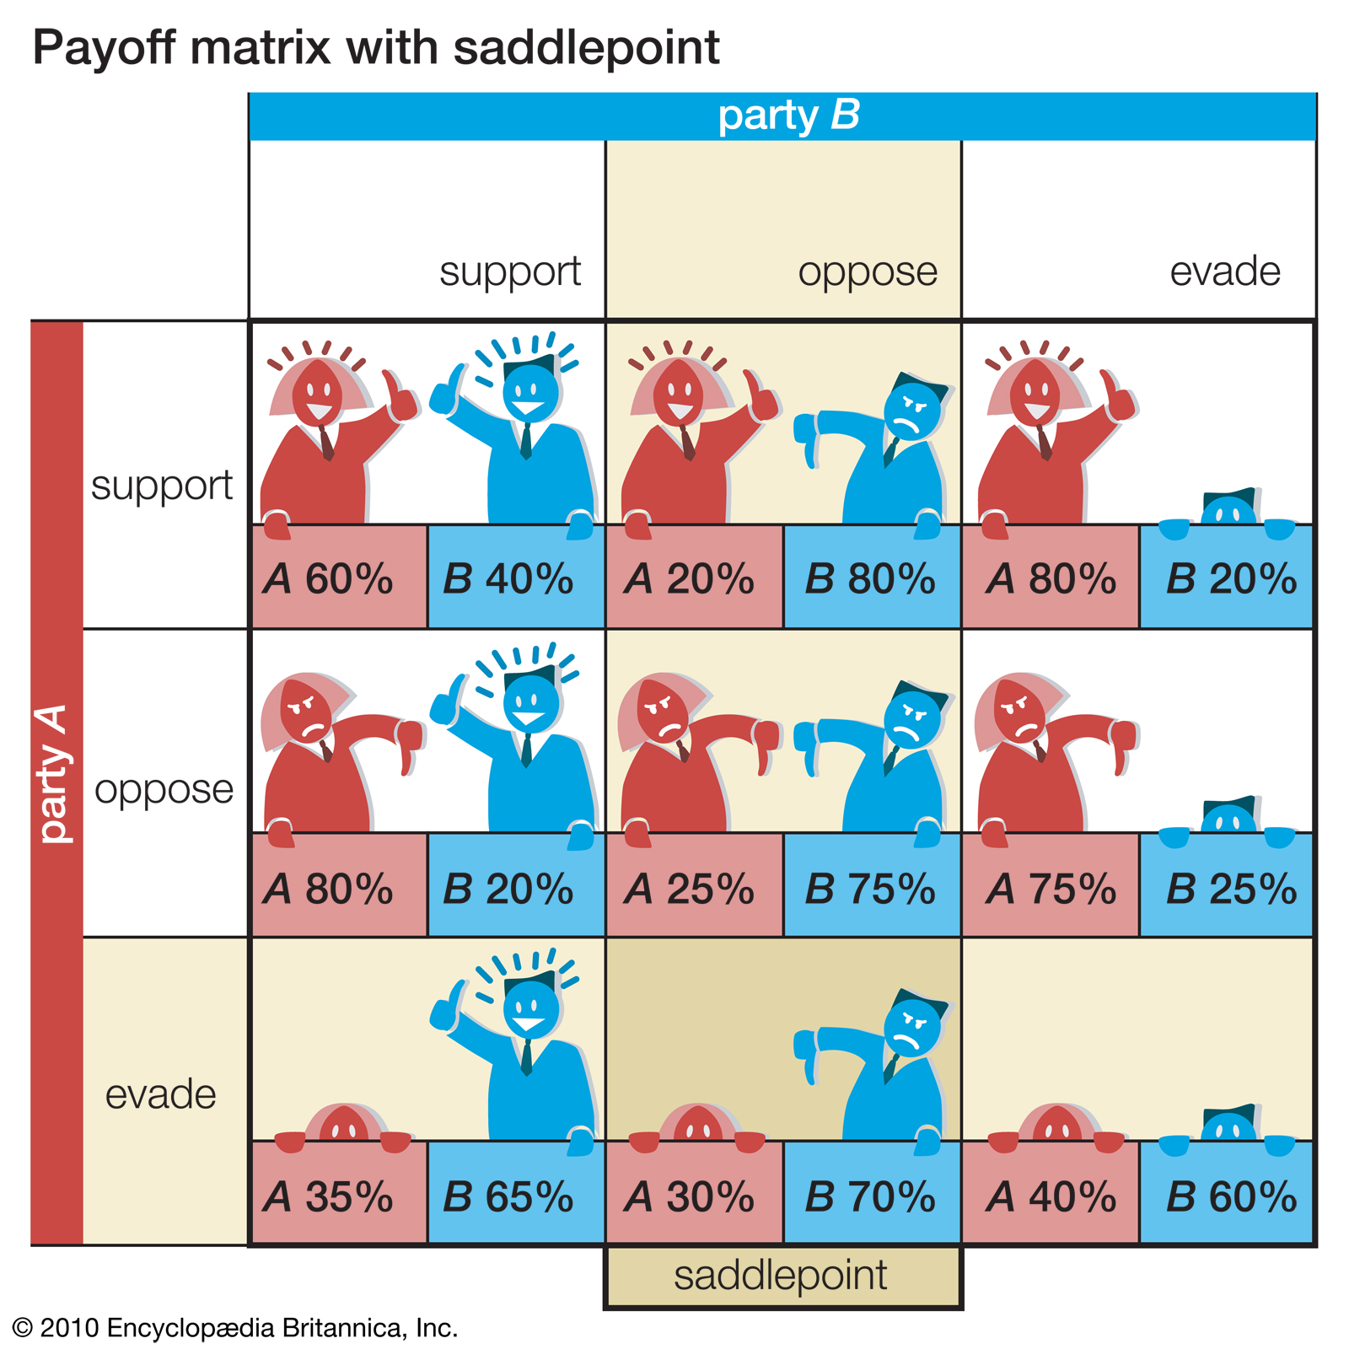
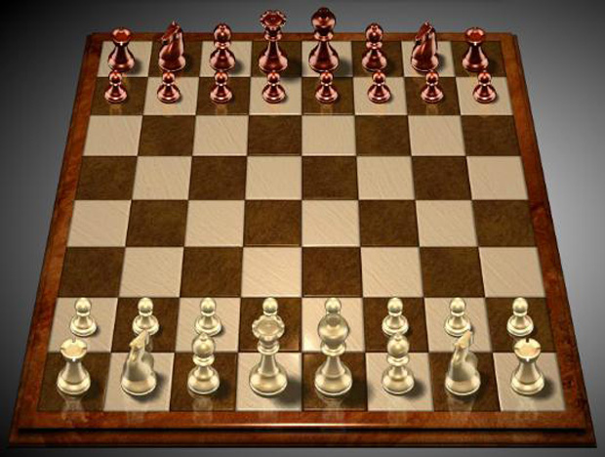
Interactive systems
Massively multiplayer game
Multiplayer game
Game
Puzzle
Toy
Purely interactive

