Slide 1
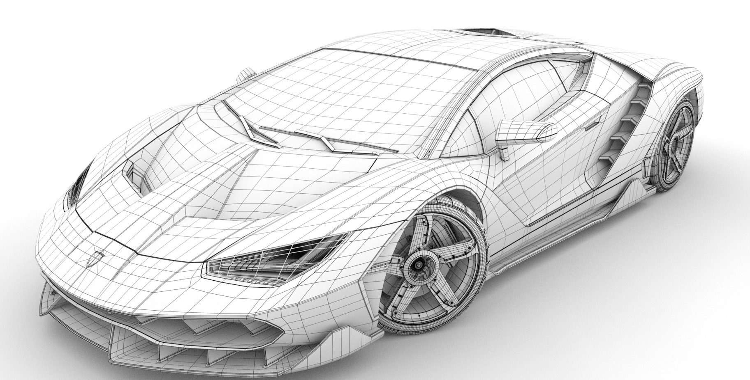
WHEELS OF CHANGE: THE AUTOMOBILE INDUSTRY
Chapter 15 of Dicken (2009) book “Global Shift: the internationalization of economic activity”.
FABIO E. FARAGO
Notes:
Pag. 588 - 624

Slide 2
IS CHANGING?
“The Industry of Industries” – The main engine for growth until 1970
The 2008 financial crisis
Decades of dominance by firms of developed economies
New global players from China and South Korea arriving in the scene
The “Industry of industries” look different from the stable picture of decades ago

Slide 3
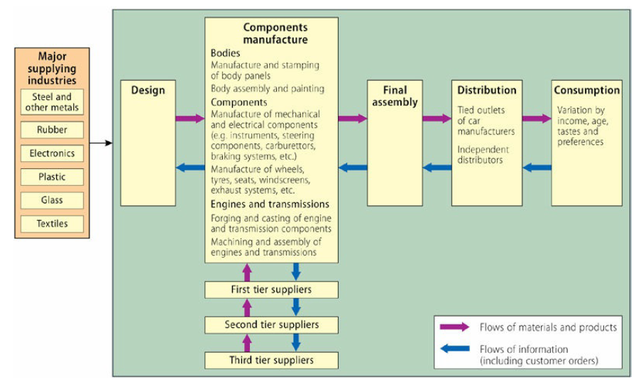
AUTOMOBILE PRODUCTION CIRCUIT

Slide 4
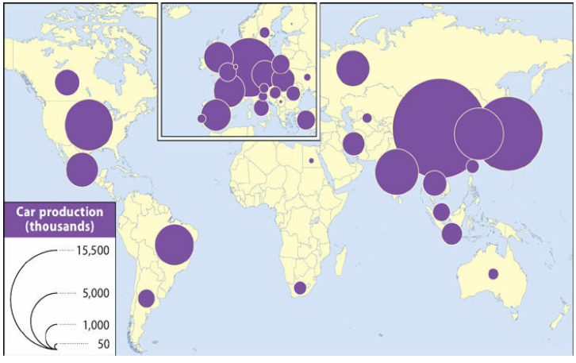
GLOBAL SHIFTS IN PRODUCTION/TRADE
70% - 7 countries
24,6% - China
13,7% - Japan
8,5% - Germany
6,6% - South Korea
6,6% - USA
5,2% - India
4,2% - Brazil
Vehicle/population

Slide 5
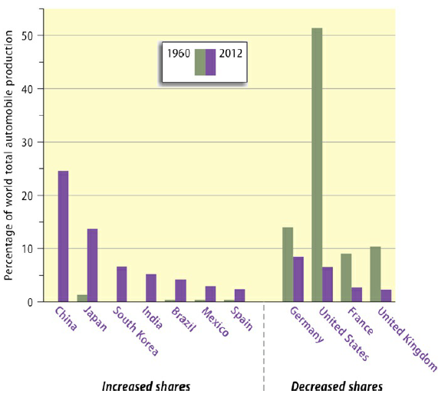

Slide 6
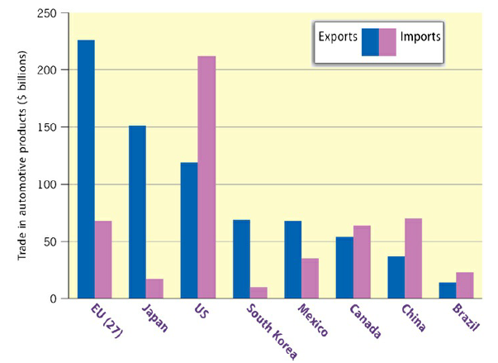
USA
Deficit of US$ 93 billion
Japan
Surplus of US$ 134 billion

Slide 7
IS CHANGING?
Three Major new technologies are being developed:
Hybrid cars: a combination of a conventional internal combustion engine and a battery which recharges from energy produced by the car.
Plug-in cars: hybrid or pure electric cars which can be recharged using a plug.
Hydrogen fuel cells: electric cars powered by hydrogen fuel cells.
The State plays a key Role, notable in:
Determining the degree of access to its domestic market, including the terms under which foreign firms are permitted to establish production plants;
The state is also heavily involved through environmental and vehicle safety policies, each of which has profound implications for the design, technology and materials used in cars and, therefore, in their cost.

Slide 8
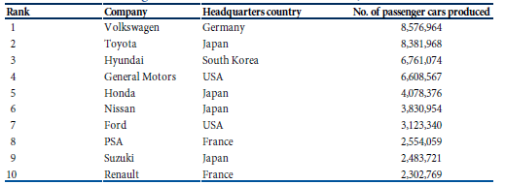
CONCENTRATION AND CONSOLIDATION
US big three has been destroyed by the rise of Japanese and European (Germany mainly) firms, and more recently, by the South Korean firm Hyundai

Slide 9
CORPORATE STRATEGIES
The consolidation of automobile producers is primarily the result of successive waves of M&A:
GM acquired companies in Europe, Britain, Australia and South Korea
VW acquired Audi, Seat, Skoda, Lamborghini, Bentley and Porsche to build the most complete portfolio
Ford: acquired Jaguar, Land Rover and Volvo
Renault: acquired 44% of Nissan in 1999 and also bought Samsung
Chrysler acquired 34% of Mitsubishi Motors in 2000
Changes after the 2008 crisis:
GM sold its luxury brand Saab and also Hummer
Ford sold its Jaguar and Land Rover to Indian company Tata in 2008 and Volvo to Chinese firm Geely
Chrysler was fully acquired by Fiat in 2014

Slide 10
CORPORATE STRATEGIES
Toyota growth: focus on efficiency, cost-cutting and a flood of new variations of successful models brought to market at an increasingly rapid rate.
Collaborative agreements and alliances with other manufacturers:
Renault engines are used by Mercedes
Peugeot and Citroën’s electric powered car is built by Mitsubishi
Fiat builds engines for Suzuki
Ford engines power Jaguars and Aston Martins
Dacia cars sell around the world with Renault or Nissan badges on them

Slide 11
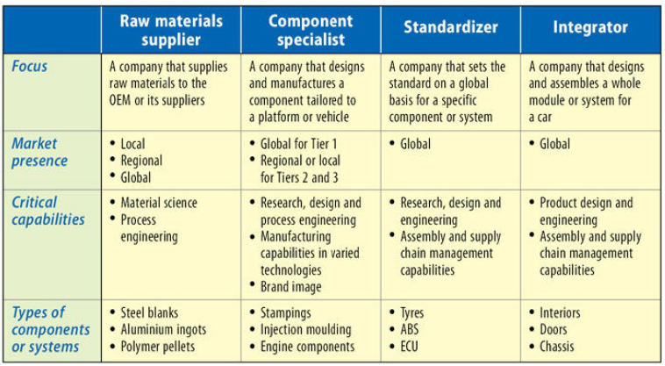
SUPLIER STRATEGIES
US

Slide 12
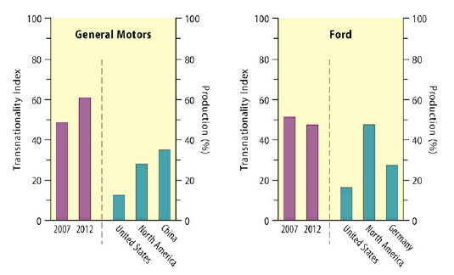
TRANSNATIONALIZATION STRATEGIES
THE US BIG TWO

Slide 13
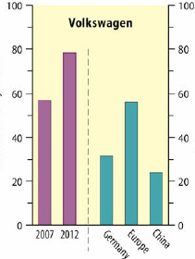
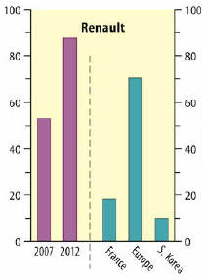
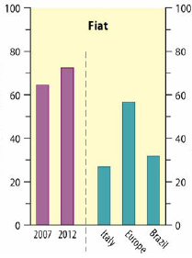
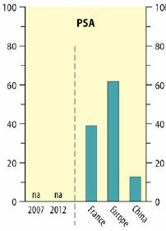
TRANSNATIONALIZATION STRATEGIES
EUROPEAN PRODUCERS

Slide 14
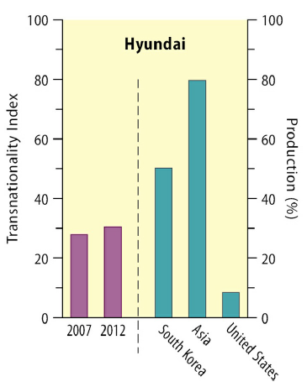
TRANSNATIONALIZATION STRATEGIES
SOUTH KOREA

Slide 15
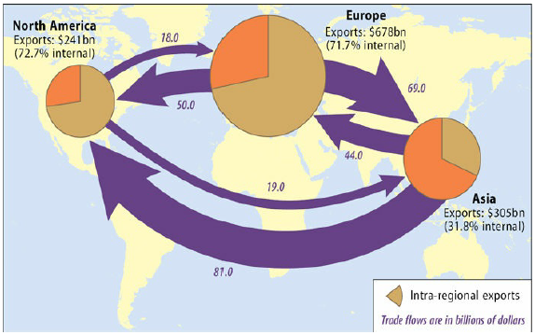
REGIONALIZATION OF PRODUCTION

Slide 16
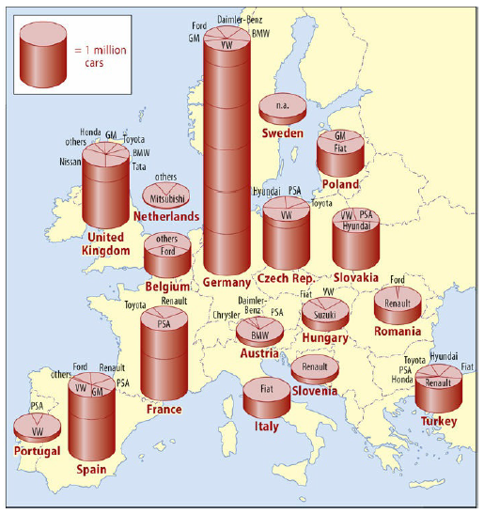
EUROPE
The geographical configuration of automobile production within Europe still bears the very strong imprint of each firm’s national origins and the history of their development.

Slide 17
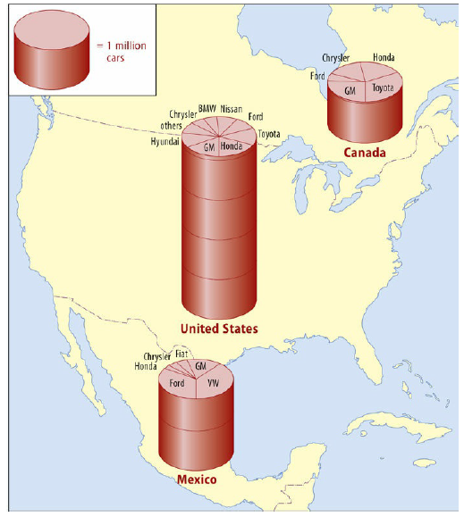
NORTH AMERICA
Prior to the 1980s, it was totally dominated by US producers.
But from the mid-1980s onwards the position changed dramatically.

Slide 18
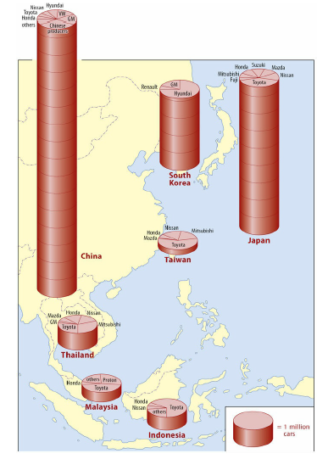
EAST ASIA
The situation in East Asia is very different from Europe and US: the region remains primarily a series of individual national markets, some of them very heavily protected against automobile imports.
The figure shows that automobile production in East Asia is dominated by China, Japan and, to a far lesser extent, Korea. However, development of the region’s automobile production network as a whole has been orchestrated primarily by Japanese firms.

Slide 19
THANKS FOR THE ATTENTION!!

