Slide 1
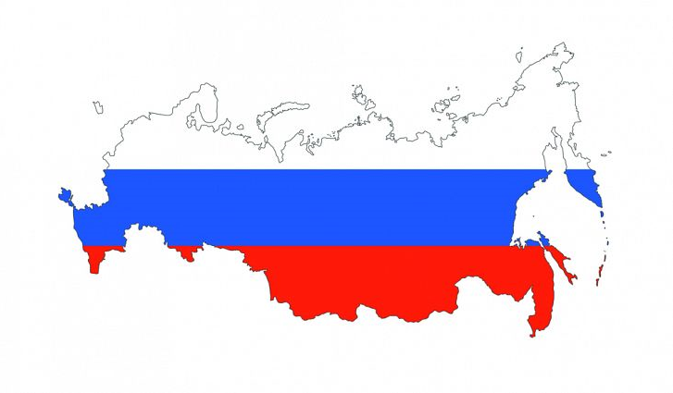
INNOVATION BY RUSSIAN EMNES
SERGEY FILIPPOV AND ALEXANDER SETTLES
Fabio Farago

Slide 2
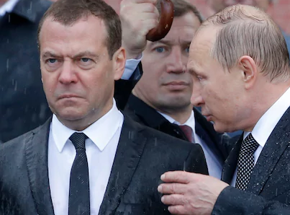
INTRODUCTION
Russian firms lack innovation and value creation
Lack of economic incentive
Lack of market orientation
Russia inherited Soviet Science and Technology (S&T)
2000 – Dependent on natural resources (80% of exports)
Dmitry Medvedev (2008-2012)
Russian multinational still under-researched
Patents

Slide 3
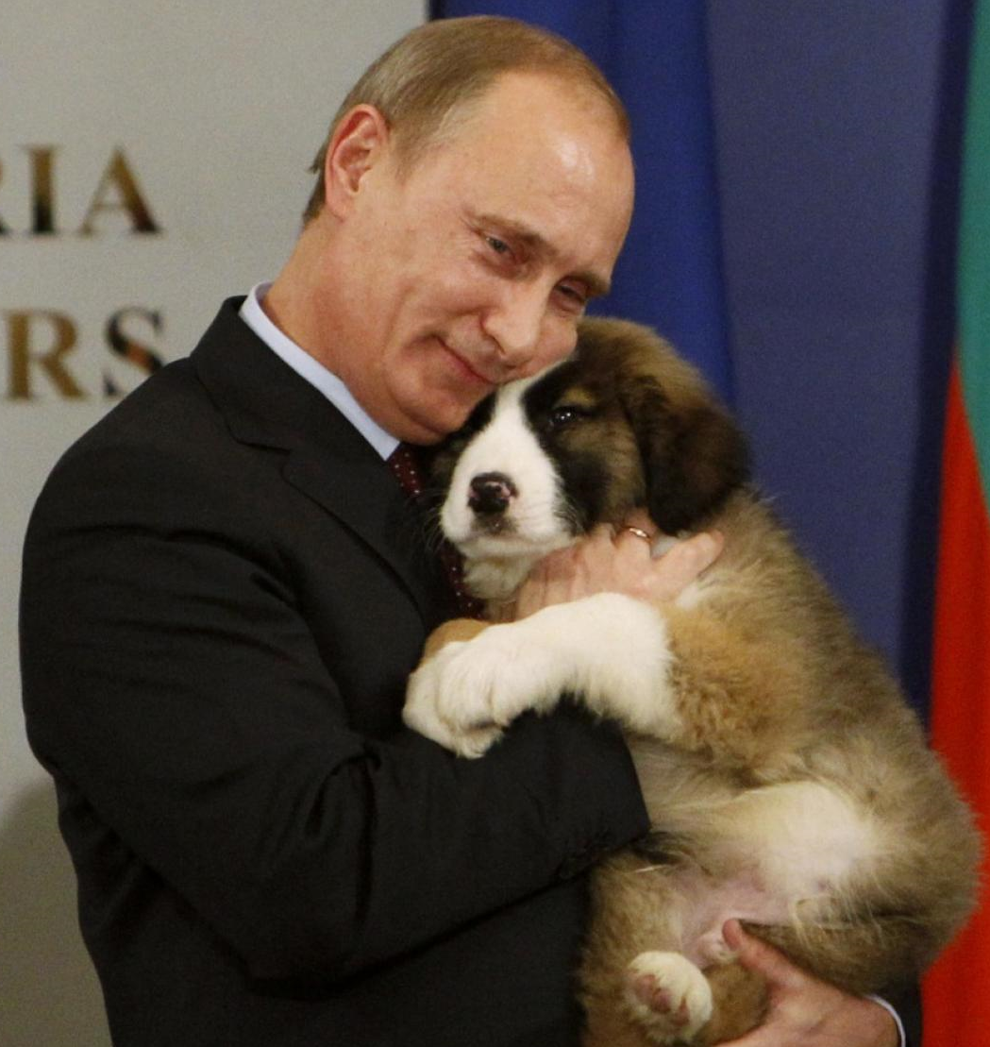
MACRO-VIEW AND PUBLIC POLICY
Soviet leadership gave priority to S&T
The economy was very resistant to innovation
1990-2000 - transition to a market economy
Potential for innovation constrained
Russian leadership established:
Commission of High Technology in 2007
Commission for Modernization of and Technological development
Funding to innovation: Rosnano (nano-technologies); Rosatom (nuclear technologies); Rostekhnologii (high-tech industrial products)
2011 Plan to increase innovations by 40-50% by 2020 (5-10% of global high tech market)
Despite the actions, the innovation situation still very disappointing

Slide 4
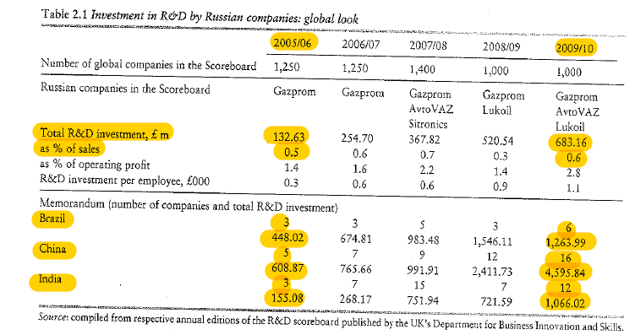
INNOVATION IN COMPARISON TO BRIC
R&D by Russian firms remain very scarce
Among the top 1000-1400 global companies in the scoreboard with highest R&D investment, Russia is represented only by Gazprom, and later by Lukoil and AvtoVAZ

Slide 5
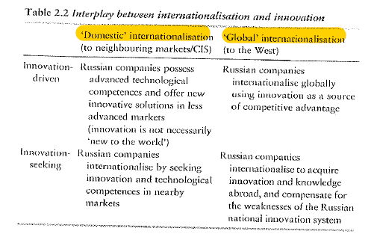
INNOVATION AND INTERNACIONALIZATION

Slide 6
CONCLUSION
What prevents Russian firms from being more innovative and competing globally using innovation as a competitive advantage?
The problem is not on supply side (education)
But in the commercialization:
Weak institutional environment
Endemic corruption
Ineffective law system
Excessive government intervention
Russian government acknowledge this major problem
State owned corporations are being instructed to design and fund innovation programmes

Slide 7
THANKS FOR THE ATTENTION!!
Fabio Farago

