Slide 1
Chapter 3:
Mechanics of Materials, 8th Edition SI Gere & Goodno
Torsion

Slide 2
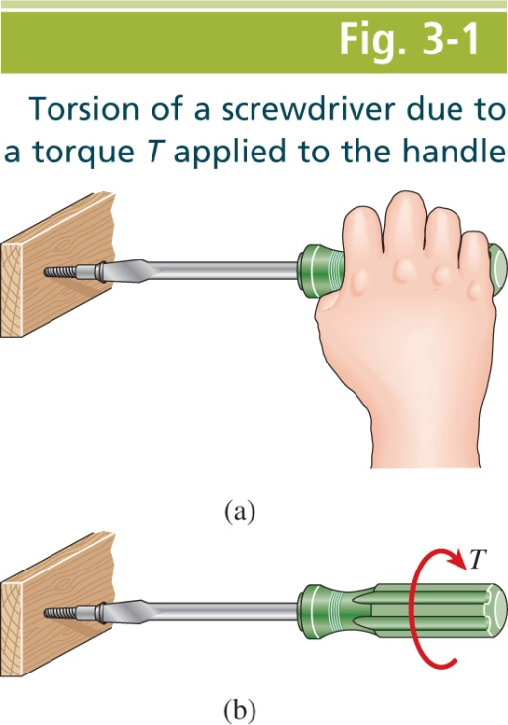
Mechanics of Materials, 8th Edition SI Gere & Goodno

Slide 3
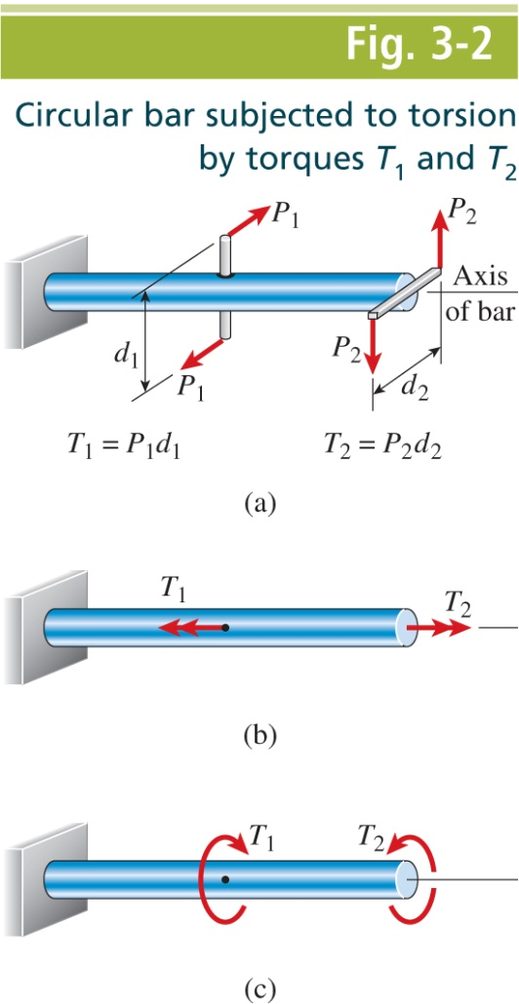
Mechanics of Materials, 8th Edition SI Gere & Goodno

Slide 4
Mechanics of Materials, 8th Edition SI Gere & Goodno

Slide 5
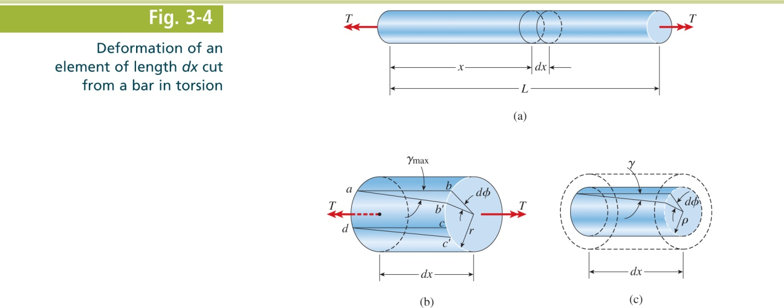
Mechanics of Materials, 8th Edition SI Gere & Goodno

Slide 6
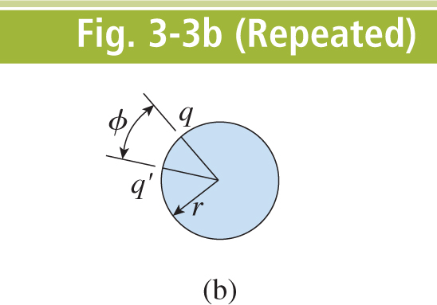
Mechanics of Materials, 8th Edition SI Gere & Goodno

Slide 7
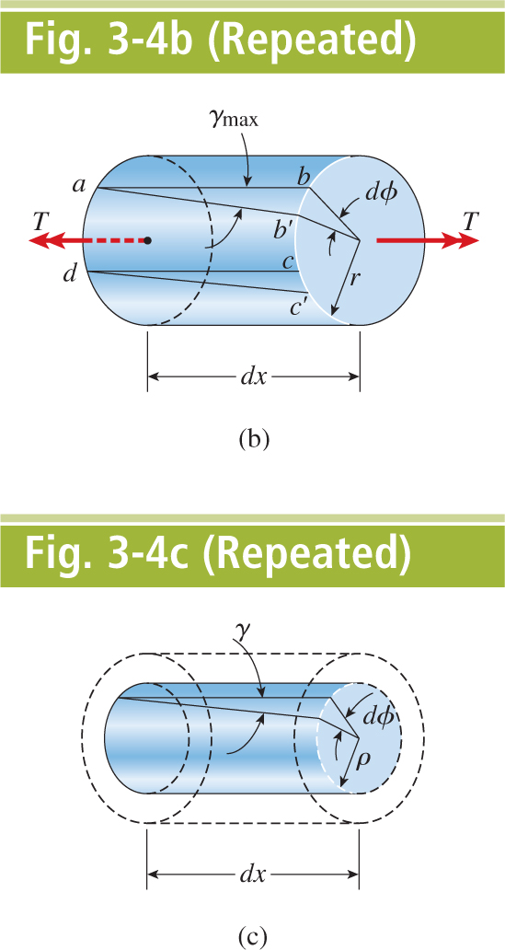
Mechanics of Materials, 8th Edition SI Gere & Goodno

Slide 8
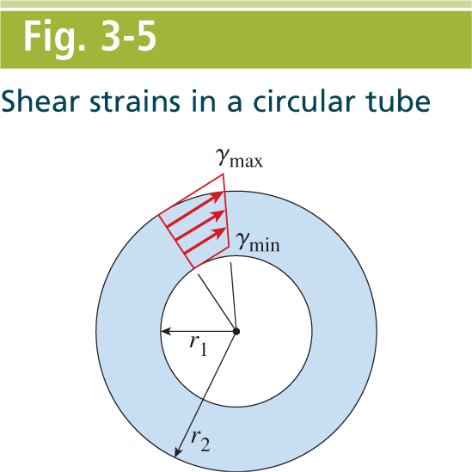
Mechanics of Materials, 8th Edition SI Gere & Goodno

Slide 9
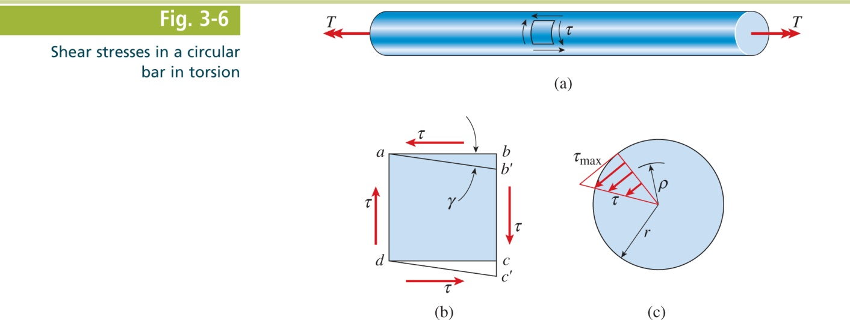
Mechanics of Materials, 8th Edition SI Gere & Goodno

Slide 10
Mechanics of Materials, 8th Edition SI Gere & Goodno

Slide 11
Mechanics of Materials, 8th Edition SI Gere & Goodno

Slide 12
Mechanics of Materials, 8th Edition SI Gere & Goodno

Slide 13
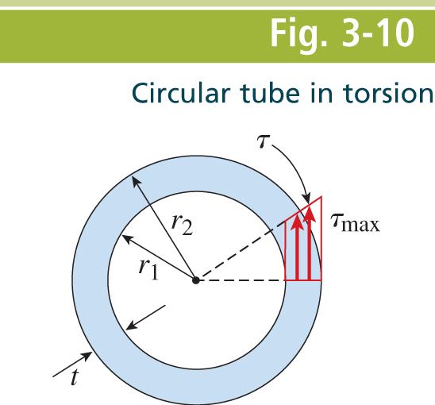
Mechanics of Materials, 8th Edition SI Gere & Goodno

Slide 14
Mechanics of Materials, 8th Edition SI Gere & Goodno

Slide 15
Mechanics of Materials, 8th Edition SI Gere & Goodno

Slide 16
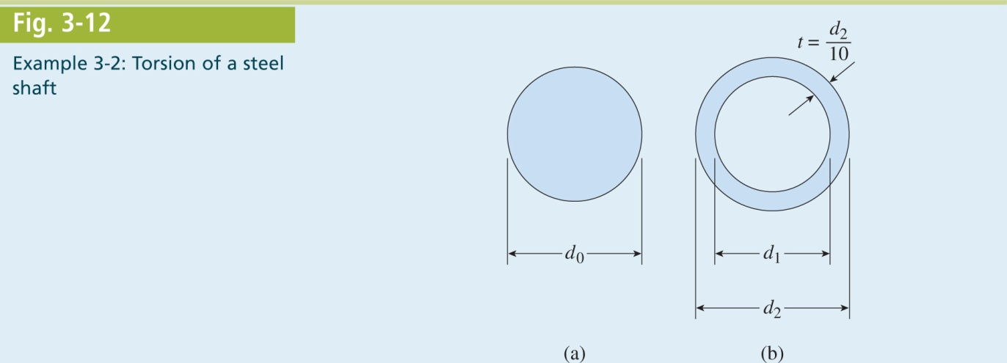
Mechanics of Materials, 8th Edition SI Gere & Goodno

Slide 17
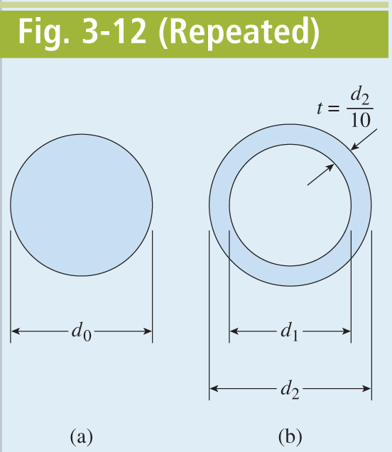
Mechanics of Materials, 8th Edition SI Gere & Goodno

Slide 18
Mechanics of Materials, 8th Edition SI Gere & Goodno

Slide 19
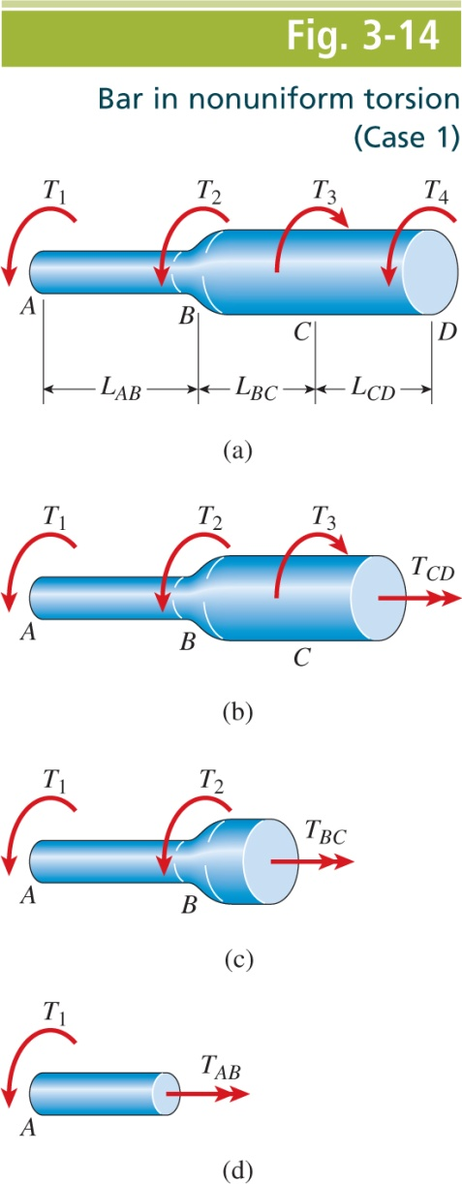
Mechanics of Materials, 8th Edition SI Gere & Goodno

Slide 20
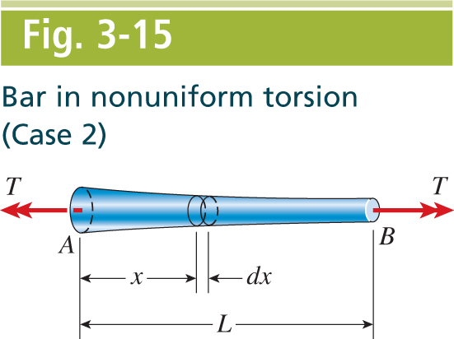
Mechanics of Materials, 8th Edition SI Gere & Goodno

Slide 21
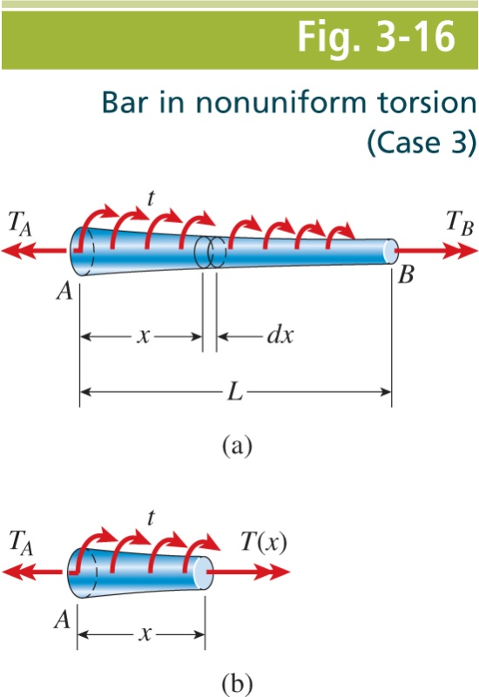
Mechanics of Materials, 8th Edition SI Gere & Goodno

Slide 22
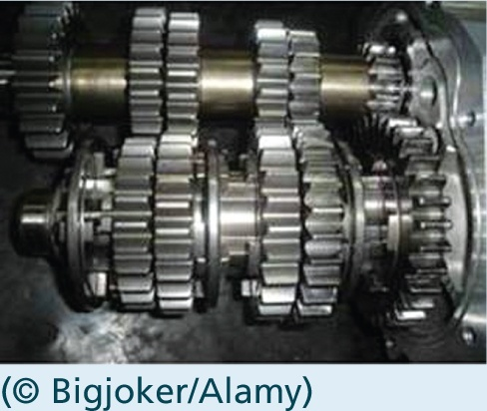
Mechanics of Materials, 8th Edition SI Gere & Goodno

Slide 23
Mechanics of Materials, 8th Edition SI Gere & Goodno

Slide 24
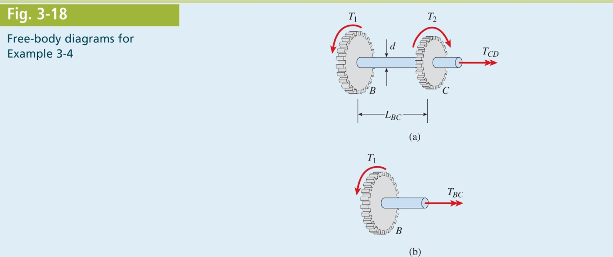
Mechanics of Materials, 8th Edition SI Gere & Goodno

Slide 25
Mechanics of Materials, 8th Edition SI Gere & Goodno

Slide 26
Mechanics of Materials, 8th Edition SI Gere & Goodno

Slide 27
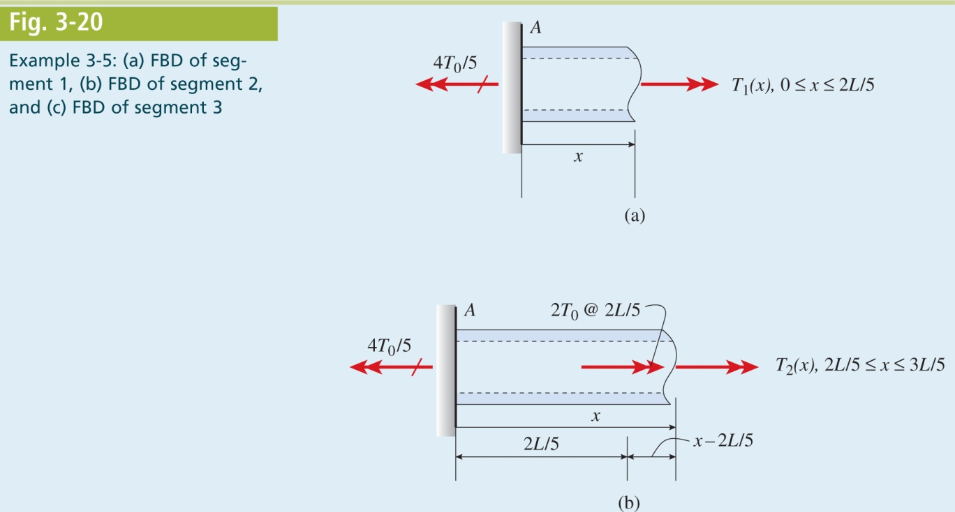
Mechanics of Materials, 8th Edition SI Gere & Goodno

Slide 28
Mechanics of Materials, 8th Edition SI Gere & Goodno

Slide 29
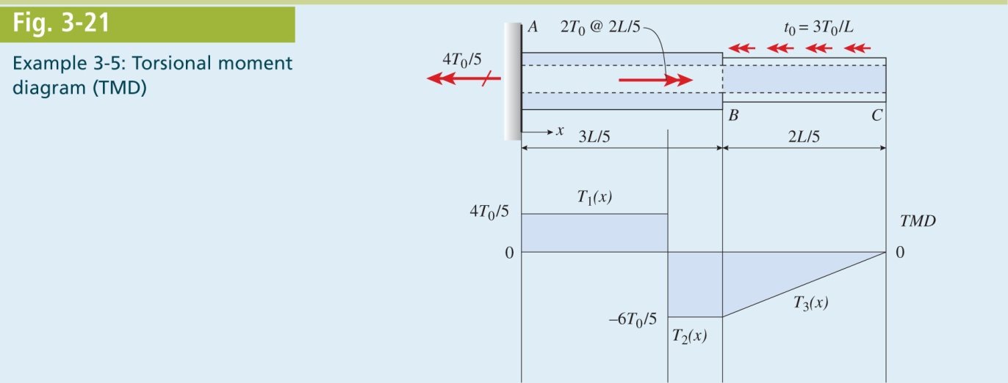
Mechanics of Materials, 8th Edition SI Gere & Goodno

Slide 30
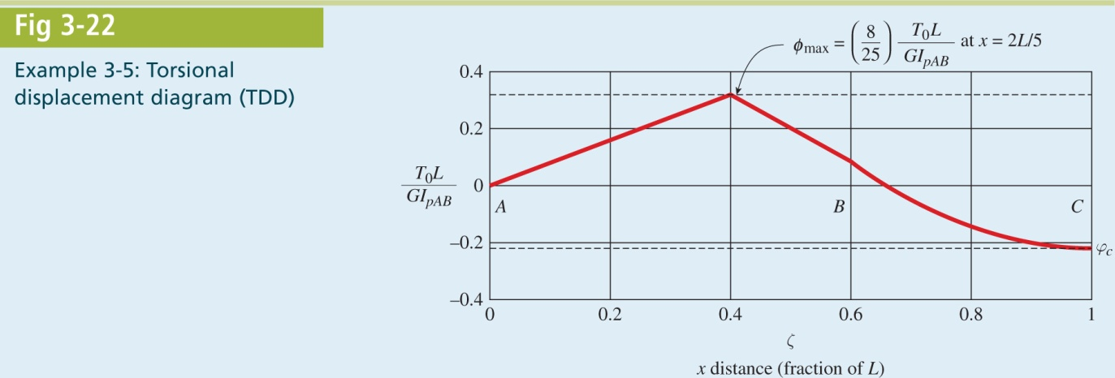
Mechanics of Materials, 8th Edition SI Gere & Goodno

Slide 31
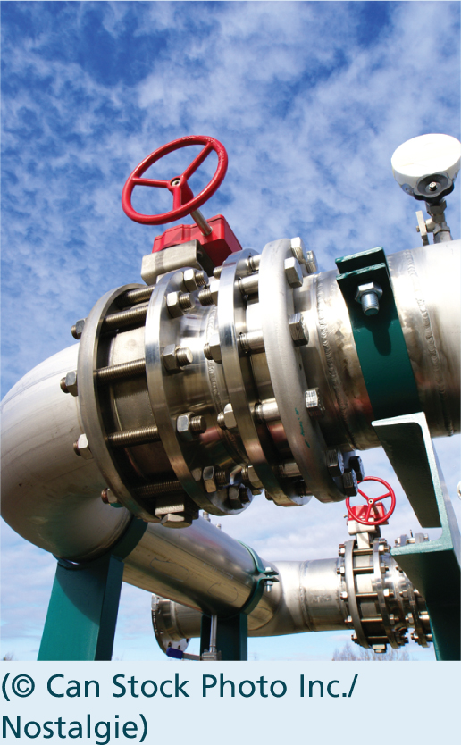
Mechanics of Materials, 8th Edition SI Gere & Goodno

Slide 32
Mechanics of Materials, 8th Edition SI Gere & Goodno

Slide 33
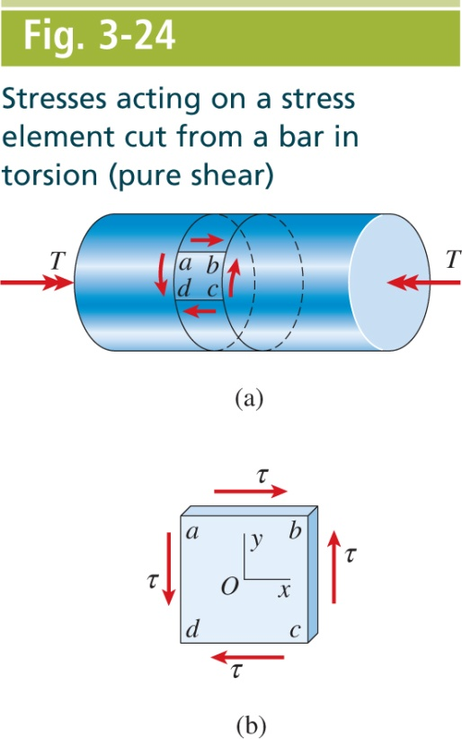
Mechanics of Materials, 8th Edition SI Gere & Goodno

Slide 34
Mechanics of Materials, 8th Edition SI Gere & Goodno

Slide 35
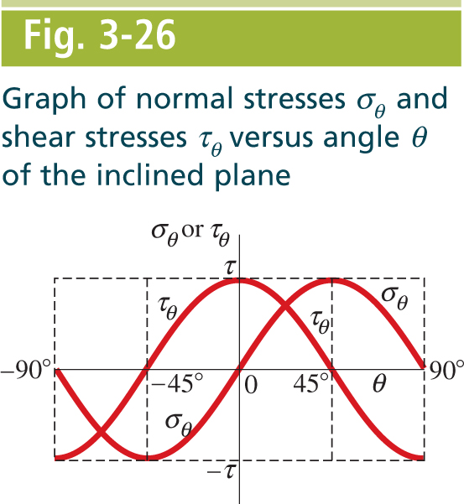
Mechanics of Materials, 8th Edition SI Gere & Goodno

Slide 36
Mechanics of Materials, 8th Edition SI Gere & Goodno

Slide 37
Mechanics of Materials, 8th Edition SI Gere & Goodno

Slide 38
Mechanics of Materials, 8th Edition SI Gere & Goodno

Slide 39
Mechanics of Materials, 8th Edition SI Gere & Goodno

Slide 40
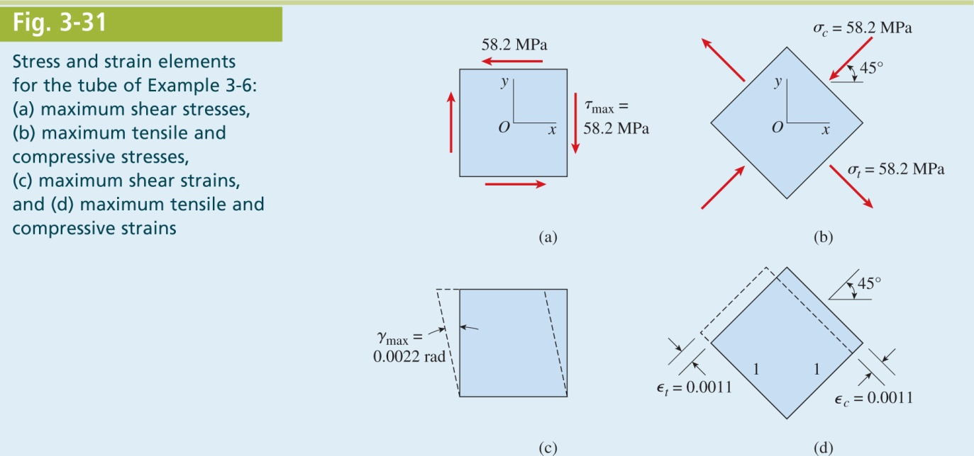
Mechanics of Materials, 8th Edition SI Gere & Goodno

Slide 41
Mechanics of Materials, 8th Edition SI Gere & Goodno

Slide 42
Mechanics of Materials, 8th Edition SI Gere & Goodno

Slide 43
Mechanics of Materials, 8th Edition SI Gere & Goodno

Slide 44
Mechanics of Materials, 8th Edition SI Gere & Goodno

Slide 45
Mechanics of Materials, 8th Edition SI Gere & Goodno

Slide 46
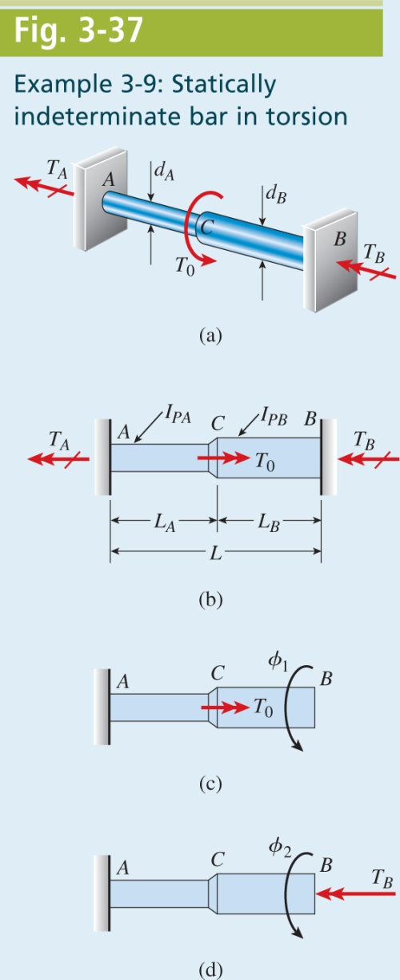
Mechanics of Materials, 8th Edition SI Gere & Goodno

Slide 47
Mechanics of Materials, 8th Edition SI Gere & Goodno

Slide 48
Mechanics of Materials, 8th Edition SI Gere & Goodno

Slide 49
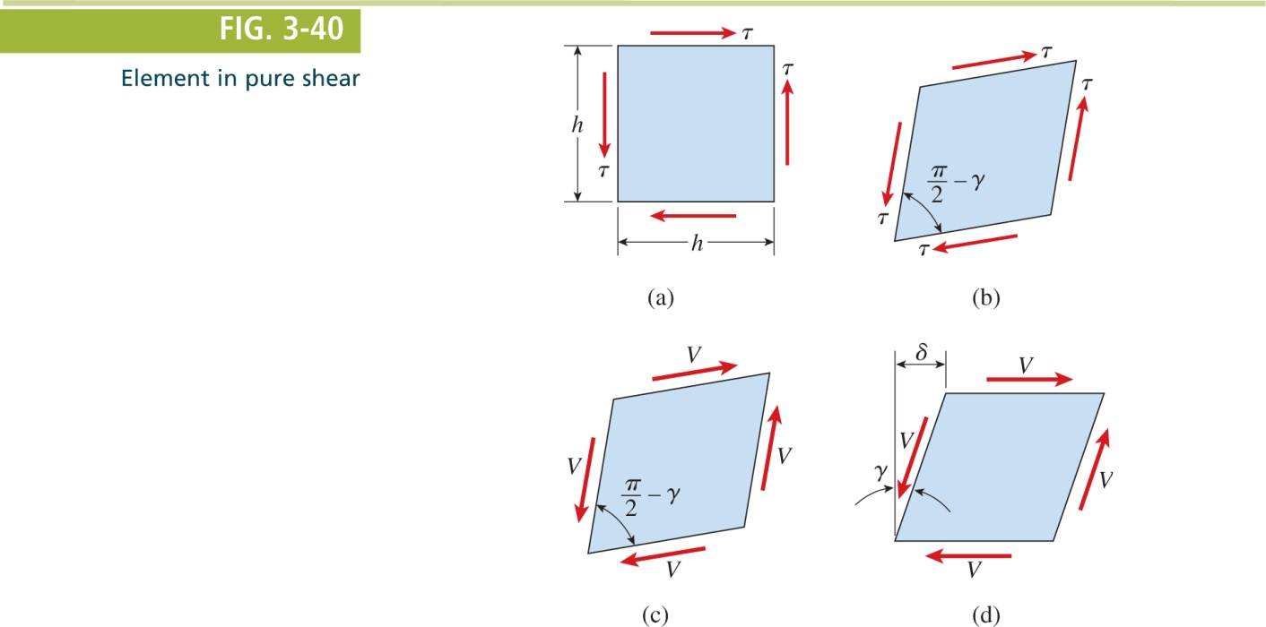
Mechanics of Materials, 8th Edition SI Gere & Goodno

Slide 50
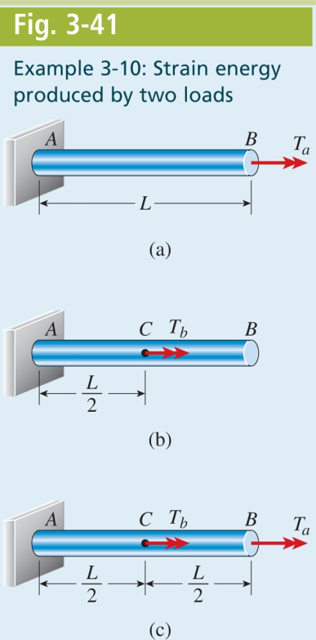
Mechanics of Materials, 8th Edition SI Gere & Goodno

Slide 51
Mechanics of Materials, 8th Edition SI Gere & Goodno

Slide 52
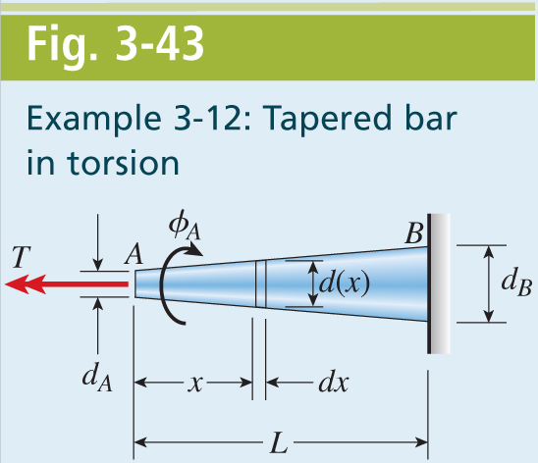
Mechanics of Materials, 8th Edition SI Gere & Goodno

Slide 53
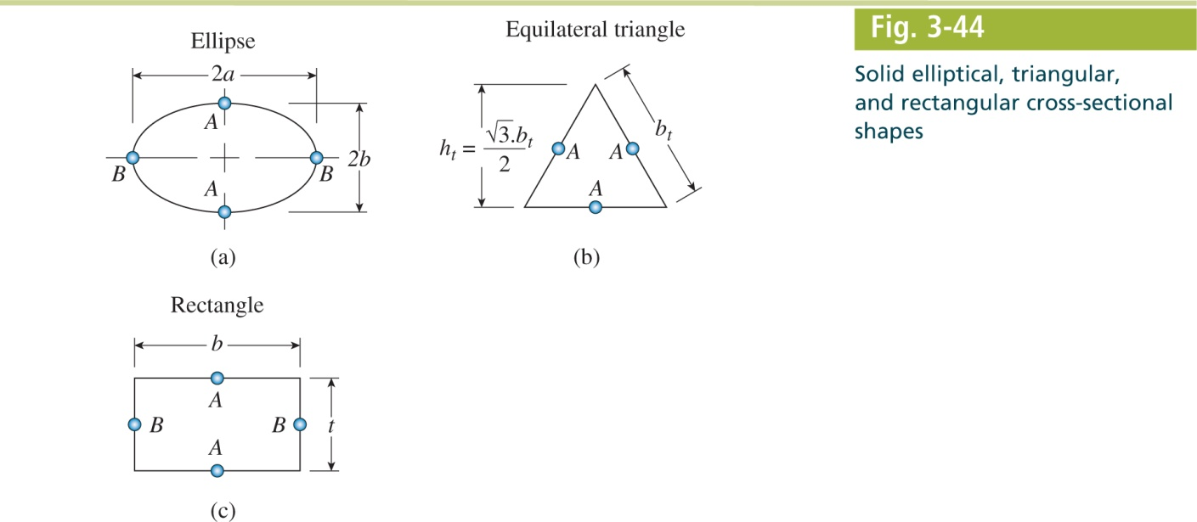
Mechanics of Materials, 8th Edition SI Gere & Goodno

Slide 54
Mechanics of Materials, 8th Edition SI Gere & Goodno

Slide 55
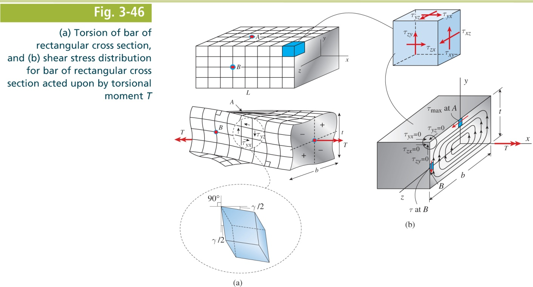
Mechanics of Materials, 8th Edition SI Gere & Goodno

Slide 56
Mechanics of Materials, 8th Edition SI Gere & Goodno

Slide 57
Mechanics of Materials, 8th Edition SI Gere & Goodno

Slide 58
Mechanics of Materials, 8th Edition SI Gere & Goodno

Slide 59
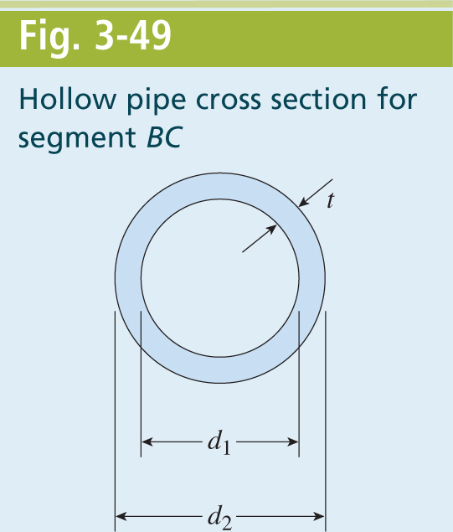
Mechanics of Materials, 8th Edition SI Gere & Goodno

Slide 60
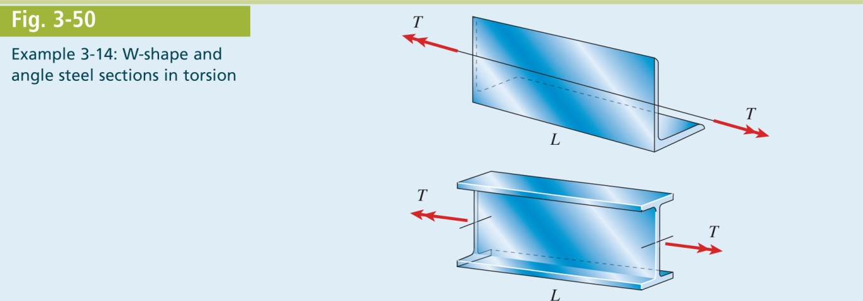
Mechanics of Materials, 8th Edition SI Gere & Goodno

Slide 61
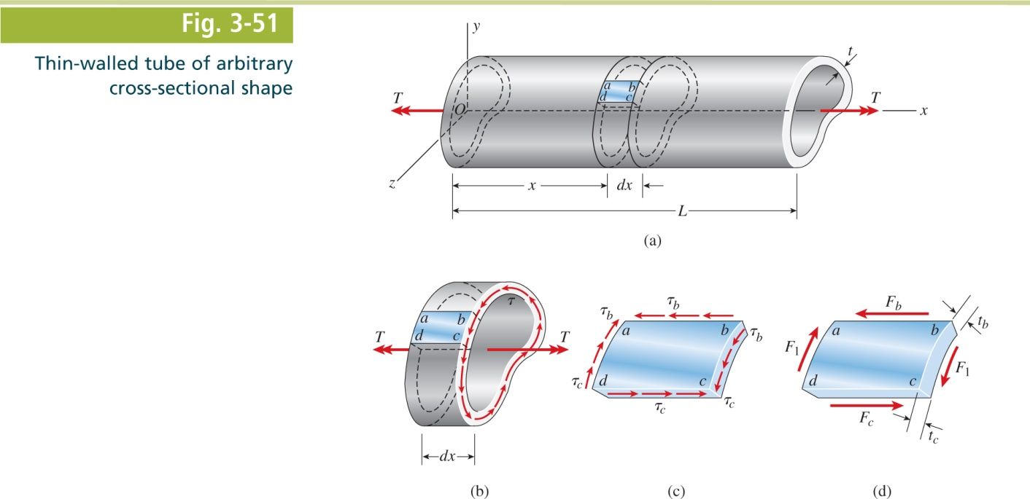
Mechanics of Materials, 8th Edition SI Gere & Goodno

Slide 62
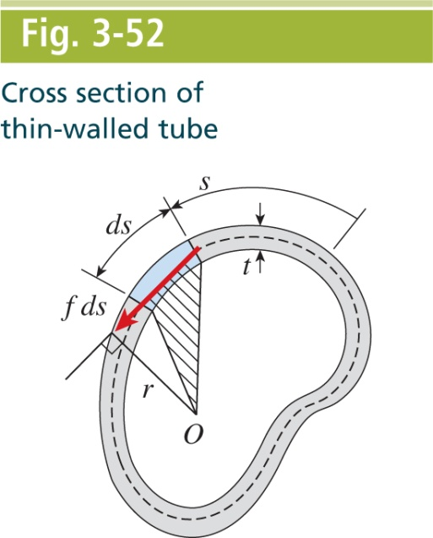
Mechanics of Materials, 8th Edition SI Gere & Goodno

Slide 63
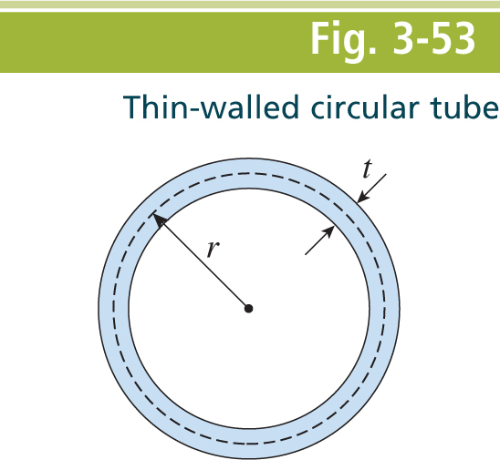
Mechanics of Materials, 8th Edition SI Gere & Goodno

Slide 64
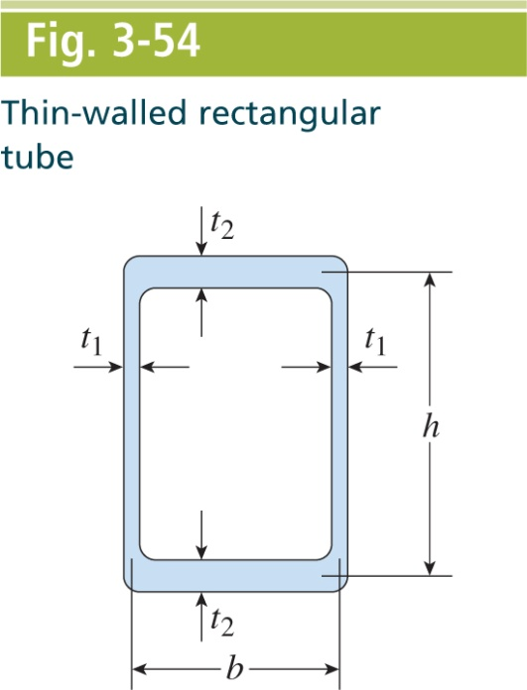
Mechanics of Materials, 8th Edition SI Gere & Goodno

Slide 65
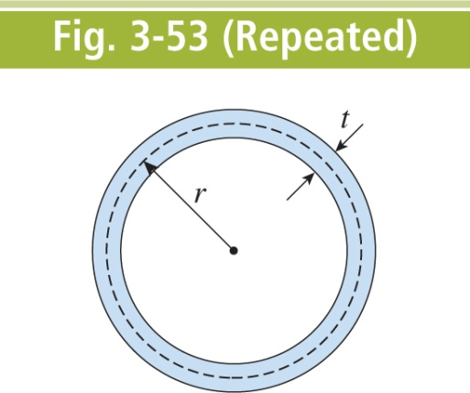
Mechanics of Materials, 8th Edition SI Gere & Goodno

Slide 66
Mechanics of Materials, 8th Edition SI Gere & Goodno

Slide 67
Mechanics of Materials, 8th Edition SI Gere & Goodno

Slide 68
Mechanics of Materials, 8th Edition SI Gere & Goodno

Slide 69
Mechanics of Materials, 8th Edition SI Gere & Goodno

Slide 70
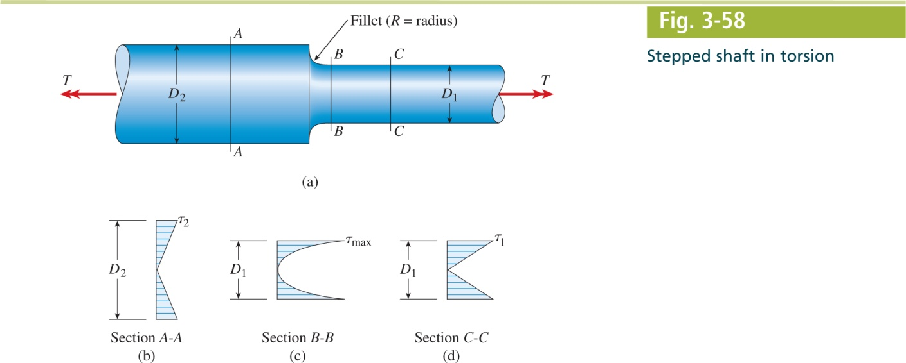
Mechanics of Materials, 8th Edition SI Gere & Goodno

Slide 71
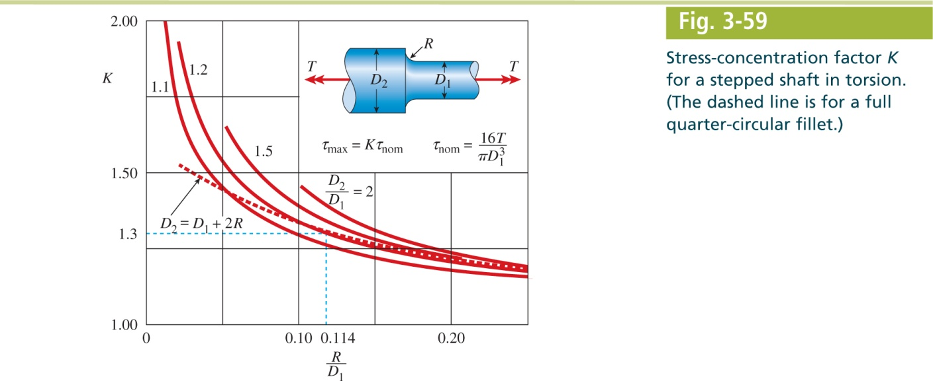
Mechanics of Materials, 8th Edition SI Gere & Goodno

Slide 72
Mechanics of Materials, 8th Edition SI Gere & Goodno

Slide 73
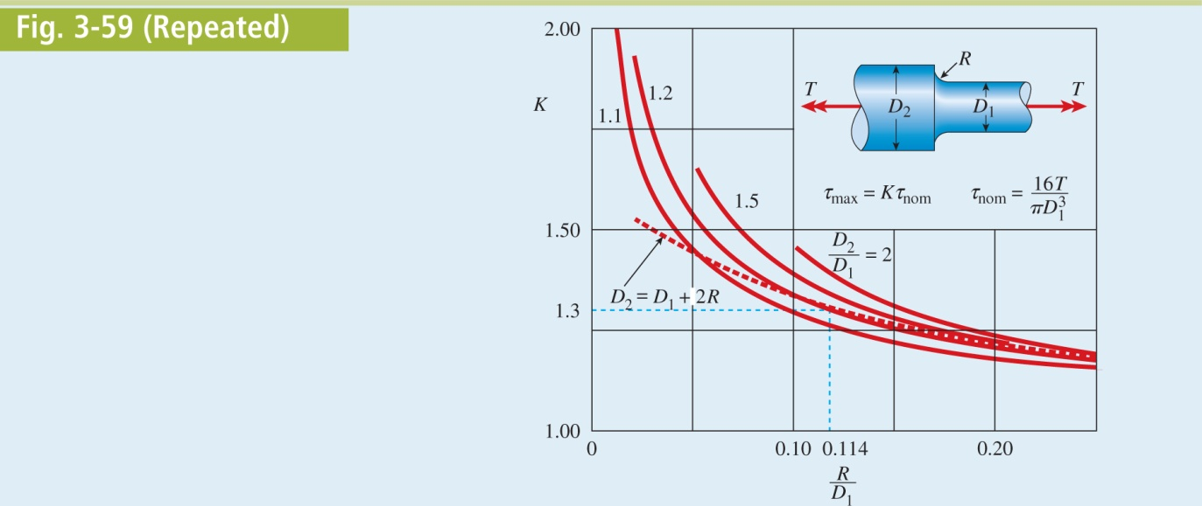
Mechanics of Materials, 8th Edition SI Gere & Goodno

