Slide 1
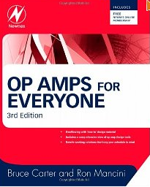
OP AMPs for Everyone Newnes, 2009

Slide 2
Active Filters

Slide 3
Comparação
Teoria x Experimento

Slide 4
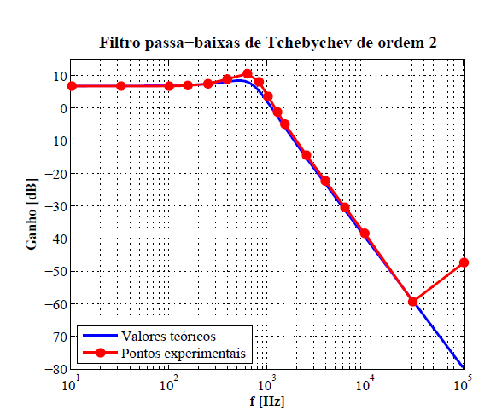
Active Filters : Theory x Experimental

Slide 5
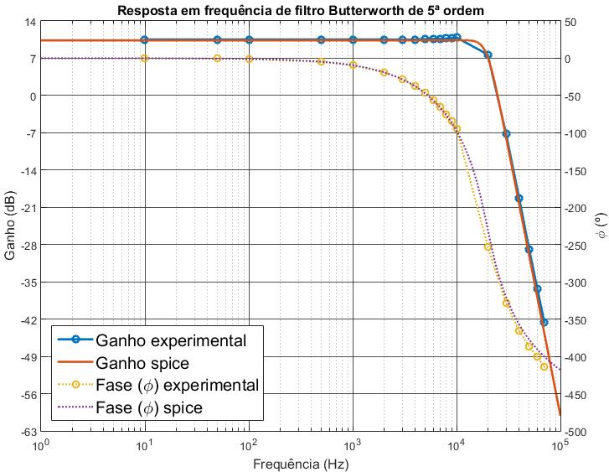
Active Filters : Theory x Experimental
Filtro Passa Baixa Butterwork, ordem n=5, f_{c}= 19.8KHz

Slide 6
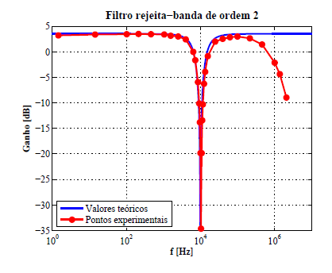
Active Filters : Theory x Experimental

Slide 7
Introduciton
Applications (few examples):
In the field of telecommunications band pass filters are used in the audio frequency range (0 – 20 KHz).
High frequency band-pass filters (several hundreds MHz) are used for channel selection in telephone centrals.
There are filters that do not filter any frequencies of a complex input signal, but just add a linear phase shift to each frequency component, thus contributing to a constant time delay. These are called all-pass filters.

Slide 8
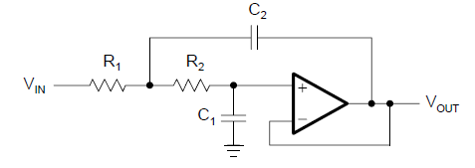
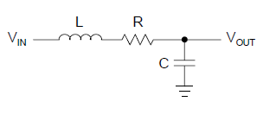
Introduction
At high frequencies (> 1 MHz), all of these filters usually consist of passive components such as inductors (L), resistors (R), and capacitors (C). They are then called LRC filters.
In the lower frequency range (1 Hz to 1 MHz), however, the inductor value becomes very
large and the inductor itself gets quite bulky, making economical production difficult.
Active filters are circuits that use an operational amplifier (op amp) as the active device in combination with some resistors and capacitors to provide an LRC-like filter performance at low frequencies.

Slide 9
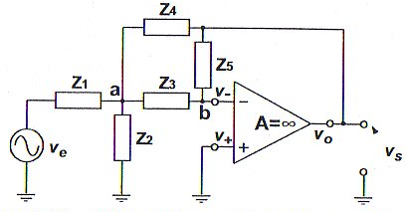
Determinação de Função de Transferência
Filtro Ativo Genérico na Configuração Realimentação Múltipla
1
O ganho de tensão deste circuito pode ser facilmente obtido utilizando-se a LCK nos nós a e b, supondo que o amp op é ideal e aplicando-se a técnica de terra virtual.
2
Nó a:
$\frac{v_{a}}{Z_{2}}$ - $\frac{v_{e}−v_{a}}{Z_{1}}$ - $\frac{v_{s}−v_{a}}{Z_{4}}$ + $\frac{v_{a}}{Z_{3}}$ = 0
$v_{a}\left(\frac{1}{Z_{1}}\text{ − }\frac{1}{Z_{2}}\text{ − }\frac{1}{Z_{3}}\text{ + }\frac{1}{Z_{34}}\right)$- $\frac{v_{e}}{Z_{1}}$= $\frac{v_{s}}{Z_{4}}$

Slide 10
Filtro Ativo Genérico na Configuração Realimentação Múltipla
3
Nó b:
$\frac{v_{s}}{Z_{5}}$ + $\frac{v_{a}}{Z_{3}}$ = 0
$v_{a}$= - $\frac{Z_{3}}{Z_{5}}$ $v_{s}$
G = $\frac{v_{s}}{v_{e}}= \frac{\frac{1}{Z_{1}Z_{3}}}{\frac{1}{Z_{5}}\left(\frac{1}{Z_{1}} \text{+} \frac{1}{Z_{2}} \text{+} \frac{1}{Z_{3}}\text{ + }\frac{1}{Z_{4}}\right)+\frac{1}{Z_{3}Z_{4}}}$

Slide 11
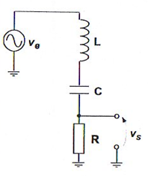
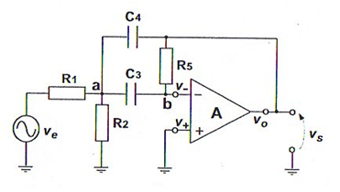
Filtro Passivo X Filtro Ativo
Mostrar que o filtro ativo passa-faixa com realimentação múltipla abaixo tem a mesma função de transferência do filtro passivo RLC.
≡
1
O ganho de tensão do circuito passivo é dado por:
G = $\frac{v_{s}}{v_{e}}= \frac{R}{\left(jwL+R+ \frac{1}{jwC}\right)}$ = $\frac{\frac{jwR}{L}}{−w^{2}+\frac{jwR}{L}+\frac{1}{LC}}=\frac{\frac{jww_{o}}{Q}}{−w^{2}+\frac{jww_{o}}{Q}+w_{o}^{2}}$
$$w_{o}^{2}= \frac{1}{LC}$$
[1]
Q$= \frac{w_{o}L}{R}$

Slide 12
2
O ganho de tensão do circuito ativo, como demonstrado, é dado por:
G = $\frac{v_{s}}{v_{e}}= \frac{\frac{1}{Z_{1}Z_{3}}}{\frac{1}{Z_{5}}\left(\frac{1}{Z_{1}} \text{+} \frac{1}{Z_{2}} \text{+} \frac{1}{Z_{3}}\text{ + }\frac{1}{Z_{4}}\right)+\frac{1}{Z_{3}Z_{4}}}$
$$Z_{1}=R_{1}$$
$$Z_{4}=1/jwC_{4}$$
$$Z_{2}=R_{2}$$
$$Z_{5}=R_{5}$$
$$Z_{3}=1/jwC_{3}$$
G = $\frac{v_{s}}{v_{e}}=−\frac{jwC_{3}}{−w^{2}C_{3}C_{4}+jw\frac{C_{3}+C_{4}}{R_{5}}+\frac{1}{R_{5}}\left(\frac{1}{R_{1}}+\frac{1}{R_{2}}\right)}$
3
Se C₃ = C₄ = C e R₅ = 2R₁ resulta:
G = $\frac{v_{s}}{v_{e}}= \frac{jw/(R_{1}C)}{−w^{2}+jw\frac{2}{R_{5}C}+\frac{1}{R_{5}C^{2}}\left(\frac{1}{R_{1}}+\frac{1}{R_{2}}\right)}$ =$\frac{\frac{jww_{0}}{Q}}{−w^{2}+\frac{jww_{0}}{Q}+w_{0}^{2}}$
$w_{0}^{2}$=$\frac{1}{2R_{5}C^{2}}\left(\frac{1}{R_{1}}+\frac{1}{R_{2}}\right)$
[2]
$Q^{2}$=$\frac{R_{1}}{2}\left(\frac{1}{R_{1}}+\frac{1}{R_{2}}\right)$
[1] = [2]

Slide 13
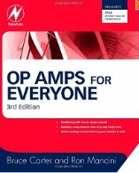
Rather than resembling just another filter book, the individual filter sections are written in a cookbook style, thus avoiding tedious mathematical derivations. Each section starts with the general transfer function of a filter, followed by the design equations to calculate the individual circuit components.
Introduction to three main filter optimizations (Butterworth, Tschebyscheff, and Bessel).
Description of the most common active filter applications:
low-pass
high-pass
band-pass
band-rejection
all-pass filters

Slide 14
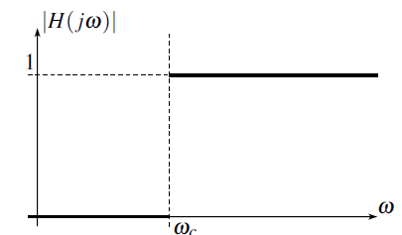
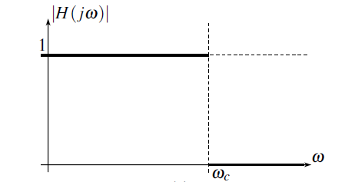
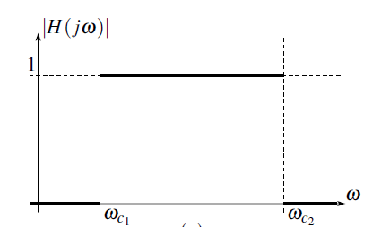
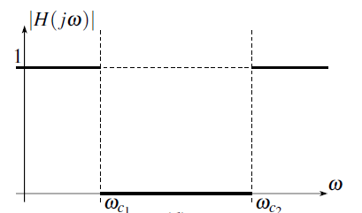
Active Filters
filtro passa-baixa
filtro passa-alta
filtro passa-faixa
filtro rejeita-faixa

Slide 15
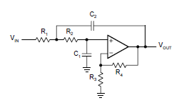
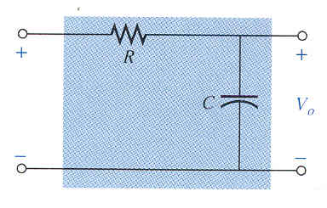
Active Filters
Active Filter
Sallen-Key Topology
filtro passa-baixa
Passive Filter

Slide 16
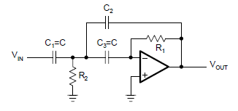
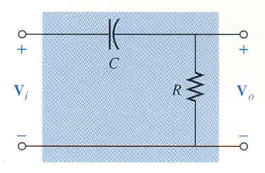
Active Filters
Active Filter
Multiple Feedback Topology
filtro passa-alta
Passive Filter

Slide 17
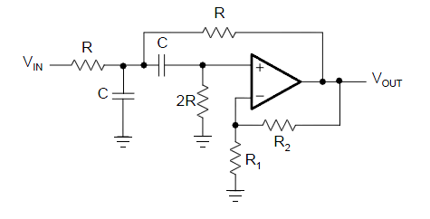
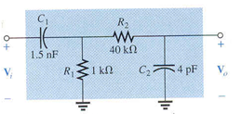
Active Filters
Active Filter
Sallen-Key Topology
Passive Filter
filtro passa-faixa

Slide 18
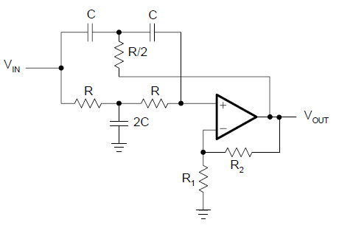
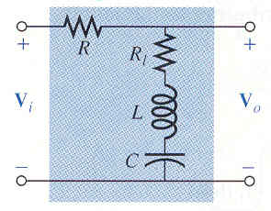
Active Filters
Active Filter
Twin-T Topology
filtro rejeita-faixa
Passive Filter

Slide 19
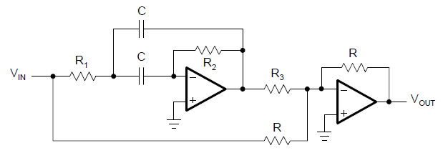
Active Filters
banda de passagem é todo o espectro de frequências
mas com defasagens diferentes ao longo do espectro !
filtro passa-tudo

Slide 20
Low Pass Filters

Slide 21
Butterworth
Low Pass Filter
Tchebysheff
Bessel

Slide 22
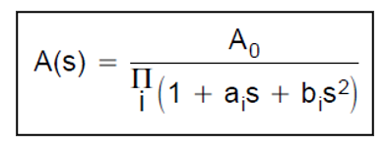
Low Pass Filter
General Transfer Function
1
The filter coefficients a_{i} and b_{i} distinguish between Butterworth, Tschebyscheff, and Bessel filters. The coefficients for all three types of filters are tabulated.
2
n determines the gain rolloff above f_{C} (n·20 dB/decade)
3
a_{i} and b_{i} determine the gain behavior in the passband.
4
The Butterworth coefficients optimizes the passband for maximum flatness.
5
The Tschebyscheff coefficients sharpes the transition from passband into the stopband.
6
The Bessel coefficients linearizes the phase response up to f_{c} .

Slide 23
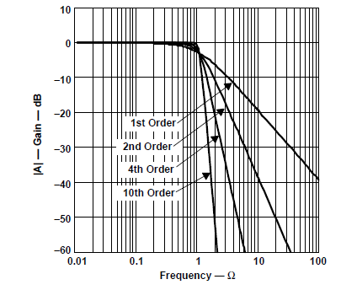
Butterworth Low Pass Filter
The Butterworth low-pass filter provides passband flatness.
Ω = f / f_{C}

Slide 24
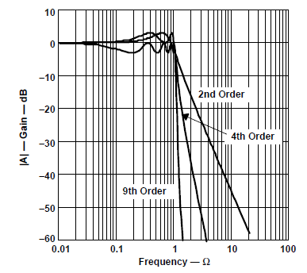
Tchebysheff Low Pass Filter
The Tschebyscheff low-pass filters provide an even higher gain rolloff above f_{C}. However, the passband gain is not monotone, but contains ripples of constant magnitude instead. For a given filter order, the higher the passband ripples, the higher the filter’s rolloff.
Ω = f / f_{C}

Slide 25
Ω = f / f_{C}
For a given filter order, the higher the passband ripples, the higher the filter’s rolloff.
Each ripple accounts for one second-order filter stage.
Filters with even order numbers generate ripples above the 0-dB line
Filters with odd order numbers create ripples below 0 dB.

Slide 26
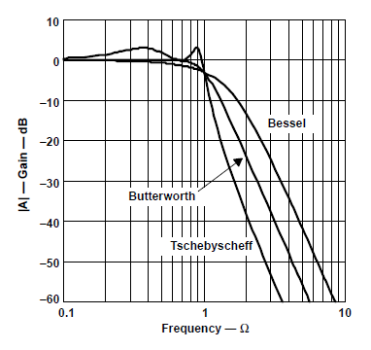
Bessel Low Pass Filter
The passband gain of a Bessel low-pass filter is not as flat as that of
the Butterworth low-pass
The transition from passband to stopband is by far not as sharp as that of a Tschebyscheff low-pass filter
Ω = f / f_{C}

Slide 27
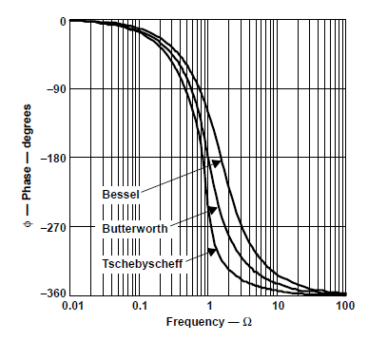
The Bessel low-pass filters have a linear phase response over a wide frequency range
Ω = f / f_{C}

Slide 28
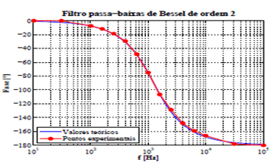
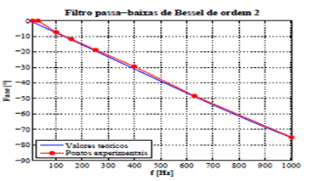
The Bessel low-pass filters have a linear phase response over a wide frequency range
(monolog scale)
(linear scale)

Slide 29
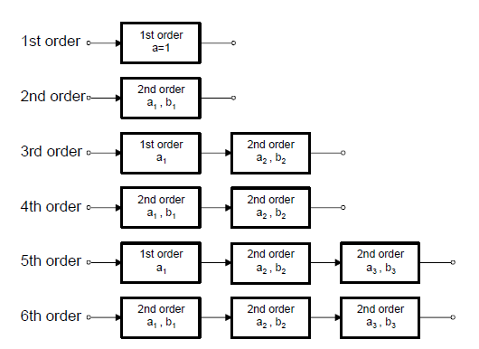
Cascade Filters
The first-order and second-order filter stages are the building blocks for higher-order filters.

Slide 30
Quality Factor
Band Pass
Filters
Low and High Pass Filters

Slide 31
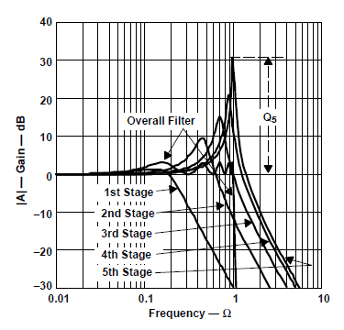
Example: low pass filter with 5 stages
$$Q_{5}= \frac{\sqrt{b_{5}}}{a_{5}}$$
Q₅(dB) = 20 logQ₅

Slide 32
Designing
Low Pass Filters

Slide 33
Filters Coefficients

Slide 34
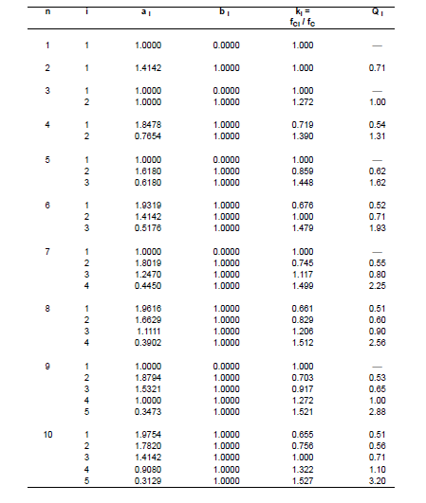
Butterworth Coefficients

Slide 35
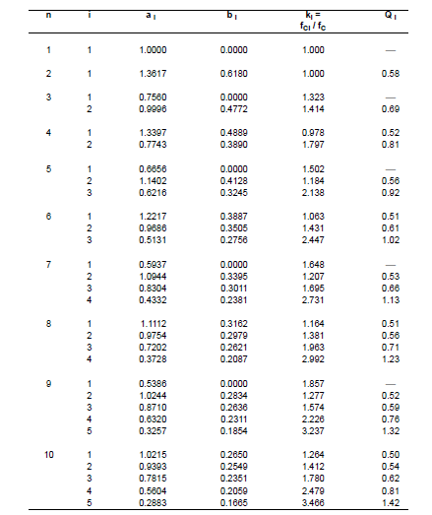
Bessel
Coefficients

Slide 36
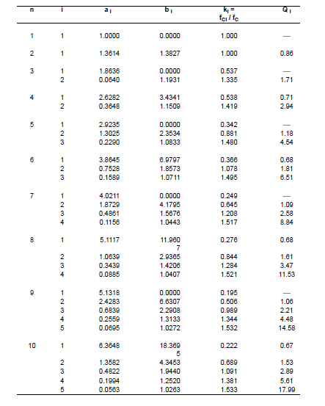
Tschebyscheff Coefficients
(0.5 dB Passband ripple)

Slide 37
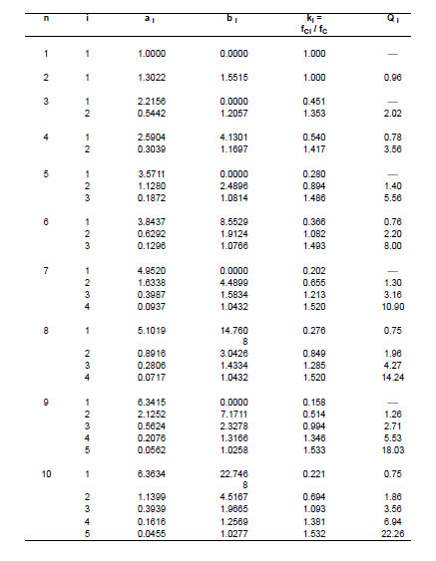
Tschebyscheff Coefficients
(1 dB Passband ripple)

Slide 38
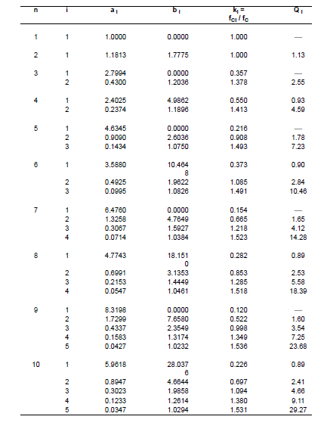
Tschebyscheff Coefficients
(2 dB Passband ripple)

Slide 39
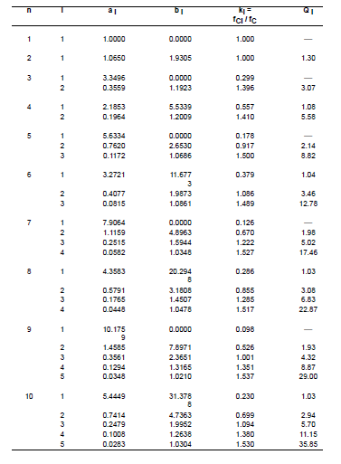
Tschebyscheff Coefficients
(3 dB Passband ripple)

Slide 40
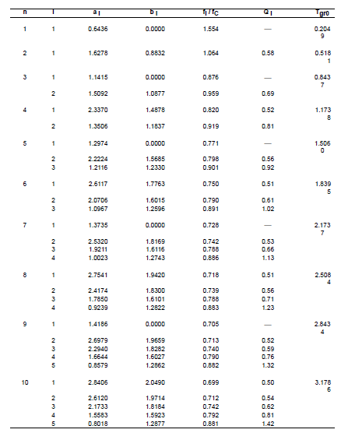
All Pass

Slide 41
First order filter
Second order filter

Slide 42
Low Pass Filters
(First Order Topology)

Slide 43
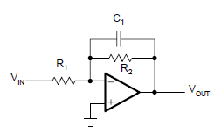
Inverting
a₁
(DC gain)

Slide 44
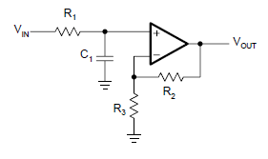
Noninverting
a₁
(DC gain)

Slide 45
Designing Low Pass Filters
(First Order Topology)

Slide 46
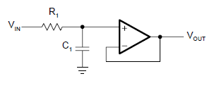
Inverting
Noninverting
(Ganho ≠ 1)
(Ganho = 1)
1
Specify f_{C}, A₀ , C₁
1
1
Specify f_{C}, C₁
Specify f_{C}, A₀, C₁
2
2
2
3
3

Slide 47
Low Pass Filters
(Second Order Topology)

Slide 48
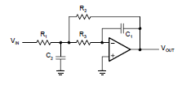
Sallen-Key Topology
General Sallen-Key Topology
Multiple Feedbak Topology

Slide 49
Sallen-Key Topology (G≠1)
The SK topology is commonly used in filters
General Sallen-Key Topology
a₁
b₁

Slide 50
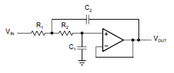
Sallen-Key Topology (G=1)
Sallen-Key Topology with unit gain
a₁
b₁

Slide 51
Multiple Feedbak Topology
The MFB topology is commonly used in filters that have high Qs and require a high gain
a₁
b₁

Slide 52
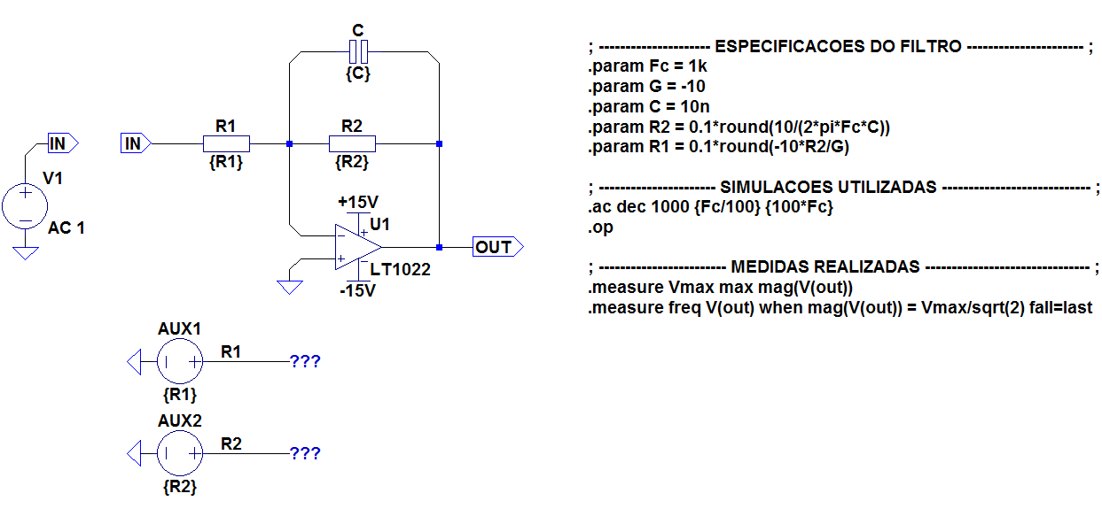
Filtro Passa-Baixa Sallen-Key Genérico de Ordem 1 Inversor

Slide 53
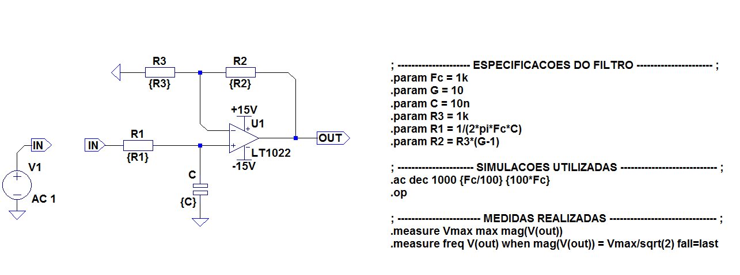
Filtro Passa-Baixa Sallen-Key Genérico de Ordem 1 Não-Inversor

Slide 54
Designing Low Pass Filters
(Second Order)
Sallen-Key Topology

Slide 55
Sallen-Key Topology
(G=1)
1
Pick C₁
2
Determine filter coefficients a₁ e b₁
3
In order to obtain real values under the square root, C2 must satisfy the following condition:
4
Calculate R₁ and R₂

Slide 56
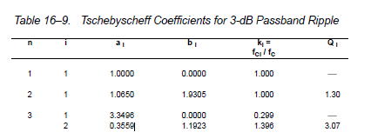
Sallen-Key Topology
(G=1)
Exemple 1:
Design a second order unity gain Tschebyscheff low pass filter with a corner frequency of 3KHz and a 3dB passband ripple
1
Pick C₁ =22nF
2
Get the Tschebyscheff filters coefficient tables: a₁ = 1.0650 and b₁ = 1,9305

Slide 57
3
3
4
Calculate R₁ and R₂
5

Slide 58
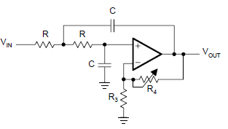
Sallen-Key Topology
(G≠1)
(R₁=R₂= R and C₁=C₂=C)

Slide 59
Sallen-Key Topology
(G≠1)
1
Get a_{n} and b_{n}
2
Pick C and get R
3
Calculate A₀ and R₄ /R₃
4
Calculate Q

Slide 60
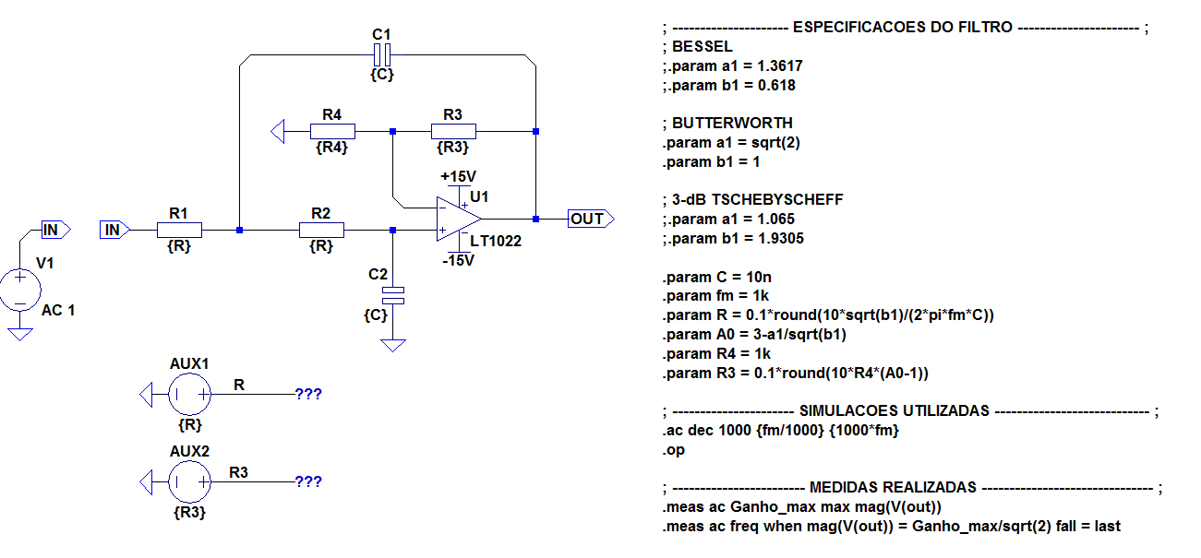
Filtro Passa-Baixa Sallen-Key Genérico de Ordem 2

Slide 61
Designing Low Pass Filters
(Higher Order)
Sallen-Key Topology

Slide 62
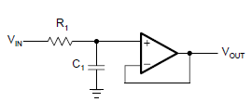
Exemple 1:
Design a fifth order unity gain Butterworth low pass filter with a corner frequency of 50KHz.

Slide 63
1
Get Butterworth Coefficients

Slide 64
First Filter: first order
2
Pick C₁ = 1nF
3
Get R₁

Slide 65
Second Filter: Sallen-Key second order
4
Pick C₁ = 820pF
5
$R_{1}=\frac{a_{1C_{2}} − \sqrt{a_{1}^{2}C_{2}^{2}−4b_{1}C_{1}C_{2}}}{4πf_{c}C_{1}C_{2}}$ = 1.87K Ω
6
With C₁ = 820pF and C₂ = 1.5nF calculate R₁ and R₂
$R_{2}=\frac{a_{1C_{2}}+ \sqrt{a_{1}^{2}C_{2}^{2}−4b_{1}C_{1}C_{2}}}{4πf_{c}C_{1}C_{2}}$ = 4.42 KΩ

Slide 66
Third Filter: Sallen-Key second order
7
Pick C₁ = 330pF
8
$R_{1}=\frac{a_{1C_{2}} − \sqrt{a_{1}^{2}C_{2}^{2}−4b_{1}C_{1}C_{2}}}{4πf_{c}C_{1}C_{2}}$ = 1.47K Ω
9
With C₁ = 330pF and C₂ = 4.7nF calculate R₁ and R₂
$R_{2}=\frac{a_{1C_{2}}+ \sqrt{a_{1}^{2}C_{2}^{2}−4b_{1}C_{1}C_{2}}}{4πf_{c}C_{1}C_{2}}$ = 4.53 KΩ
10

Slide 67
Designing Low Pass Filters
(Second Order)
Multiple Feedback Topology

Slide 68
Multiple Feedbak Topology
The MFB topology is commonly used in filters that have high Qs and require a high gain

Slide 69
1
Choose C₁ , C₂
2
Calculate R₁, R_{2,} R₃

