Slide 1
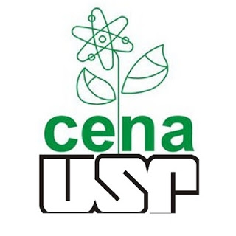
Universidade de São Paulo
Genômica e Bioinformática
Anotação estrutural e funcional de genomas
Tema 5
Doscente
Diego Mauricio Riano Pachon
Discentes
Aline Giovana da França
Luis Fernando Merloti
Natalia Fernandes Carr
Piracicaba, março de 2019

Slide 2
Introdução
1
Summary
Introduction
Annotation
Genome organization
Relevant Concepts
Pipeline for Eukariotic Genome Annotation
Functional Annotation
Predicting metabolic pathways
How to do annotation?
Visualizing the annotation data
Quality control
Conclusion
Sequenciamento
Montagem
Anotação

Slide 3
Introdução
2
Summary
Introduction
Annotation
Genome organization
Relevant Concepts
Pipeline for Eukariotic Genome Annotation
Functional Annotation
Predicting metabolic pathways
How to do annotation?
Visualizing the annotation data
Quality control
Conclusion
O que é anotação de genoma?
A anotação de um genoma consiste na identificação de suas regiões funcionais ou de relevância biológico, o que pode incluir:
• Genes codificantes de proteínas.
• Regiões funcionais em proteínas.
• Genes de RNA não-codificantes (tRNAs, rRNAs, etc).
• Regiões de DNA repetitivo.
• Promotores, terminadores, Operons, Riboswitches e outras regiões regulatórias.

Slide 4
Introdução
3
Summary
Introduction
Annotation
Genome organization
Relevant Concepts
Pipeline for Eukariotic Genome Annotation
Functional Annotation
Predicting metabolic pathways
How to do annotation?
Visualizing the annotation data
Quality control
Conclusion
GENE
Unidade funcional do DNA que controla a síntese de polipeptídios ou uma molécula de RNA estrutural.
rRNA
tRNA
snoRNA
siRNA
mRNA
RNA
ncRNA
Notes:
Structural RNAs/small ncRNAs
Structural RNAs (5S, 16S, and 23S rRNAs) are highly conserved in closely related prokaryotic species. For the 16S and 23S rRNAs the NCBI Reference Sequence Collection (RefSeq) contains a curated set of reference sequences. The pipeline uses a BLASTn search against the reference set to identify these rRNA. 5S rRNAs and small ncRNAs are identified using RFAM HMMs, these hits are further refined using Cmsearch. Partial alignments that fall below 50% of the average length are dropped.
tRNAs
To identify tRNA genes, the input genome sequence is split into ~200nt windows with overlap of ~100nt and passed through tRNAscan-SE. tRNAscan-SE identifies 99–100% of transfer RNA genes in DNA sequence while giving less than one false positive per 15 gigabases. It is currently one of the most powerful tRNA identification tools, and uses different, targeted parameter sets for Archaea and Bacteria. tRNA predictions below a tRNAscan-SE score of 20 are discarded.

Slide 5
Introdução
4
Summary
Introduction
Annotation
Genome organization
Relevant Concepts
Pipeline for Eukariotic Genome Annotation
Functional Annotation
Predicting metabolic pathways
How to do annotation?
Visualizing the annotation data
Quality control
Conclusion
Procarioto
• Sem introns.
• Estrutura gênica simples.
• Fácil predição de novo/ab initio.

Slide 6
Introdução
5
Summary
Introduction
Annotation
Genome organization
Relevant Concepts
Pipeline for Eukariotic Genome Annotation
Functional Annotation
Predicting metabolic pathways
How to do annotation?
Visualizing the annotation data
Quality control
Conclusion
Eucarioto
Genes divididos em exons/introns.
Estrutura gênica complexa.
Difícil predição de novo/ab initio.

Slide 7
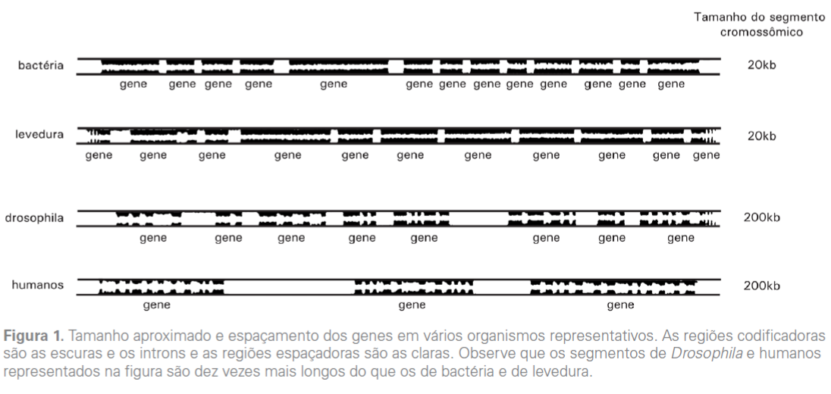
Introdução
6
Summary
Introduction
Annotation
Genome organization
Relevant Concepts
Pipeline for Eukariotic Genome Annotation
Functional Annotation
Predicting metabolic pathways
How to do annotation?
Visualizing the annotation data
Quality control
Conclusion
Notes:
Ao observarmos a figura , vemos que há importantes diferenças na organização dos cromossomos apresentados. Observa-se que no cromossomo de bacteria e da levedura há pouco espaço entre os genes , enquanto uma fração pequena do cromossomos humano codifica uma proteína. Oberva-se também que o numero e o tamnho dos introns aumenta da levedura ao homem.

Slide 8
Introdução
7
Summary
Introduction
Annotation
Genome organization
Relevant Concepts
Pipeline for Eukariotic Genome Annotation
Functional Annotation
Predicting metabolic pathways
How to do annotation?
Visualizing the annotation data
Quality control
Conclusion

Slide 9
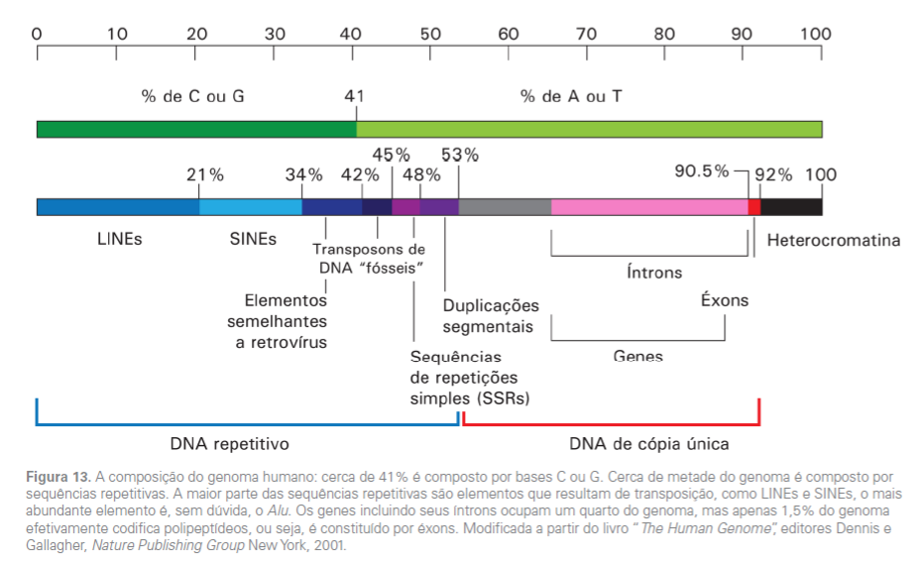
Introdução
8
Summary
Introduction
Annotation
Genome organization
Relevant Concepts
Pipeline for Eukariotic Genome Annotation
Functional Annotation
Predicting metabolic pathways
How to do annotation?
Visualizing the annotation data
Quality control
Conclusion

Slide 10
Introdução
9
Summary
Introduction
Annotation
Genome organization
Relevant Concepts
Pipeline for Eukariotic Genome Annotation
Functional Annotation
Predicting metabolic pathways
How to do annotation?
Visualizing the annotation data
Quality control
Conclusion
Conceitos importantes
ORF (Open Read Frame): Sequencia de DNA constituída por códons (tamanho múltiplo de 3), sendo o primeiro um códon de iniciação (normalmente um ATG), e que termina com um códon de terminação. ORFs podem ser, mas não necessariamente são, regiões codificantes de facto.
CDS (Coding DNA sequence): Sequencia de DNA codificante para uma proteína. Uma CDS pode ser uma ORF, mas nem toda ORF é uma CDS. CDS podem ser constituída Também pela “soma” das regiões de exons de um gene de eucariotos.
Pseudogene: Uma região no genoma que, durante o processo evolutivo, deixou de ser um gene, normalmente por conta de frameshifts (alteração de case de leitura)
Expressed sequence tags (ESTs): é uma subsequência curta de um cDNA. As ESTs podem ser usadas para identificar transcritos, na descoberta de genes e na determinação de sequencias gênicas

Slide 11
PIPELINE FOR EUKARYOTIC GENOME ANNOTATION
10
Summary
Introduction
Annotation
Genome organization
Relevant Concepts
Pipeline for Eukariotic Genome Annotation
Functional Annotation
Predicting metabolic pathways
How to do annotation?
Visualizing the annotation data
Quality control
Conclusion
Phase 1
“The computational or structural phase”
Phase 2
“The annotation or functional phase”
Visualizing the annotation data
Step 1. Repeat Identification and Masking
Step 2. Evidence alignment
Step 3. Ab initio gene prediction
Step 3. Evidence-Driven gene prediction
Data are synthesized into gene annotations
Quality control
Making data publicly
Many different tools
Current pipelines focused in protein-coding genes
Non-coding RNAs (ncRNAS) → using specific pipelines
Notes:
Expressed sequence tags (ETSs)
Protein
RNA-seq..
Are alighned and ab initio or evidence driven are generated

Slide 12
PIPELINE FOR EUKARYOTIC GENOME ANNOTATION
11
Summary
Introduction
Annotation
Genome organization
Relevant Concepts
Pipeline for Eukariotic Genome Annotation
Functional Annotation
Predicting metabolic pathways
How to do annotation?
Visualizing the annotation data
Quality control
Conclusion
Phase 1
“The computational phase”
Step 1. Repeat Identification and Masking
Identification of repeat elements
“Low-complexity” sequences: homopolymeric runs of nucleotides
Mobile elements: viruses, long and short interspersed nuclear elements (LINEs and SINEs)
Poorly conserved
Solution: creation of a repeat library sequence for the genome of interest
Homology-based tools
De novo tools
Carefully post-process de output
Highly conserved protein-coding genes
Novel repeat families
Notes:
1 – Dar o exemplo de elementos repetitivos do genoma humano: 47% e eucariotos de forma geral
Tradução: Arquivo de saída deve ser cuidadosamente processado, que pode incluir genes codificadores de proteínas altamente conservados e novas famílias de repetição

Slide 13
PIPELINE FOR EUKARYOTIC GENOME ANNOTATION
12
Summary
Introduction
Annotation
Genome organization
Relevant Concepts
Pipeline for Eukariotic Genome Annotation
Functional Annotation
Predicting metabolic pathways
How to do annotation?
Visualizing the annotation data
Quality control
Conclusion
Phase 1
“The computational phase”
Step 1. Repeat Identification and Masking
Sequencing alignment tools
After repeat library created:
RepeatMasker
Repeat library
Identify and signals repeat sequences
Gene prediction tools
RepeatMaker tool:
Identify stretches of sequences in a target genome that are homologous to known repeat
Signals repetitive regions for the later steps: sequence alignment and gene prediction tools
If you do not have a library: Tools like RepeatModeler can identify repetitive regions based on the structure of transcripts
Notes:
RepeatMask - Identificar trechos de seqüências em um genoma alvo que sejam homólogos a repetições conhecidas
Sinaliza regiões repetitivas para os passos posteriores: alinhamento de sequências e ferramentas de predição de genes
Tools such as RepeatMasker
Identify stretches of sequences in a target genome that are homologous to known repeats
Masking process
Masking repeat sequences
It signals repetitive regions for the later steps: sequence alignment and gene prediction tools

Slide 14
PIPELINE FOR EUKARYOTIC GENOME ANNOTATION
13
Summary
Introduction
Annotation
Genome organization
Relevant Concepts
Pipeline for Eukariotic Genome Annotation
Functional Annotation
Predicting metabolic pathways
How to do annotation?
Visualizing the annotation data
Quality control
Conclusion
Phase 1
“The computational phase”
Step 2. Evidence alignment
After repeat masking:
Align proteins, transcripts and RNA-seq data to the genome assembly. These sequences include previously identified transcripts and proteins from the organism whose genome is being annotated.
UniprotKB/ SwissProt
Might be used to supplement database (additional protein and transcritps to data set)
Notes:
Alinhar proteínas, ESTs e dados de RNA-seq à montagem do genoma e transcritos e proteínas previamente identificados cujo genoma está sendo anotado.

Slide 15
PIPELINE FOR EUKARYOTIC GENOME ANNOTATION
14
Summary
Introduction
Annotation
Genome organization
Relevant Concepts
Pipeline for Eukariotic Genome Annotation
Functional Annotation
Predicting metabolic pathways
How to do annotation?
Visualizing the annotation data
Quality control
Conclusion
Phase 1
“The computational phase”
Step 2. Evidence alignment
Alignment for transcripts or proteins: 1º Alignment step
Tools
BLAST
BLAT...
Transcripts or
Protein
on the genome
Transcripts or
Protein
Transcripts or
Protein
Clustered
Clustered
Indentify approximate regions and
Filtering
Filtering: Using metrics such as % of similarity and % identity to remove marginal alignments
After, the remains data sets are (sometimes) clustered to identify overlapping alignments and predictions
Notes:
BLAST and BLAT → identificar regiões aproximadas de homologia rapidamente
Clustering tem dois propósitos. Primeiro, agrupa diversos resultados computacionais em um único cluster de dados, todos apoiando o mesmo gene. Em segundo lugar, identifica e expurga evidências redundantes; genes altamente expressos, por exemplo, pode ser suportado por centenas, se não milhares de ESTs idênticos.
INDENTIFICAR E AGRUPAR EVIDÊNCIAS/ E RETIRAR EVIDÊNCIAS REDUNDANTES !!!

Slide 16
PIPELINE FOR EUKARYOTIC GENOME ANNOTATION
15
Summary
Introduction
Annotation
Genome organization
Relevant Concepts
Pipeline for Eukariotic Genome Annotation
Functional Annotation
Predicting metabolic pathways
How to do annotation?
Visualizing the annotation data
Quality control
Conclusion
Alignment for ESTs and proteins: 2º Alignment step or “Polishing”
Options of tools
Splign
Spidey
sim4
Exonarate
Transcripts or
Protein
clustered
Transcripts or Proteins
aligned
Realign increasing the precision of
exons boundaries
After clustering, the similar sequences identified are realigned to the target genome in order to obtain greater precision at exons boundaries
Tools such as Splign, Spidey, sim4 and Exonarate, are used and having much improved information about splice sites and exons boundaries.

Slide 17
PIPELINE FOR EUKARYOTIC GENOME ANNOTATION
16
Summary
Introduction
Annotation
Genome organization
Relevant Concepts
Pipeline for Eukariotic Genome Annotation
Functional Annotation
Predicting metabolic pathways
How to do annotation?
Visualizing the annotation data
Quality control
Conclusion
Phase 1
“The computational phase”
Step 2. Evidence alignment
Alignment for RNA-seq
RNA-seq can be assembled by de novo:
Using tools as ABySS, SOAP and Trinity
The resulting transcripts are then realigned to the same way ESTs
RNA-seq can be directly aligned to the genome reference
Using tools such as HISAT2, GSNAP or Scripture, fallowed by assemble of alignments (rather than reads) into transcripts using tools such as Cufflinks
Notes:
O uso da melhor abordagem para lidar com dados de RNA-Seq depende da biologia do genoma:
contiguidade e completude da montagem do genoma.
Densidade do gene também.
Se os genes são pouco espaçados no genoma→ Cuffllink pode dar erros→ usar o de novo

Slide 18
PIPELINE FOR EUKARYOTIC GENOME ANNOTATION
17
Summary
Introduction
Annotation
Genome organization
Relevant Concepts
Pipeline for Eukariotic Genome Annotation
Functional Annotation
Predicting metabolic pathways
How to do annotation?
Visualizing the annotation data
Quality control
Conclusion
Phase 1
“The computational phase”
Step 3. Ab initio gene prediction
Predictor tools, that provide a fast and easy means to identify genes in assembled DNA sequences.
They use mathematical models rather than external evidences to identity genes and determine their intron-exon structure
Find the likely coding sequences (CDS)
Report, as optional function, untranslated regions (UTRs) or alternatively spliced transcripts
They use codon frequencies and distributions of intron– exon lengths, to distinguish genes from intergenic regions and to determine intron–exon
Precalculated parameter files that contain such information for a few classic genomes, such as D. melanogaster, Arabidopsis thaliana
Notes:
alternatively spliced transcripts

Slide 19
PIPELINE FOR EUKARYOTIC GENOME ANNOTATION
18
Summary
Introduction
Annotation
Genome organization
Relevant Concepts
Pipeline for Eukariotic Genome Annotation
Functional Annotation
Predicting metabolic pathways
How to do annotation?
Visualizing the annotation data
Quality control
Conclusion
Phase 1
“The computational phase”
Step 3. Ab initio gene prediction
The predictor needs to be trained on the genome that is under study
In principle, alignments of transcripts, RNA-seq and protein sequences to a genome can be used to train gene predictors even in the absence of pre-existing reference gene models
MAKER pipeline provides a simplified process for training the predictors as AUGUSTUS and SNAP
Ab initio recognizes signals in the transcripts: SHINE Delgano sequence

Slide 20
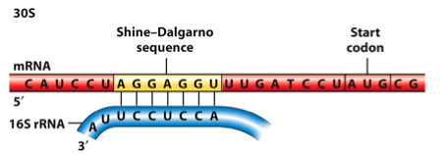
PIPELINE FOR EUKARYOTIC GENOME ANNOTATION
19
Summary
Introduction
Annotation
Genome organization
Relevant Concepts
Pipeline for Eukariotic Genome Annotation
Functional Annotation
Predicting metabolic pathways
How to do annotation?
Visualizing the annotation data
Quality control
Conclusion
Phase 1
“The computational phase”
Step 3. Ab initio gene prediction
Ab initio search for signs where there may possibly be genes
SHINE Delgarno sequence, HMMs, ORFS…

Slide 21
PIPELINE FOR EUKARYOTIC GENOME ANNOTATION
20
Summary
Introduction
Annotation
Genome organization
Relevant Concepts
Pipeline for Eukariotic Genome Annotation
Functional Annotation
Predicting metabolic pathways
How to do annotation?
Visualizing the annotation data
Quality control
Conclusion
Phase 1
“The computational phase”
Step 3. Evidence driven gene prediction
Predictor tools, that provide a fast and easy means to identify genes in assembled DNA sequences
They use external evidences to improve the quality of gene prediction
ESTs, protein or RNA-seq must be aligned to the genome
Splice site must be identified and processed before gene finder
Require many tools
Notes:
Ferramentas preditivas, que fornecem meios rápidos e fáceis de identificar genes em sequências de DNA montadas
Eles usam evidências externas para melhorar a qualidade da predição genética
ESTs, proteína ou RNA-seq devem estar alinhados ao genoma
O site de emenda deve ser identificado e processado antes do localizador de gene

Slide 22
PIPELINE FOR EUKARYOTIC GENOME ANNOTATION
21
Summary
Introduction
Annotation
Genome organization
Relevant Concepts
Pipeline for Eukariotic Genome Annotation
Functional Annotation
Predicting metabolic pathways
How to do annotation?
Visualizing the annotation data
Quality control
Conclusion
Phase 2
“The annotation or functional phase”

Slide 23
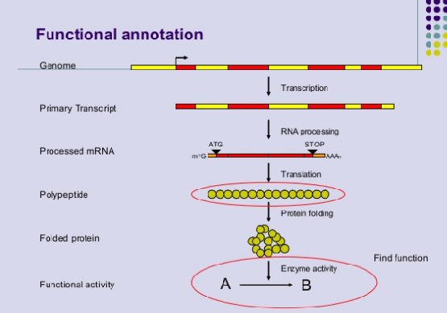
Functional annotation
22
Summary
Introduction
Annotation
Genome organization
Relevant Concepts
Pipeline for Eukariotic Genome Annotation
Functional Annotation
Predicting metabolic pathways
How to do annotation?
Visualizing the annotation data
Quality control
Conclusion
Notes:
As análises funcionais genômica são importantes ferramentas para se caracterizar os processos e domínios dos genes. Pois através dessa caracterização é mais fácil compreender as funções genicas, a distribuição deles em cada genoma e para futuras comparações em diversos organismos
Manually
Human genome annotators would review the evidence for each gene in order to decide on their intron–exon structures.
Automated annotation
Run different gene finders and then to use a ‘chooser algorithm’ (also known as a ‘combiner’) to select the single prediction whose intron–exon structure best represents the consensus

Slide 24
Functional annotation
23
Summary
Introduction
Annotation
Genome organization
Relevant Concepts
Pipeline for Eukariotic Genome Annotation
Functional Annotation
Predicting metabolic pathways
How to do annotation?
Visualizing the annotation data
Quality control
Conclusion
Attaching biological information to genomic elements
Biochemical function
Biological function
Involved regulation and interactions
Expression
For instance: Rubisco - expressed in leaves
functions in photosynthesis - found in chloroplasts.
Notes:
função bioquímica - função biológica - regulação e interações envolvidas – expressão
É possível se estender as informações referentes à um determinado gene através da identificação das funções e processos biológicos associados a ele

Slide 25
Functional Annotation: Gene Product Names
24
Summary
Introduction
Annotation
Genome organization
Relevant Concepts
Pipeline for Eukariotic Genome Annotation
Functional Annotation
Predicting metabolic pathways
How to do annotation?
Visualizing the annotation data
Quality control
Conclusion
Based on similarity to known proteins
Known or Putative: Identical or strong similarity to documented gene(s) in Genbank or has high similarity to a Pfam domain.
e.g. kinase, Rubisco
Expressed Protein: Only match is to an transcript with an unknown function; thus have confirmation that the gene is expressed but still do not know what the gene does.
Hypothetical Protein: No database match except possibly other hypotheticals.
Notes:
Known or Putative: Identical or strong similarity to documented gene(s) in Genbank or has high similarity to a Pfam domain; e.g. kinase, Rubisco
Expressed Protein: Only match is to an EST with an unknown function; thus have confirmation that the gene is expressed but still do not know what the gene does
Hypothetical Protein: Predicted solely by gene prediction programs; no database match except possibly other hypotheticals (some annotation centers would call this a conserved hypothetical protein)

Slide 26
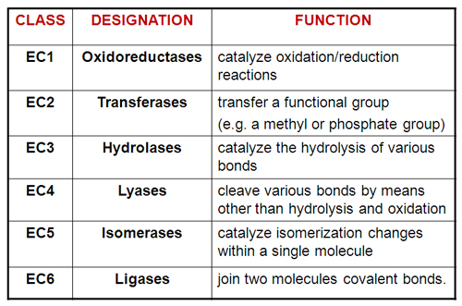
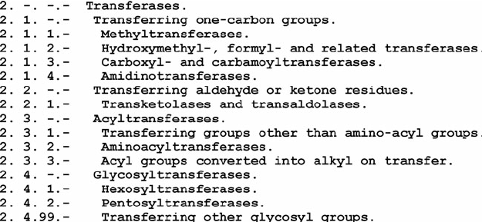
Functional Annotation: EC number
25
Summary
Introduction
Annotation
Genome organization
Relevant Concepts
Pipeline for Eukariotic Genome Annotation
Functional Annotation
Predicting metabolic pathways
How to do annotation?
Visualizing the annotation data
Quality control
Conclusion
EC number: Enzyme Commission
standardized nomenclature for enzymes
EC 5.3.3.2 (isopentenyldiphosphate isomerase)
Automated annotation can add EC number and gene symbol based on sequence similarity or publication reports of gene function.
Notes:
função bioquímica - função biológica - regulação e interações envolvidas - expressão

Slide 27
Functional Annotation: Expression patterns
26
Summary
Introduction
Annotation
Genome organization
Relevant Concepts
Pipeline for Eukariotic Genome Annotation
Functional Annotation
Predicting metabolic pathways
How to do annotation?
Visualizing the annotation data
Quality control
Conclusion
Used to deduce function based on correlative evidence.
Obtained from EST frequency, microarrays, MPSS, etc.
Used to identify regulatory motifs of co-regulated genes.
Limited in application to date - will be greatly expanding in the future.
Notes:
função bioquímica - função biológica - regulação e interações envolvidas - expressão

Slide 28
Functional Annotation: Gene Ontology assignments
27
Summary
Introduction
Annotation
Genome organization
Relevant Concepts
Pipeline for Eukariotic Genome Annotation
Functional Annotation
Predicting metabolic pathways
How to do annotation?
Visualizing the annotation data
Quality control
Conclusion
Unified ontologies that categorize genes into 3 categories:
Molecular Function
- what the gene product does
- think ‘activity’
Biological Process
- a biological objective
- must have more than one distinct step
Cellular Component
- location in the cell (or smaller unit)
- or part of a complex
Notes:
Use of ontologies to annotate gene products
(Molecular function, biological process and cellular component). Will allow for querying across genomes

Slide 29
Database – Identifying biological function
28
Summary
Introduction
Annotation
Genome organization
Relevant Concepts
Pipeline for Eukariotic Genome Annotation
Functional Annotation
Predicting metabolic pathways
How to do annotation?
Visualizing the annotation data
Quality control
Conclusion
The database of Clusters of Orthologous Groups of proteins (COGs) is an attempt on a phylogenetic classification of the proteins encoded in 21 complete genomes of bacteria, archaea and eukaryotes.
Others database: Eggnog
OrthoDB
PANTHER
The Gene Ontology knowledgebase is both human-readable and machine-readable, and is a foundation for computational analysis of large-scale molecular biology and genetics experiments in biomedical research.
Notes:
Bancos de dados como Clusters of Orthologous Groups (COG) e o Gene Ontology (GO), organizam em estruturas hierárquicas estas funções, e usam um conjunto limitado e curado de termos para a identificação de cada função e processo biológico.

Slide 30
Software tool for automatic functional annotation
29
Summary
Introduction
Annotation
Genome organization
Relevant Concepts
Pipeline for Eukariotic Genome Annotation
Functional Annotation
Predicting metabolic pathways
How to do annotation?
Visualizing the annotation data
Quality control
Conclusion
Blast2GO is a bioinformatics software tool for the automatic, high-throughput functional annotation of novel sequence data (genes/proteins).
It makes use of the BLAST algorithm to identify similar sequences to then transfers existing functional annotation from yet characterized sequences to the novel one.
The functional information is represented via the Gene Ontology, a controlled vocabulary of functional attributes.
Notes:
Além disso, algumas ferramentas como o BLAST2GO, permitem que a função de uma determinada proteína seja predita através da comparação dos seus resultados de BLAST contra um banco de dados de referência, com os termos GO.

Slide 31
Predicting metabolic pathways
30
Summary
Introduction
Annotation
Genome organization
Relevant Concepts
Pipeline for Eukariotic Genome Annotation
Functional Annotation
Predicting metabolic pathways
How to do annotation?
Visualizing the annotation data
Quality control
Conclusion
KAAS (KEGG Automatic Annotation Server) provides functional annotation of genes by BLAST or GHOST comparisons against the manually curated KEGG GENES database. The result contains KO (KEGG Orthology) assignments and automatically generated KEGG pathways. https://www.genome.jp/kegg/kaas/
MinPath (Minimal set of Pathways) only considers the minimum number of pathways required to explain the set of enzymes in the sample. http://omics.informatics.indiana.edu/MinPath/
PathPred (Pathway prediction server) a web-based server to predict plausible pathways of multi-step reactions starting from a query compound, based on the local RDM pattern match and the global chemical structure alignment against the reactant pair library. https://www.genome.jp/tools/pathpred/
RAST (Rapid Annotation using Subsystem Technology) is a fully-automated service for annotating complete or nearly complete bacterial and archaeal genomes. It provides high quality genome annotations for these genomes across the whole phylogenetic tree. http://rast.nmpdr.org/
Notes:
Além da determinação da função de uma proteína, é possível também se reconstruir rotas metabólicas através das funções preditas para cada proteína do genoma. Ferramentas como KAAS, MinPaths e PathPred utilizam bancos de dados como o KEGG Pathways e o SEED como base para a identificação de proteínas ortologas relacionadas à rotas já elucidadas.

Slide 32
How to do annotation?
31
Summary
Introduction
Annotation
Genome organization
Relevant Concepts
Pipeline for Eukariotic Genome Annotation
Functional Annotation
Predicting metabolic pathways
How to do annotation?
Visualizing the annotation data
Quality control
Conclusion
Automated annotation of gene models:
Relies on a variety of software tools and different data sources to create gene annotations. Typically, these tools are combined into programs referred to as pipelines.
Due to the volumes of genome data today, most genome projects are annotated primarily using automated methods with limited manual annotation.
Notes:
pipelines são conjuntos de ferramentas que são executadas em uma sequência lógica, aonde a saída (output) de uma é a entrada (input) de outra.

Slide 33
How to do annotation?
32
Summary
Introduction
Annotation
Genome organization
Relevant Concepts
Pipeline for Eukariotic Genome Annotation
Functional Annotation
Predicting metabolic pathways
How to do annotation?
Visualizing the annotation data
Quality control
Conclusion
Manual annotation of gene models:
Involves human expertise which will identify the annotation data types and interpret it.
-Examine the results of the automated pipeline
Edit the predicted structures of genes
Identify new genes
Quality control of automatically derived gene annotations and in-depth analyses of genes of interest often requires manual gene annotation.

Slide 34
Pros and cons
33
Summary
Introduction
Annotation
Genome organization
Relevant Concepts
Pipeline for Eukariotic Genome Annotation
Functional Annotation
Predicting metabolic pathways
How to do annotation?
Visualizing the annotation data
Quality control
Conclusion
Automated: Fast, cheap, rapidly updated - accuracy can be compromised.
Manual: slow, expensive, slowly updated - accurate.
Money and interest determine the blend of automated versus manual annotation for a genome!!!
HOW TO DECIDE?

Slide 35
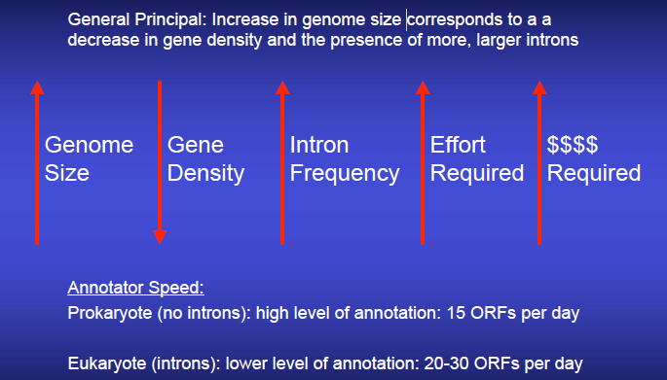
How many genes are there and how fast can I annotate them?
34
Summary
Introduction
Annotation
Genome organization
Relevant Concepts
Pipeline for Eukariotic Genome Annotation
Functional Annotation
Predicting metabolic pathways
How to do annotation?
Visualizing the annotation data
Quality control
Conclusion
The Institute for Genomic research, 2007
Notes:
Use of ontologies to annotate gene products

Slide 36
PIPELINE FOR EUKARYOTIC GENOME ANNOTATION
35
Summary
Introduction
Annotation
Genome organization
Relevant Concepts
Pipeline for Eukariotic Genome Annotation
Functional Annotation
Predicting metabolic pathways
How to do annotation?
Visualizing the annotation data
Quality control
Conclusion
Visualizing the
annotation data
Output files need to describe the intron–exon structures of each annotation, their start and stop codons, UTRs and alternative transcripts.
Currently formats: GenBank, GFF3, GTF and EMBL
Fully documented formats are important to:
Helping writing software to convert outputs into a format that other tools can use
The formats using controlled vocabularies and ontologies and helping in the “interoperability” between analysis tools
Comparative genomic analyses are very difficult with no common vocabulary
GMOD project
Notes:
A visualização de anotações em um navegador genoma e a criação de um banco de dados do genoma requer um arquivo de saída mais descritivo do que o formato FASTA.
A comunidade do projeto Genetic Model Organism Database (GMOD) desenvolveu uma série de padrões e ferramentas para a análise descritiva, visualização e redistribuição de anotações do genoma

Slide 37
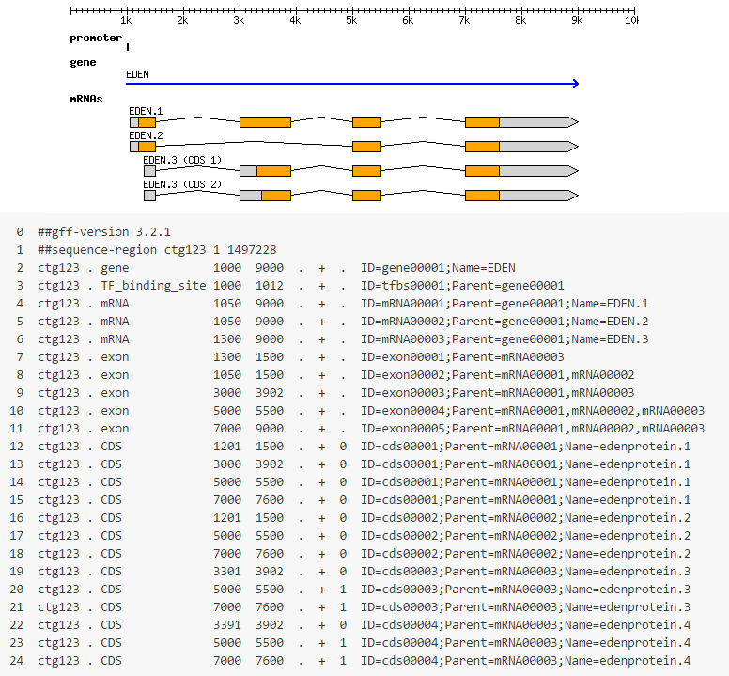
PIPELINE FOR EUKARYOTIC GENOME ANNOTATION
36
Summary
Introduction
Annotation
Genome organization
Relevant Concepts
Pipeline for Eukariotic Genome Annotation
Functional Annotation
Predicting metabolic pathways
How to do annotation?
Visualizing the annotation data
Quality control
Conclusion
Visualizing the
annotation data
GFF3 format
Notes:
A visualização de anotações em um navegador genoma e a criação de um banco de dados do genoma requer um arquivo de saída mais descritivo do que o formato FASTA.
A comunidade do projeto Genetic Model Organism Database (GMOD) desenvolveu uma série de padrões e ferramentas para a análise descritiva, visualização e redistribuição de anotações do genoma

Slide 38
PIPELINE FOR EUKARYOTIC GENOME ANNOTATION
37
Summary
Introduction
Annotation
Genome organization
Relevant Concepts
Pipeline for Eukariotic Genome Annotation
Functional Annotation
Predicting metabolic pathways
How to do annotation?
Visualizing the annotation data
Quality control
Conclusion
Quality control
Quantify the % of annotations that encode proteins with known domains (among the eukaryotes is reasonably constant – 57-75%)
Annotation edit distance (AED), for example, measures how congruent each annotation is with its overlapping evidence
Apollo, Argo and Artemis - approaches to fixing an erroneous annotation is to edit its intron-exon coordinates manually

Slide 39
PIPELINE FOR EUKARYOTIC GENOME ANNOTATION
38
Summary
Introduction
Annotation
Genome organization
Relevant Concepts
Pipeline for Eukariotic Genome Annotation
Functional Annotation
Predicting metabolic pathways
How to do annotation?
Visualizing the annotation data
Quality control
Conclusion
Making data publicly
avalaible
Publication of a paper
Publicly available annotations
Essential resource for annotation genome projects
Updating annotations
Update and improve the existing annotations

Slide 40
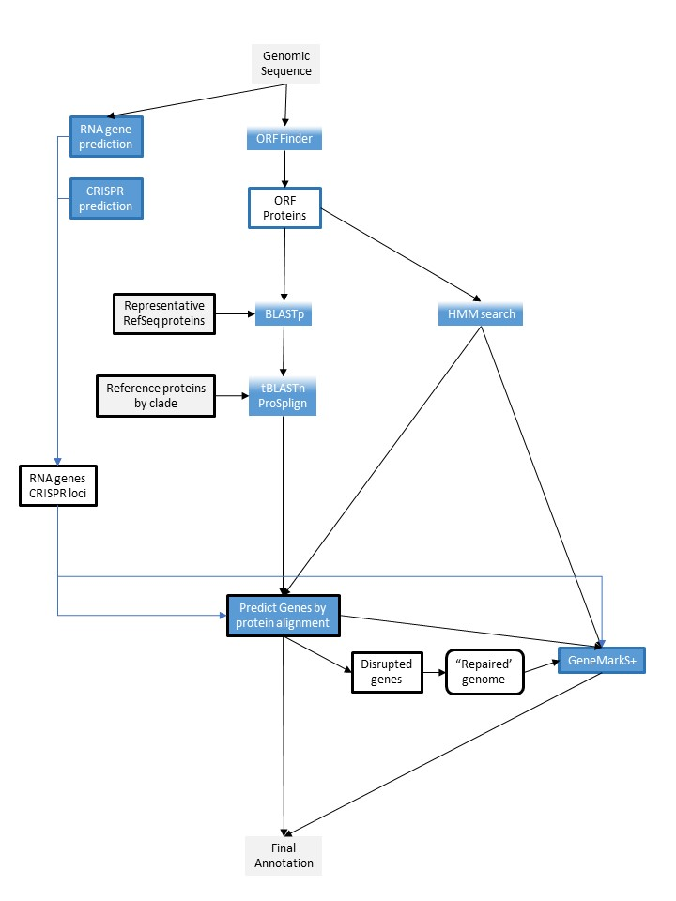
NCBI PROKARYOTIC GENOME ANNOTATION PROCESS
39
Summary
Introduction
Annotation
Genome organization
Relevant Concepts
Pipeline for Eukariotic Genome Annotation
Functional Annotation
Predicting metabolic pathways
How to do annotation?
Visualizing the annotation data
Quality control
Conclusion
The PGAP comparing ORFs to:
libraries of protein hidden Markov models (HMMs)
representative RefSeq proteins
proteins from well characterized reference genomes
Structural
Functional
Notes:
In molecular genetics, an open reading frame (ORF) is the part of a reading frame that has the ability to be translated. An ORF is a continuous stretch of codons that begins with a start codon (usually AUG) and ends at a stop codon (usually UAA, UAG or UGA).

Slide 41
NCBI PROKARYOTIC GENOME ANNOTATION PROCESS
40
Summary
Introduction
Annotation
Genome organization
Relevant Concepts
Pipeline for Eukariotic Genome Annotation
Functional Annotation
Predicting metabolic pathways
How to do annotation?
Visualizing the annotation data
Quality control
Conclusion
GeneMark S+ then makes ab initio coding region predictions for genomic regions that lack HMM or protein evidence and selects start sites for ORFs whose evidence comes from HMMs.
Structural
Functional
Notes:
O GeneMark S + faz então previsões de região de codificação ab initio para regiões genômicas que não possuem evidência de HMM ou proteína e seleciona locais de início para ORFs cuja evidência é proveniente de HMMs.

Slide 42
NCBI PROKARYOTIC GENOME ANNOTATION PROCESS
41
Summary
Introduction
Annotation
Genome organization
Relevant Concepts
Pipeline for Eukariotic Genome Annotation
Functional Annotation
Predicting metabolic pathways
How to do annotation?
Visualizing the annotation data
Quality control
Conclusion
Tools are used to identification of:
Non-coding RNA
Structural RNAs/small ncRNAs
tRNAs
Mobile/fast evolving genes
Phages
CRISPR
Frameshift detection
Functional annotation
More complete information: https://www.ncbi.nlm.nih.gov/genome/annotation_prok/process/
Notes:
O GeneMark S + faz então previsões de região de codificação ab initio para regiões genômicas que não possuem evidência de HMM ou proteína e seleciona locais de início para ORFs cuja evidência é proveniente de HMMs.

Slide 43
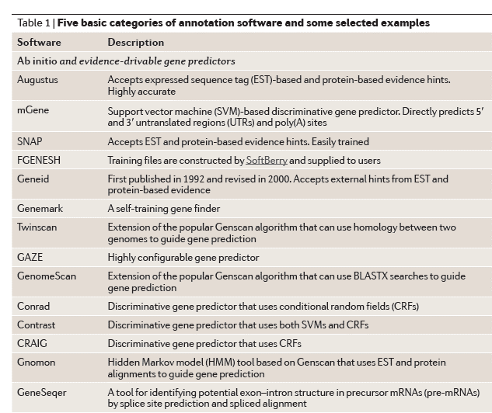
42
Summary
Introduction
Annotation
Genome organization
Relevant Concepts
Pipeline for Eukariotic Genome Annotation
Functional Annotation
Predicting metabolic pathways
How to do annotation?
Visualizing the annotation data
Quality control
Conclusion
Notes:
O GeneMark S + faz então previsões de região de codificação ab initio para regiões genômicas que não possuem evidência de HMM ou proteína e seleciona locais de início para ORFs cuja evidência é proveniente de HMMs.

Slide 44
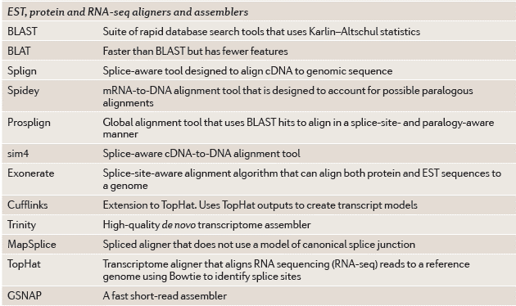
43
Summary
Introduction
Annotation
Genome organization
Relevant Concepts
Pipeline for Eukariotic Genome Annotation
Functional Annotation
Predicting metabolic pathways
How to do annotation?
Visualizing the annotation data
Quality control
Conclusion
Notes:
O GeneMark S + faz então previsões de região de codificação ab initio para regiões genômicas que não possuem evidência de HMM ou proteína e seleciona locais de início para ORFs cuja evidência é proveniente de HMMs.

Slide 45
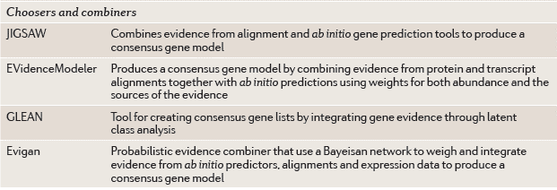
44
Summary
Introduction
Annotation
Genome organization
Relevant Concepts
Pipeline for Eukariotic Genome Annotation
Functional Annotation
Predicting metabolic pathways
How to do annotation?
Visualizing the annotation data
Quality control
Conclusion
Notes:
O GeneMark S + faz então previsões de região de codificação ab initio para regiões genômicas que não possuem evidência de HMM ou proteína e seleciona locais de início para ORFs cuja evidência é proveniente de HMMs.

Slide 46
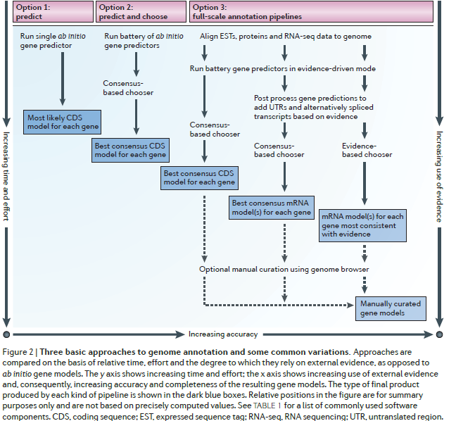
45
Summary
Introduction
Annotation
Genome organization
Relevant Concepts
Pipeline for Eukariotic Genome Annotation
Functional Annotation
Predicting metabolic pathways
How to do annotation?
Visualizing the annotation data
Quality control
Conclusion

Slide 47
Conclusion
46
Summary
Introduction
Annotation
Genome organization
Relevant Concepts
Pipeline for Eukariotic Genome Annotation
Functional Annotation
Predicting metabolic pathways
How to do annotation?
Visualizing the annotation data
Quality control
Conclusion
Annotation accuracy is dependent of available supporting data at the time of annotation and update information is necessary.
Gene predictions and functional assignments will change over time as new data becomes available (NCBI) that are much similar than previous ones.
As long as tools and sequencing technologies continue to develop, periodic updates to every genome’s annotations will remain necessary
Incorrect and incomplete annotations poison every experiment that makes use of them
Notes:
função bioquímica - função biológica - regulação e interações envolvidas - expressão

Slide 48
REFERENCES
47
CHAN, Kuang-Lim et al. Seqping: gene prediction pipeline for plant genomes using self-training gene models and transcriptomic data. BMC bioinformatics, v. 18, n. 1, p. 1, 2017.
FARIA, José P. et al. Methods for automated genome-scale metabolic model reconstruction. Biochemical Society Transactions, v. 46, n. 4, p. 931-936, 2018.
JENSEN LJ, JULIEN P, KUHN M, et al. eggNOG: automated construction and annotation of orthologous groups of genes. Nucleic Acids Res. 2007;36 (Database issue):D250-4.
MI H, HUANG X, MURUGANUJAN A, et al. PANTHER version 11: expanded annotation data from Gene Ontology and Reactome pathways, and data analysis tool enhancements. Nucleic Acids Res. 2016;45 (D1):D183-D189.
STEIN, Lincoln. Genome annotation: from sequence to biology. Nature reviews genetics, v. 2, n. 7, p. 493, 2001.
TAYLOR, Richard S. et al. MicroRNA annotation of plant genomes− Do it right or not at all. BioEssays, v. 39, n. 2, p. 1600113, 2017.
YANDELL, Mark; ENCE, Daniel. A beginner's guide to eukaryotic genome annotation. Nature Reviews Genetics, v. 13, n. 5, p. 329, 2012.

