Slide 1
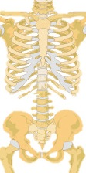
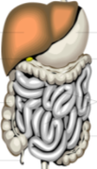
Respiratory system
Gas exchange
Digestive system
Water and Nutrient uptake
Circulatory system
Nutrient transport
Nervous system
Perception, control
Skeletal system
Support
Gas exchange takes place through thousands of stomata
Energy assimilation takes place throughout photosynthetic tissues
Nutrients are transported from cell to cell and through vascular tissues
Perception (of light, pathogens etc.) occurs through receptors and other sensors found in most cells
Water and nutrient uptake take place across the root (and sometimes shoot) surfaces
Signals to control and coordinate plant functions move from cell to cell and through vascular tissues
Support comes from cell walls and hydrostatic pressure

