Slide 1
Zika

Slide 2
Classification …
Discovered in 1947, Uganda (Zika Forest)
Arbovirus (transmitted by infected mosquitoes) (see dengue, chikungunya, yellow fever, etc.)
Zika: mosquitoes from the Aedes species
Symptoms: fever, headache, muscle pain, red eyes, joint pain
Major risks
- pregant women: microcephaly in new-born babies
- adults: Guillain-Barré syndrome (sickness of the nervous system)

Slide 3
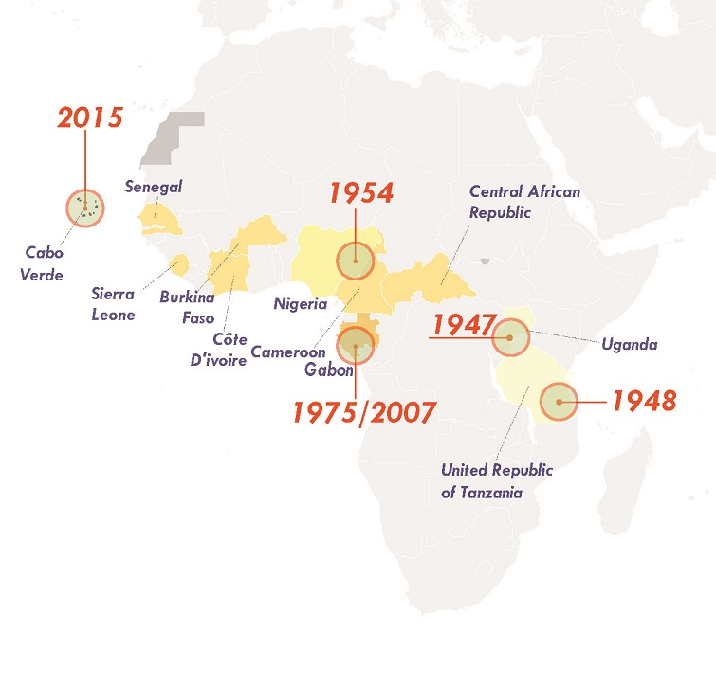
Chronology …
1947: the virus is isolated in samples taken from
a captive rhesus monkey
1948: the virus is recovered from the mosquito
Aedes africanus in the Zika Forest
1952: first human cases detected in Uganda and
other African countries
Thereafter: repeated outbreaks in tropical Africa, South-East Asia and the Pacific Islands since the 1950s

Slide 4
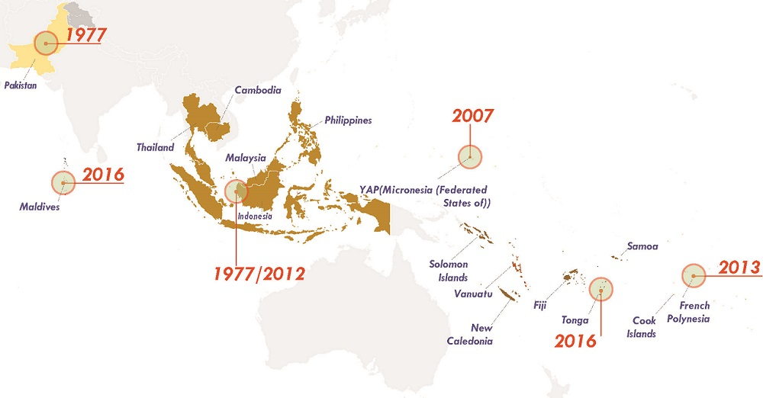
The spread of Zika over the decades in South-East Asia
Before 2007, at least 14 cases of Zika had been documented

Slide 5
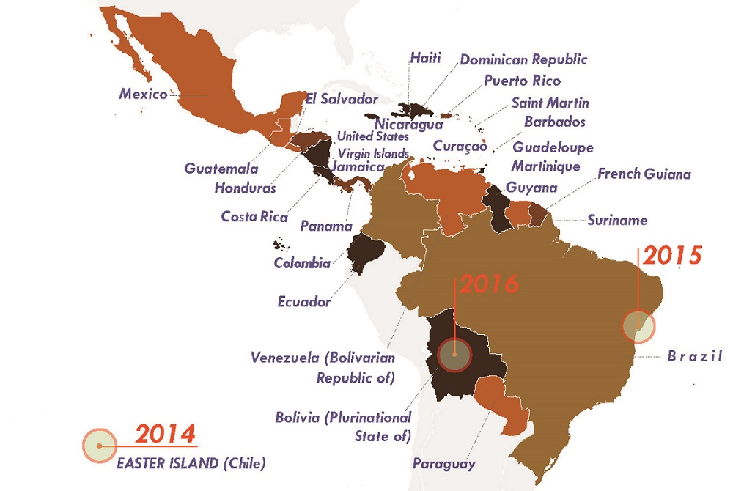
Arrives in the Americas in 2014 (Easter Island)
February 2015 – 29 April 2015: nearly 7,000 (mild) cases without Zika being suspected as the cause of the disease (skin rash)
21 January 2016: Brazil reports 3,893
cases of microcephaly in new-borns
(including 49 deaths)
22 January 2016: Brazil reports 1,708
cases of Guillain-Barré Syndrome
1 February 2016: WHO declares a
Public Health Emergency of International
Concern

Slide 6
Zika in Brazil
A perfect breeding ground
tropical climate
precarious public health system
precarious infrastructure
deficient sanitation
plastic waste
mosquito-infested regions (particularly the North and North-East)
Social, economic and political inequalities

Slide 7
Response of the Brazilian government
Campaigning / awareness-raising
- 13 February 2016: Zika Zero Day
Zika Zero Day, Zika Zero Campaign, Campanha Dengue, Zika e Chikungunya
- the effort mostly excluded favelas
Deploying the armed forces in the fight against zika
Multilateral vaccine development
- developed by the Evandro Chagas Institute (in collaboration with the University of Texas)
- to be tested in humans in 2018

Slide 8
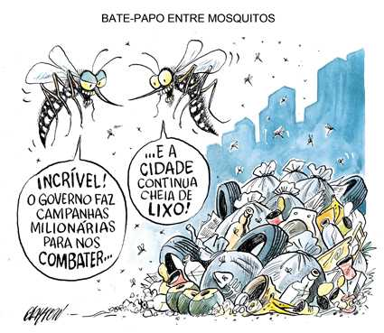
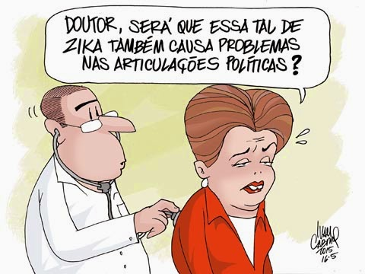
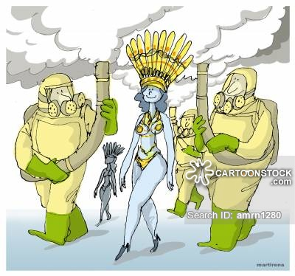
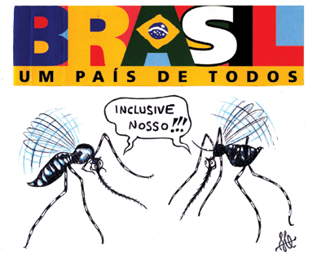
Ironies …

Slide 9
Think about other responses to epidemics discussed in this course (Ebola, Influenza, HIV/AIDS, etc.). How does Brazil‘s response to Zika compare?
Compare the international media coverage of the Ebola crisis with the Brazilian media coverage of the Zika crisis. What do you find?
Discuss how the Zika epidemic was socially constructed by the Brazilian government (compare with HIV/AIDS, WHO on H5N1, etc.)
What did the Zika epidemic (not) tell us about Brazilian and international approaches to epidemics as well as the logic of global health governance in general?

Slide 10
The story that has been ignored …
The pregnant women and microcephalic babies in the Northeast Region of Brazil
Zika, documentary by Debora Diniz

