Slide 1
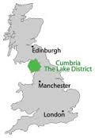
William Wordsworth 1770 – 1850 - born in Cockermouth in the Lake District

Slide 2
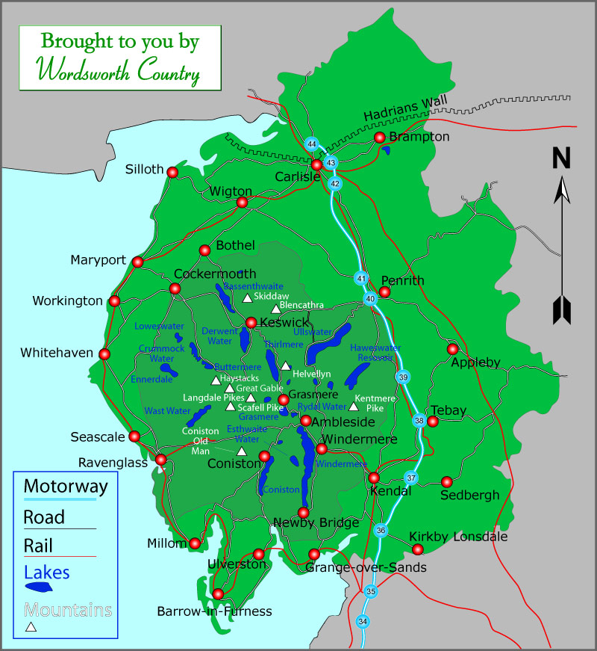
Wordsworth Country

Slide 3
Lake Poets
Lake District, region of mountains and lakes, c.30 mi (50 km) in diameter, Cumbria, NW England. It includes the Cumbrian Mts. and part of the Furness peninsula. The district comprises 15 lakes. Many of the region's valleys were deforested following Roman and Norse invasions. Numerous ancient relics remain, such as the stone circle near Keswick and the ruins of old castles and churches. William Wordsworth, Samuel Taylor Coleridge, and Robert Southey were known as the Lake Poets.

