Slide 1
DISCOURSE STUDIES (ESTUDOS DISCURSIVOS)
CLASS 1- 05/09/19
PROF. DR. DANIEL FERRAZ

Slide 2
Today’s class
Class 1 (05/08/19) –
Introduction activity: Notions of discourse (videos and images)
Planning and Methodology (analysis, discussion, suggestions)
Evaluation (discussion)

Slide 3
intro >> Getting to know each other + expectations
(THE DISCIPLINE IN GENERAL)

Slide 4
Daniel ferraz about the professor?
Fast intro...
Questions?

Slide 5
2018
UNIVERSIDADE DE SÃO PAULO
DEPARTAMENTO DE LETRAS MODERNAS – INGLÊS
PPGELLI – PROGRAMA DE PÓS-GRADUAÇÃO EM ESTUDOS LINGUÍSTICOS E LITERÁRIOS EM INGLÊS
UNIVERSIDADE FEDERAL DO ESPÍRITO SANTO (PROGRAMA DE PÓS-GRADUAÇÃO EM LINGUÍSTICA – PPGEL)
ARE YOU GRADUATING???

Slide 6
What is discourse? (1) https://www.youtube.com/watch?v=fz_7luovxPc

Slide 7
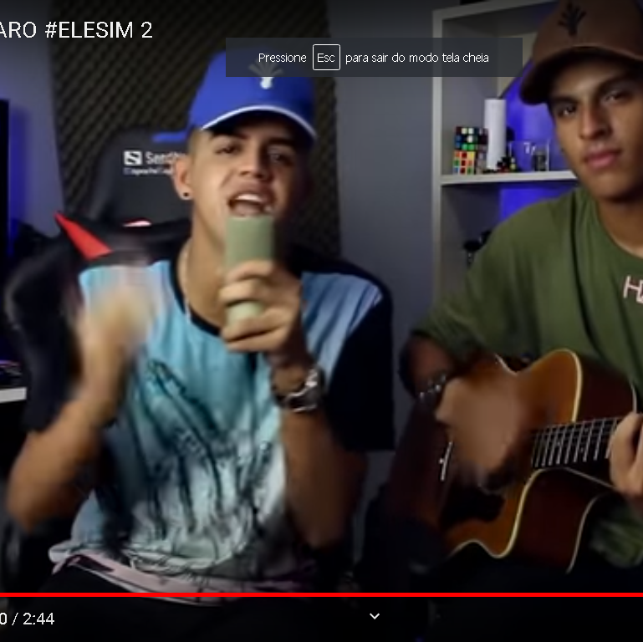
what is discourse? (2) https://www.youtube.com/watch?v=WxVf0666IXw
CONTEXT:
Right before elections 2018
The video:
RAP DO BOLSONARO #ELESIM 2
Circulation of discourses:
109.231 visualizações
LIKES: 5,4 Mil
DISLIKES: 1,,1 mil

Slide 8
What is discourse? (3)
CONTEXT:
Lucas Afonso no Festival Lula Livre #EleNão
CIRCULATION OF DISCOURSES
VISUALIZATIONS: 4.811 visualizações
LIKES: 426
DISLIKES: 17

Slide 9
TEXT >> REVISTA PUB DE ESTUDOS INTERDISCIPLINARES - FERRAZ

Slide 10
What is discourse? (4) text <<>> images

Slide 11
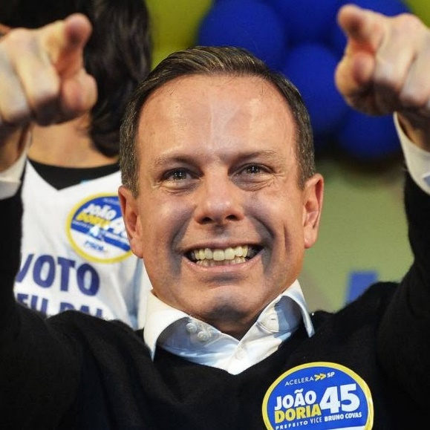
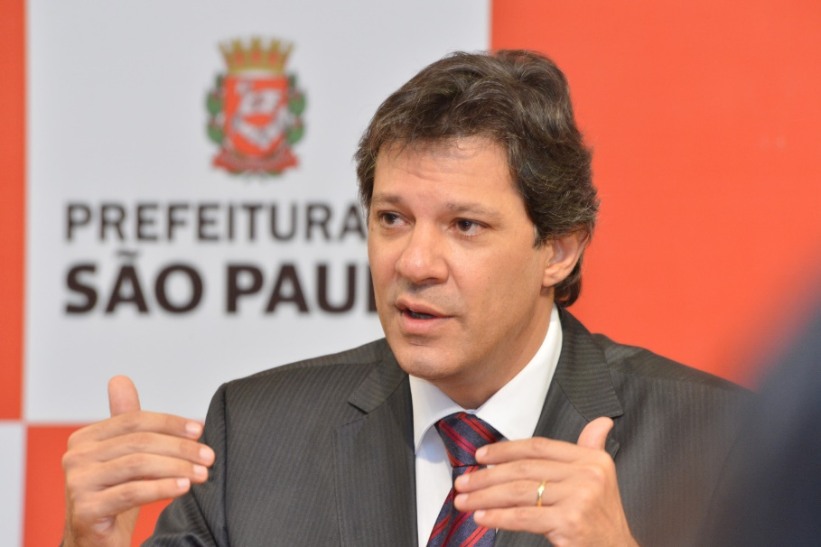

Slide 12
From instagram...

Slide 13
Museu do amanhã rj

Slide 14
What is discourse? (5) from words to images

Slide 15
Ugur gallen,
Turkish artist

Slide 16
TO START...
PRAGMATICS AND DISCOURSE ANALYSIS VERSUS (MORPHOLOGY, PHOMOLOGY, SINTAX, SEMANTICS, PRAGMATICS – still structuralist)
LANGUAGE IN USE
VIEWS OF DISCOURSE......................................... (CONTINUUM)
DISCOURSE ANALYSIS >>>>> SENTENCE + SENTENCE + SENTENCE = TEXT (discourse is there, it is IDELOGICAL, it is HISTORICAL)

Slide 17
Part 2 – About the course
At home – read through the PROGRAMME
If possible (and urgent), talk to me and or send me an email

Slide 18
NOW...
METHODOLOGY: ACADEMIC ARTICLES (MANDATORY AND COMPLEMENTARY), VIDEOS AND CINEMA (LOTS OF!), DIALOGIC (T<>SS, SS<>SS), LAB CLASSES, DYNAMICS, CLASS PRODUCTIONS, RESPONSE PAPERS (SEMINARS??)
THEMES: DISCOURSE>>> DA –DISCOURSE ANALYSIS SCHOOLS (FRENCH SCHOOL, NORTH AMERICAN) >>> CDA >>> FOUCAULDIAN + BAKHTINIAN PERSPECTIVES ON D.
PRESENCE + PARTICIPATION >>> ESSENTIAL

Slide 19
ACADEMIC RESULTS
PROJECT
STUDENT’S VOICES
SINCE 2014

Slide 20
ACADEMIC RESULTS
PROJECT
STUDENT’S VOICES
SINCE 2014

Slide 21
Pedagogical personal results

Slide 22
SUGGESTIONS?

Slide 23
EVALUATION???

Slide 24
FINALLY, HOMEWORK SUGGESTIONS... WHAT IS DIScOURSE?
https://www.youtube.com/watch?v=kQTO9tKBNLQ
LECTURE: FOUCAULT

Slide 25
What is discourse?
https://www.youtube.com/watch?v=qEB4rAZanpM

Slide 26
ALSO: PARTNERSHIP
LABORATÓRIO DE LETRAMENTO ACADÊMICO
ACADEMIC WRITING LAB
COORDINATOR: PROFA. DRA. MARÍLIA M. FERREIRA
Add mark?

Slide 27
Events...

Slide 28
Next class (C2):
Class 2 (12/08/19) – Locus of enunciation 1: Language (língua e linguagem); Language as Structure x social practice; + What is discourse/Discourse? + Connections to Teacher education/Language education (locus of enunciation 2) | Text 1 – The Discourse Studies Reader: An Introduction (ANGERMULLER, J.; MAINGUENEAU, D.; WODAK, R, 2003). Complementary: (Pós) Modernidade, (Pós) estruturalismo e educação linguística: Construindo sentidos, ensejando transformações (FERRAZ, 2019).

Slide 29
End notes
FOLDER – OPEN AT COPY CENTRE????
ATENDIMENTO: MON 13-14 / mon 18h30-19h30
(ROOM 32)
danielferrazusp@gmail.com

Slide 30
THANK YOU!!!

