Slide 1
Nano Class 2020

Slide 2
Table 1 - Variables and levels in design of experiments (DoE) to prepare nanocrystals.
Independent Variables | Levels
 | Low (-1) | Medium (0) | High (+1)
Surfactant (%w/w) | 1.00 | 2.00 | 2.00
Process time (days) | 3 | 5 | 7
Stirring speed (rpm) | 800 | 1000 | 1200
Dependent variable
Hydrodynamic diameter (HD, z-average) of the nanocrystals

Slide 3
Table 2 – Design of experiments (DoE) – Surface response design.
Formulation | Order | Level | Blocks | Surfactant (% w/w) | Stirring speed (rpm) | Process time (days)
11 | 1 | -1 | 1 | 2 | 800 | 5
5 | 2 | 1 | 1 | 1 | 800 | 7
8 | 3 | 1 | 1 | 3 | 1200 | 7
14 | 4 | -1 | 1 | 2 | 1000 | 7
19 | 5 | 0 | 1 | 2 | 1000 | 5
4 | 6 | 1 | 1 | 3 | 1200 | 3
20 | 7 | 0 | 1 | 2 | 1000 | 5
18 | 8 | 0 | 1 | 2 | 1000 | 5
15 | 9 | 0 | 1 | 2 | 1000 | 5
13 | 10 | -1 | 1 | 2 | 1000 | 3
16 | 11 | 0 | 1 | 2 | 1000 | 5
12 | 12 | -1 | 1 | 2 | 1200 | 5
10 | 13 | -1 | 1 | 3 | 100 | 5
3 | 14 | 1 | 1 | 1 | 1200 | 3
9 | 15 | -1 | 1 | 1 | 1000 | 5
7 | 16 | 1 | 1 | 1 | 1200 | 7
2 | 17 | 1 | 1 | 3 | 800 | 3
17 | 18 | 0 | 1 | 2 | 1000 | 5
1 | 19 | 1 | 1 | 1 | 800 | 3
6 | 20 | 1 | 1 | 3 | 800 | 7

Slide 4
Table 2 – Design of experiments (DoE) – Box-Behnken Design – and observed results.
F | Order | Level | Surfactant | Speed | Time | HD ± SD | PdI ± SD
11 | 1 | -1 | 2 | 800 | 5 | 313.0 ± 29.3 | 0.441 ± 0.027
5 | 2 | 1 | 1 | 800 | 7 | 196.4 ± 0.9 | 0.129 ± 0.004
8 | 3 | 1 | 3 | 1200 | 7 | 190.4 ± 1.1 | 0.120 ± 0.006
14 | 4 | -1 | 2 | 1000 | 7 | 229.7 ± 1.7 | 0.150 ± 0.014
19 | 5 | 0 | 2 | 1000 | 5 | 216.1 ± 1.6 | 0.136 ± 0.012
4 | 6 | 1 | 3 | 1200 | 3 | 265.9 ± 8.8 | 0.150 ± 0.051
20 | 7 | 0 | 2 | 1000 | 5 | 239.9 ± 1.4 | 0.120 ± 0.035
18 | 8 | 0 | 2 | 1000 | 5 | 225.3 ± 2.1 | 0.104 ± 0.017
15 | 9 | 0 | 2 | 1000 | 5 | 228.2 ± 1.9 | 0.144 ± 0.007
13 | 10 | -1 | 2 | 1000 | 3 | 265.3 ± 1.0 | 0.144 ± 0.024
16 | 11 | 0 | 2 | 1000 | 5 | 219.1 ± 2.0 | 0.143 ± 0.006
12 | 12 | -1 | 2 | 1200 | 5 | 189.4 ± 0.7 | 0.127 ± 0.010
10 | 13 | -1 | 3 | 100 | 5 | 234.6 ± 2.0 | 0.144 ± 0.011
3 | 14 | 1 | 1 | 1200 | 3 | 239.5 ± 1.7 | 0.144 ± 0.016
9 | 15 | -1 | 1 | 1000 | 5 | 198.3 ± 1.4 | 0.157 ± 0.018
7 | 16 | 1 | 1 | 1200 | 7 | 171.9 ± 2.2 | 0.166 ± 0.011
2 | 17 | 1 | 3 | 800 | 3 | 416.6 ± 9.6 | 0.209 ± 0.030
17 | 18 | 0 | 2 | 1000 | 5 | 201.3 ± 1.0 | 0.109 ± 0.006
1 | 19 | 1 | 1 | 800 | 3 | 338.1 ± 3.4 | 0.147 ± 0.036
6 | 20 | 1 | 3 | 800 | 7 | 253.3 ± 2.1 | 0.156 ± 0.004

Slide 5
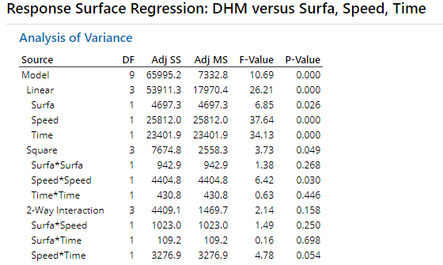
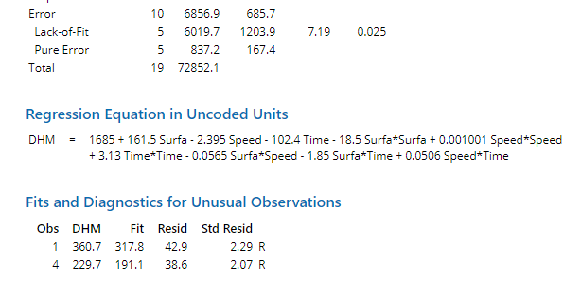
Minitab

Slide 6
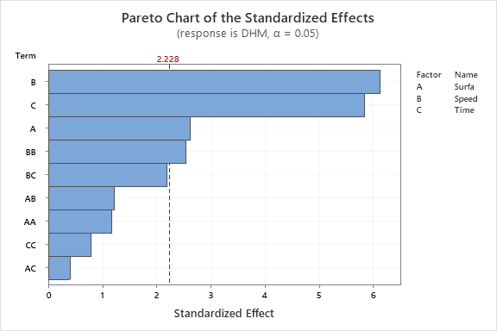

Slide 7
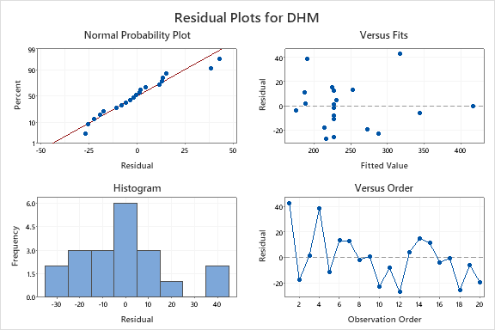

Slide 8
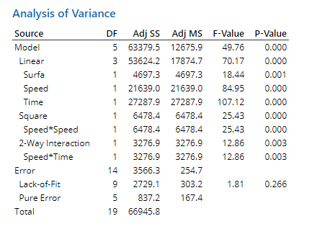
Após ajuste

Slide 9
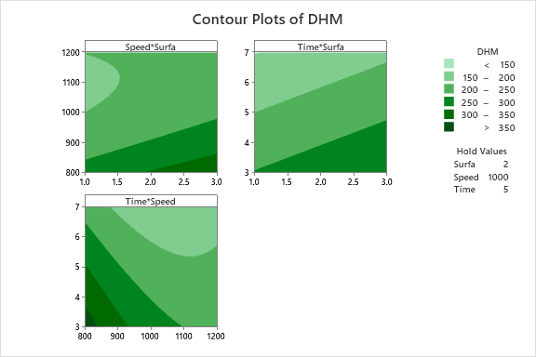

Slide 10
