Slide 1
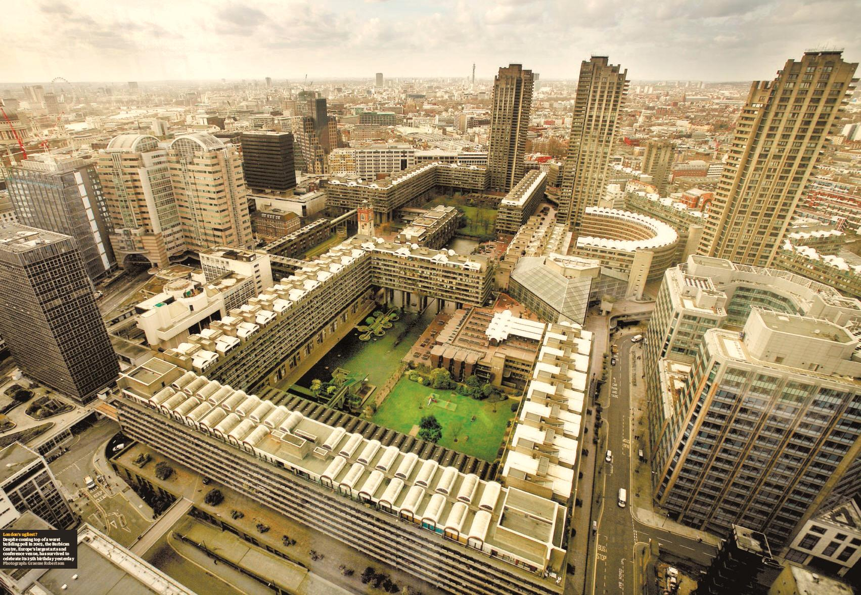
THE BARBICAN ESTATE CITY OF LONDON
LUCIANA mathew I MARCELO mello I NOR IZZATI mohammad salem I SHAKER majali I SAACHI padubidri

Slide 2
BEECH STREET
ALDERSGATE STREET
Land Size 18 Ha
Year of Construction 1952 – 1982
Architects Geoffrey Powell, Peter Chamberlin, and Christof Bon
Location Cripple gate area – Close to the Financial District
N
CONTEXT MAP
THE BARBICAN ESTATE

Slide 3
BEECH STREET
ALDERSGATE STREET
Land Size 18 Ha
Year of Construction 1952 – 1982
Architects Geoffrey Powell, Peter Chamberlin, and Christof Bon
Location Cripple gate area – Close to the Financial District
N
CONTEXT MAP
THE BARBICAN ESTATE

Slide 4
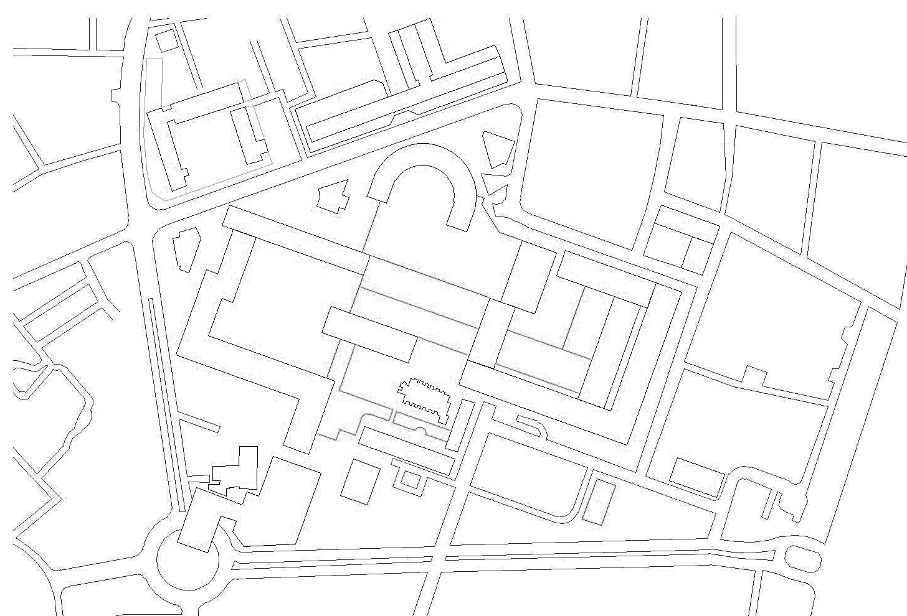
green
water body
vehicular
pedestrian
commercial
residential
barbican center
Institutional
Educational
N
LAND USE MAP
THE BARBICAN ESTATE

Slide 5
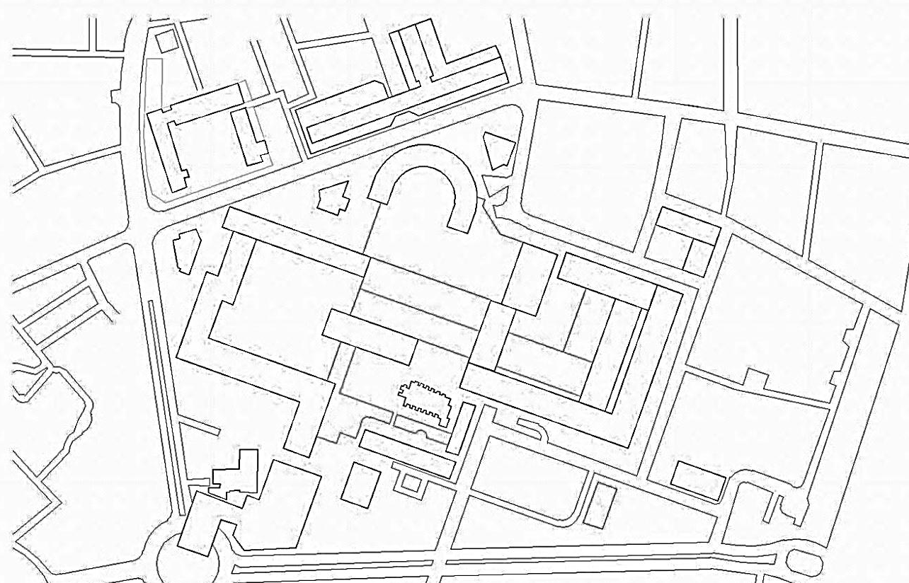
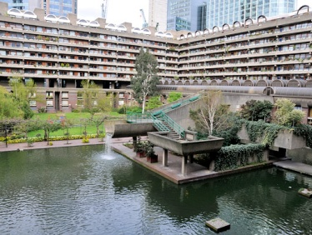
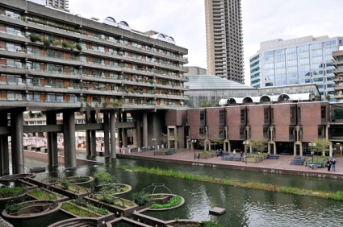
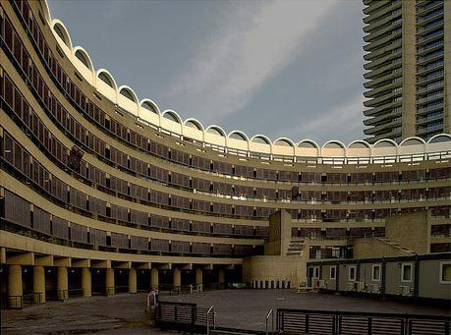
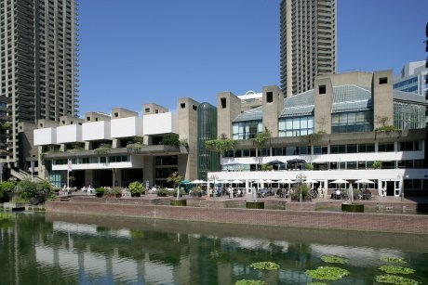
A major portion of the barbican consists of residential facilities.
residential
N
commercial
institutional
The barbican was designed to house professionals since 1959 as it was planned to work like Paris and Rome where they lived and worked in the same vicinity
The family units were catered to as a last minute addition in the tower units
No. of apartments
LAND USE AND OCCUPANCY
THE BARBICAN ESTATE

Slide 6
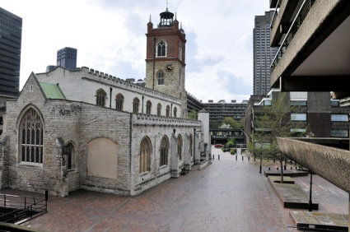
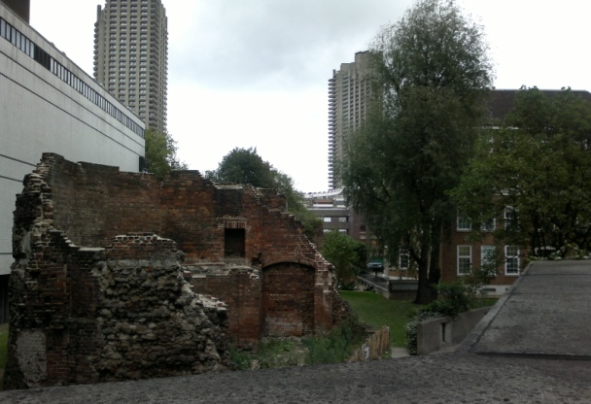
High Density housing scheme
(2018 flats)
Girls School
Church
Theatre
Concert Hall
Art Gallery
Restaurants
Shops
Swimming pool
Gymnasium
Tiled plaza was created with an artificial lake
and fountains
Called Barbican from the Roman name “Barbecana” – meaning fortified gateway
CONTEXT
THE BARBICAN ESTATE

Slide 7
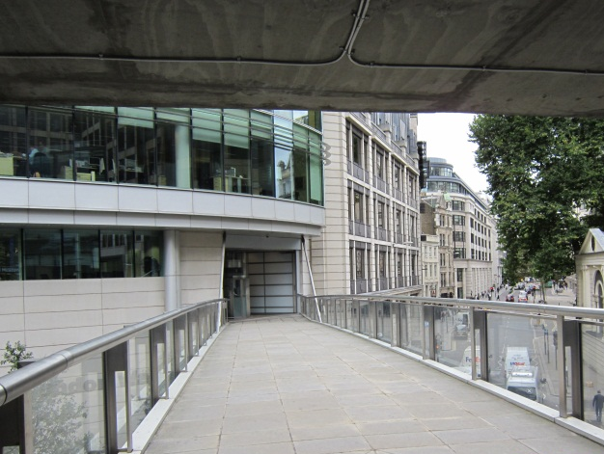
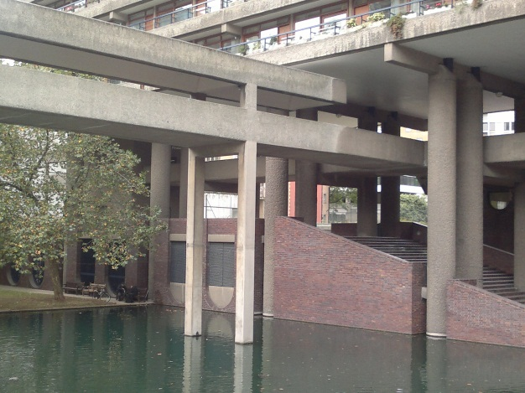
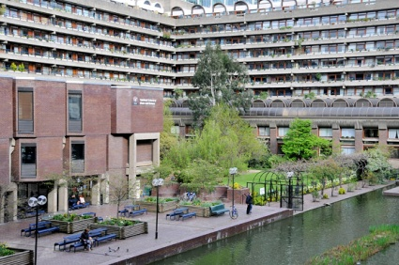
Pilotis
Skywalks
Powerful expression of building structure
Monumental character of exposed concrete
Natural use of materials
Rectilinear and Curved forms
Raw aesthetics of materials – Ceramic tile, brick, concrete
Principles of Le Corbusier was integrated with Brutalistic architecture.
ARCHITECTURE
THE BARBICAN ESTATE

Slide 8
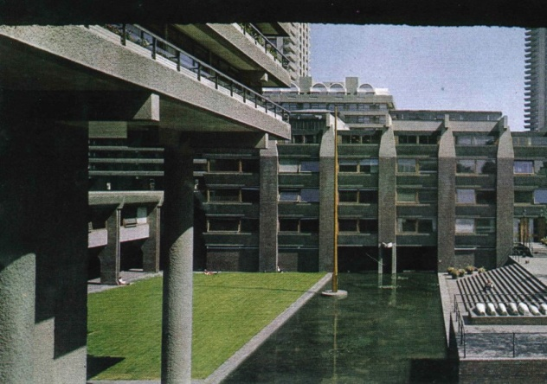
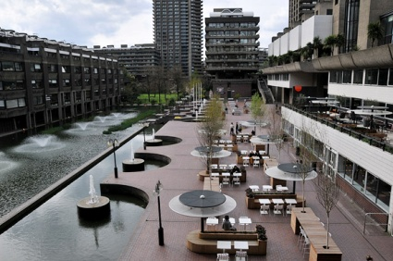
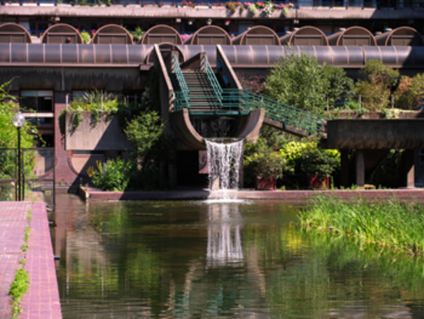
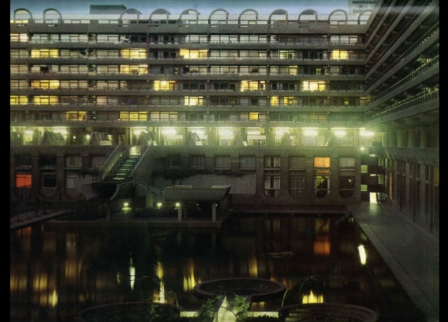
Creation of an artificially raised ground level
The podium allows segregation of pedestrian and vehicular movement
Discreet servicing and extensive under-block car parking
Large areas of the site to remain open for landscaping and amenity.
Characterised by offset open courtyards
Water bodies on an east-west axis.
A convenient and pleasant environment providing residents the opportunity to move freely around enjoying the constant change of perspectives of terraces, lawns, trees and flowers.
Concept : Create a coherent residential precinct
DESIGN INTENT
THE BARBICAN ESTATE

Slide 9
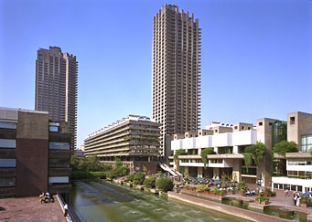
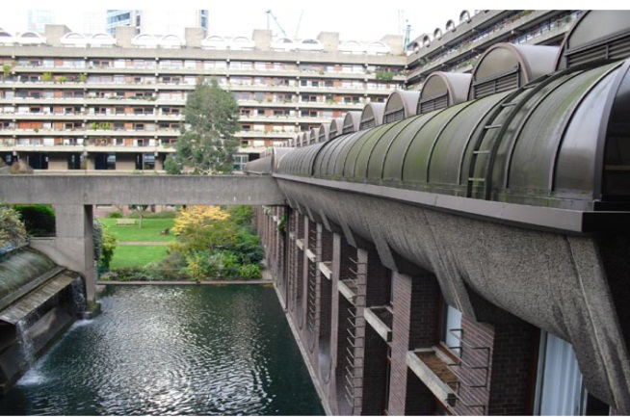
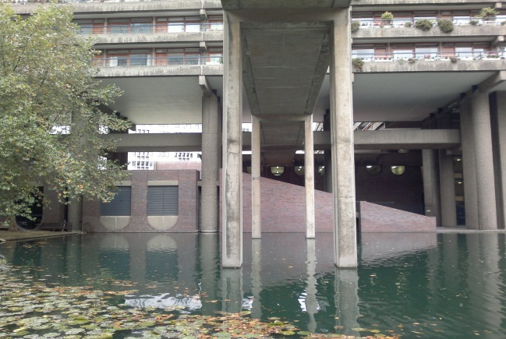
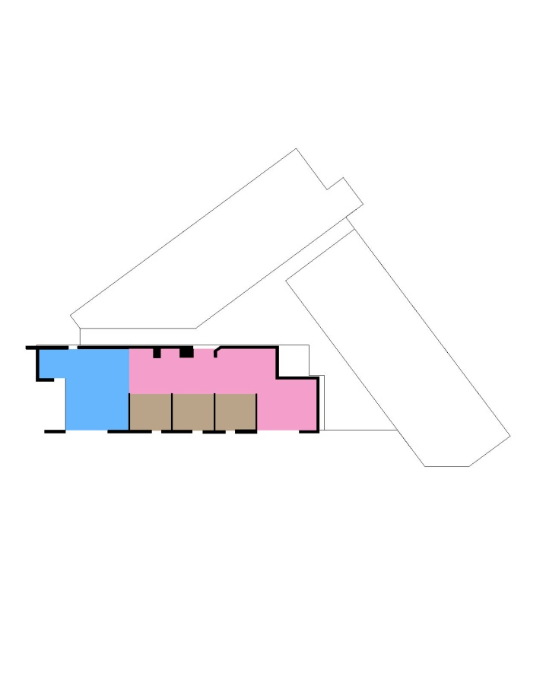
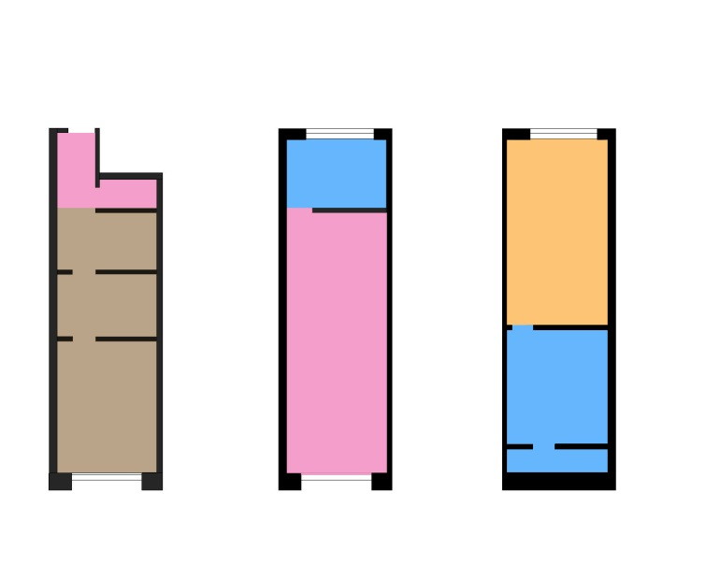
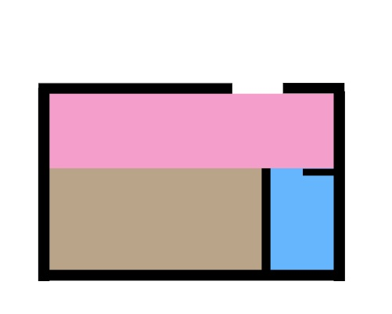
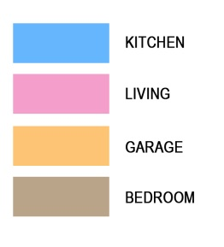
High rise
Mews style
Terraced apartments
High-rise living with long views over London (the towers)
Mews style living with immediate outlooks at, or near, natural ground level (the plinth).
Terraced apartments raised on pilotis (the slab blocks)
The residential building typology effectively uses just three architectural forms – towers, slab blocks and plinth
RESIDENTIAL BUILDINGS
THE BARBICAN ESTATE

Slide 10
Forecast
Increase of 1K on yearly mean temperature
Summer temperatures will rise by 2K
Increase Overheating problems
Precipitation tend to increase on winter and decrease drastically on summer
Increase probability of flood on winter
Lack of rain and warming air will tend to decrease Relative Humidity
Design Ideas
Use of evaporative cooling to mitigate overheating problems
Use of water bodies as rain capture through winter to help contain flood situations
PREDICTIONS FOR CLIMATE
THE BARBICAN ESTATE

Slide 11
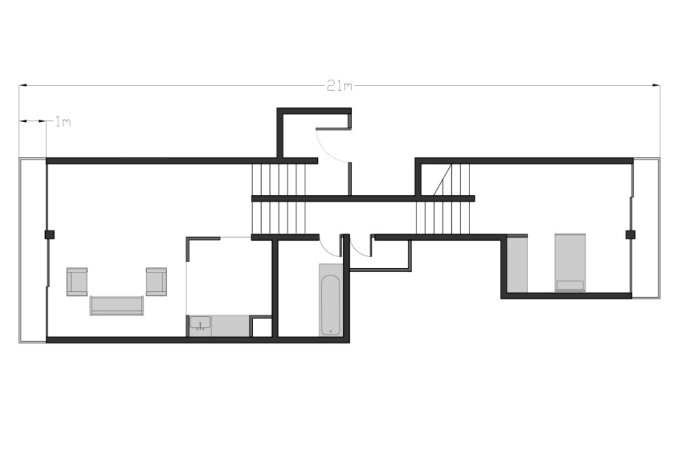
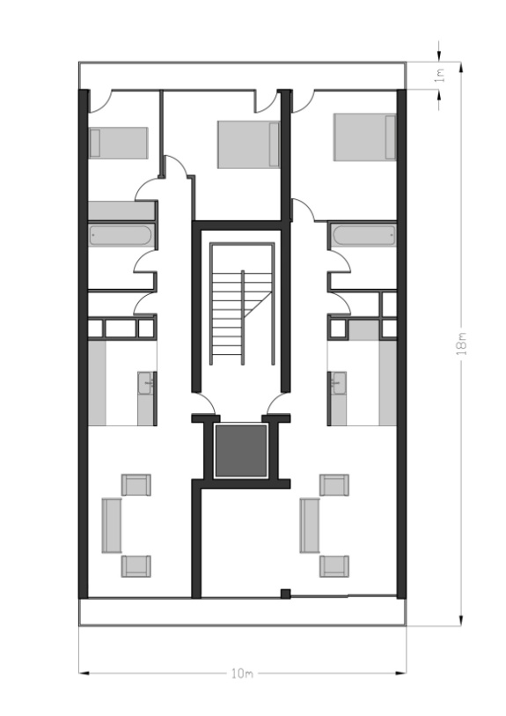
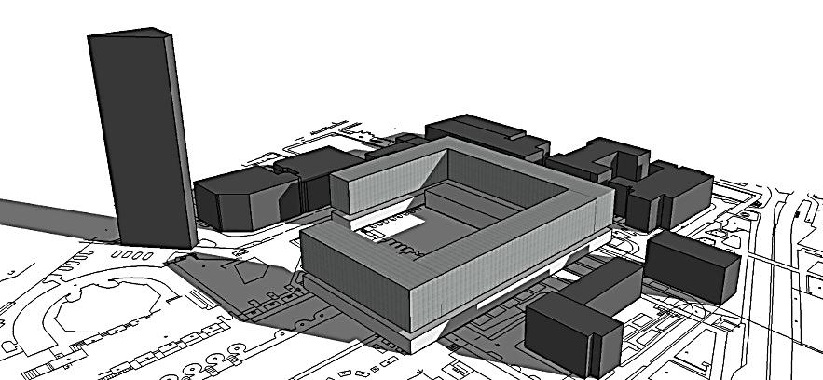
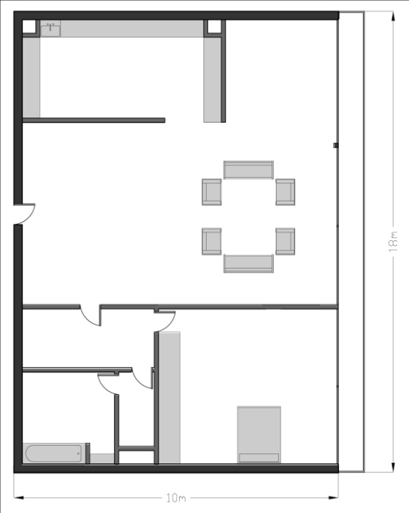
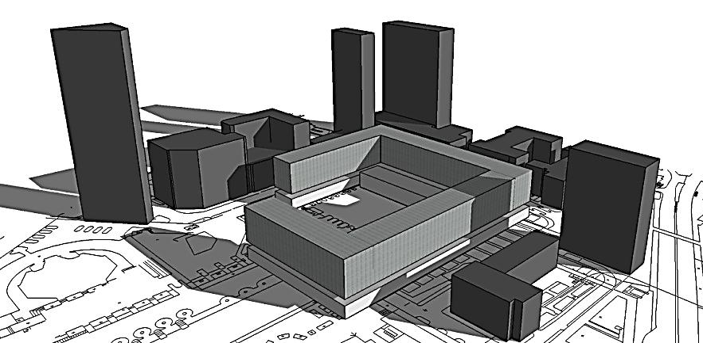
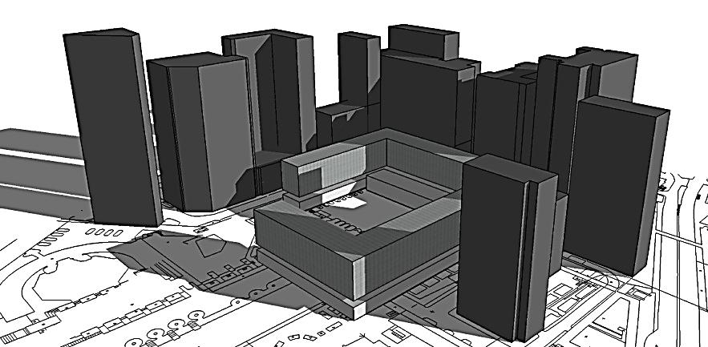
WILLOUGHBY HOUSE
PAST CONTEXT
SPEED HOUSE
ANDREWES HOUSE
GILBERT HOUSE
PRESENT CONTEXT
122M
99M
N
FUTURE CONTEXT
OVERALL MASTER PLAN
FEB
2012
THE BARBICAN ESTATE

Slide 12
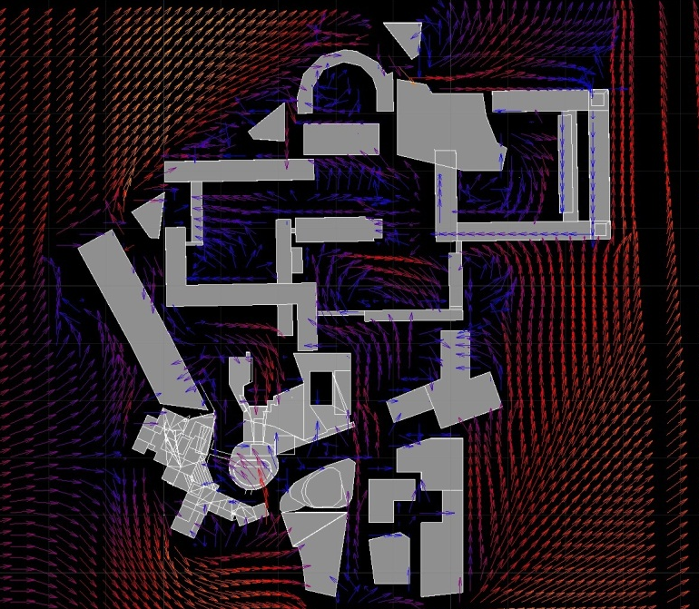
High towers cause wind turbulence
Complex acts as a barrier reducing
wind speed on ground level
Reduce cross ventilation of ground level flats
Wind simulation- ground level
SIMULATIONS FOR EXISTING CONDITIONS OF THE SITE
THE BARBICAN ESTATE

Slide 13
Reduced levels of insolation
Some Flats do not receive direct sunlight
Decrease of space quality
Annual cumulative insulation- ground level
SIMULATIONS FOR EXISTING CONDITIONS OF THE SITE
THE BARBICAN ESTATE

Slide 14
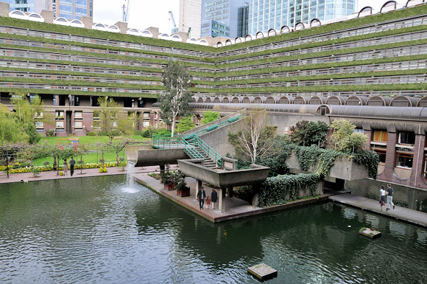
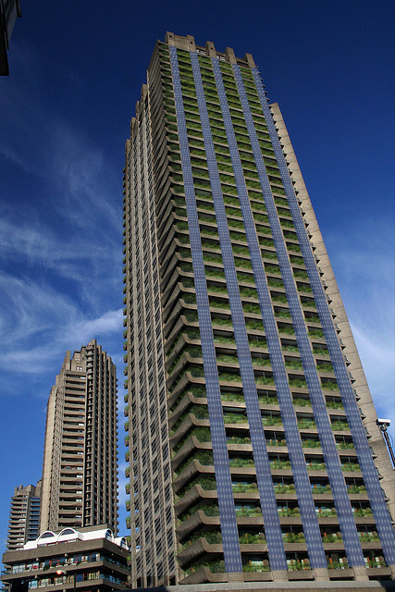
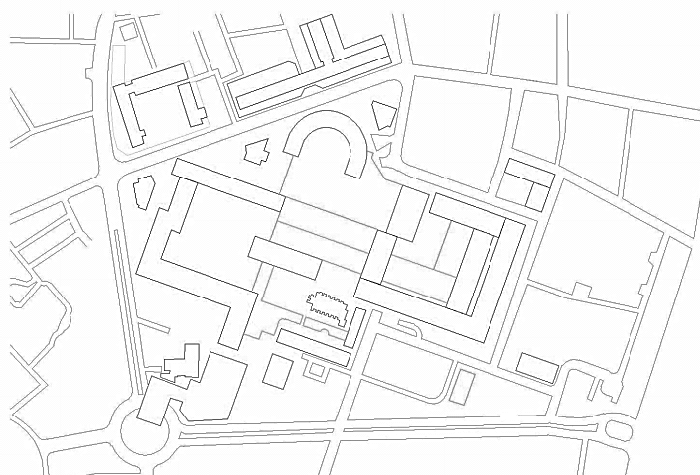
Additional skin and interactive circulation paths
Additional skin
Building design strategies
FUTURE SCENARIOS
THE BARBICAN ESTATE

Slide 15
!
THE BARBICAN ESTATE

Slide 16
THE BARBICAN ESTATE

Slide 17
?
THE BARBICAN ESTATE

Slide 18
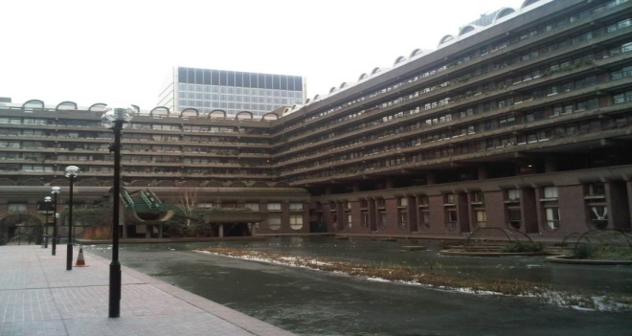
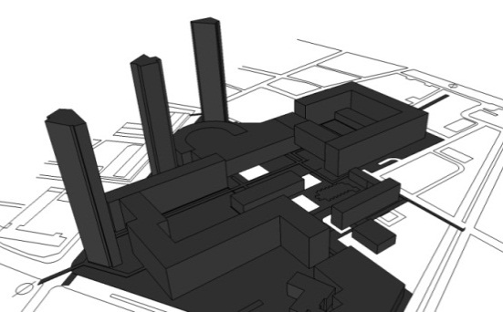
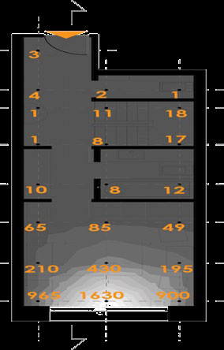
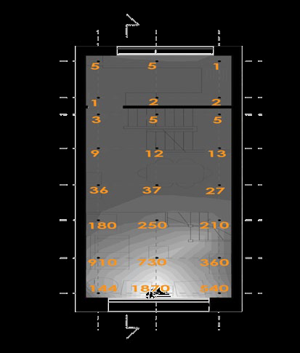
REFERÊNCIAS ACADÊMICAS
REFERÊNCIAS PROFISSIONAIS
PESQUISA COM USUÁRIOS
THE BARBICAN ESTATE

Slide 19
DEEP PLAN
OBSTRUCTIONS
SELF SHADING AT CORNERS,PRIVACY ISSUES
HEAT LOSS THROUGH GLAZING
VIEW FROM LIVING AREAS
EXISTING BUILDING ISSUES
THE BARBICAN ESTATE

Slide 20
FIELDWORK
THE BARBICAN ESTATE

Slide 21
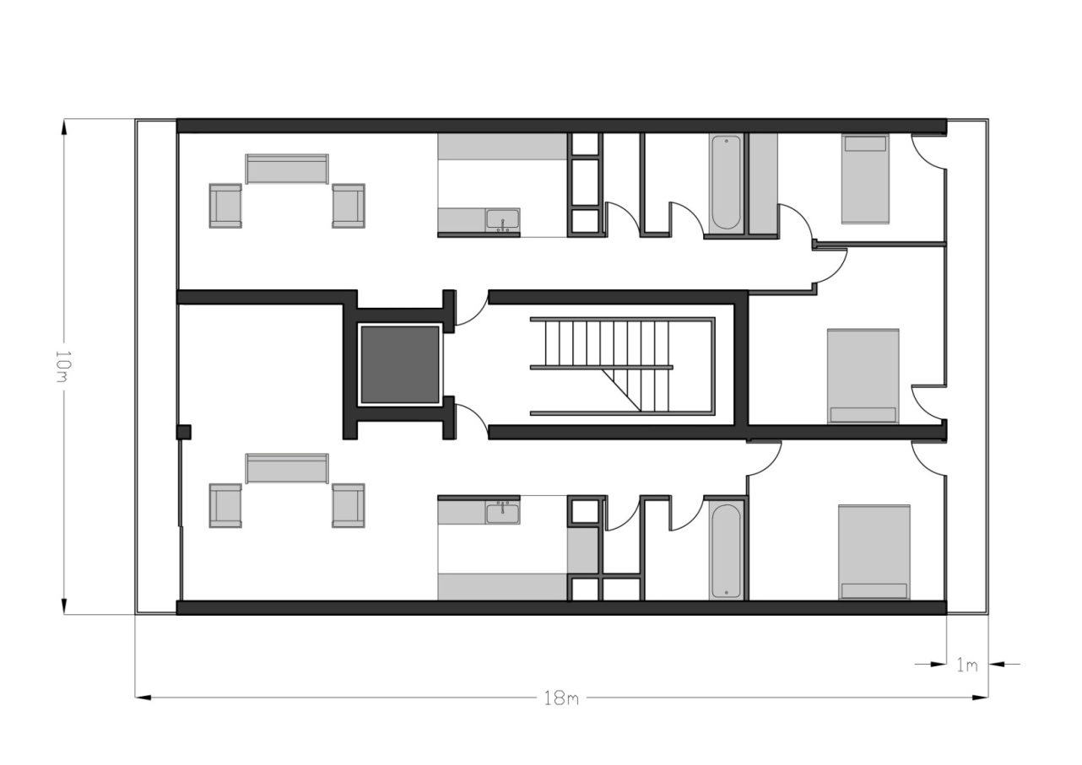
166 W/K
166 W/K
U-value
5.6 W/m2K (window)
1.6 W/m2K (walls)
PLAN
balcony
Not exposed face
living area
kitchen
bathroom
Heat loss coefficient Flat type 20/21=2.07W/m2K
Infiltration=1.4ac/h
bedroom
service core
N
SECTION
Flat type 20/21
TERRACED APARTMENTS-ANDREWES
THE BARBICAN ESTATE

Slide 22
Heating loads Andrewes
10% window facing south
20% window facing south
140
Heat load:134 W/m2K
130
possible
desirable
systems
120
Heating load annually (kWh/m2)
Heat load:112 W/m2K
110
100
90
80
70
60
50
Infilteration:0.25ac/h
Ventilation:0.25ac/h
40
30
U-value
Window : 2 W/m2K
Walls : .25 W/m2K
20
Heat load:12kWh/m2
Heat load:5kWgh/m2
10
Heat load:10kWh/m2
0
Heat load:4kWh/m2
base case
Air tightness
U values regulations
Night shutters
Change in glazing ratio
Enclosing balcony on the south facade
Scheduling thermostat
THERMAL ANALYSIS-ANDREWES
THE BARBICAN ESTATE

Slide 23
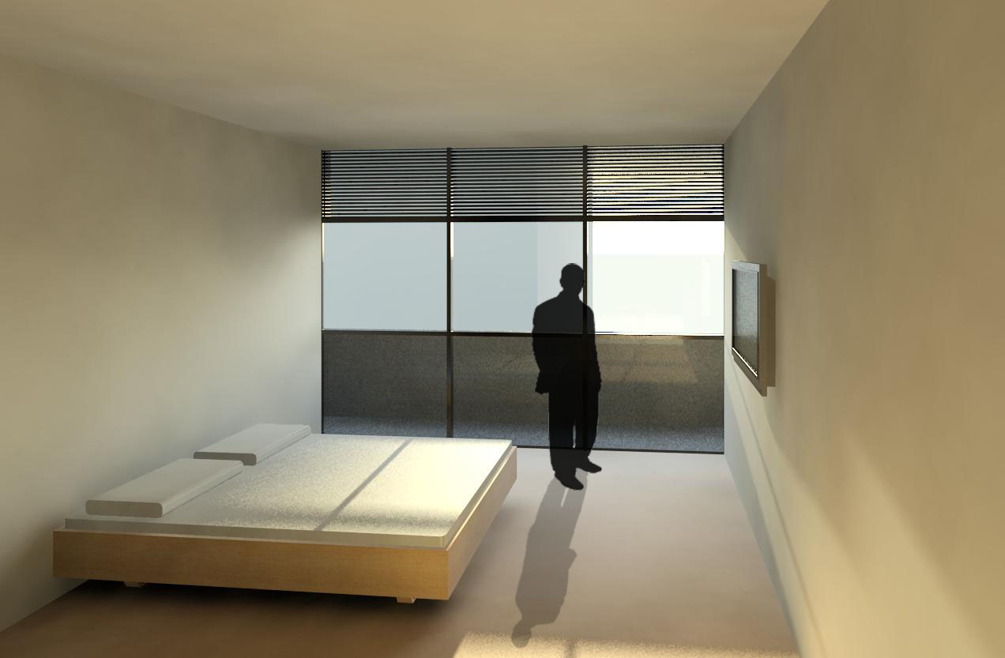
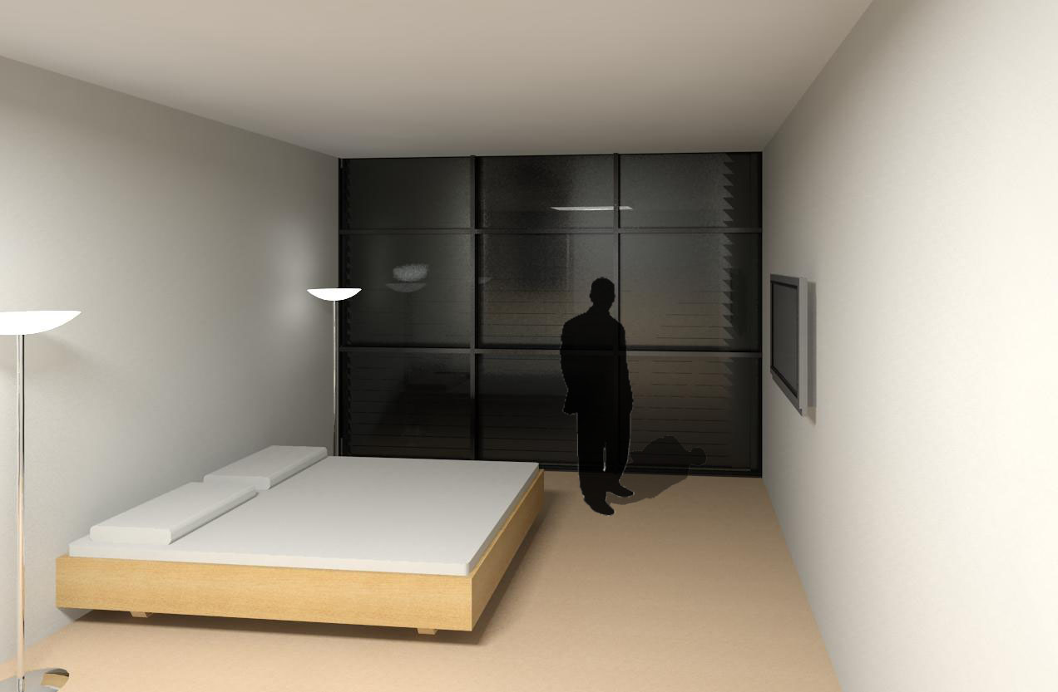
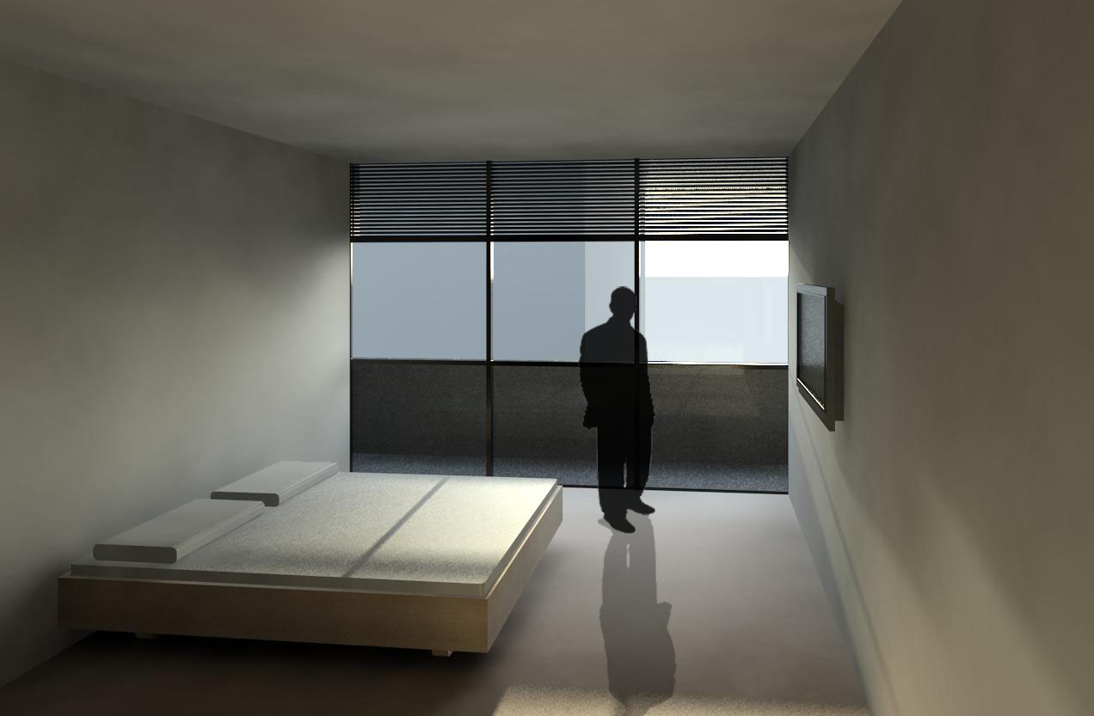
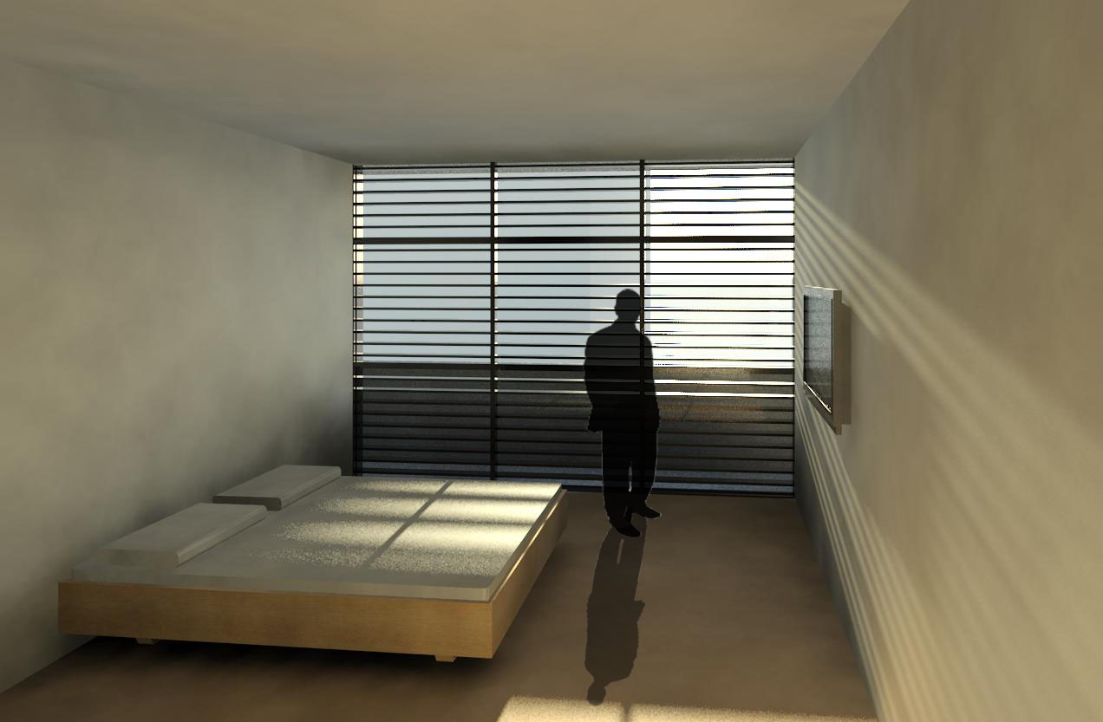
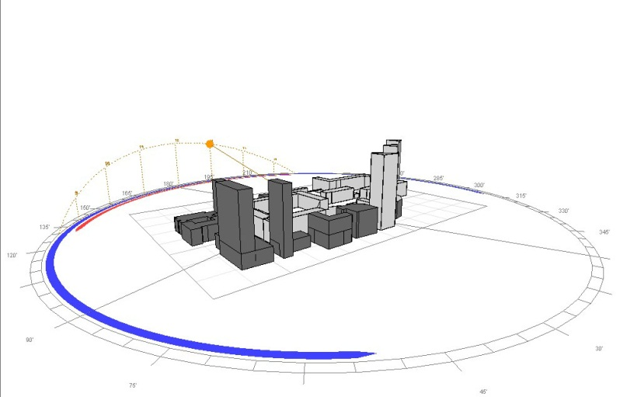
WINTER CLOUDY DAY
DECEMBER 21ST
13:00PM
WINTER SUNNY DAY
DECEMBER 21ST
13:00PM
WINTER NIGHT
DECEMBER 21ST
13:00PM
ADAPTIVE STRATEGIES-night shutters
THE BARBICAN ESTATE

Slide 24
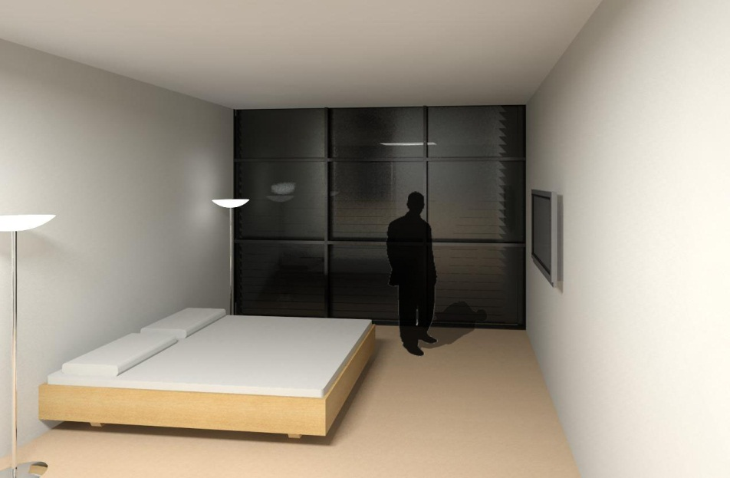
WINTER CLOUDY DAY 16.4°C
WINTER NIGHT 16.4°C
External temp: 6.4°C
External temp: 4.7°C
WINTER SUNNY DAY_open shutters 22.3°C
WINTER SUNNY DAY_closed shutter 21.4°C
External temp: 13°C
ADAPTIVE STRATEGIES-night shutters
THE BARBICAN ESTATE

Slide 25
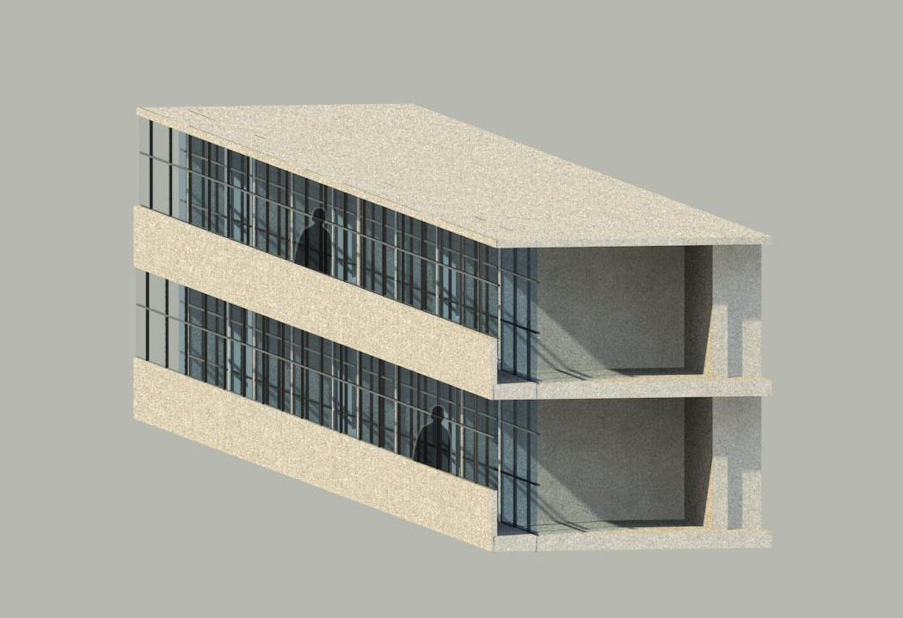
DESIGN INTERVENTION-thermal buffer
THE BARBICAN ESTATE

Slide 26
DESIGN INTERVENTION-scheduling thermostat
THE BARBICAN ESTATE

Slide 27
THE BARBICAN ESTATE

Slide 28
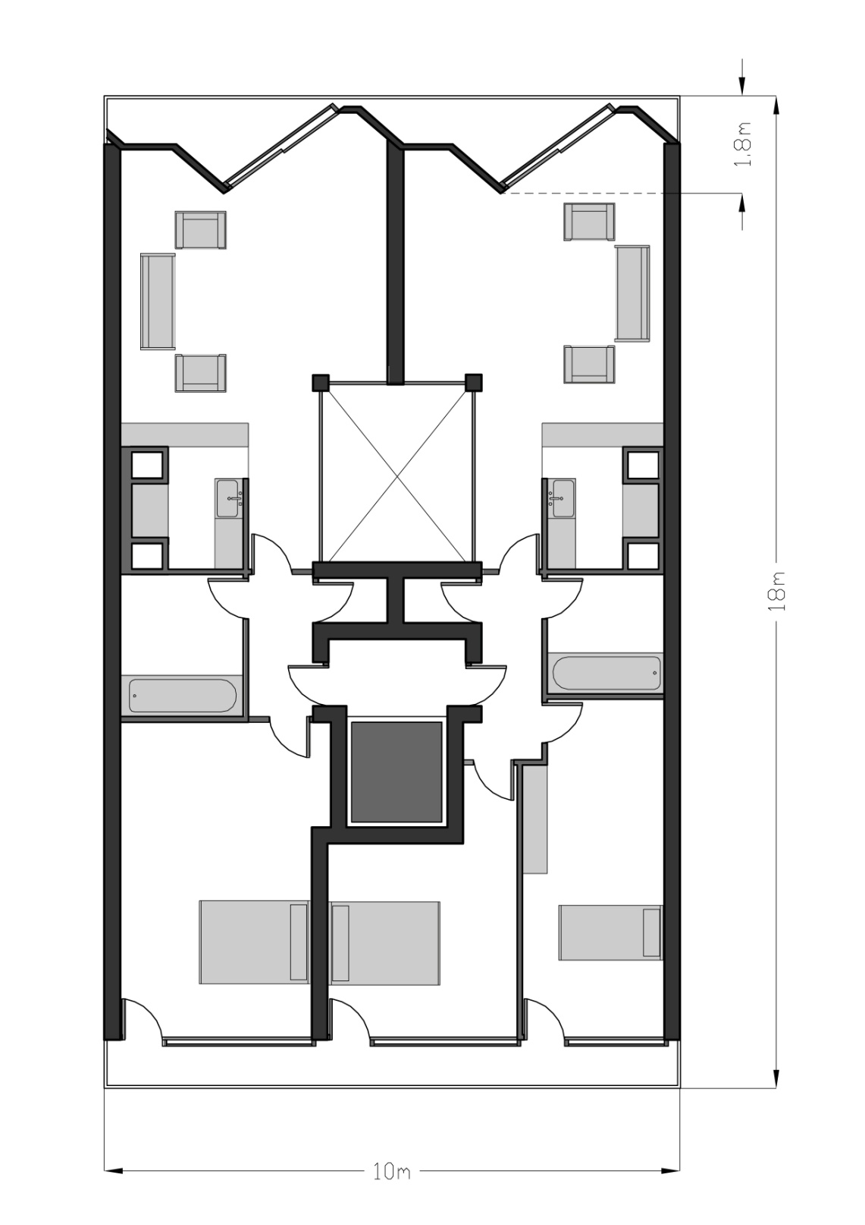
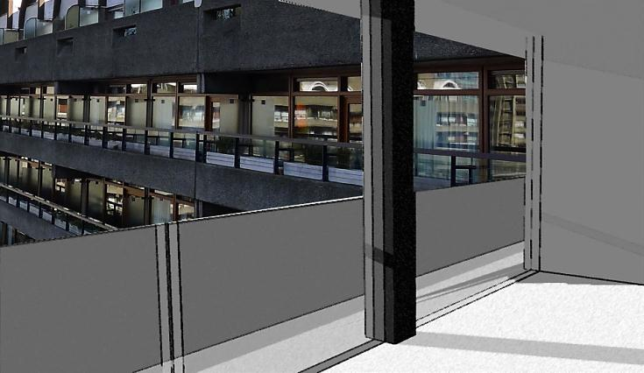
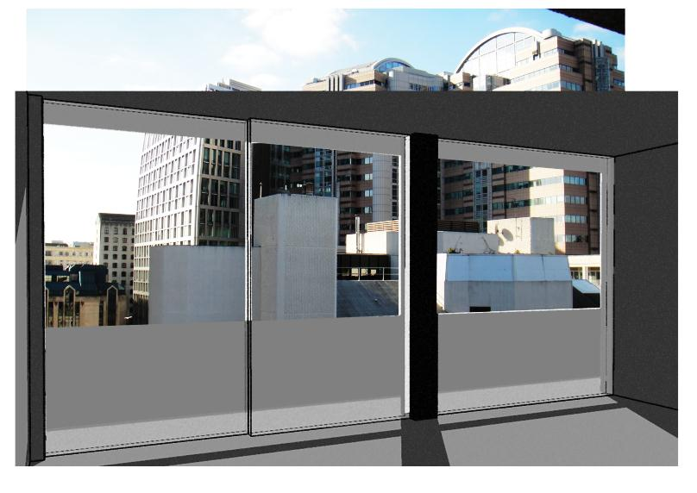
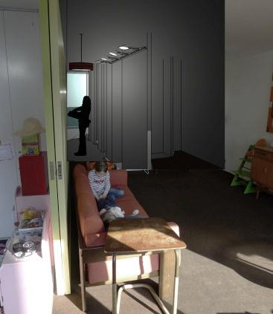
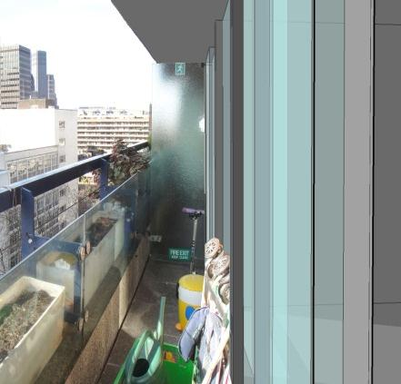
No privacy facing the courtyard
Existing view from the living area
service core
balcony
kitchen
bathroom
living area
bedroom
N
Internal layout changes as per function
Insufficient daylight
Unused balcony space
DESIGN INTERVENTION-internal layout
THE BARBICAN ESTATE

Slide 29
WINTER SUNNY DAY
DECEMBER 21ST
13:00PM
SUMMER SUNNY DAY
DECEMBER 21ST
13:00PM
WINTER CLOUDY DAY
DECEMBER 21ST
13:00PM
ADAPTIVE STRATEGIES
FEB
2012
THE BARBICAN ESTATE

Slide 30
WINTER CLOUDY DAY 16.7°C
SUMMER SUNNY DAY 23.9°C
External temp: 6.4°C
External temp: 28.3°C
WINTER SUNNY DAY_open shutters 17.2°C
WINTER SUNNY DAY_closed shutter 17.2°C
External temp: 13°C
ADAPTIVE STRATEGIES
THE BARBICAN ESTATE

Slide 31
ADAPTIVE STRATEGIES-EXTERNAL VIEW
THE BARBICAN ESTATE

Slide 32
DAYLIGHT ANALYSIS THROUGH LIGHTWELL
LIGHT WELL REMOVED TO GIVE ADDITIONAL SPACE WITHIN THE FLATS
VIEW OF DAYLIGHT QUALITY IN THE FLAT
DAYLIGHT QUALITY-light well
THE BARBICAN ESTATE

Slide 33
157.48 W/K
PLAN
157.48W/K
U-value
5.6 W/m2K (window)
1.6 W/m2K (walls)
balcony
Not exposed face
living area
kitchen
bathroom
Heat loss coefficient Flat type 90=1.45 W/m2K
Infiltration=1.4ac/h
bedroom
service core
SECTION
N
Flat type 90
TERRACED APARTMENTS-WILHOUBY
THE BARBICAN ESTATE

Slide 34
street
NOTE:
Changes as per andrewes house
Heating loads reduced to 8KWh/m2
Strategies applied only on the eastern façade facing the street
Desirables included are night shutters and incorporating balcony into the bedroom area
Courtyard
PLAN
street
Courtyard
SECTION
Internal layout changes to reduce heating loads
N
ADAPTIVE STRATEGIES-night shutters
THE BARBICAN ESTATE

Slide 35
WINTER CLOUDY DAY
DECEMBER 21ST
13:00PM
WINTER SUNNY DAY
DECEMBER 21ST
13:00PM
WINTER NIGHT
DECEMBER 21ST
13:00PM
ADAPTIVE STRATEGIES-night shutters
THE BARBICAN ESTATE

Slide 36
WINTER CLOUDY DAY
WINTER NIGHT
WINTER SUNNY DAY_open shutters
WINTER SUNNY DAY_closed shutter
ADAPTIVE STRATEGIES-night shutters
THE BARBICAN ESTATE

Slide 37
ADAPTIVE STRATEGIES-EXTERNAL VIEW
THE BARBICAN ESTATE

Slide 38
Inner city is catered for young couples, however when they have families the trend is to move to the peripherals of the city
Barbican in its very sense acts as a gated community whereby it can cater to having families within its complex
Apartment types can change to accommodate more families
Current scenario
Internal flat changes for change in occupancy patterns
Future scenario
Cardiff University – Barbican Urban Design Case Study
FUTURE DESIGN INTERVENTION
THE BARBICAN ESTATE

Slide 39
NOTE:
ESTIMATED AREA OF PV PANELS-1200m²
ASSUMING 6kW, 30 PANELS COULD BE FIT 46m²
EVERY 30 PANELS GENERATES 5500kWh OF ENERGY
TOTAL NUMBER OF PANELS REQUIRED 780
HENCE
143000kWh/A EMERGY CAN BE GENERATED FROM THE BARBICAN EASTERN BLOCK ROOF
FUTURE DESIGN INTERVENTION-PV panels
THE BARBICAN ESTATE

Slide 40
Residents
David Hills – Andrewes House, Barbican
Rob Barker – Lauderdale Tower, Barbican
Sarah Guventa – Willoughby House, Barbican
Klaus Bode and Joanna Goncalves – Park Hill Case Study
Cardiff University – Barbican Urban Design Case Study
ACKNOWLEDGEMENTS
THE BARBICAN ESTATE

