Slide 1
Vive viajando, neh?
Emprego e trabalho no Turismo
Profa. Dra. Karina Solha
Disciplina: Análise Estrutural do Turismo
ECA/USP

Slide 2
Emprego e Trabalho no Turismo
As premissas, o mito e a realidade
Quanto trabalho? Quanto emprego?
Relevância econômica da atividade turística
Qual trabalho? Qual emprego?
As questões de nossa época
Qualificar quem e para que?

Slide 3
O que mensurar?

Slide 4
Emprego turístico?
The concept of tourism employment, in accordance with the IRTS 2008, refers to “employment strictly related to the goods and services acquired by visitors and produced by either tourism industries or other industries”.
Hence, tourism employment is a measure of the number of jobs directly attributable to tourism demand in tourism and non-tourism industries, held by employees, self-employed and contributing family workers

Slide 5
Questões conceituais e dificuldades de mensuração
It should be admitted that it is more difficult to measure employment in the tourism industries than is the case for many other industries. The reason being that tourism employment is often characterised by one or more of the following factors:
Seasonality;
Part-time and/or excessive hours of work;
Low-paid (or unpaid) family labour;
Informal or sometimes illegal labour where measurement is notably more difficult. (OMT,2014 )

Slide 6
One of the problems related to human resources in the tourism industries is the rapid turnover of staff. Tourism industries rely on a flexible workforce based on part-time, fixed term, temporary contracts and agency work far more than any other industry.
There are in fact a variety of other reasons for employee turnover, of which poor career prospects, low pay, unsocial working hours and physical stress appear to play a part. Working hours are irregular for half of all employees in the tourism industries, most of whom perform work on Sundays and in the evenings and almost half of whom also work at night.
Further, employment in the tourism industries involves a disproportionately high degree of employers/owner/proprietors, as well as own-account workers (self-employed), i.e. those who work on a contractual basis for a specified period of time but where there is no formal employeremployee relationship. Information on these entities is frequently difficult to obtain and, from the employer’s point of view, they are considered to be an intermediate cost and not part of the labour cost.

Slide 7
No Brasil
Estudos do IPEA
Estudos do IBGE

Slide 8
Formalidade

Slide 9
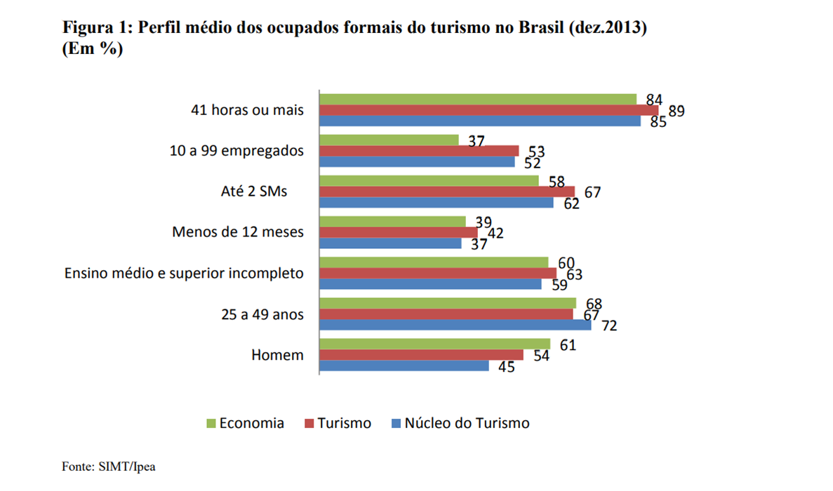

Slide 10
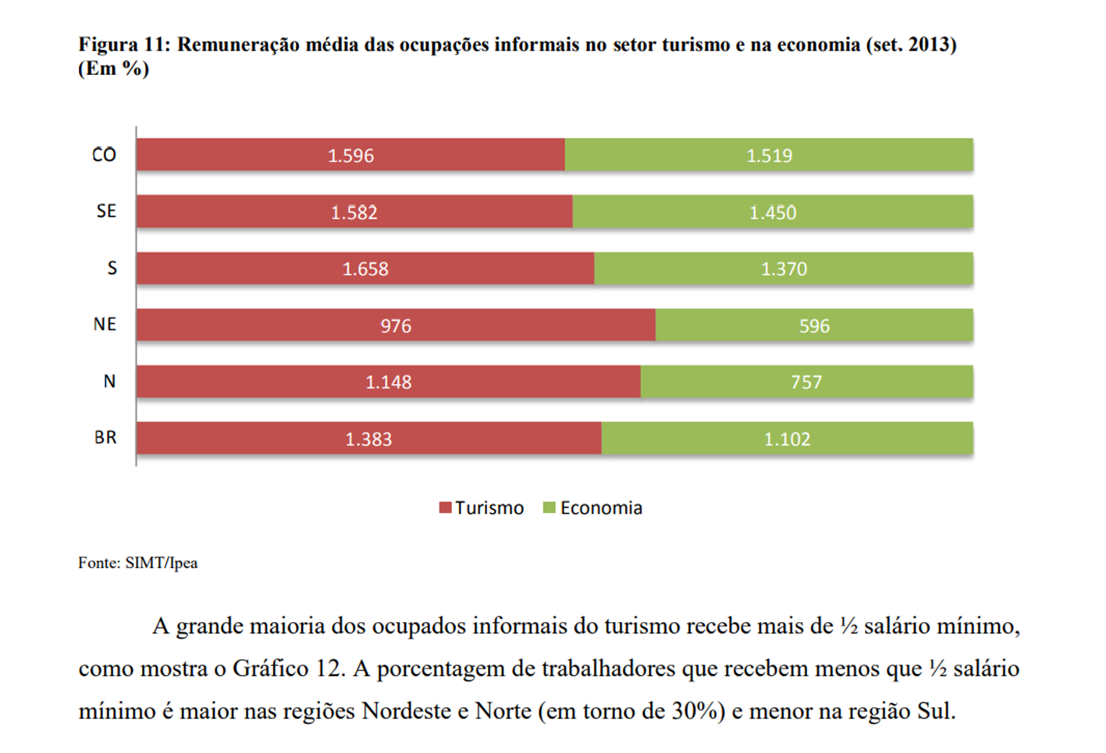
Informalidade

Slide 11
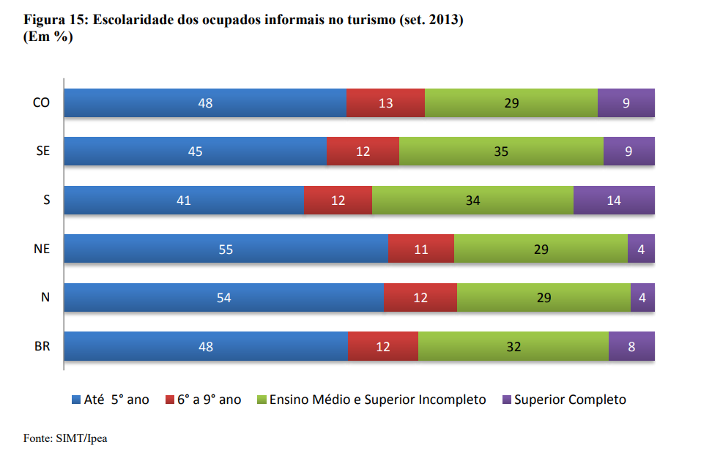

Slide 12
Poder de geração de emprego
TAKASAGO, 2010

Slide 13
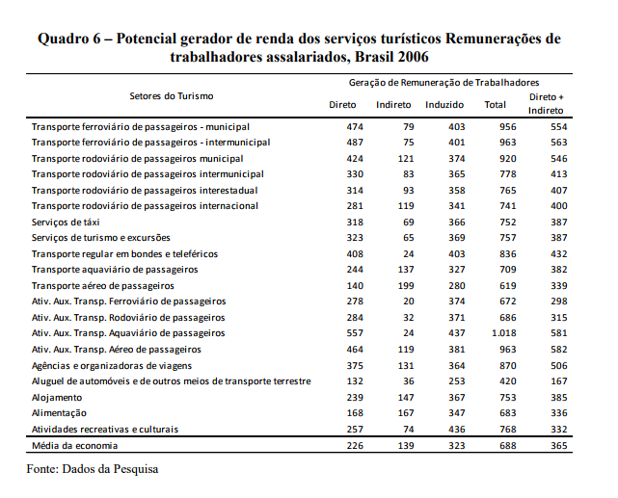
Potencial gerador de renda
TAKASAGO, 2010

Slide 14
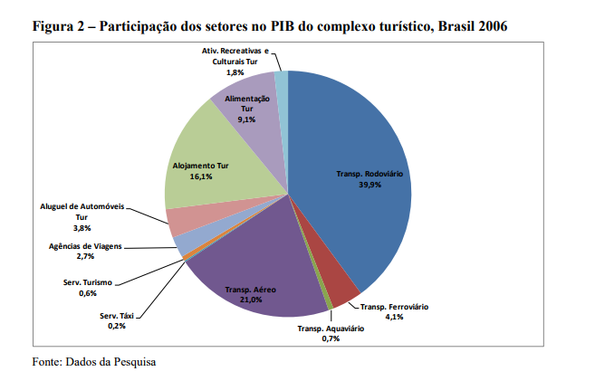

Slide 15
Algumas considerações

Slide 16
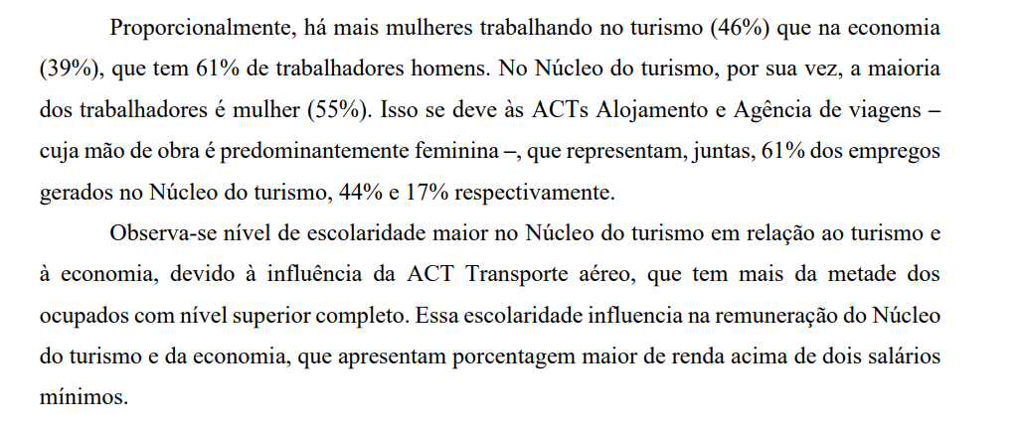
E as outras questões?

Slide 17
Referências
MINTUR/IPEA. Relatório com as estimativas da caracterização da ocupação formal e informal do turismo, com base nos dados da RAIS* e da PNAD** 2013, para o Brasil e regiões. Brasilia. 2013. Disponível em http://www.ipea.gov.br/portal/images/stories/PDFs/150619_caract_br
TAKASAGO, M. et al. The potential to create employment and income from tourism in Brazil MPRA. 2010. Disponível em https://mpra.ub.uni-muenchen.de/30693/1/MPRA_paper_30693.pdf
MINTUR. Política Nacional de Qualificação Profissional em Turismo. Brasilia. 2017 (Documento de Consulta Publica) Disponível em http://www.turismo.gov.br/images/pdf/CONSULTA_PBLICA_PNQ.pdf
MINTUR. Diretrizes Nacionais de Qualificação em Turismo. Disponível em http://www.turismo.gov.br/sites/default/turismo/noticias/todas_noticias/Noticias_download/mtur_book_diretrizes_para_publicacao.PDF
OMT. Measuring Employment in the Tourism Industries. Guide with Best Practices. 2014. Disponível em http://cf.cdn.unwto.org/sites/all/files/141015_measuring_employment_4c_stsa_wm.pdf

