Slide 1
CLASS #4
Weighting Methods

Slide 2
1 – Direct rating
Looking at within each family...
According to experience of decision maker
Based on historical data
Based on a survey

Slide 3
2 - Swing weight (last class)
First, it is needed to define a hypothetical situation, characterized as being the worst possible situation.
After this, it is asked to the decision maker which scenario would be choose in case of only one of them could be improved.
It was choose the attribute Closeness to customers (weight of 100)
Then, the others weight are given by comparing each attribute with “closeness to customer”

Slide 4
Applying the Swing weighting Method to Select a Logistics Operator
Step 1 – Hypothetical situation: the worst evaluation
Criterion | DHLX | TEGMAY | ILOGZ | The worst scenario
Handling | 50 | 100 | 75 | 50
Service Level (SL) | 90 | 30 | 80 | 30
Reputation | 40 | 40 | 100 | 40
Step 2 – Which those criteria would you choose, if someone could be improved? This criterion will be chosen as the most important. It means a criteria which would cause large impact on the final results
SL
Reputation
3. Handling

Slide 5
Applying the Swing weighting Method to Select a Logistics Operator
Step 3 – Give the score 100 to this best criteria. Now, compare this to the others. Example, supposing that “Reputation” is 70% important related to this criterion (SL). Then, the weight will be 70 = 0.7 x 100. Handling represents 30% (see table below)
Step 4 – Normalisation
Criterion | Weight | Normalised weight
SL | 100 | 100/200 = 0.5
Reputation | 70 | 70/200 = 0.35
Handling | 30 | 30/200 = 0.15

Slide 6
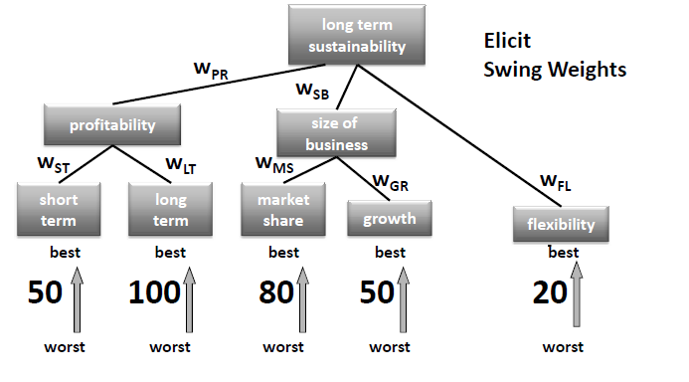
Como funciona no V.I.S.A?

Slide 7
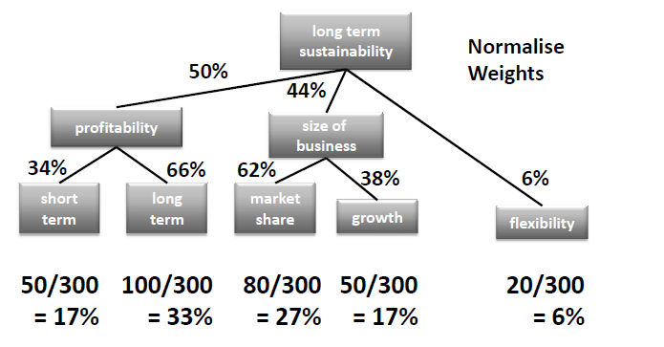
Normalização dos pesos (Swing-Weights)

Slide 8
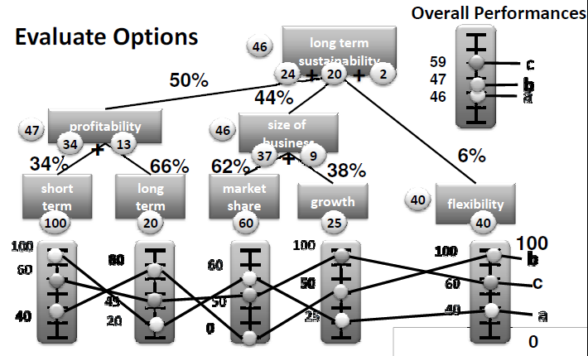
Avaliação de alternativas
U(a) = [100 (0.34) + 20 (0.66)] x 0.50 + [60 (0.62) + 25 (0.38)] x 0.44 + 40 (0.06) = [34 + 13] x 0.50 + [37.2 + 9.5] x 0.44 + 2.4 = 23.50 + 20.54 + 2.4 = 46.44

Slide 9
3 - SMARTER
The analysis of value functions and swing weights in SMART(S) is not intuitive and decision-makers are not always confident about the numbers they are providing for the decision model. As a result, the model may not accurately reflect the decision-maker’s true preferences.
Edwards and Barron have suggested a simplified form of SMART, the SMARTER (SMART Exploiting Ranks).

Slide 10
SMARTER (SMART Exploiting Ranks)
Differences:
Value functions are always assumed to be linear.
Ex: value function for office floor area (0 for 400 ft2 and 100 for 1500 ft2). Now we should ask the decision-maker to think about small increases in the office floor area. Would a 100 ft2 increase in the floor area be more attractive if it fell near the bottom of scale (e.g 400-500 ft2), in the middle (e.g 1000-1100 ft2) or near the top (e.g 1400-1500 ft2), or would it not matter where the increase occurred? If it does not matter, then a linear approximation can be used.

Slide 11
SMARTER (SMART Exploiting Ranks)
Differences:
Elicitation of the swing weights.
Ask the decision maker to rank the swings in order of importance. Then we can compare the swings from the worst to best position on different attributes when converting those into a set of approximate weights with ROC (“rank order centroid”).
Ex: a swing from the worst to the best position for “office visibility” was considered to be 80% as important as a swing from the worst to the best position for “closeness to customers”.

Slide 12
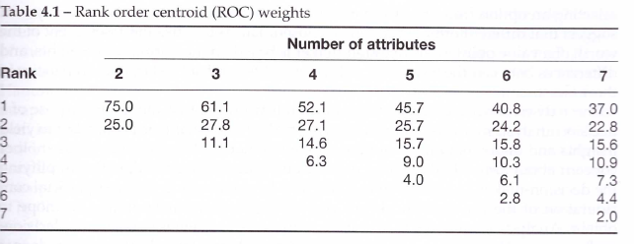
ROC (“rank order centroid”)
Weights are given according to an order of importance of the attributes.

Slide 13
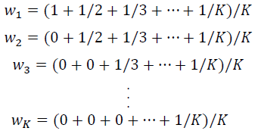
ROC (“rank order centroid”)
How to calculate the weights:
Where wk is the ROC weight from the attributes from order of preference k. Also, we know that it goes from w1 (the attribute most important) to wk (the less important).

Slide 14
ROC and SMART
Edwards and Barron results of extensive simulations suggested that SMART and SMARTER will agree on which option has the highest aggregate benefits in 75-87% of cases.

Slide 15
SMARTER and SMART
Discrepancies:
Careful when using it to separate costs from benefits, their results can be different. This differences become less important if we recall the main goal of the decision analysis model, which is to understand and give insights about the problem studied.
However, by simplifying the decision-maker’s judgmental task, we may be encouraging a superficial consideration of the problem and hence precluding the insights we hope to obtain.
ROC requires sophisticated mathematics (not usual to decision-makers).

