Slide 1
Certificate in EMI Skills Module 1 Part 3 Language for Lectures
Luciana Carvalho Fonseca & John Corbett

Slide 2
Session outcomes
To focus on aspects of cohesion in introductions and conclusions of lectures
To improve use of stress to highlight key words

Slide 3
Activity 1
Form groups of three.
Read a transcript of an introduction & conclusion to a lecture.
Identify missing words and phrases that help signal the structure of the lesson (aspects of cohesion).
How would you stress the words in the missing phrases?

Slide 4
Activity 1

Slide 5
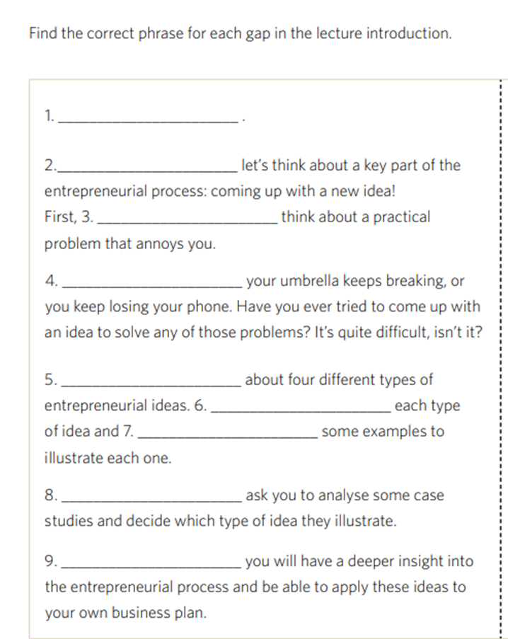
Activity 1
Possible answers

Slide 6
Activity 1
Answers
1.H
2. I
3. E
4. C
5. G
6. F
7. D
8. B
9. A

Slide 7
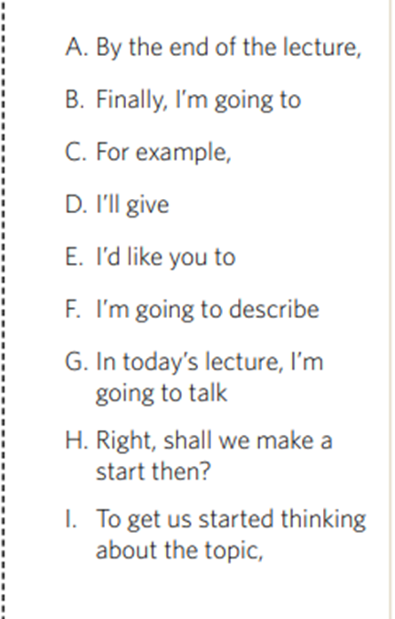
Activity 1
Use some of this language to draft the opening for a lecture in your disciplinary area.

Slide 8
Activity 2

Slide 9
Activity 2

Slide 10
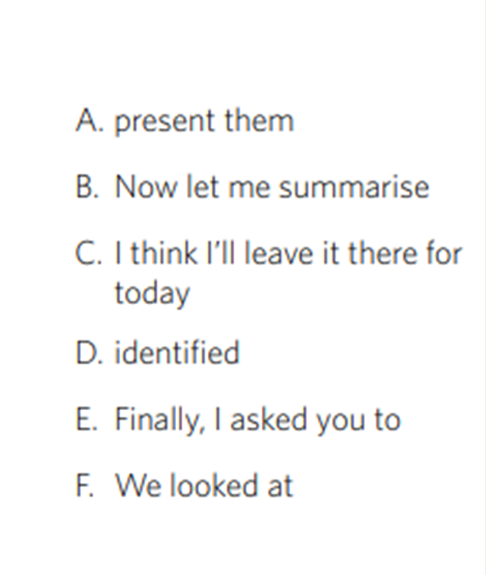
Activity 2
Answers
1. B
2. F
3. D
4. E
5. A
6. C

Slide 11
Activity 3: Write a conclusion for this introduction
Good morning everyone! I’m glad to see you all
here today!
To get you to think about the topic, I’d like you to
close your eyes for a moment and think about a
lecturer you had at college or university. What
was it that made their lectures effective? OK,
you can open your eyes! And that’s today’s topic:
How to give effective lectures.
By the end of this lecture you will be able to
identify three key features of effective lectures
and understand how they help to make your
lectures clearer and easier for your students to
follow.

Slide 12
Wrapping up
Take-home messages:
Key words and phrases help listeners to navigate your lectures
Openings and conclusions are important places to indicate the key structure and content of the lecture
Pay attention to signalling vocabulary, and make sure it is clearly pronounced!

Slide 13
CAE Cert in EMI Skills EMI@USP
Next session: Signposting

