Slide 1
Produto e Operações
pROF. DR. GUILHERME ARY PLONSKI
ARTUR VILAS BOAS

Slide 2
Justificativa: produto e operações
-Produto como design e experiência do usuário se tornam uma das principais alavancas no contexto de startups;
-Um bom produto depende diretamente do time e da qualidade da operação;
-Time e operação dependem de cultura.
“Culture eats strategy for breakfast” P. Drucker.

Slide 3
99 x Easy
-Monashees vs Rocket Internet
-Mindset para cultura vs Mindset para velocidade
-Construção de times vs Alta rotatividade
-Algoritmo robusto vs Algoritmo Fast Draw
-Caso Johnnie Walker (2014).

Slide 4
Produto
como
experiência.

Slide 5
Experiência do Usuário
“A experiência do usuário é afetada por toda a história: marca, campanhas, literatura, websites, design da loja, embalagem, experiências ‘fora da caixa’, design do produto, design de interação, apoio ao cliente, comunidade do usuário, disposição/substituição. É absurdo pensar que uma pessoa só é capaz de projetar tudo isso. UX é trabalho de todo mundo, do redator aperfeiçoando suas manchetes para o site se comunicar com a audiência certa, ao desenvolvedor afinando seu código para o aplicativo responder mais rapidamente ao toque. Eu preferiria que considerássemos mais UX como valor e menos como uma disciplina.” Nielsen Group
-Experiência do Usuário vai muito além do digital: eventos, apresentações de consultoria, dinâmicas, abordagens para venda de produtos financeiros, imersão na Disney etc.

Slide 6
Temas relevantes em UX atualmente
-DesignTech Companies
-Frictionless
-”Fim dos apps” (app killers dos OS) e o crescimento do conteúdo e das notificações
-Experiências pró-ativas e AI
-Novas interfaces (relógios, dispositivos de voz, features dos smartphones etc.)
-Engineering as Marketing (bots, testes etc.)
-Algoritmos
Livros : The Design of Everyday Things; Design para quem não é designer.

Slide 7
Experiências relevantes = recorrência e recomendação
O “customer delight” pode existir em produtos físicos ou digitais, se desdobrando em muitas possibilidades:
-Experiência dentro do produto: momentos específicos em que a experiência te encanta, como uma interferência proativa positiva do google; atalhos e processos inteligentes; feeds e algoritmos.
-Experiência de atendimento: Nubank e outros que colocam o cliente acima de tudo.
-Experiência de entrada ou pós-venda: estratégias de onboarding (Notion).
Caso SuperHuman de construção de produto.

Slide 8
Who controls your facebook feed
“When you study computer science, one of the first algorithms you learn is a sorting algorithm,” Alison says. He scribbles a list of positive integers in dry erase: 4, 1, 3, 2, 5
The simple task at hand: devise an algorithm to sort these numbers into ascending order. “Human beings know how to do this,” Alison says. “We just kind of do it in our heads.” Computers, however, must be told precisely how. That requires an algorithm: a set of concrete instructions by which a given problem may be solved. The algorithm Alison shows me is called “bubble sort,” and it works like this:
>>For each number in the set, starting with the first one, compare it to the number that follows, and see if they’re in the desired order.
>>>If not, reverse them.
>>>>Repeat steps 1 and 2 until you’re able to proceed through the set from start to end without reversing any numbers.

Slide 9
Who controls your facebook feed
Prediction Algorithms
Algoritmos para prever resultados = melhores experiências do usuário (feed com posts que você gostaria de ver; plataforma com as notícias certas para você; indicação correta do melhor produto financeiro; melhor taxista para sua experiência; filme/série que você vai se viciar etc.)
Palmeiras x Corinthians – quem ganha?
GSW x Rockets – 1 milhão de reais em jogo. Como você decidiria?

Slide 10
Who controls your facebook feed
“You’re probably going to start by looking at historical data,” he says. “You’re going to look at the win-loss record of each team, the records of the individual players, who’s injured, who’s on a streak.” Maybe you’ll take into account environmental factors: Who’s the home team? Is one squad playing on short rest, or after a cross-country flight? Your prediction algorithm might incorporate all of these factors and more. If it’s good, it will not only predict the game’s winner, but tell you its degree of confidence in the result.
That’s analogous to what Facebook’s news feed algorithm does when it tries to predict whether you’ll like a given post. I ask Alison how many variables—”features,” in machine-learning lingo—Facebook’s algorithm takes into account. “Hundreds,” he says.

Slide 11
Who controls your facebook feed
-What if people “like” posts that they don’t really like, or click on stories that turn out to be unsatisfying? The result could be a news feed that optimizes for virality, rather than quality—one that feeds users a steady diet of candy, leaving them dizzy and a little nauseated, liking things left and right but gradually growing to hate the whole silly game. How do you optimize against that? Do we have any blind spots?
Facebook started by gathering more subtle forms of behavioral data: not just whether someone clicked, but how long he spent reading a story once he clicked on it; not just whether he liked it, but whether he liked it before or after reading. For instance: Liking a post before you’ve read it, Facebook learned, corresponds much more weakly to your actual sentiment than liking it afterward.
Feed Quality Panel

Slide 12
Who controls your facebook feed
Most of the time, when people see a story they don’t care about in their news feed, they scroll right past it. Some stories irk them enough that they’re moved to click on the little drop-down menu at the top right of the post and select “Hide post.” Facebook’s algorithm considers that a strong negative signal and endeavors to show them fewer posts like that in the future.
Not everyone uses Facebook the same way, however. Facebook’s data scientists were aware that a small proportion of users—5 percent—were doing 85 percent of the hiding. When Facebook dug deeper, it found that a small subset of those 5 percent were hiding almost every story they saw—even ones they had liked and commented on. For these “superhiders,” it turned out, hiding a story didn’t mean they disliked it; it was simply their way of marking the post “read,” like archiving a message in Gmail.

Slide 13
Who controls your facebook feed
That might sound like a simple fix. But the algorithm is so precious to Facebook that every tweak to the code must be tested—first in an offline simulation, then among a tiny group of Facebook employees, then on a small fraction of all Facebook users—before it goes live. At each step, the company collects data on the change’s effect on metrics ranging from user engagement to time spent on the site to ad revenue to page-load time. Diagnostic tools are set up to detect an abnormally large change on any one of these crucial metrics in real time, setting off a sort of internal alarm that automatically notifies key members of the news feed team.
Once a change like Tas’ has been tested on each of these audiences, he’ll present the resulting data at one of the news feed team’s weekly “ranking meetings” and field a volley questions from Mosseri, Allison, Marra, and his other colleagues as to its effect on various metrics. If the team is satisfied that the change is a positive one, free of unintended consequences, the engineers in charge of the code on the iOS, Android, and Web teams will gradually roll it out to the public at large.
Even then, Facebook can’t be sure that the change won’t have some subtle, longer-term effect that it had failed to anticipate. To guard against this, it maintains a “holdout group”—a small proportion of users who don’t see the change for weeks or months after the rest of us.

Slide 14
O que esperar
de um bom
algoritmo no
Spotify?

Slide 15
Inside Spotify's Plan To Take On Apple Music
-Fresh Finds takes a central component of The Echo Nest's original methodology—its web content crawler and natural language processing technology—to mine music blogs and reviews from sites like Pitchfork and NME and figure out which artists are starting to generate buzz, but don't yet have the listenership to show for it. Using natural language processing, the system analyzes the text of these editorial sources to try and understand the sentiment around new artists.
-Discover Weekly analyzes your own listening history, with an emphasis on what you've been bingeing on recently. It then takes that knowledge and compares it to the playlisting behavior of other users in the hopes of tapping into that distinctly human, gut feeling that dictates why one song sounds good following another or why this particular collection of 35 songs feels perfect for your mood on a given afternoon. Scanning millions of playlists, the system tries to find tracks that are commonly listed alongside the music with which you're already familiar, and then group those tracks together into a new, personalized playlist.

Slide 16
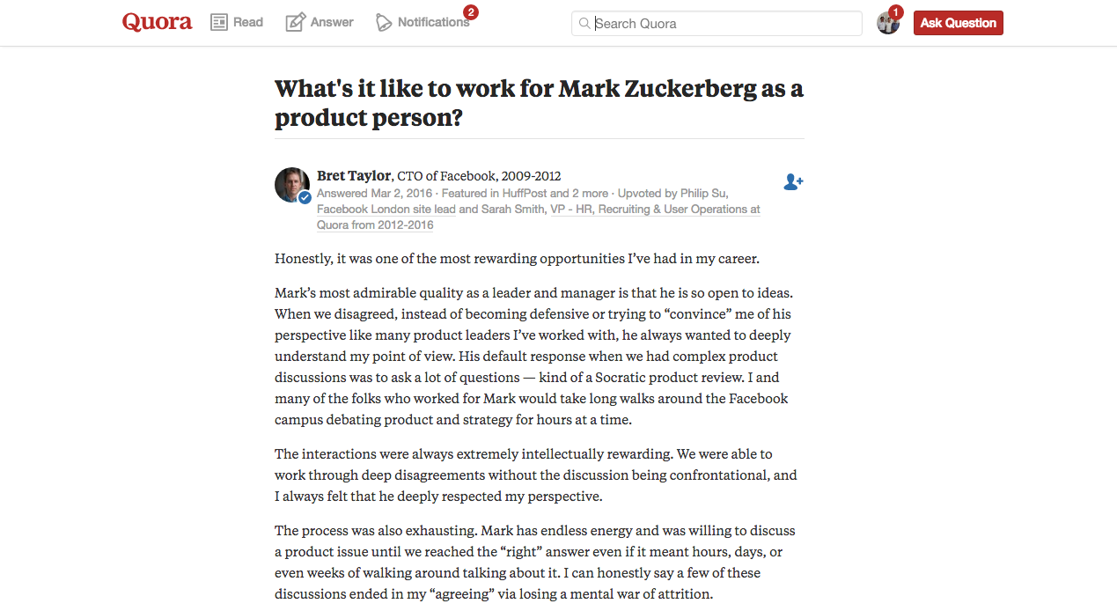

Slide 17
Produto =
Time +
Operação

Slide 18
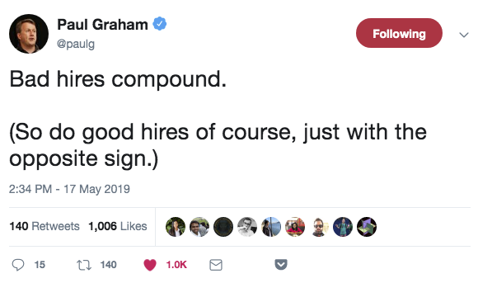
Time e cultura são chave.
How spotify works?
How google works?
-Gympass: 3 usuários + interno (com guildas de operação). 5-9 eng para 1 UX + PO.
-Modelo Agile em startups.
-Case Harvard: The Ordinary Heroes of the Taj

Slide 19
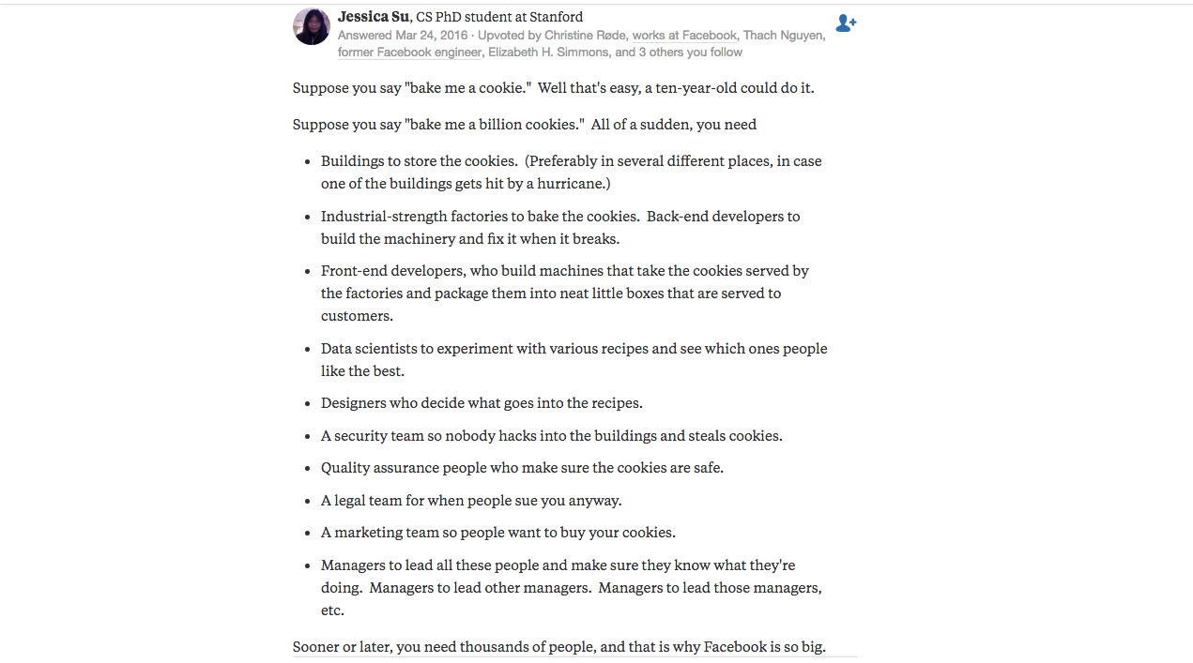
Back-end e arquitetura do produto
Front-end e experiência do usuário
Operações e Product management

Slide 20
The Black Box of Product Management
Product Management is the by-product of two exponential forces being exerted on a company.
Speed: The company exists in an industry where the rate of technological innovation is accelerating
Scale: Growth in the company’s product, organization, and customers are creating complexity
Speed is an exponential force because with every period of time, more change is occurring than in the last. Similarly with scale; every extra feature, employee, or user is adding more complexity to the system than the last.

Slide 21
The Black Box of Product Management
Software development itself has a lowered bar of entry. Approachability of high level programming languages, and the prevalence of open source libraries has super charged developers with unprecedented productivity. At the same time, the infrastructure costs of building a functional product and deploying it has dropped to basically zero.
This means that every large problem in the world likely has hundreds of independent teams working to solve it.
In this way, speed has two meanings: both how quickly you can get something to market with software development, and (critically) how competition forces companies to go faster to survive.

Slide 22
The Black Box of Product Management
Scale: as the company grows, complexity emerges as more features are added, customers become more diverse, and the team grows. And that complexity grows exponentially.

Slide 23
Sobre escalar uma startup:
-Lies, Booze and Billions (Zenefits);
-My year in startup hell;
-From co-founder to ousted CEO of 500px;
Livros sobre gestão e escala:
-Hard Things about Hard Things;
-Only the paranoid survive;
-Criatividade S/A;
-Inspired (Marty Cagan);
-Powerful (Patty McCord).

Slide 24
Four Startup Engineering Killers
“In 2016, I gave technical advice to a first-time entrepreneur building a seed-funded food delivery marketplace. In my view, every tech choice the company had made was wrong. The CEO believed in “empowering the engineer.” They then let their first engineer choose the framework (Scala/Play) because it was what the engineer wanted to use, not because it made sense for the company, their use case, or the recruiting pool. Much of the early technical work had been outsourced. Their product roadmap was widely optimistic (web and mobile concurrently) despite the fact that most of the business was still unvalidated. It was a recipe for disaster.”
1. Premature Scaling (build large scale when you’re small – “technical debt”)
2. Using Untested Technology (escolha do stack da empresa)
3. Hiring the wrong engineer (large company, elite comp sci, junior, dev shops)
4. Bad product management (otimismo excessive e engineering advisors)

Slide 25
Links utilizados
https://medium.com/nossa-coletividad/ux-n%C3%A3o-%C3%A9-um-t%C3%ADtulo-%C3%A9-um-estilo-de-vida-6a34b84e8ab8
https://brasil.uxdesign.cc/nosso-trabalho-é-desenhar-cada-vez-menos-interfaces-acee0d004681
http://www.slate.com/articles/technology/cover_story/2016/01/how_facebook_s_news_feed_algorithm_works.single.html?utm_content=buffer63d1b&utm_medium=social&utm_source=facebook.com&utm_campaign=buffer
https://medium.com/the-black-box-of-product-management/the-black-box-of-product-management-3feb65db6ddb
Muito importante: how to build products that users love.

