Slide 1
MAC5784 – AI in videogames
Flavio Soares Correa da Silva
2nd semester 2020

Slide 2
Purpose of AI (from AIMA 3rd edition)
AIMA = Russell, S. and Norvig, P. Artificial Intelligence, a Modern Approach (Elsevier) – 3rd edition, 2010
 | As Humans / As Rational Agents
Thinking / Acting | Think as Humans | “Think” as Rational Agents ???
 | Act as Humans | Act as Rational Agents

Slide 3
Agent modeling
Empathic
Social
Strategic
Rational

Slide 4
Rational agents (AIMA 3ed)
Agent
Environment
Sensors
Behaviour
Actuators

Slide 5
Strategic agents
Agent
Environment + Other Agents
Sensors
Behaviour
Actuators

Slide 6
Social agents
“Global” agent
Agency
Individuals
Agents

Slide 7
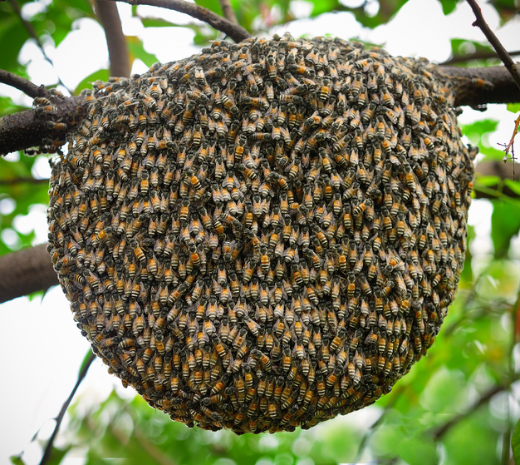
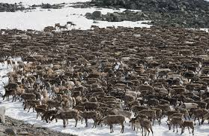
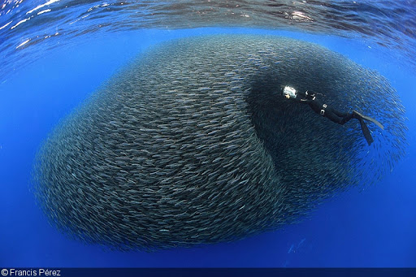
Social agents – swarm intelligence

Slide 8
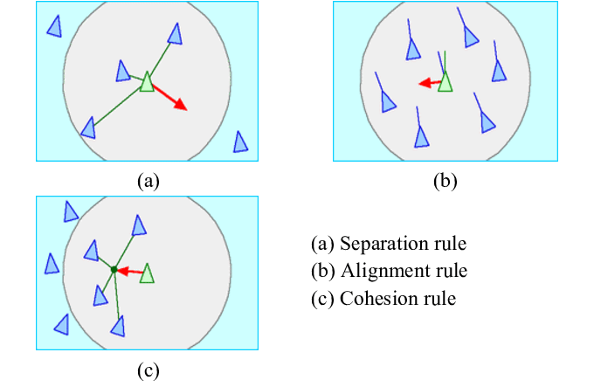
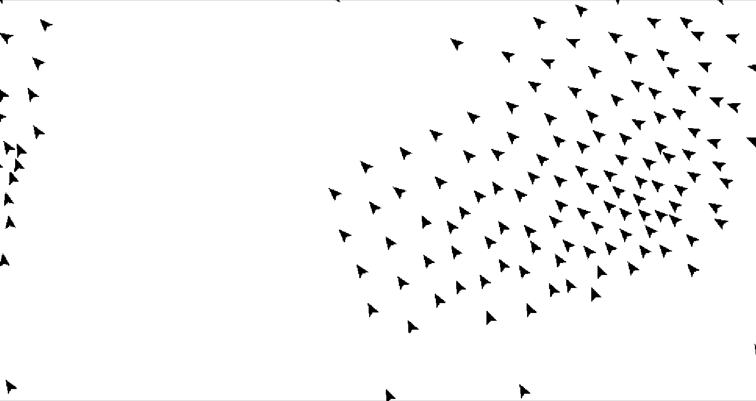
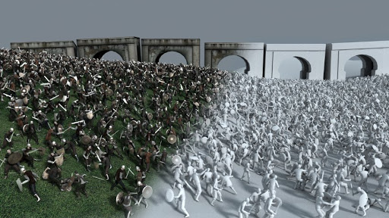
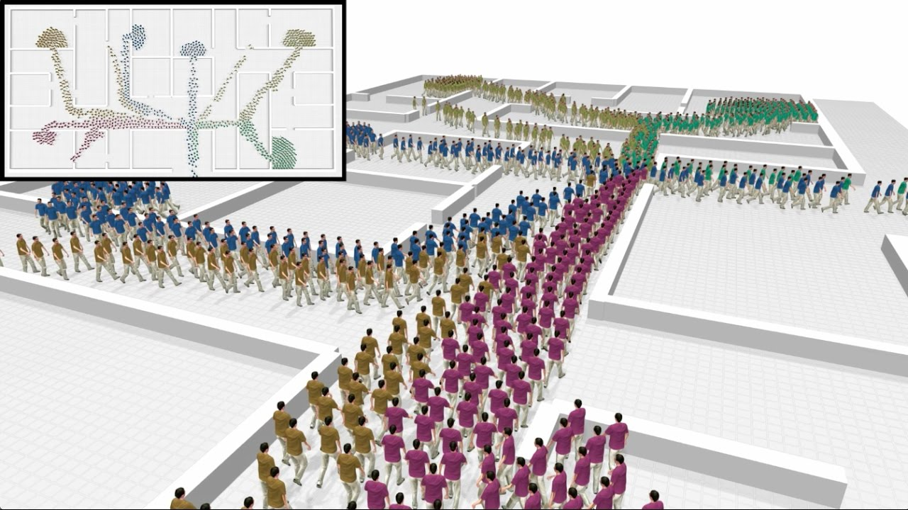
Social agents – swarm intelligence

Slide 9
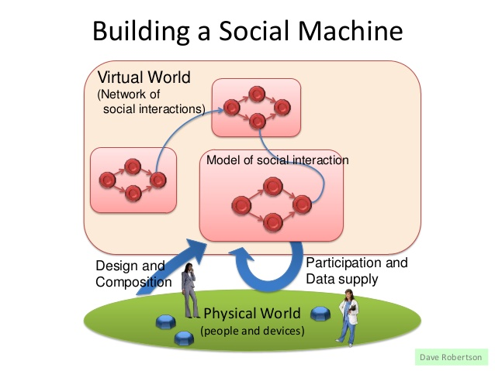
Social agents – interaction protocols

Slide 10
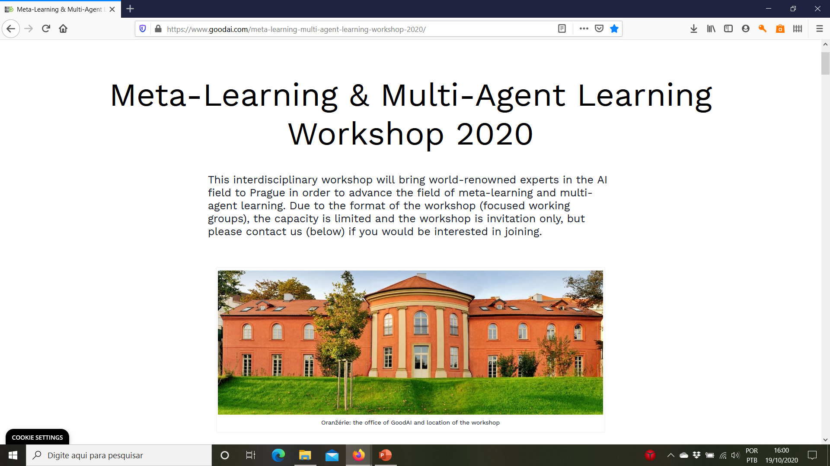
Social agents – “multi-mini-agent” architecture

