Slide 1
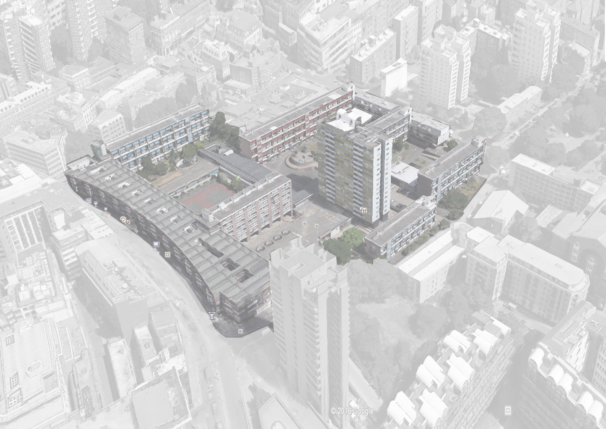
Golden Lane Estate
Since 1957
DEEPENDRA, HASSAN, OGUZ, SANJOG

Slide 2
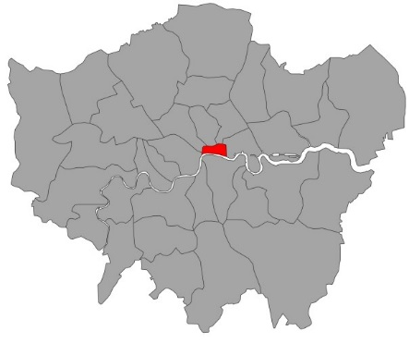
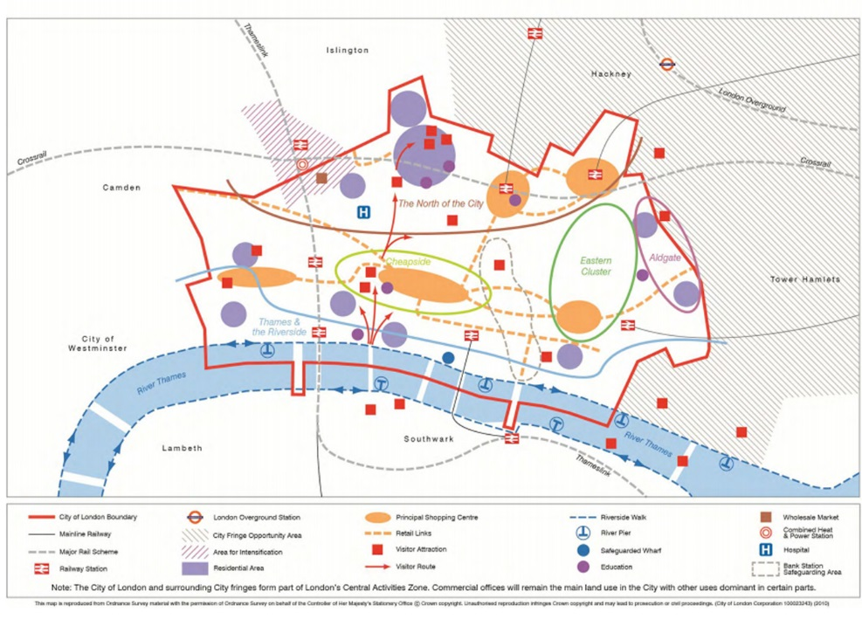
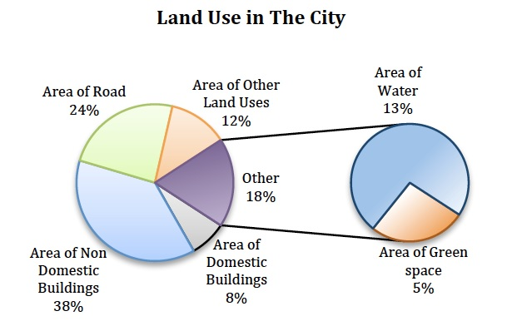
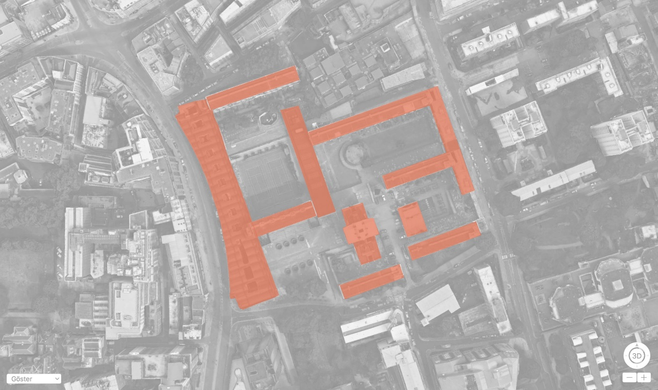
INTRODUCTION
London
Source: City of London, Local plan, Jan 2015 , pg. 18
Source: http://blogs.lse.ac.uk/
sustainability/2014/09/26/urban_greening/
City Of London
City Of London
Golden Lane Estate
The north of the City contains over 50% of the Square Mile’s residential population, with the highest concentration at the Barbican and Golden Lane estates.
Plan to lead the potential development as a ‘ecodesign’ district by capitalising on mixed use character, improved public transport, low car ownership levels, opportunities for improved cycle infrastructure and the combined cooling heat and power network in the area.
The City is a major business and financial centre.
Throughout the 19th century, the City was the world's primary business centre.
Fixed Resident Population: 7,000 (2011) Non Resident commuting population: 300,000
Source: Google earth
Golden Lane Estate

Slide 3
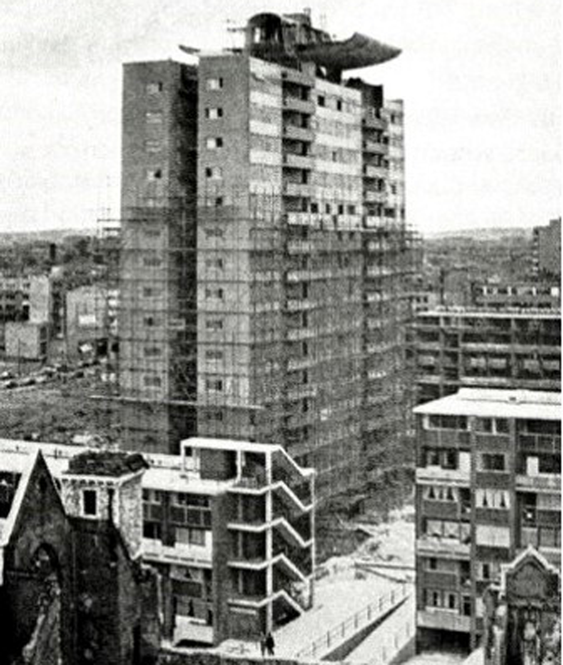
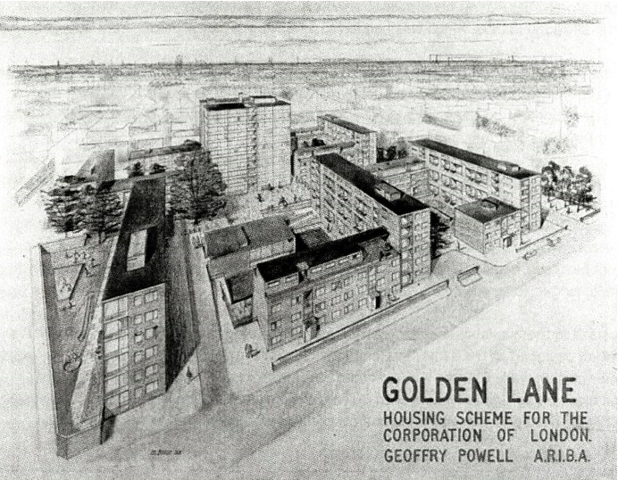
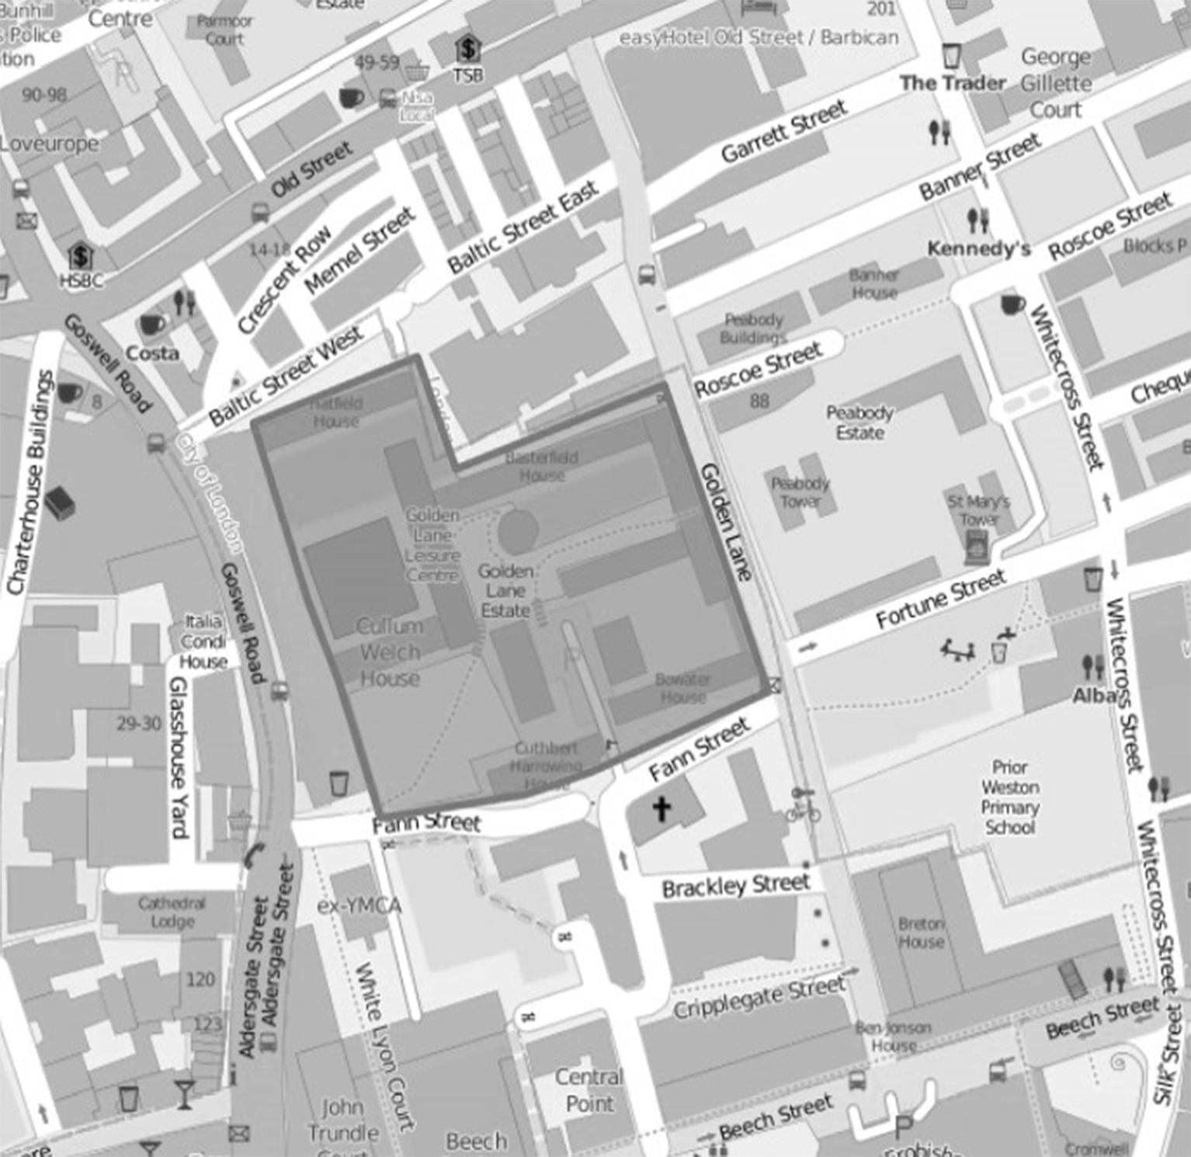
GOLDEN LANE ESTATE
History
The Competition
The construction of the scheme had to be economical and the minimum amount of steel was to be specified as this was an expensive and scarce material after the war.
It lead to the use of brick masonry built as a frame structure as well as load bearing.
Other requirements:
Daylight and ventilation, especially to living rooms and bathrooms.
A drying room or cupboard and a balcony sufficiently large.
Architects: Chamberlin, Powell and Bonn
Construction Period: 1953- 1962
Design Philosophy of Le Corbusier
Block of 11 storeys as the dominating feature and 12 low blocks and a community centre all arranged as an inward looking layout around a series of courts- an urban village
Each dwelling had central heating and hot water system.
The buildings are Grade II and II* listed.
Source: Twentieth Century Architects: Chamberlin, Powell & Bon by Elain Hardwood
In mid 19th century because of the 2nd world war , the population of the city dropped from 130,000 to just 5,000 by 1952.
Housing estates were developed to bring back the displaced population into the centre.
Business and commerce had become the main uses of land in the City.
Source: Twentieth Century Architects: Chamberlin, Powell & Bon by Elain Hardwood
Source: http://www.wikiwand.com/en/Golden_Lane,_London

Slide 4
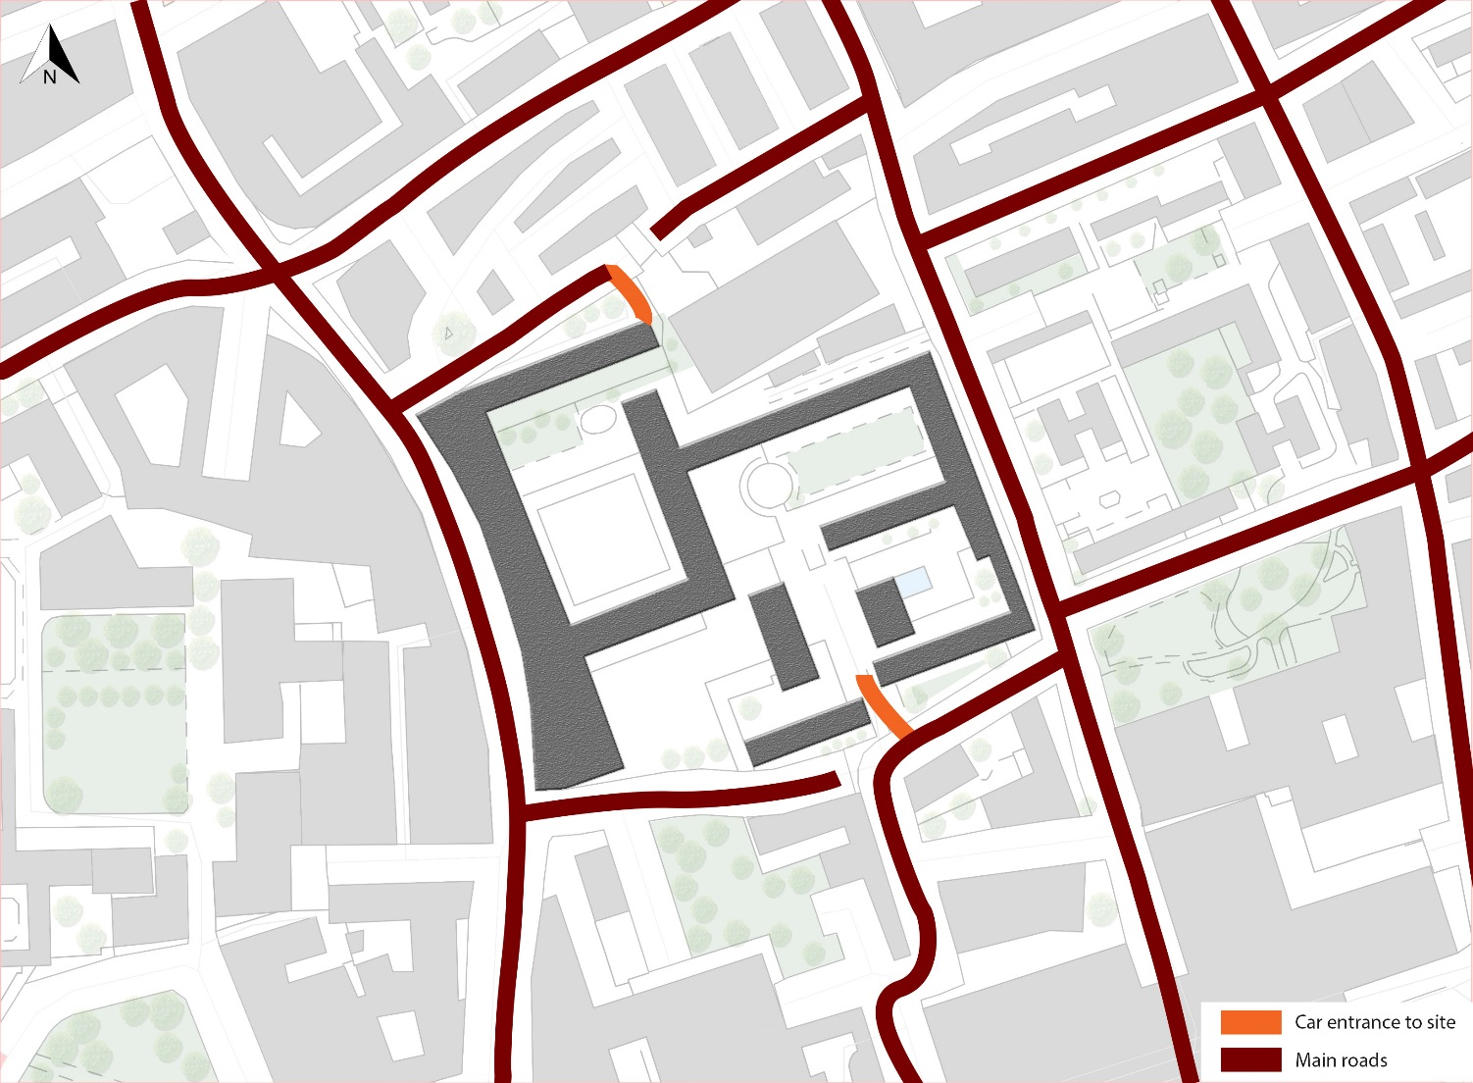
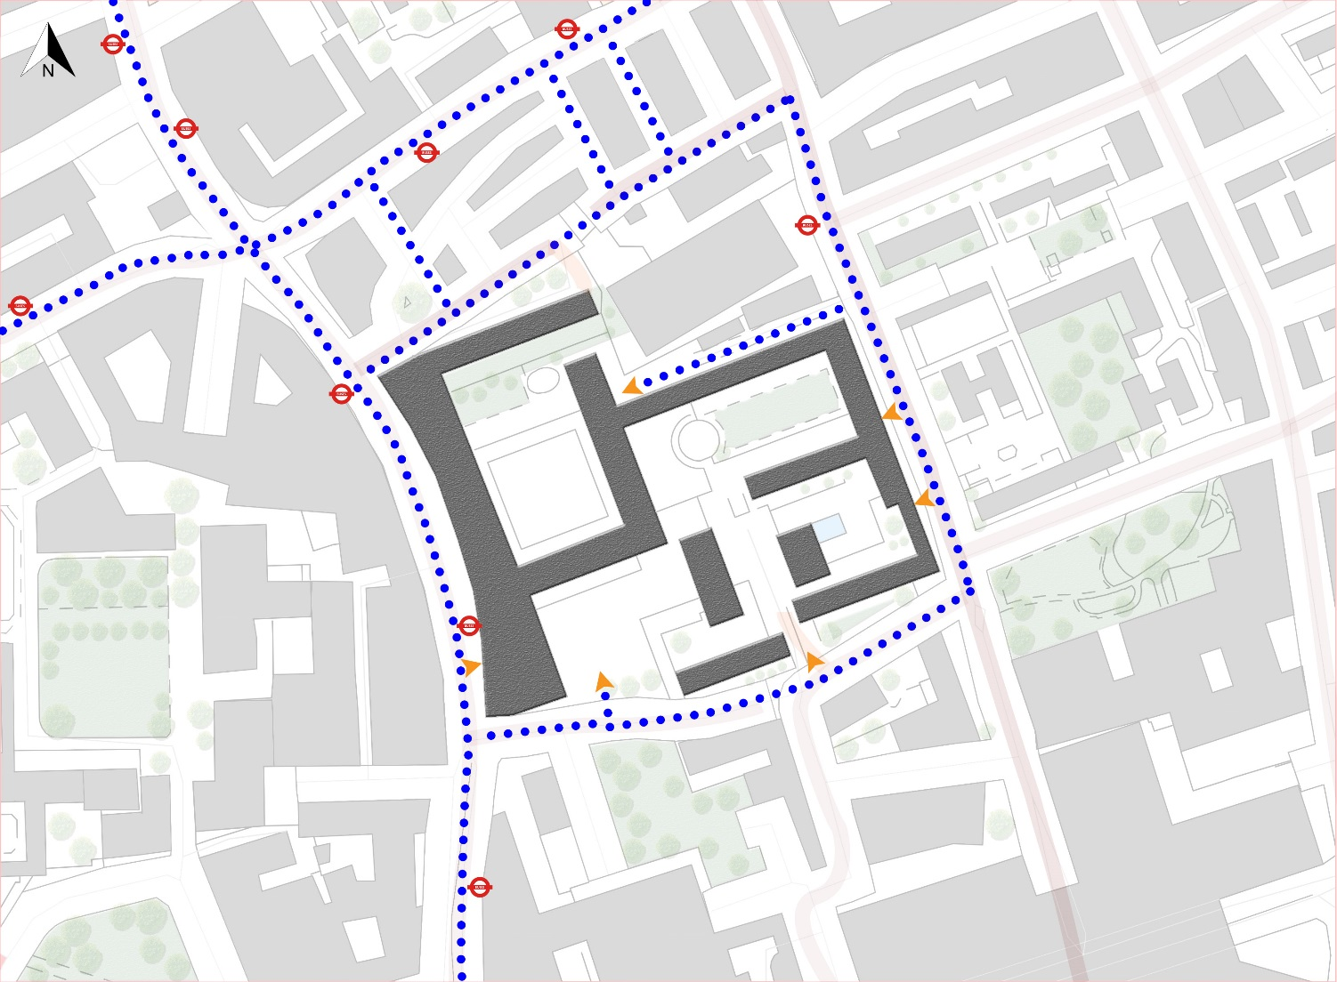
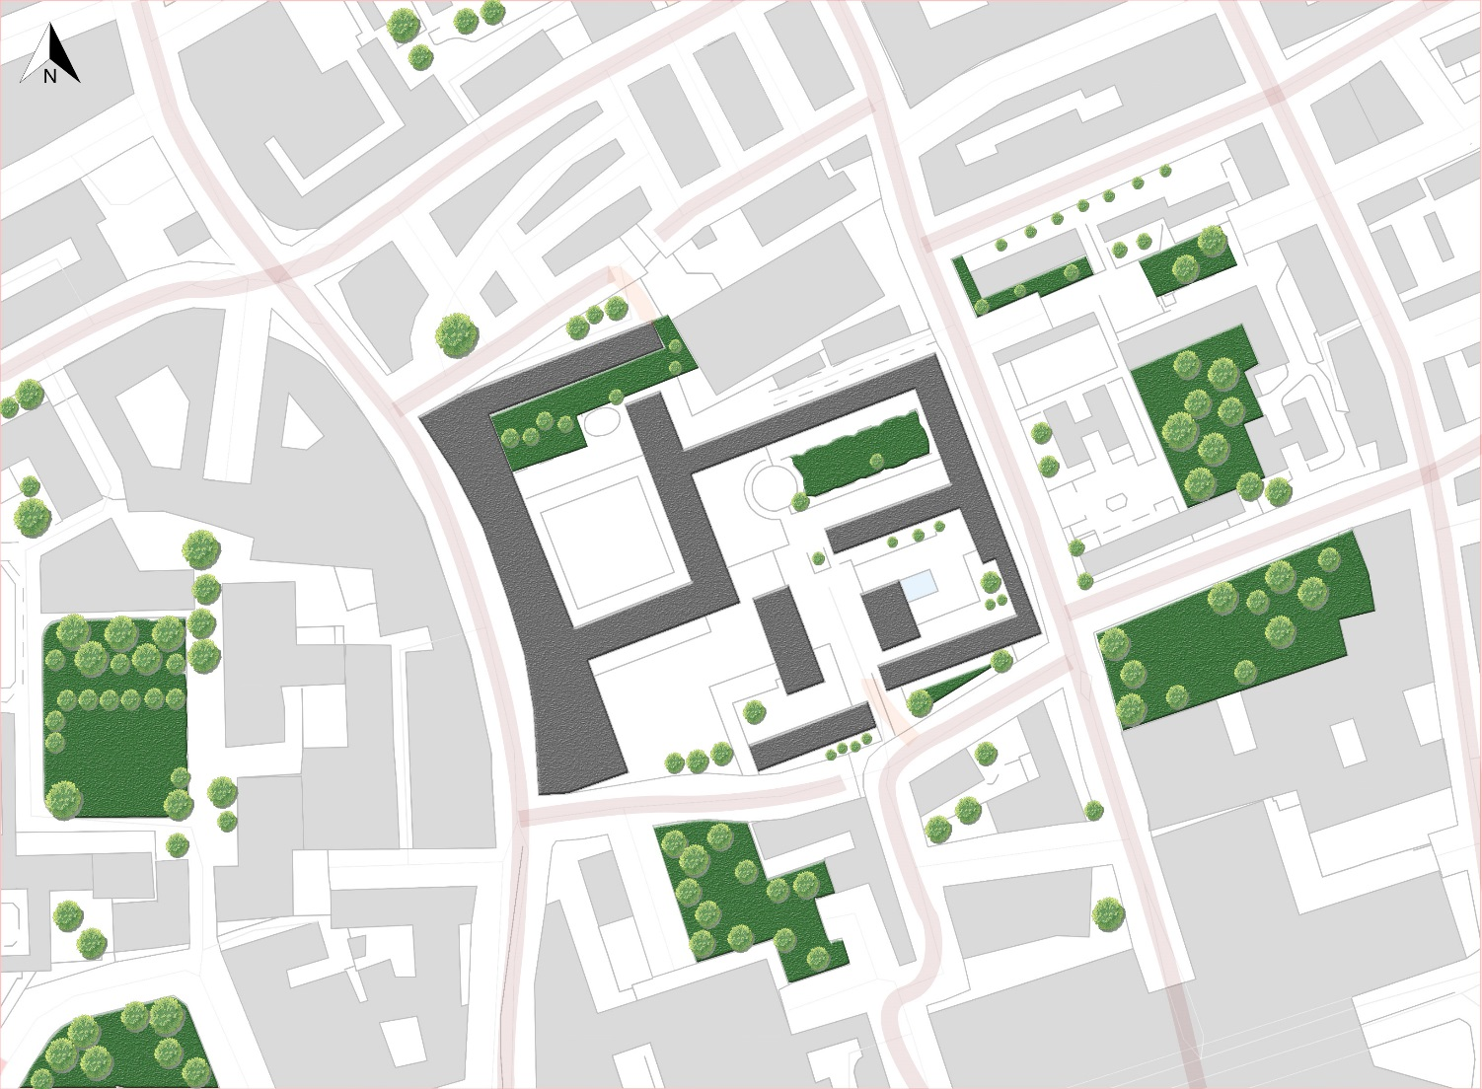
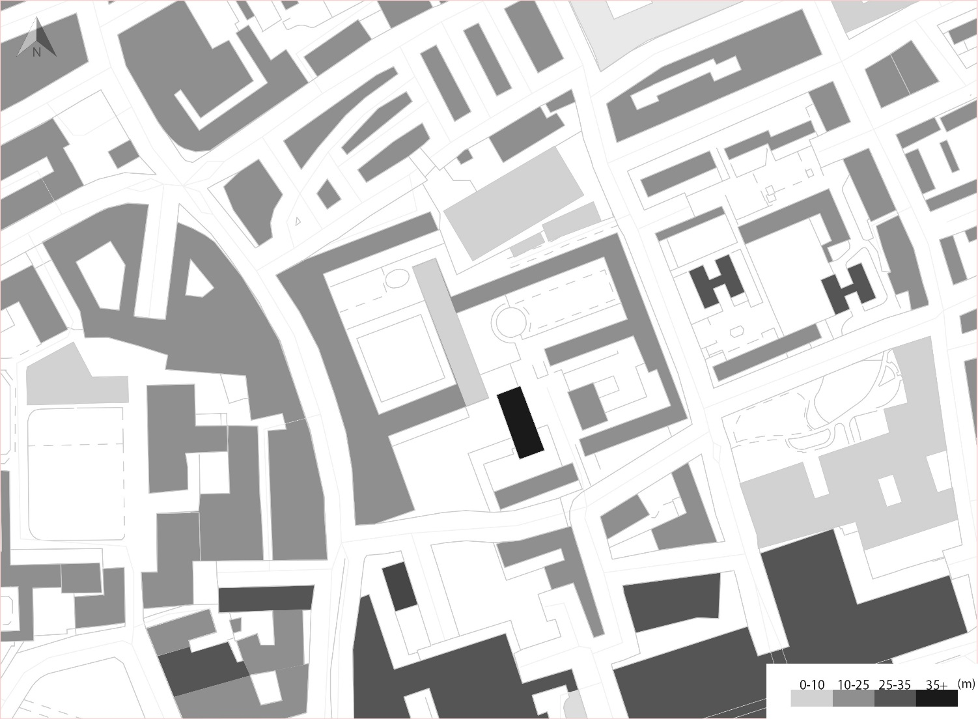
SITE CONTEXT
1
Traffic Route
2
Pedestrian Route
3
Green Areas
4
Building Heights

Slide 5
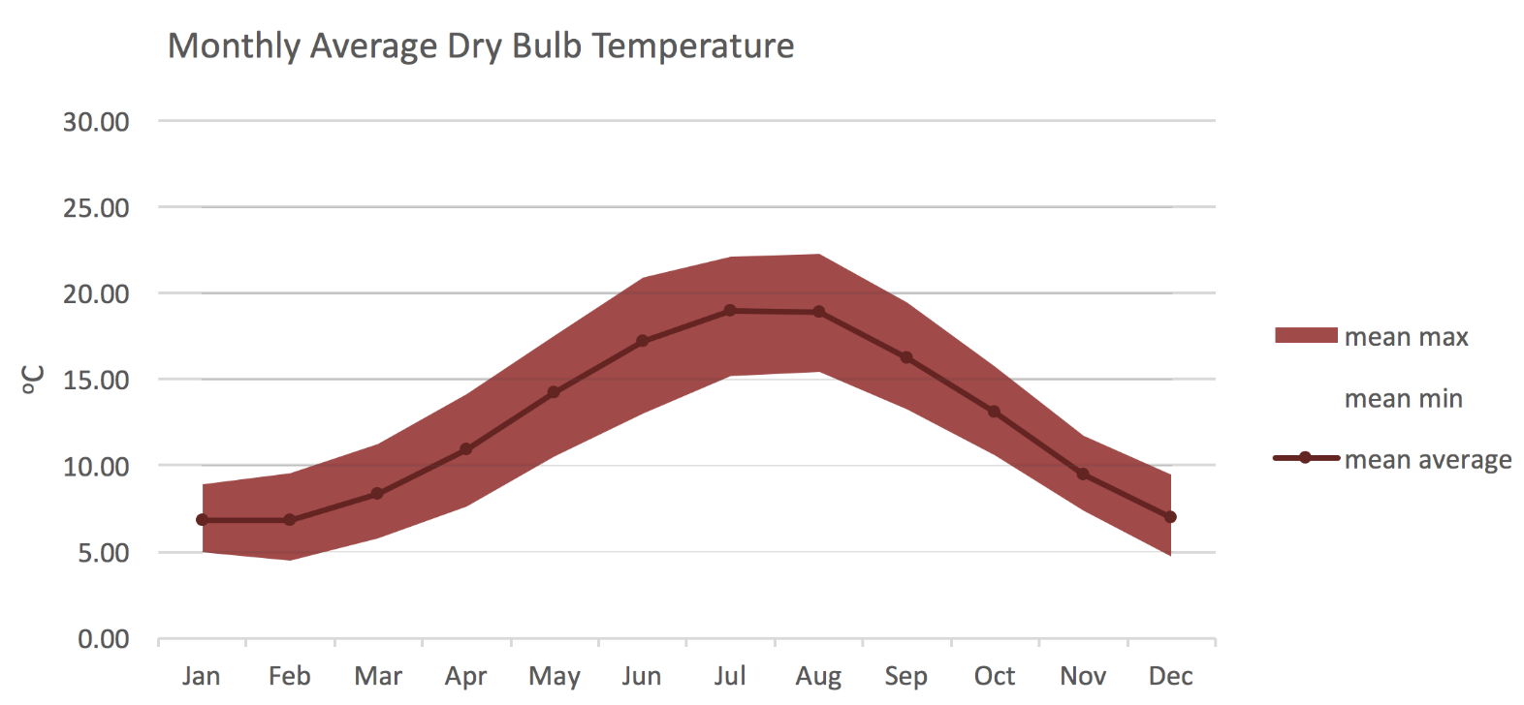
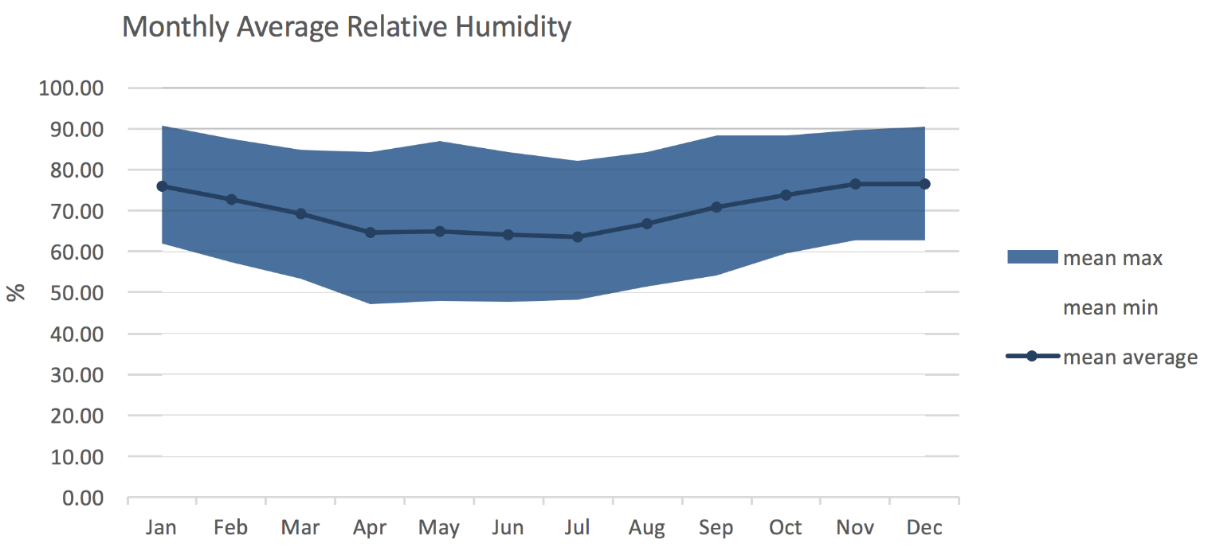
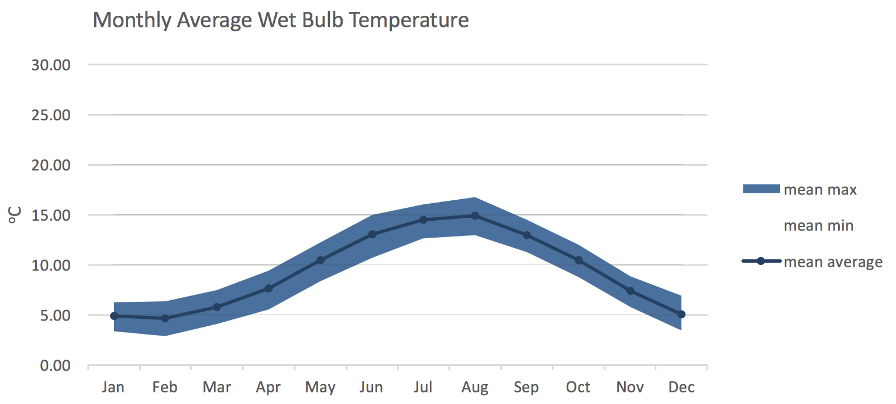
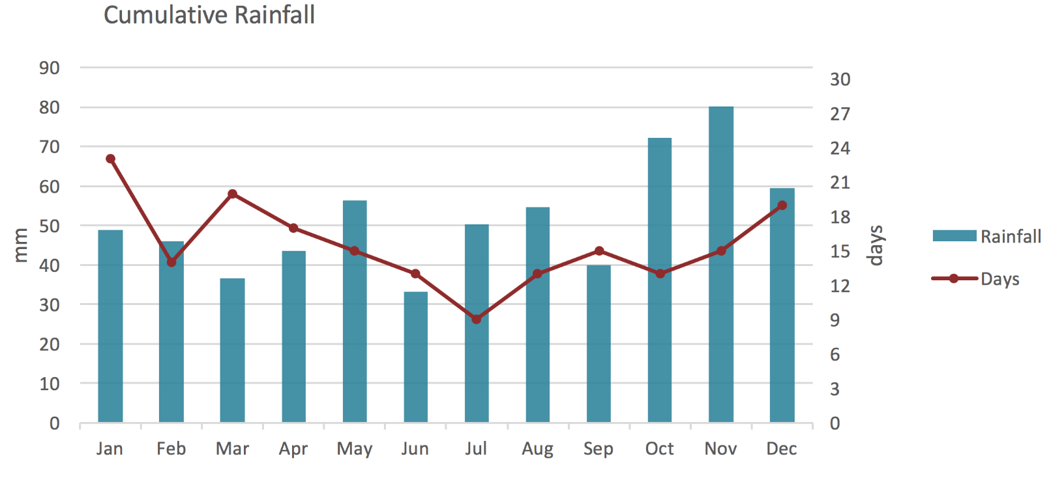
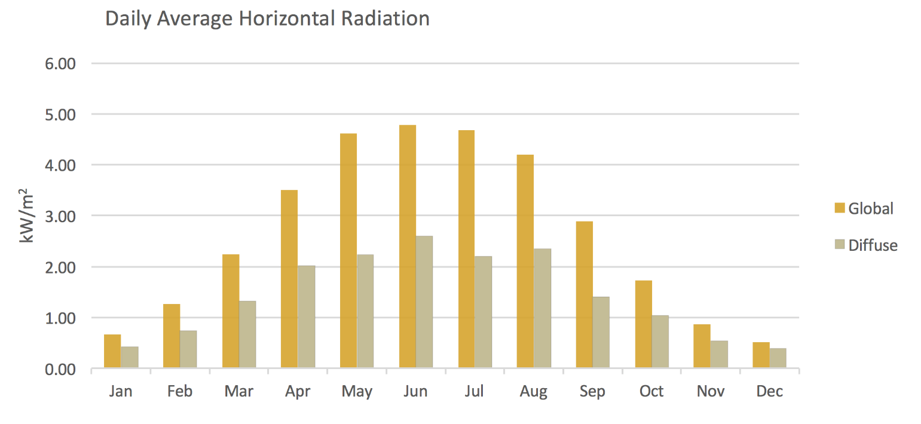
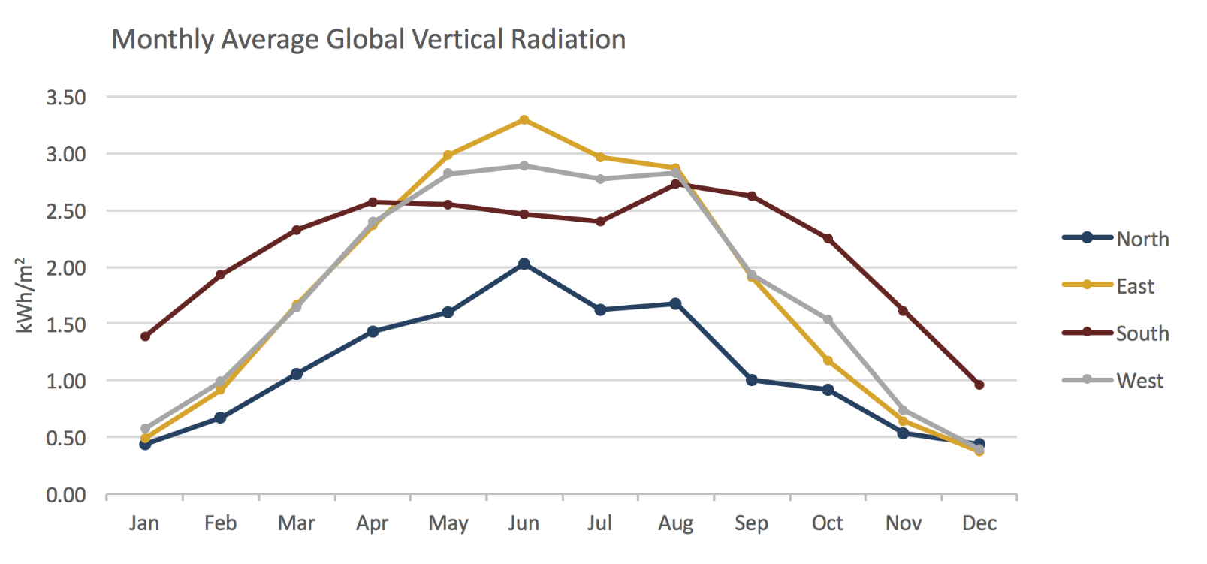
CLIMATE OF LONDON
Source: Meteonorm data, London weather C.

Slide 6
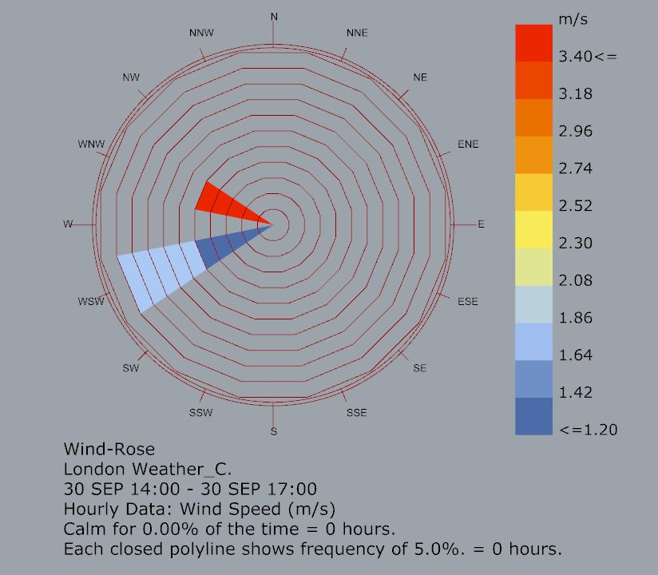
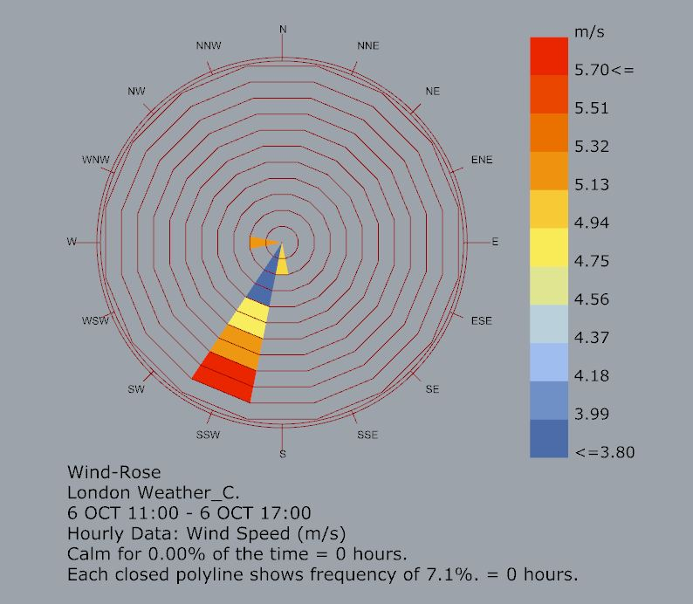
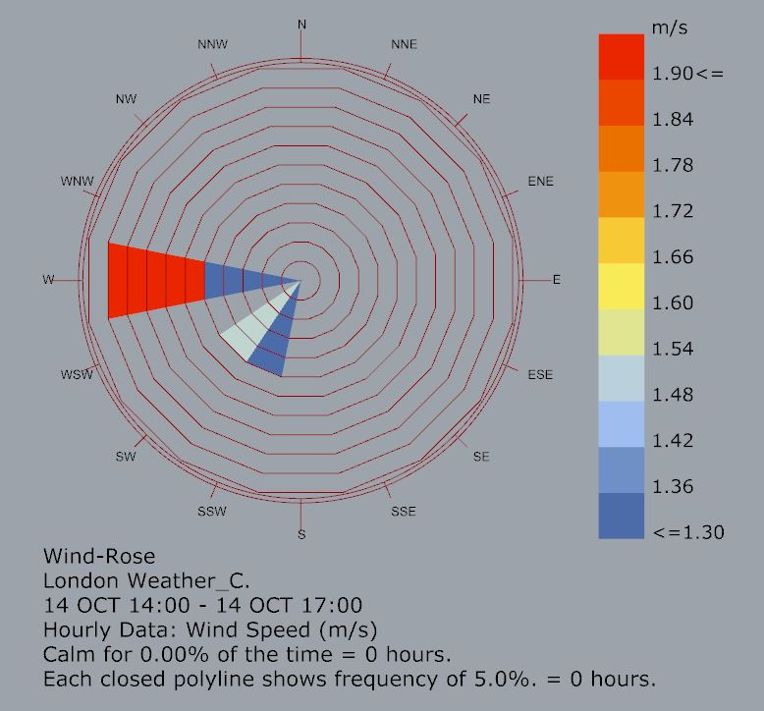
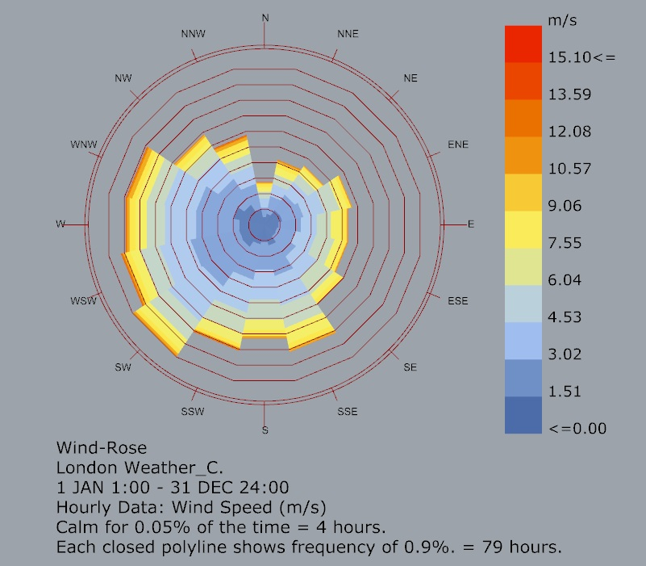
WIND PATTERN ANALYSIS
30 SEPTEMBER
6 OCTOBER
14 OCTOBER
ENTIRE YEAR

Slide 7
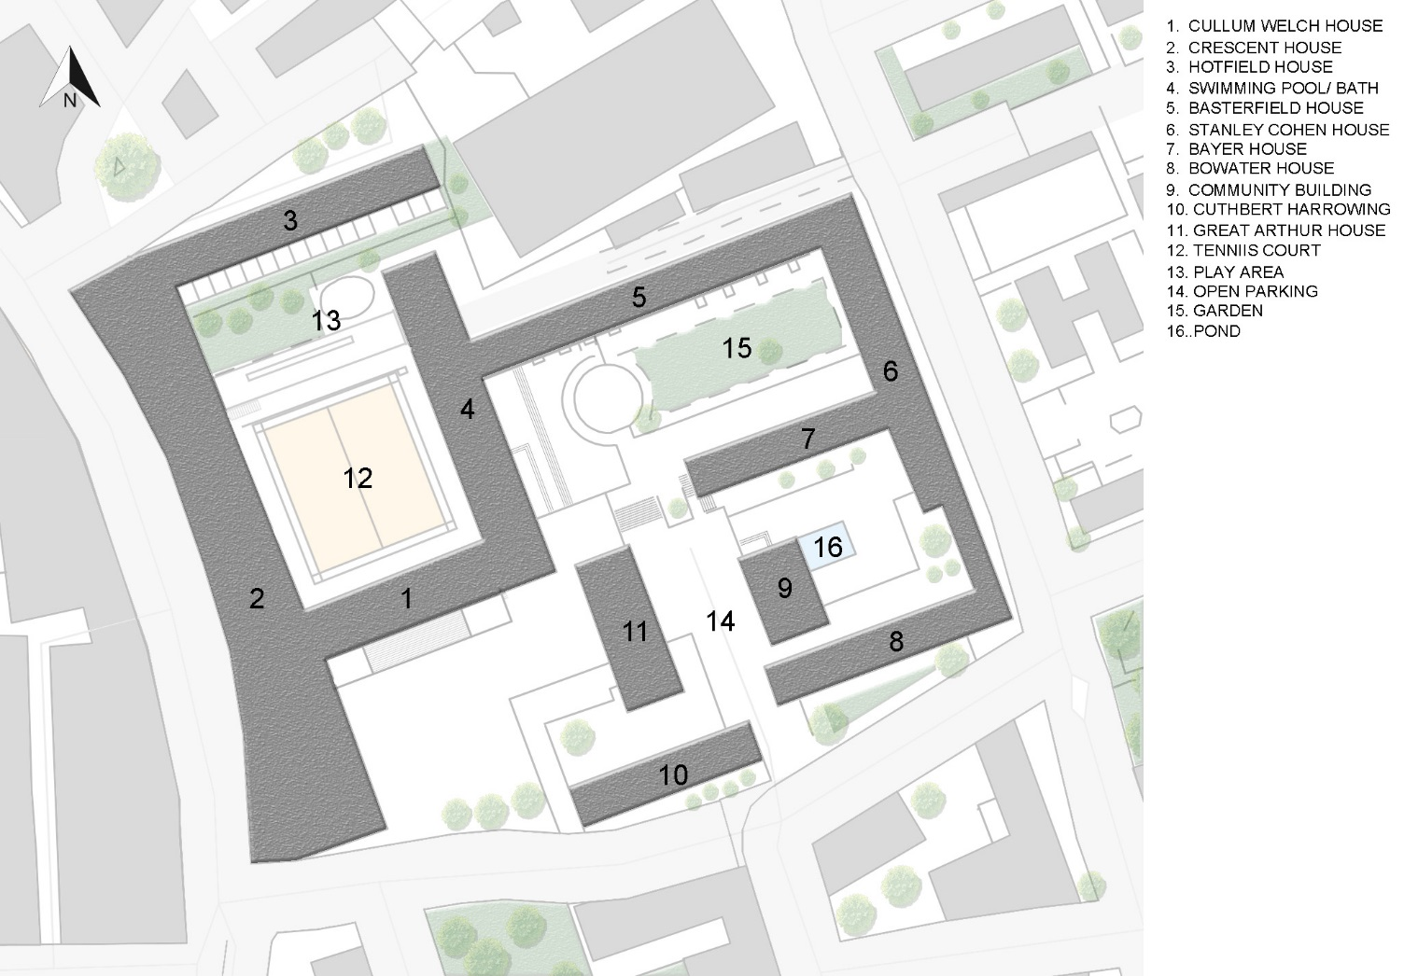
SITE PLAN
LEGENDS:

Slide 8
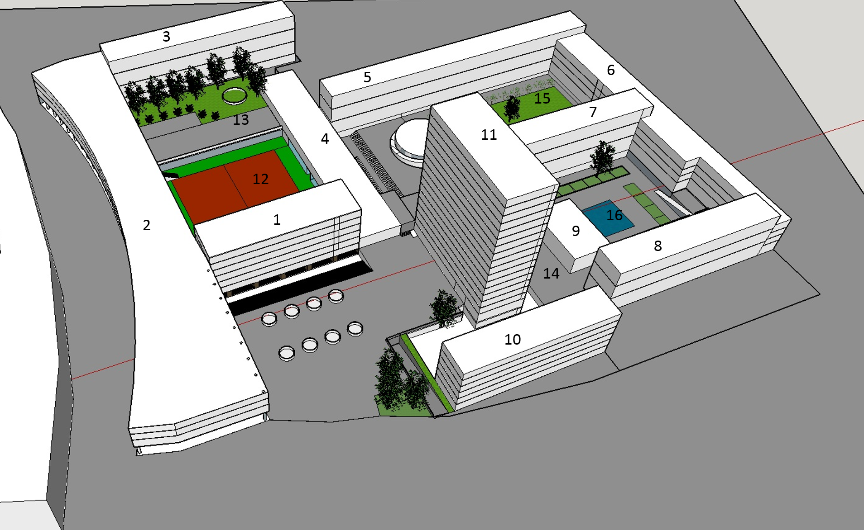
AERIAL VIEW
LEGEND
SITE CHARACTERISTICS
Total Area 28,000 sq. mtr
Total Residential building: 9
No. of Dwellings: 580
Total Population : Around 1500
Maisonettes building : 5
Flat system buildings : 4
MATERIALS:
71%
17%
11%
17%
1%
Concrete:19,880
Sq. Mtr
Grass: 4,760
Sq. Mtr
Asphalt: 3,080
Sq. Mtr
Water: 208
Sq. Mtr
Notes:
Thermal conductivity , emmissibility :
Brick: 0.6-1,0.75, Concrete Stone: 1.7,0.63, asphalt:0.7,0.93, water:0.5,

Slide 9
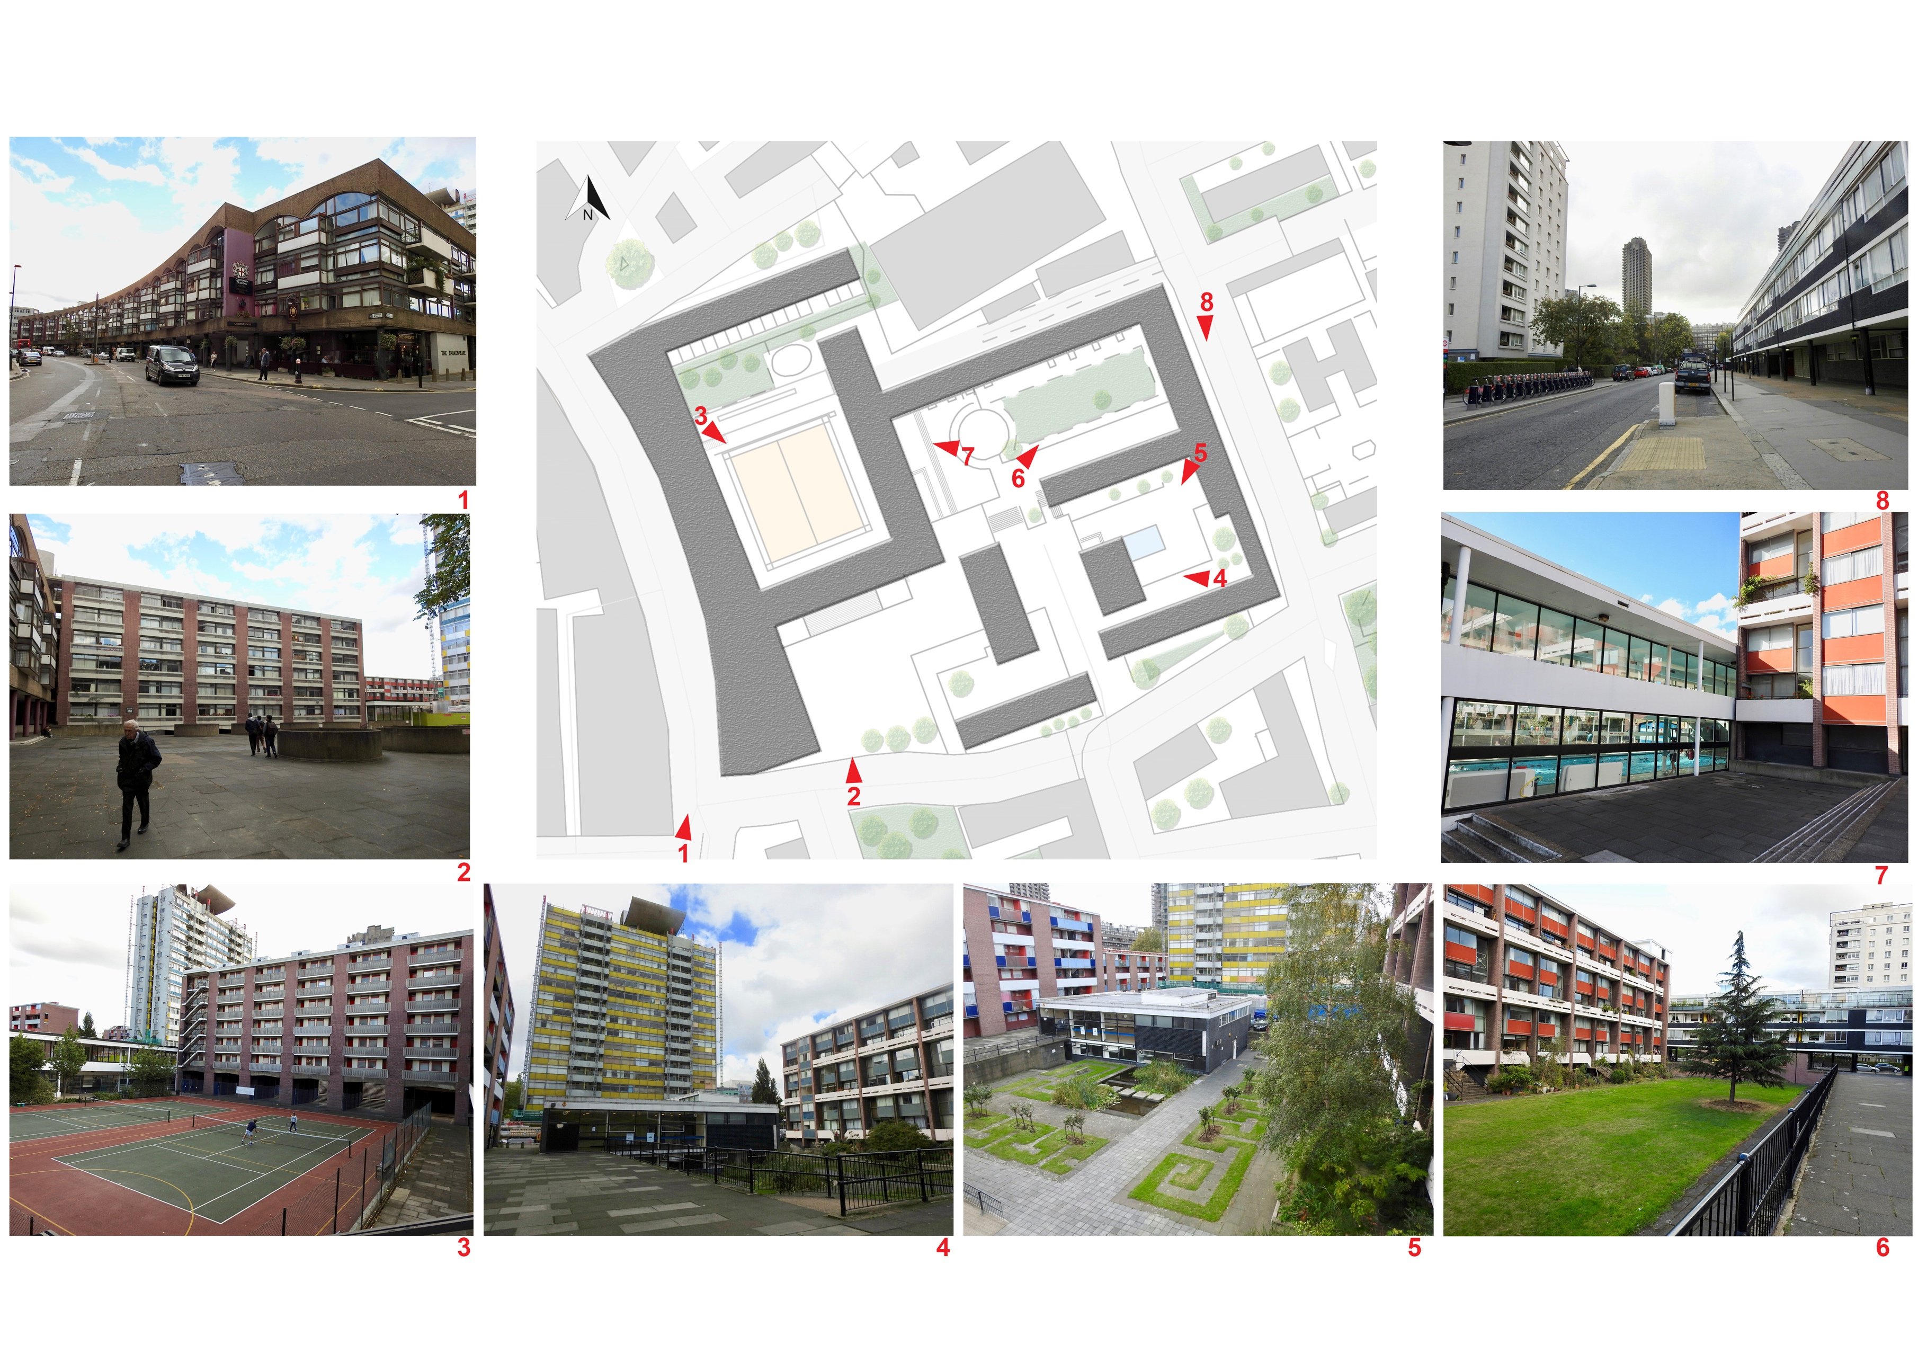
SITE PHOTOS
Notes:
Thermal conductivity , emmissibility :
Brick: 0.6-1,0.75, Concrete Stone: 1.7,0.63, asphalt:0.7,0.93, water:0.5,

Slide 10
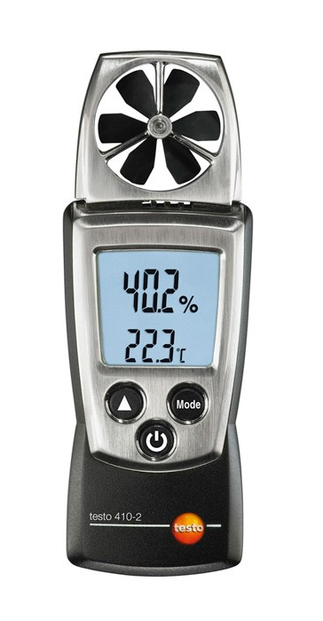
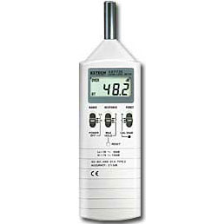
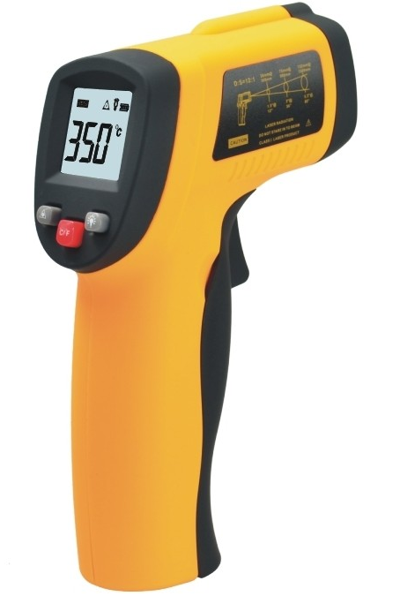
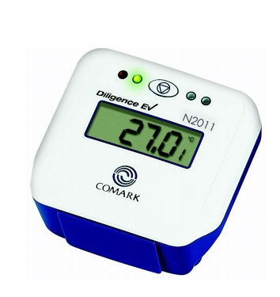
TOOLS USED FOR MEASUREMENTS
Lux Meter
Anemometer
Decibel Meter
Infrared Thermometer
Data Logger
Data Logger

Slide 11
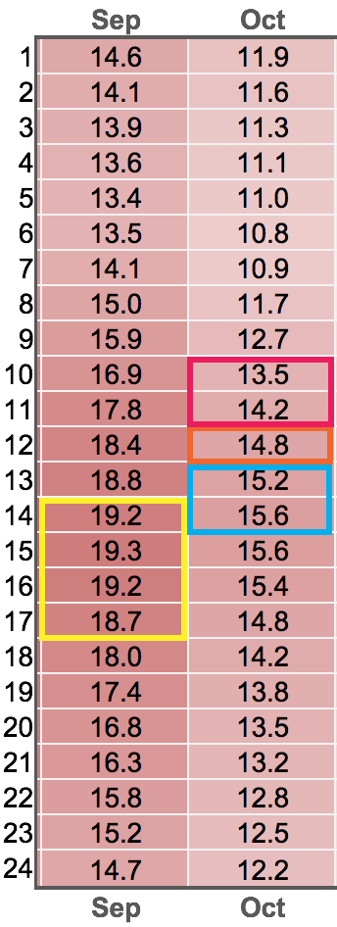
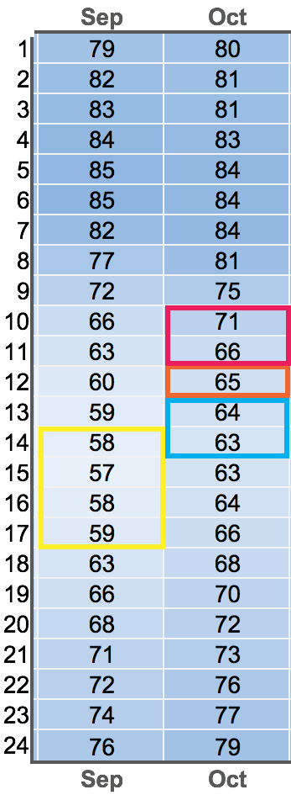
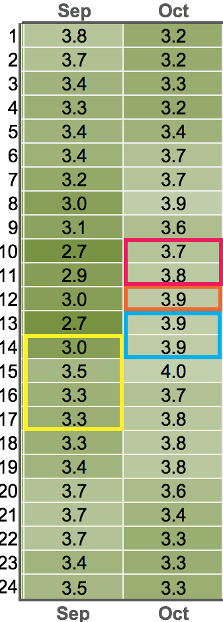
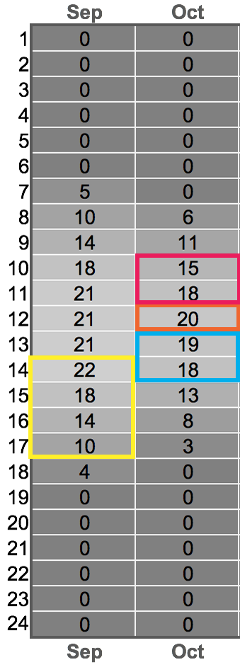
WEATHER DATA
METEONORM DATA
Daily Average Dry
Bulb Temperature (℃)
Daily Average Relative
Humidity (%)
Daily Average Air
Velocity (m/s)
Daily Average Diffuse
Illuminance (klux)
 | 30thSept. | 5th Oct. | 6th Oct. | 14th Oct.
Temperature (Avg) | 14.1 | 13.4 | 11.4 | 11.3
RH (Avg) | 77.39 | 62.7 | 62.7 | 75.8
Air velocity (Avg) | 3.63 | 6.16 | 4.51 | 3.28
WEATHER STATION DATA
AVERAGE ON SITE WEATHER DATA
Average of data collected at site on various dates

Slide 12
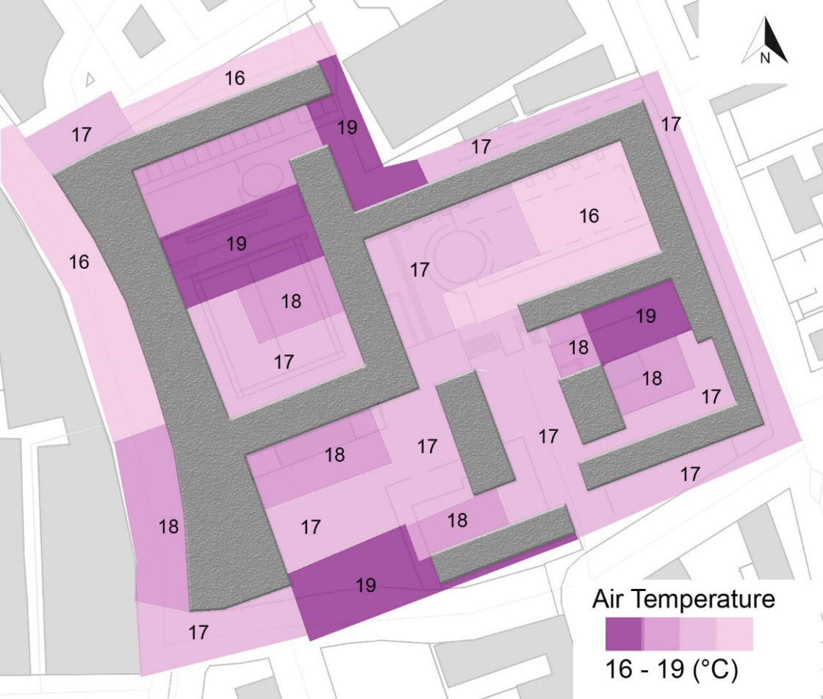
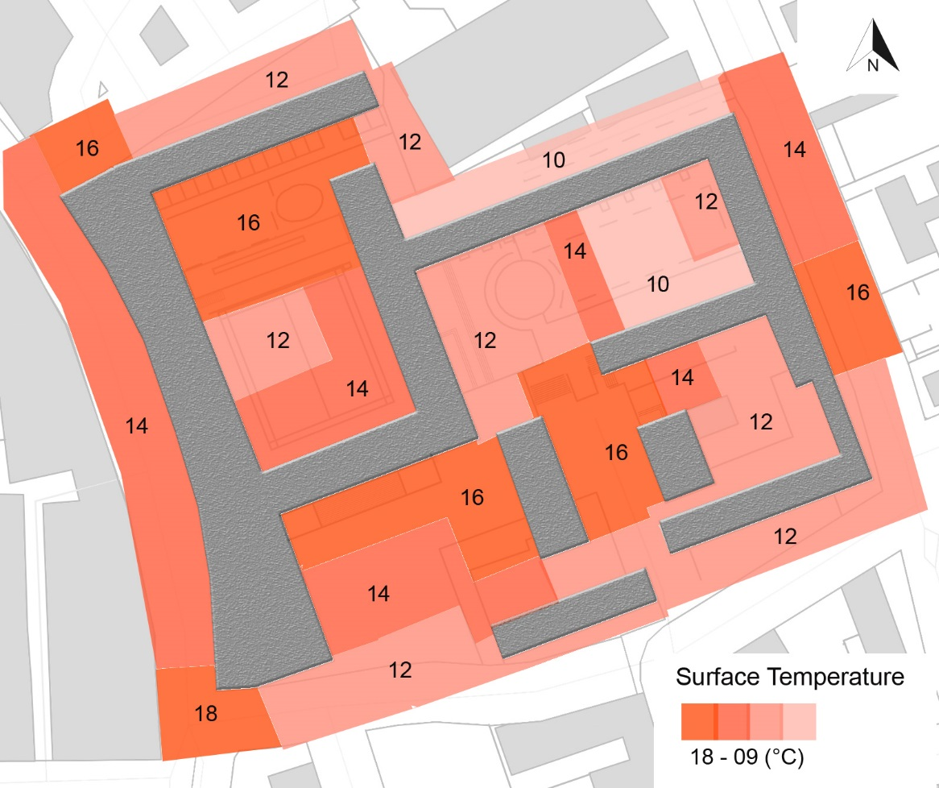
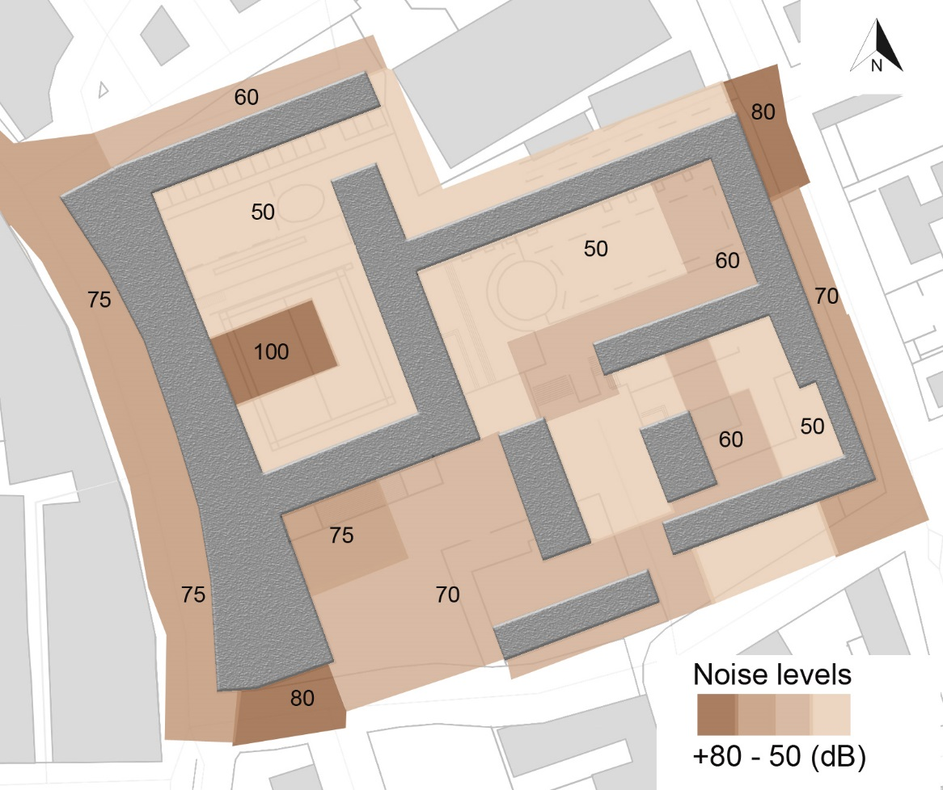
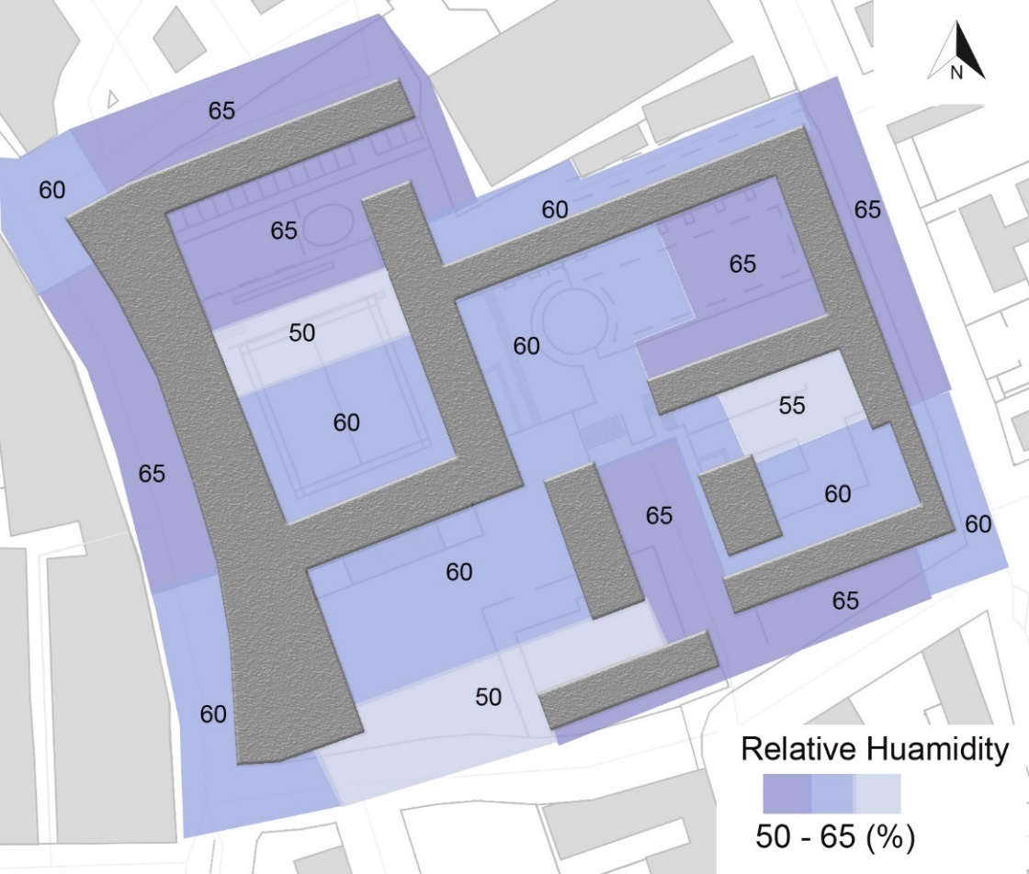
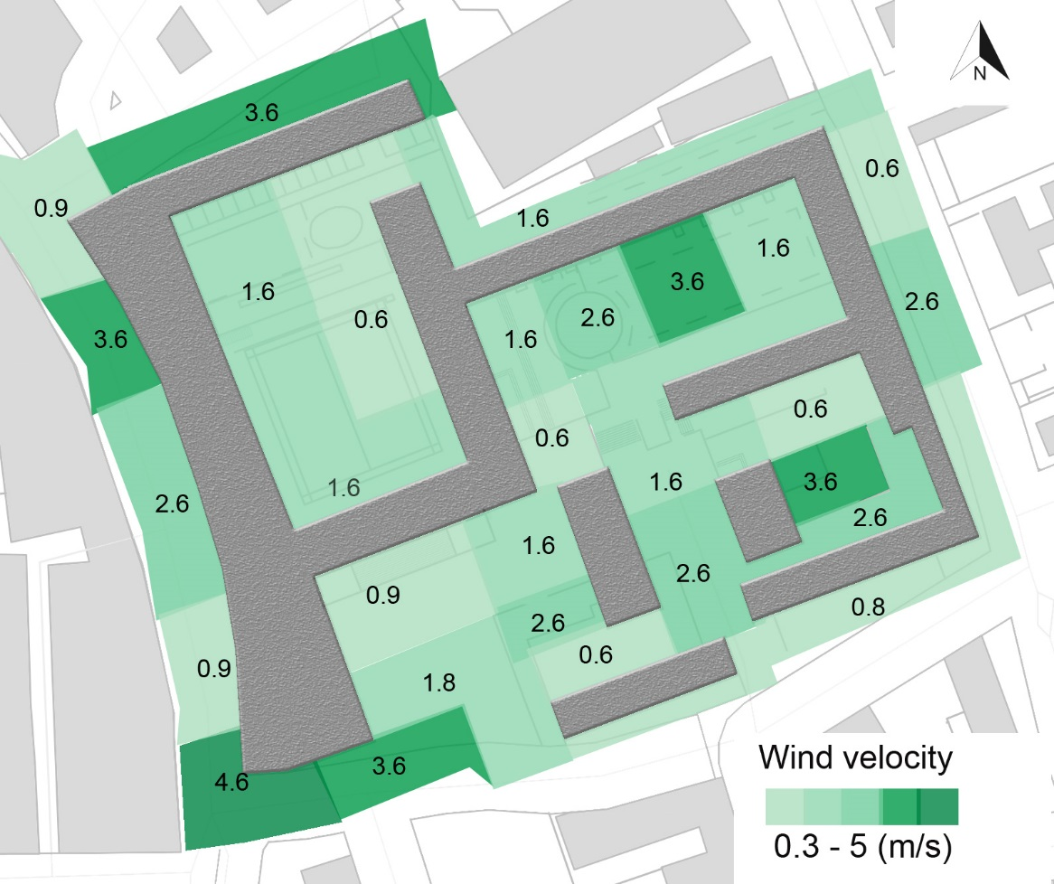
ON-SITE MEASUREMENTS
(20.10.16 11:30-13:00)
(T:13ºC, RH:72%, W:N 3.33 m/s)
09-18
50-80+

Slide 13
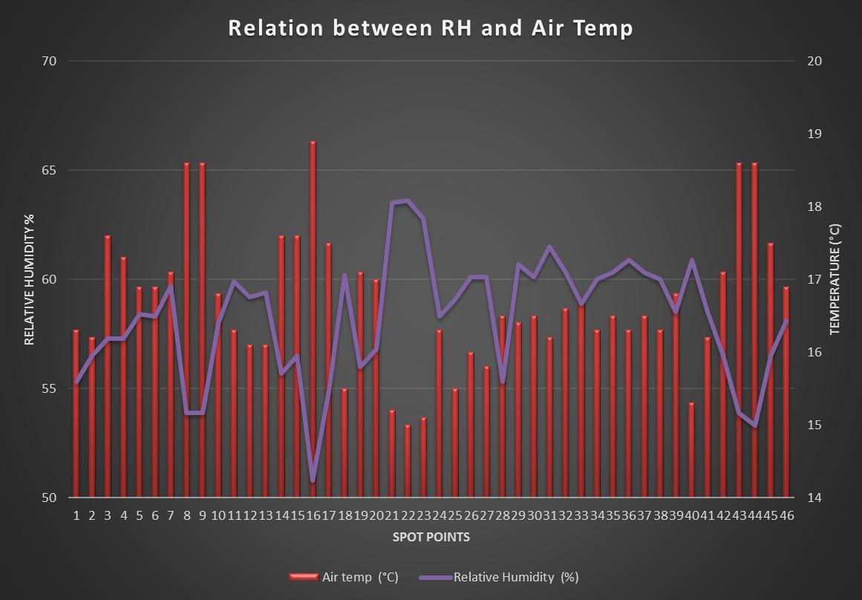
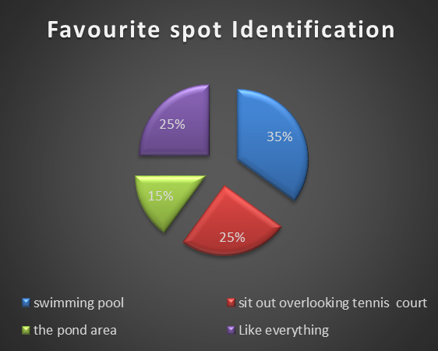
USER EXPERIENCE DATA
Notes:
Wind should be kept in section’s slide

Slide 14
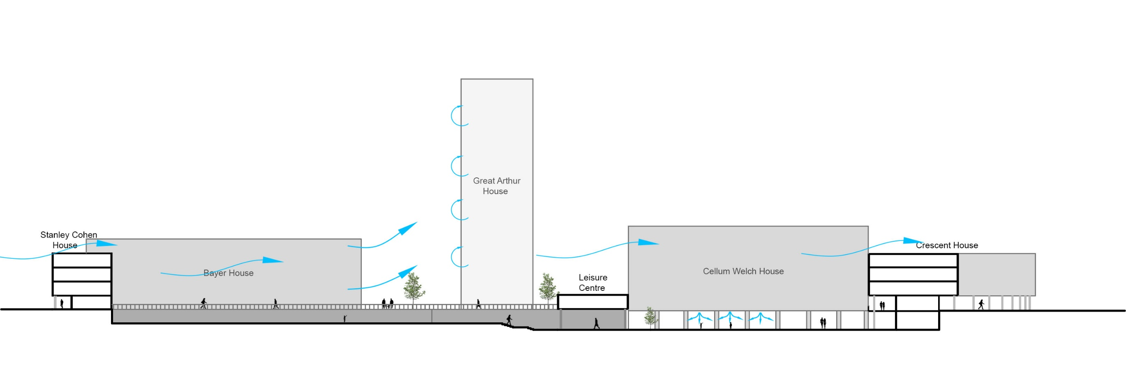
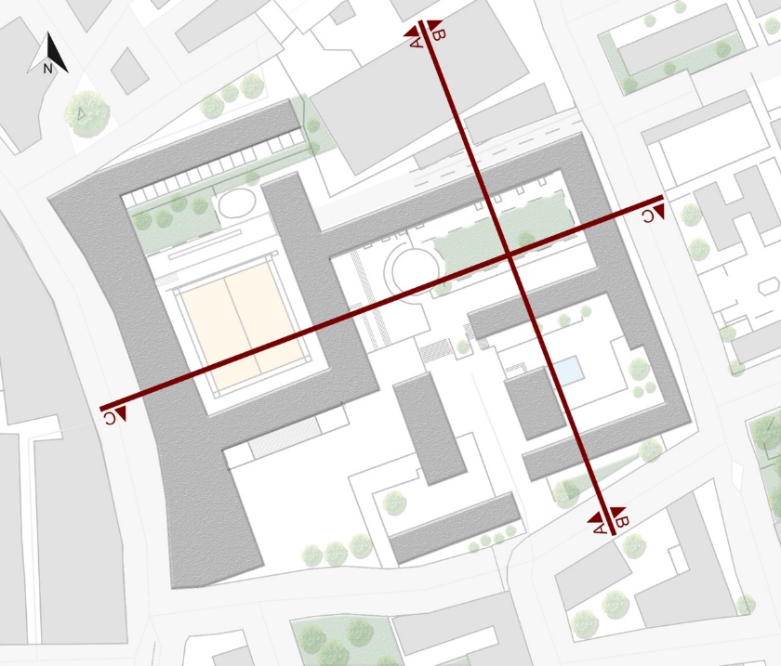
WIND PATTERN ANALYSIS
A-A SECTION
0
5
10
25
C-C SECTION
0
5
10
25
B-B SECTION
0
5
10
25

Slide 15
CFD ANLAYSIS FOR WIND
At 15 mtr. from ground
At 5 mtr. from ground

Slide 16
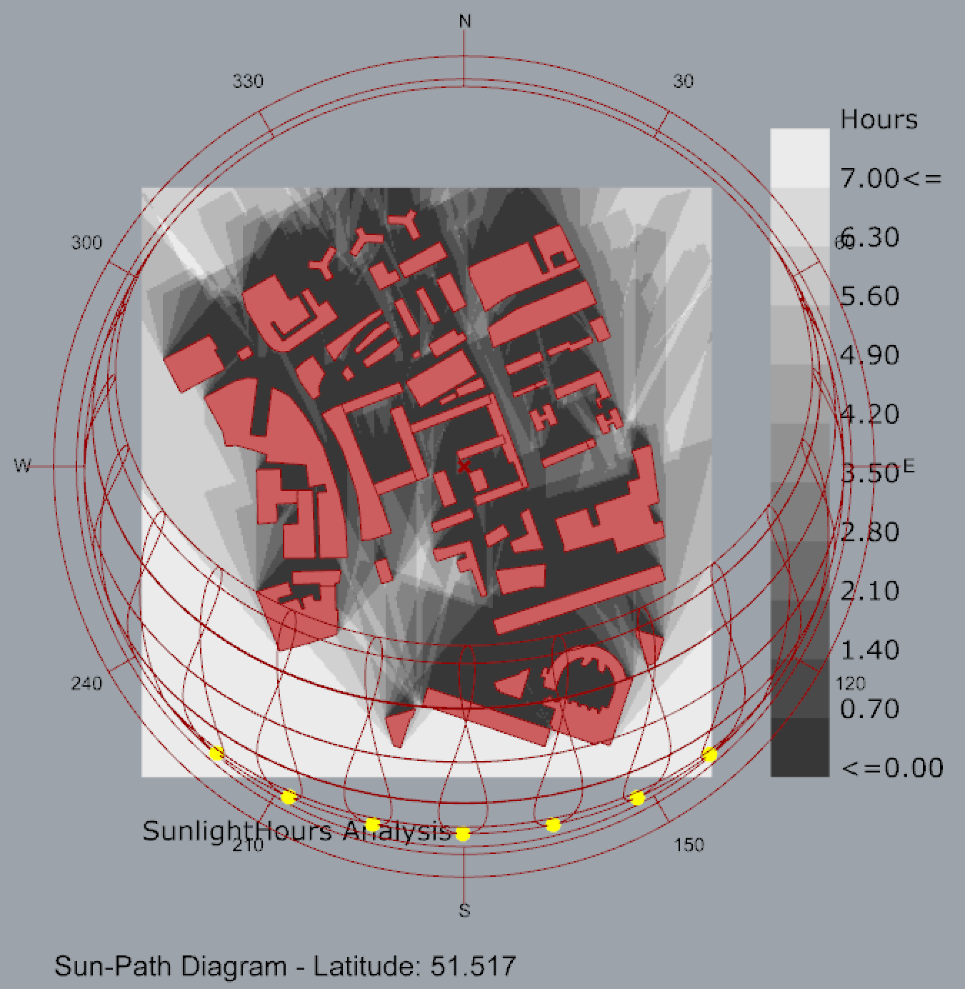
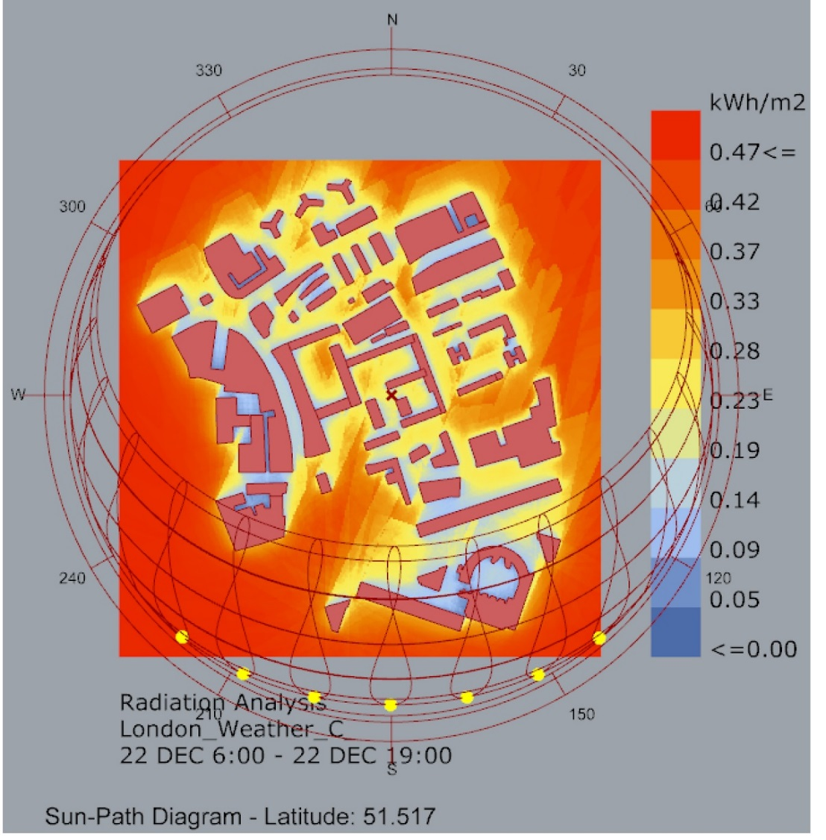
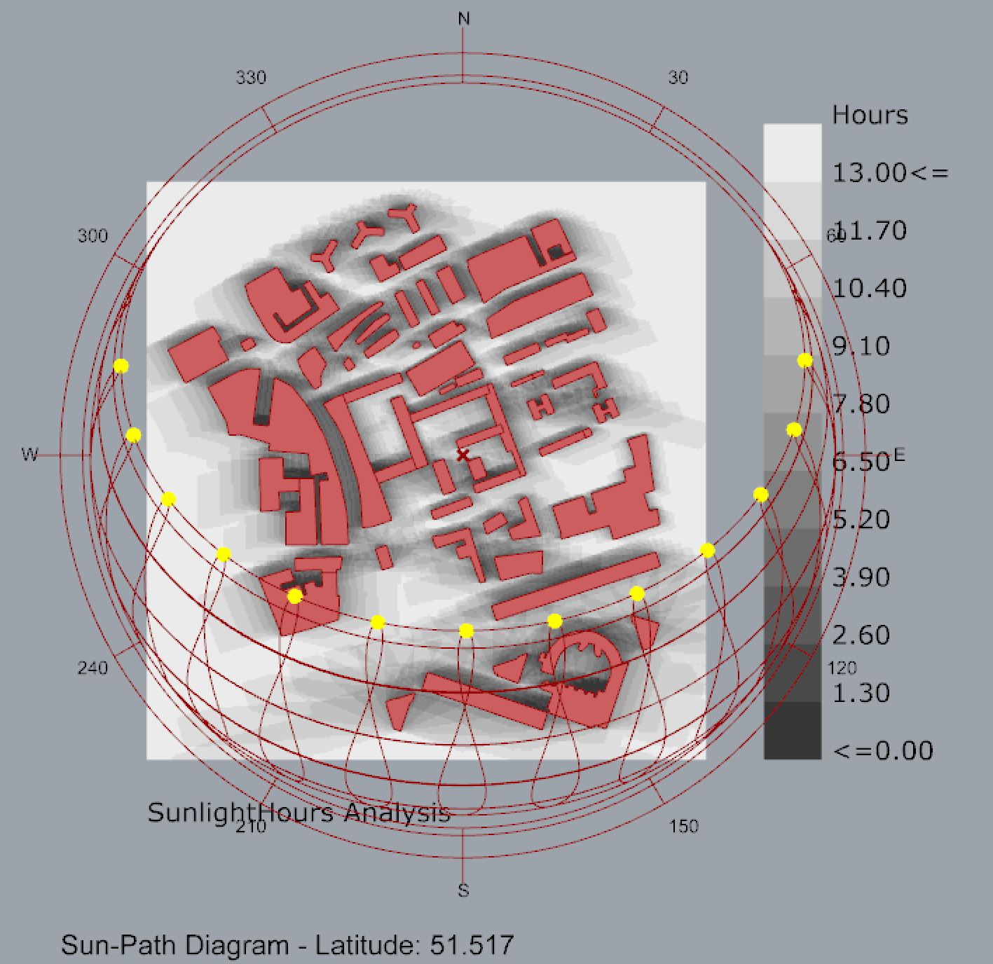
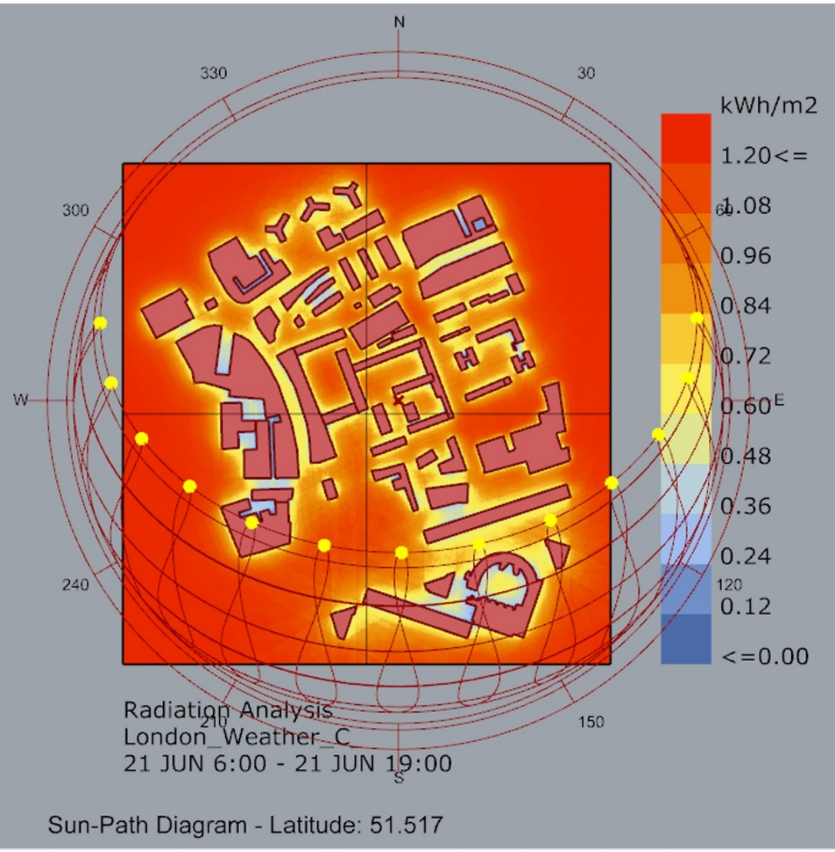
SUN SHADE – RADIATION ANLAYSIS
22 DECEMBER (SHORTEST DAY)
21 JUNE (LONGEST DAY)

Slide 17
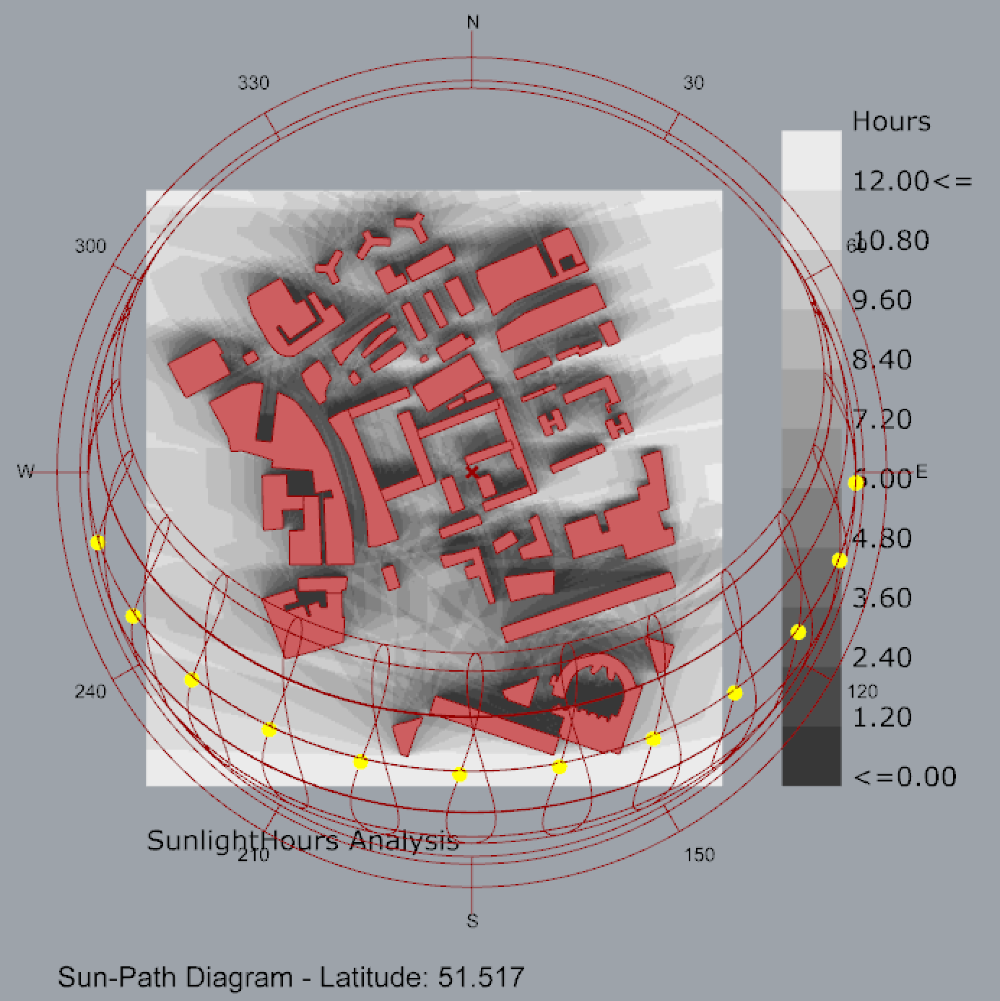
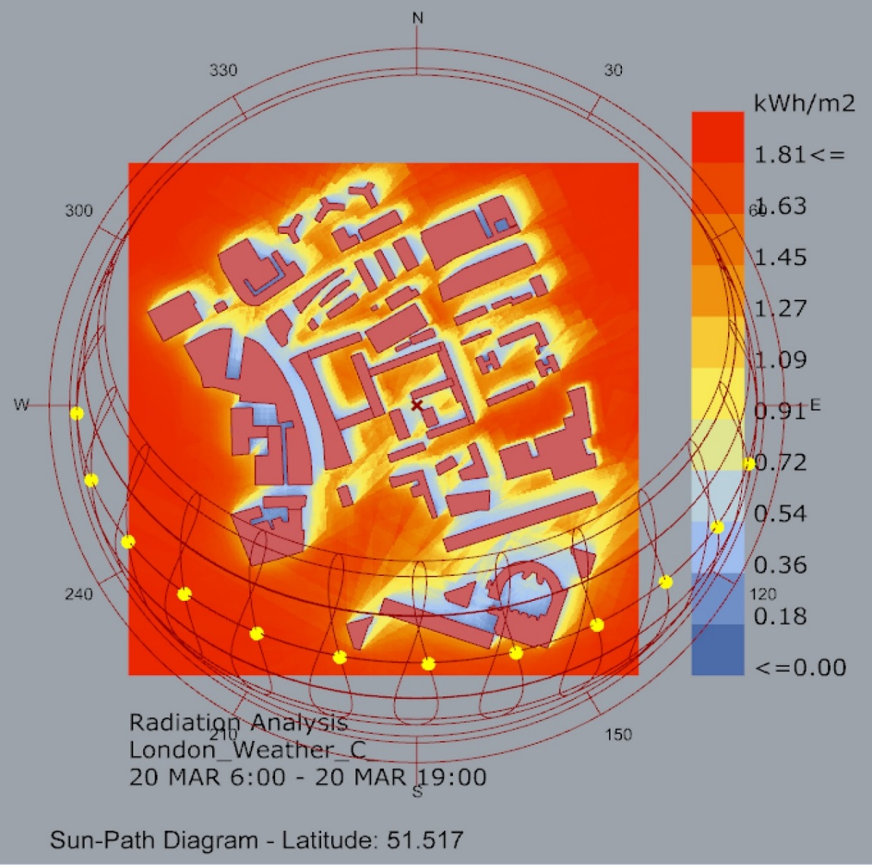
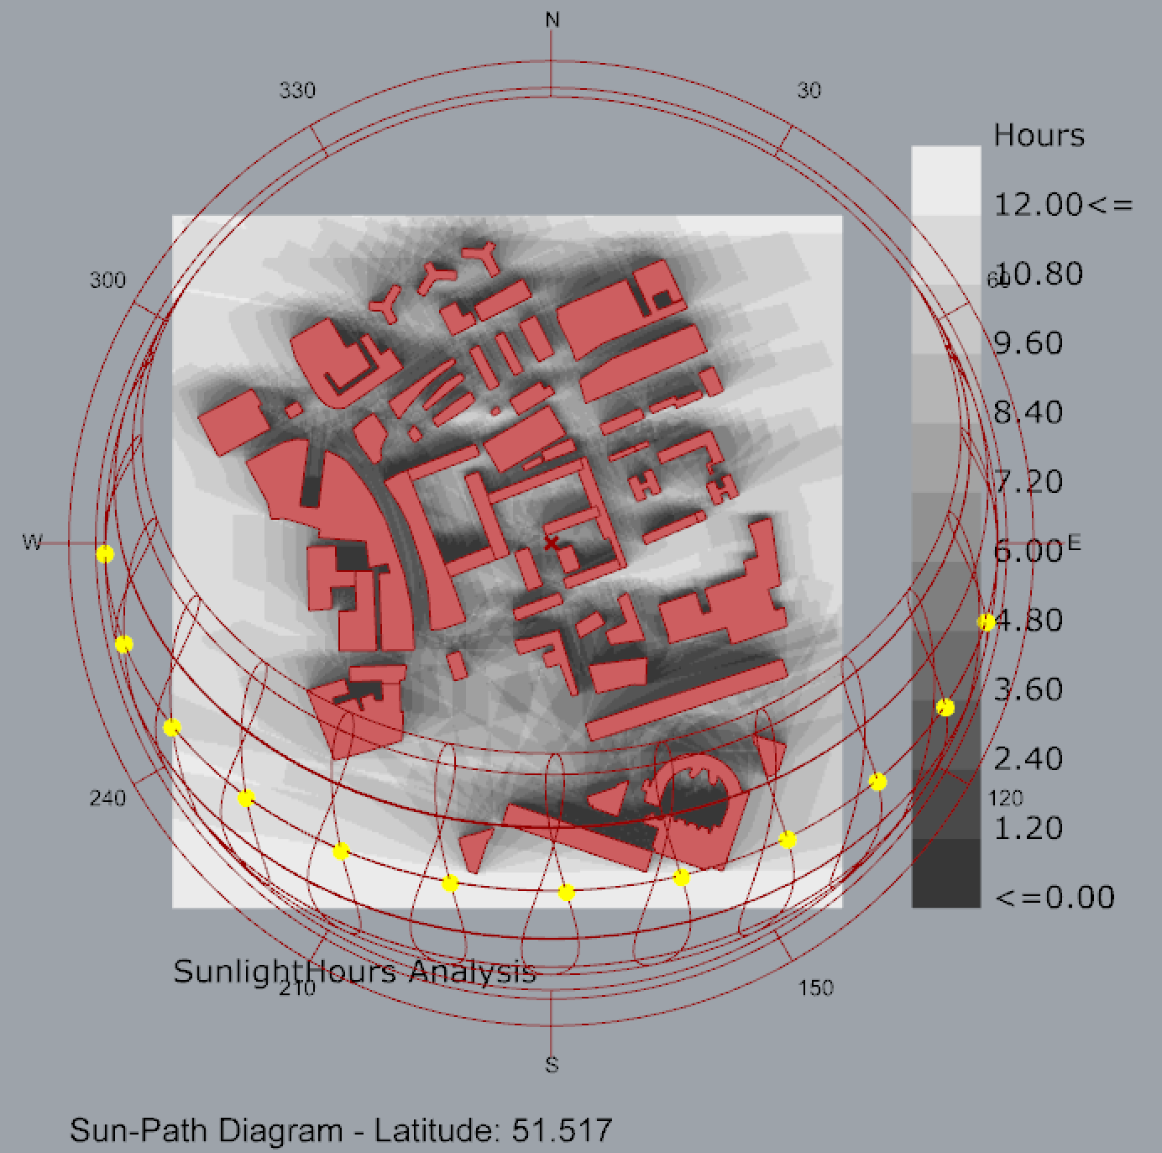
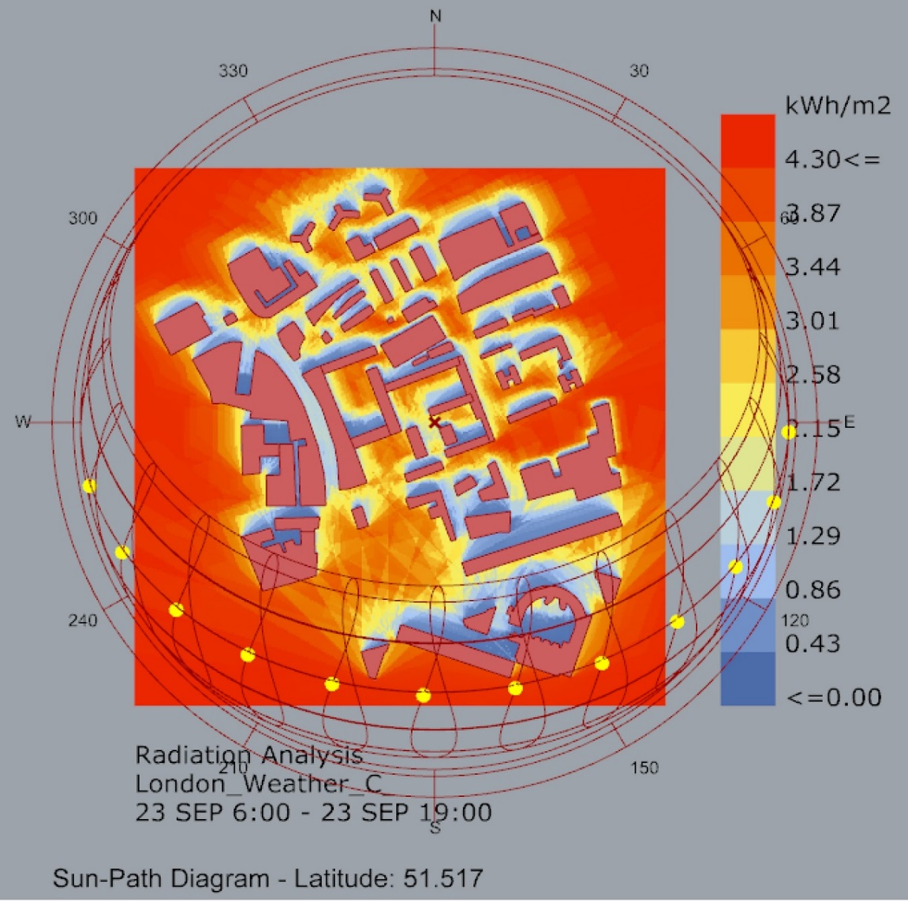
SUN SHADE – RADIATION ANLAYSIS
20 MARCH (EQUINOX)
23 SEPTEMBER (EQUINOX)

Slide 18
BAYER HOUSR FLAT NO. 4
SE
South East View
North West View
1
2
1
2

Slide 19
BAYER HOUSE FLAT NO. 4
Planning characteristics
Large glass opening on south east side
Brick wall on North side and between units
Service spaces on North side
Almost in original state
Single glazed windows

Slide 20
BAYER HOUSE
Observation
Placement of the radiators near the sliding door.
The sliding door usage as the primary ventilation strategy.
Concentrating of radiator only along one side.
Continuous use of radiator
Problem with high electric bills and over heated water in taps.
Single glazed windows.

Slide 21
BAYER HOUSE MEASUREMENTS
WEATHER CONDITIONS (10 am-12 noon)
Avg. Temp. : 12° C
Avg. Humidity : 70%

Slide 22
SOLAR RADIATION AND SHADOW ANALYSIS
22 DECEMBER (SHORTEST DAY)
21 JUNE (LONGEST DAY)
20 MARCH (EQUINOX)

Slide 23
BAYER HOUSE- DAYLIGHTING AND SOLAR GAIN
Single glazed wall
15°
Solar Radiation
sun path on Dec 23rd
Aluminium panel
Spandrel panels acting as reflectors also as trombe wall
Minimal sun infiltration in
summer to full sun infiltration in winter
Overhang projection factor of 0.29
Sun Penetration

Slide 24
BAYER HOUSE-DAYLIGHT ANALYSIS
BALCONY
BEDROOM 2
LIVING ROOM
KITCHEN
WASH-
ROOM
BEDROOM 1
BALCONY
0% DAYLIGHT FACTOR 10%
0% DAYLIGHT FACTOR 10%

Slide 25
BAYER HOUSE-VENTILATION AND WIND ANALYSIS
Grating on Floor

Slide 26
BAYER HOUSE-INFERENCE

Slide 27
BAYER HOUSE COMFORT ANALYSIS
Occupancy hours on weekdays
Bar chart showing the comfort levels in different Rooms for different parameters
Computation of Comfort index using adaptive method

Slide 28
STANLEY COHEN HOUSE FLAT NO.10
NE
South West View
North East View
2
1
1
2

Slide 29
STANLEY COHEN HOUSE FLAT NO.10
Planning characteristics
North east –south west orientation
Black painted external walls
Bedrooms along external street
Renovated flat with double glazing and wall insulation

Slide 30
STANLEY COHEN HOUSE
Observation
The exterior doors had seepage issues.
Kitchen and toilet fitted with mechanical extract
The radiators are rarely operated unless very cold
The living room is used primarily in the evening and morning hours only.
Sound issues on the side overlooking the road
Double glazed windows in the living area
Double Glazing Window

Slide 31
STANLEY COHEN HOUSE-SPOT MEASUREMENTS
WEATHER CONDITIONS (2 pm-3 pm)
Avg. Temp. : 14° C
Avg. Humidity : 63%

Slide 32
SOLAR RADIATION AND SHADOW ANALYSIS
22 DECEMBER (SHORTEST DAY)
21 JUNE (LONGEST DAY)
20 MARCH (EQUINOX)

Slide 33
STANLEY COHEN HOUSE-SOLAR GAIN AND WIND ANALYSIS
Heat
Transfer
Indirect Solar Radiation
CROSS SECTIONAL WALL

Slide 34
STANLEY COHEN HOUSE- DAYLIGHT ANALYSIS
0% DAYLIGHT FACTOR 10%

Slide 35
STANLEY COHEN HOUSE-COMFORT ANALYSIS
Occupancy hours on weekdays
Computation of Comfort index using adaptive method
Bar chart showing the comfort levels in different Rooms for different parameters

Slide 36
Q AND A

Slide 37
THANK YOU !

