Slide 1
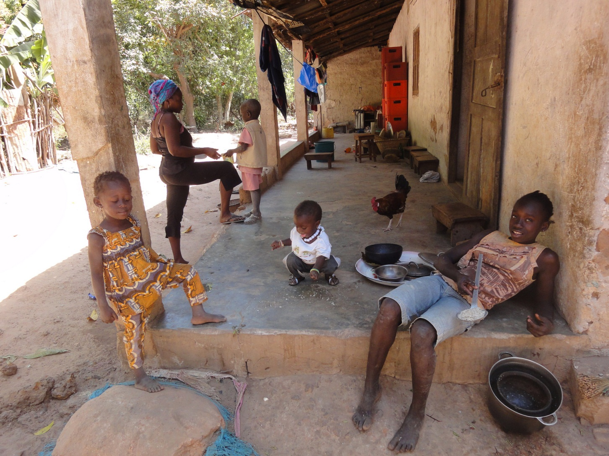
LNIE II
Aula 7 – Gubeeher TAM 29.10.2020
Alexander Yao Cobbinah
DL/USP

Slide 2
Valency | Object is noun phrase |  |  |  | Object is affix
Monovalent constructions | Alex Alex | a-ceem-i 3-sleep-perf
 | ‘Alex sleeps/slept’
Bivalent construction | Alex Alex | a-wuul-i 3-see-perf |  | Asaña Asaña | a-wuul-em 3-see-3sg.obj.perf_{anim}
 | ‘Alex saw Asaña.’ |  |  |  | ‘He saw her.’
 | Alex Alex | a-wuul-i 3-see-perf |  | koloŋ well | a-wuul-i [ø] 3-see-perf [ø]
 | ‘Alex saw the well.’ |  |  |  | ‘He saw [it].’
Trivalent constructions | i-nëër-o 1-give-2sg.obj | dërëm-ëŋ money-pl | inëër-em-em 1-give-3sg.obj-3sg.obj
 | ‘I give you money.’ |  | ‘I gave her to her.’

Slide 3
O sistema pronominal
Persona | Free pronoun | Subject prefix | Subject suffix | Object affix
1sg | me | i- | -i | -Vm
2sg | fi | u- | -o | -o
3sg | u-mër | a- | -Vŋ | -Vm
1pl.incl | mino | in- -o | -e | -mino
1pl.excl | min | i- -min | -min | -min
2pl | iŋkaan | u- -Vŋ | -oŋ | -Vːnuŋ
3pl | i-mër | an- | -VŋVŋ | -eeneŋ
Affirmarivo
i- ceem
u-ceem
a-ceem
in- ceem- o
i-ceem-min
u-ceem-eŋ
an-ceem
Perf. Neg
ceem-ir-i
ceem-ur-o
ceem-er-eŋ
ceem-r-e
ceem-ir-i-min
ceem-ur-oŋ
ceem-e-reŋeŋ

Slide 4
TAM - Gubëeher
perfectivo
subjunctivo/narrativo
-i
zero
verbo dinámico
i -dëëk -i
1Sg - ir -Perf
'fui'
i - dëëk
1Sg - ir
'eu vá/vou'
verbo estativo
a - ceen -i
3Sg - vermelho -Perf
'e̒ vermelho'
a - ceen
3Sg - vermelho
‚e̒ vermelho/seja vermelho'

Slide 5
Compare: Kriolu Guineense
perfectivo
imperfectivo
zero
na
i bai
3Sg ir
‚ele/a foi'
i na bai
3Sg Pres ir
‚ele/a vai/irá'
verbo dinámico
verbo estativo
i burmeju
3Sg vermelho
‚ele/a e̒ vermelho'
i na burmeju
3Sg Pres vermelho
‚ele/a será vermelho/
deve ser vermelho'

Slide 6
outras línguas
Bambara
n y‘ a dɔn
1Sg Perf 3Sg conhecer
'Eu o/a conheço‚ (* eu o/a conheci)
BP
gostei, adorei, curti

Slide 7
Perfectivo -i
Past -ot
i -ñoŋ - i
1Sg-pegar – Perf
'Peguei'
i -ñoŋ - ot
1Sg-pegar - Past
'eu pegara'
ñoŋ - ir - i
pegar - Perf:Neg - 1Sg
'não peguei'
ñoŋ - ir - i -ot
pegar - Perf:Neg - 1Sg Past
'eu não pegara'
ñoŋ - ur - o
pegar - Perf:Neg - 2Sg
‚Você não pegou'
ñoŋ - ur - o -ot
pegar - Perf:Neg - 2Sg -Past
‚Você não pegara'

Slide 8
a -ceen - i
3Sg-vermelho – Perf
'elx e̒ vermelhx'
a -ceen - ot
3Sg-vermelho – Past
'elx foi vermelhx'
a -dox - ot
3Sg -curto - Past
'elx foi̒ curtx'
a -dox - i
3Sg -curto - Perf
'elx e̒ curtx'
a - muutini - i
3Sg -escuro - Perf
'elx e̒ escuro'
a - muutin - ot
3Sg -escuro - Past
'elx foi escuro'

Slide 9
extensões verbais
Form | Functions | Gloss
-a(h) | passive | pass
-a(h) | reflexive/middle | refl
-ay | reciprocal, comitative | rec
-ëla | distributive | distr
-una | causative, applicative | caus
-liin | causative | caus
-ul | reversive, repetitive, | rev
-intiin | anticipatory | antcp
-um | applicative | appl
-ur | benefactive | ben
-ahiin | pluractional (repeated action on one or several objects) | der
-ot | venitive | ven

Slide 10
Stem | Gloss | Derived stem | Gloss
ñóóp | ‘hide (tr.)’ | ñoop-a | ‘hide (oneself)’
yiñ | ‘shave (tr.)’ | yiñ-a | a) ‘shave (oneself)’ b) ‘get shaved’
niig | ‘look at’ | niig-ay | ‘look at each other’
dëëk | ‘go’ | dëëk-ay | ‘go together’
dëëk | ‘go’ | dëëk-ëla | ‘stroll around’
ñooc | ‘wash’ | ñooc-ëla | ‘wash listlessly’
fur | ‘leave’ | fur-um | ‘go out from’
yaax | ‘eat’ | yaax-um | a) ‘eat with (instrument)’ b) ‘eat with (side dish)’
fóób | ‘cover (blanket)’ | fóób-ul | ‘uncover’
rax-un | ‘lock’ | rax-ul | ‘unlock’
lód | ‘build’ | lód-ur | ‘build for’
tib | ‘search’ | tib-ur | ‘search for’
ceŋ | ‘get up’ | ceŋ-intiin | ‘get up early’
toox-ul | ‘cut’ | toox-ël-ahiin | ‘cut into pieces’
babb | ‘be same’ | babb-ël-ahiin | ‘mix together’
xuc | ‘descend’ | xuc-ot | ‘descend towards speaker’
nen | ‘fall’ | nen-et | ‘fall down (if speaker is down)’

Slide 11
Voz passiva
a-naax-em gu-tuma
3-tell-1sg.obj.perf cl.gu-story
‘S/he told me a story.’
LM, valency questionnaire
gu-tuma a-naax-a
cl.gu-story 3-tell-pass
‘The/a story has been told.’
LM, valency questionnaire
muŋkoonam a-laac-a
inside 3-shout-pass
‘There is shouting going on inside. [lit.: Inside it is shouted.]’
LM, valency questionnaire

Slide 12
gu-bol a-ñooc-a
cl.gu-bowl 3-wash-pass
‘The bowl has been washed’
LM, DJI280212AC8
gu-bol ñooc-ër-a
cl.gu-bowl wash-neg-pass
‘The bowl has not been washed’
LM, DJI280212AC8
passivo não combina com perfectivo
negação: Neg + Pass
a-ñooc-a-i
3-wash-refl-perf
‘S/he has washed[his/her body].’
*‘S/he was washed.’
LM, DJI280212AC8
ñooc-a-r-aŋ
wash-refl-neg-3sg.subj
‘S/he has not washed his/her body
*‘S/he has not been washed.’
LM, DJI280212AC8
Reflexivo combina com perfectivo
negação: Refl + Neg

