Slide 1
Topics in Phonetics
John Corbett: USP-CAPES International Fellow
Session 1: Introduction & Review

Slide 2
Today’s session
What do you already know?
Course aims & structure.
The International Phonetic Alphabet and the standard lexical set

Slide 3
General course aims
A disciplina propicia uma continuidade aos estudos do sistema sonoro do inglês, abordando aspectos relativos ao acento, ritmo e entoação. Com base em constante exposição do aluno a materiais variados aliados a exercícios práticos, o curso busca ajudá-lo a perceber, identificar, distinguir e analisar padrões acentuais e entoacionais do idioma, contribuindo para o aprimoramento da sua pronúncia na língua inglesa. Esse conhecimento o habilita a desenvolver atividades orais relevantes em sua práticas docente, tendo em vista sua reflexão e prática dos conteúdos desenvolvidos no curso.

Slide 4
Course structure
Introduction: Review of IPA & lexical sets
Review: Transcribing connected speech
Accents of English 1: Reference accents (Gen Am and RP)
Revisiting English as a lingua franca
Accents of English 2: Two American accents
Accents of English 3: Two British Accents
Accents of English 4: Accents of World English
Accents of English 5: Brazilian English accents

Slide 5
Course structure
Acoustic phonetics: Using spectograms
Rhythms of English: Poetic metre
Rhythms of English: Rhythm in speech
Discourse intonation 1
Discourse intonation 2
Course review

Slide 6
Assessment
Complete at least 5 of 10 weekly activities on moodle. (10% per activity)
Two drafts of a course essay:
First draft: 40%
Revised draft: 10%
The course essay will require you to do fieldwork, ie to record and analyse someone’s English pronunciation

Slide 7
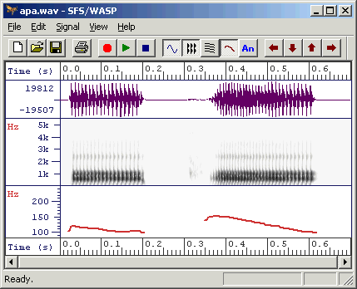
Resources on moodle
Course slides
Further reading
Assessed quizzes & essay titles
Links to useful web resources
e.g. WASP

Slide 8
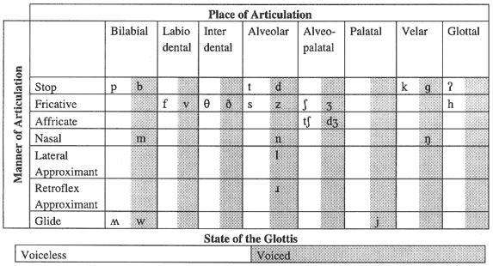
Plotting consonants: the IPA

Slide 9
Interesting consonants
/ʍ/ is used by speakers of those accents that make a difference in the pronunciation of ‘whales’ and ‘Wales’.
We sometimes hear /ʔ/ instead of /t/ in the middle and end of words like ‘butter’ or ‘slight’. This is the famous ‘glottal stop’.
In some (non-rhotic) accents, /r/ is not pronounced word-finally or before consonants. Where it is pronounced, it can be pronounced in many ways, eg
[r] (trill)
[ɾ] (tap or flap]
[ɹ] (approximant)
[R] retroflex approximant, ‘uvular r’

Slide 10
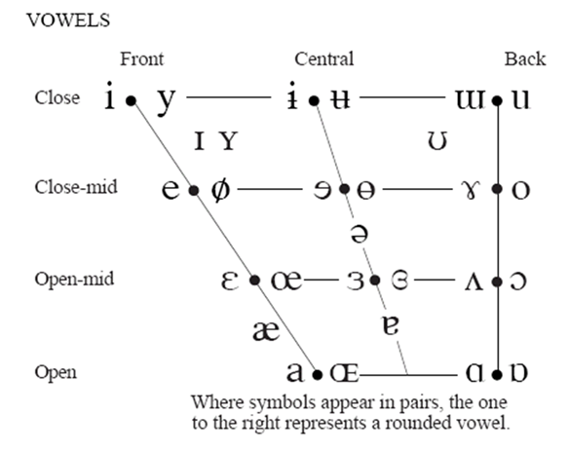
The Vowel Space

Slide 11
Standard lexical sets (Wells 1982)

Slide 12
Speech accent archive (George Mason University)
The elicitation paragraph:
Please call Stella. Ask her to bring these things with her from the store: Six spoons of fresh snow peas, five thick slabs of blue cheese, and maybe a snack for her brother Bob. We also need a small plastic snake and a big toy frog for the kids. She can scoop these things into three red bags, and we will go meet her Wednesday at the train station.
http://accent.gmu.edu/browse.php

Slide 13
Can you transcribe?
Please call Stella. Ask her to bring these things with her from the store: Six spoons of fresh snow peas, five thick slabs of blue cheese, and maybe a snack for her brother Bob.

Slide 14
One possible transcription (English RP)
Please call Stella. Ask her to bring these things with her from the store: Six spoons of fresh snow peas, five thick slabs of blue cheese, and maybe a snack for her brother Bob.
/pli:z kɔ:l stɛlʌ ɑ:sk ə tə brɪŋ ði:z θɪŋz wɪð ə frəm nə stɔ: sɪks spu:nz əv frɛʃ snəʊ pi:z faɪv θɪk slæbz əv blu: ʧi:z ən meɪbi ə snæk fər ə brʌðə bɔ:b/

Slide 15
Fieldwork tools
The vowels of the standard lexical set will help identify differences between accents.
We will use the Speech Accent Archive to illustrate some key difference between accents of English, using the standard lexical sets as points of reference, eg
The KIT vowel, or the SQUARE vowel is realised as… in this accent.
There is a merger of the BATH and PALM vowels in this accent.

Slide 16
First moodle activity
Identification of vowels in the standard lexical set in the SAA elicitation paragraph.
Can you identify possible TRAP and STRUT vowels?
Please call Stella. Ask her to bring these things with her from the store: Six spoons of fresh snow peas, five thick slabs of blue cheese, and maybe a snack for her brother Bob. We also need a small plastic snake and a big toy frog for the kids. She can scoop these things into three red bags, and we will go meet her Wednesday at the train station.

Slide 17
First moodle activity
Identification of vowels in the standard lexical set in the SAA elicitation paragraph.
Can you identify TRAP and STRUT vowels?
Please call Stella. Ask her to bring these things with her from the store: Six spoons of fresh snow peas, five thick slabs of blue cheese, and maybe a snack for her brother Bob. We also need a small plastic snake and a big toy frog for the kids. She can scoop these things into three red bags, and we will go meet her Wednesday at the train station.

Slide 18
Next week
Revisiting connected speech

