Slide 1
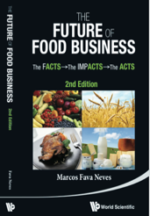
Go to Market Strategies
RAD2402 – Strategies in Agribusiness
Chapters 45, 46, 47,48 and 49
Aulas de 21/09, 28/09 e 05/10
Prof. Dr. Marcos Fava Neves
Faculdade de Administraçao (FEA/RP) – Universidade de São Paulo, desde 1995
Escola de Administração de Empresas (EAESP/FGV), desde 2018
Center for Agricultural Business - Purdue University (Indiana/USA), desde 2013
PAA – FAUBA – Universidade de Buenos Aires, desde 2006
Criador da Markestrat (www.markestrat.com.br) em 2004
Especialista em planejamento estratégico no agronegócio
www.doutoragro.com

Slide 2
Perguntas e Ferramentas (Respostas) desta Coleção
1 – Como desenhar a ida ao mercado (“go to market”) de uma empresa? Resposta: Plano de Canais
2 – Como entender os fluxos que existem entre a empresa e o consumidor final? Resposta: 4 tabelas de fluxos
3 – Como entender o futuro de canais de distribuição de produtos? - Resposta: 20 perguntas de canais
4 - Como analisar uma joint-venture? Resposta: Modelo de análise de JV’s
5 – Como analisar uma franquia? Resposta: Modelo de análise de franquias.
6 – Como analisar uma integração vertical? Resposta: Modelo de análise de integração vertical

Slide 3
The Focal Company Network
Flows of Products, Services and Marketing Communications
Flows of Market/Consumer Information, Financials and Product Requests
Impact of Macro-Environmental Variables (Uncontrollable)
Legal-Political, Econ/Natural, Social-Cultural and Technological
S
U
P
P
L
I
E
R
S
D
I
S
T
R
I
B
U
T
O
R
S
F
I
N
A
L
C
O
N
S
U
M
E
R
SUPPLIER
A
Other Networks
CHANNEL A
SUPPLIER
B
FOCAL
COMPANY
CHANNEL B
SUPPLIER
C
Competitors
CHANNEL C
Facilitator Companies: logistics operators, transportation companies, warehouses, banks, insurance companies, and certification companies.
Focal Company Supply Chain
Focal Company Marketing Channels
Notes:
Desenhar e entender a rede da empresa;
Analisar:
Rede Interna de Contratos:
O que pode ser feito por terceiros?
Rede Externa de Contratos:
Integração Vertical, Contratos, Mercado Spot
Identificação nos Fluxos dos Canais
Armazenagem, Serviços, Financiamento, Riscos e outros
Ações Coletivas
Com quem?
Ações Tipo 1, 2 e 3

Slide 4
Developing the Marketing Channels (Go to Market)

Slide 5
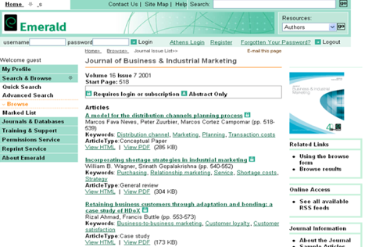
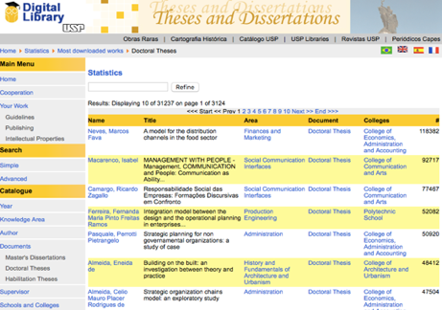
A Method for the Distribution Channels Planning Process (1999)
UNDERSTANDING
PHASE
OBJECTIVES/GOALS PHASE
IMPLEMENTATION PHASE
MONITORING AND REVISION
1 - DESCRIPTION OF THE CHAIN
6 - COMPANY’S OBJECTIVES
9 – CHANNEL SELECTION
11 – CHANNEL MANAGEMENT
2 - DESCRIPTION OF EXISTING CHANNELS
7 – CONSUMERS’ NEEDS/BUYING PROCESSES
10 – BUILDING CONTRACTS
3 – ENVIRONM. ANALYSIS
8 - GAP ANALYSIS AND ADJUSTMENTS
4 - ASSET SPECIFICITY ANALYSIS
5- EXISTING CONTRACTUAL ANALYSIS

Slide 6
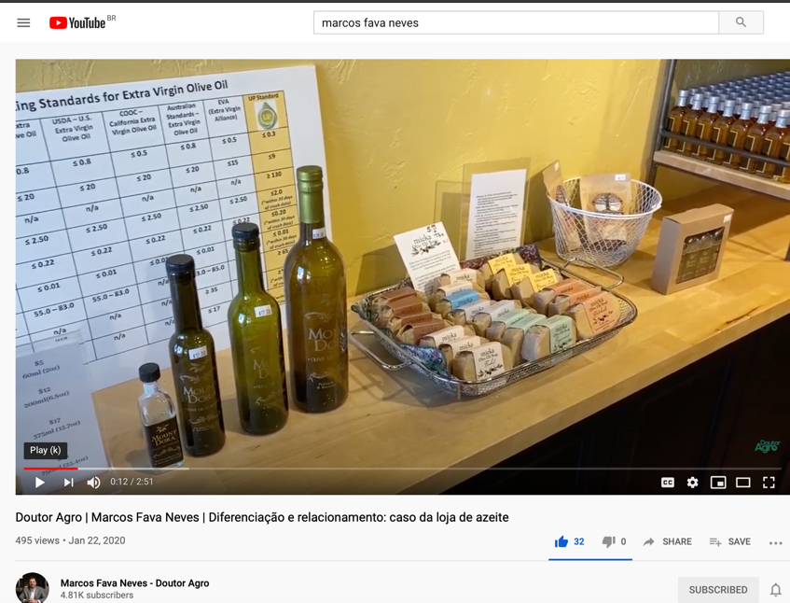

Slide 7
Let’s think about Nespresso!

Slide 8
Nestlé Nespresso Go to Market
Products + Services; Communications
Web Nestlé
Channels
Other Web
Consumer
Government Emb
Supermarket
Events
Convenience St.
(Own Sales Force)
Own Stores
Bakeries
Nestlé Nespresso
Nespresso Franchise
Other Franchise
Universities
Hotels
Wholesale
Distributor
Vending Machines
Restaurants
Boutiques
Coffee Shops
Others
Companies Office
Information; Money
Source: Marcos Fava Neves: The Future of Food Business, World Scientific, 2014

Slide 9
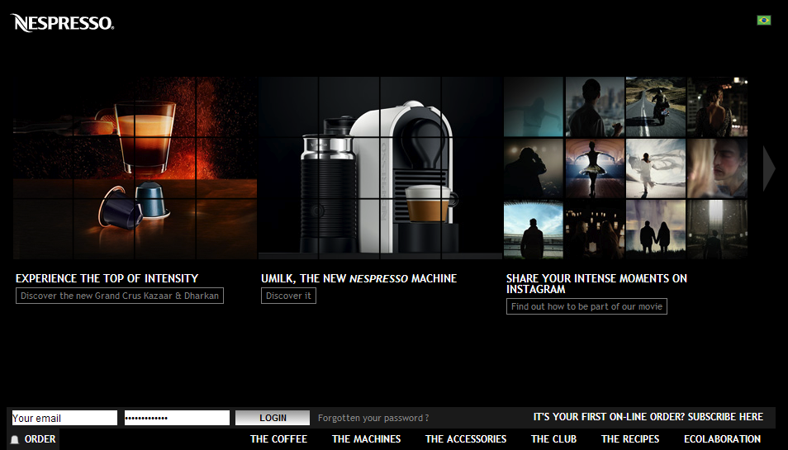
Nespresso Case Study

Slide 10
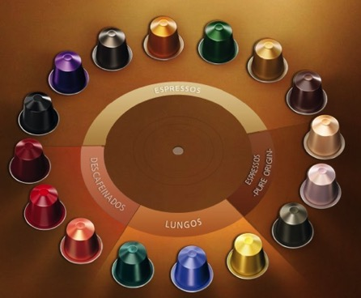
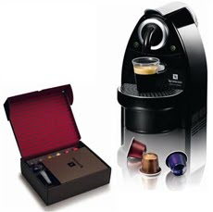
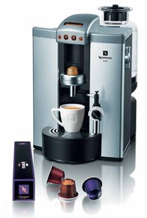
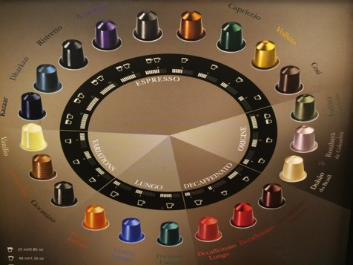

Slide 11
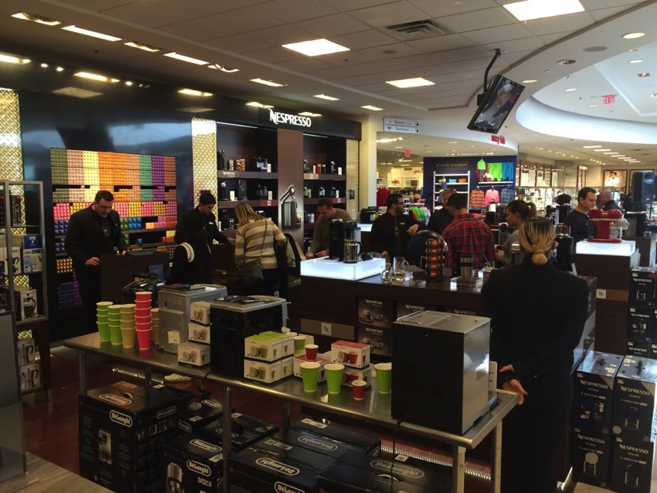

Slide 12
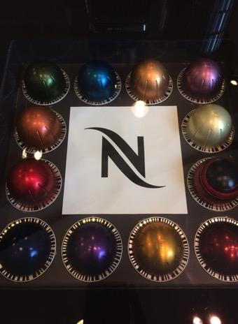

Slide 13
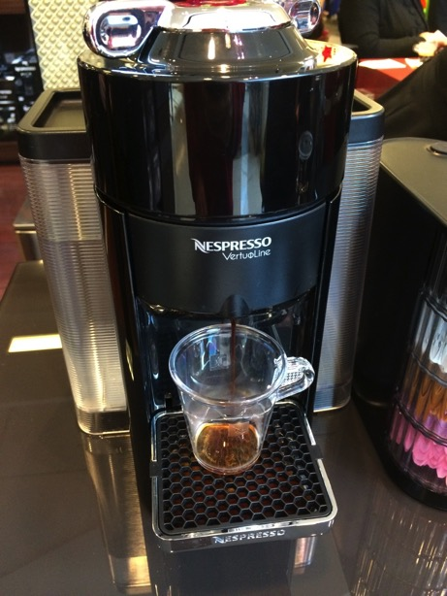
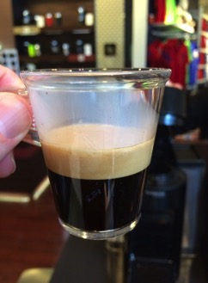

Slide 14
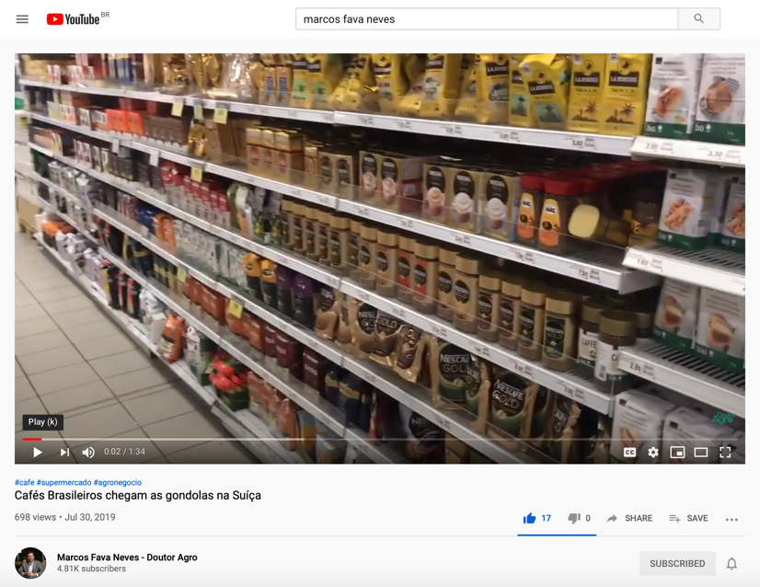

Slide 15
Describe the Go To Market (channels of Nespresso) and the existing flows...

Slide 16
Flow table (of the distribution channels)
Function | Responsibility Analysis (who does it and how) | Possible improvement (proposals)
Products and services functions
Inventory management and its levels
Product delivery
Product modification
Product lines and variety
New product evaluation
Sales volume (performance) forecast
User help/installation technical service
After sales service and Sales service supply (team)
Training: range and costs
Product maintenance
Package/specifications issues
Exclusivity and Territorial rights
Market coverage expected
Exports aspects expected
Time frame (period to carry out the flows)
Adaptation for specific legislations
Others
Source: Marcos Fava Neves: The Future of Food Business, World Scientific, 2014

Slide 17
Flow table (of the distribution channels)
Function | Responsibility Analysis (who does it and how) | Possible improvement (proposals)
Products and services functions
Exclusivity and Territorial rights
Market coverage expected
Exports aspects expected
Time frame (period to carry out the flows)
Adaptation for specific legislations
Source: Marcos Fava Neves: The Future of Food Business, World Scientific, 2014

Slide 18
Flow table (of the distribution channels)
Function | Responsibility Analysis (who does it and how) | Possible improvement (proposals)
Communication Functions
Advertisement (all forms)
Sales promotion (all)
Public relations actions (all)
Direct marketing actions
Information about the products
Participation in the communication budget
New media forms of communication
Package information
Others…
Source: Marcos Fava Neves: The Future of Food Business, World Scientific, 2014

Slide 19
Flow table (of the distribution channels)
Function | Responsibility Analysis (who does it and how) | Possible improvement (proposals)
Information Functions
Share info. about the consumer market
Share info. about the competition
Share info. about the changes in the environment
Participation in the planning process
Frequency and quality of the information
Share information about complaints
Electronic orders
Others (fill in)
Source: Marcos Fava Neves: The Future of Food Business, World Scientific, 2014

Slide 20
Flow table (of the distribution channels)
Function | Responsibility Analysis (who does it and how) | Possible improvement (proposals)
Variables of Payments and Requests
Frequency of product orders
Policies for prices and payments
Margin analysis
Commissions (volume and frequency)
Grant credit to the final consumer
Billing consumers
Search for sources of finance
Price guarantees
Others (fill in)
Source: Marcos Fava Neves: The Future of Food Business, World Scientific, 2014

Slide 21
What may happen to the future of Nespresso’s Go to Market?

Slide 22
Nestlé Nespresso Go to Market
Products + Services; Communications
Web Nestlé
Channels
Other Web
Consumer
Government Emb
Supermarket
Events
Convenience St.
(Own Sales Force)
Own Stores
Bakeries
Nestlé Nespresso
Nespresso Franchise
Other Franchise
Universities
Hotels
Wholesale
Distributor
Vending Machines
Restaurants
Boutiques
Coffee Shops
Others
Companies Office
Information; Money
Source: Marcos Fava Neves: The Future of Food Business, World Scientific, 2014

Slide 23
20 General Questions for Analysis of Channels and Trends
1. How is the marketing channel structured today? Who are the participants?
2. What is the percentage of sales from each of these marketing channels?
3. What are the margins in each of these channels?
4. What are services offered by the channels? List the services channel wise. Which participants in each channel offer these services?
5. What are the margins of the agents in each of the channels?
6. Which available channels have not been utilized until this moment by your company and for what reasons?
Source: Marcos Fava Neves: The Future of Food Business, World Scientific, 2014

Slide 24
20 General Questions for Analysis of Channels and Trends
7. How are the macro-environmental variables i.e. political/legal; economic; sociocultural and technological changes affecting the different channels presently? How will these variables affect different channels in the future?
8. What are the trends (concentration/internalization) and features of each channel at this moment? What will be the trends and features in the future?
9. How are marketing channels financing consumption? What are the risks involved?
10. What are the opportunities and possible benchmarks in using web/digital sales platforms?
Source: Marcos Fava Neves: The Future of Food Business, World Scientific, 2014

Slide 25
20 General Questions for Analysis of Channels and Trends
11. How are the marketing channels of competitors structured?
12. What is the mechanism for the flow of products in the channel? What is the role of each participant?
13. What is the mechanism for flow of information from the consumer to the company in each of the channels?
14. What is the mechanism for the financial flow from channels to company and how would you improve it?
15. Are there creative ideas in a network concept that could re-shape distribution? If yes, list them.
Source: Marcos Fava Neves: The Future of Food Business, World Scientific, 2014

Slide 26
20 General Questions for Analysis of Channels and Trends
16. What types of loyalty programs exist in the marketing channels? Are there any programs that could be benchmarked?
17. What types of strategies should be evolved to deal with competitors in marketing channels?
18. What types of strategies should be evolved with non competitors that operate in the same marketing channels?
19. How will marketing channels of this industry look like in 20 years?
20. How to organize all these ideas in a project framework to make the company more competitive?
Source: Marcos Fava Neves: The Future of Food Business, World Scientific, 2014

Slide 27
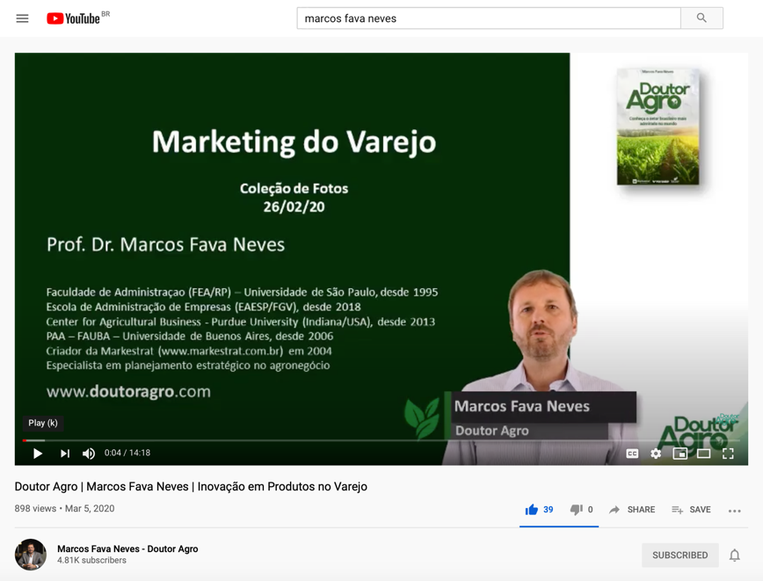

Slide 28
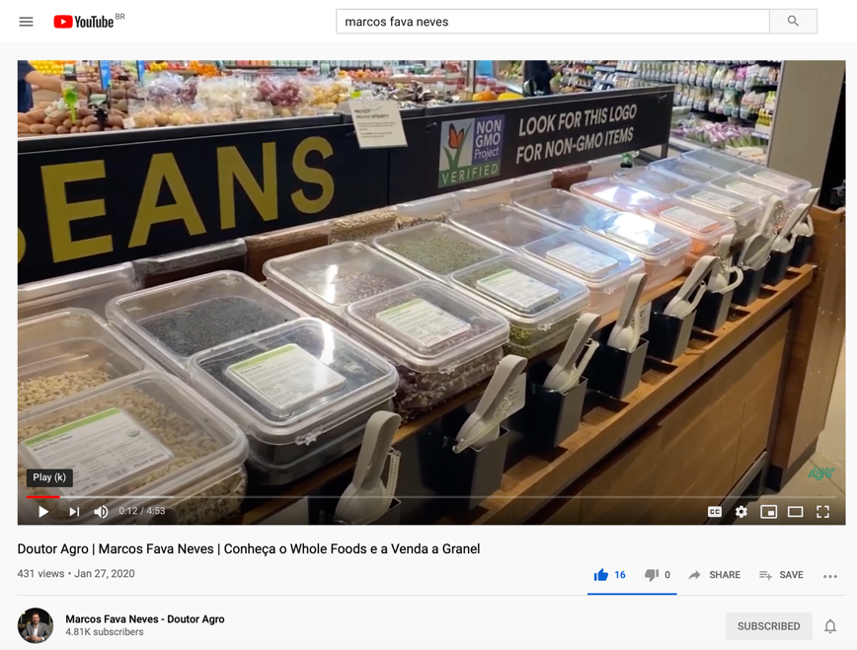

Slide 29
We are in a Board Meeting and have to decide upon investing in own stores (vertical integration), joint-ventures or a franchise system to expand. Discuss these possibilities.

Slide 30
What could be done in a joint-venture to access consumers by Nespresso and Other Company.

Slide 31
Advantages and Risks in Strategic Alliances (Joint Ventures)
Advantages of Strategic Alliances /
Joint Ventures
Risks of Strategic Alliances / Joint Ventures
Can increase access to critical resources;
Avoid legal and economical entry barriers;
Gain more market force and coverage (scale);
Spread risks;
Acquire experience and contact network;
Avoid supplier and/or distributor power;
Access to distribution channels;
Decrease in stocks, better logistic coordination
Idle capacity utilization;
Adaptation capacity in local markets;
Lower cultural risks to enter new markets;
Increase R&D;
Unite efforts to reach common objectives;
Conflicts between companies (cultural diferences);
Delicate construction of the administrative team;
Creating its own identity is critical;
Risk of technology transfer without any compensation;
Risks of unbalanced power;
Hold-up risk (contract break) when only one of the parts makes investments in specific assets;
Partners can disagree about the division of the investments, marketing or other policies;
A dynamic partner in a joint venture can become a strong competitor;
Risk of choosing the wrong partner.
Source: Marcos Fava Neves: The Future of Food Business, World Scientific, 2014

Slide 32
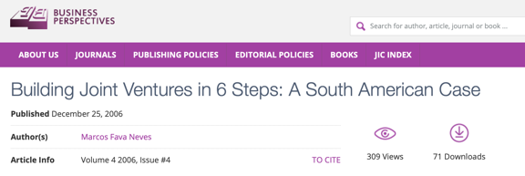
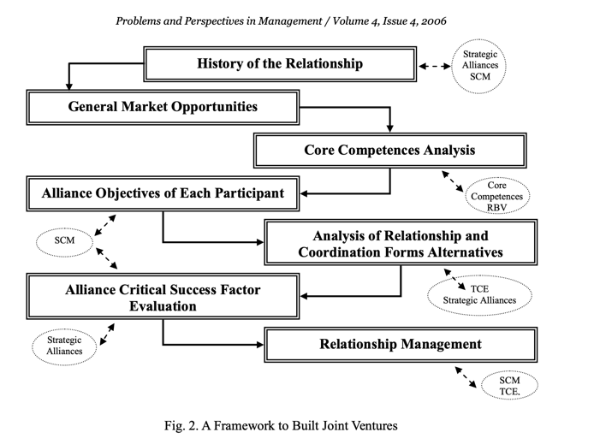
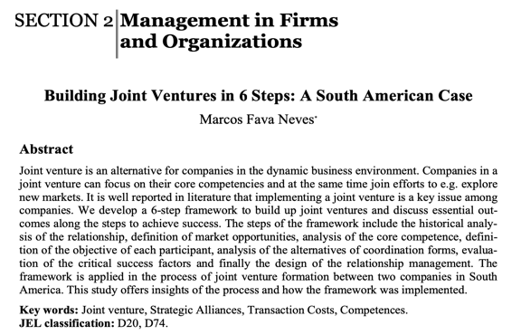

Slide 33
Notes:
https://www.youtube.com/watch?v=sKmK-5xqBJg

Slide 34
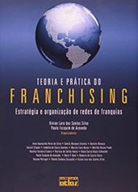
How to organize a Franchise System for Nespresso?

Slide 35
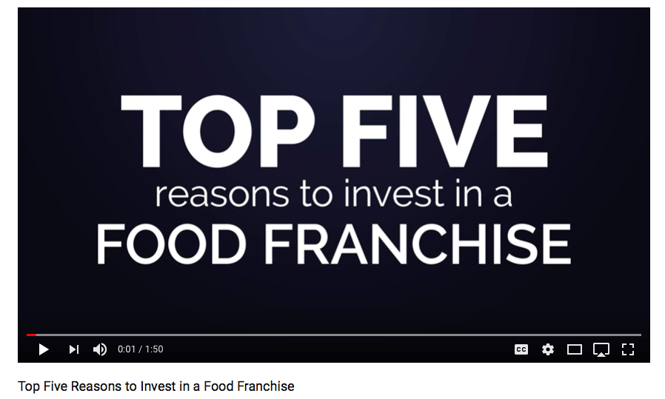
Notes:
https://www.youtube.com/watch?v=pInJgEM8gCg

Slide 36
Advantages and Risks in Franchising
Advantages in franchises
For the franchiser (the owner of the concept):
Risks in franchises
For the franchiser (the owner of the concept):
Long-term strategic relationship;
Business expansion without demanding high levels of investment.
Brand management and control;
More flexibility than vertical integration;
Scale for marketing and technology (advertisement, new product development, administrative procedures);
Capture local knowledge of the franchisee;
Capture entrepreneurial spirit of the franchisee and incentives (it is his business)
Network integration process and participation of the franchisees in strategies and new developments;
Receive marketing support;
Location for the venture;
Efficiency in the supply chain;
Market research;
Project and layout;
Financial counseling;
Operational manuals;
Administrative training;
Employee training;
Knowledge already acquired from the franchiser’s experience;
Access to consolidated brands in the market.
“Franchise brokers” and “franchisee cooperatives” (where franchisees meet to increase their bargain power with the franchiser) can threaten the system;
Concentration in the hands of few franchisees can make the negotiation process unequal between the parts;
Labor aspects on the franchisee’s behalf that could result in law suits for the franchiser;
Brand value loss due to the offering of lower quality products;
Other activities done by the franchisee
Ex-franchisees copying the business.
Unknown expenses in the system;
Geographical concentration of franchisees in the same area generating competition within the franchise system;
Lack of investments from the franchiser in marketing and innovation;
Can limit creativity and innovation of entrepreneurs or franchisees;
The payment system can be discouraging with the initial fixed fee plus part of the economic result (royalties) and contributions for communication;
Mandatory purchase of inputs from the franchiser that can be overpriced;
New units in the area competing;
Lack of openess to discuss environmental changes.
Source: Marcos Fava Neves: The Future of Food Business, World Scientific, 2014

Slide 37
Own stores... Vertical Integration... How to do it, what are the advantages and disadvantages?

Slide 38
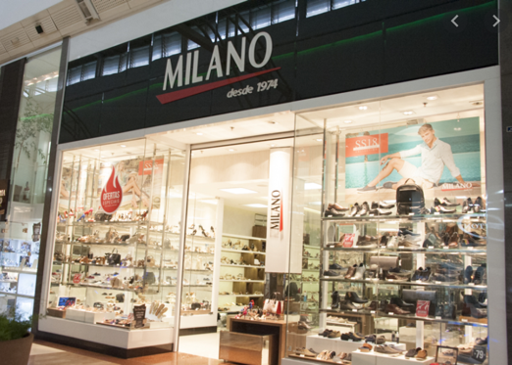
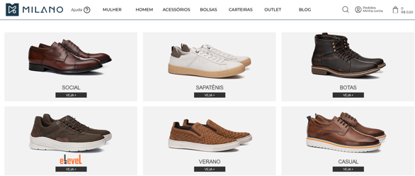

Slide 39
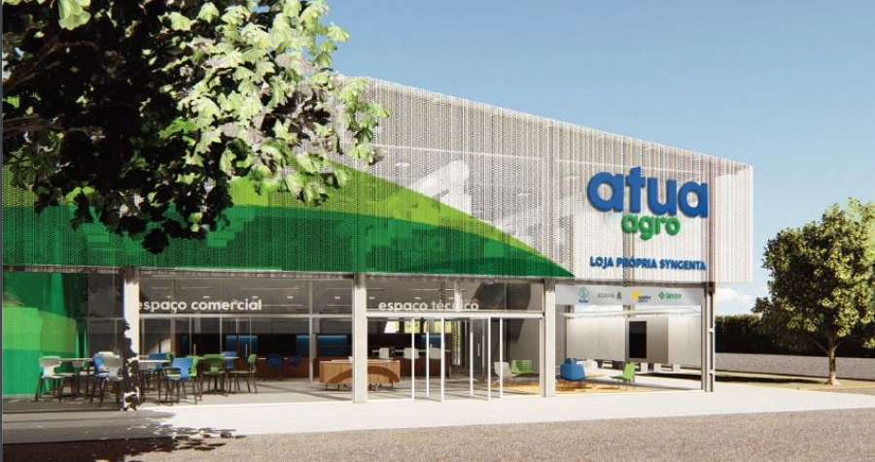

Slide 40
Factors to Consider and Risks in the Vertical Integration Strategies
Factors to Consider
in Vertical Integration
Risks in Vertical Integration
Complete control of the channels or supply;
Access to market information;
Protection against market oscillations;
“Agency” costs as a result of different interests in the organization;
Integrated tax planning in the chain;
Differentiation opportunity;
Increased negotiation power with other distributors or suppliers;
Creation of scale and entry barriers to new competitors;
Units working as consumer laboratories
The cost to change becomes too high;
Costs and expenses associated with the integration can be higher than other alternatives;
Possible lack of flexibility;
Larger investments and exit barriers;
May reduce and limit the innovation rate;
Clients may become competitors;
Differences in optimum production scale;
Possible lack of administrative synergy;
Problems in one production stage threaten production and profitability of all other stages;
The activities may be very different.
Source: Marcos Fava Neves: The Future of Food Business, World Scientific, 2014

Slide 41
Factors to Consider and Risks in the Vertical Integration Strategies
Factors to Consider
in Vertical Integration
Risks in Vertical Integration
Complete control of the channels or supply;
Access to market information;
Protection against market oscillations;
“Agency” costs as a result of different interests in the organization;
Integrated tax planning in the chain;
Differentiation opportunity;
Increased negotiation power with other distributors or suppliers;
Creation of scale and entry barriers to new competitors;
Units working as consumer laboratories
The cost to change becomes too high;
Costs and expenses associated with the integration can be higher than other alternatives;
Possible lack of flexibility;
Larger investments and exit barriers;
May reduce and limit the innovation rate;
Clients may become competitors;
Differences in optimum production scale;
Possible lack of administrative synergy;
Problems in one production stage threaten production and profitability of all other stages;
The activities may be very different.
Source: Marcos Fava Neves: The Future of Food Business, World Scientific, 2014

Slide 42
Marcos Fava Neves is an international expert on global agribusiness issues and a part-time professor of planning and strategy at the School of Business (FEARP) of the University of São Paulo (USP) and FGV Business School, both in Brazil. He graduated as an agronomic engineer from ESALQ/USP - Piracicaba in 1991. He earned his master’s degree in 1995 and his doctorate in management in 1999 from the FEA/USP School of Economics and Business – São Paulo. Marcos completed postgraduate studies in European agribusiness at ESSEC-IGIA in France in 1995 and in chains/networks at Wageningen University, in the Netherlands (1998-1999). In 2013 he spent the year as a visiting international professor at Purdue University (Indiana, USA) where he maintains the linkage as a permanent International Adjunct Professor. Since 2006 he is an international professor at the University of Buenos Aires, Argentina.
He has specialized in strategic-planning processes for companies and food chains and works as a board member of both public and private organizations, being member of mor than 10 international boards since 2004. Also in 2004, he created the Markestrat think tank with other partners, today employing around 60 people and doing international projects, studies and research in strategic planning and management for more than 250 agri-food business organizations. Some of these projects were very important in suggesting public policies for food chains that were implemented in Brazil with economic and social impacts.
Also as an experience in the private sector, from 1992 to 1993 he worked in citrus juice exporter and from 1994 to 1995 in a veterinarian company. In 2008, he became CEO of Brazil’s second-largest biofuel holding company, a position he occupied until 2009, when he returned to the University of São Paulo (USP) and Markestrat.
At the academic side, since 1995 (when he was hired by USP), Marcos has advised more than 30 doctorate dissertations and master’s theses and helped to form around 1200 Bachelors in Business Administration in Brazil with around 120 courses taught to undergraduates at USP.
His writings are strongly focused on supplying simple and effective methods for business. He has published more than 100 articles in international journals and has been author and editor of 63 books by 10 different publishers in Brazil, Uruguay, Argentina, South Africa, Singapore, Netherlands, China, the United Kingdom and the United States. He is also a regular contributor for China Daily Newspaper and has written two case studies for Harvard Business School (2009/2010), one for Purdue (2013) and five for Pensa/USP in the nineties. Recognized as the Brazilian academic with the largest number of international publications about orange juice and sugar cane chain and one of the top 3 most cited Brazilian authors in the area of food and agribusiness. He has reached more than 4000 citations in Google Scholar index.
Marcos is one of the most active Brazilian speakers, having done more than 1050 lectures and presentations in 25 countries. He received around 150 recognitions from Brazilian and international organizations, and is considered a “Fellow” of the IFAMA (International Food and Agribusiness Management Association), title received in Minneapolis - 2015.
Coming from a family of farmers, he is a worldwide defender of agriculture and farmer’s role in the development of the society. In the social side, together with his parents, Marcos is one of the creators and maintainers of Mucapp, a NGO that in 20 years has built more than 450 houses for families in Brazil that face very unfavorable conditions.

