Slide 1
Gabrielle Goliath, Christina Sharpe

Slide 2
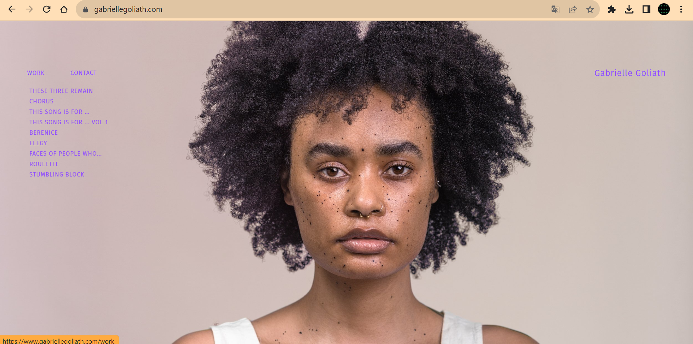

Slide 3
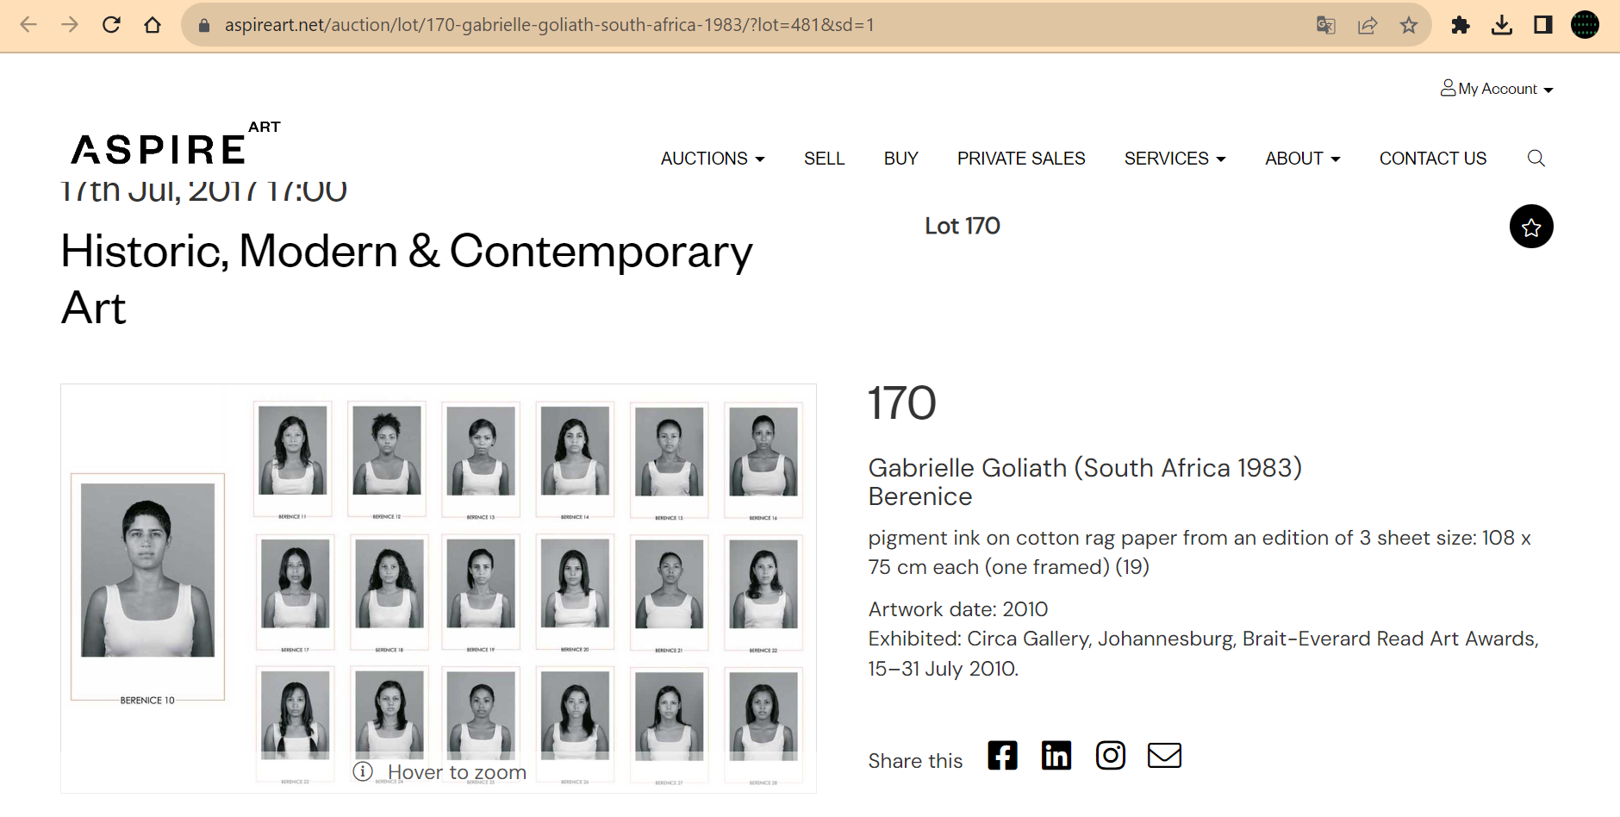

Slide 4
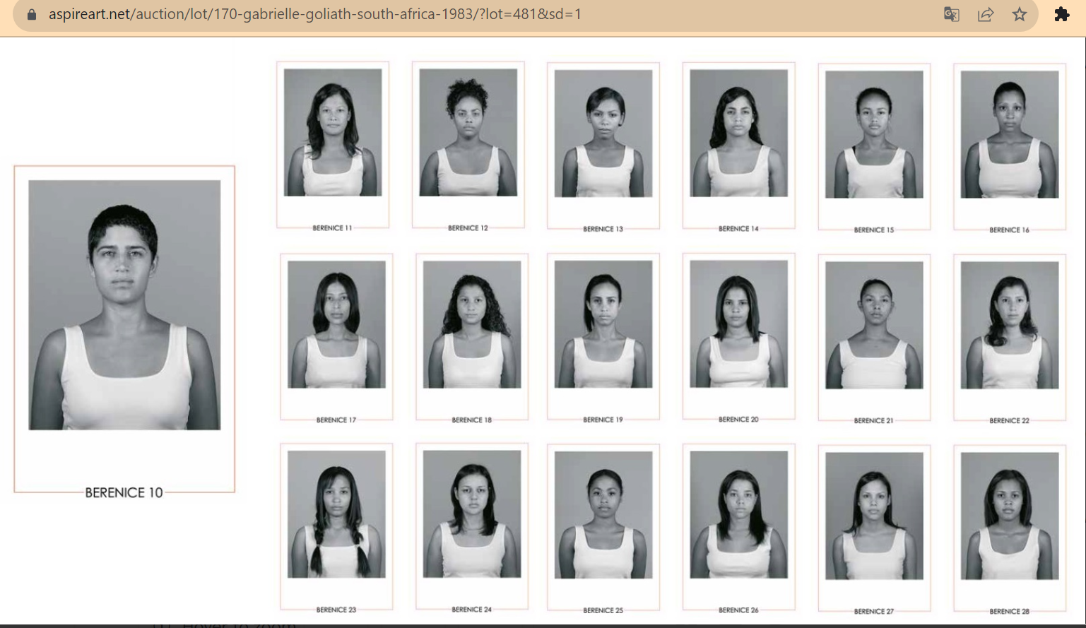

Slide 5
Berenice
“Berenice, a name spoken over me, into me, never to be mine, and yet mine and of my heart – to be borne, as part of me and to be shared… On Christmas eve 1991, news came of a not-so-silent night. Berenice, my childhood friend, was dead; shot at home in what was spoken of after – when spoken of at all – as a ‘domestic incident’. The next day, my mother took me over to their house to share our condolences with the family. On seeing me her mother hailed me, calling out a name – not Gabrielle, but Berenice – and then held me so tight and for so long.”
In Berenice 10-28 (2010), nineteen brown women offer themselves as surrogate presences, 'standing in' for Berenice. In the acknowledged (but nevertheless insistent) failure of this gesture, each sitter marks her absent presence – one portrait for every year unlived, from her death in 1991 to the series’ realisation in 2010.
In 2022, the artist decided to revisit the work as Berenice 29-39, reanimating its commemorative gesture as a “life-work of mourning”. This time in colour, the eleven portraits present another community of peers, older now, but still bearing this name as a collective work of refusal.
“For we cannot imagine and seek to realise a world otherwise, if we fail to mourn and bear with us those lost to or still surviving an order of violence we hope to – and must – transform.”
The series will continue.

Slide 6
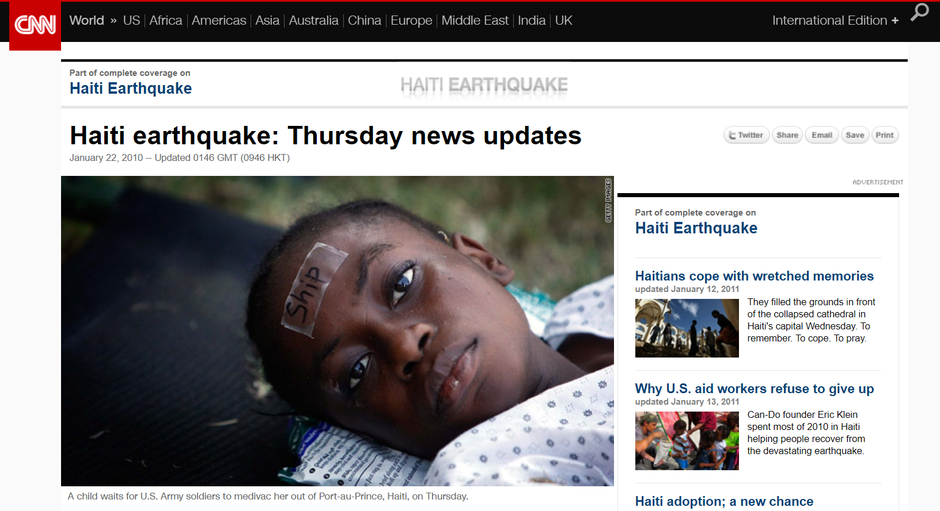
No vestígio - Christina Sharpe
Link notícia
Representação jornalística e informativa sempre “no vestígio”.

