Slide 1
Inter-American Politics: Old Dilemmas and the Current Conjuncture
A.W. Pereira
11/5/18

Slide 2
Questions
1 How have inter-American politics shifted in the first part of the 21st century?
2 What is the relationship between inter-American and global politics?
3 What are the most important issues in inter-American politics?

Slide 3
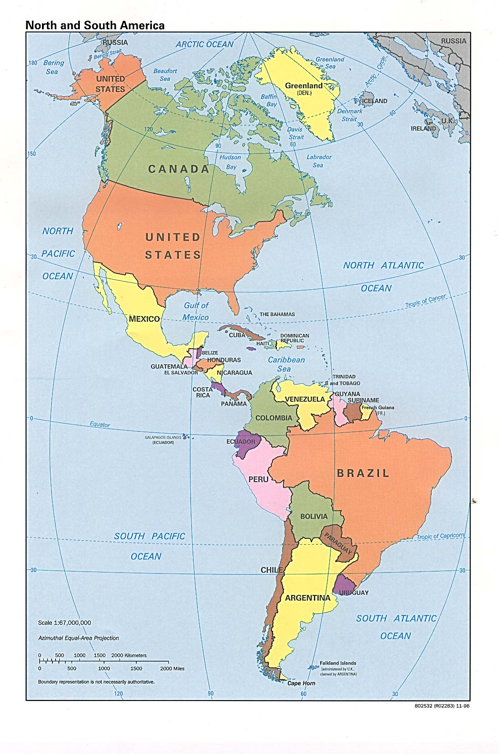
Notes:
Map of Brazil in the Western Hemisphere.

Slide 4
How have inter-American politics shifted in the first part of the 21st century?
?

Slide 5
Some possible answers
The emergence (and partial decline) of left and centre-left governments in Latin America
Steady growth on the back of the commodity boom, and a decline in poverty (and some inequality) in Latin America
The relative decline in importance of the US
The rise of China as a major trade partner
The creation of new multilateral fora (Unasur, SADC, Celac) and growing S. American autonomy
Trump

Slide 6
Some Trump actions
Withdrawal from the TPP
Withdrawal from the Paris climate change agreement
Withdrawal from the Iran nuclear deal
Decision to move US Embassy to Jerusalem
Renegotiation of NAFTA
Imposition of tariffs on steel and aluminium
Demand that China reduce its trade surplus with the USA by $200 billion (60%) by the end of 2020

Slide 7
Is Trump a threat or an opportunity for Brazil?

Slide 8
What is the relationship between regional and global politics?
?

Slide 9
Some possible answers
Globalization has integrated the world through networks of capital, people, goods and services, and information technology.
But geography is still relevant: regions matter and globalization has taken place, in part, through regional blocs.
Many regional issues (i.e. migration, drug and arms trafficking, the environment) are also global issues.

Slide 10
What are the most important issues in inter-American politics?
?

Slide 11
Some specific answers (examples)
The implosion of Chavismo in Venezuela
A failed state in Haiti
The consolidation of the peace process in Colombia
The reversal of the “thaw” in US-Cuban relations
Reputational damage to Brazilian businesses in the wake of Lava Jato
Latin American immigration to the US
Trump’s isolationism and protectionism

Slide 12
Others
High rates of violence and human rights violations, including state violence, in many countries
Limitations on regional economic integration and regional economic development
A need for improvements in basic education

Slide 13
US Trade with Central and South America (2017) in US$ (millions)
Exports | Imports | Balance
150,228.7 | 115,961.2 | 34,267.6
Notes:
Source: US Census Bureau, Foreign Trade, https://www.census.gov/foreign-trade/balance/c0009.html at 10/05/18.

Slide 14
Brazilian Trade with the US, 2017 (US$, millions)
Year | Exports | Imports | Balance
2017 | 29,427.3 | 37,076.9 | -7,649.6
Notes:
Source: https://www.census.gov/foreign-trade/balance/c3510.html on 10 May, 2018.

Slide 15
Brazilian Trade with the US, 2016
EXPORTS
Manufactured goods, 61.3%
Semi-manufactured goods, 16.9%
Basic goods, 13.7%
Special transactions, 8.0%
IMPORTS
Manufactured goods, 93.8%
Semi-manufactured goods, 1.5%
Basic goods, 4.7%
Notes:
Source: same as previous slide, p. 4

Slide 16
How have inter-American politics changed in the first part of the 21st century?
?

Slide 17
Some possible answers
The emergence of left and centre-left governments (now declining?) in Latin America
Steady growth on the back of the commodity boom, and a decline in poverty (and some inequality) in Latin America
The relative decline in importance of the US
The rise of China as a major trade partner
The creation of new multilateral fora (Unasur, SADC, Alba, Celac)
Trump

Slide 18
The Trump Administration – the former Sec of State
Notes:
Rex Tillerson, US Secretary of State, fired by Trump in a tweet.

Slide 19
Some officials
Sec of State – Mike Pompeo
Assistant Secretary of State for Western Hemisphere Affairs – Francisco Palmieiri (acting)
US Ambassador to Brazil - Michael McKinley (appointed by Obama)
US Consul General in Sao Paulo - Ricardo Zuniga (Obama appointee)
National Security Officer – John Bolton
Left the State Department – Tom Shannon

Slide 21
Trump’s appointment to the NSC: Western Hemisphere Affairs
Special Assistant to the President and Senior Director for Western Hemisphere Affairs: Craig Deare
Craig Deare since 2010 has worked as the Dean of Administration for the College of International Security Affairs, where he researches security issues in Latin America and the Caribbean.
Prior to his time at the College of International Security Affairs, Deare served for two decades in the U.S. Army, and he was deputy commander of the joint counterintelligence operations element in Honduras.

Slide 22
And then…
In a talk at the Wilson Center, Deare criticized the Trump administration’s policies towards Latin America, especially the poor US relations with Mexico. He was upset about Trump’s remarks about Mexico, and Trump’s phone call with Pres. Pena Nieto. (He also marveled at how attractive Ivanka Trump was.)
Trump fired Deare on 18 February, 2017, and he was escorted out of his office in the Executive Office Building.
He was replaced by Rick Waddell, a two-star general in the Army Reserve.

Slide 24
Francisco Palmieri
Acting Assistant Secretary, Bureau of Western Hemisphere Affairs, US Department of State.
Trump has not appointed a new Assistant Secretary.
He has also not appointed a new Ambassador to Brazil or a new US Consul General in Sao Paulo.
38 ambassadorships remain unfilled under Trump.

Slide 25
The US retains the posture of a military superpower: the US Military Commands
U.S. Africa Command
U.S. Central Command
U.S. European Command
U.S. Northern Command
U.S. Pacific Command
U.S. Southern Command

Slide 26
The Americas: not Europe, but a politically cohesive region by world standards
Political relations between the states in the Americas involve a combination of conflict and cooperation.
There is a network of regional organizations that try to address common problems.
The political systems of states and the societies in the region share many similarities and are experiencing similar problems (i.e. the crisis of institutions in Brazil and the USA).

Slide 27
The region is both peaceful and violent
There is only one nuclear power in the region. Latin America is a nuclear-free zone (Treaty of Tlatelolco, 1968).
Border disputes are relatively minor. There is not much inter-state war or threat of inter-state war.
But while Latin America has 8% of the world population, it has about a third of its homicides. (It has also urbanized faster than other regions.) Brazil has the highest number of homicides, in absolute terms.

Slide 28
The USA-Brazil relationship is asymmetrical
The United States in its foreign policy largely ignores Latin American and operates as a global power.
Brazil in its foreign policy has usually been concerned to preserve its autonomy vis-à-vis the USA and avoid both automatic alignment and neglect of the relationship.
The USA-Brazil relationship is asymmetrical.

Slide 29
US and Brazilian regional priorities are not the same
For Brazilian foreign policy, South America seems to be the region that matters most. South America is a platform for Brazil’s global ambitions.
The United States is still a global power in military terms (although less and less so in economic and political terms). The focus of its foreign policy is the Middle East, Central Asia, East Asia, and Europe. In the Americas, its focus used to be NAFTA (Canada, the USA and Mexico) but it looks increasingly like it is just itself (“America First”).

Slide 30
An interesting question…
Could the USA and Brazil ever be genuine partners in a common project for the Americas (i.e. play the role that France and Germany do in Europe)?

Slide 31
The inter-American state system has been shaped by common events
Shared events and processes that have shaped the inter-American state system. We will study four of the most important of these: World War II, the 1959 Cuban revolution, the 1964 coup in Brazil, and the 1973 coup in Chile.

Slide 32
Questions about the reading – Dominguez
For Dominguez, why is the end of the Cold War in the Americas similar to the end of the Napoleonic wars and the end of WW II?
How did the rise of China in world markets affect Latin America?
What are some of the institutions created in the Western Hemisphere that show the decline of US influence and a rise in the autonomy of Latin American states?

Slide 33
More questions about Dominguez
Was there a decline in the “liberal-democratic, pro-market” consensus in the region? If so, what were the causes of this decline?
How do Latin American states balance against US power differently?
What are some examples of the reduced effectiveness of international institutions for policy coordination?

Slide 34
Ikenberry
Is Ikenberry right about the liberal world order?
Is it actually always liberal?
Is it really hierarchical but not imperial?
How widely shared are the gains from participation in the system?
Presuming it is worth preserving the liberal world order, on what grounds could we be more pessimistic than Ikenberry about its survival?

Slide 35
Hurrell
Are rumours of the demise of the BRICS premature?
Is Brazil part of the emergence of a “post-Western” world order?
Are nationalist backlashes really a global phenomenon?
What does Hurrell mean by the new pluralism?
Could the emergence of new powers improve global order?

Slide 36
Break time
Enough questions. Time for a break!

