Slide 1
Electromagnetic radiation versus biological energy levels
$$E_{\text{total}}=E_{\text{eletronic}}+E_{\text{nuclear}}+E_{\text{rota}\text{t}\text{ional}}+E_{\text{vibra}\text{t}\text{ional}}+E_{\text{transla}\text{t}\text{ional}}$$
Magnetic coupling
Nuclear Electronic
Vibronic
transitions
Electronic
transitions
Vibrational
Radio
Microwave
Infrared
Visible
Ultraviolet
X-rays
Gamma
10³
10²
10¹
10⁰
10⁻¹
10⁻²
10⁻³
10⁻⁴
10⁻⁵
10⁻⁶
10⁻⁷
10⁻⁸
10⁻⁹
10⁻¹⁰
10⁻¹¹
10⁻¹²
10⁻¹³
Wavelength, m
10⁵
10⁶
10⁷
10⁸
10⁹
10¹⁰
10¹¹
10¹²
10¹³
10¹⁴
10¹⁵
10¹⁶
10¹⁷
10¹⁸
10¹⁹
10²⁰
10²¹
Frequency, Hz

Slide 2
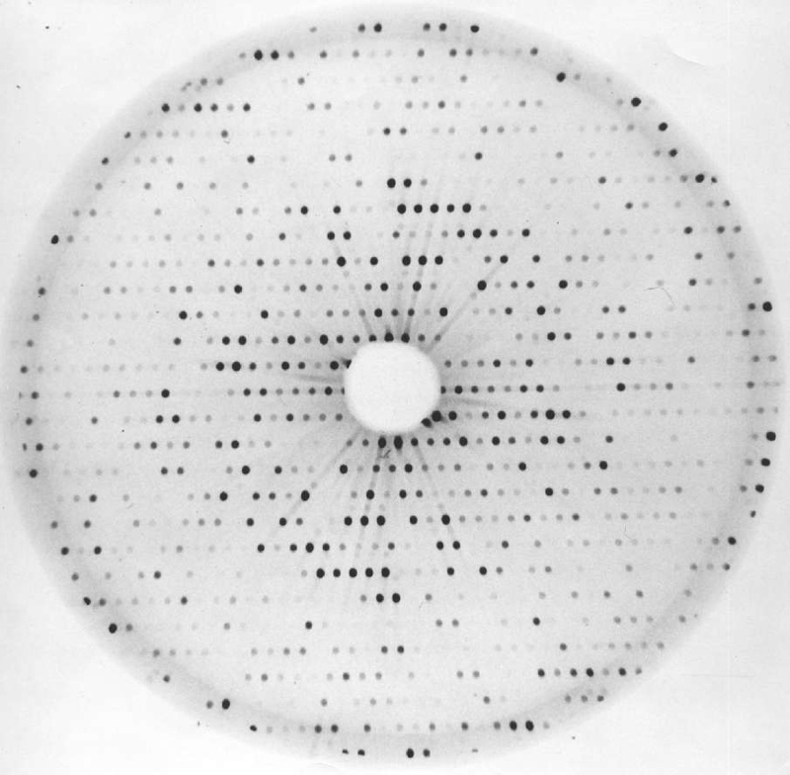
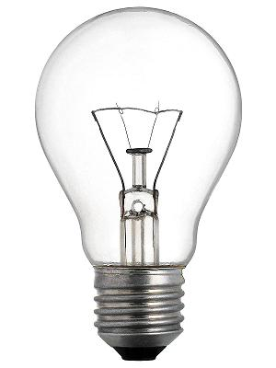
Cristalografia por difração de raios X
- Espalhamento elástico de raios X;
- Determinação de modelo atômico experimental (alta resolução) da macromolécula.
Raios X
Padrão de difração
Mapa de densidade eletrônica
Cristais
Fonte de luz
Amostra
Hoje!
Processamento
Detector
Arranjo
Experimental
Preparo de
amostra
Processamento
de dados
Qualidade
do resultado
Acessível
Fácil
Fácil
Útil
Especializado
Muito difícil
Muito difícil
Melhor possível

Slide 3
What is Crystallography of Biological Macromolecules by X-ray diffraction?
Definition: the study of the atomic structure of proteins, DNA, RNA and lipids in crystalline arrangement, using X-rays as a measurement tool
Main feature: multidisciplinarity (Biology + Physics + Chemistry + Mathematics) Biology: interest problem to be studied and correlation results; Chemistry: construction, interpretation and validation of the atomic model; Physics and Mathematics: description, formalism and interpretation of the phenomenon. In a typical Structural Biology laboratory one can find biologists, biochemists, pharmacists, physicists, chemists, doctors, veterinarians, engineers, etc ...

Slide 4
How to do it, in 4 steps
Definition: the study of the atomic structure of proteins, DNA, RNA and lipids in crystalline arrangement, using X-rays as a measurement tool

Slide 5
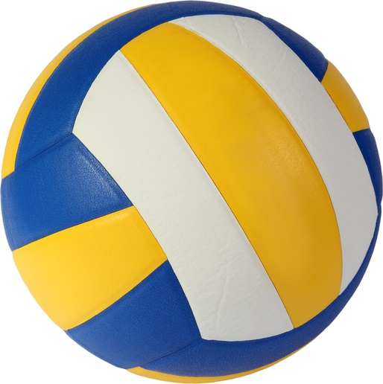
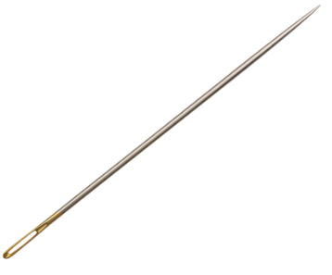
3. Why X-rays?
General rule: the resolution (or the minimum resolvable distance) in which we can describe an object is strictly dependent on the measuring tool
The wristwatch, as “seen” by a volleyball
The wristwatch, as “seen” by a sewing needle

Slide 6
3. Why X-rays?
General rule: the resolution (or the minimum resolvable distance) in which we can describe an object is strictly dependent on the measuring tool
- Typical size of biological macromolecules: a few tens of Å (1 Å = 10⁻¹⁰ m)
- Distances between two covalently linked atoms (C, N, O e S) é entre 1 e 2 Å;
Electrostatic and hydrophobic interactions occur between 2 and 4 Å;

Slide 7
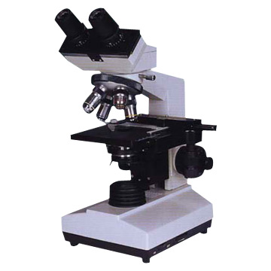
3. Why X-rays?
However...
X-rays are not detectable by the human eye;
There is no "direct" way to see molecules with X-rays;
We can not reflect or refract X-rays easily (RI always 1);
No instrument-based lenses can change the path of X-rays;
Therefore, an X-ray microscope is discarded.
Fortunately, there is an indirect way to do this: MATHEMATICALLY!

Slide 8
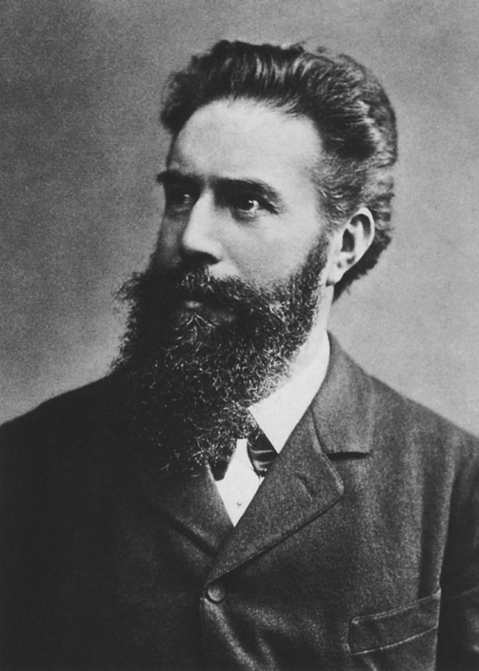
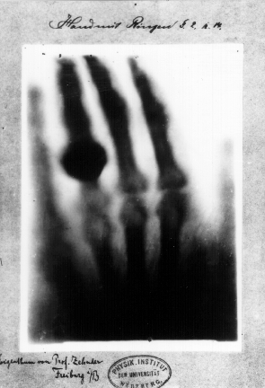
The X-man
Wilhelm Conrad Röntgen
8/11/1895
(Nobel Prize 1901)

Slide 10
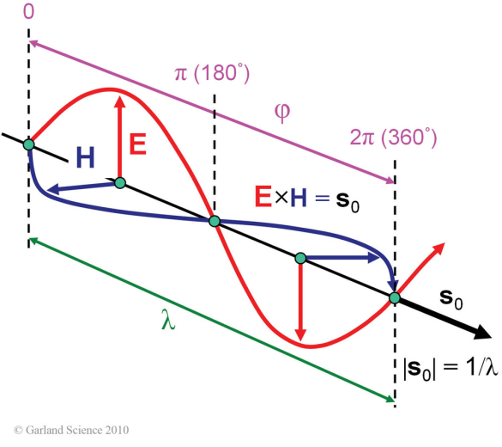
Interaction of radiation (X-rays) with matter
Electromagnetic wave
The electric field vector E is perpendicular to the magnetic field vector H and both oscillate perpendicularly to the propagation vector s_{o}, with a wavelength λ, and phase φ.
The interaction between E and matter (atoms) is approximately SIX orders of magnitude more significant than that for H (Electrodynamics). Therefore, we will only consider E.
When X-rays interact with atoms, what happen?
Nothing (99% of the time)
Photoelectric effect
Compton Scattering (inelastic)
Thompson Scattering (elastic)

Slide 11
Electromagnetic wave
Force exerted on the atom in the presence of the electric field of the X-ray:
Newton's Second Law: $\vec{F}=m.\vec{a}$, onde $\vec{F}=q.\vec{E}$
$∴q.\vec{E}=m.\vec{a}$, ou
$\vec{a}=$ $\frac{q.\vec{E}}{m}$
Electron: $\frac{qe.\vec{E}}{me}$
Proton: $\frac{(−)qe.\vec{E}}{2000.me}≪elétron$
Neutron: $\frac{0.\vec{E}}{2000.me}$ = 0
A significant interaction occurs only with the electron cloud of atoms, i.e., depends on Z

Slide 12
The atomic scattering factor f
- f depends strictly on the electron shell properties of the atom (number and energy of shells and number of electrons per shell);
- this dependence is given by the Cromer-Mann coefficients , which are known and are tabulated for every naturally-occuring atom in the periodic table; X-ray scattering factors computed from numerical Hartree-Fock wave functions, by Don T. Cromer and Joseph B. Mann, Acta Cryst. (1968) A24,321
- f also depends on the X-ray wavelength and falls exponentially as the angle of detection increases;
- At the incidence angle (θ = 0º), f is equal to the number of electrons in the atom;
- f unit is given in electrons;
Crommer-Mann coefficients for carbon, Z=6
i | 1 | 2 | 3 | 4
a_{i} (e⁻) | 2.310 | 1.020 | 1.589 | 0.865
b_{i} (Å²) | 20.844 | 10.208 | 0.569 | 51.651
c_{i} (e⁻) | 0.216 | - | - | -

Slide 13
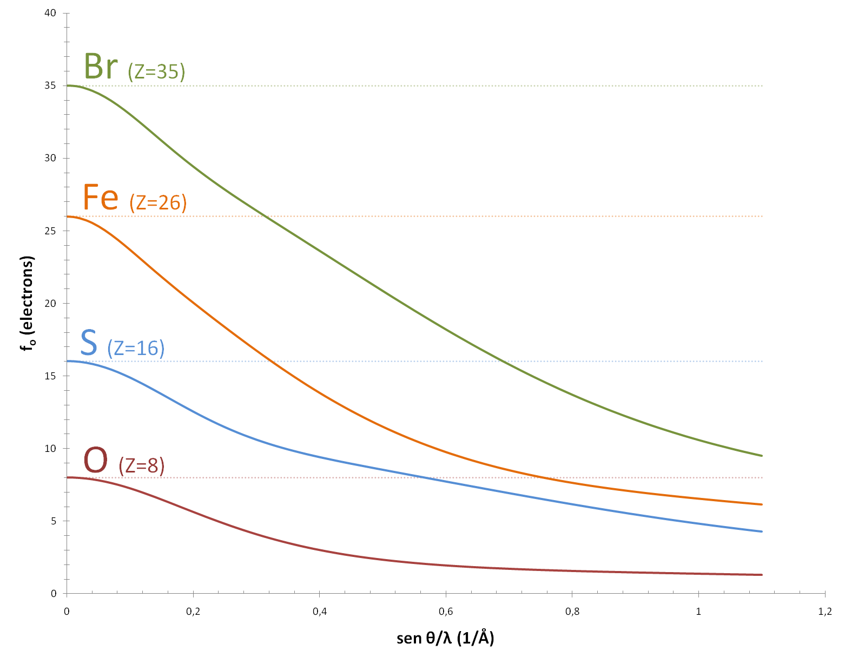
The atomic scattering factor f
One atom X-ray scattering

Slide 14
The atomic scattering factor f
Non-dispersive component
(free electron)
Dispersive component
(damped oscillator)
A special (and very useful) case must be considered when the X-ray energy matches the energy of an electron shell (resonance happens), but we will come back to that latter.
The atomic scattering factor f is often simply written as

Slide 15
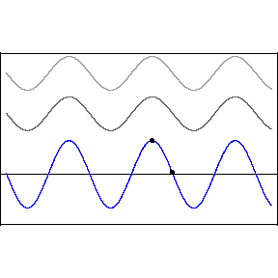
ISSUE #1 ...
Proteins, however, are formed by hundreds or even thousands of amino acids;
1 amino acid has on average 8 non-hydrogen atoms!
What happens then? Answer: Wave Interference
Wave interference
(construtive or destructive)

Slide 16
X-ray scattering by molecules and the structure factor
One atom X-ray scattering
One molecule
X-ray scattering
Wave interference
(construtive or destructive)
2
2
1
r₁₄
3
1
r₂₅
3
2
5
4
1
r₃₅
3
5
4
5
4
Structure factor
Each detected wave is the sum of the contribution from each atom in the molecule, and that is the Structure Factor.

Slide 17
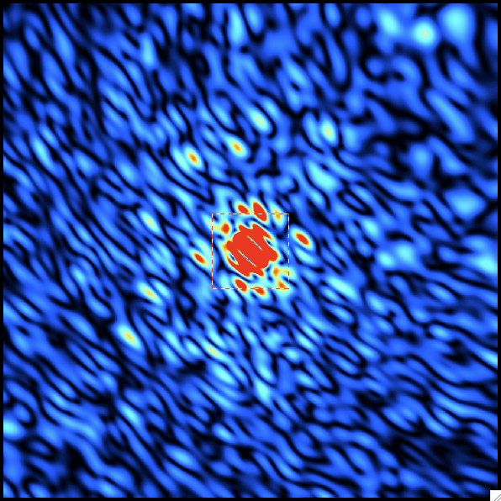
Cada orientação da molécula gera um padrão de interferência diferente
More detail
Less detail
$$F\left(s\right)= \sum_{j=1}^{n}{f_{j}e^{2πi(s∙r_{j})}}$$

Slide 18
ISSUE #2 ...
Unfortunately, under the current technical limitations, it is not possible to measure scattering of a molecule only.
What can we do then?
Answer: crystals!

Slide 19
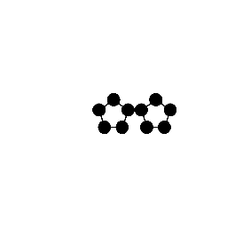
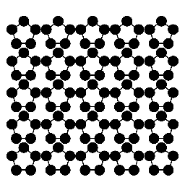
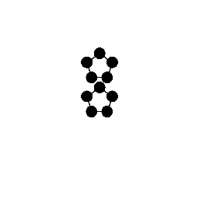
We can now perform the experiment
Diffraction: interference between scattering originating from scatterers in periodic arrangement
One molecule…
… and its diffraction pattern
Two-mol crystal, horizontal…
… and its diffraction pattern
Two-mol crystal, vertical…
… and its diffraction pattern
Crystalline assemble…
… and its diffraction pattern

Slide 20
A real diffraction pattern (billions of molecules packed)
EM RESUMO (ATÉ AGORA)
Each spot is the sum of the scattering from ALL atoms from ALL protein molecules that make up the crystal.
Therefore, the spot intensity is directly related to the electronic distribution of the scatterer.
What determines the spot position on the detector?
Let’s try to predict it, but first we must learn a bit about crystals.

Slide 21
A possible representation: Introducing the scattering vector S for a scatterer
Can be any scaterrer (atom, molecule, unit cell, etc)
s₁
Elastic scattering: $\left|\vec{s}o\right|$=$\left|\vec{s}1\right|$=$\frac{1}{λ}$
α
s_{o}
S is the scattering vector

Slide 22
In principle, any scattering angle is possible and the definition of S always holds true
s₁
S
250º
45º
-s_{o}
s_{o}
-s_{o}
s_{o}
s₁
S
S
s₁
100º
0º
-s_{o}
s_{o}
-s_{o}
s_{o}
s₁

Slide 23
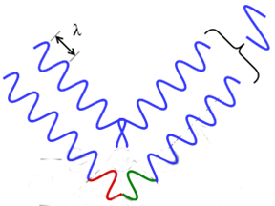
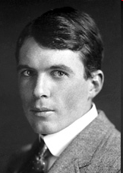
Two or more scatterers in a periodic arrangement
s_{o}
s₁
θ
θ
.
.
s_{o}
x
x
s₁
d_{hkl}
θ
θ
For constructive interference 2x=nλ
s₁
W. L. Bragg
reflection
Bragg’s Law
s_{o}
θ
θ

Slide 24
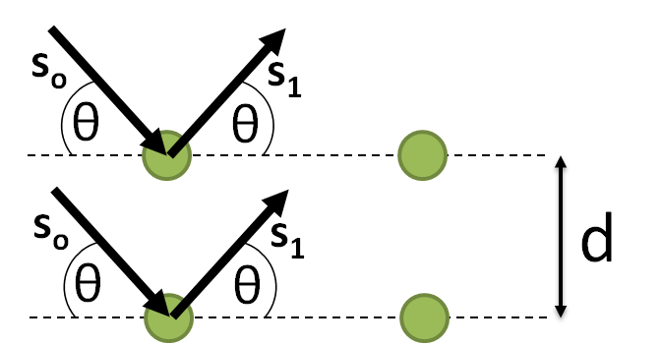
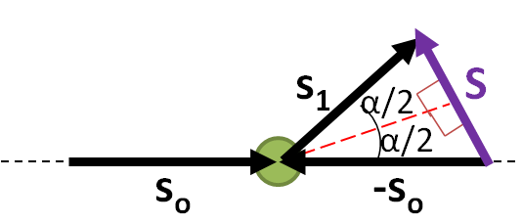
The relationship between S and d* = the diffraction condition
The relationship between S and d*
In our representation, α/2=θ. Therefore,
Diffraction condition:
Scattering vector + Bragg’s Law = Ewald Sphere

Slide 25
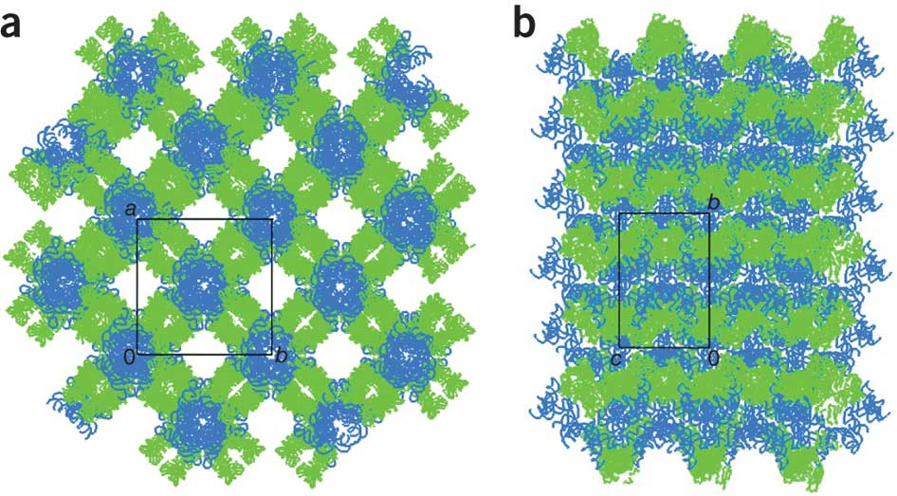
Crystal packing

Slide 26
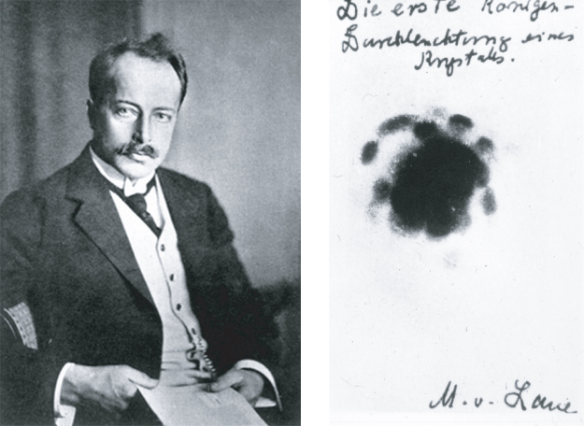
The very first x-ray diffraction image: Max von Laue

Slide 27
For that, we mest learn a little more about crystals
Examples of protein crystals

Slide 28
And what is in it?
General rule: The crystal morphology reflects certain features of the packing mode of the molecules that constitute it.
Repeating geometrical pattern
The crystal are generated by translation of the repeating geometrical pattern

Slide 29
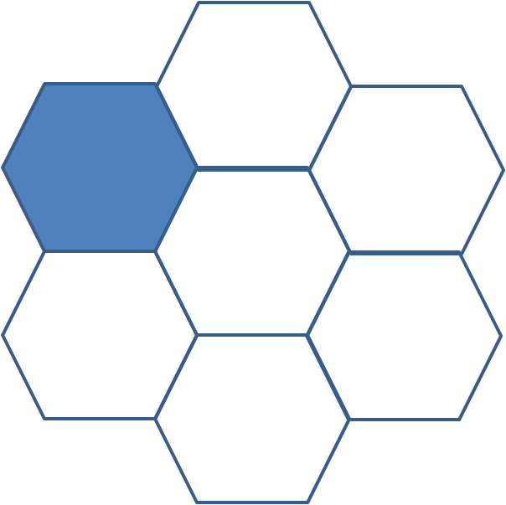
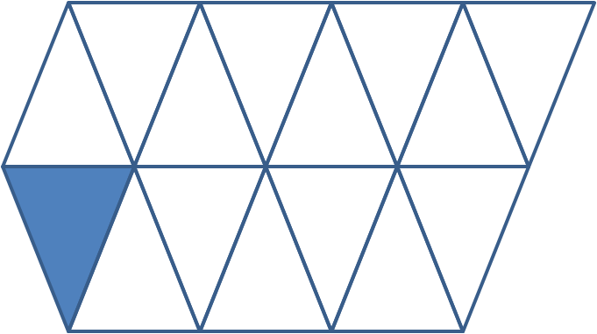
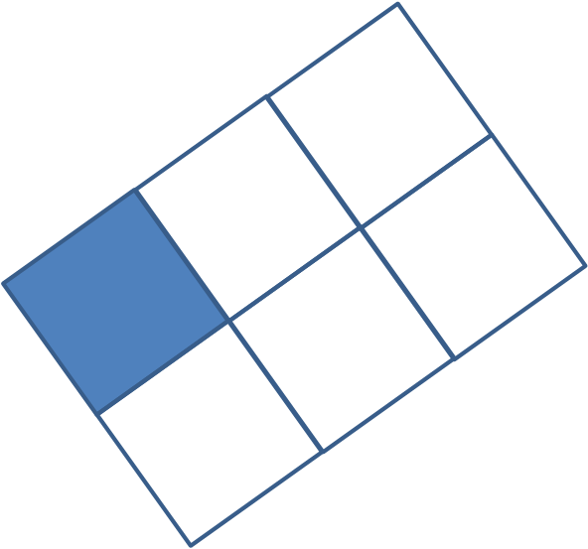
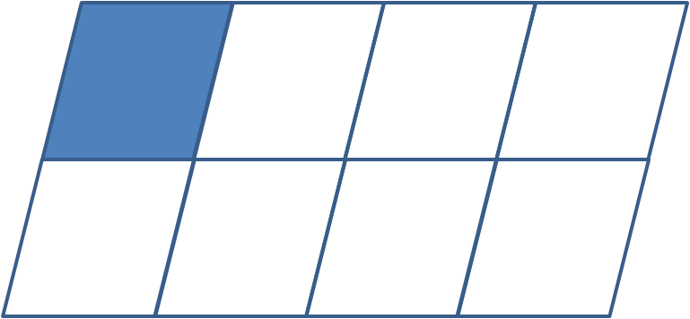
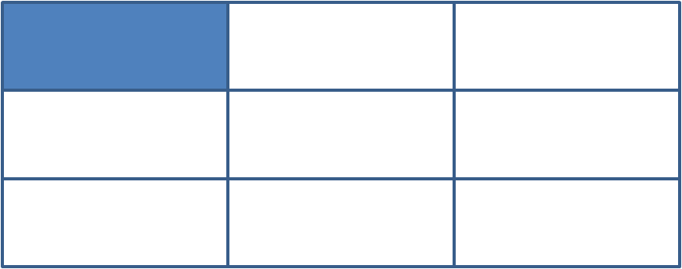
Lattice
Repeating geometrical pattern = Unit cell
Repeating geometrical pattern
A feature of the repeating geometrical pattern
is that it must completely fill the space when translated! This is the crystal lattice!
The crystal lattice can be thought of as an array of 'small boxes‘ (a unit cell) infinitely repeating in all three spatial directions.
Such a unit cell is the smallest unit of volume that contains all of the structural and symmetry information to build-up the macroscopic structure of the lattice by translation.

Slide 30
Lattice points and lattice parameters
Lattice point: A point at the intersection of two or more grid lines in a lattice.
Crystal lattice
Lattice points
b
Lattice parameters
(lenghts a, b, c and angles α, β, γ)
β
β
b
α
b
β
b
a
α
α
a
α
a
a
a
b

Slide 31
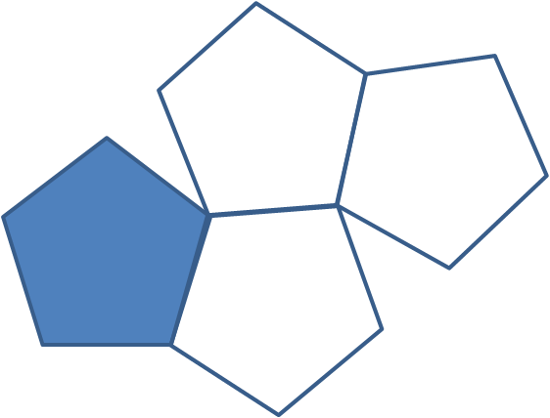
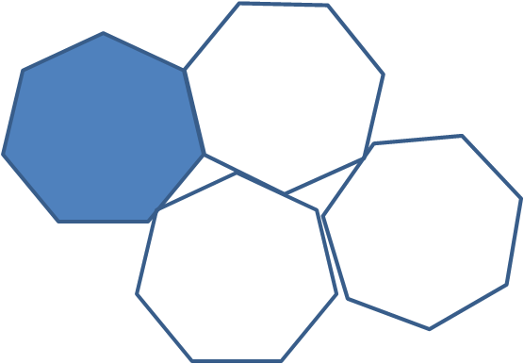
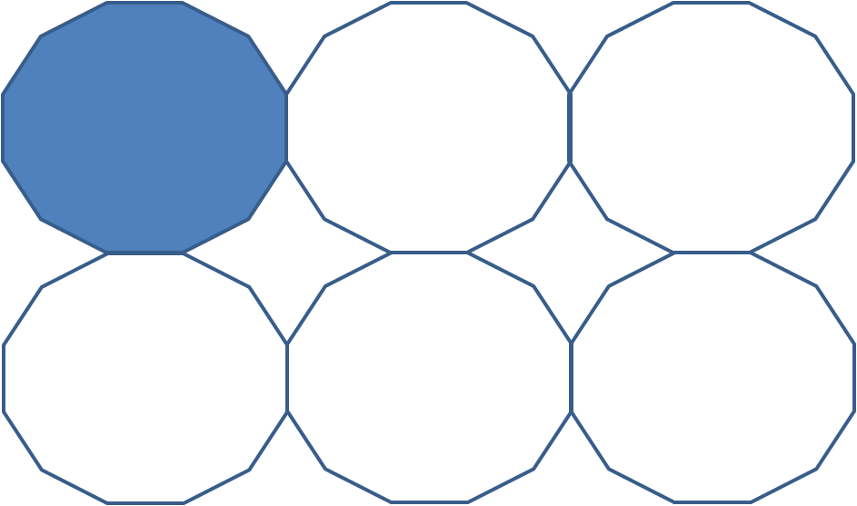
Crystallographic restriction theorem
Crystal lattice
Lattice points
Are ALL geometric shapes are possible for a unit cell? NO!

Slide 32
A real diffraction pattern (billions of molecules packed)
EM RESUMO (ATÉ AGORA)
Each spot is the sum of the scattering from ALL atoms from ALL protein molecules that make up the crystal.
Therefore, the spot intensity is directly related to the electronic distribution of the scatterer.
The spot position on the detectoris determined by the spatial frequency of the lattice points

Slide 33
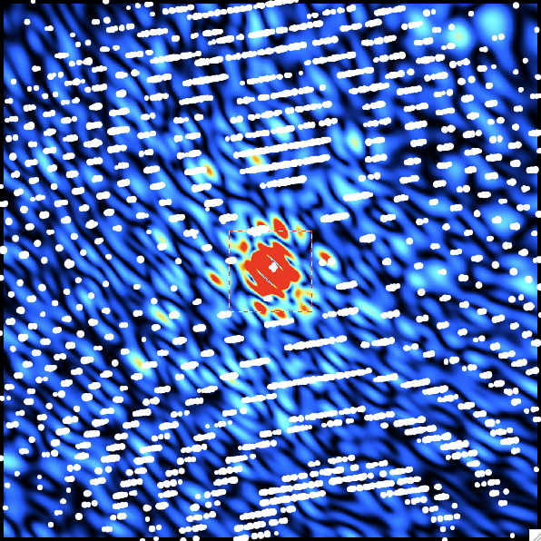
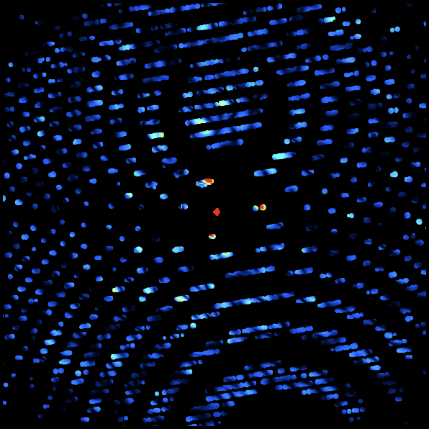
Single molecule
X-ray scattering
$$F\left(s\right)= \sum_{j=1}^{n}{f_{j}e^{2πi(s∙r_{j})}}$$
X-ray diffraction by a crystal

Slide 34
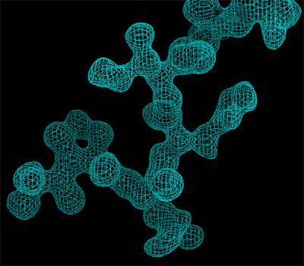
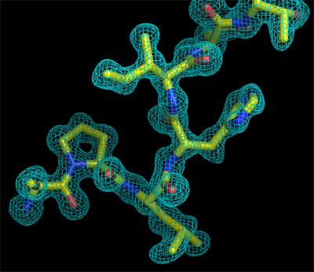
High resolution means more details

Slide 35
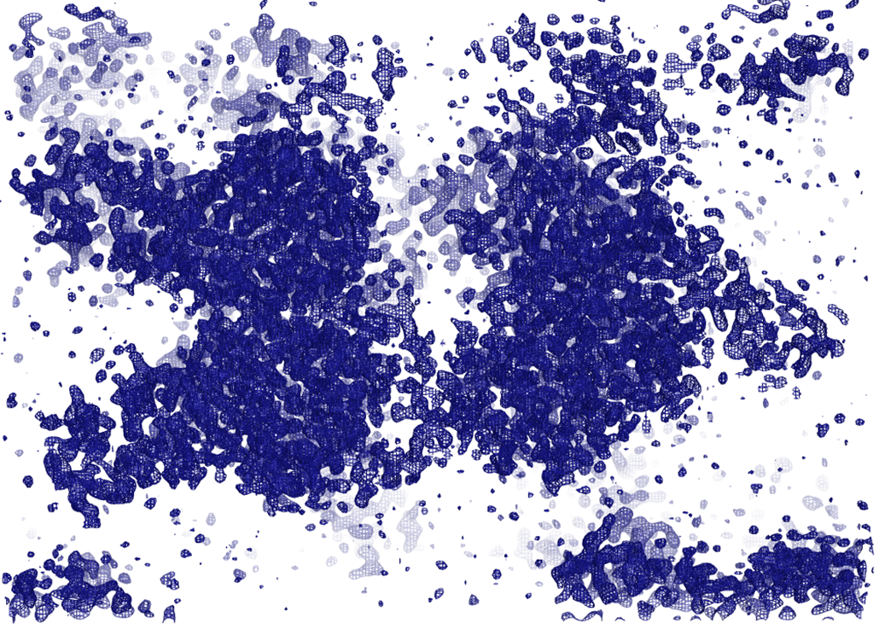
Visualizing the electron distribution function
FT
FT⁻¹

Slide 36
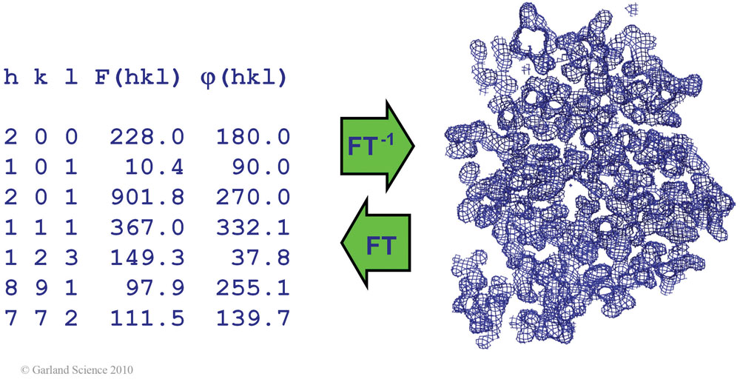

Slide 37
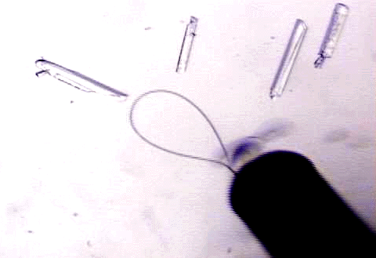
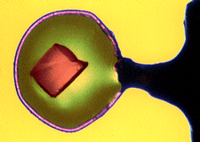
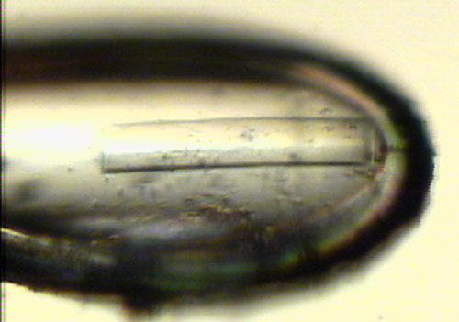
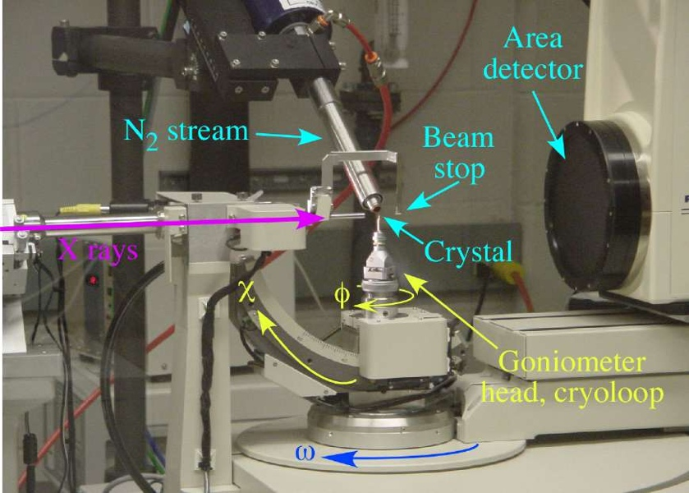
The data collection setup
Crystals can be mounted in capillaries (collection room temperature) or nylon ties (collection at cryogenic temperatures).
The crystal must be rotated during collection, so the contribution from all planes can be measured.
(2-D projections are required for reconstruction of 3-d objects)

Slide 38
So, am I ready to diffract my crystal, calculate the electron density distribution and build my protein, all directly from the diffraction pattern?
NO!

Slide 39
ISSUE #3 ...
Porém, existe uma “pequena” limitação devido à maneira que o experimento é realizado (it is a techincal limitation)…
The phases of the Structure Factors are lost when upon detection.
This is the PHASE PROBLEM!
What we measure is the amount of energy transfered from the electric field to the unit area of the detector (in W·m⁻²) (Poynting vector), averaged over time.
In the spam of one second, 10¹⁸ wave oscilations hit the detector.

