Slide 1
Chapter 16 Current Trends in Strategic Management
Prof. Luciano Thomé e Castro

Slide 2
© 2013 Robert M. Grant
www.contemporarystrategyanalysis.com

Slide 3
Current Trends in Strategic Management
OUTLINE
The new external environment of business
New directions in strategic thinking
Redesigning the organization
The changing role of managers
© 2013 Robert M. Grant
www.contemporarystrategyanalysis.com

Slide 4
The Turbulent 21st Century
2000: Collapse of “New Economy”
Dot.com bubble bursts
March 2000 NASDAQ
hits all-time peak
9 Sept. 2001:Terrorism Attacks of September 11, 2001
Invasion of Afghanistan & Iraq
Nov. 2001:Corporate scandals
Enron, WorldCom, Parmalat
2011: Euro crisis
2008-9:
Financial crisis
Volatile Markets
E.g. June ‘09
Brent crude $148; Dec. ‘09 $38
Decline of US
world influence
--emergence of a
multi-polar world
2011:
Arab Spring
The Third Industrial Revolution:
Digital technologies
Intelligent systems
Disintermediation of human beings
Natural Disasters
Indian Ocean tsunami ‘04
Hurricane Katrina ‘05
Earthquakes in
Haiti ‘10, Japan ‘11
Demands of society
Social & environmental responsibility
Ethics & fairness: Occupy Wall St
Quest for meaning
International
competition intensifies
© 2013 Robert M. Grant
www.contemporarystrategyanalysis.com

Slide 5
US Productivity Growth: Annual Changes in Non-Farm Output per Hour Worked, 1995-2012
© 2013 Robert M. Grant
www.contemporarystrategyanalysis.com

Slide 6
Return on Equity of US Manufacturing Corporations, 1990-2012
© 2013 Robert M. Grant
www.contemporarystrategyanalysis.com
Source: US Bureau of the Census

Slide 7
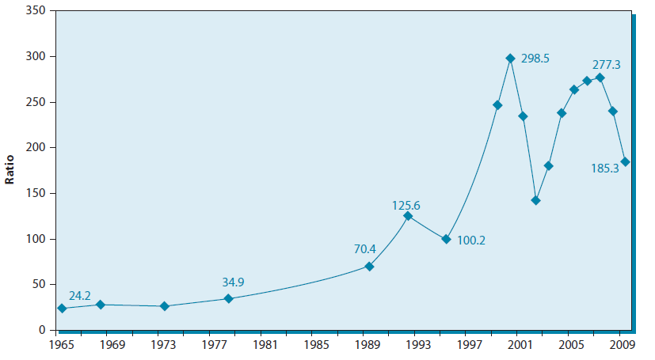
Ratio of Average CEO Pay to that of Average US Production Worker, US 1965-2009
Source: Economic Policy Institute based on data from Wall Street Journal/Mercer and Hay Group
© 2013 Robert M. Grant
www.contemporarystrategyanalysis.com

Slide 8
New Directions in Strategy
Redefining the quest for value
Avoiding short-termism
Focusing on the drivers of profit
Embracing sustainability and legitimacy
Seeking multiple & more complex sources of competitive advantage
Multiple layers of competitive advantage
More complex patterns of interaction and integration
Need for innovation & new business development
Managing options
Turbulence increases option values
Strategies to create options: lower financial leverage, experimentation, exploratory R&D, alliances, product placements
The challenge of strategic fit
Complexity and complementarity
© 2013 Robert M. Grant
www.contemporarystrategyanalysis.com

Slide 9
Redesigning the Organization
Managing Complexity
How to build multiple, complex organization capabilities
Managing Dilemmas
Incompatible performance goals
Multidimensional Structures
Informal Organization
Harnessing Human Energy & Creativity
Rethinking the role of managers
© 2013 Robert M. Grant
www.contemporarystrategyanalysis.com

Slide 10
Trends in Organizational Design
The Past | The Future
Emphasis on control | Emphasis on co-ordination
Single performance goal | Multiple performance goals
Decisions located centrally | Decisions located where relevant knowledge exists
Simples structures, unified line of command | Multidimensional structures, diffused authority, but clear responsibilities
Organization by design | Self organization
© 2013 Robert M. Grant
www.contemporarystrategyanalysis.com

Slide 11
New Models of Leadership: What Competencies Do Top Managers Need?
THE REQUIRED COMPETENCIES OF BUSINESS LEADERS
Business literacy
Creativity
Cross-cultural effectiveness
Empathy
Flexibility
Proactivity
Problem-solving
Relation-building
Teamwork
Vision
THE LEADERSHIP NEEDS OF ORGANIZATIONS
The ability to:
Build confidence
Build enthusiasm
Cooperate
Deliver results
Form networks
Influence others
Use information
© 2013 Robert M. Grant
www.contemporarystrategyanalysis.com

Slide 12
Adjusting to the New Business Environment: The Case of General Electric
 | The Jack Welch Era | The Jeff Immelt Era
Strategy | Cost cutting Downsizing M&A Exploiting financial synergies | Customer solutions through bundling Customer focus Innovation New business development
Structure | Delayering Widening spans of control – forcing decentralization of decisions US leadership | Recentralization: major business sectors cut from 12 to 5 Cross-sectional units for R&D, marketing, business development Multipolar leadership
Systems | Rigorous financially-based performance management Rewarding top performers Major CEO initiatives | Focus on revenue growth HQ as “development partner” rather than “overseer” Internationalization of management development
© 2013 Robert M. Grant
www.contemporarystrategyanalysis.com

