Slide 1
Strategic Analysis BRF Foods
Bukola Ifeoluwa Jaiyesimi Letícia Franco Martinez Vitor Nardini Marques
1

Slide 2
Agenda
1. History of the company
2. External analysis
3. Internal analysis and financial position
4. Identification of the core strategy
5. Recommendations

Slide 3
1. History of the company
80+ years
of history and tradition in the Brazilian market
5+ million tons
of food produced/year
Owner of the
most valuable
food brands
in Brazil
Largest exporter
of chicken in the world
1
1
1
5
1
1
1
2nd largest chicken producer
company in the world
50+ plants in the world,
1
4
1
1
1
5
1
1
30+ in Brazil
35
20
Largest producer
of pork, turkey and chicken in Brazil
40+ distribution centers in the world,
20 in Brazil
8
9
3
2
International Operations
Productivity units Distribution centers
Source: BRF Foods October 2018 presentation based on Watt Global Media (2015)
3

Slide 4
1. History of the company
Global Food Company
Portfolio (+4 thousands of SKU’s):
Ready to eat meals and frozen food
Sausages
Cold cuts, chicken cuts and others
Margarine
Ingredientes, Animal food
Vision: Making BRF the Most Inspiring and Important Global Food Company
Source: BRF annual report 2017
4

Slide 5
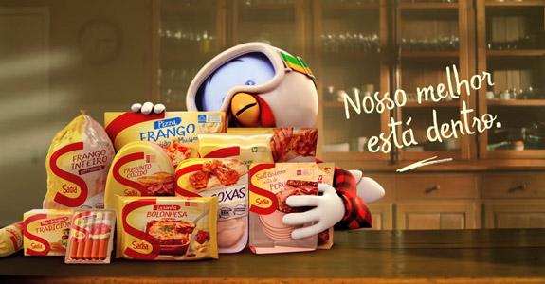
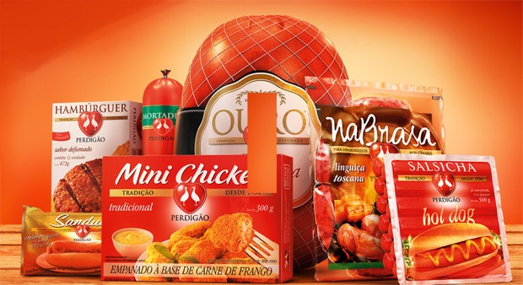
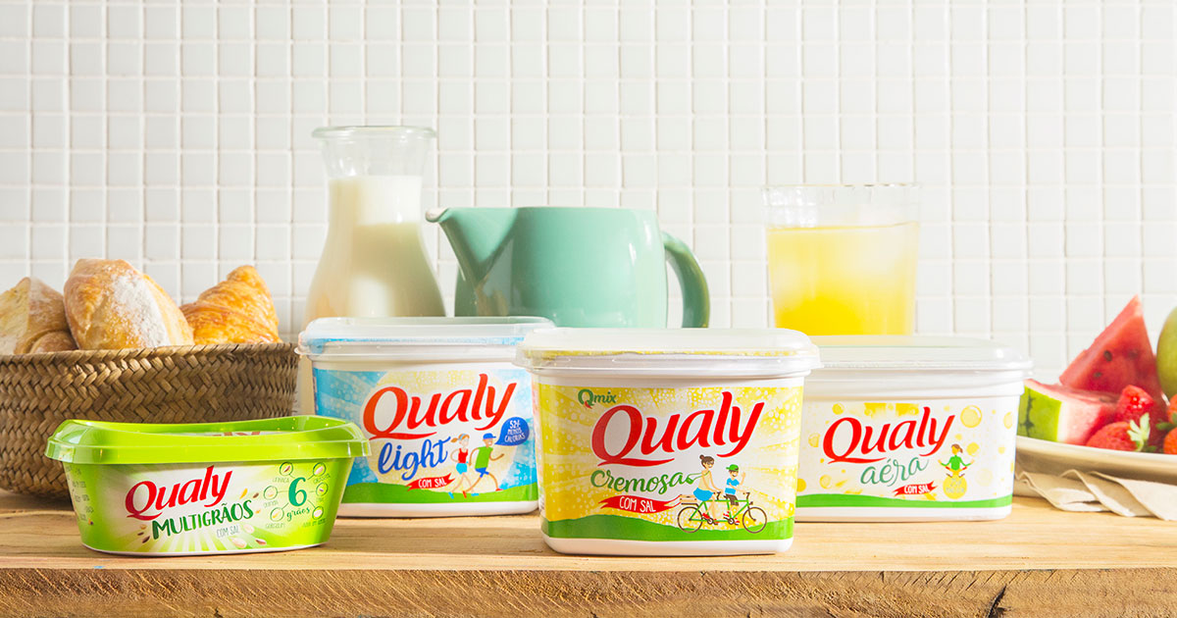
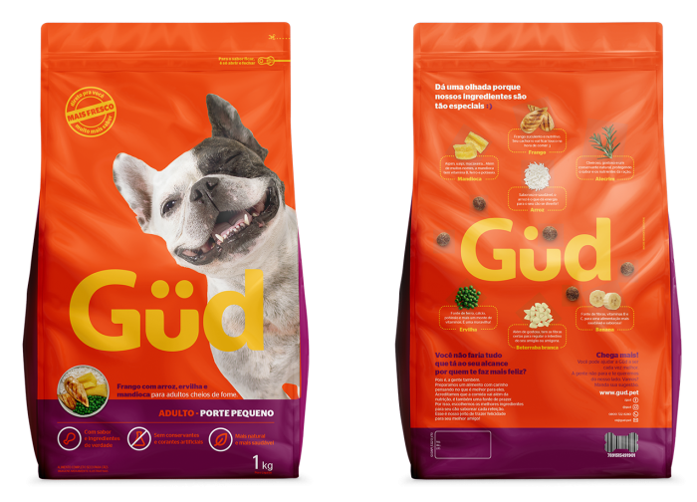
1. History of the company

Slide 6
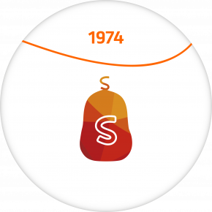
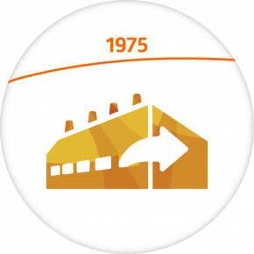
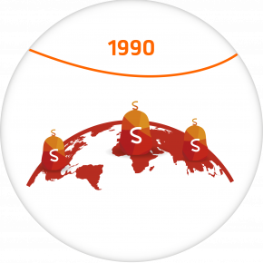
Timeline
1. History of the company
Sadia built Frigobrás (refrigerated facility company) and began the exportation of meat.
Sadia mascot was created in 1971 as the company trademark.
Perdigão was founded by two Italian families in Videira (SC).
Sadia was founded in Concordia (SC).
Sadia became the leader among national exporters to Middle-East.
Perdigão became a pionner in exporting Brazillian chicken meat to Saudi Arabia.
Sadia opened it doors around the world.
Sadia launched the Qualy brand.
Source: BRF website

Slide 7
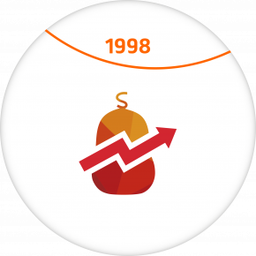
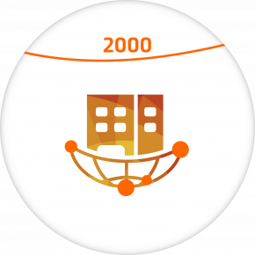
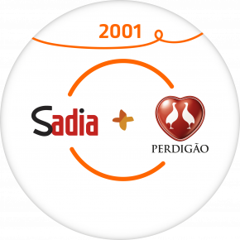
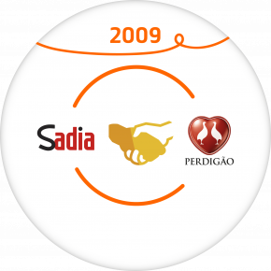
Timeline
1. History of the company
Perdigão became the first Brazillian company to be listed in Wall Street.
Perdigão adquired Batávia S. A. and partnership with CCLP.
Sadia reached its goal of exporting to over 40 countries.
Perdigão opened an office in London.
Perdigão and Sadia announced the unification process.
BRF was founded with the merger of the companies.
BFR started the operations of the OneFoods subsidiary, dedicated to the halal market.
Perdigão and Sadia formed BRF trading for the purpose of selling food.
Source: BRF website

Slide 8
Agenda
1. History of the company
2. External analysis
3. Internal analysis and financial position
4. Identification of the core strategy
5. Recommendations

Slide 9
2. External Analysis
Supplier Power
Rivarly of Competitors
The threat of new entrants
Competition from Substitutes
Buyers Power
Source: Porter

Slide 10
2. External Analysis - Rivarly of Competitors
Main Competitors
Another Competitors
Cooperatives
Companies
+ Local producers that operate in informal market with lower quality and prices
Source: Associação Brasileira de Proteína Animal e BRF report 2018

Slide 11
2. External Analysis – Rivarly of Competitors
Product Diversification
Marketshare of BRF in 2018
Source: BRF annual report 2017

Slide 12
2. External Analysis – Rivarly of Competitors
Indicators | Evaluation | Score
Number of competitors | High | 4
Concentration of market | High | 4
Competitors diversity | Very high | 5
Potential for product differentiation | Medium | 3
Costs of businesses | High | 4
 | Average | 4.0

Slide 13
2. External Analysis – Supplier Power
Poultry
Indicators | Evaluation | Score
Dependency of your company with one or a few suppliers | Zero | 0
*Possibility of replacing suppliers' products | High | 1
*Degree of importance of your company to suppliers | Very high | 0
Costs involved in changing supplier | Very low | 1
 | Average | 0.5
130,000 families owning small aviaries
3,100 production farms
15,000 fattening farms
Swine
System of Integrated Producers
*Indicator with inverted score.
Source: Mapeamento e Quantificação da Cadeia de Suínos e Associação Brasileira de Proteína Animal

Slide 14
2. External Analysis – Buyers Power
Food Retailers
Indicators | Evaluation | Score
Price sensitivity | Medium | 3
Bargaining power | High | 4
Concetration of industry | Very high | 5
*Integration among suppliers | Medium | 3
Capacity to determine the prices | Medium | 3
 | Average | 3.6
R$ 432,9 billions of revenue in 2018
= Represent 35% of revenue
*Indicator with inverted score.
+ Small retailers with less power
Source:BRF anual report and IBEVAR ranking 2018

Slide 15
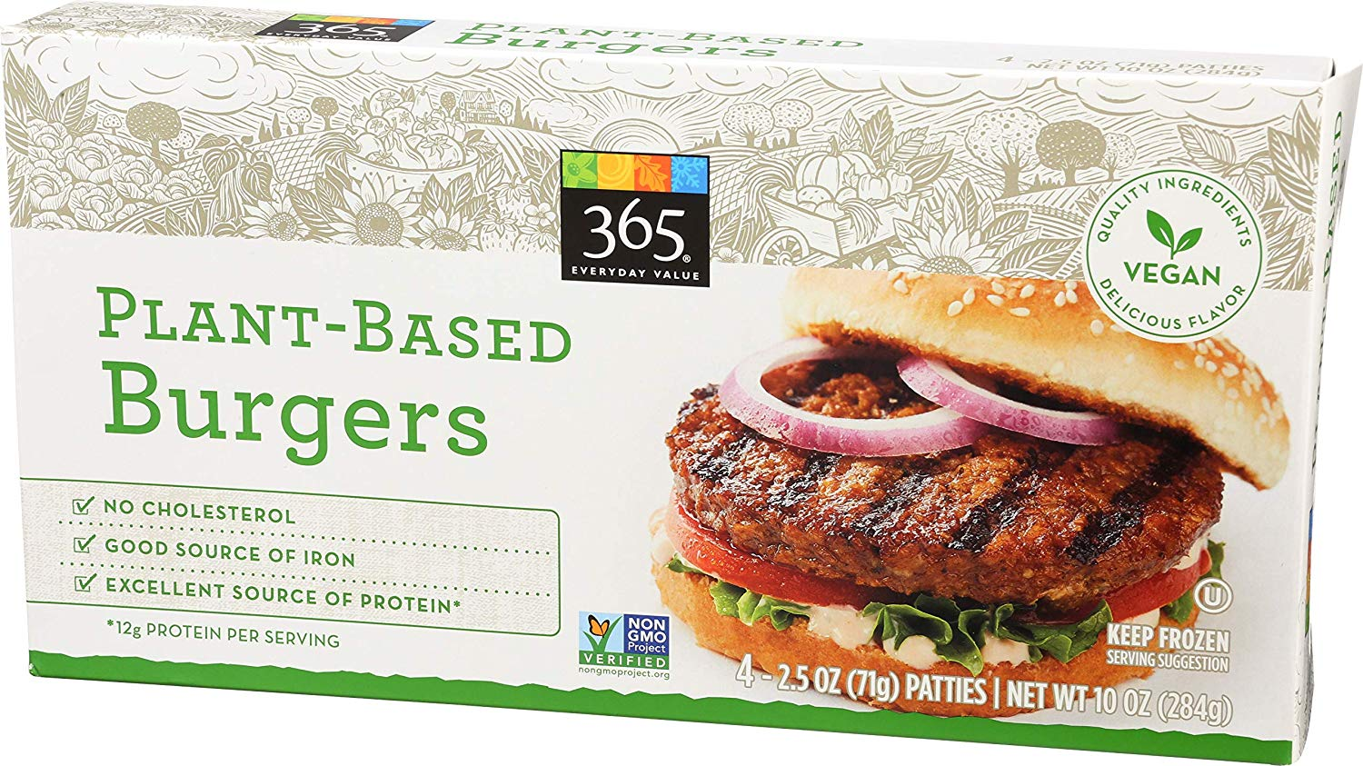
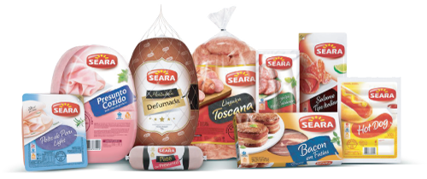
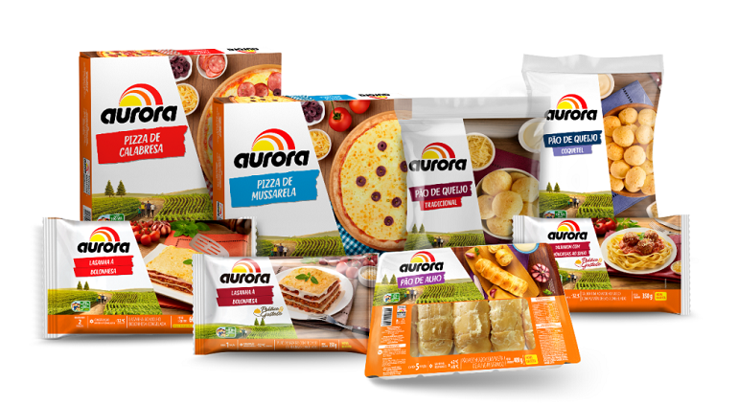
2. External Analysis – Competition from Substitutes
Diversification of products and brands
Indicators | Evaluation | Score
Propensity of buyers to replace brands | Medium | 3
Substitute products availability | High | 4
Impact of prices | Medium | 3
Cannibalization of portfolios | High | 4
 | Average | 3.7
*Indicator with inverted score.
Source:BRF annual report

Slide 16
2. External Analysis – Threat of New Entrants
Production Specifications
Indicators | Evaluation | Score
*Investments in production | Medium | 2
*Difficult to acess suppliers | High | 1
*Difficult to acess channels | Medium | 2
*Legal barries | Medium | 2
*Valorization of current brands | Very high | 0
 | Average | 1.4
Contrats with suppliers (integrated system)
Legal barriers
Exports qualification (Halal slaughter)
*Indicator with inverted score.
Source:BRF annual report

Slide 17
2. External Analysis – Final Frame
Rivarly of Competitors
Competition from Substitutes
Supplier Power
Threat of New Entrants
Buyers Power

Slide 18
Agenda
1. History of the company
2. External analysis
3. Internal analysis and financial position
4. Identification of the core strategy
5. Recommendations

Slide 19
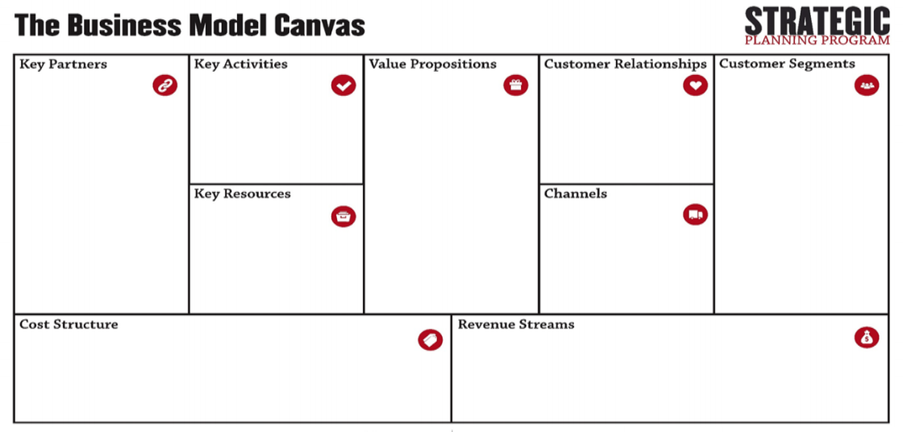
3. Internal Analysis and Financial Situation
Source:Purdue Strategic Planning Program

Slide 20
Agricultural R&I
researchd dedicated to continious innovations
Integrated supply management;
Brands management
low cost products
strong brand name
global presence
strategic location
innovation
Domestic and international suppliers of raw materials;
Integrated outgrowers e.g Agroceres, Danbred;
Local producers;
Third party international producers;
Packaging companies.
Creating new, convenient, practical and healthy products for consumers.
Capture value for the strong brands.
Following the pillars of governance, quality and innovation.
Diversified:
Mass market
Niche market
Customers looking for:
Convenience Practicality
Speed
Facility
Good meals
Existing industrial facilities (slide 3);
Distribution centers (slide 3);
Brand name;
Professionals with PhDs
diversified products
Strong network channels;to reach all Brazillian states and others 150 countries
Cost driven in most part of the segments;
research, development and innovation
Scale and quality of production;
Infrastructure costs (adaptation for halal units).
Consolidated operating activities;;distribution,selling,manufacturing
Consolidated investing activities e.g fixed assets,stocks and bonds
Consolidated financing activities from creditors and investors

Slide 21
3. Internal Analysis and Financial Situation
Financial Indicators (Billion R$)
 | 2015 | 2016 | 2017 | 2018
Total revenue | 32.20 | 33.73 | 33.47 | 30.19
Gross profit | 10.10 | 7.53 | 6.90 | 4.87
Operating income | 4.23 | 1.82 | 0.74 | -0.21
Net profit | 3.11 | -0,37 | -1.13 | -4.45
Source: Investing.com

Slide 22
Agenda
1. History of the company
2. External analysis
3. Internal analysis and financial position
4. Identification of the core strategy
5. Recommendations

Slide 23
4. Identification of the core strategy

Slide 24
4. Identification of the core strategy
Question 1: What is “the core” of the business?
What are the business’ core capabilities? | Who are the business’ core customers? | What are the business’ cost advantages? | What are the business’ core products/services?
Innovation: strong brands, committed people and a robust and flexible operation; Governance: Ethics, integrity and leadership development; Quality in all processes, products and relationships; | B2B: bakery, restaurants, supermarkets and other retailers. | Competitive advantage - producers located in some international markets (lower production costs and efficiency gains in animal production in Brazil; Scale/Quality: -compete effectively with the main producers Programs designed to improve cost efficiency - Streamline supply chain, integrating demand, production, inventory management and customer service. | BRF has a big diversification (Sadia, Perdigão, Batavo, Elegê, Qualy, Cotoché, Perdix) Sadia and Perdigão are the most important brands Sadia bet on the “ready dishes” (lasanna, stroganoff) Perdigão bet on “built-in products”: the pepperoni sausage as a leading product

Slide 25
4. Identification of the core strategy
Question 2: What are sources of full potential to “deepen” the core?
Strategic | Operational | Organizational | Financial
Pillars of corporate culture, quality, innovation, branding, and e-commerce 150 countries + de 220 million custumers + 40% of the international sales volume comes from own distribution 58 own factories in 9 countries + 4 thousand SKUs adapted to the characteristics of each region in which they operate | 440 thousand monthly deliveries to customers in Brazil Smart packaging Have sales teams directed to each client (bakery, supermarkets) Technology in the whole process Sustainability | 3.4 thousand people involved in discussions of attributes and commitments 89% of employees declared themselves engaged 17.80% was the turnover rate in 2017, well below the 28.21% rate recorded in 2015 Transparency channel | R$ 684.6 million were invested in 2017, focusing on the growth of production and efficiency Restructuring plan: (i) divestments in Europe, Thailand and Argentina; (ii) sale of non-operating assets; (iii) better management of working capital, mainly frozen raw material and finished product stocks; and (iv) securitization of receivables Expects a cash injection of. approximately R $ 5 billion

Slide 26
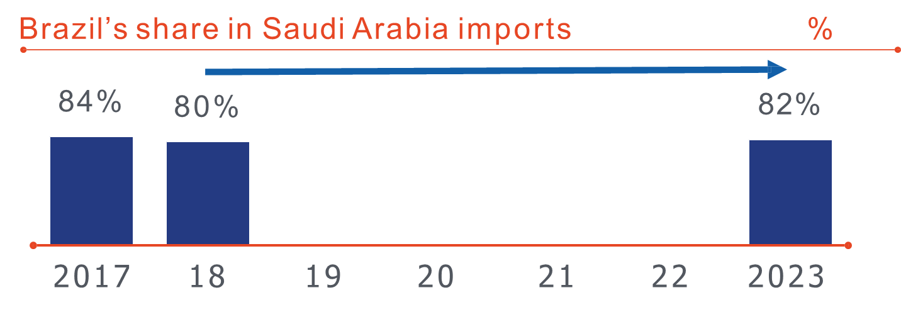
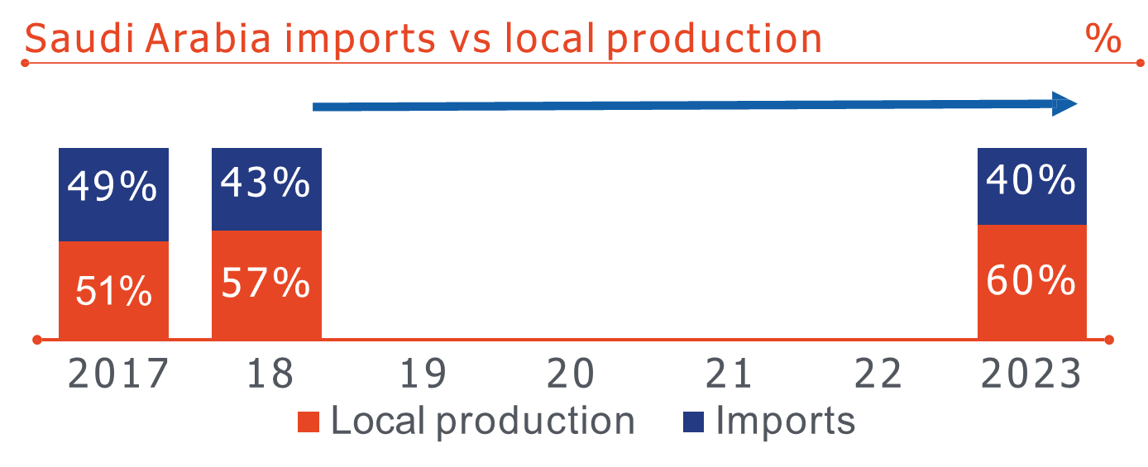
4. Identification of the core strategy
Question 3: What adjacencies should we extend into?
Some Recommendations
New market opportunities:
Opportunities for growth in the Middle East – with diversification of products in Saudi Arabia and Turkey;
Source: BRF report and

Slide 27
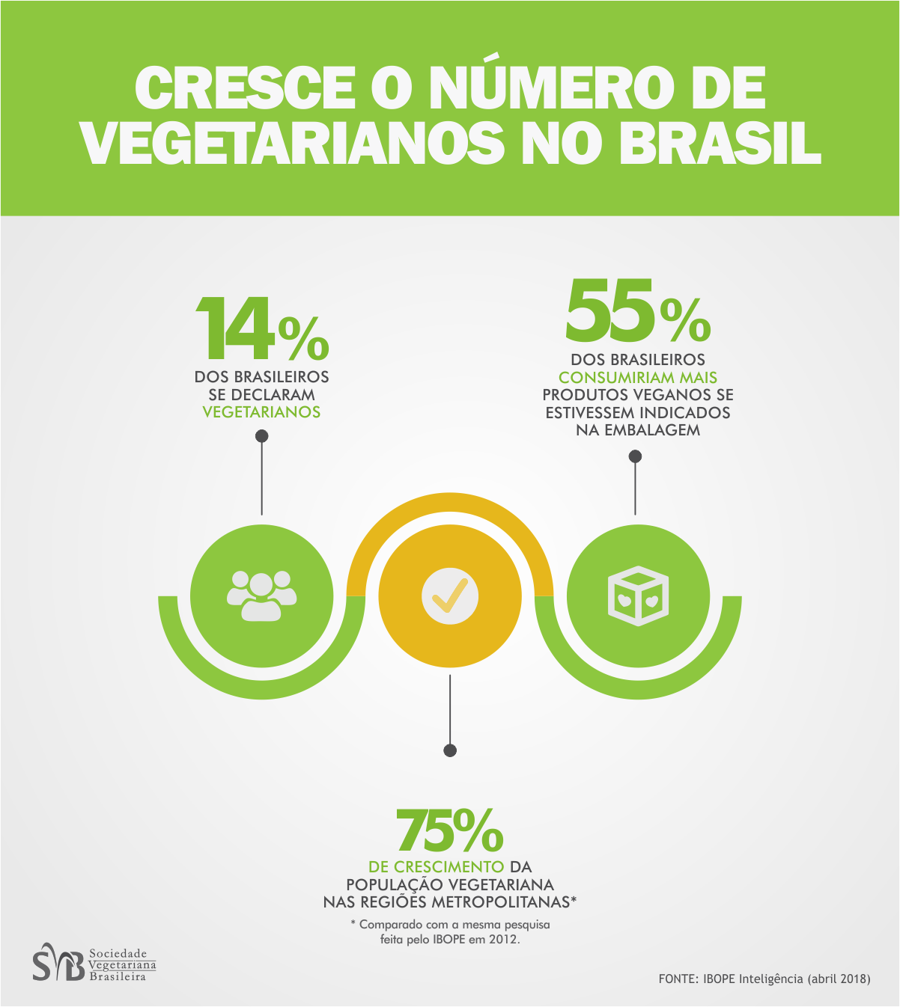
4. Identification of the core strategy
Question 3: What adjacencies should we extend into?
Some Recommendations
New market opportunities:
Opportunities for growth in healthy and local food.
Source: Revista Exame e Sociedade Brasileira de Vegetarianos

Slide 28
4. Identification of the core strategy
Question 3: What adjacencies should we extend into?
New businesses
One Foods BRF Subsidiary in the Middle East - harness productive capacity, product portfolio and channels;
BRF Ingredients - new solutions in food ingredientes, animal nutrition, plant nutrition and health and wellness.
Source: One Foods website and BRF ingredients website

Slide 29
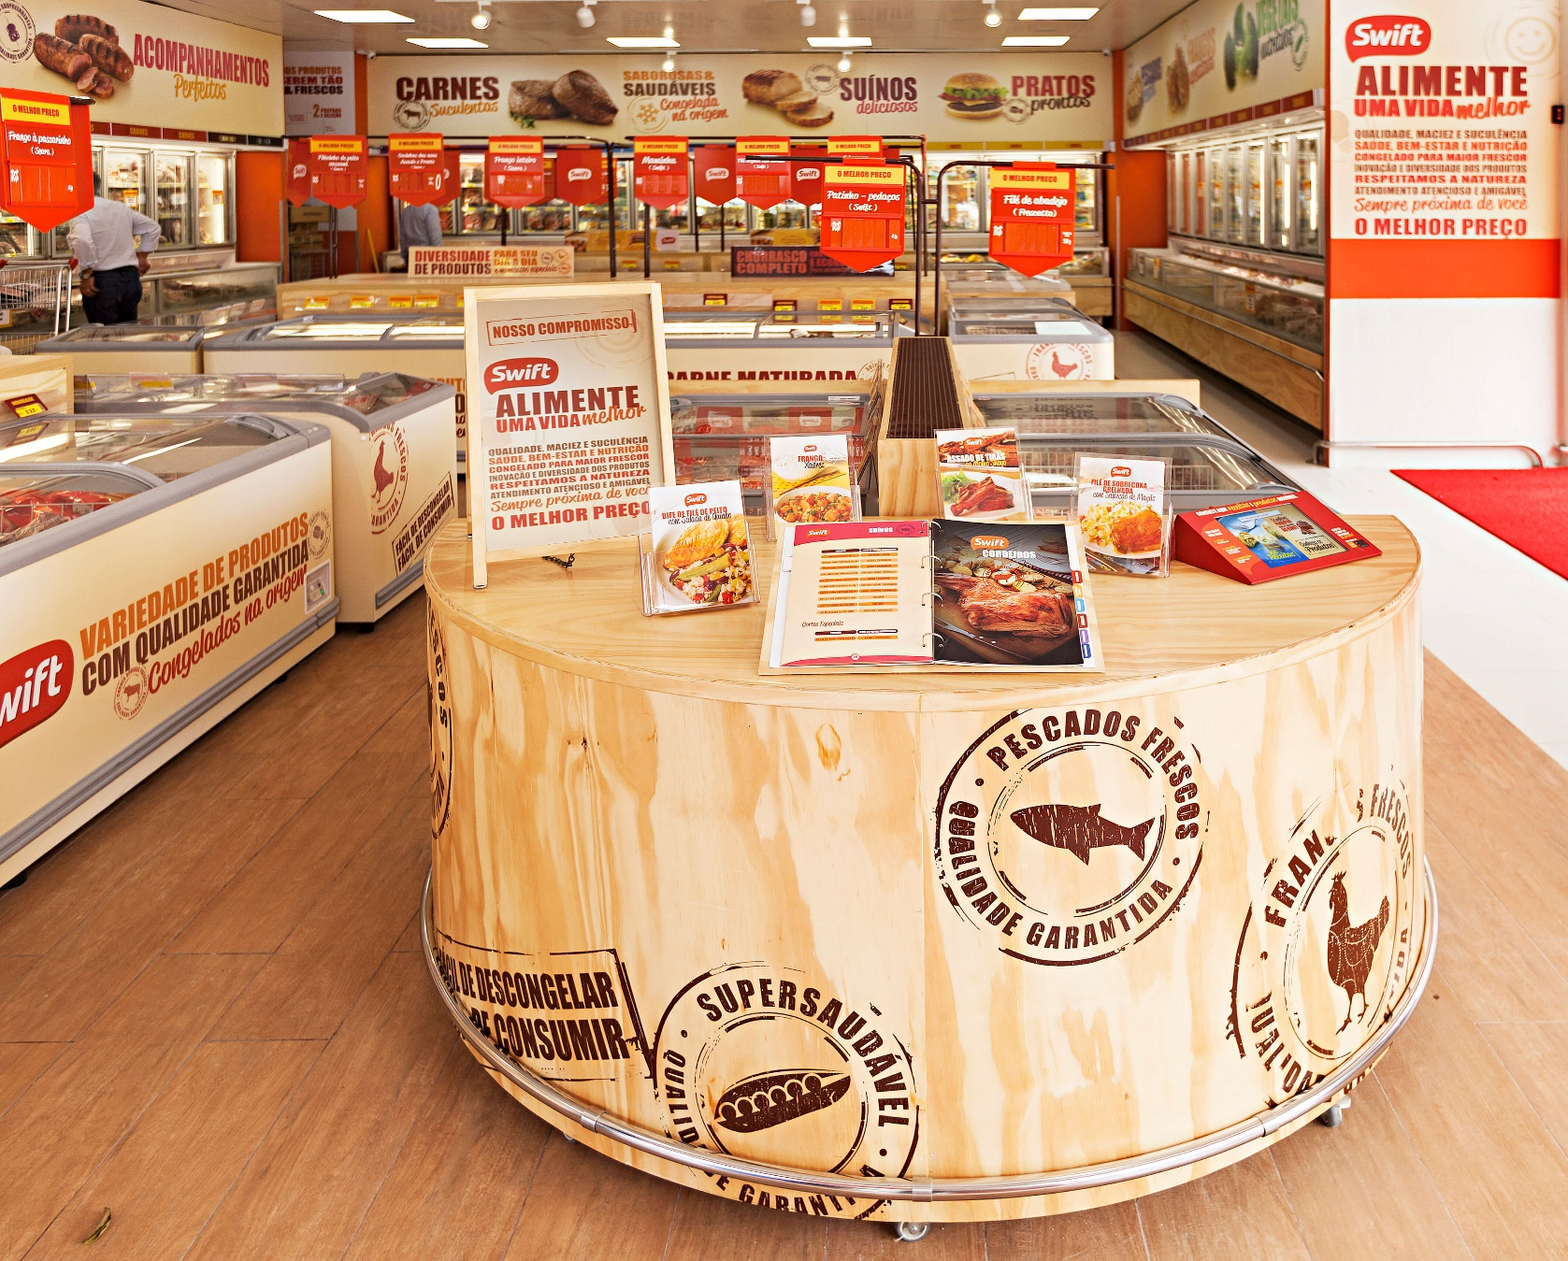
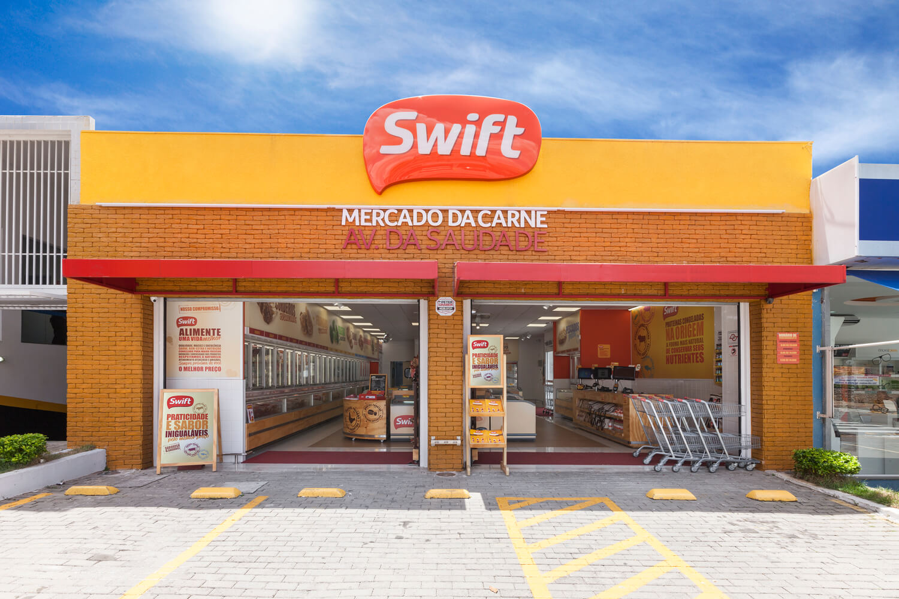
4. Identification of the core strategy
Question 3: What adjacencies should we extend into?
New channels
Opportunities in food service partnerships;
Opportunities in direct distribution – increase margins.

Slide 30
4. Identification of the core strategy
Question 4: When and how will I need to redefine the core?
BRF is today a company with strong brands because did well-made acquisitions, has well defined strategies and reaches a broad market with excellence.
The environment today is favorable to this business model. Only time, political, economic, social / natural and technological factors will generate a need to change the core.
The right moment to redefine the core is when the external environment and its variables demand.

Slide 31
Agenda
1. History of the company
2. External analysis
3. Internal analysis and financial position
4. Identification of the core strategy
5. Recommendations

Slide 32
5. Recommendations – Future Scenario
Data driven framework for adapting to changes over mid and long term
Uncertainty | Response
Risk health risk, recall off tons of chicken, animal disease outbreak, cross border operation risk. | Forecast based on historical occurrences
Structural uncertainties Trade barriers, government policies, chinese government anti dumping investigation, pressure from local producers, Saudi Arabia’s no stunning requirement. | Multiple scenario based planning which takes into consideration the range of uncertainty
Unknowables “Carne fraca” operation, “Trapaça” operation, rapidly changing digital environment, emerging markets. | Develpop perceptual skills to ensure rapid and improved reacting skills.

Slide 33
5. Recommendations
Strategic Projects:
Grow in the Middle East –diversification of products mainly in Saudi Arabia and Turkey;
Increase the portfolio in healthy food;
Create product line based on vegan, vegetarian and allergics;
Grown the business of ingredient in animal nutrition;
Create iniciatives for food service or direct distribution.
Attention Points:
In-depth analysis of stakeholders and shareholders (Beware of scandals: “Operação Carne Fraca”);
Strategic Talent Management

Slide 34
Thank you

Slide 35
UNITED STATES SECURITIES AND EXCHANGE COMMISSION Washington, D.C. 20549 FORM 20-F, available at .https://s3.amazonaws.com/mz-filemanager/4d44a134-36cc-4fea-b520-393c4aceabb2/265334a0-2259-4663-89fe-ed7b84386e48_brfform20f_2018.htm%20-%20Generated%20by%20SEC%20Publisher%20for%20SEC%20Filing.pdf
BRF STRATEGIC AND COMPETITVE ADVANTAGES. available at https://www.brf-global.com/en/about/brf/strategies-and-competitive-advantages/https://www.brf-global.com/en/about/brf/strategies-and-competitive-advantages/
ILIYA BARAEV FUTURE SCENERIO PLANNING IN STRATEGIC MANAGEMENT
ALLAN GRAY FRAMEWORKS OF STRATEGY: ANALYSIS AND DEVELOPMENT
FAVA NEVES DEMAND DRIVEN STRATEGIC PLANING
References

