Slide 1
Economies of scale and imperfect competition – part i
Econ 490
International Economics
UIUC, Fall 2019
Mauro Rodrigues

Slide 2
Economies of scale Some Definitions
Constant returns to scale
If production increases, costs vary proportionally
Cost per unit does not depend on total production
Market size does not matter
Economies of scale
If production increases, cost per unit goes down
Market size matters
Trade can affect market size

Slide 3
Economies of scale Some Definitions
Internal economies of scale
At the firm level
Firm internalizes that the more it produces, the lower is the cost per unit
For instance, in the presence of fixed costs
External economies of scale
At the industry level
Individually, each firm is unable to affect its industry’s cost per unit
But jointly firms can move industry productivity
Externality, case for industrial policy

Slide 4
Krugman model Motivation
We first talk about internal economies of scale and trade
Krugman model
Consumers value product diversity
There are different varieties of a given good
Products are therefore heterogenous
Varieties are not perfect substitutes
Producers have market power (imperfect competition)
Market size matters
Consumers have access to a wider range of products
Trade enlarges market and provides access to more variety

Slide 5
Krugman model Intraindustry trade
Therefore, we have intraindustry trade
For a given industry, varieties are both exported and imported by the same country
We can have trade between similar countries (in the limit, identical countries)
Trade provides access to more varieties
North-North trade: between developed countries
Ricardian and Heckscher-Ohlin models
Trade – explore differences between countries
Between distinct countries
North-South trade: between developed countries and developing countries
Interindustry trade:
Homogeneous goods
Countries either export or import the product of an industry

Slide 6
Intraindustry trade Some Facts
Large fraction of world trade is between developed countries (North-North trade)
For instance, in the European Union (EU):
63% of exports destined to other EU countries
63% of imports also from other EU countries
Among developed countries, share of intraindustry trade is larger

Slide 7
Intraindustry trade Gruber-Lloyd Index
Intraindustry trade index (Gruber-Lloyd) for a given sector $i$:
$${GL}_{i}=1−\frac{\left|X_{i}−M_{i}\right|}{X_{i}+M_{i}}$$
$X_{i}$: exports of industry $i$
$M_{i}$: imports of industry $i$
${GL}_{i}$ is a number between zero and 1
If trade is only of the intraindustry type, then $X_{i}=M_{i}$, and ${GL}_{i}=1$
If trade is only of the interindustry type, that either $X_{i}=0$ or $M_{i}=0,$ which implies that ${GL}_{i}=0$
Therefore, the closer ${GL}_{i}$ to 1, the more important is the intraindustry component

Slide 8
[Table from Van Marrewijk, C. International Trade. Oxford U Press]

Slide 9
[Figure from Van Marrewijk, C. International Trade. Oxford U Press]
8.3 evolution of intra-industry trade; global weighted average, 1962-2006
0.5
0.4
GL 3-digit
0.3
Grubel-Lloyd index
GL 5-digit
0.2
0.1
year
1962
1966
1970
1974
1978
1982
1986
1990
1994
1998
2002
2006

Slide 10
[Table from Van Marrewijk, C. International Trade. Oxford U Press]

Slide 11
Krugman model Outline
Reference: Krugman, P. R. (1979). “Increasing returns, monopolistic competition, and international trade.” Journal of International Economics 9: 469-479.
http://ideas.repec.org/a/eee/inecon/v9y1979i4p469-479.html
Only one sector, composed of different varieties of the same good
Imperfect substitutes
Monopolist competition: each variety produced by one firm (market power)
Economies of scale: production subject to a fixed cost

Slide 12
Krugman model Outline
Only one factor: labor
Shut down Heckscher-Ohlin channel
No differences in technology
Shut down Ricardian channel
No differences in preferences
Countries only differ in their sizes (number of workers)
But even if they have the same size, we will have trade
Trade motivated by access to a larger set of varieties

Slide 13
Krugman model Preferences
A given country (Home) has $\overline{L}$ identical consumers/workers
Measure of country size
In this country, suppose consumers have access to $i=1,2,…,n$ varieties
Initially autarchy, so that consumers have access only to varieties produced in their country
Let’s specialize and assume a CES utility function to represent the consumer’s preference over available varieties
$$U=U\left(c_{1},c_{2},…,c_{n}\right)=\frac{1}{γ}\left[c_{1}^{γ}+c_{2}^{γ}+…+c_{n}^{γ}\right]=\frac{1}{γ}\sum_{i=1}^{n}{c_{i}^{γ}}$$
Where $c_{i}$ is individual consumption of variety $i$
$γ∈(0,1)$ is a preference parameter

Slide 14
Krugman model Preferences
Parameter $γ$ is key here
Because it is smaller than 1, varieties are not perfect substitutes
It induces product differentiation
To understand this, let’s draw the indifference curve between two varieties $i$ and $j$
Slope is the marginal rate of substitution (MRS), which is the ratio of marginal utilities
$${MRS}_{c_{i},c_{j}}=\frac{∂U/∂c_{i}}{∂U/∂c_{j}}=\frac{c_{i}^{γ−1}}{c_{j}^{γ−1}}={\left(\frac{c_{j}}{c_{i}}\right)}^{1−γ}$$
Indifference curves are convex towards the origin

Slide 15
Figure 1
Indifference curve
$$c_{j}$$
$$U=\overline{U}$$
$$c_{i}$$
15

Slide 16
Krugman model Preferences
If $γ=1$, MRS is constant
Indifference curves are linear
Perfect substitutes; homogeneous products
Since we assume $γ<1$, we will have product differentiation
This assumption also induces preference for variety
For simplicity, assume that prices of varieties is 1; consumption is constant across varieties
Let’s then increase the number of varieties available, but keep the consumer’s budget unchanged
She will have to cut consumption of each variety by half. Is she better off?

Slide 17
Krugman model Preferences
With income $I$ and $n$ varieties, consumers gets $c_{i}=I/n$. Her utility is:
$$U=\frac{1}{γ}\sum_{i=1}^{n}{c_{i}^{γ}=\frac{1}{γ}n{\left(\frac{I}{n}\right)}^{γ}=}\frac{1}{γ}I^{γ}n^{1−γ}$$
Therefore, since $γ<1$, if we increase $n$ (keeping income constant), utility rises
Increase in access to more varieties raises utility
But dividing budget across more varieties lowers welfare
If $γ<1$, the first effect dominates

Slide 18
Krugman model Preferences
So far, we considered a discrete set of varieties – $i=1,2,…,n$
It’s easier to solve the model with a continuum of varieties – $i∈[0,n]$
Interpret $n$ as the size of the set of available varieties
Higher $n$, access to a wider range of differentiated products
In the utility function, replace sum by an integral:
$$U=\frac{1}{γ}\int_{0}^{n}{c_{i}^{γ}di}, 0<γ<1$$

Slide 19
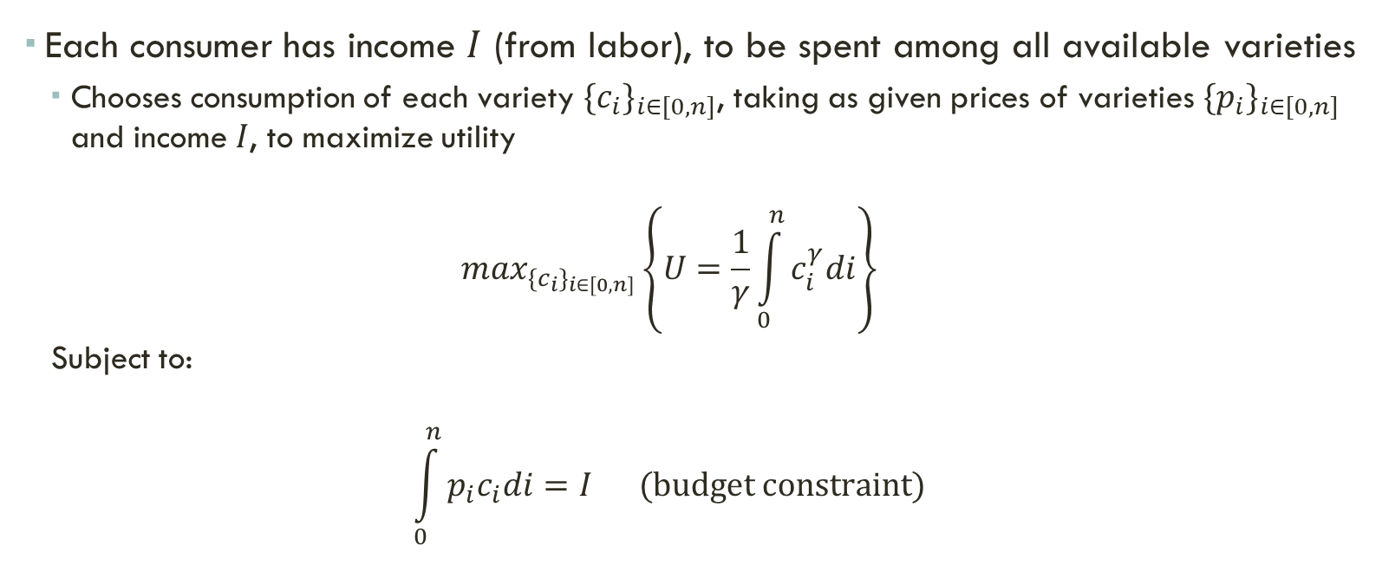
Consumers Consumer’s problem
Each consumer has income $I$ (from labor), to be spent among all available varieties
Chooses consumption of each variety ${{\{c}_{i}\}}_{i∈[0,n]}$, taking as given prices of varieties ${{\{p}_{i}\}}_{i∈[0,n]}$ and income $I$, to maximize utility
$$\max_{{{\{c}_{i}\}}_{i∈[0,n]}}\left\{U=\frac{1}{γ}\int_{0}^{n}{c_{i}^{γ}di}\right\}$$
Subject to:
$$\int_{0}^{n}{p_{i}c_{i}di}=I (budget constraint)$$

Slide 20
Consumers Consumer’s problem
$p_{i}$: price of variety $i∈[0,n]$
$c_{i}$: individual consumption of variety $i∈[0,n]$
$p_{i}c_{i}$: individual spending on variety $i∈[0,n]$
When we integrate across available varieties, we get total spending by the consumer
It has to be equal to income

Slide 21

Consumers Consumer’s problem
Lagrangian:
$$ℒ=\frac{1}{γ}\int_{0}^{n}{c_{i}^{γ}di}+λ\left[I−\int_{0}^{n}{p_{i}c_{i}di}\right]$$
First-order condition (with respect to $c_{i}$):
$$\frac{∂ℒ}{∂c_{i}}=c_{ⅈ}^{γ−1}−λp_{i}=0$$

Slide 22
Consumers Demand Functions
Solving for $c_{i}$ gives us the individual demand for variety $i$
$$c_{i}={\left(λp_{i}\right)}^{\frac{1}{γ−1}}$$
Since there are $\overline{L}$ identical consumers, market demand for variety $i$is simply:
$${x_{i}=\overline{L}c}_{i}$$
$x_{i}=\overline{L}{\left(λp_{i}\right)}^{\frac{1}{γ−1}}$ (1)
This equation will enter as a constraint in variety $i$ producer’s problem

Slide 23
Consumers Demand Functions
Market demand is isoelastic (has constant price elasticity)
Price elasticity of demand:
$$ε=−\frac{dlnx_{i}}{dlnp_{i}}$$
Notice that:
$$lnx_{i}=ln\overline{L}+\frac{1}{γ−1}[lnλ+lnp_{i}]$$
Then elasticity is:
$$ε=−\frac{dlnx_{i}}{dlnp_{i}}=\frac{1}{1−γ}$$
Larger $γ$  Demand more elastic
Consumers substitute more easily across varieties
Less product differentiation

Slide 24
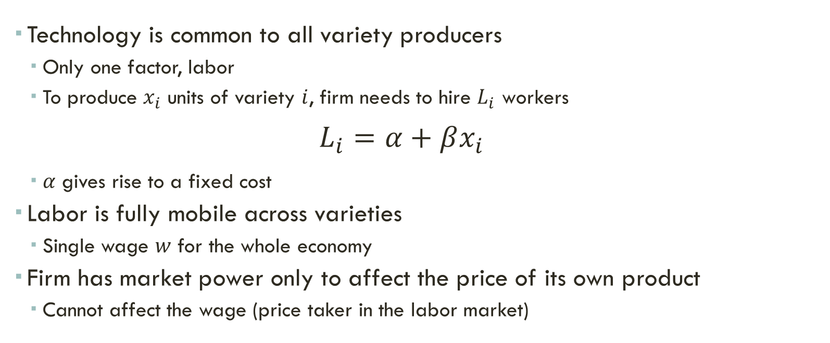
production Technology
Technology is common to all variety producers
Only one factor, labor
To produce $x_{i}$ units of variety $i$, firm needs to hire $L_{i}$ workers
$$L_{i}=α+βx_{i}$$
$α$ gives rise to a fixed cost
Labor is fully mobile across varieties
Single wage $w$ for the whole economy
Firm has market power only to affect the price of its own product
Cannot affect the wage (price taker in the labor market)

Slide 25

production Technology
Variety $i$’s total cost is therefore:
$$C\left(x_{i}\right)=wL_{i}=w(α+βx_{i})$$
Then:
$$C\left(x_{i}\right)=αw+βwx_{i}$$
Fixed cost: $αw$
Variable cost: $βwx_{i}$

Slide 26

production Technology
Average cost (cost per unit):
$$AC=\frac{C\left(x_{i}\right)}{x_{i}}=\frac{αw}{x_{i}}+βw$$
Declining, converges to $βw$ as production goes to infinity
Marginal cost:
$$MC=C^{′}\left(x_{i}\right)=βw$$

Slide 27
Figure 2
Cost Functions
$${AC, MC}_{}$$
$$AC=\frac{αw}{x_{i}}+βw$$
$$MC=βw$$
$$x_{i}$$
27

Slide 28
Market structure Monopolistic Competition
Monopolistic competition:
Variety $i$ can be produced by only one producer
Producer has therefore market power (can set price above marginal cost)
If profits are positive, new varieties are introduced
This creates a link between market size and the range of available varieties
Larger markets have larger sets of varieties
Higher welfare

Slide 29
Market structure Producer’s problem
Variety $i$’s producer chooses price $p_{i}$ and quantity $x_{i}$ to maximize profits
Take as given the wage $w$…
… and the market demand function (1) from consumers’ decisions
$$\max_{{p_{i},x}_{i}}\left\{π_{i}={p_{i}x}_{i}−C\left(x_{i}\right)={p_{i}x}_{i}−αw−βwx_{i}\right\}$$
Subject to:
$$x_{i}=\overline{L}{\left(λp_{i}\right)}^{\frac{1}{γ−1}}$$

Slide 30

Market structure Producer’s problem
Easier to solve for $p_{i}$ and plug into profit function:
$$p_{i}={\left(\frac{x_{i}}{\overline{L}}\right)}^{γ−1}\frac{1}{λ}=\frac{x_{i}^{γ−1}{\overline{L}}^{1−γ}}{λ} (2)$$
Profit function:
$$π_{i}={p_{i}x}_{i}−αw−βwx_{i}=\frac{x_{i}^{γ−1}{\overline{L}}^{1−γ}}{λ}x_{i}−αw−βwx_{i}$$
$$π_{i}=\frac{x_{i}^{γ}{\overline{L}}^{1−γ}}{λ}−αw−βwx_{i}$$
Maximization problem is now:
$$\max_{x_{i}}\left\{π_{i}=\frac{x_{i}^{γ}{\overline{L}}^{1−γ}}{λ}−αw−βwx_{i}\right\}$$

Slide 31
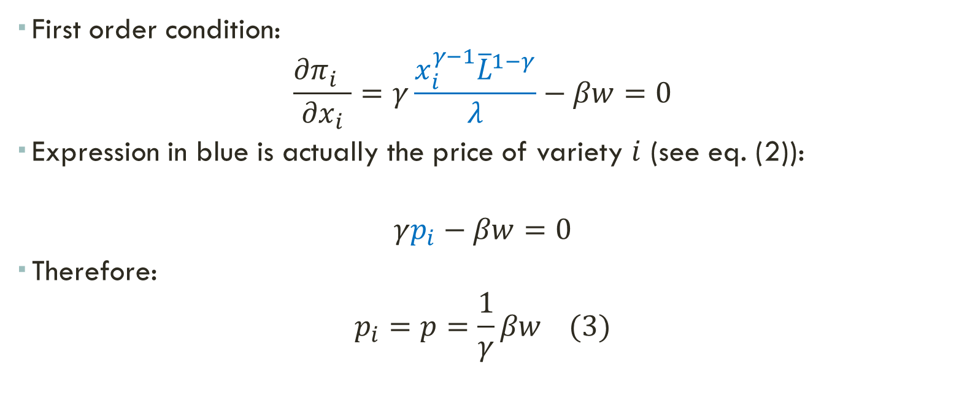
Market structure Producer’s problem
First order condition:
$$\frac{∂π_{i}^{}}{∂x_{i}}=γ\frac{x_{i}^{γ−1}{\overline{L}}^{1−γ}}{λ}−βw=0$$
Expression in blue is actually the price of variety $i$ (see eq. (2)):
$$γp_{i}−βw=0$$
Therefore:
$$p_{i}=p=\frac{1}{γ}βw (3)$$

Slide 32
Market structure Producer’s problem
Since $γ<1$, then $\frac{1}{γ}>1$
Firms are therefore able to charge a markup over the marginal cost ($βw$)
Large $γ$, smaller markup
Closer substitution between varieties
In equilibrium, all firms end up charging the same price
Same marginal cost (common tech)
Same price-elasticity of demand (symmetry in preference)
From the market demand (1), it follows that all firms produce the same quantity:
$$x_{i}=x=\overline{L}{\left(λp\right)}^{\frac{1}{γ−1}}$$

Slide 33
Market structure Entry
If profits are positive, more varieties are introduced
Therefore, the number of varieties is such that profits are zero
$$π=px−αw−βwx=0$$
$$x\left(p−βw\right)=αw$$
From the firm’s first order condition (3), $p=βw/γ$. Then:
$$x\left(\frac{βw}{γ}−βw\right)=αw$$
$$x=\frac{α}{β}\frac{γ}{1−γ}$$
Therefore, production per variety does not depend on market size
Effect of market size works only through the range of available varieties
This is specific to the CES preference

Slide 34
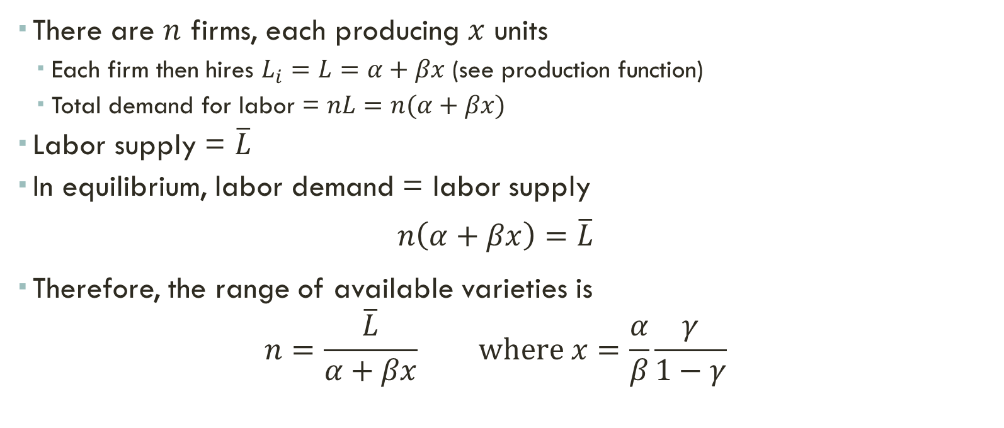
equilibrium Labor Market
There are $n$ firms, each producing $x$ units
Each firm then hires $L_{i}=L=α+βx$ (see production function)
Total demand for labor = $nL=n(α+βx)$
Labor supply = $\overline{L}$
In equilibrium, labor demand = labor supply
$$n\left(α+βx\right)=\overline{L}$$
Therefore, the range of available varieties is
$$n=\frac{\overline{L}}{α+βx} where x=\frac{α}{β}\frac{γ}{1−γ}$$

Slide 35
equilibrium Extent of the market
KEY RESULT
In a closed economy, larger markets ($\overline{L}$) will have a wider set of differentiated varieties ($n$)

Slide 36
equilibrium Scale and Welfare
Larger scale will also affect welfare
Welfare measured using utility function of representative consumer
$$U=\frac{1}{γ}\int_{0}^{n}{c_{i}^{γ}di}$$
Variety $i$’s total production/consumption = $x$
Individual consumption: $c_{i}=x/\overline{L}$
Range of varieties: $n=\frac{\overline{L}}{α+βx}$

Slide 37
equilibrium Scale and Welfare
Welfare is therefore:
$$U=\frac{1}{γ}\int_{0}^{n}{{\left(\frac{x}{\overline{L}}\right)}^{γ}di}=\frac{1}{γ}n{\left(\frac{x}{\overline{L}}\right)}^{γ}$$
$$U=\frac{1}{γ}\left(\frac{\overline{L}}{α+βx}\right){\left(\frac{x}{\overline{L}}\right)}^{γ}=\frac{1}{γ}\frac{x^{γ}}{α+βx}{\overline{L}}^{1−γ}$$
Then, in a closed economy, larger markets will also display higher welfare
Since $γ<1$, $U$ is increasing in $\overline{L}$

