Slide 1
Aging and Reproductive health

Slide 2
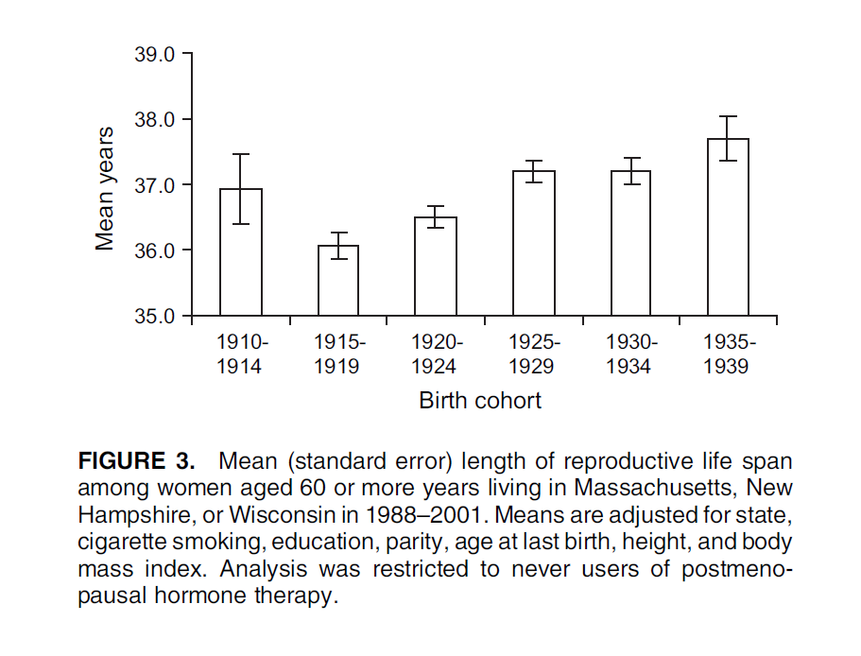
Female Reproductive lifespan
Subfecundity
Subfecundity
Menarche
menopause
Menarche=
Onset of menstruation
Absence of menses 12 consecutive months

Slide 3
Menopause & women’s health
Globally, 1 of 3 women dies from CVD

Slide 4
Hormones and Cadiovascular disease

Slide 5
Nurse study
Objective: assess the benefits and risks of estrogen + progestin HRT treatment
Design: a prospective cohort study
Population : 32,317 postmenopausal married registered nurses ages 30-55 free for coronary disease from 11 States in the US
Data Source: Questionnaire Baseline 1976+ follow ups 1978, 1979 & 1980 & Medical records , State vital records, hospital records, death certificates to ascertain CHD
Measures
Outcome: myocardial infarctions and fatal coronary heart disease
Exposure: HRT treatment (unopposed estrogens )
Covariates: age prior coronary disease , diabetes, hypertension, high serum cholesterol levels, parental history of myocardial infarction, height, weight, smoking, and use of OCPs.
Main Results
Reduced age-adjusted RR of CVD associated with HRT (RR=0.5). Current users RR=0.3, past users RR=0.7
Conclusion: current hormone users had a reduced rate of coronary disease compared with women who had never used hormones. Confidence intervals were wide reflecting uncertainty about the precise magnitude of this protective effect
Rossouw et al JAMA. 2002 288(3):321-33.

Slide 6
HERS study
Objective: assess the benefits and risks of estrogen + progestin HRT treatment to prevent new CHD events among women with established coronary disease
Design: double blinded randomized control trial with clinical follow up every every 6 months
Setting : 20 clinical centers in the US
Population 1,380 HRT and 1,383 placebo postmenopausal women <80 years (average 66.7y) with established coronary disease and an intact uterus
Data Source: Questionnaire every 4 months and clinical examination every year
Measures
Outcome: CHD events (nonfatal myocardial infarction or CHD death)/ other cardiovascular outcomes such as, coronary artery bypass graft surgery or stroke, mortality, cancers, hip fracture, gall bladder disease, ect
Exposure: HRT treatment (estrogen +progestin) vs placebo treatment
Main Results
No difference in CHD events, or any other cardiovascular outcomes between HRT and non HRT
higher rates of CHD in the 1st year of treatment and lower risks in the 4th & 5th year
increased risk of VTE & gallbladder diseases
Conclusion: HRT treatment should not be recommended for preventing CHD unless women have already started the treatment to receive the health benefits in the 4th and 5th year of treatment.
Hulley et al

Slide 7
WHI study
Objective: assess the benefits and risks of estrogen + progestin HRT treatment
Design: double blinded randomized control trial with clinical follow up every every 6 months
Population : n=8,506 treatment & n=8,102 placebo: convenience sample of postmenopausal women 50-79 years (average 63.3 years ) .
Data Source: Questionnaire every 6 months and clinical examination every year
Measures
Outcome: CHD, breast cancer + global index (stroke, PE, endometrial cancer, hip fracture and death from other causes)
Exposure: HRT treatment (estrogen +progestin) vs placebo treatment
Covariates age, race/ethnicity, prior hormone use, duration of hormone use, BMI, blood pressure, smoking, parity, age at first birth, diabetes, hypertension, cholesterol, statin & asiprin use, aspirin, history of MI, angina, stroke, DVT, fracture and family history of breast cancer
Main Results
women in HRT arm were at increased risk of CHD (HR, 1.22; 95% CI, 1.09-1.36), breast cancer, stroke, and PE. HRT was protective of colorectal cancer and fractures. The absolute excess risks of events in the global index was 19 per 10,000 person-years attributable to the HRT
Conclusion: Trial stopped after 5 years, because HRT was associated with more harm than benefit. HRT should not be initiated or continued for the primary prevention of CHD.

Slide 8
WHI study
Study | Age | CVD risk factors | Type of HRT treatment
Nurse | 30-55 | Exclude women with previous MI or angina | Missing info from original Q Oestrogen alone
HERS | Average 66.7 | Women with CVD : MI, coronary artery bypass graft surgery, percutaneous coronary revascularization, or 50% occlusion of at least 1 major coronary artery | Oestrogen + Progestin
WHI | Average 63 years |  | Oestrogen + Progestin

Slide 9
Menopause
Hormones and Cadiovascular disease
Observational Studies
Meta-analysis 25 studies (including Nurse’s study)
RR=0.70 (0.65-0.75)
Randomized trials
HERS : women with preexisting CHD mean age (67 years)
RR=0.99 (0.80-1.22), and 1 year increase (1.52 (1.01-2.29)
WHI : WHI E + P shows an increase in CHD events at 5 years in the HRT group but no increase in WHI-E alone.
E+P RR=1.29 (1.02-1.63)/ E RR=0.91 (0.75-1.12)
Giordano et al. Am J Med Sci. 2015 July ; 350(1): 27–35
Notes:
The differential results between observational studies, such as NHS, and WHI studies were attributed to differences in study designs and study populations. The most prominent of these include: age and time since menopause, pre-existing CVD, the composition of the estrogen and progestin used, and their route of administration [22]

Slide 10
Timing hypothesis
Estrogen levels decrease with age while cardiovascular disease (CVD) events increase with age
WHI Stratified analysis by timing of treatment and time since treatment initiation
decreased risk when HRT started within 10 ys (HR, 0.76; (0.50-1.16)
The CHD-free survival curves cross at around 6 years (95% CI 2-10 years)
Difference between WHI-E + P and WHI-E
Danish Osteoporosis Prevention Study (DOPS) among women 45-58y indicates a 50% reduction in CHD risk if MHT was begun immediately after menopause.
Kronos Study (KEEPS) : women 42-56 years. no effect on atherosclerosis progression
ELITE: slower progression of CIMT in women treated early (<6 years) compared to those treated late (>10 years) after menopause
Giordano et al. Am J Med Sci. 2015 July ; 350(1): 27–35
Notes:
In 2005, Phillips and Langer proposed a unified hypothesis, the “timing hypothesis”, which stated that the time since menopause determined the effect of MHT on the cardiovascular system: MHT was cardioprotective in women who were perimenopausal or early postmenopausal, while MHT administered late in menopause had neutral or detrimental cardiovascular effects.
Subsequent follow up analyses of the WHI-E and WHI E + P studies that stratified data by age demonstrated a decreased HR for the primary outcomes of CHD death and non-fatal MI in women who began MHT within the first 10 years of menopause (HR, 0.76; 95%CI 0.50-1.16) and an increased HR in women who began therapy 10-19 years (HR, 1.10; 95%CI 0.84-1.45) or 20+ years after menopause (HR,1.28; 95%CI 1.03-1.58) (Figure 1)

Slide 11
The role of Estrogen in the cardiovascular system supports the timing hypothesis
Animal Models
E2 inhibits the vascular injury response (inhibitory effects on inflammation & neointima formation in injured arteries )
E2 (17 β-estradiol) delays CVD progression and attenuates the inflammatory response to acute vascular injury in animal models,
MPA blocks the vaso-protective effects of E2 in response to vascular injury(align with WHI-E + P findings)
E2 has age dependent effects on neointima formation and inflammation in vivo and in vitro—
differential effects of E2 in young and aged animals
Translational Studies
Human uterine arteries have differential responses to E2 dependent on time since menopause:
Increasing pro-inflammatory response to E2 of the arteries with increasing time post menopause supports the timing hypothesis
Giordano et al. Am J Med Sci. 2015 July ; 350(1): 27–35

