Slide 1
《The Entrepreneurial State：Debunking Public vs. Private Sector Myths》
——Mariana Mazzucato
Chapter 2
TECHNOLOGY, INNOVATION
AND GROWTH
Xu Kunwei

Slide 2
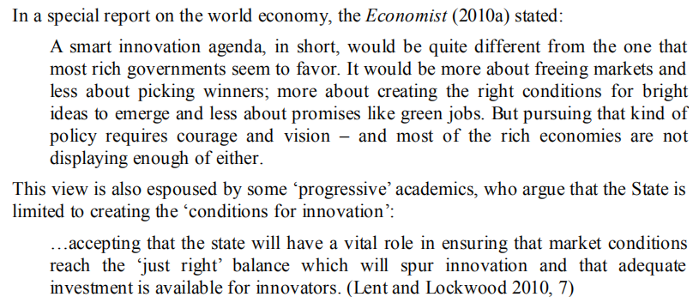
The Role of The State in Economic Growth
Maket Failure

Slide 3
The Role of The State in Economic Growth
Maket Failure
Adam Smith:
- “Invisible Hand”
The capitalist markets left on their own would self-regulate, with the State's role being limited to that of creating basic infrastructure (schools, hospitals, motorways) and making sure that private property
On this basis, liberal economists put forward that market failure is caused by external factors, public goods, asymmetric information, market with insufficient competition, and inefficient allocation of resources caused by principal-agent problems.
An important part of the government's work is to correct market failures, such as supporting basic research that is difficult to finance as a public good.

Slide 4
The Role of The State in Economic Growth
Economists, inspired by the work of Joseph Schumpeter (1883–1950), have gone further, asking that the government also spend on those specific areas that increase a nation’s capacity for innovation (reviewed further below). Support for innovation can take the form of investments made in R&D, infrastructure, labour skills, and in direct and indirect support for specific technologies and companies.
John Maynard Keynes:
- business investment(I)
- government investment (G)
- consumption spending (C)
- net exports (X−M)
- Keynesians have argued forcefully for the importance of using government spending.

Slide 5
Technology and Growth
Exogenous Growth Theory
Y = A (t) F (K, L)
Technological progress and productivity increase are the main driving forces of economic growth.
Endogenous or New Growth Theory
- Technology as the endogenous outcome of an R&D investment function, as well as investment in human capital formation.

Slide 6
From Market Failures to System Failures
- Nelson and Winter (1982) building on the work of Joseph Schumpeter (1934, 1942 [2003])argued that the production function framework (exogenous or endogenous) was in fact the wrong way to understand technological change. , they argued for an 'evolutionary theory' of production (and economic change), which delved inside the 'black box' of the production function in order to understand how innovation occurs and affects competition and economic growth.

Slide 7
From Market Failures to System Failures
Their work further developed into the creation of new system theories (Innovation System). A new system was pronounce righteousness "is a macro view system, its each kind of organization of public and private departments in the network, network of the various kinds of interaction and activity organization in hair, lead into the spread, modify, and the new technology," this is a kind of between macro and micro visual Angle, focus on stock, not only only is but cycle and to the spread of the economy.
On this basis, the system failure theory holds that innovation originates from the effective flow of knowledge and information within the innovation system, so what the government should do is to strengthen the foundation of knowledge (education and education training) and integration of different sectors to better promote commercialization.

Slide 8
Myths about Drivers of Innovationand Ineffective Innovation Policy
Myth 1: Innovation is about R&D
The relationship between R&D spending and fast-growing firms only holds in specific periods of the industry life-cycle, when competition is particularly fierce
Myth 2: Small is Beautiful
The most robust evidence available emphasizes not the role of small firms in the economy but to a greater extent the role of young high-growth firms. And while many high-growth firms are small, many small firms are not high growth.
Furthermore, small firms have lower average wages, fewer skilled workers, less training, fewer fringe benefits and higher instances of bankruptcy.Although there is much talk about small firms creating jobs, and increasingly a focus of policymakers, this is mainly a myth. While by definition small firms will create jobs, they will in fact also destroy a large number of jobs when they go out of business.

Slide 9
Myths about Drivers of Innovationand Ineffective Innovation Policy
Myth 3: Venture Capital is Risk Loving
in fact that it has been the State which has put up the money for Visions or for the early stages of idea, and kept the funds coming to those early, risky times of technology development, and which ultimately led to major technological changes over our lifetimes. One of the myths she debunks is that private Venture Capital is available for these risky investments.
Myth 4: We Live in a Knowledge Economy – Just Look at all the Patents!
The rise in patents does not however reflect a rise in innovation, but a change in patent laws and a rise in the strategic reasons why patents are being used.

Slide 10
Myths about Drivers of Innovationand Ineffective Innovation Policy
Myth 5: Europe's Problem is all about Commercialization
In fact, EU problems don't come from poor flow of knowledge from research but from the EU firms’ smaller stock of knowledge. This is due to the great differences in public and private spending on R&D.
Myth 6: Business Investment Requires 'Less Tax and Red Tape'
The rise in patents does not however reflect a rise in innovation, but a change in patent laws and a rise in the strategic reasons why patents are being used.

Slide 11
Conclusion
This chapter has argued that many of the assumptions that underlie current growth policy should not be taken for granted. Over the last decade or so, policymakers searching for proxies for economic growth have looked to things they can measure such as R&D spending, patents, venture capital investment, and the number of small firms that are assumed to be important for growth.

Slide 12
THANK YOU

