Slide 1
Topics of Language and Culture – Class 5 (week of 12/10/20) GUIDED STUDIES
Prof. Dr. Daniel Ferraz

Slide 2
TODAY – class 4
Part 1 – kramsch – review I (STUDENTS’)
PART 2 – REVIEW II - ANOTHER TEXT
Part 3 – CANAGARAJAH S TEXT
Part 4 - your tragedies?

Slide 3
PART 1 - STUDENTS’ DISCUSSION: CRITICALLY POSITIONED... (do you really need me...? Lol...)

Slide 4
Marcel Soares, Renata Vellone e Priscila Carletti (FFOM WHATSAPP)

Slide 5
Juliana cruz, marina evangelista, camila abecassis (FRom whats áudios)
Play!!!

Slide 6
Caroline parra, Giulia Fabiano, Larissa purvinni (googledocs)

Slide 7
PART 2 - LANGUAGE AND CULTURE – KRAMSCH (2014)
5 QUESTIONS (P. 30)
How is cultural meaning encoded in the linguistic sign?
How is cultural meaning expressed pragmatically through verbal action?
How is culture co-constructed by participants in interaction?
How is research on language and culture affected by language technologies?
What are the the current methodological trends in the study of language and culture?

Slide 8
1. How is cultural meaning encoded in the linguistic sign? (P. 32)
LANGUAGE AND CULTURE – INTERCONNECTED
VIEW OF LANGUAGE>>
VIEW OF CULTURE
IN THIS CASE: TRADITIONAL LGG VIEW – DICHOTOMY NATIVE X NON NATIVE
ACQUIRE CULTURE OF THE NATIVE
Phase 1 (80s 90s 00s) – VYGOTSKY AND SOCIOCULTURAL THEORY (SCT)
The question arose then as to whether second language learners can appropriate for themselves the culture of the native speakers of that language (Lantolf 1999).
culture = acquisition only means the ability to momentarily see the world through the eyes of a native speaker

Slide 9
THUS... (Kramsch)
Culture is linked to language in three major ways: semiotically, linguistically, discursively.
Not in a deterministic way, and not in the dictionary meanings of words, but in the enunciative choices of speakers and writers and in the affective, social, and political meanings they assign to these words.

Slide 10
PRAGMATICS: LANGUAGE IN USE
How do people use language across culture?
Cultural (language) awareness

Slide 11
3. How is culture co-constructed by participants in spoken interaction?
In the last 15 years, with globalization, applied linguists have had to deal with the multilingual uses of language in multicultural contexts and the co-construction of multiple, changing and sometimes conflictual cultural flows.

Slide 12
This view
Culture is not a fixed, stable institutional reality that individuals belong to by virtue of having been socialized in it and that pre-exists the individual.
Culture is, rather, a process of language use that is integrated with other semiotic systems such as “ritual, dance, music, graffiti, beat-boxing, clothing, gestures, posture,ways of walking and talking”

Slide 13
But at the same time, the performative shows that the very political forces that have constructed culture can also be used to deconstruct and reconstruct culture in different ways. Performativity can indeed be seen as transformativity (Pennycook 2007: 77).

Slide 14
4. How are language and culture affected by language technologies?
The relation of language and culture in Applied Linguistics is inseparable from the issues surrounding the use of language technologies.
The print culture of the book, the virtual culture of the Internet, the online culture of electronic exchanges all have their own ways of redrawing the boundaries of what may be said, written and done within a given discourse community.
They are inextricably linked to issues of power and control.

Slide 15
5. Current methodological trends
Language education has to face two major challenges in its relation to culture.
The first is political. Since the global crisis of capitalism in 2008, the increased competition for economic resources of all kinds, and the growing inequality around the world, culture wars have been exacerbated, and the symbolic power struggles have become more pronounced

Slide 16
PART 3 – CANAGARAJAH’S TEXT

Slide 17
SURESH CANAGARAJAH
Sri Lankan linguist and currently an Edwin Erle Sparks Professor of Applied linguistics, English, and Asian studies at Pennsylvania State University
TRANSLANGUAGING
TRANSLINGUAL PRACTICES AND NEOLIBERALISM
TODAY S TEXT: MY FAVORITE!! (L AND C, AUTOETHNOGRAPHY, NARRATIVES...AS POWEFUL WAYS OF TELLING STORIES AND OPENING UP FOR SELF-CRITIQUE AND LEARNING

Slide 18
(canagarajah)
“As we design a pedagogy based on certain expectations, we might be surprised to see students’ interests changing.”
Ruth Spack (1997) warns: “Teachers should be careful not to create curricula on unexamined assumptions about what students will need to succeed. ... We cannot safely predict what texts and activities will be most beneficial for our students’ development” (p. 8).

Slide 19
CHALLENGE!
More importantly, teachers cannot also be expected to have familiarity with the linguistic and cultural heritage of all their students in contemporary classrooms that feature students from diverse backgrounds

Slide 20
BUT, THEN, IF THE TEACHER ALLOWS HERSELF/HIMSELF...
Negotiations of values and discourses in classrooms can constructively contribute to shaping teachers’ own identities.
New university??
PLURIVERSITY? (Sousa Santos 2018)

Slide 21
It s Paramount...
…us to rethink our pedagogies as we strive to construct more ethical and effective practices in our teaching (p.1)

Slide 22
narratives
Scholars in teacher development have adopted narratives from practitioners to enable critical reflection and reconstruction of their beliefs, identities, and practices

Slide 23
NARRATIVES AND RESEARCH
NARRATIVES (TEACHERS AND STUDENTS)
SELF-NARRATIVES
AUTOBIOGRAPHIES
AUTOETHNOGRAPHY

Slide 24
Then , canagajarah and kyoko... 4 tragedies...

Slide 25
Kyoko!!!

Slide 26
Prof. C (self critique)

Slide 27
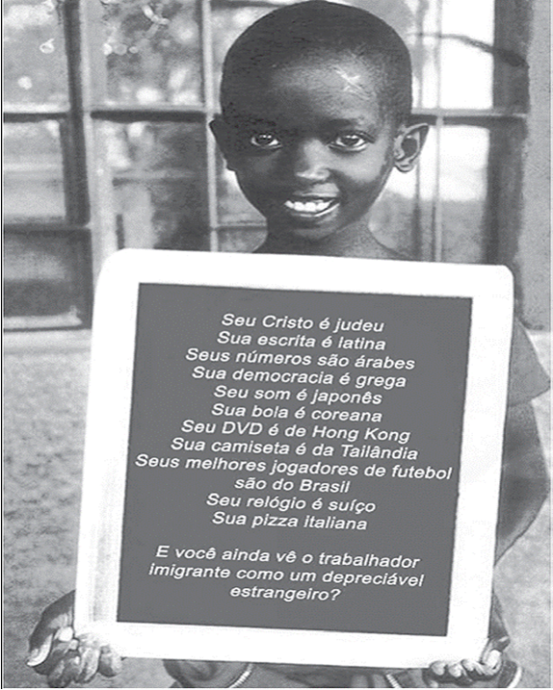
Conclusion 1
Being human, we are shaped by our own backgrounds and biases that we find it difficult to adopt more objective and fair perspectives on others. Furthermore, dominant ideologies and norms are difficult to disassociate from.

Slide 28
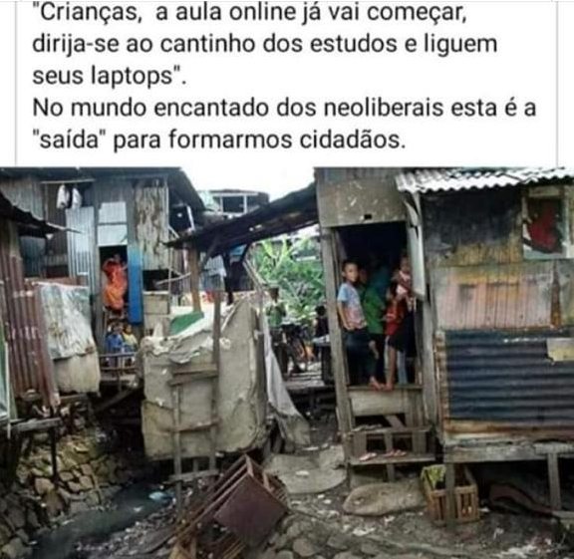
Conclusion II
Teachers have to consider every act of instruction a renegotiation of beliefs and knowledge with our students, considering both diversity negotiations and teacher identities as “ongoing”

Slide 29
CONCLUSION III – HUMBLENESS (BY ferraz)
WE PROFESSORS AND RESEARCHERS HAVE FLAWS, LOTS OF THEM,
ADMITING THEM IS HUMAN
RECOGNIZING THEM IS BEAUTIFUL

Slide 30
This week!! 16 out 15h

Slide 31
CLASS 6 (19/10) - GUESTS
Class 6 (19/10/20) – Themes: Language education (2) - Language education and Black lives matter - Language education and ideology & culture | INVITED GUESTS 10am - Prof. Dr. MIRIAM JORGE -University of Missouri-St Louis 9pm - Prof. Dr. MARA BARBOSA – Texas A&M University Corpus Christi Complementary material on MOODLE: Jorge and Barbosa s texts

Slide 32
THANK YOU!!!

