Slide 1
Retrospective Voting Theory and Russian Elections in 1990s

Slide 2
Part I: Theory of Retrospective Voting

Slide 3
Already long ago, from when we sold our vote to no man, the People have abdicated our duties; for the People who once upon a time handed out military command, high civil office, legions — everything, now restrains itself and anxiously hopes for just two things: bread and circuses
(Juvenal, Satire 10.77–81)

Slide 4
Rationality in government support
Theory of retrospective voting (Kramer, 1971; Fiorina, 1981; Lewis-Beck, 1988):
People evaluate performance of government from the perspective of well-being changes;
Increase of well-being determines raise of support; decrease determines negative trend in support;
The economic factors are the basic predictors for support rate.

Slide 5
Limitations of the Theory
External validity: the theory is tested in democratic institutional and regime settings
Internal validity: there are much more factors that may affect the voters`actions

Slide 6
Limitations to rationality (1)
Natural disasters: people blame politicians and bureaucrats for events that are actually not under their control (Achen and Bartels, 2004; Cole, Healy and Werker, 2012)
Exogenous economic shocks (Leigh, 2009)

Slide 7
Limitations to rationality (2)
Irrelevant events:
Sports: the results “on the eve” of the elections may shape electoral behavior (Healy, Malhotra, Mo, 2010)
Christmas Lottery outcomes in Spain (Bagues and Esteve-Volart, 2011)

Slide 8
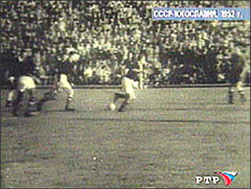
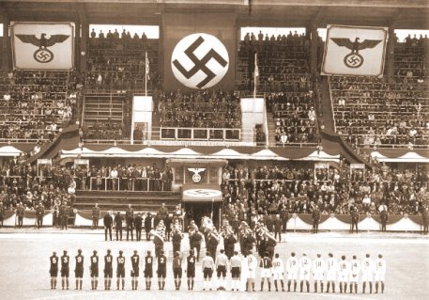
Football and Politics
Football as a mechanism of regimes support and influence in Europe in 1930s-50s

Slide 9
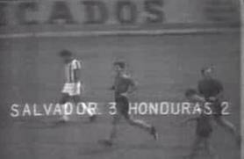
Football and Politics
“Soccer war” between El Salvador and Honduras (1969)

Slide 10
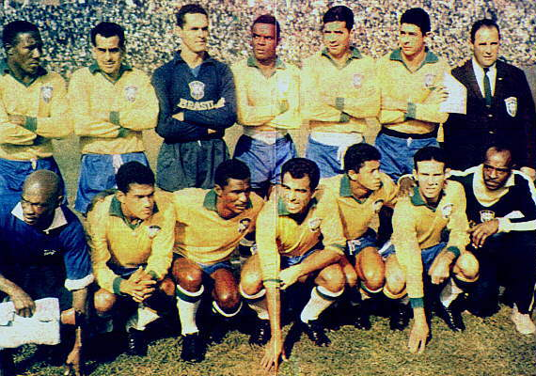
Football and Politics
World Cup success against political crisis in Brazil (1961-1962)

Slide 11
Part II: Russian Federal Elections in 1990s

Slide 12
Elections to Federal Assembly (1st Convocation)
Decree No. 1400 of 21 September 1993, 'On Gradual Constitutional Reform in the Russian Federation', dissolved the old Russian legislature, whose powers were to be transferred to a new bicameral Federal Assembly, and simultaneously suspended the operation of the old Constitution.
The existing Federation Council was to be vested with the functions of the upper chamber of the Assembly, while elections to the new lower chamber, the State Duma, were to take place on 12 December 1992
Notes:
The decree was accompanied by acts establishing the framework for the forthcoming
elections: the Provisions (polozhenie) on Federal Organs of Power for the Transitional
Period; and the Provisions for the Election of Deputies to the State Duma. The
juridical status of these acts was unclear, since 'provisions' fall somewhat short even
of decrees, let alone laws, although in this case the provisions were to have the force of law once the decree dissolving parliament came into force. The new legislature the rules regulating its election were thus born in a process that was both unconstitutional and anti-constitutional. This irregular procedure, while breaking the 18- long impasse in the struggle between the Supreme Soviet and the president undermined the development of a legal basis for Russian government. Mo during the course of the campaign the rules governing the election and the referendum were changed apparently at will by the president, further undermining their legitimacy

Slide 13
Elections to the Council of Federation (1st Convocation)
A total of 494 candidates struggled directly for seats in the 178-seat upper chamber.
Approximately 40% of candidates for the Council of Federation were leaders of executive authorities and 16% were heads of regional legislatures

Slide 14
Elections to State Duma (1st Convocation)
A party or electoral bloc required at least 100 000 nominations (signatures of the supporters), with no more than 15 000 signatures drawn from any one of Russia's 89 regions and republics, so that the bloc or party had to have demonstrable support in at least seven units of the RF

Slide 15
Elections to State Duma (1st Convocation)
225 seats by proportional system: party (bloc) list and 5% threshold
225 seats by relative majority electoral system: a candidate should have received simple majority of votes in the electoral district

Slide 16
Elections to State Duma (1st Convocation)
LDPR (V.F. Zhirinovsky) – 22,92% (64 seats)
Choice of Russia (Y.T. Gaydar) – 15,51% (64)
CPRF (G.A. Zyuganov) – 12,4% (42)
Women of Russia (A.V. Fedulova) – 8,13% (23)
Agrarian Party (M.I. Lapshin) – 7,99% (37)
Yabloko (G.A. Yavlinsky) – 7,86% (27)
Party of Russian Unity and Accord (S.M. Shahray) – 6,73% (22)
DPR (N.I. Travkin) – 5,52% (14)
Russian Movement for Democrtatic Reforms (A.A. Sobchak) – 4,08% (5)
Civil Union (A.I. Volsky) – 1,93% (10)
Future of Russia – New Names (V.V. Lashevsky) – 1,25% (2)
Cedar – Green Party (L.M. Lymar) – 0,76% (1)
Dignity and Mercy (K.V. Frolov) – 0,7% (3)
Against All – 4,22% and invalid vote – 6,84%

Slide 17
And now let´s talk on the social and economic situation in Russia between elections of 1993 and elections of 1995-96

Slide 18
Elections to State Duma (2nd Convocation)
The changes in the party system?
Electoral volatility?
The voting patterns?

