Slide 1
Genômica: fluxo de informação na célula, estrutura de genomas, estratégias de sequenciamento de genomas
Luiz Lehmann Coutinho
llcoutinho@usp.br

Slide 2
Por que sequenciar genomas?
Conhecer a biodiversidade
10-15 milhões de espécies de eucariotos; Trilhões espécies de baterias e arqueias → 2,3 milhões conhecidos
Extinção de 50% das espécies até o ano de 2050
“Unimaginable biological secrets are held in the genomes of the millions of known and unknown organisms on our planet. This “dark matter” of biology could hold the key to unlocking the potential for sustaining planetary ecosystems on which we depend and provide life support systems for a burgeoning world population”
Compreensão da biologia, ecossistemas e evolução
Permitir a conservação e preservação e regeneração da biodiversidade
Maximizar retornos para a sociedade

Slide 3
Por que sequenciar genomas?
Investimento no genoma humano foi de bilhões de dólares
Gerou perto de 1 trilhão de dólares em atividade econômica e emprega mais de 47 mil pessoas.
Engenharia genética em plantas e microrganismos gera 300 bilhões de dólares por ano de receita
Outros exemplos?

Slide 4
Por que sequenciar genomas?
Identificação de variação genética
Conservação e estudo de biodiversidade
Estudar a evolução
Identificação e diagnóstico de doenças genéticas
Melhoramento genético
Mapeamento de QTL
Seleção genômica
Estudo de expressão gênica
Estudo do controle da expressão gênica
It’s more than stamp collecting: how genome sequencing can unify biological research, Richards, 2015, Trends in Genetics

Slide 5
Por que sequenciar genomas?
Earth BioGenome Project: Sequencing life for the
future of life; Harris A. Lewin et al. 2018, PNAS

Slide 6
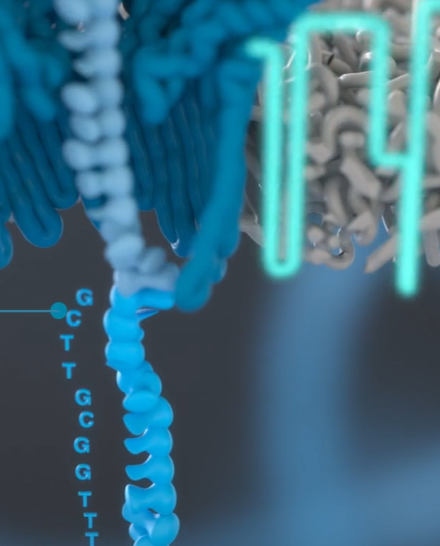
Evolução do Sequenciamento:

Slide 7
Desafios para o sequenciamento Sanger e NGS:
Tamanho do genoma e tamanho de sequência produzida
Solução: Fragmentação do genoma e redundância
Impossibilidade de sequenciar continuamente uma única molécula
Solução: Sequenciamento em larga escala
Intensidade de sinal
Solução: Clonagem ou PCR
Solução: Radiação ou Fluorescência

Slide 8
Sequenciamento Sanger

Slide 9
Sequenciamento Illumina - SBS

Slide 10
Construção de Bibliotecas

Slide 11
Adição de adaptadores nas extremidades
Dual Index Library shown
The aim of the sample prep step is to obtain nucleic acid fragments with adapters attached on both ends
Notes:
Same general template architecture regardless of application or input starting material.
For cluster generation: libraries must have P5 and P7 binding regions, which will interact with oligos of complementary sequence on the surface of the flow cell.
For sequencing: Libraries must have sequencing primer binding regions.
For multiplexing: libraries must have an index.

Slide 12
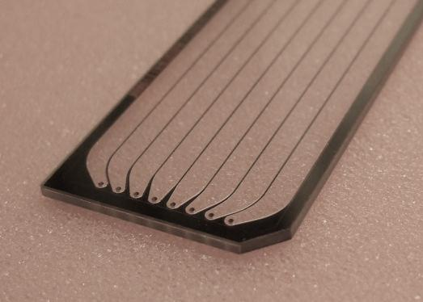
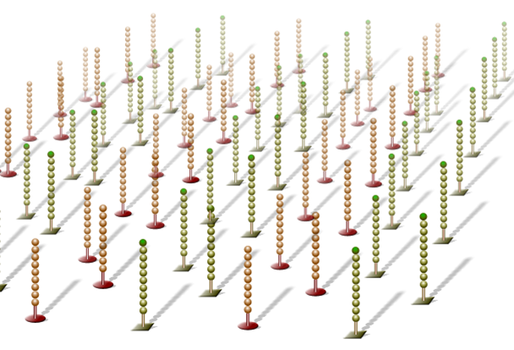
Geração de clusters
Cluster generation occurs on a flow cell
A flow cell is a thick glass slide with channels or lanes
Each lane is randomly coated with a lawn of oligos that are complementary to library adapters

Slide 13
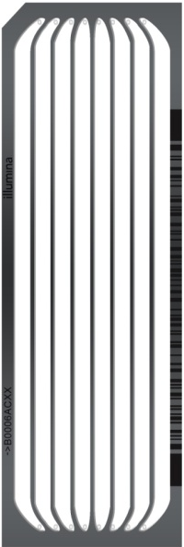
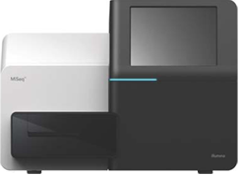
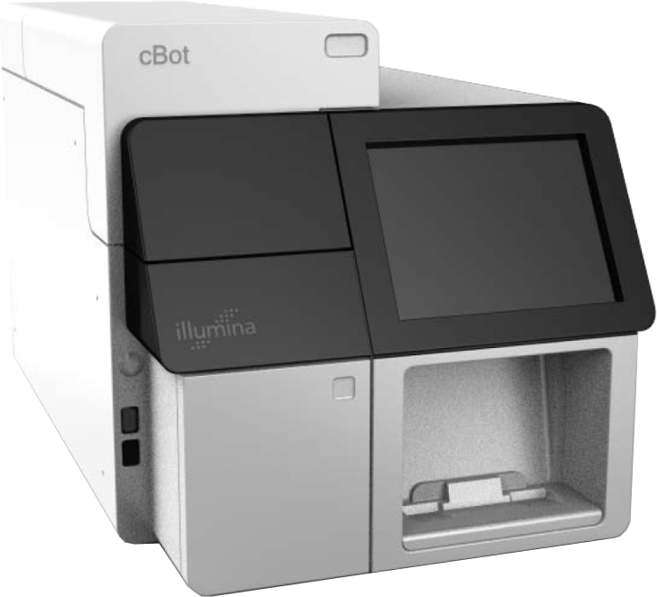
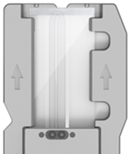
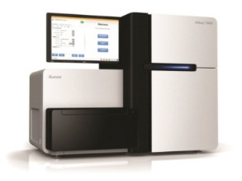
Equipamento
Single DNA Library
Amplified Clonal Cluster
cBot
Sequencer
Notes:
-------------
To Cluster a library:
Step 1: Denature double stranded library
Step 2: Load single stranded library onto flowcell
Clustering unit automates the aspiration of DNA libraries into the flowcell and amplification of single DNA libraries into clonal clusters.
A GA IIX and HiSeq flowcell contains 8 separate lanes and is clustered on a cBot.
A MiSeq flowcell has a single lane and is clustered directly on the MiSeq in conjunction with a sequencing run.

Slide 14
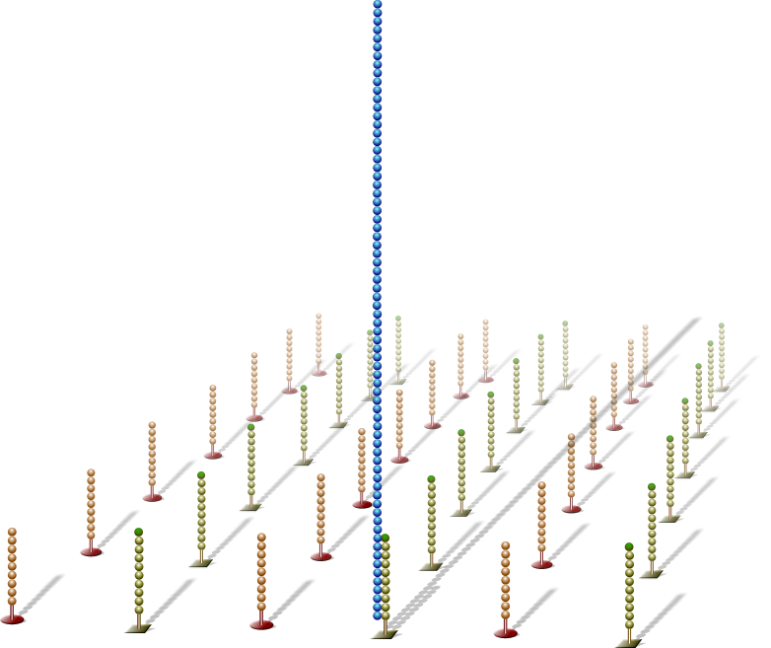
Hibridização e extensão
Adapter sequence
Single DNA libraries are hybridized to primer lawn
Bound libraries then extended by polymerases
Surface of flow cell coated with a lawn of oligo pairs
3’ extension
Notes:
Schematic representation of cluster generation process

Slide 15
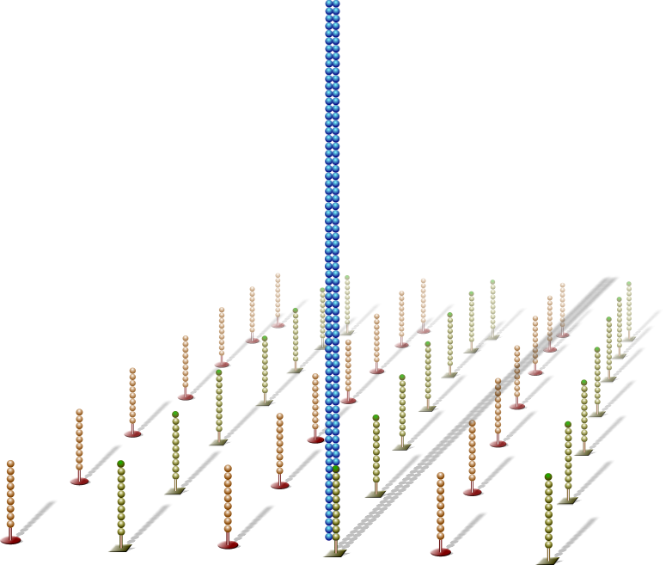
Desnaturação do DNA
Newly synthesized strand
Double-stranded molecule is denatured
Original template
Original template washed away
discard
Newly synthesized strand is covalently attached to flow cell surface

Slide 16
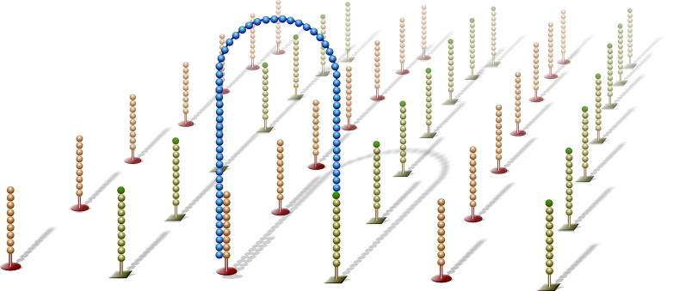
Amplificação em ponte (PCR na superfície da lâmina)
Single-stranded molecule flips over and forms a bridge by hybridizing to adjacent, complementary primer
Hybridized primer is extended by polymerases

Slide 17
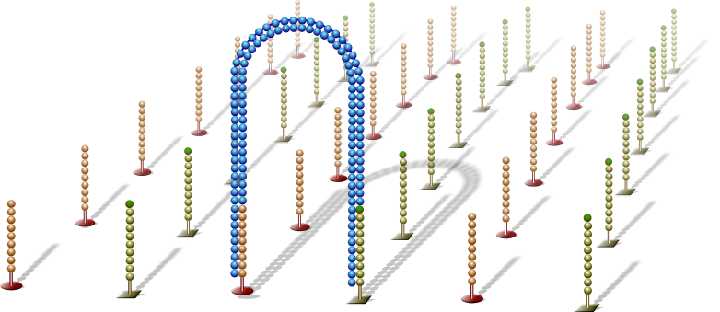
Bridge Amplification
Double-stranded bridge is formed

Slide 18
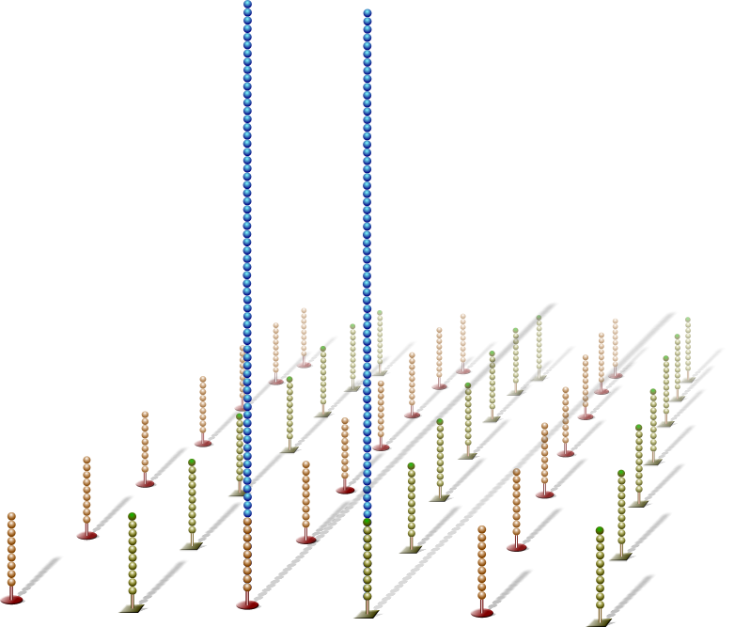
Denature Double-stranded Bridge
Double-stranded bridge is denatured
Result:
Two copies of covalently bound single-stranded templates

Slide 19
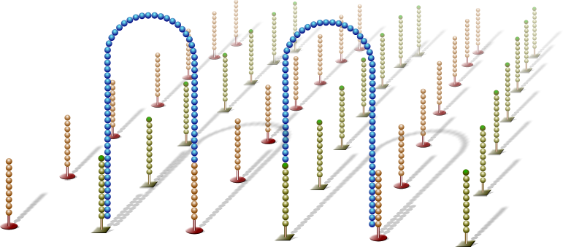
Bridge Amplification
Single-stranded molecules flip over to hybridize to adjacent primers
Hybridized primer is extended by polymerase

Slide 20
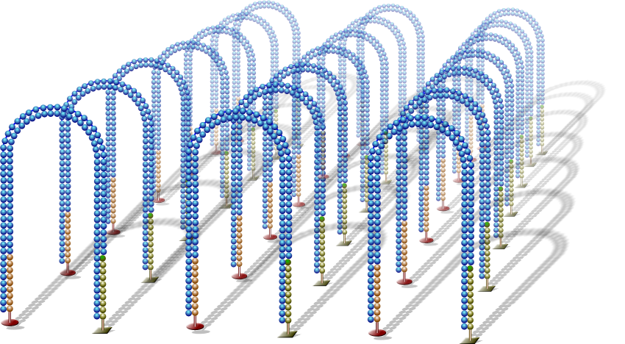
Bridge Amplification
Bridge amplification cycle repeated until multiple bridges are formed

Slide 21
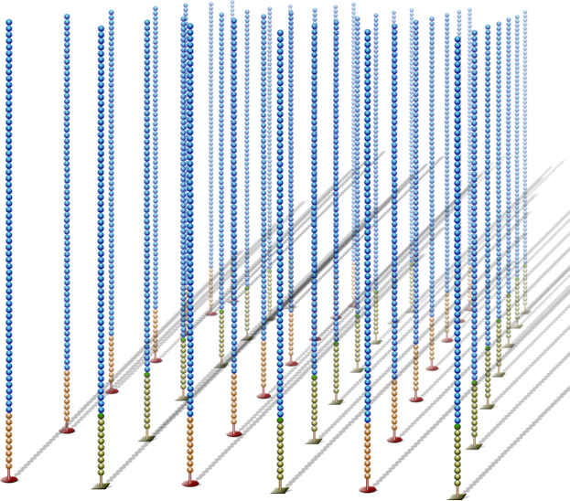
Linearization
dsDNA bridges are denatured

Slide 22
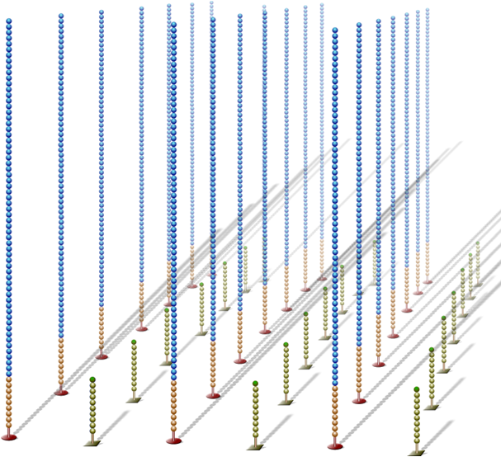
Reverse Strand Cleavage
Reverse strands cleaved and washed away, leaving a cluster with forward strands only

Slide 23
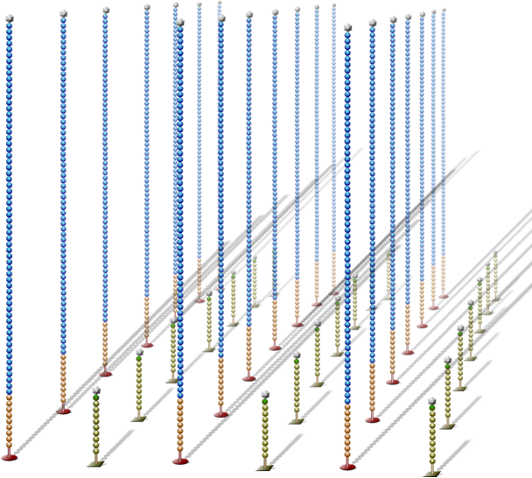
Blocking
Free 3’ ends are blocked to prevent unwanted DNA priming

Slide 24
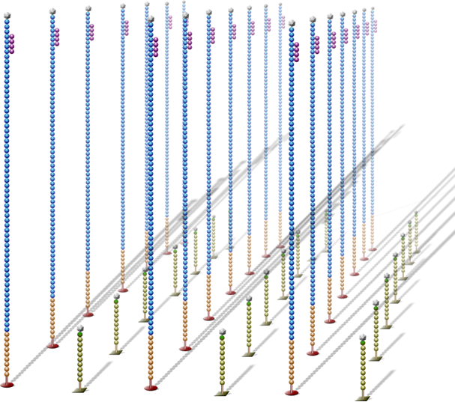
Read 1 Primer Hybridization
Sequencing primer is hybridized to adapter sequence
Sequencing primer

Slide 25
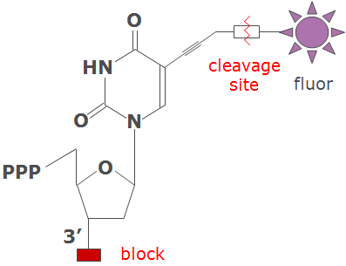
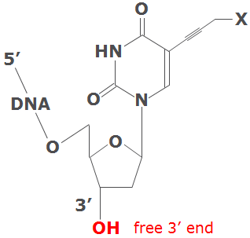
Reversible Terminator Chemistry
All 4 labeled nucleotides in 1 reaction
Higher accuracy
No problems with homopolymer repeats
Next Cycle
Incorporation
Detection
Deblock
Fluor Removal

Slide 26
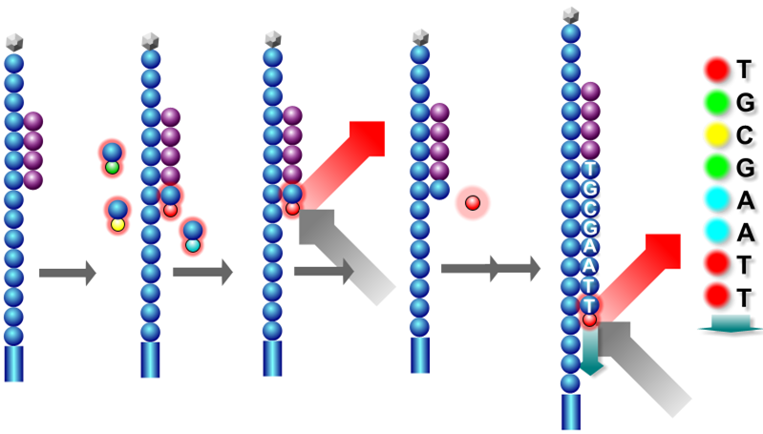
Sequencing By Synthesis
Add 4 Fl-NTP’s + Polymerase
Incorporated FI-NTP imaged
Terminator & fluorescent dye cleaved from FI-NTP
X 36 - 251
Notes:
In the SBS technology just one base is added in each cycle. The nucleotides are reversibly terminated and individually fluorescently labeled.
In each cycle there is the addition of a nucleotide, imaging, cleavage of the fluorophore and deblock.
Details: There are 2 market unique features to the Illumina technology for genome analysis = template clusters (in the flow cell) and reversibly terminated, individually fluorescently labeled nucleotides for Sequencing by Synthesis. The steps for sequencing by synthesis supported by this slide are:
Hybridize sequencing primer (complimentary to terminal adaptor)
Add polymerase and all 4 dNTPs
Each dNTP is individually fluorescently labeled and is reversibly blocked at the 3’ hydroxyl
The 3’ block ensures only a single base addition.
Once the single base addition occurs the clusters can be excited by a laser and the color of the added base can be imaged and determined.
For every cluster, in cycle 1, the first base is added turning the entire cluster the color of the base. In the example shown in this cartoon at “T” is added, turning this cluster “green”.
Once the first base has been imaged and determined, the fluorescent label is cleaved and 3’ blocking group is removed, regenerating a 3’-OH and enabling extension.
Add polymerase and all 4 dNTPs and single base extension will occur for the second base in the template (in this cartoon the 2nd base is a “G”)
The clusters can be excited by a laser and the color of the 2nd base is imaged and determined (in this cartoon the cluster color would be “blue”)
Repeating this process allow us to step-wise determine the sequence of the original template.
Conclusion: Explanation of technology behind sequencing by synthesis

Slide 27
Clusters
100 Microns
Notes:
This is an actual cluster pattern from a flow cell (4-color overlay)

Slide 28
Paired End Sequencing

Slide 29
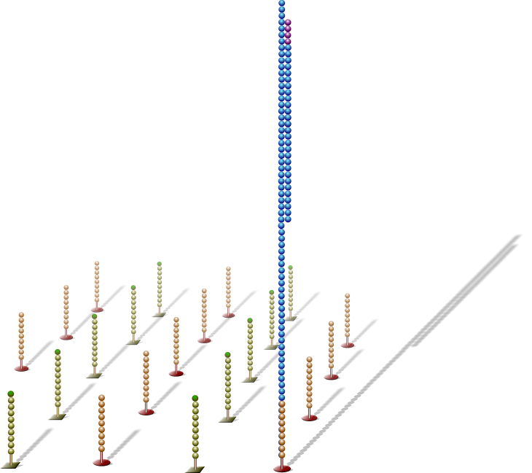
Paired End Sequencing
Blocked 3’-ends
Sequenced strand
Sequenced strand is stripped off
3’-ends of template strands and lawn primers are unblocked

Slide 30
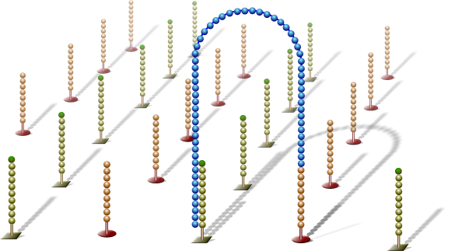
Paired End Sequencing
Single-stranded template loops over to form a bridge by hybridizing with a lawn primer
Bridge formation
3’-ends of lawn primer is extended
3’ extension

Slide 31
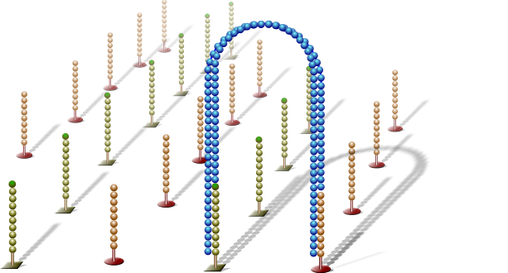
Paired End Sequencing
Double stranded DNA

Slide 32
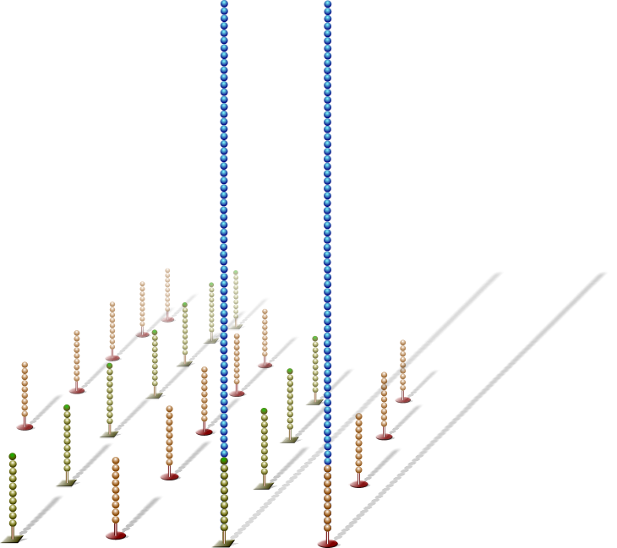
Paired End Sequencing
Bridges are linearized and the original forward template is cleaved
Original forward strand

Slide 33
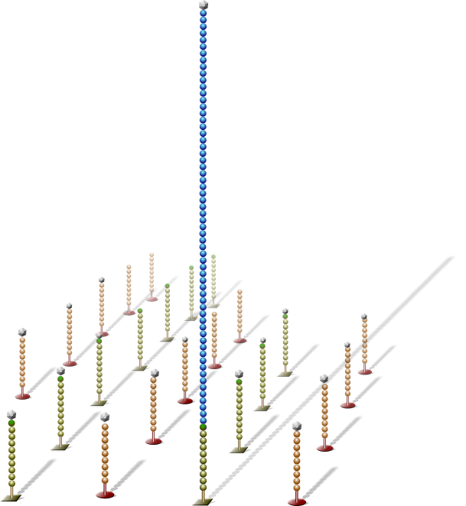
Paired End Sequencing
Blocked 3’-ends
Free 3’ ends of the reverse template and lawn primers are blocked to prevent unwanted DNA priming
Sequencing primer
Sequencing primer is hybridized to adapter sequence
Reverse strand
template

Slide 34
Estratégias para sequenciamento de genomas:

Slide 35
Estratégias para sequenciamento de genomas:
Shotgun Sequencing

Slide 36
Desafios no sequenciamento de genomas
Genomes. 2nd edition, 2002

Slide 37
Desafios na montagem de novo de genoma:

Slide 38
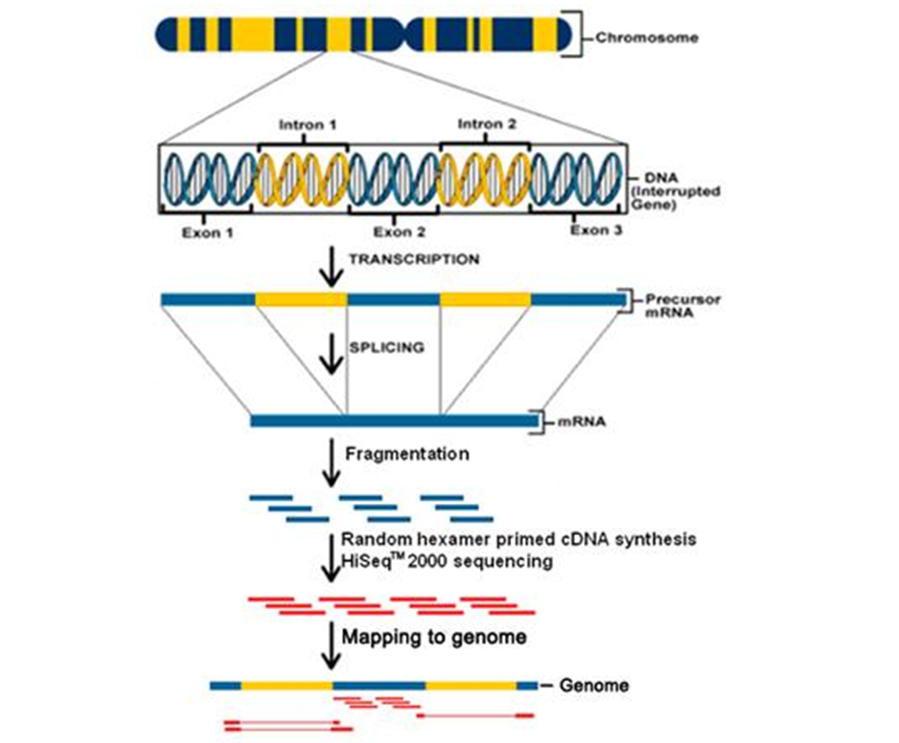
Desafios no estudo do transcriptoma
The Cell: A Molecular Approach 2nd. Edition, 2000

Slide 39
Desafios na identificação de variação estrutural com sequencias curtas:

Slide 40
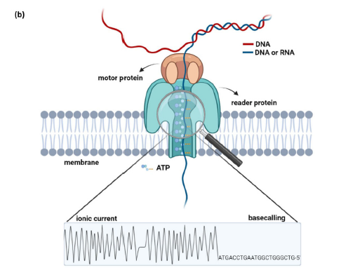
Sequenciamento de terceira geração (TGS):
- Sequenciamento contínuo de uma única molécula
- Fragmentos maiores

Slide 41
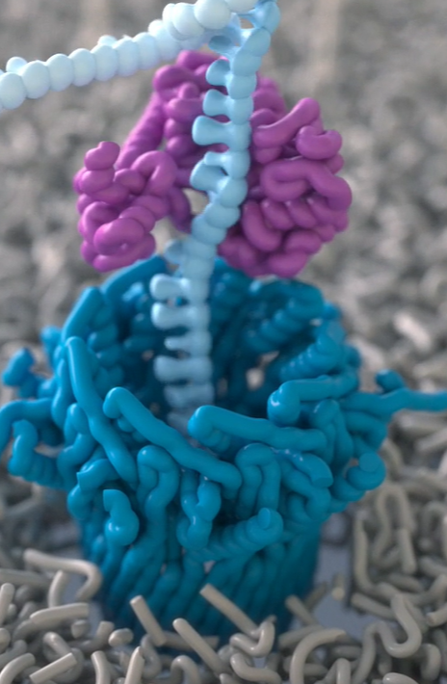
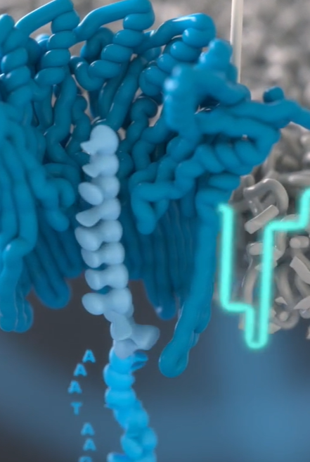
Sequenciamento Nanopore:

Slide 42
Vantagens em relação a NGS:
Não necessita de PCR
Montagem de novo de genomas (regiões repetidas)
Análise completa do transcriptoma (RNAm completo, isoformas)
Identificação de variações estruturais (deleções, duplicações, etc)
Target Sequencing (adaptive sequencing Nanopore, permite o enriquecimento de regiões alvo)
Epigenética
Metagenoma (MAG, 16S (completo ao invés de uma região)

Slide 43
Desafios na montagem de novo de genoma:

Slide 44
Desafios na montagem do Transcriptoma

Slide 45
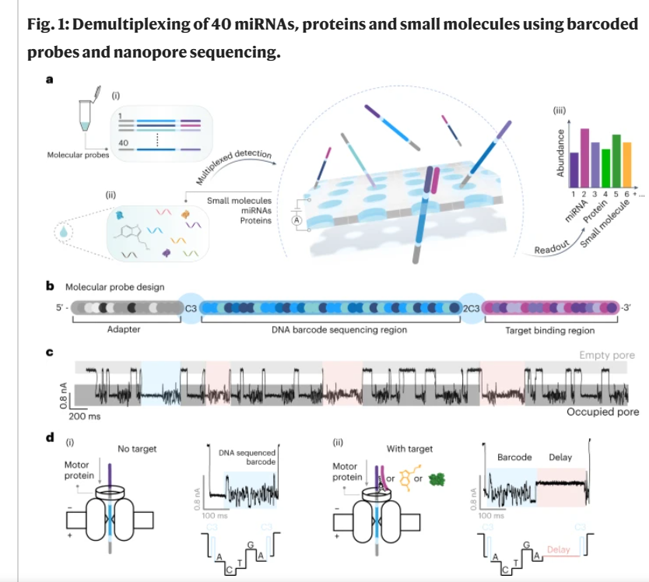
Novas aplicações:

Slide 46
Limitações:
Taxa de erro, custo e programas de análise de dados

Slide 47
Aplicações do sequenciamento de ácidos nucleicos:

Slide 48
Qual sequenciador usar?
The Federal Trade Commission has said Illumina controls roughly 90% of the market for sequencing machines in the U.S. Management estimates that it compiles 80% of the world's genomic information each year.

Slide 49
Centro de Genômica Funcional
Luiz Lehmann Coutinho
llcoutinho@usp.br

Slide 50
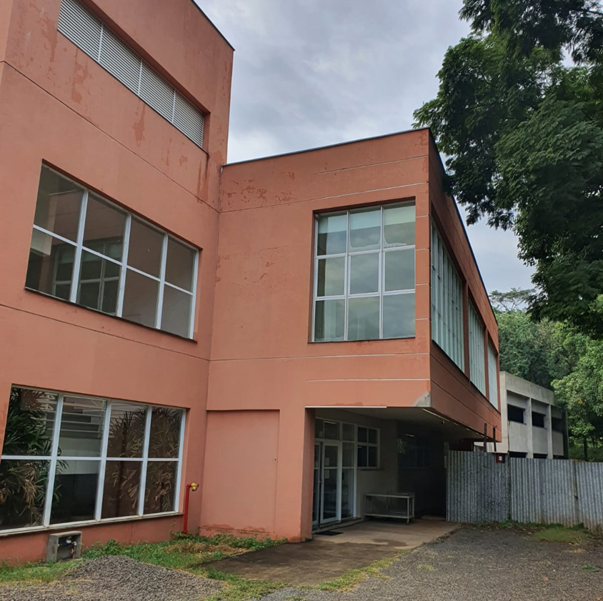
CGF
Ligado a Central Multiusuário da USP
Financiamento da FINEP, FAPESP, USP, CAPES

Slide 51
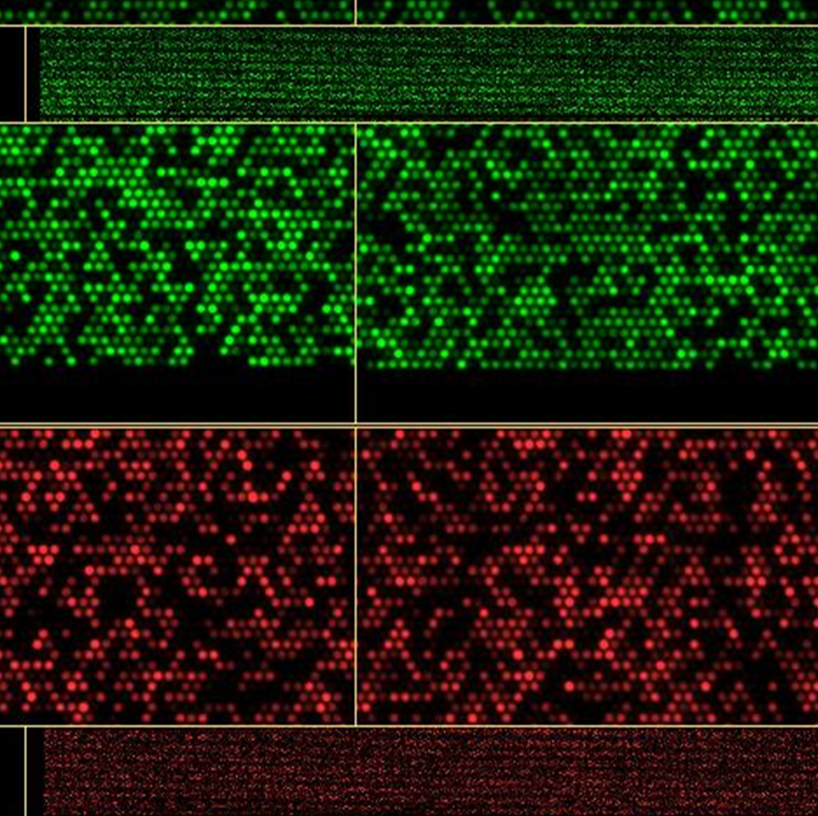
Por que montar um Centro de Genômica?
Evolução dos equipamentos e tecnologias
Maior capacidade de gerar dados
Menor custo por dado gerado
Equipamentos de alto custo

Slide 52
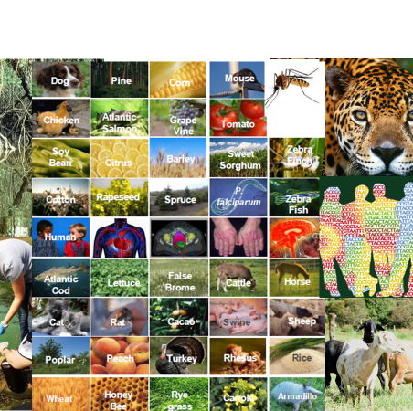
Objetivos do Centro de Genômica
Dar suporte científico e tecnológico para pesquisadores atuando na área de genômica
Gerar resultados com qualidade e agilidade
Treinamento de recursos humanos na área de genômica
Aberto para todos os interessados

Slide 53
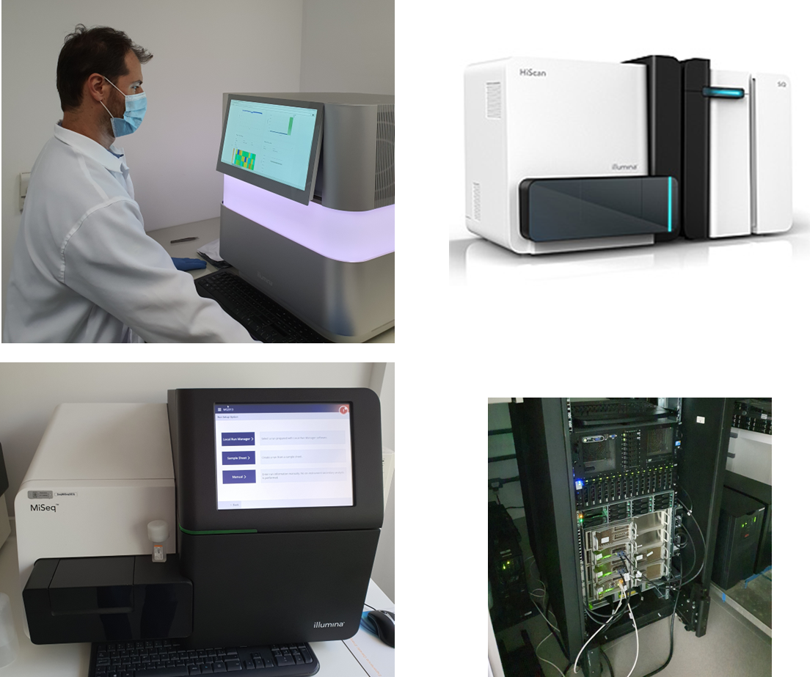
Tecnologias Disponíveis
Sequenciamento
Genotipagem
Bioinformática
Cultura de Células
PCR Quantitativo
PCR Digital

Slide 54
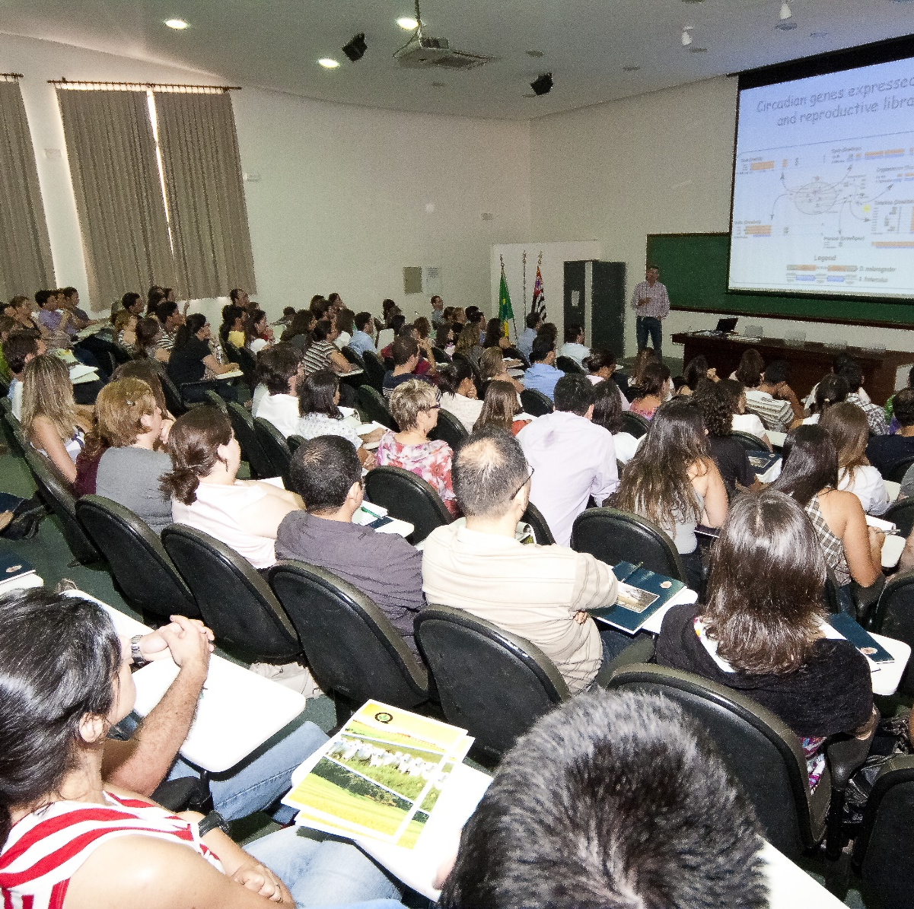
Workshop e treinamento de usuários
Cursos de bioinformática
Treinamento em construção de bibliotecas
Notes:
170 participantes
Apresentação dos equipamentos
Resultados dos usuários
Levantamento

Slide 55
Workshop e treinamento de usuários
Curso com o Dr. Tony Reverter da Australia

Slide 56
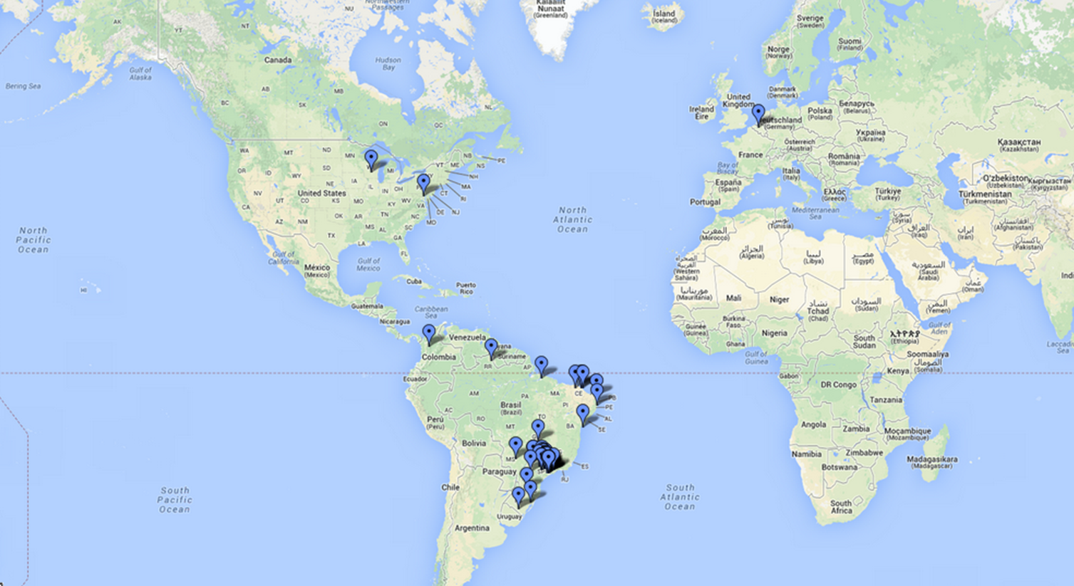
Usuários de Centro
Mais de 300 pesquisadores com múltiplos projetos
Vários usuários receberam treinamento

Slide 57
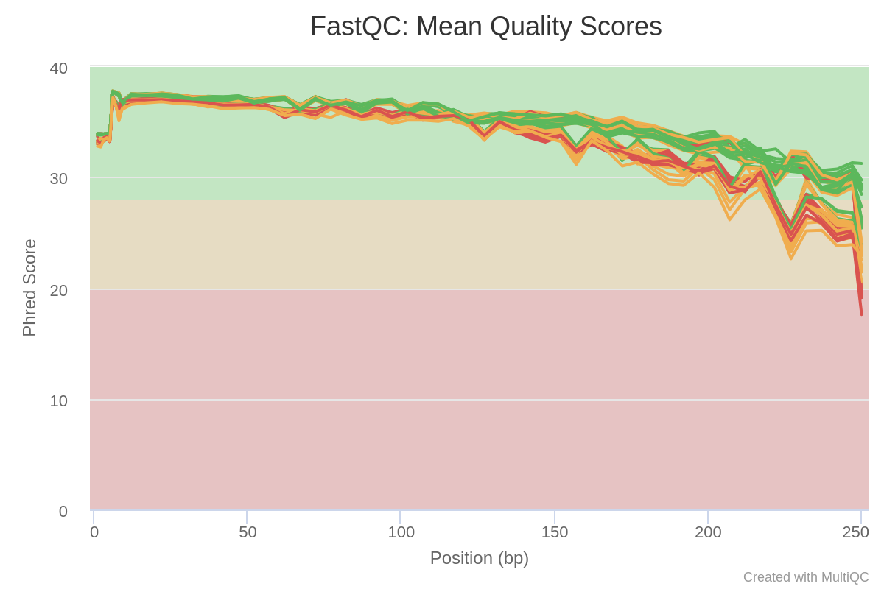
MiSeq vs NextSeq

Slide 58
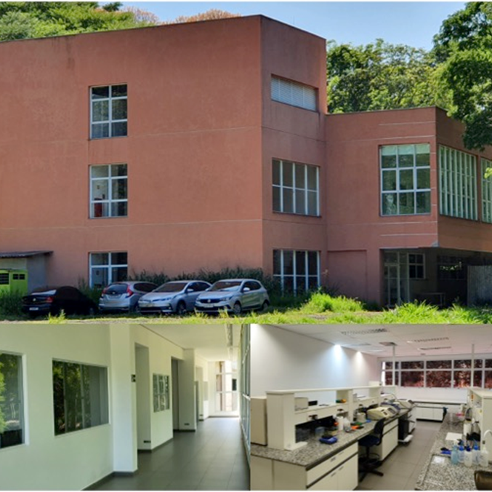
Centro de Genômica Funcional
llcoutinho@usp.br
Website https://uspmulti.prp.usp.br/public/centrais/48

