Slide 1
Milharal Guarani
Denilson Baniwa

Slide 6
The dinner party
Judy Chicago

Slide 8
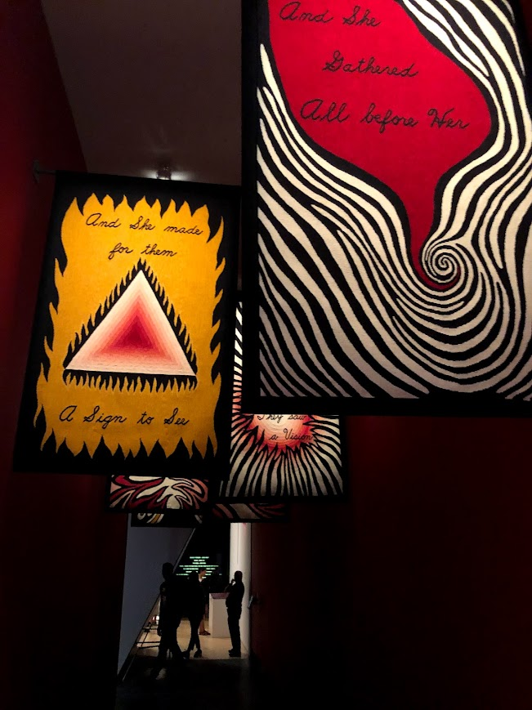

Slide 9
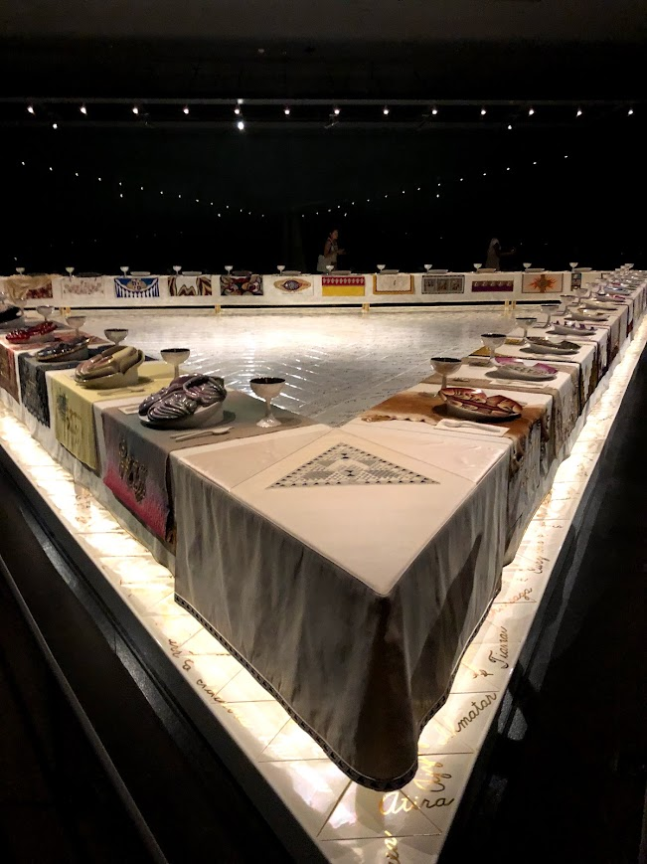

Slide 10
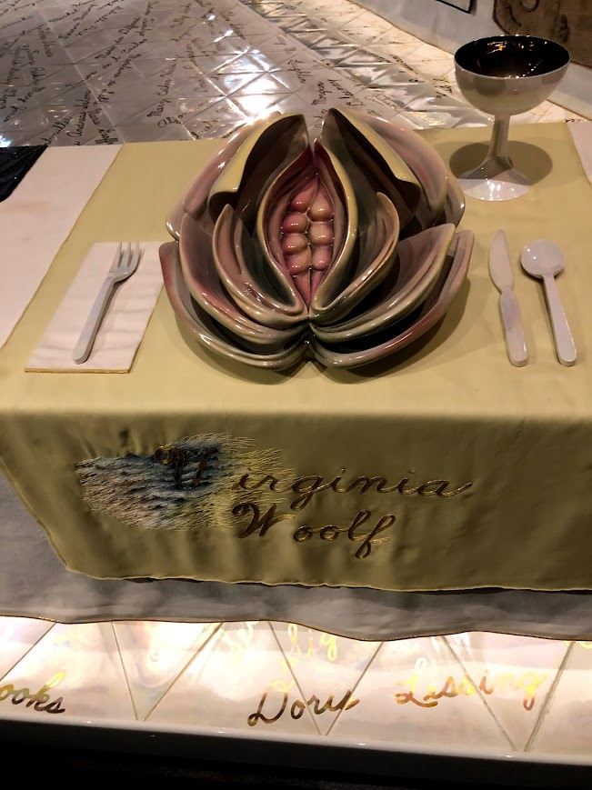

Slide 11
