Slide 1
Economies of scale and imperfect competition – part iI
Econ 490
International Economics
UIUC, Fall 2019
Mauro Rodrigues

Slide 2
Krugman model Trade
Consider now the Krugman model, as discussed previously
Now there are two countries: Home and Foreign
Foreign identified by an asterisk
Same technology (parameters $α$ and $β$ in the production function for varieties)
Same preferences (utility function, CES with parameter $γ$)
Countries differ (potentially) only in their market sizes
$\overline{L}$: number of consumers/workers in the Home country
${\overline{L}}^{∗}$: number of consumers/workers in the Foreign country
Even with ${\overline{L}=\overline{L}}^{∗}$ (identical countries), we will have trade

Slide 3
Krugman model Autarchy Equilibrium
Suppose both countries are initially in autarchy
In the last lecture, we showed how to obtain range of varieties ($n$) in autarchy
In the Home country:
$$n=\frac{\overline{L}}{α+βx} where x=\frac{α}{β}\frac{γ}{1−γ}$$
In the Foreign country:
$$n^{∗}=\frac{{\overline{L}}^{∗}}{α+βx} where x=\frac{α}{β}\frac{γ}{1−γ}$$
$x$ is the production of each variety
Same in both countries, since they have identical $α$, $β$ and $γ$

Slide 4
Krugman model Open-economy equilibrium
Suppose now countries open up to trade
No barriers to trade
Consumers in each countries have access to a larger set of varieties
Let:
Set of varieties produced in the Home country: $[0,n]$
Set of varieties produced in the Foreign country: $(n,n+n^{∗}]$
We assume these sets are disjoint (no intersection)
Varieties produced in the Home country are different from those produced in the Foreign country
If they were identical, producers would have incentive to differentiate
In an open economy, consumers in both countries have access to the whole set $[0,n+n^{∗}]$

Slide 5
Krugman model Open-economy equilibrium
We can now solve the model as if this is a closed economy of size $\overline{L}+{\overline{L}}^{∗}$
Range of varieties in the world economy (Home + Foreign):
$$n+n^{∗}=\frac{\overline{L}+{\overline{L}}^{∗}}{α+βx} where x=\frac{α}{β}\frac{γ}{1−γ}$$
The range of varieties produced in each country is then proportional to country size:
$$n=\frac{\overline{L}}{\overline{L}+{\overline{L}}^{∗}}(n+n^{∗})$$
$$n^{∗}=\frac{{\overline{L}}^{∗}}{\overline{L}+{\overline{L}}^{∗}}(n+n^{∗})$$

Slide 6
Krugman model Trade Flows
Home:
Produces varieties $[0,n]$
Consumes varieties $[0,n+n^{∗}]$
Therefore, imports varieties $(n,n+n^{∗}]$, exports varieties $[0,n]$
Foreign:
Produces varieties $(n,n+n^{∗}]$
Consumes varieties $[0,n+n^{∗}]$
Therefore, imports varieties $[0,n]$, exports varieties $(n,n+n^{∗}]$
Intraindustry trade:
Each country exports and imports varieties of the same product

Slide 7
Krugman model Gains from Trade
Gains from trade are related to access to a larger set of differentiated varieties
Let’s compare autarchy to open economy
In autarchy, Home consumers have access to $n$ varieties; each consumer gets$c_{i}=x/\overline{L}$ of variety $i$
$$n=\frac{\overline{L}}{α+βx} where x=\frac{α}{β}\frac{γ}{1−γ}$$
In autarchy, Foreign consumers have access to $n^{∗}$ varieties; each consumer gets$c_{i}^{∗}=x/{\overline{L}}^{∗}$of variety $i$
$$n^{∗}=\frac{{\overline{L}}^{∗}}{α+βx} where x=\frac{α}{β}\frac{γ}{1−γ}$$

Slide 8
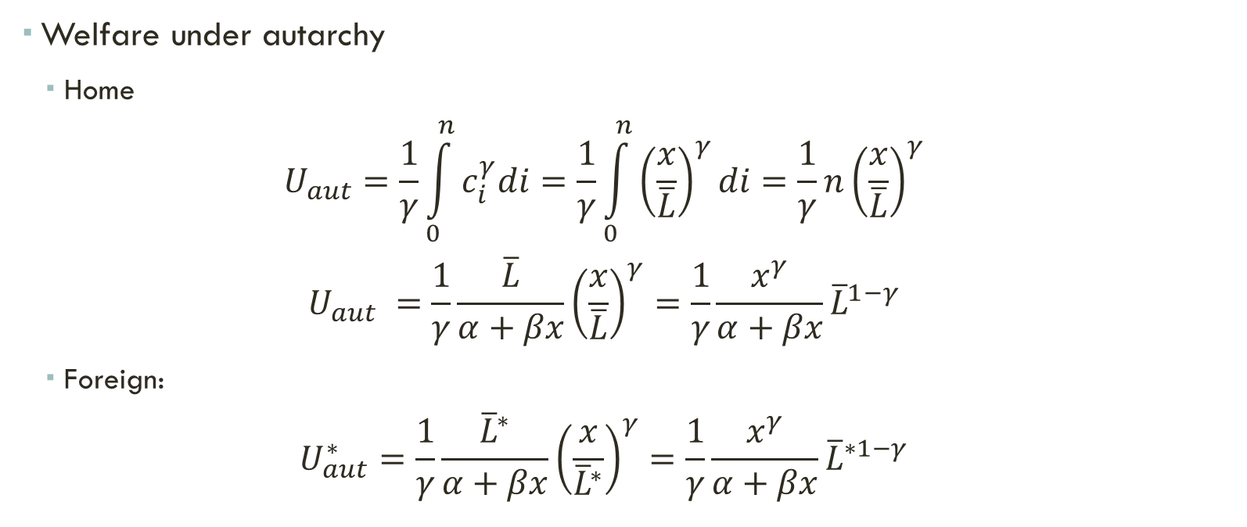
Krugman model Gains from Trade
Welfare under autarchy
Home
$$U_{aut}=\frac{1}{γ}\int_{0}^{n}{c_{i}^{γ}di}=\frac{1}{γ}\int_{0}^{n}{{\left(\frac{x}{\overline{L}}\right)}^{γ}di}=\frac{1}{γ}n{\left(\frac{x}{\overline{L}}\right)}^{γ}$$
$$U_{aut} =\frac{1}{γ}\frac{\overline{L}}{α+βx}{\left(\frac{x}{\overline{L}}\right)}^{γ}=\frac{1}{γ}\frac{x^{γ}}{α+βx}{\overline{L}}^{1−γ}$$
Foreign:
$$U_{aut}^{∗}=\frac{1}{γ}\frac{{\overline{L}}^{∗}}{α+βx}{\left(\frac{x}{{\overline{L}}^{∗}}\right)}^{γ}=\frac{1}{γ}\frac{x^{γ}}{α+βx}{\overline{L}}^{∗1−γ}$$

Slide 9
Krugman model Gains from Trade
Open economy:
Consumers have access to $n+n^{∗}$varieties; each consumer gets$c_{i}=c_{i}^{∗}=\frac{x}{\overline{L}+{\overline{L}}^{∗}}$ of variety $i$
$$n+n^{∗}=\frac{\overline{L}+{\overline{L}}^{∗}}{α+βx} where x=\frac{α}{β}\frac{γ}{1−γ}$$
Welfare is the same in both countries
$$U_{open}=U_{open}^{∗}=\frac{1}{γ}\int_{0}^{n+n^{∗}}{c_{i}^{γ}di}=\frac{1}{γ}\int_{0}^{n+n^{∗}}{{\left(\frac{x}{\overline{L}+{\overline{L}}^{∗}}\right)}^{γ}di}=\frac{1}{γ}(n+n^{∗}){\left(\frac{x}{\overline{L}+{\overline{L}}^{∗}}\right)}^{γ}$$
$$U_{open}=U_{open}^{∗}=\frac{1}{γ}\frac{\overline{L}+{\overline{L}}^{∗}}{α+βx}{\left(\frac{x}{\overline{L}+{\overline{L}}^{∗}}\right)}^{γ}=\frac{1}{γ}\frac{x^{γ}}{α+βx}{(\overline{L}+{\overline{L}}^{∗})}^{1−γ}$$

Slide 10
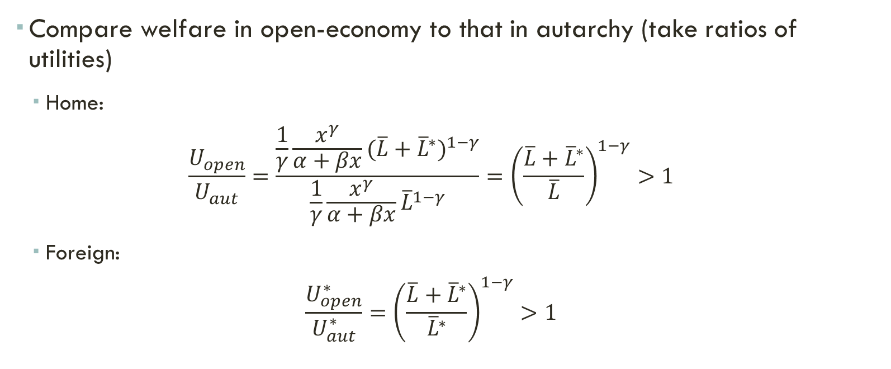
Krugman model Gains from Trade
Compare welfare in open-economy to that in autarchy (take ratios of utilities)
Home:
$$\frac{U_{open}}{U_{aut}}=\frac{\frac{1}{γ}\frac{x^{γ}}{α+βx}{(\overline{L}+{\overline{L}}^{∗})}^{1−γ}}{\frac{1}{γ}\frac{x^{γ}}{α+βx}{\overline{L}}^{1−γ}}={\left(\frac{\overline{L}+{\overline{L}}^{∗}}{\overline{L}}\right)}^{1−γ}>1$$
Foreign:
$$\frac{U_{open}^{∗}}{U_{aut}^{∗}}={\left(\frac{\overline{L}+{\overline{L}}^{∗}}{{\overline{L}}^{∗}}\right)}^{1−γ}>1$$

Slide 11
Krugman model Gains from Trade
Gains from trade come from access to a larger set of varieties
Smaller countries tend to benefit more:
The smaller a country ($\overline{L}$), the larger the ratio of utilities
Small countries experience larger variation in the range of available varieties
Notice the importance of having parameter $γ$ between zero and 1 (that is, varieties are differetiated)
If $γ→1$, ratio of utilities goes to 1 (gains from trade go to zero)
Homogeneous products

Slide 12
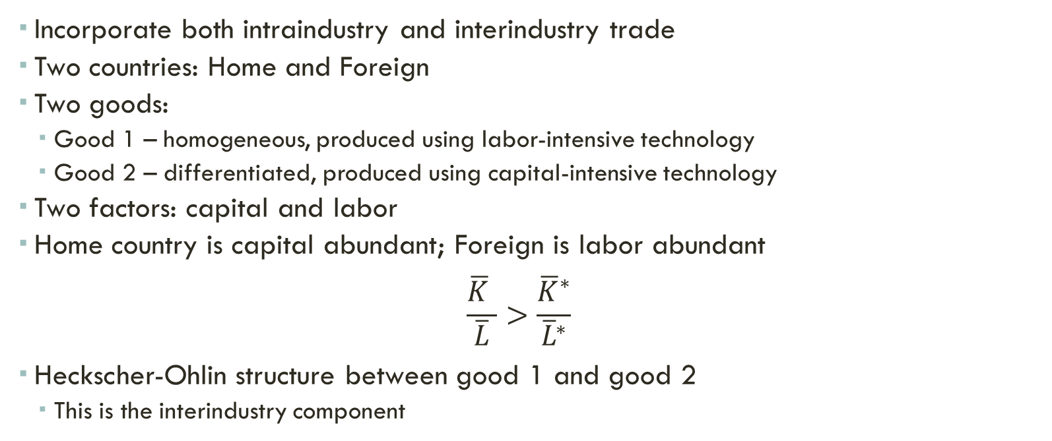
extensions Hybrid Model
Incorporate both intraindustry and interindustry trade
Two countries: Home and Foreign
Two goods:
Good 1 – homogeneous, produced using labor-intensive technology
Good 2 – differentiated, produced using capital-intensive technology
Two factors: capital and labor
Home country is capital abundant; Foreign is labor abundant
$$\frac{\overline{K} }{\overline{L}}>\frac{{\overline{K}}^{∗}}{{\overline{L}}^{∗}}$$
Heckscher-Ohlin structure between good 1 and good 2
This is the interindustry component

Slide 13
extensions Hybrid Model
Sector 2 is composed of differentiated varieties (as in the Krugman model)
Production subject to a fixed cost (average cost decreasing, marginal cost constant)
Monopolistic competition
Consumers value diversity of good 2 (would like to have access to varieties produced in both countries)
This is the intraindustry component
Preference:
$$U=u\left(c_{1}\right)+v\left(c_{2}\right)$$
$$v\left(c_{2}\right)=\frac{1}{γ}\int_{0}^{n+n^{∗}}{c_{2i}^{γ}di}, 0<γ<1$$

Slide 14
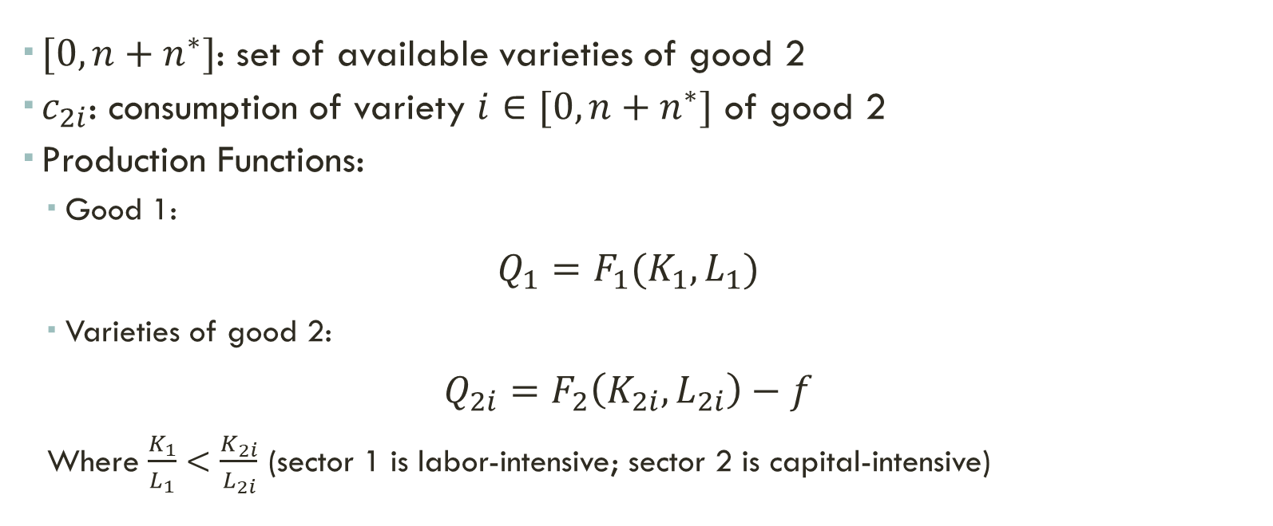
extensions Hybrid Model
$[0,n+n^{∗}]$: set of available varieties of good 2
$c_{2i}$: consumption of variety $i∈[0,n+n^{∗}]$ of good 2
Production Functions:
Good 1:
$$Q_{1}=F_{1}(K_{1},L_{1})$$
Varieties of good 2:
$$Q_{2i}=F_{2}\left(K_{2i},L_{2i}\right)−f$$
Where $\frac{K_{1}}{L_{1}}<\frac{K_{2i}}{L_{2i}}$ (sector 1 is labor-intensive; sector 2 is capital-intensive)

Slide 15
extensions Hybrid Model
$F_{1}$and $F_{2}$exhibit constant returns to scale
Marginal cost is constant in both sectors
$f$ gives rise to a fixed cost
Average cost decreasing in sector 2
$K_{1},L_{1}$: capital and labor employed by sector 1
$K_{2i},L_{2i}$: capital and labor employed by variety $i$ of sector 2
Full mobility of capital and labor
Equilibrium in factor markets (Home):
$$K_{1}+nK_{2i}=\overline{K}$$
$$L_{1}+nL_{2i}=\overline{L}$$

Slide 16
Home
(capital abundant)
Good 2
Good 1
Interindustry
trade
Intraindustry
trade
Foreign
(labor abundant)

Slide 17
extensions Hybrid Model
Interindustry Trade
Since Home is capital abundant, it will produce most varieties in the World
It will therefore be a net exporter of good 2
Importer of good 1
Foreign produces a smaller share of world varieties
Net importer of good 2
Exporter of good 1

Slide 18
extensions Hybrid Model
Intraindustry Trade
Consumers of both goods consume all available varieties: $[0,n+n^{∗}]$
Varieties $[0,n]$ produced in Home country
Varieties $(n,n+n^{∗}]$ produced in Foreign country
Home exports $[0,n]$; imports $(n,n+n^{∗}]$
Foreign exports $(n,n+n^{∗}]$; imports $[0,n]$

Slide 19
extensions Hybrid Model
Larger difference between countries (i.e., difference between ${\overline{K}}/{\overline{L}}$ and ${{\overline{K}}^{∗}}/{{\overline{L}}^{∗}}$):
Larger fraction of world varieties produced in Home country
Interindustry component becomes more important
In this case, we will have larger effects in income distribution
Larger impact on relative prices, change in industrial structure
Intraindustry trade: welfare gains are more evenly distributed (access to more varieties)

Slide 20
Imperfect competition International Price Differences
Prices of goods vary considerably across countries
Large differences in cost of living
Trade is costly
Trade restrictions
Transportation cost
Information frictions
Gravity model:
Trade between two countries explained by country sizes (GDPs) and distance
Larger countries trade more
More distant countries tend to trade less

Slide 21
Imperfect competition Gravity Model
$$T_{ij}=\frac{A×Y_{i}^{ρ}×Y_{j}^{μ}}{d_{ij}^{σ}}$$
$T_{ij}$: trade between countries $i$ and $j$
$A$: constant
$Y_{i}$: country $i$’s GDP
$Y_{j}$: country $j$’s GDP
$d_{ij}$: distance between $i$ and $j$
$ρ$, $μ$ and $σ$ are parameters to be estimated (with trade data)
We consistently get positive estimates
Distance negatively affects trade (evidence of trade costs)
“Shipping good apples out”
Countries tend to export higher quality products
Consistent with fixed transportation cost

Slide 22
Imperfect competition International Price Differences
But there are other factors driving price differences:
Information frictions (Telegraph example)
Heterogeneous products
Even with identical products, we still get price differences:
Online prices in the EU
Countries within the Euro area = small price differences
Countries with different currencies = larger price differences
International price discrimination
Firms with market power
Market power is different across countries
For instance, there is less competition in the domestic market than in the international market
Firm can charge higher price within their own home market (textbook case)

Slide 23
International price discrimination A Simple Example
Monopolist operates in two markets:
Domestic market, where it has higher market power
External market, where it faces more competition (lower market power)
It will charge different prices for the same good
For simplicity, suppose that:
In the domestic market, firm faces a downward sloping demand curve
But it is price taker in the external market (external demand curve is infinitely elastic)
Key assumption: product cannot be exported back to the domestic market

Slide 24
International price discrimination A Simple Example
Linear domestic demand (D_{DOM})
Domestic marginal revenue (MR_{DOM}) is downward sloping and steeper than demand
In the external market, firm is a price taker
External Demand (D_{EXT}) = External Marginal Revenue (MR_{EXT}) = Price (P_{EXT})
Marginal cost is increasing (same for selling domestically or exporting)
For a given unit of the good:
Firm prefers to sell domestically if MR_{DOM} > MR_{EXT}
Firm prefers to sell abroad if MR_{DOM} < MR_{EXT}
Then total marginal revenue is the max of the two marginal revenue curves
Firm will sell domestically units below Q_{DOM}
It exports the rest

Slide 25
Cost, C and
Price, P
P_{DOM}
C
MR_{TOT}
MC
B
A
P_{EXT}
D_{EXT} = MR_{EXT}
D_{DOM}
MR_{DOM}
Q_{DOM}
Q_{TOT}
Quantities produced
and demanded, Q
Domestic sales
Exports
Total output

Slide 26
International price discrimination A Simple Example
Monopolist chooses quantity such that total marginal revenue = marginal cost (point A)
Find total quantity produced Q_{TOT}
Then sells Q_{DOM} domestically, since for these units MR_{DOM} > MR_{EXT}
The rest (Q_{TOT} – Q_{DOM}) is exported
For these units, MR_{DOM} < MR_{EXT}
To find the domestic price P_{DOM}, use domestic demand curve
Notice that P_{DOM} > P_{EXT}

Slide 27
External economies of scale Definitions
Reference: Krugman, Obstfeld and Melitz, chapter 7
Economies of scale at the industry level
The more the industry produces, the lower the cost per unit of its firms
Examples: firm discovers new techniques as it produces, which benefit other firms within the industry
Larger industry production  more innovation  higher productivity of the whole industry
Spatial concentration of firms
Externality
Each firm does not take into account its effect on aggregate productivity
Role for government intervention
Trade policy

Slide 28
External economies of scale Possible Channels
Spatial concentration of economic activity
Specialization of suppliers
Labor market pooling
Knowledge spillovers
Average cost curve is declining at the industry level
Higher industry production is associated with lower costs per unit

Slide 29
Figure 6-9: External Economies and Specialization
(average cost curve of industry)
Price, cost
(per unit)
C0
AC
Quantity (industry)

Slide 30
External economies of scale Efficiency
In the presence of external economies of scale, not necessarily the most efficient country will be the producer of a good
For historical reasons, another country started producing the good before
It has high production, low average costs
Country with lower AC curve will not be able to enter market
This may lead to an inefficient outcome under free trade
Can trade policy help to improve efficiency?
Focus on a given sector, whose production is subject to external economies of scale
Two countries potentially serving the world demand for the good – Home and Foreign
Home is more efficient – lower AC curve
But, for historical reasons, Foreign is the only country producing
Can Home enter this market?

Slide 31
External economies of scale Simple Model
Within the industry, each firm is a price taker
Sets production so that price = average cost
Therefore, the supply curve for each country coincides with the AC curve
Suppose the world demand curve is downward sloping
The Home country demand curve is also downward sloping, but to the right of the that of the world (Home market < World market)
Point A (next slide) represents an equilibrium in which only the Foreign country produces:
At this point, cost per unit = P_{A} < C₀
Home does not produce: cost is too high relative to world prices
Only Foreign produces, even though it has a higher AC curve

Slide 32
Figure 6-9: External Economies and Specialization
Price, cost
(per unit)
C0
A
P1
ACForeign
ACHome
DWorld
Q1
Quantity (industry)

Slide 33
External economies of scale Dynamic efficiency gains
Trade policy:
Government protects industry from competition
Home demand served only by local producers now
Equilibrium in closed economy: Home Demand = Home AC (point B)
Home industry can now expand and reduce its costs
Becomes competitive: P_{B} < P_{A}
Protection can later be removed
Size of domestic market is crucial for this strategy
If domestic market is small, Home production will not be able to expand substantially
Costs per unit will not fall by a sufficient amount to make Home industry competitive

Slide 34
Figure 6-9: External Economies and Specialization
(domestic market sufficiently large)
Price, cost
(per unit)
C0
A
PA
ACForeign
PB
B
ACHome
D_{Home}
DWorld
QA
Quantity (industry)

Slide 35
Figure 6-9: External Economies and Specialization
(small domestic market)
Price, cost
(per unit)
C0
PB
B
A
PA
ACForeign
ACHome
D_{Home}
DWorld
QA
Quantity (industry)

Slide 36
External economies of scale Infant Industry Argument
Dynamic economies of scale
Average cost falls over time – learning, experience
Experience measured by cumulative output to date
Learning curve (next slide):
Higher cumulative output  lower average cost (at industry level)
With protection, cumulative output grows over time
Higher experience = dynamic productivity gains
But prices are temporarily higher = static cost

Slide 37
Figure 6-9: Learning curve
(average cost curve of industry)
Price, cost
(per unit)
C0
A
PA
AC
Cumulative output (industry)

Slide 38
External economies of scale Infant Industry Argument
Suppose the rest of the world has been producing a good for a long time (for historical reasons)
High cumulative output  low average cost/price
If a country has no experience, it may not enter the market (even if it has a lower learning curve)
Foreign cumulative experience is such that price = P_{A} < C₀
Therefore, production is zero, industry does not accumulate experience, and country remains out of the market (infant industry)

Slide 39
External economies of scale Infant Industry Argument
Protection: local market served by local firms
Production is now positive; experience accumulates through time
Dynamic productivity gains
But prices are temporarily high; fall over time as costs decline
Does protection enhance welfare?
Compare dynamic productivity gains with static cost from higher prices
Tradeoff is more favorable when:
Domestic markets are larger = cumulative output grows faster
Learning curve is steeper
In these cases, prices and costs fall faster

Slide 40
Figure 6-9: Learning curve
(average cost curve of industry)
Price, cost
(per unit)
C0
AC
Cumulative output (industry)

Slide 41
External economies of scale Infant Industry Argument
Protection has to be temporary:
Either prices declined and protection is no longer needed…
Or the policy failed to reduce prices substantially
Remember that there are static costs as a result of keeping it
Implementation issues:
“Picking winners”
Learning curve is not known beforehand
Political economy

