Slide 1
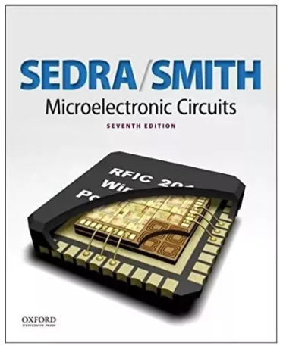
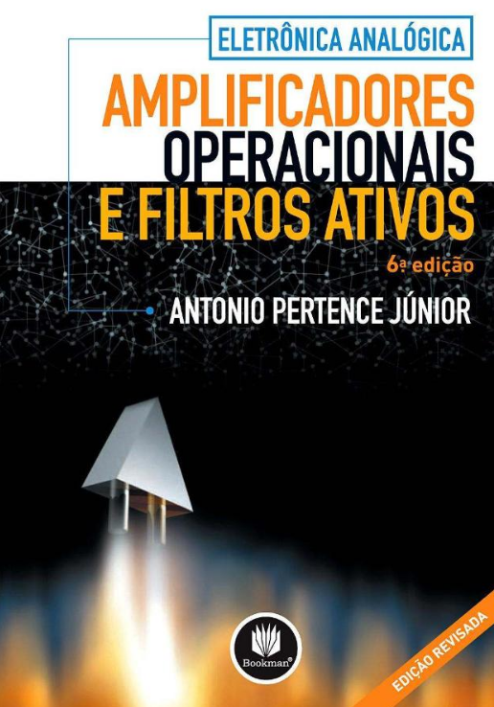
Referências Bibliográficas
Oxford University Press
2015, 7th Edition
Bookman
2003, 6ª edição

Slide 2
In the mid-1960s the first integrated-circuit (IC) op amp was produced. This unit (the μA 709) was made up of a relatively large number of transistors and resistors all on the same silicon chip. Although its characteristics were poor (by today’s standards) and its price was still quite high, its appearance signaled a new era in electronic circuit design.
Electronics engineers started using op amps in large quantities, which caused their price to drop dramatically. They also demanded better-quality op amps. Semiconductor manufacturers responded quickly, and within the span of a few years, high-quality op amps became available at extremely low prices (tens of cents) from a large number of suppliers.
One of the reasons for the popularity of the op amp is its versatility. One can do almost anything with op amps!
Equally important is the fact that the IC op amp has characteristics that closely approach the assumed ideal. This implies that it is quite easy to design circuits using the IC op amp.
Also, op-amp circuits work at performance levels that are quite close to those predicted theoretically. It is for this reason that we are studying op amps at this early stage.
The circuit inside the op amp will not be discussed in this chapter. Rather, we will treat the op amp as a circuit building block and study its terminal characteristics and its applications. This approach is quite satisfactory in many op-amp applications.
Nevertheless, for the more difficult and demanding applications it is quite useful to know what is inside the op-amp package. This topic is studied in Chapter 13 – Operational Amplifiers Circuit of the book Microelectronics Circuits (Sedra – Smith, 7th edition). More advanced applications of op amps appears in the later chapters of this book.

Slide 3
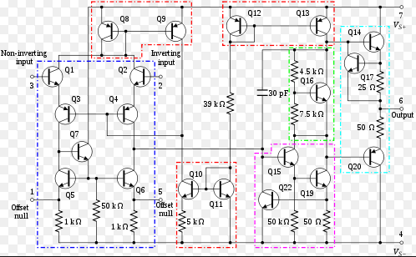
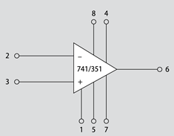
Op Amp 741
O Op Amp é um circuito integrado composto de resistores, transistores e capacitores.

Slide 4
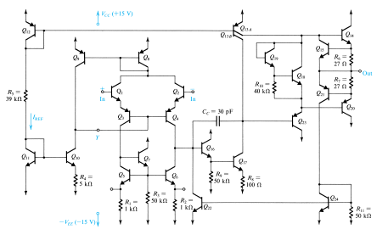
Op Amp 741
Second Stage
(Class AB)
Reference Bias
Current
Firt Stage
(Active Load)
Output
Stage
Short Circuito Protection

Slide 5
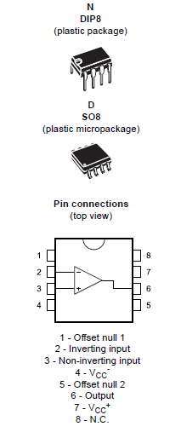
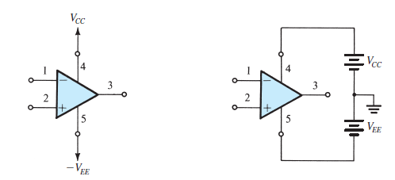
The Op-Amp Terminals
circuit symbol
The op amp shown connected to dc power supplies

Slide 6
Ideal Op Amp

Slide 7
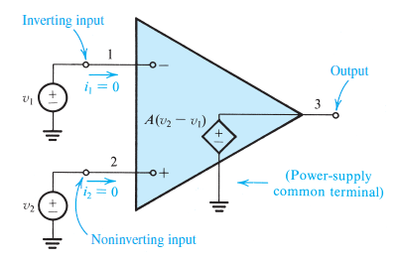
Function and Characteristics of the Ideal Op Amp
The op amp is designed to sense the difference between the voltage signals applied at its two input terminals (v₁ and v₂), multiply this by a number A, and cause the resulting voltage the resulting voltage A(v₂ − v₁) to appear at output terminal 3. The voltage at a terminal we mean the voltage between that terminal and ground. Thus:
$v_{3}$=A$\left(v_{2}−v_{1}\right)$
The ideal op amp is not supposed to draw any input current. That is, the signal current into terminal 1 and the signal current into terminal 2 are both zero. In other words, the input impedance of an ideal op amp is supposed to be infinite.

Slide 8
This terminal 3 is supposed to act as the output terminal of an ideal voltage source. That is, the voltage between terminal 3 and ground will always be equal to A(v₂ − v₁), independent of the current that may be drawn from terminal 3 into a load impedance. In other words, the output impedance of an ideal op amp is supposed to be zero.
The output is in phase with (has the same sign as) v₂ and is out of phase with (has the opposite sign of) v₁. For this reason, input terminal 1 is called the inverting input terminal and is distinguished by a “−” sign, while input terminal 2 is called the noninverting input terminal and is distinguished by a “+” sign.

Slide 9
The op amp responds only to the difference signal v₂ − v₁ and hence ignores any signal common to both inputs. That is, if v1 = v2 = 1 V, then the output will (ideally) be zero. We call this property common-mode rejection, and we conclude that an ideal op amp has zero common-mode gain or, equivalently, infinite common- mode rejection.
The gain A is called the differential gain, for obvious reasons. Perhaps not so obvious is another name that we will attach to A: the open-loop gain. The reason for this name will become obvious later on when we “close the loop” around the op amp and define another gain, the closed-loop gain.

Slide 10
The ideal op amp has a gain A that remains constant down to zero frequency and up to infinite frequency. That is, ideal op amps will amplify signals of any frequency with equal gain, and are thus said to have infinite bandwidth.
The ideal op amp should have a gain A whose value is very large and ideally infinite. One may justifiably ask: If the gain A is infinite, how are we going to use the op amp? The answer is very simple: In almost all applications the op amp will not be used alone in a so-called open-loop configuration. Rather, we will use other components to apply feedback to close the loop around the op amp.

Slide 12
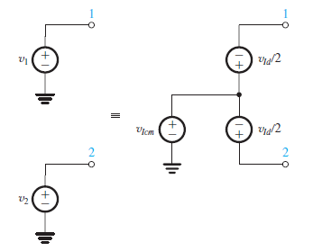
Differential and Common-Mode Signals
The differential input signal v_{Id} is simply the difference between the two input signals v₁ and v₂; that is,
$v_{Id}$= $v_{2}−v_{1}$
The common-mode input signal v_{Icm} is the average of the two input signals v₁ and v_{2:}
$v_{Icm}$= $\frac{1}{2}\left(v_{2}+v_{1}\right)$
$v_{Id}$= $v_{2}−v_{1}$
$v_{1}$=$v_{Icm }$-$\frac{v_{Id}}{2}$
$v_{Icm}$= $\frac{1}{2}\left(v_{2}+v_{1}\right)$
$v_{2}$=$v_{Icm }$+$\frac{v_{Id}}{2}$

Slide 13
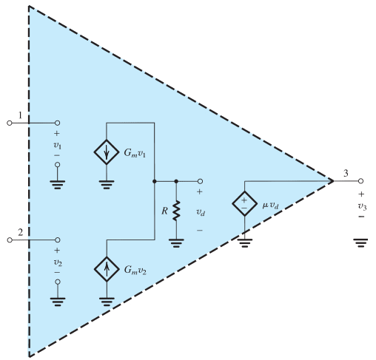
EXERCISES
The internal circuit of a particular op amp can be modeled by the circuit shown in the figure below. Express v₃ as a function of v₁ and v₂. For the case G_{m} = 10 mA/V,
R = 10 kΩ, and μ = 100, find the value of the open-loop gain A.
$v_{3}$= μ$v_{d}$
$v_{d}$=$\left(G_{m}v_{2}−G_{m}v_{1}\right)R=G_{m}$ $R$ $\left(v_{2}−v_{1}\right)$
$v_{3}$= μ$G_{m} R \left(v_{2}−v_{1}\right)$
$A$= μ$G_{m}$
$A$= μ$G_{m}=100x10x10={10}^{4}$V/V = 80dB

Slide 14
Inverting
Amplifier

Slide 15
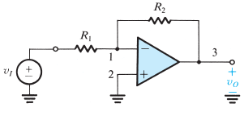
The Inverting Configuration
Op amps are not used alone; rather, the op amp is connected to passive components in a feedback circuit. There are two such basic circuit configurations employing an op amp and two resistors: the inverting configuration and the noninverting configuration.
Resistor R₂ is connected from the output terminal of the op amp, terminal 3, back to the input terminal, terminal 1.
We speak of R₂ as applying negative feedback.
If R₂ were connected between terminals 3 and 2 we would have called this positive feedback.

Slide 16
We will do so assuming the op amp to be ideal. The gain A is very large (ideally infinite).
$G$= $\frac{v_{o}}{v_{i}}$
$v_{2}−v_{1}=\frac{v_{o}}{A}$ =0
It follows that the voltage at the inverting input terminal (v₁) is given by v₁ = v₂. That is, because the gain A approaches infinity, the voltage v₁ approaches and ideally equals v₂. We speak of this as the two input terminals “tracking each other in potential.” We also speak of a “virtual short circuit” that exists between the two input terminals. Here the word virtual should be emphasized, and one should not make the mistake of physically shorting terminals 1 and 2 together while analyzing a circuit. A virtual short circuit means that whatever voltage is at 2 will automatically appear at 1 because of the infinite gain A. But terminal 2 happens to be connected to ground; thus v₂ = 0 and v₁ = 0. We speak of terminal 1 as being a virtual ground— that is, having zero voltage but not physically connected to ground.

Slide 17
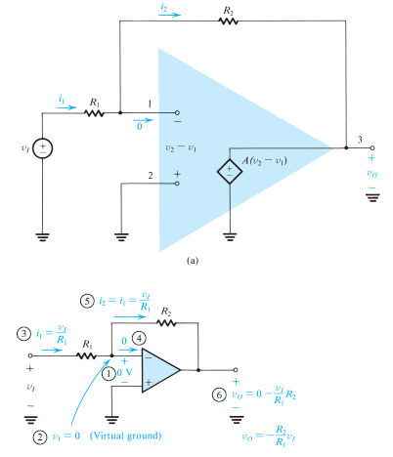
$v_{1}$=$\frac{v_{I}−v_{1}}{R_{1}}$= $\frac{v_{i}−0}{R_{1}}=\frac{v_{i}}{R_{1}}$
Where will this current go? It cannot go into the op amp, since the ideal op amp has an infinite input impedance and hence draws zero current. It follows that i₁ will have to flow through R₂ to
the low-impedance terminal 3.
$v_{O}$= $v_{1}−i_{1}R_{2}=0−\frac{v_{I}}{R_{1}}$
$\frac{v_{O}}{v_{I}}$ = - $\frac{R_{2}}{R_{1}}$

Slide 18
The fact that the closed-loop gain depends entirely on external passive components (resistors R₁ and R₂) is very significant. It means that we can make the closed-loop gain as accurate as we want by selecting passive components of appropriate accuracy.
We started out with an amplifier having very large gain A, and through applying negative feedback we have obtained a closed-loop gain that is much smaller than A but is stable and predictable. That is, we are trading gain for accuracy.

Slide 19
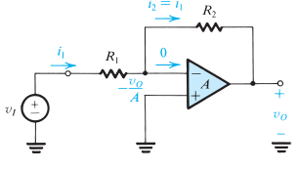
Effect of Finite Open-Loop Gain
Analysis of the inverting configuration taking into account the finite open-loop gain of the op amp.
If we denote the output voltage v_{O} then the voltage between the two input terminals of the op amp will be v_{o}/A. Since the positive input terminal is grounded, the voltage at the negative input terminal must be - v_{o}/A (out of phase with respect the output). The current i₁ through R₁ can now be found:
$i_{1}$=$\frac{v_{I}−\left(−v_{o}/A\right)}{R_{1}}$ = $\frac{{ v}_{I}+v_{o}/A}{R_{1}}$
The infinite input impedance of the op amp forces the current i₁ to flow entirely through R₂. The output voltage v_{O} can thus be determined from:
$v_{o}$= - $\frac{v_{o }}{A}$ - ${i_{1}R}_{2}$= - $\frac{{ v}_{o }}{A} −\left(\frac{{ v}_{I}+v_{o}/A}{R_{1}}\right)R_{2}$
$G$= - $\frac{v_{o }}{v_{i }}$ = $\frac{−R_{2}{/R}_{1}}{1+\left(1+R_{2}{/R}_{1}\right)/A}$

Slide 20
$G$= -$\frac{v_{o }}{v_{i }}$= $\frac{−R_{2}R_{1}}{1+\left(1+R_{2}R_{1}\right)/A}$
We note that as A approaches ∞, G approaches the ideal value – R₂ /R₁ .
Also, we see that as A approaches ∞, the voltage at the inverting input (–v_{o}/A) terminal approaches zero. This is the virtual-ground assumption we used in our earlier analysis when the op amp was assumed to be ideal.
Finally, note that the gain equation in fact indicates that to minimize the dependence of the closed-loop gain G on the value of the open-loop gain A, we should make $\left(1+R_{2}R_{1}\right)$ <<A.

Slide 21
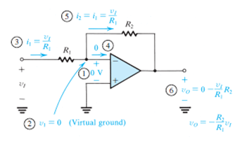
Input Resistance
$R_{i}$= $\frac{v_{i }}{i_{i }}$ =$\frac{v_{i }}{{ v}_{i }/R_{1 }}$
$R_{i}$= $R_{1 }$
Amplifier input resistance forms a voltage divider with the resistance of the source that feeds the amplifier. Thus, to avoid the loss of signal strength, voltage amplifiers are required to have high input resistance.
In the case of the inverting op-amp configuration we are studying, to make R_{i} high we should select a high value for R₁. However, if the required gain is also high, then R₂ could become impractically large (e.g., greater than a few megohms).
We may conclude that the inverting configuration suffers from a low input resistance.

Slide 22
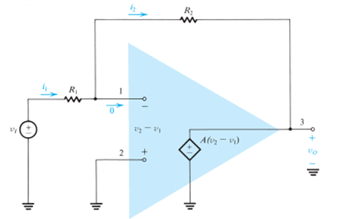
Output Resistance
Since the output of the inverting configuration is taken at the terminals of the ideal voltage source A(v₂ − v₁), it follows that the output resistance of the closed-loop amplifier is zero.

Slide 23
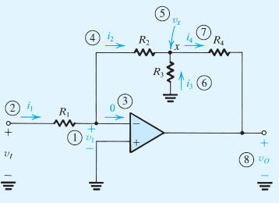
A solution to problem of low input resistance is discussed in the exercise
Assuming the op amp to be ideal, derive an expression for the closed-loop gain of the circuit shown.
Use this circuit to design an inverting amplifier with a gain of 100 and an input resistance of 1 MΩ.
Assume that for practical reasons it is required not to use resistors greater than 1 MΩ.
Compare your design with that based on the basic inverting configuration.

Slide 24
The analysis begins at the inverting input terminal of the op amp, where the voltage is:
$v_{i}$ = - $\frac{{ v}_{o }}{A}=\text{− }\frac{{ v}_{o }}{\text{∞}}=0$
Knowing v₁, we can determine the current i₁ as follows:
$i_{1}$ = $\frac{v_{I}−v_{1}}{R_{1}}$ = $\frac{v_{I}−0}{R_{1}}=\frac{v_{I}}{R_{1}}$
Since zero current flows into the inverting input terminal, all of i₁ will flow through R₂, and thus:
$i_{2}$ = $i_{1}$ $=\frac{v_{I}}{R_{1}}$

Slide 25
Now we can determine the voltage at node x:
$v_{x}$ = $v_{1}$- $i_{2}R_{2}=\text{0 −}\frac{v_{I}}{R_{1}}R_{2}$= $\frac{v_{I}}{R_{1}}R_{2}$
This in turn enables us to find the current i₃:
$i_{3}=\frac{{0−v}_{x}}{R_{3}}=$ $\frac{R_{2}}{R_{1}R_{3}}$ $v_{I}$
Next, a node equation at x yields i₄:
$i_{4}=i_{2}+i_{3}=\frac{v_{I}}{R_{1}}+$ $\frac{R_{2}}{R_{1}R_{3}}$ $v_{I}$

Slide 26
Finally, we can determine v_{O} :
$v_{0}$ = $v_{x}$- $i_{4}R_{4}=−\frac{R_{2}}{R_{1}}v_{I}$-$\left(\frac{v_{I}}{R_{1}}+\frac{R_{2}}{R_{1}R_{3}}v_{I}\right)R_{4}$
$\frac{v_{0}}{v_{I}}$= $−\left[\frac{R_{2}}{R_{1}}+\frac{R_{4}}{R_{1}}\left(1+\frac{R_{2}}{R_{3}}\right)\right]$
$\frac{v_{0}}{v_{I}}$= $−\frac{R_{2}}{R_{1}}\left(1+\frac{R_{4}}{R_{2}}+\frac{R_{4}}{R_{3}}\right)$

Slide 27
$\frac{v_{0}}{v_{I}}$= $−\frac{R_{2}}{R_{1}}\left[1+\frac{R_{4}}{R_{2}}+\frac{R_{4}}{R_{3}}\right]$
Now, since an input resistance of 1 MΩ is required, we select R₁ = 1 MΩ. Then, with the limitation of using resistors no greater than 1 MΩ, the maximum value possible for the first factor in the gain expression is 1 and is obtained by selecting R₂ = 1 MΩ.
To obtain a gain of −100, R₃ and R₄ must be selected so that the second factor in the gain expression is 100.
If we select the maximum allowed (in this example) value of 1 MΩ for R₄, then the required value of R₃ can be calculated to be 10.2 kΩ.
Thus this circuit utilizes three 1-MΩ resistors and a 10.2-kΩ resistor. In comparison, if the inverting configuration were used with R₁ = 1 MΩ we would have required a feedback resistor of 100 MΩ, an impractically large value!
Observe that because of the virtual ground at the inverting input terminal of the op amp, R₂ and R₃ are in effect in parallel.

Slide 28
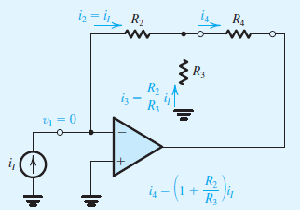
$$i_{3}=\frac{R_{2}i_{I}}{R_{3}}$$
$i_{4}$=${ i}_{2}+i_{3}=\left(1+\frac{R_{2}}{R_{3}}\right)$ $i_{I}$
I₄ não depende de R₄ !
≡

Slide 29
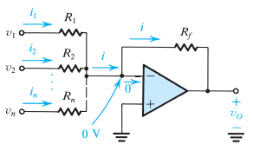
The Weighted Summer
$i_{1}$=$\frac{v_{1}}{R_{1}}$
$i_{2}$=$\frac{v_{2}}{R_{2}}$
$i_{n}$=$\frac{v_{n}}{R_{n}}$
...
$i$=$i_{1}$ + $i_{2} ….$ $i_{n}$
$v_{o}$=$−\left(\frac{R_{f}}{R_{1}}v_{1}+\frac{R_{f}}{R_{2}}v_{2}+…\frac{R_{f}}{R_{n}}v_{n}\right)$
$v_{o}$=$0−$ i$R_{f}$
That is, the output voltage is a weighted sum of the input signals v1, v2, . . . , vn. This circuit is therefore called a weighted summer. Note that each summing coefficient may be independently adjusted by adjusting the corresponding “feed-in” resistor (R₁ to R_{n}). This nice property, which greatly simplifies circuit adjustment, is a direct consequence of the virtual ground that exists at the inverting op-amp terminal.

Slide 30
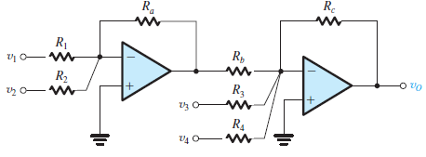
In the weighted summer saw all the summing coefficients must be of the same sign. The need occasionally arises for summing signals with opposite signs. Such a function can be implemented, however, using two op amps as shown below. Assuming ideal op amps, it can be easily shown that the output voltage is given by:
$v_{o}$=$v_{1}\left(\frac{R_{a}}{R_{1}}\right)\left(\frac{R_{c}}{R_{b}}\right)$+ $v_{1}\left(\frac{R_{a}}{R_{2}}\right)$ $\left(\frac{R_{c}}{R_{b}}\right)$- $v_{3}\left(\frac{R_{c}}{R_{3}}\right)$ - $v_{4}\left(\frac{R_{c}}{R_{4}}\right)$
Weighted summers are utilized in a variety of applications including in the design of audio systems where they can be used in mixing signals originating from diferente musical intruments !

Slide 31
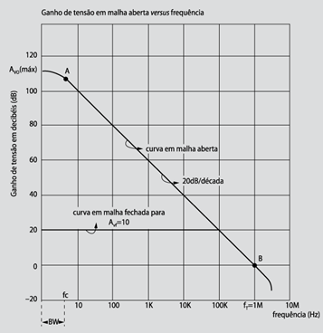
Resposta em Frequência
LF351: f_{T} = 4MHz
LM318: f_{T} = 15MHz

Slide 32
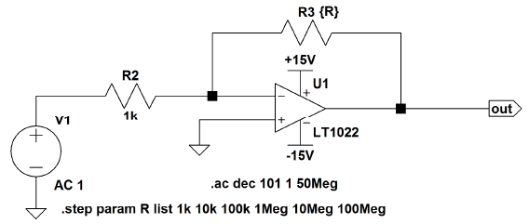
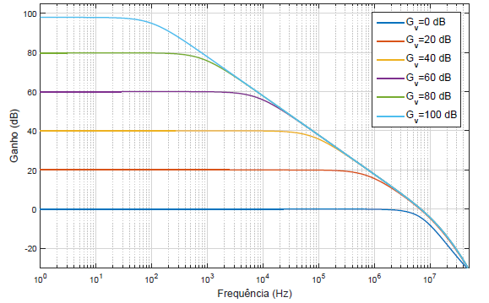
Resposta em Frequência em Simulação (LTSPice )

Slide 33
Noninverting
Amplifier

Slide 34
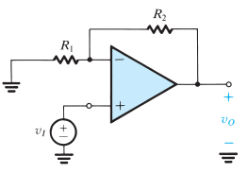
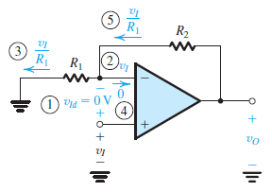
The Noninverting Configuration
Here the input signal v_{Id} is applied directly to the positive input terminal of the op amp while one terminal of R₁ is connected to ground.
$v_{Id}=\frac{v_{o}}{A}$ = 0
$$\frac{v_{O}}{v_{I}}=1+\frac{R_{2}}{R_{1}}$$
$v_{o}=v_{I}+ \left(\frac{v_{I}}{R_{1}}\right)$ $R_{2}$

Slide 35
Effect of Finite Open-Loop Gain
it can be shown that the closed-loop gain of the noninverting amplifier circuit is given by
$G$= $\frac{v_{o }}{v_{i }}$ = $\frac{1+\left(R_{2}{/R}_{1}\right)}{1+\left(1+R_{2}{/R}_{1}\right)/A}$
A>> 1+$\frac{R_{2}}{R}$
$$G=1+\frac{R_{2}}{R_{1}}$$
If
Input and Output Resistance
The gain of the noninverting configuration is positive—hence the name noninverting.
The input impedance of this closed-loop amplifier is ideally infinite, since no current flows into the positive input terminal of the op amp.
The output of the noninverting amplifier is taken at the terminals of the ideal voltage source A(v₂ − v₁), thus the output resistance of the noninverting configuration is zero.

Slide 36
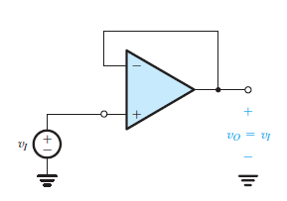
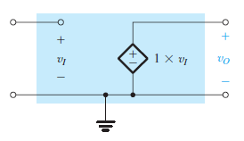
The Voltage Follower
$$G=1+\frac{R_{2}}{R_{1}}$$
R₂ = 0 and R₁ = ∞
≡
There are situations in which one is interested not in voltage gain but only in a significant power gain. For instance, the source signal can have a respectable voltage but a source resistance that is much greater than the load resistance. Connecting the source directly to the load would result in significant signal attenuation. In such a case, one requires an amplifier with a high input resistance (much greater than the source resistance) and a low output resistance (much smaller than the load resistance) but with a modest voltage gain (or even unity gain). Such an amplifier is referred to as a buffer amplifier.

Slide 37
Loading Effect Op Amp Isolador
O divisor resistivo com 10kΩ e 1KΩ diminui consideravelmente a tensão na carga de 1KΩ.

Slide 38
Single Op Amp
Difference Amplifier

Slide 39
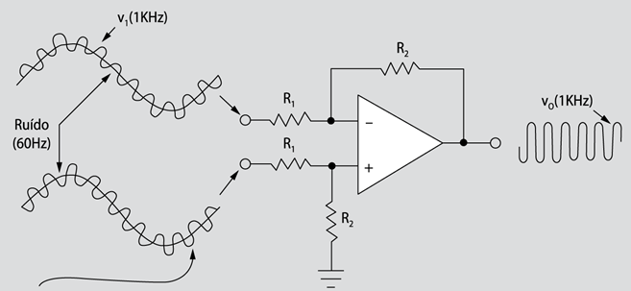
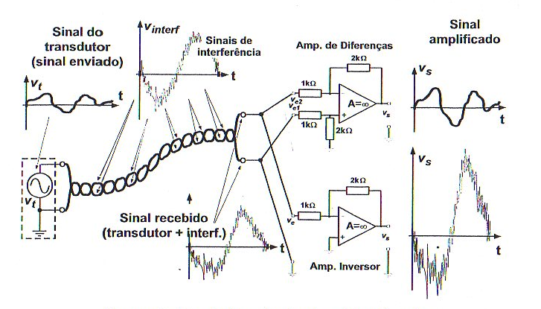
A Single-Op Difference Amplifier
A difference amplifier is one that responds to the difference between the two signals applied at its input and ideally rejects signals that are common to the two inputs.
Inversor Amplifier
Difference Amplifier
X
Inversor Amplifier

Slide 40
Although ideally the difference amplifier will amplify only the differential input signal v_{Id} and reject completely the common-mode input signal v_{Icm}, practical circuits will have an output voltage v_{O} given by
$$v_{o}=A_{d}v_{Id}+A_{cm}v_{Icm}$$
Where A_{d} denotes the amplifier differential gain and A_{cm} denotes its common-mode gain (ideally zero). The efficacy of a differential amplifier is measured by the degree of its rejection of common-mode signals in preference to differential signals. This is usually quantified by a measure known as the common-mode rejection ratio (CMRR), defined as:
$CMRR=$20 $log\frac{\left|A_{d}\right|}{\left|A_{cm}\right|}$

Slide 41
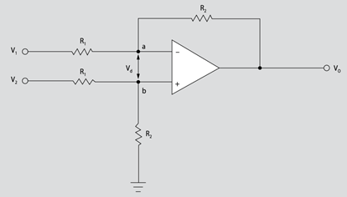
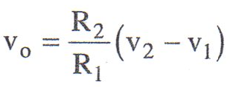
A Single Op-Amp Difference Amplifier
Nó a:
Nó b:
V_{a} = V_{b} (terra virtual)

Slide 42
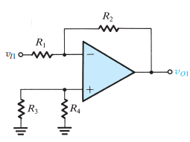
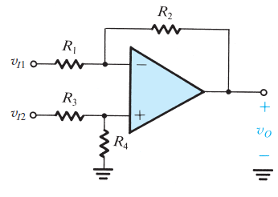
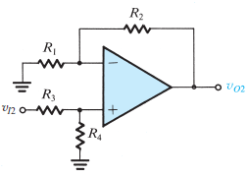
Specifically, we wish to determine the output voltage v_{O} in terms of v_{I1} and v_{I2}. Toward that end, we observe that the circuit is linear, and thus we can use superposition.

Slide 43
To apply superposition, we first reduce v_{I2} to zero, that is ground the terminal to which v_{I2} is applied, and then find the corresponding output voltage, which will be due entirely to v_{I1}. We denote this output voltage v_{O1}.
$$v_{o1}=−\frac{R_{2}}{R_{1}}v_{L1}$$
Next, we reduce v+ to zero and evaluate the corresponding output voltage v_{O2}. The circuit will now take the form shown which we recognize as the noninverting configuration with an additional voltage divider, made up of R₃ and R₄, connected to the input v_{I2}.
$$v_{o2}=v_{I2}\frac{R_{4}}{R_{3}+R_{4}}\left(1+\frac{R_{2}}{R_{1}}\right)$$
If
$\frac{R_{4}}{R_{3}+R_{4}}\left(1+\frac{R_{2}}{R_{1}}\right)$ = $\frac{R_{2}}{R_{1}}$
$$\frac{R_{4}}{R_{3}+R_{4}}=\frac{R_{2}}{R_{2}+R_{1}}$$
$$\frac{R_{4}}{R_{3}}=\frac{R_{2}}{R_{1}}$$
$$v_{o2}=v_{I2}\frac{R_{2}}{R_{1}}$$

Slide 44
The superposition principle tells us that the output voltage v_{O} is equal to the sum of v_{O1} and v_{O2}. Thus we have
$$v_{o}=\frac{R_{2}}{R_{1}}\left(v_{I2}−v_{I1}\right)$$
$$A_{d}=\frac{R_{2}}{R_{1}}$$

Slide 45
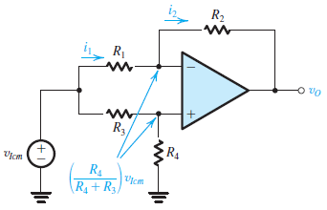
Let’s next consider the circuit with only a common-mode signal applied at the input, as shown in the circuito below:
v_{x}
$i_{1}=\frac{1}{R_{1}}\left[v_{Icm}−\frac{R_{4}}{R_{4}+R_{3}}v_{Icm}\right]=v_{Icm}\frac{R_{3}}{R_{4}+R_{3}}$ $\frac{1}{R_{1}}$
x
$$v_{o}=\frac{R_{4}}{R_{4}+R_{3}}v_{Icm}−i_{2}R_{2}$$
$$i_{2}=i_{1}$$
$v_{0}=\frac{R_{4}}{R_{4}+R_{3}}\left(1−\frac{R_{2}}{R_{1}}\frac{R_{3}}{R_{4}}\right)$ $v_{Icm}$
$$A_{cm}=\frac{R_{4}}{R_{4}+R_{3}}\left(1−\frac{R_{2}}{R_{1}}\frac{R_{3}}{R_{4}}\right)$$
Any mismatch in the resistance ratios can make A_{cm} nonzero and hence CMRR finite !
$$\frac{R_{4}}{R_{3}}=\frac{R_{2}}{R_{1}}$$
$$A_{cm}=0$$

Slide 46
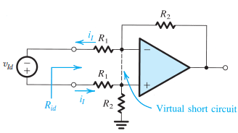
Input Resistance
In addition to rejecting common-mode signals, a difference amplifier is usually required to have a high input resistance. To find the input resistance between the two input terminals (i.e., the resistance seen by v_{Id}), called the differential input resistance R_{id}, consider the circuit below. Here we have assumed that the resistors are selected so that:
$$R_{3}=R_{1}$$
$$R_{4}=R_{2}$$
$$R_{id}=\frac{v_{id}}{i_{I}}$$
$$R_{id}=\frac{v_{id}}{i_{I}}$$
Since the two input terminals of the op amp track each other in potential, we may write a loop equation and obtain:
$v_{id}=R_{1}i_{I}$+ $R_{1}i_{I}$
$$R_{id}=\frac{v_{id}}{i_{I}}$$
$R_{id}=2$ $R_{1}$

Slide 47
If the amplifier is required to have a large differential gain, then R₁ will be relatively small and the input resistance will be correspondingly low. This is a drawback of this circuit.
Another drawback of the circuit is that it is not easy to vary the differential gain of the amplifier.
Both of these drawbacks are overcome with another kind of difference amplifier named instrumentation amplifier.

Slide 48
Medida da CMRR
Se v_{c} =0
$v_{o}$= $A_{d}v_{d}$ +$A_{c}v_{c}$
$A_{d}$ = $\frac{v_{od}}{v_{d}}$
$A_{d}$ = |$\frac{v_{od}}{2v_{1}}$|
$v_{d}$= $v_{1}$ - $v_{2}$
$v_{1}$ = - $v_{2}$
$v_{c}$= $\frac{v_{1}\text{ + }v_{2} }{2}$
$v_{d}$= $v_{1}$ - $v_{2}$ = 2 $v_{1}$
A_{d} - ganho diferencial
A_{c} - ganho em modo comum
Se $v_{1}$ = 0,5V
$A_{d}$ = |$v_{od}$|
Se v_{d} =0
$A_{c}$ = $\frac{v_{oc}}{v_{c}}$
$v_{1}$ = $v_{2}$
$A_{c}$ = |$\frac{v_{oc}}{v_{1}}$|
$v_{c}$ = $v_{2}$
Se $v_{1}$ = 1V
$A_{c}$ = |$v_{oc}$|
$CMRR$ = |$\frac{A_{d}}{A_{c}}|$

Slide 49
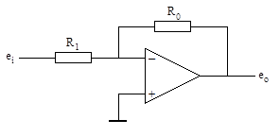
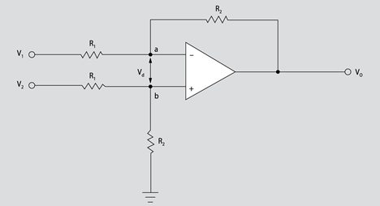
Medida de A_{d} (ganho em modo diferencial)
Para medir A_{d} utilize o circuito abaixo sendo |v₁^{max} |= |v₂^{max}| = 0,5V.
A medida da CMRR
em simulação reproduz resultados muito próximos de data sheet !
Gerador de Função
$A_{d}$ = |$v_{od}$|
Inversor com ganho 1
Medida de A_{c} (ganho em modo comum)
Para medir A_{c} utilize o circuito abaixo sendo v₁^{max} = v₂^{max} = 1V.
Gerador de Função
$CMRR$ = |$\frac{A_{d}}{A_{c}}|$
$A_{c}$ = |$v_{oc}$|

Slide 50
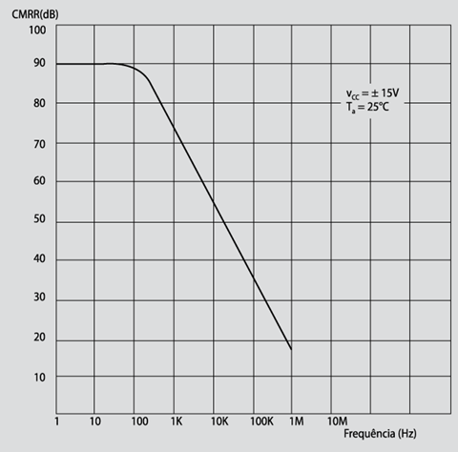
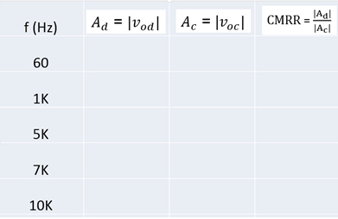
$CMRR$ = |$\frac{A_{d}}{A_{c}}|$
Typical CMRR Curve

Slide 51
Instrumentation
Amplifier

Slide 52
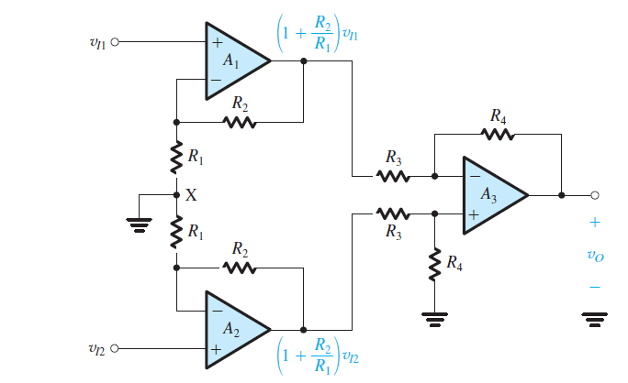
A Superior Circuit - The Instrumentation Amplifier
A solution for the low-input-resistance problem of the difference amplifier can be solved trying to get some voltage gain. It is especially interesting that we can achieve this without compromising the high input resistance simply by using followers with gain.

Slide 53
1st stage
2nd stage
It consists of two stages in cascade:
The first stage is formed by op amps A₁ and A₂ and their associated resistors.
The second stage is the difference amplifier formed by op amp A₃ and its four associated resistors.
Observe that each of A₁ and A₂ is connected in the noninverting configuration and thus realizes a gain of (1+R₂/R₁).
It follows that each of v_{I1} and v_{I2} is amplified by this factor, and the resulting amplified signals appear at the outputs of A₁ and A₂, respectively.

Slide 54
The difference amplifier in the second stage operates as follows:

Slide 55
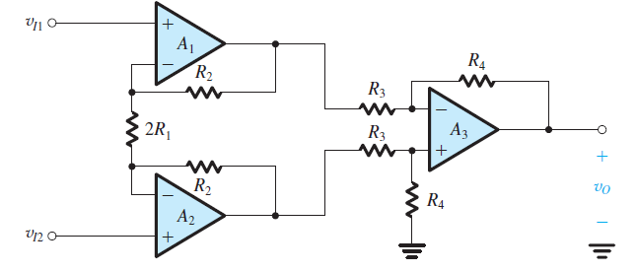
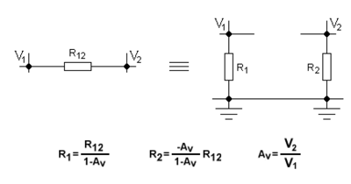
Noninverting Amplifier
The circuit with the connection between node X and ground removed and the two resistors R₁ and R₁ lumped together.
This simple wiring change dramatically improves performance !
Difference
Amplifier
Teorema
de Miller

Slide 56
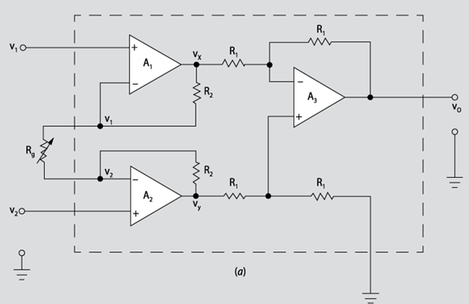
B
A
3.2
B
O estágio seguinte é um amplificador diferencial :
3.3
Das equações (3.1), (3.2) e (3.3), resulta :
A
3.1

Slide 57
Achieving the required gain in this new first stage of the differential amplifier eases the burden on the difference amplifier in the second stage, leaving it to its main task of implementing the differencing function and thus rejecting common-mode signals.
If R₄=R₃ and R_{g} =2R₁

Slide 58
The common-mode gain will be zero because of the differencing action of the second-stage amplifier.
$$A_{cm}=0$$

Slide 59
Advantage
The circuit above has the advantage of very high (ideally infinite) input resistance and high differential gain. Also, provided A₁ and A₂ and their corresponding resistors are matched, the two signal paths are symmetric ⎯ a definite advantage in the design of a differential amplifier.

Slide 60
Disadvantages
The two amplifier channels in the first stage have to be perfectly matched, otherwise a spurious signal may appear between their two outputs.
To vary the differential gain A_{d}, two resistors have to be varied simultaneously, say the two resistors labeled R₁. At each gain setting the two resistors have to be perfectly matched which is a difficult task.

Slide 61
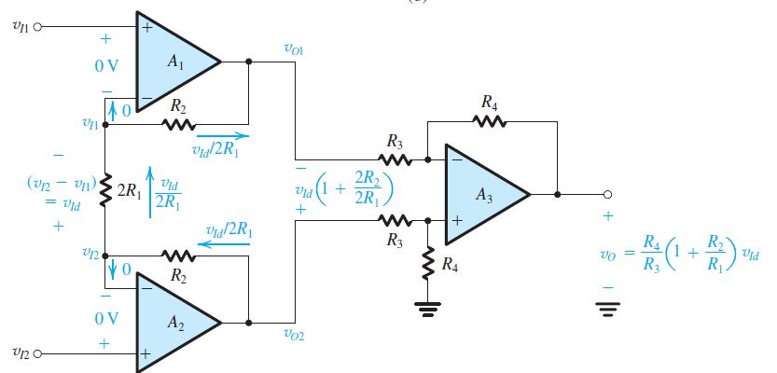
The virtual short circuits at the inputs of op amps A₁ and A₂ cause the input voltages v_{I1} and v_{I2} to appear at the two terminals of resistor (2R₁).
Thus the differential input voltage v_{I2} − v _{I1} = v_{Id} appears across 2R₁ and causes a current to flow through 2R₁ and the two resistors labeled R₂.
This current in turn produces a voltage difference between the output terminals of A₁ and A₂ given by
$$v_{01}−v_{02}=\frac{v_{Id}}{R_{1}}(2R_{1}+R_{2})$$
$$v_{01}−v_{02}=\left(1+\frac{2R_{2}}{{2R}_{1}}\right)v_{Id}$$

Slide 62
The difference amplifier formed by op amp A₃ and its associated resistors senses the voltage difference (v_{O2} − v_{O1}) and provides a proportional output voltage v_{O} :
$$v_{0}=\frac{R_{4}}{R_{3}}\left(1+\frac{2R_{2}}{{2R}_{1}}\right)v_{Id}$$
$$v_{0}=\frac{R_{4}}{R_{3}}\left(1+\frac{R_{2}}{R_{1}}\right)v_{Id}$$

Slide 63
Consider next what happens when the two input terminals are connected together to a common mode input voltage v_{Icm}.
a) An equal voltage appears at the negative input terminals of A₁ and A₂, causing the current through 2R₁ to be zero. Thus there will be no current flowing in the R₂ resistors, and the voltages at the output terminals of A₁ and A₂ will be equal to the input (v_{Icm}). Thus the first stage no longer amplifies v_{Icm} . it simply propagates v_{Icm} to its two output terminals, where they are subtracted to produce a zero common-mode output by A₃.
b) Finally, we observe from the gain expression that the it can be varied by changing only one resistor, 2R₁.
This is an excellent differential amplifier circuit and is widely employed as an instrumentation amplifier; that is, as the input amplifier used
in a variety of electronic instruments !

Slide 64
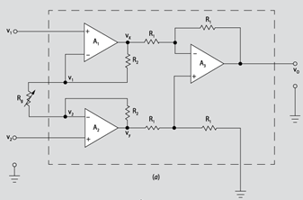
≡
Resistência de entrada muito alta
Resistência de saída menor que a dos amp ops comuns
CMRR superior superior à 100 dB
Exemplo:
LH36 (National)
R_{i} = 300 MΩ
R_{i} = 0,5Ω
CMRR = 100 dB
Ganho de tensão em malha aberta muito superior ao dos amp ops comuns
Tensão de offset muito baixa
Drift térmico extremamente baixo

Slide 65
Medida da CMRR
A medida da CMRR
em simulação reproduz resultados muito próximos de data sheet !
Medida de A_{d} (ganho em modo diferencial)
Para medir A_{d} utilize o circuito abaixo sendo |v₂^{max} |= |v₂^{max}| = 0,5V
Gerador de Função
$A_{d}$ = |$v_{od}$|
Inversor com ganho 1
Medida de A_{c} (ganho em modo comum)
Para medir A_{c} utilize o circuito abaixo sendo v₁^{max} = v₂^{max} = 1V.
$CMRR$ = |$\frac{A_{d}}{A_{c}}|$
Gerador de Função
$A_{c}$ = |$v_{oc}$|

Slide 66
$CMRR$ = |$\frac{A_{d}}{A_{c}}|$
Typical CMRR Curve

Slide 67
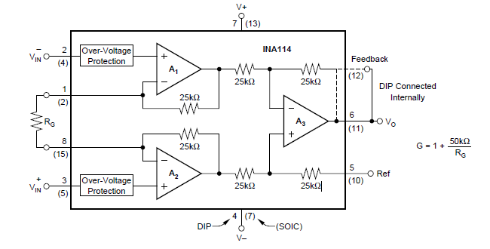
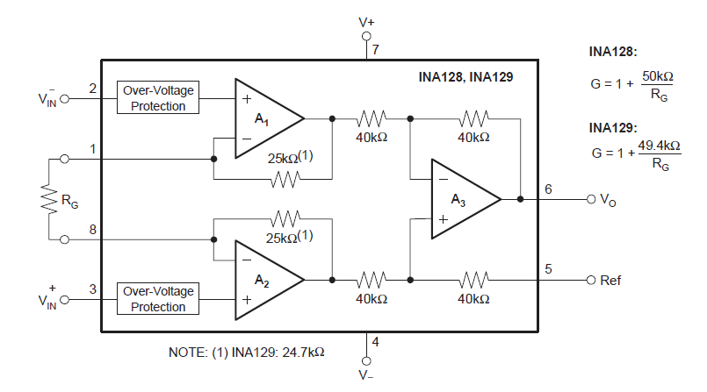
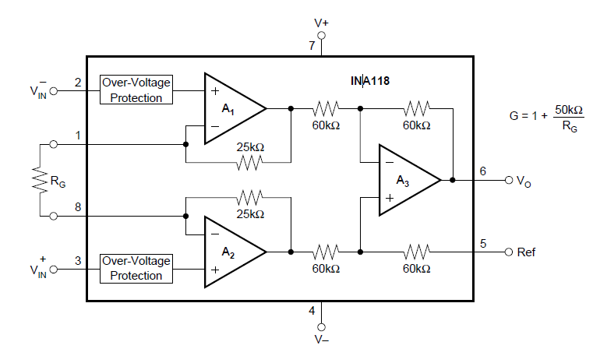
Integrated Instrumentation Amplifiers
INA114 (tecnologia BJT)
INA128 - INA129 (tecnologia BJT)
INA118 (tecnologia BJT)

Slide 68
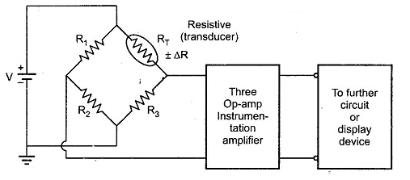
Application of Instrumentation Amplifier
In many industrial applications it is necessary to measure various physical quantities such as temperature, humidity, water flow etc. These are measured by transducers. The output of transducer is required to be amplified for which instrumentation amplifier is used. The Fig. shows a practical instrumentation amplifier with a transducer bridge.

Slide 69
Temperature indicator
The circuit of the instrumentation amplifier can be used as a temperature indicator if the transducer in the bridge circuit is a thermistor and the output meter is calibrated in degrees Celsius or Fahrenheit. The bridge can be balanced at a desired reference condition, for instance 25′C. As the temperature varies from its reference value, the resistance of the thermistor changes and the bridge becomes unbalanced. This unbalanced bridge in turn produces the meter movement. The meter can be calibrated to read a desired temperature range by selecting an appropriate gain for the differential instrumentation amplifier. In figure the metal movement is dependent on the amount of imbalance in the bridge that is, the change ∆R in the value of the thermistor resistance.
Temperature controller
A simple and inexpensive temperature control circuit may be constructed by using a thermistor in the bridge circuit and by replacing a meter with a relay in the circuit of instrumentation amplifier. The output of the differential instrumentation amplifier drives a relay that controls the current in the heat-generating circuit. A properly designed circuit should energize a relay when the temperature of the thermistor drops below a desired value, causing the heat unit to turn on.
Light-intensity meter
The circuit in the figure can be used as a light-intensity meter if a transducer is a photocell. The bridge can be balanced for darkness conditions. Therefore, when exposed to light the bridge will be unbalanced and cause the meter to deflect. The meter can be calibrated in terms of lux to measure the change in light intensity.
The light-intensity meter using an instrumentation bridge amplifier is more accurate and stable than single-input inverting or non-inverting configurations because the common-mode (noise) voltages are effectively rejected by the differential configuration.

Slide 70
Integrator
The op-amp circuit applications we have studied thus far utilized resistors in the op-amp feedback path and in connecting the signal source to the circuit (feed-in ), that is, in the feed-in path. As a result, circuit operation has been (ideally) independent of frequency.
By allowing the use of capacitors together with resistors in the feedback and feed-in paths of op-amp circuits, a door is open to a very wide range of useful and exciting applications of the op amp.
The op-amp–RC circuits are considering two basic applications, namely, signal integrators and differentiators.

Slide 71
The Inverting Configuration with General Impedances

Slide 72
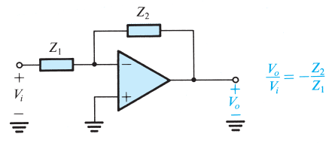
The inverting closed-loop configuration with impedances Z₁(s) and Z₂(s) replacing resistors R₁ and R₂, respectively is shown below.
The resulting circuit, for an ideal op amp, has the following closed-loop transfer function:
$\frac{V_{o}(s)}{V_{i}(s)}=$ - $\frac{Z_{2}(s)}{Z_{1}(s)}$
By replacing s by jω provides the transfer function, that is, the transmission magnitude and phase for a sinusoidal input signal of frequency ω.

Slide 73
Note
A single time constant network (STC ) is one that is composed of, or can be reduced to, one reactive component (inductance or capacitance) and one resistance.
Examples
low-pass network
high-pass network

Slide 74
Exemplo
For the circuit below:
a) Derive an expression for the transfer function.
b) Show that the transfer function is that of a low-pass STC (single time constant) circuit.
c) By expressing the transfer function in the standard form shown find the dc gain and the 3-dB frequency.
d) Design the circuit to obtain a dc gain of 40 dB, a 3-dB frequency of 1 kHz, and an input resistance of 1 kΩ.

Slide 75
a
To obtain the transfer function of the circuit we substitute in the transfer function Z₁ = R₁ and since Z₂ is the parallel connection of two components, it is more convenient to work in terms of Y_{2.} that is, we use the following alternative form of the transfer function:
Low-pass STC
network (k=R₂/R₁)
f_{o} =1kHz
c
The capacitor behaves as an open circuit at dc. Thus at dc the gain is simply (-R₂ /R₁).

Slide 76
d
Now to obtain a dc gain of 40 dB, that is, 100 V/V, we select R₂ /R₂ = 100.
For an input resistance of 1 kΩ, we select R₁ = 1 kΩ, and thus R₂ = 100 kΩ. Finally, for a
3dB frequency at f₀ = 1 kHz, we calculate C₂ :

Slide 77
The
Integrator

Slide 78
The Inverting Integrator
By placing a capacitor in the feedback path and a resistor at the input, we obtain the circuit below. We shall now show that this circuit realizes the mathematical operation of integration.
Let the input be a time-varying function v_{I}(t). The virtual ground at the inverting op-amp input causes v_{I}(t) to appear in effect across R, and thus the current i₁(t) will be v_{I}(t)/R
This current flows through the capacitor C, causing charge to accumulate on C. If we assume that the circuit begins operation at time t = 0, then at an arbitrary time t the current i₁(t) will have deposited on C the following charge Q:
$$Q=\int_{0}^{t}{i_{I}\left(t\right)dt}$$
The capacitor voltage v_{c}(t) will change by:
$$v_{c}\left(t\right)=\frac{1}{C}\int_{0}^{t}{i_{I}\left(t\right)dt}$$

Slide 79
If the initial voltage (at t=0) on C is V_{c} , thus
$$v_{c}\left(t\right)=V_{c}+\frac{1}{C}\int_{0}^{t}{i_{I}\left(t\right)dt}$$
The output voltage v_{O}(t) = - v_{C}(t). Thus,
$$v_{0}\left(t\right)=\frac{1}{RC}\int_{0}^{t}{v_{I}\left(t\right)dt −V_{c}}$$
Thus the circuit provides an output voltage that is proportional to the time integral of the input, with V_{C} being the initial condition of integration and RC the integrator time constant.
Note that there is a negative sign attached to the output voltage, and thus this integrator circuit is said to be an inverting integrator. It is also known as a Miller integrator.
$\frac{V_{o}(s)}{V_{i}(s)}=$ - $\frac{Z_{2}(s)}{Z_{1}(s)}$

Slide 80
Comparison of the frequency response of the integrator to that of an STC low-pass network indicates that the integrator behaves as a low-pass filter with a corner frequency of zero. Observe also that at ω = 0, the magnitude of the integrator transfer function is infinite. This indicates that at dc the op amp is operating with an open loop.

Slide 81
The dc problem of the integrator circuit can be alleviated by connecting a resistor R_{F} across the integrator capacitor C, as shown below, and thus the gain at dc will be –R_{F}/R rather than infinite. Such a resistor provides a dc feedback path.
Unfortunately, however, the integration is no longer ideal, and the lower the value of R_{F}, the less ideal the integrator circuit becomes. This is because R_{F} causes the frequency of the integrator pole to move from its ideal location at ω = 0 to one determined by the corner frequency of the STC network (R_{F},C). Specifically, the integrator transfer function becomes:
The lower the value we select for R_{F} , the higher the corner frequency will be and the more nonideal the integrator becomes. Thus selecting a value for R_{F} presents the designer with a trade-off between dc performance and signal performance.

Slide 82
Exercício
Find the output produced by a Miller integrator in response to an input pulse of 1-V height and 1-ms width as shown below. Let R = 10 kΩ and C = 10 nF. If the integrator capacitor is shunted by a 1-MΩ resistor, how will the response be modified? The op amp is specified to saturate at ± 13V.
In response to a 1V, 1ms input pulse, the integrator output, if V_{C} = 0, will be:
$$v_{o}\left(t\right)=\frac{1}{RC}\int_{0}^{t}{v_{I}\left(t\right)dt −V_{c}}$$
$$v_{o}\left(t\right)=\frac{1}{RC}\int_{0}^{t}{1dt }$$
0 ≤ t ≤ 1ms
$$v_{o}\left(t\right)=−10t$$

Slide 83
That the output is a linear ramp should also be obvious from the fact that the 1-V input pulse produces a constant current through the capacitor of 1V/10KΩ. This constant current I = 0.1 mA supplies the capacitor with a charge and thus the capacitor voltage changes linearly as (It/C) resulting in v_{o}(t) = -(It/C). It is worth remembering that charging a capacitor with a constant current produces a linear voltage across it.
Next consider the situation with resistor connected R_{F} – 1MΩ across C. As before, the 1V pulse will provide a constant current I = 0.1 mA. Now, however, this current is supplied to an STC network composed of R_{F} in parallel with C. Thus, the output will be an exponential heading toward −100V with a time constant Ԏ =CR_{F} = 10 x 10⁻⁹ x 10⁶ = 10ms.
$v_{o}\left(t\right)=v_{ofinal}−(v_{ofinal}$ - $v_{oinitial})e^{−t/\text{Ԏ}}$
$$v_{ofinal}=−IR_{f}=−0.1x{10}^{6}=−100$$
$$v_{o}\left(t\right)=−100(1−e^{−t/10)})$$
$$v_{oinitial}=0$$
0 ≤ t ≤ 1ms
$$v_{o}\left(1ms\right)=−100\left(1−e^{−1/10)}\right)=−9,5V$$

Slide 84
The output waveform is shown below, from which we see that including R_{F} causes the ramp to be slightly rounded such that the output reaches only −9.5 V, 0.5 V short of the ideal value of −10 V. Furthermore, for t > 1 ms, the capacitor discharges through R_{F} with the relatively long time-constant of 10 ms. Finally, we note that op amp saturation, specified to occur at ±13V, has no effect on the operation of this circuit.
This example hints at an important application of integrators, namely, their use in providing triangular waveforms in response to square-wave inputs.
Integrators have many other applications, including their use in the design of filters

Slide 85
The Differenciator

Slide 86
The Op Amp Differentiator
Interchanging the location of the capacitor and the resistor of the integrator circuit results in the circuit that performs the mathematical function of differentiation.
To see how this comes about, let the input be the time-varying function, and note that the virtual ground at the inverting input terminal of the op amp causes to appear in effect across the capacitor C. Thus the current through C will be C(dv_{I}/dt), and this current flows through the feedback resistor R providing at the op-amp output the following voltage:
The frequency-domain transfer function of the differentiator circuit can be found by substituting Z₁(s)=R₁/sC and Z₂(s)= R in the transfer function of an inverting configuration with general impedances:
$\frac{V_{o}(s)}{V_{i}(s)}=$ - $\frac{Z_{2}(s)}{Z_{1}(s)}$

Slide 87
The Bode plot of the magnitude response can be found by noting that for an octave increase in ω, the magnitude doubles (increases by 6 dB). Thus the plot is simply a straight line of slope +6 dB/octave (or, equivalently, +20 dB/decade) intersecting the 0 dB
line where RC is the differentiator time-constant.
We should note that a differentiator circuit causes it to be a “noise magnifier.” This is due to the spike introduced at the output every time there is a sharp change in V_{I}(t) and such a change could be interference coupled electromagnetically (“picked up”) from adjacent signal sources. For this reason and because they suffer from stability problems differentiator circuits are generally avoided in practice. When the circuit is used, it is usually necessary to connect a small-valued resistor in series with the capacitor. This modification, unfortunately, turns the circuit into a nonideal differentiator.,

Slide 88
DC Imperfections

Slide 89
Offset Voltage
Op amps are direct-coupled devices with large gains at dc, they are prone to dc problems. The first such problem is the dc offset voltage.
Note
There are many applications in which it is important that the amplifier maintain its gain at low frequencies down to dc. Furthermore, monolithic integrated-circuit (IC) technology does not allow the fabrication of large coupling capacitors. Thus IC amplifiers are usually designed as directly coupled or dc amplifiers (as opposed to capacitively coupled, or ac amplifiers). Figure shows the frequency response of a dc amplifier. Such a frequency response characterizes what is referred to as a low-pass amplifier.
Frequency response of a directly coupled amplifier.

Slide 90
If the two input terminals of the op amp are tied together and connected to ground, it will be found that despite the fact that v_{Id} = 0, a finite dc voltage exists at the output.
The op-amp output can be brought back to its ideal value of 0 V by connecting a dc voltage source of appropriate polarity and magnitude between the two input terminals of the op amp. This external source balances out the input offset voltage of the op amp. It follows that the input offset voltage (V_{OS}) must be of equal magnitude and of opposite polarity to the voltage we applied externally.
The input offset voltage arises as a result of the unavoidable mismatches present in the input differential stage inside the op amp.
General-purpose op amps exhibit V_{OS} in the range of 1 mV to 5 mV.
The value of V_{OS} depends on temperature. The op amp data sheets usually specify typical and maximum values for V_{OS} at room temperature as well as the temperature coefficient of V_{OS} (usually in μV/°C). They do not, however, specify the polarity of V_{OS} because the component mismatches that give rise to V_{OS} are obviously not known a priori. Different units of the same op-amp type may exhibit either a positive or a negative V_{OS}.

Slide 91
To analyze the effect of V_{OS} on the operation of op-amp circuits, we need a circuit model for the op amp with input offset voltage, as shown below.
Circuit model for an op amp with input offset voltage V_{OS}
Note
We should note that real op amps have nonideal effects additional to those discussed in this chapter. These include finite nonzero common-mode gain or, equivalently, noninfinite CMRR, noninfinite input resistance, and nonzero output resistance. The effect of these, however, on the performance of most of the closed-loop circuits studied here is not very significant.

Slide 92
Pelo Teorema da Superposição, em ambos os amplificadores, o circuito abaixo representa o efeito de V_{os} na análise DC.
Modelo da presença de V_{os}
no amplificador inversor
Modelo da presença de V_{os}
no amplificador não inversor

Slide 93
This output dc voltage can have a large magnitude.
For instance, a noninverting amplifier with a closed-loop gain of 1000, when constructed from an op amp with a 5-mV input offset voltage, will have a dc output voltage of +5 V or −5 V (depending on the polarity of V_{OS}) rather than the ideal value of 0 V.
Now, when an input signal is applied to the amplifier, the corresponding signal output will be superimposed on the 5-V dc. Obviously then, the allowable signal swing at the output will be reduced. Even worse, if the signal to be amplified is dc, we would not know whether the output is due to V_{OS} or to the signal !

Slide 94
Some op amps are provided with two additional terminals to which a specified circuit can be connected to trim to zero the output dc voltage due to V_{OS} . The circuit below shows such an arrangement that is typically used with general-purpose op amps.
A potentiometer is connected between the offset-nulling terminals with the wiper of the potentiometer connected to the op-amp negative supply. Moving the potentiometer wiper introduces an imbalance that counteracts the asymmetry present in the internal op-amp circuitry and that gives rise to V_{OS}.
It should be noted, however, that even though the dc output offset can be trimmed to zero, the problem remains of the variation (or drift) of V_{OS} with temperature.

Slide 95
One way to overcome the dc offset problem is by capacitively coupling the amplifier. This, however, will be possible only in applications where the closed-loop amplifier is not required to amplify dc or very-low-frequency signals. Figure below shows a capacitively coupled amplifier. Because of its infinite impedance at dc, the coupling capacitor will cause the gain to be zero at dc.
As a result the equivalent circuit for determining the dc output voltage resulting from the op-amp input offset voltage V_{OS} will be:
Thus V_{OS} sees in effect a unity-gain voltage follower, and the dc output voltage V_{O} will be equal to V_{OS} rather than V_{OS} (1 + R₁/R₂). which is the case without the coupling capacitor.

Slide 96
Exercise 2.2 – Classroom
Consider an inverting amplifier with a nominal gain of 1000 constructed from an op amp with an input offset voltage of 3 mV and with output saturation levels of ± 10V.
What is (approximately) the peak sine-wave input signal that can be applied without output clipping?
If the effect of V_{OS} is nulled at room temperature (25°C), how large an input can one now apply if:
The circuit is to operate at a constant temperature?
(ii) The circuit is to operate at a temperature in the range 0°C to 75°C and the temperature coefficient of V_{OS} is 10 μV/°C?

Slide 97
Exercise 2.3 – Classroom
Consider the same amplifier as before - that is, an inverting amplifier with a nominal gain of 1000 constructed from an op amp with an input offset voltage of 3 mV and with output saturation levels of ± 10V. Except here let the amplifier be capacitively coupled.
(a) What is the dc offset voltage at the output, and what (approximately) is the peak sine-wave signal that can be applied at the input without output clipping? Is there a need for offset trimming?
(b) If R₁ = 1 kΩ and R₂ = 1 MΩ, find the value of the coupling capacitor C₁ that will ensure that the gain will be greater than 57 dB down to 100 Hz.

Slide 98
Input Bias and Offset Currents
The second dc problem encountered in op amps (ones constructed using BJTs) is illustrated below. In order for the op amp to operate, its two input terminals have to be supplied with dc currents, termed the input bias currents.
The op-amp
input bias currents
These two currents are represented by two current sources, I_{B1} and I_{B2}, connected to the two input terminals.
The op-amp manufacturer usually specifies the following currents:
Input bias current
$$I_{B}=\frac{I_{B1}+I_{B2}}{2 }$$
(Typical value: I_{B} = 100nA)
Input offset current
$$I_{OS}=\left|I_{B1}−I_{B2}\right|$$
(Typical value: I_{B} = 10nA)

Slide 99
We now wish to find the dc output voltage of the closed-loop amplifier due to the input bias currents. To do this we ground the signal source and obtain the circuit shown below for both the inverting and noninverting configurations.
The output dc voltage is given by:
$$V_{O}=I_{B1}R_{2}\text{≅} I_{B}$$
This obviously places an upper limit on the value of R₂. Fortunately, however, a technique exists for reducing the value of the output dc voltage due to the input bias currents.

Slide 100
The method consists of introducing a resistance R₃ in series with the noninverting input lead, as shown below.
From a signal point of view, R₃ has a negligible effect (ideally no effect).
The appropriate value for R₃ can be determined by analyzing the circuit, and the output voltage is given by
I_{R1}
If
$$I_{B1}=I_{B2}=I_{B}$$
Thus we can reduce V_{O} to zero by selecting R₃ such that:

Slide 101
If
$$I_{B1}\text{≠}I_{B2}$$
$$I_{B1}\text{= }I_{B}+\frac{I_{OS}}{2}$$
$$I_{B2}\text{= }I_{B}−\frac{I_{OS}}{2}$$
which is usually about an order of magnitude smaller than the value obtained without R₃.

Slide 102
Exercício
Consider an inverting amplifier circuit designed using an op amp and two resistors, R₁ = 10 kΩ and R₂ = 1 MΩ. The op amp is specified to have an input bias current of 100nA and an input offset current of 10 nA.
a) Find the output dc offset voltage resulting.
b) Find the value of a resistor R₃ to be placed in series with the positive input lead in order to minimize the output offset voltage. What is the new value of V_{O}?
$$I_{B1}\text{= }I_{B}+\frac{I_{OS}}{2}$$
If I_{B} = 100nA
I_{OS} = 10nA
$$I_{B2}\text{= }I_{B}−\frac{I_{OS}}{2}$$

Slide 103
Effect of V_{OS} and I_{OS} on the Operation of the Inverting Integrator
The discussion of the inverting integrator circuit mentioned the susceptibility of this circuit to saturation in the presence of small dc voltages or currents. It behooves us therefore to consider the effect of the op-amp dc offsets on its operation.
To see the effect of the input dc offset voltage V_{OS}, consider the integrator circuit below, where the input signal source is short-circuited (the superpostion theorem says that to see the effect of V_{OS} we should short circuited the ac input) .
Assuming for simplicity that at time t = 0 the voltage across the capacitor is zero, the output voltage as a function of time is given by:
$$C=\frac{Q}{v_{o}−v_{OS}}$$
Thus v_{O} increases linearly with time until the op amp saturate - clearly an unacceptable situation ! As should be expected, the dc input offset current I_{OS} produces a similar problem.

Slide 104
As mentioned before the dc problem of the integrator circuit can be alleviated by connecting a resistor R_{F} across the integrator capacitor C.
Such a resistor provides a dc path through which the dc currents and I_{OS} can flow, with the result that v_{O} will now have a dc component [V_{OS}(1 + R_{F}⁄R) + I_{OS}R_{F}] instead of rising linearly.
To keep the dc offset at the output small, one would select a low value for R_{F}. Unfortunately, however, the lower the value of R_{F}, the less ideal the integrator circuit becomes.
Note
V_{OS}(1 + R_{F}⁄R) + I_{OS}R_{F}
The Superposition Theorem was consider in the detemination of the dc component:
V_{OS}(1 + R_{F}⁄R) is the contribution of V_{OS} (I_{OS} is not considered)
I_{OS}R_{F} is the contribution of I_{OS} (V_{OS} is not considered)

Slide 105
Effect of Finite Open-Loop Gain and
Bandwidth on Circuit Performance
The differential open-loop gain A of an op amp is not infinite; rather, it is finite and decreases with frequency. The figure below shows a plot for |A|, with the numbers typical of some commercially available general-purpose op amps (such as the popular 741-type op amp, available from many semiconductor manufacturers).
Note that although the gain is quite high at dc and low frequencies, it starts to fall off at a rather low frequency (10 Hz in our example). The uniform –20-dB/decade gain rolloff shown is typical of internally compensated op amps. These are units that have a network
(usually a single capacitor) included within the same IC chip whose function is to cause the op-amp gain to have the single-time-constant (STC) low-pass response shown.
This process of modifying the open-loop gain is termed frequency compensation, and its
purpose is to ensure that op-amp circuits will be stable (as opposed to oscillatory).

Slide 106
Note that although the gain is quite high at dc and low frequencies, it starts to fall off at a rather low frequency (10 Hz in our example). The uniform –20-dB/decade gain rolloff shown is typical of internally compensated op amps. These are units that have a network
(usually a single capacitor) included within the same IC chip whose function is to cause the op-amp gain to have the single-time-constant (STC) low-pass response shown.

Slide 107
By analogy to the response of low-pass STC, the gain A(s) of an internally compensated op amp may be expressed as:
where A₀ denotes the dc gain and ω_{b} is the 3-dB frequency (corner frequency or “break” frequency).
For frequencies ω >>ω_{b} (about 10 times and higher) the equation can be approximated by:
from which it can be seen that the gain |A| reaches unity (0 dB) at a frequency denoted by ω_{t} and given by:
The frequency f_{t} = w_{t} / 2π is usually specified on the data sheets of commercially available
op amps and is known as the unity-gain bandwidth.

Slide 108
Observe that this relationship correlates with the Bode plot. Specifically, for f >> fb, doubling f (an octave increase) results in halving the gain (a 6-dB reduction). Similarly, increasing f by a factor of 10 (a decade increase) results in reducing |A| by a factor of 10 (20 dB).
As a matter of practical importance, we note that the production spread in the value of f_{t}
between op-amp units of the same type is usually much smaller than that observed for A₀ and f_{b}. For this reason f_{t} is preferred as a specification parameter.
Finally, it should be mentioned that an op amp having this uniform –6-dB/octave (or equivalently –20-dB/decade) gain rolloff is said to have a single-pole model. Also, since this single pole dominates the amplifier frequency response, it is called a dominant pole.

Slide 109
Frequency Response of Closed-Loop Amplifiers
We next consider the effect of limited op-amp gain and bandwidth on the closed-loop transfer functions of the two basic configurations: the inverting circuit and the noninverting circuit. The closed-loop gain of the inverting amplifier, assuming a finite op-amp open-loop gain A, was derived before:
which is of the same form as that for a low-pass STC network). Thus the inverting amplifier has an STC low-pass response with a dc gain of magnitude equal to R₂/R₁.
The closed-loop gain rolls off at a uniform –20-dB/decade slope with a corner frequency
(3-dB frequency) given by:

Slide 110
Frequency Response of a Inverting Amplifier
(LTSPice Simulation)

Slide 111
Similarly, analysis of the noninverting amplifier assuming a finite open-loop
gain A, yields the closed-loop transfer function:
Substituting for A and making the approximation A_{o} >>1+ R₂/R₁ results in:
Thus the noninverting amplifier has an STC low-pass response with a dc gain of
(1 + R₂/R₁ ) and a 3dB frequency also given by:

Slide 112
LF351: f_{T} = 4MHz
LM318: f_{T} = 15MHz

Slide 113
Large-Signal Operation of Op Amps
Output Voltage Saturation
Similar to all other amplifiers, op amps operate linearly over a limited range of output voltages. Specifically, the op-amp output saturates in the manner shown below with L+ and L– within 1 V or so of the positive and negative power supplies, respectively. Thus, an op amp that is operating from ± 15V supplies will saturate when the output voltage reaches about +13 V in the positive direction and –13 V in the negative direction. For this particular op amp the rated output voltage is said to be ± 13V. To avoid clipping off the peaks of the output waveform, and the resulting waveform distortion, the input signal must be kept correspondingly small.
An amplifier transfer characteristic that is linear except for output saturation

Slide 114
Large-Signal Operation of Op Amps
Similar to all other amplifiers, op amps operate linearly over a limited range of output voltages. Specifically, the op-amp output saturates in the manner shown below with L+ and L– within 1 V or so of the positive and negative power supplies, respectively. Thus, an op amp that is operating from ± 15V supplies will saturate when the output voltage reaches about +13 V in the positive direction and –13 V in the negative direction. For this particular op amp the rated output voltage is said to be ± 13V. To avoid clipping off the peaks of the output waveform, and the resulting waveform distortion, the input signal must be kept correspondingly small.
Output Voltage Saturation
An amplifier transfer characteristic that is linear except for output saturation

Slide 115
Large-Signal Operation of Op Amps
Output Current Limits
Another limitation on the operation of op amps is that their output current is limited to a
specified maximum. For instance, the popular 741 op amp is specified to have a maximum output current of ± 20mA. Thus, in designing closed-loop circuits utilizing the 741, the designer has to ensure that under no condition will the op amp be required to supply an output current, in either direction, exceeding 20 mA. This, of course, has to include both the current in the feedback circuit as well as the current supplied to a load resistor. If the circuit requires a larger current, the op-amp output voltage will saturate at the level corresponding to the maximum allowed output current.

Slide 116
Exercise – Classroom
Consider the noninverting amplifier circuit shown below. The circuit is designed for a nominal gain (1+ R₂ /R₁)=10V/V. It is fed with a low-frequency sine-wave signal of peak voltage V_{P} and is connected to a load resistor R_{L}. The op amp is specified to have output saturation voltages ± 13V and output current limits of ± 20mA.
a) For V_{p} = 1 V and R_{L} = 1 kΩ, specify the signal resulting at the output of the amplifier.
b) For V_{p} = 1.5 V and R_{L} = 1 kΩ, specify the signal resulting at the output of the amplifier.
c) For R_{L} = 1 kΩ, what is the maximum value of V_{p} for which an undistorted sine-wave output is obtained ?
d) For V_{p} = 1 V, what is the lowest value of R_{L} for which an undistorted sine-wave output is
obtained?

Slide 117
Large-Signal Operation of Op Amps
Slew Rate
Another phenomenon that can cause nonlinear distortion when large output signals are present is slew-rate limiting. The name refers to the fact that there is a specific maximum rate of change possible at the output of a real op amp. This maximum is known as the slew rate (SR) of the op amp and is defined as
and is usually specified on the op-amp data sheet in units of V/μs. It follows that if the input signal applied to an op-amp circuit is such that it demands an output response that is faster than the specified value of SR, the op amp will not comply. Rather, its output will change at the maximum possible rate, which is equal to its SR.

Slide 118
As an example, consider an op amp connected in the unity-gain voltage-follower configuration shown below, and let the input signal be the step voltage shown in the figure.
The output of the op amp will not be able to rise instantaneously to the ideal value V; rather, the output will be the linear ramp of slope equal to SR, as shown. The amplifier is then said to be slewing, and its output is slew-rate limited.

Slide 119
In order to understand the origin of the slew-rate phenomenon, we need to know about the internal circuit of the op amp. For the time being, however, it is sufficient to know about the phenomenon and to note that it is distinct from the finite op-amp bandwidth that limits the frequency response of the closed-loop amplifiers, studied in the previous section. The limited bandwidth is a linear phenomenon and does not result in a change in the shape of an input sinusoid; that is, it does not lead to nonlinear distortion.
The slew-rate limitation, on the other hand, can cause nonlinear distortion to an input sinusoidal signal when its frequency and amplitude are such that the corresponding ideal output would require v_{O} to change at a rate greater than SR.
We should point out that if the step input voltage V is sufficiently small, the output can be the exponentially rising ramp shown below.

Slide 120
The transfer function of the follower can be found by substituting R₁ = ∞ and R₂ = 0 in transfer function of noninverting amplifier:
which is a low-pass STC response with a time constant Its step response would therefore be:
The initial slope of this exponentially rising function is ω_{t}V. Thus, as long as V is sufficiently
small so that ω_{t}V ≤ SR, the output will be as shown before.

Slide 121
Large-Signal Operation of Op Amps
Full-Power Bandwidth
Op-amp slew-rate limiting can cause nonlinear distortion in sinusoidal waveforms. Consider once more the unity-gain follower with a sine-wave input given by
The rate of change of this waveform is given by
with a maximum value of wV_{i}. This maximum occurs at the zero crossings of the input sinusoid. Now if wV_{i} exceeds the slew rate of the op amp, the output waveform will be distorted in the manner shown below. Observe that the output cannot keep up with the large rate of change of the sinusoid at its zero crossings, and the op amp slews.

Slide 122
The op-amp data sheets usually specify a frequency f_{M} called the full-power bandwidth. It is the frequency at which an output sinusoid with amplitude equal to the rated output voltage of the op amp begins to show distortion due to slew-rate limiting.
If we denote the rated output voltage V_{omax} then f_{M} is related to SR as follows:
It should be obvious that output sinusoids of amplitudes smaller than will show slew rate distortion at frequencies higher than ω_{M}. In fact, at a frequency ω higher than ω_{M}, the maximum amplitude of the undistorted output sinusoid is given by:

Slide 123
CA741
SR = 0,5 X 10⁶ V/s, V_{out} = 12V
f ≈ 6.63 KHz
LM318
SR = 70 X 10⁶ V/s, V_{out} = 12V
f ≈ 928,4 KHz

Slide 124
Exercise – Classroom
An op amp has a rated output voltage of ± 10V. and a slew rate of 1 V/μs.
What is its full-power bandwidth?
If an input sinusoid with frequency f = 5f_{M} is applied to a unity-gain follower constructed using this op amp, what is the maximum possible amplitude that can be accommodated at the output without incurring SR distortion?

