Slide 1
Chapter 8 Industry Evolution and Strategic Change
Prof. Luciano Thomé e Castro

Slide 2
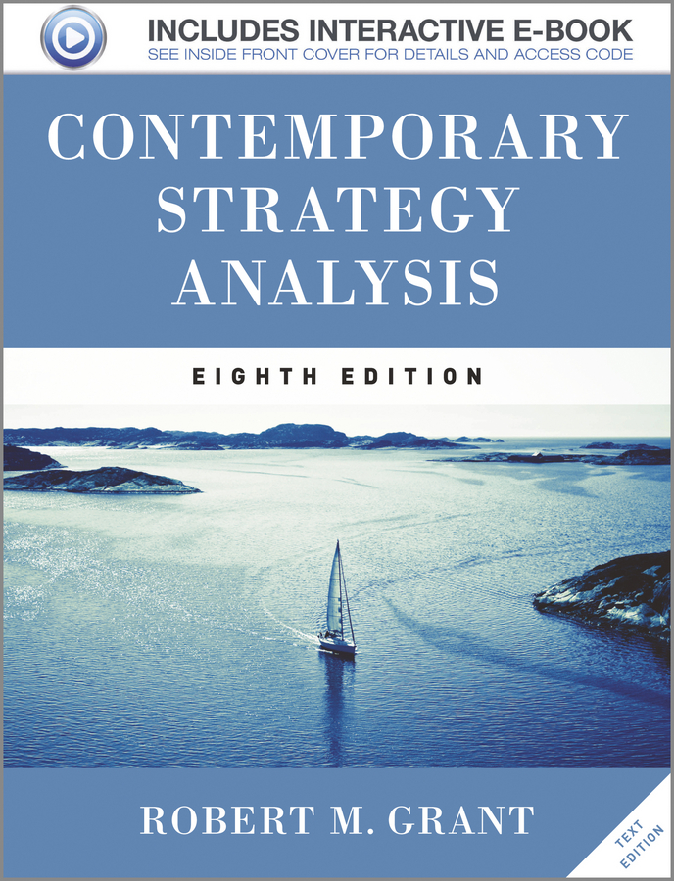
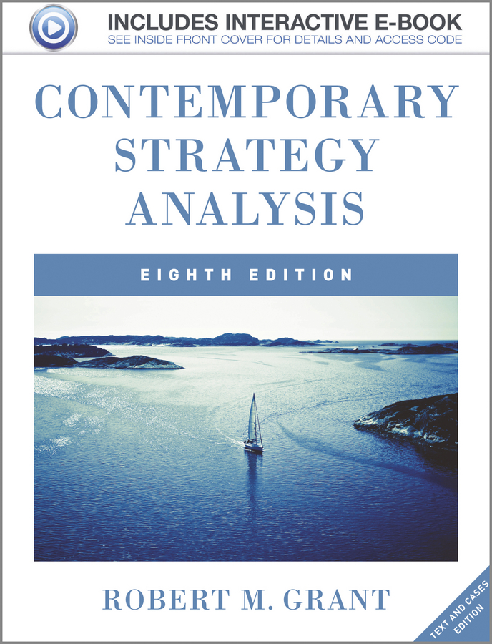
© 2013 Robert M. Grant
www.contemporarystrategyanalysis.com

Slide 3
Industry Evolution and Strategic Change
OUTLINE
Industry evolution and the industry life cycle
The challenge of organizational adaptation and strategic change
Managing strategic change
Developing new capabilities
© 2013 Robert M. Grant
www.contemporarystrategyanalysis.com

Slide 4
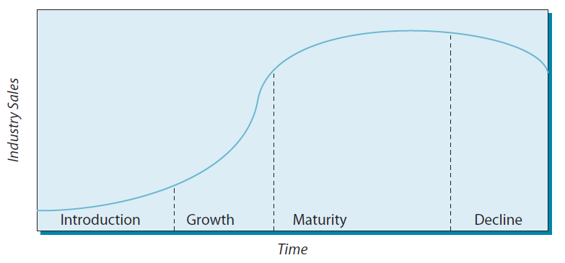
The Industry Life Cycle
Drivers of industry evolution:
Demand growth
Creation and diffusion of knowledge
© 2013 Robert M. Grant
www.contemporarystrategyanalysis.com

Slide 5
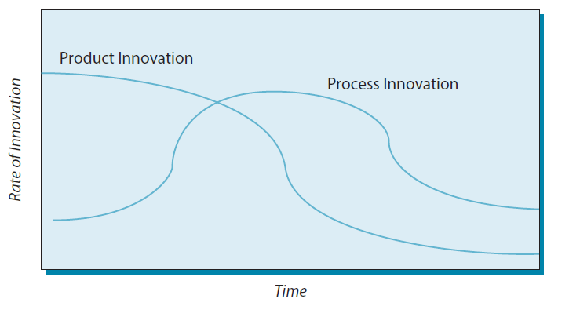
Product and Process Innovation
Over Time
© 2013 Robert M. Grant
www.contemporarystrategyanalysis.com

Slide 6
How Typical is the Life Cycle Pattern?
Technology-intensive industries (e.g. pharmaceuticals, semiconductors, computers) may retain features of emerging industries
Other industries (especially those providing basic necessities, e.g. food processing, construction, apparel) reach maturity, but not decline
Industries may experience life cycle regeneration, e.g. motorcycles, TVs:
Life cycle model can help us to anticipate industry evolution—but dangerous to assume any common, pre-determined pattern of industry development
Sales
Sales
Flat screen
Color
Portable
HDTV
B&W
MOTORCYCLES
TELEVISIONS
1900 1950 1980 2012
1930 1950 1970 1990 2010
© 2013 Robert M. Grant
www.contemporarystrategyanalysis.com

Slide 7
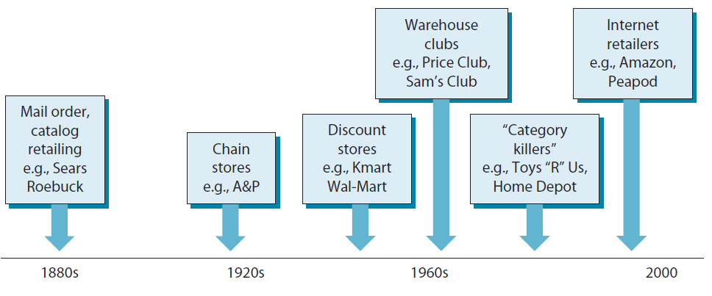
Innovation & Renewal Over the Industry Life Cycle: Retailing
© 2013 Robert M. Grant
www.contemporarystrategyanalysis.com

Slide 8
Evolution of Industry Structure
over the Life Cycle
 | Introduction | Growth | Maturity | Decline
Demand | Early adopters | Rapid increase in market penetration | Replacement/ repeat buying; price sensitive customers | Obsolescence
Technology | Competing technologies; rapid product innovation | Standardization; rapid process innovation | Diffused know how; incremental knowledge | Little innovation
Products | Wide variety of features and designs | Design & quality improve; dominant design emerges | Commoditization; brand differentiation | Differentiation difficult
Manufacturing | Short-runs, skill intensive | Capacity shortage; mass production | Over-capacity emerges, deskilling | Overcapacity
Trade | Production shifts from advanced to emerging companies
Competition | Few companies | Entry, mergers exist | Shakeout and consolidation | Price wars and exit
KSFs | Product innovation | Design for manufacture; process innovation | Cost efficiency (scale economics low cost inputs) | Low overheads; rationalization

Slide 9
The Driving Forces of Industry Evolution
BASIC CONDITIONS
INDUSTRY STRUCTURE
COMPETITION
Customers become more knowledgeable & experienced
Customers become more price conscious
Quest for new sources of differentiation
Products become more standardized
Diffusion of technology
Production becomes less R&D and skill-intensive
Production shifts to low-wage countries
Price competition intensifies
Excess capacity reached
Demand growth slows as market saturation approaches
Distribution channels consolidate
Bargaining power of distributors increases
© 2013 Robert M. Grant
www.contemporarystrategyanalysis.com

Slide 10
Changes in the Population of Firms Over the Industry Life Cycle: US Auto Industry 1895-1960
Source: S. Klepper, Industrial & Corporate Change, August 2002, p. 654.
© 2013 Robert M. Grant
www.contemporarystrategyanalysis.com

Slide 11
The World’s Biggest Companies by Market Capitalization, 1912 and 2009
1912 | $bn
US Steel | 0.74
Standard Oil NJ (Exxon) | 0.39
J&P Coates | 0.29
Pullman | 0.20
Royal Dutch Shell | 0.19
Anaconda | 0.18
General Electric | 0.17
Singer | 0.17
American Brands | 0.17
Navistar | 0.16
British American Tobacco | 0.16
De Beers | 0.16
2012 | $bn
Apple | 429
ExxonMobil | 407
Microsoft | 254
IBM | 228
Wal-Mart Stores | 212
Chevron Texaco | 210
ChinaMobile | 204
General Electric | 201
China Construction Bank | 198
Google | 194
Nestlé | 191
Johnson & Jonson | 179
© 2013 Robert M. Grant
www.contemporarystrategyanalysis.com

Slide 12
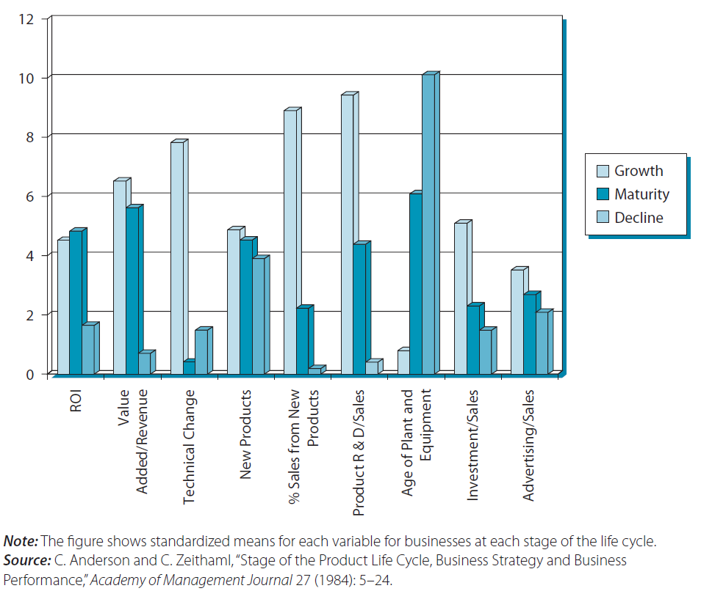
Strategy & Performance Across the Industry Life Cycle
© 2013 Robert M. Grant
www.contemporarystrategyanalysis.com

Slide 13
Organization Adaptation and Change: The Sources of Inertia
Organizational Routines – Existing patterns of coordinated activity make it difficult to develop new capabilities
Social & Political Structures – Change threatens existing social relationships and power structures
Conformity – Imitation locks firms into common structures and strategies (“institutional isomorphism”)
Limited Search – “boundary rationality”, preference of exploitation over exploration, and satisfying behavior limit firms to incremental change
Complementarities between strategy, structure, and systems – Firms create unique configurations of organizational features; localized changes tend to be dysfunctional; change needs to be systematic
© 2013 Robert M. Grant
www.contemporarystrategyanalysis.com

Slide 14
Tools of Strategic Change Management
Creating perception of crisis – A crisis facilitates organizational change. If there’s no crisis—create the perception of one
Establishing Stretch Targets – Demanding performance targets can generate ambition and mobilize effort
Creating Individual Initiatives – Initiatives launched by the CEO can be useful vehicles for change e.g. Jack Welch at GE
Reorganization and New Blood – Changing the organizational structure breaks down existing power bases and creates openings for external hires
Dynamic Capabilities - Are the “ability to integrate, build, and reconfigure internal and external competences to address rapidly changing environments” (David Teece)
Multiple Scenario Analysis – Offers a structured approach for managers to address the forces s that are changing their business environment and to prepare for the future
© 2013 Robert M. Grant
www.contemporarystrategyanalysis.com

Slide 15
Managing Strategic Change: Dual Strategies and Organizational Ambidexterity
Derek Abell’s Dual Strategies
Firms need:
A strategy for today that focuses on exploiting existing resources and capabilities and current market positions
A strategy for tomorrow based upon adaptation to future challenges
Michael Tushman & Charles O’Reilly’s Ambidextrous Organization
Firms need to:
Exploit existing resources and capabilities and market positions
Explore new opportunities for the future
Structural Ambidexterity – Exploration and exploitation allocated to different organizational units
Contextual Ambidexterity – Same organizational units and people perform both exploration and exploitation
© 2013 Robert M. Grant
www.contemporarystrategyanalysis.com

Slide 16
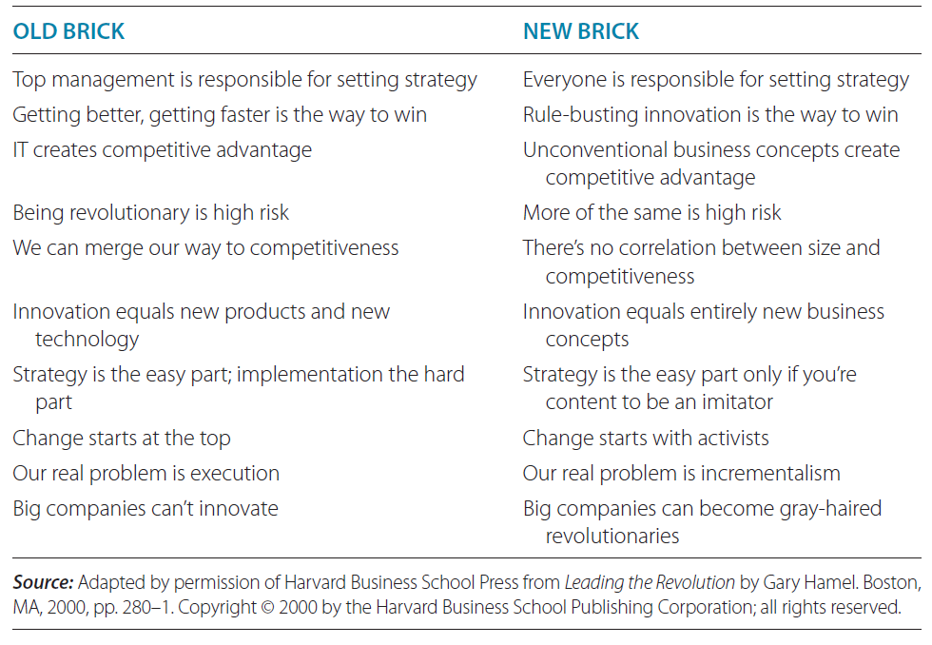
Gary Hamel: Shaking the Foundations
© 2013 Robert M. Grant
www.contemporarystrategyanalysis.com

Slide 17
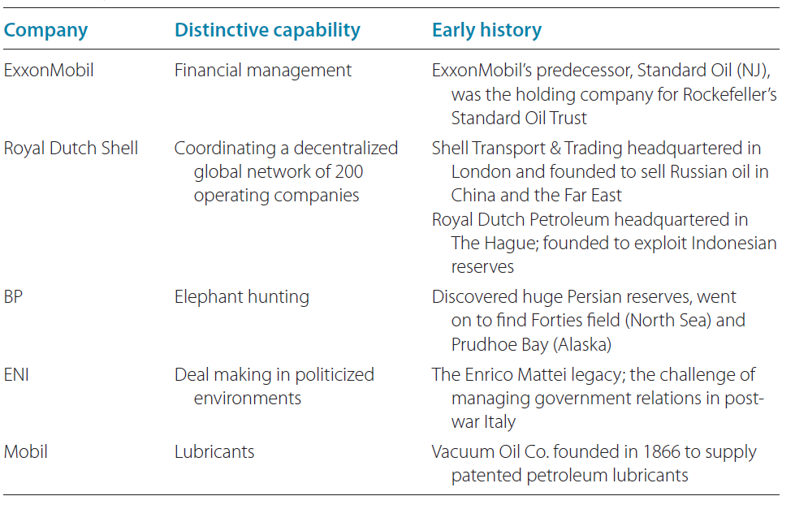
The Challenge of Developing New Capabilities: Distinctive Capabilities as a Consequence of Childhood Experiences: The Oil Majors
© 2013 Robert M. Grant
www.contemporarystrategyanalysis.com

Slide 18
Integrated resources to create organizational capability
ORGANIZATIONAL
CAPABILITIES
Processes
Organizational
Structure
Motivation
Organizational
Alignment
TANGIBLE | INTANGIBLE | HUMAN
Financial Physical | Technology Reputation Culture | Skills/know-how capacity for communication & collaboration Motivation
© 2013 Robert M. Grant
www.contemporarystrategyanalysis.com

Slide 19
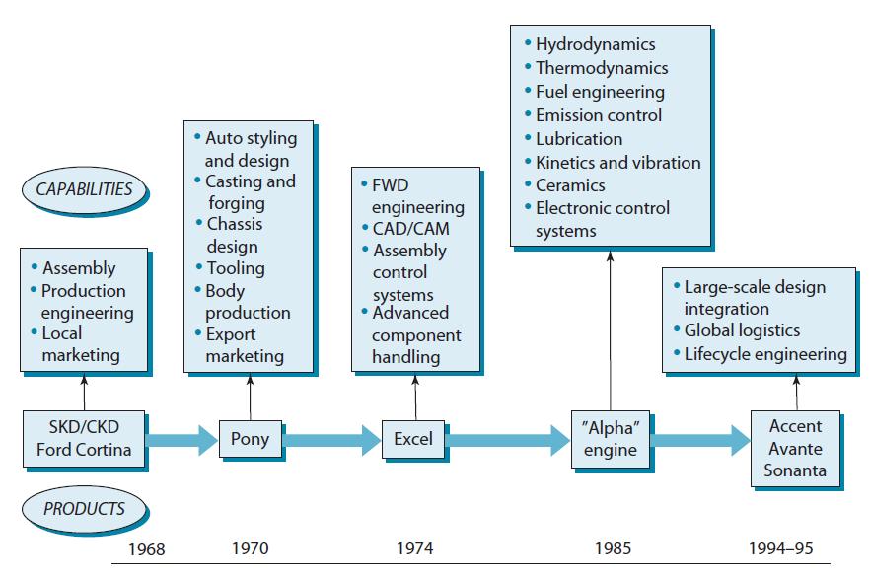
Hyundai Motors: Developing Capabilities Through Product Development
© 2013 Robert M. Grant
www.contemporarystrategyanalysis.com

Slide 20
Knowledge Management & the Knowledge-Based View: Types of Knowledge
Type of Knowledge | Characteristics | Implications
Explicit: Knowing about | Easy and cheap to transfer. A “public good” (non-exclusive) | Easy to exploit within the firm – but difficult to protect from rivals: hence, a weak basis for substantial advantage
Tacit: Knowing how | Difficult to articulate or codify. Transfer is slow and costly. Requires observation and practice | Sound basis for sustainable competitive advantage; Challenge is to replicate it internally
© 2013 Robert M. Grant
www.contemporarystrategyanalysis.com

Slide 21
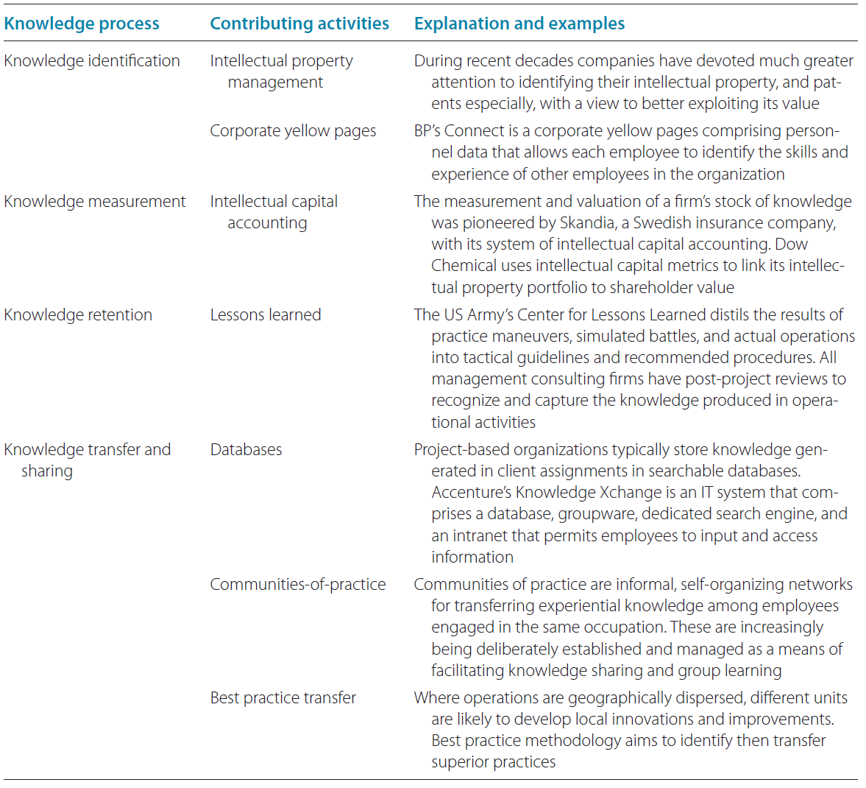
Knowledge Management Practices
© 2013 Robert M. Grant
www.contemporarystrategyanalysis.com

Slide 22
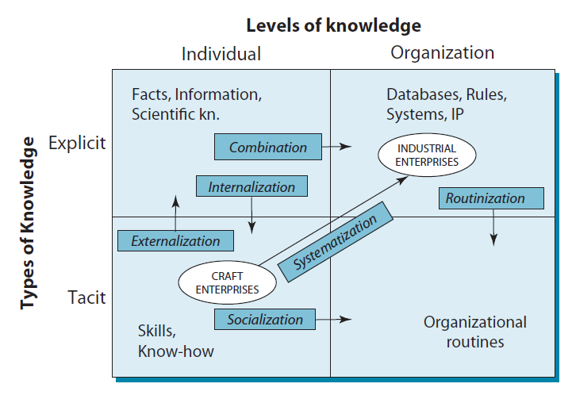
Knowledge Conversion
© 2013 Robert M. Grant
www.contemporarystrategyanalysis.com

