Slide 1
Discourse Network Analysis

Slide 4
Definition
Discourse network analysis refers to a scope of methods used for the analysis of actor-based debates (verbal interactions between political actors about a given policy), such as policy debates or political discussions.
Examples?

Slide 5
Policy debates and outcomes
PD determine which policies make it onto the governance agenda and which to be dropped as a result of agenda setting.
PD are closely related to public opinion, which in turn reflects in the domain of political decision-making.
PD serve as a signaling mechanism (formal and informal) between actors
PD have the potential to translate immediate policy outputs into actual outcomes by altering actors’ problem perceptions before policies are implemented.

Slide 6
What do we focus on?
Statements
Speeches
Documents
Political programmes
Parliamentary hearings
NB! Also informal or shadow statements that are discussed behind the ´closed doors´

Slide 7
Theoretical frameworks
Argumentative discourse analysis (Hajer, 1993, 1995)
Advocacy coalition framework (Sabatier 1988; Henry 2011)
Punctuated equilibrium theory (Baumgartner & Jones 2003; True et al. 2007)
Policy entrepreneur models (Kingdon 1995; Mintrom 2000; Kirst & Wirt 2009)
Epistemic communities framework (Haas, 1992; Roth and Bourgine, 2005)

Slide 8
Research strategy
Discourse network analysis can be descriptive or inferential. If the goal is to trace a debate over time, visualize competing coalitions, and analyze their characteristics, this can be achieved by employing several descriptive network analysis methods. In particular, six simple transformations of the data are useful for exploring policy debates:
(i) an affiliation network,
(ii) an actor congruence network,
(iii) an actor conflict network,
(iv) a concept congruence network,
(v) a time window network,
(vi) and an attenuation network.

Slide 9
Algorithm and methods (1)
Empirical discourse network analysis is based on a combination of:
category-based content analysis: text data are annotated using a coding scheme that is amenable to network analysis. Depending on the type of debate to be analyzed, useful text sources may be newspaper articles, parliamentary testimony, or other types of documents.
network analysis.

Slide 10
Algorithm and methods (2)
A statement may consist of four variables:
The actor a ∈A={a1, a2,…,am} is the person or organization who speaks.
2. The concept c ∈C={c1, c2,…,cn} is an abstract representation of the contents that are discussed.
3. Variable in each statement consists of the agreement relation r ∈R={r1, r2,…,rl} ⁠. It acts as an edge qualifier and is usually a dichotomous variable (that is, l = 2), which captures the sentiment of the statement. It is said to be “positive” (r₁) if the actor refers to the concept in an affirmatory way and “negative” (r₂) if the actor rejects the concept or uses a negative connotation.
4. Each statement carries a time or date stamp, for example, the day on which the statement is made. This allows for the temporal analysis of policy debates. Time is actually continuous, but for the sake of simplicity it is modeled here as discrete in the first couple of steps before introducing dynamic methods that make use of time as a continuous variable. Therefore T={t1,t2,…,tk} denotes the set of discrete time steps, for example the set of months or years in which statements are made.

Slide 11
Algorithm and methods (3)
The first step is to create an affiliation network (two-mode network or bipartite graph) from the statements that have been annotated in the text. In this notation, a statement can be understood as an edge from an actor to a concept at a specific point in time in a positive or negative way, denotes the set of edges in relation r and time slice t.

Slide 12
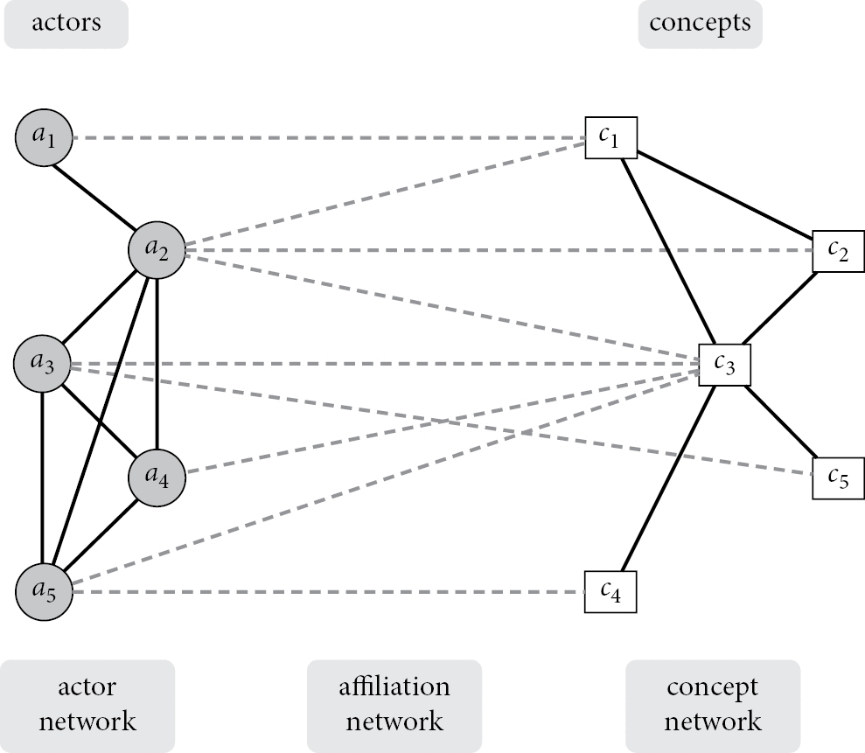
Figure 12.1 Simple transformations for descriptive discourse network analysis. Simplified illustration without agreement ...
Notes:
Figure 12.1 Simple transformations for descriptive discourse network analysis. Simplified illustration without agreement relation. Source: Janning et al. (2009) and Leifeld (2016b).
Unless provided in the caption above, the following copyright applies to the content of this slide:

Slide 13
Algorithm and methods (4)
Similarly, one can create a conflict network, in which a tie is established (or its weight is increased) if both actors have opposing agreement patterns. Substantively, this results in a network with negative ties (Labianca and Brass, 2006). The value of an edge indicates the intensity of conflict between two actors. This can be interesting, because a congruence network only captures agreement, whereas disagreement must be inferred from the absence of edges. This may be insufficient in some cases, because it is not possible to distinguish between absent edges due to disagreement and absent edges due to the fact that some actors do not reveal their preferences.

Slide 14
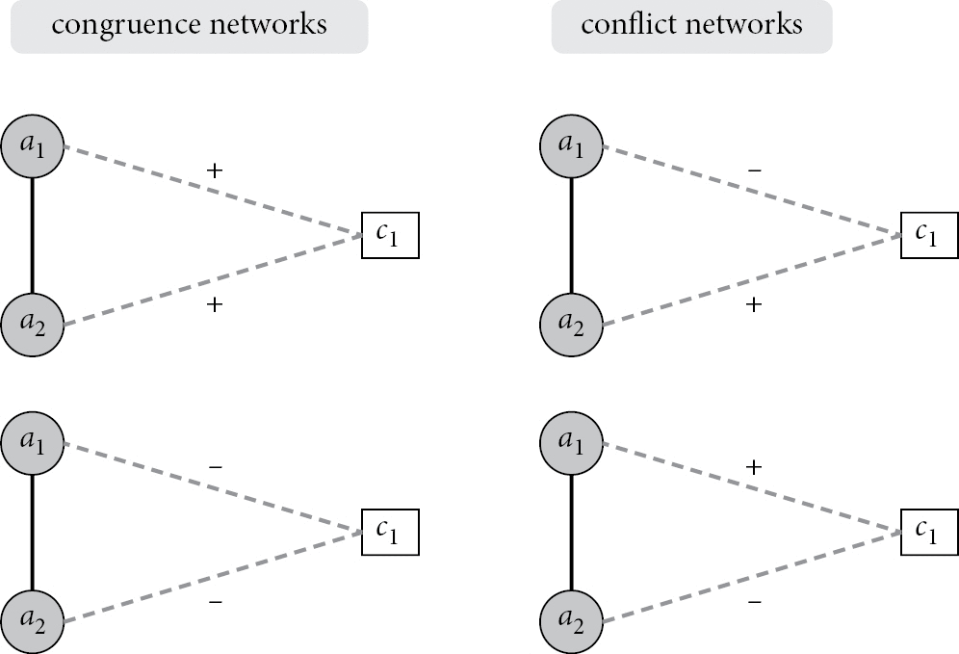
Figure 12.2 Different types of actor networks.
Notes:
Figure 12.2 Different types of actor networks.
Unless provided in the caption above, the following copyright applies to the content of this slide:

Slide 15
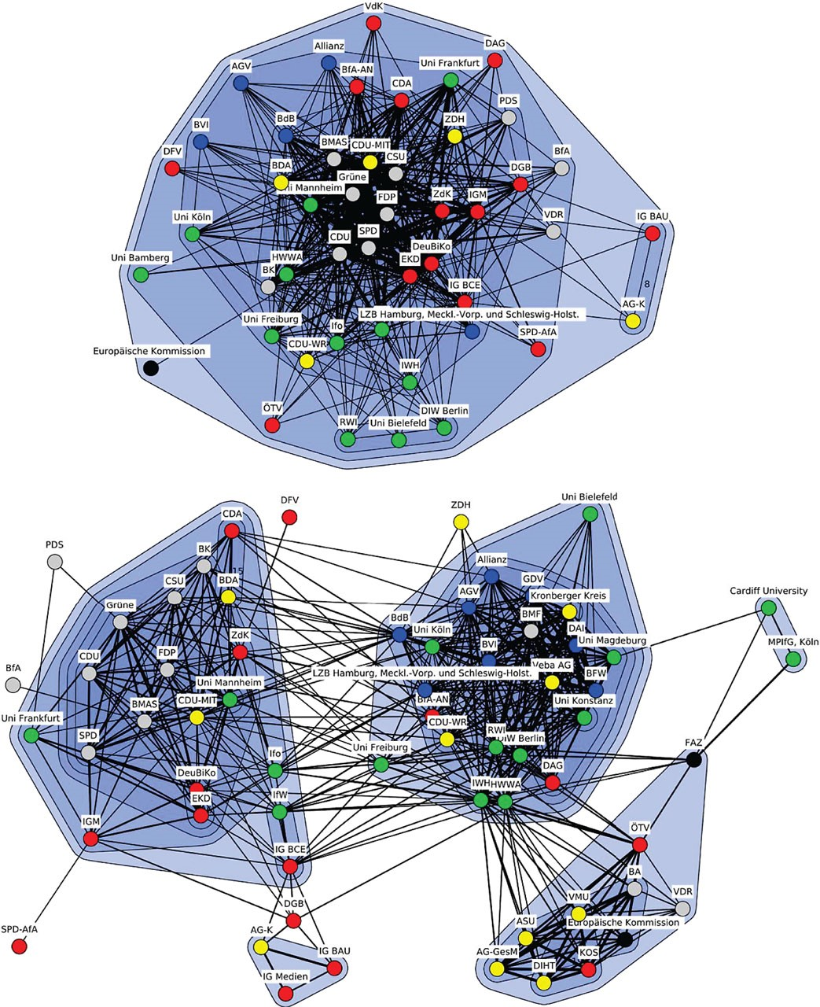
Figure 12.3 Normalization. Upper panel: An example from German pension politics, January to June 2000. Lower panel: Same ...
Notes:
Figure 12.3 Normalization. Upper panel: An example from German pension politics, January to June 2000. Lower panel: Same network as before, but with normalization.
Unless provided in the caption above, the following copyright applies to the content of this slide:

Slide 16
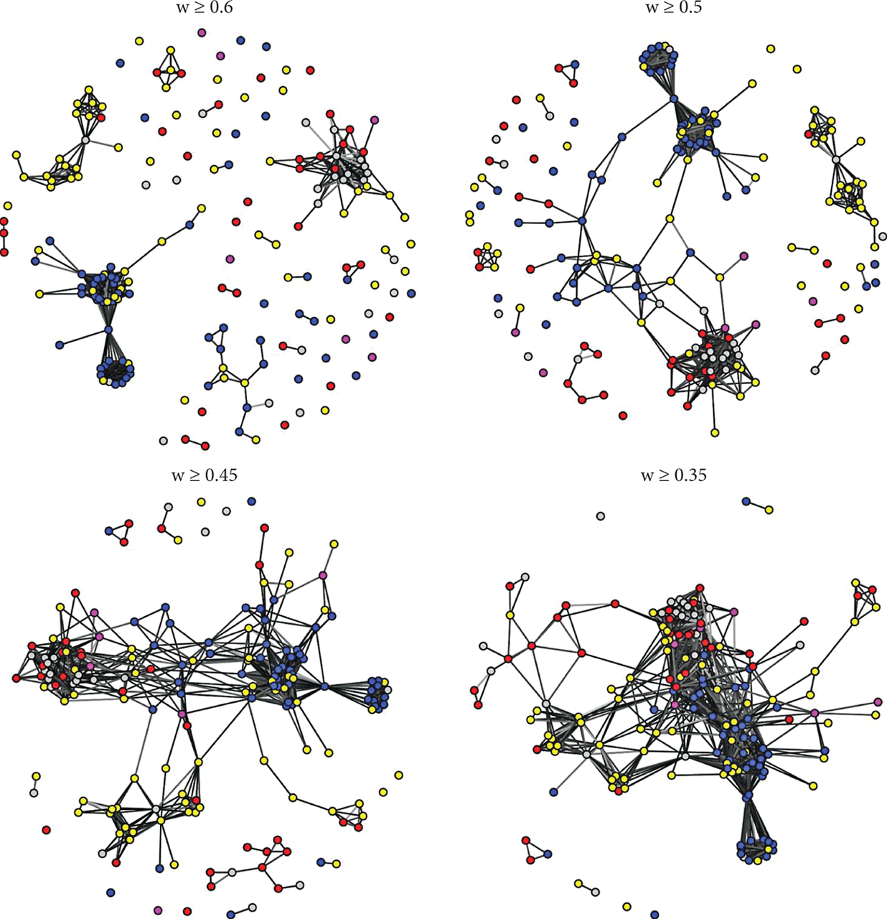
Figure 12.4 Threshold values. Whole time period from 1993 to 2001 in the German pension policy debate. Actor congruence ...
Notes:
Figure 12.4 Threshold values. Whole time period from 1993 to 2001 in the German pension policy debate. Actor congruence network with varying threshold values. Source: Leifeld (2016b).
Unless provided in the caption above, the following copyright applies to the content of this slide:

Slide 17
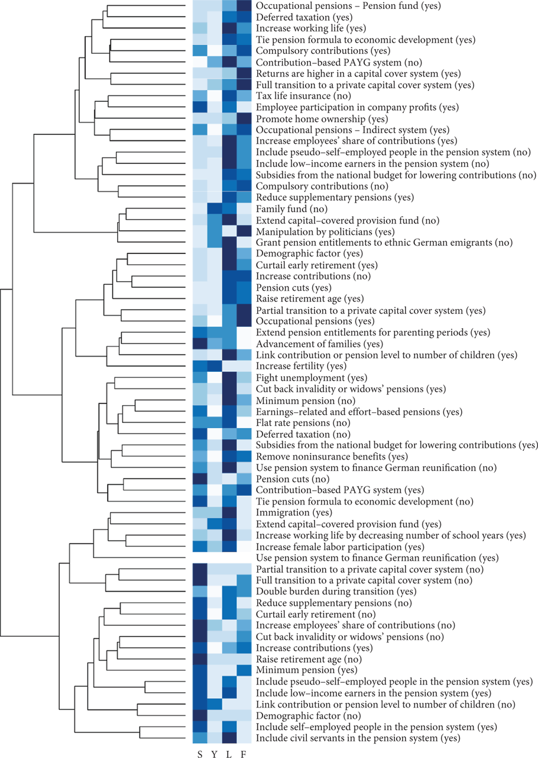
Figure 12.5 Concept network. Hierarchical cluster analysis of the Jaccard-normalized concept congruence network ...
Notes:
Figure 12.5 Concept network. Hierarchical cluster analysis of the Jaccard-normalized concept congruence network (dendrogram on the left). Partitioning of concept-agreement tuples into actor categories for easier interpretation of the frame clusters at the actor level (level plot in the middle). Darker shades of blue indicate larger relative shares of activity by the actor group denoted at the bottom. S = social interest group or trade union; Y = young interest group; L = liberal interest group or employers’ association; F = financial market actor. Source: Leifeld (2016b).
Unless provided in the caption above, the following copyright applies to the content of this slide:

Slide 18
Two types of inferentional DNA
(i) Macro topology, or aggregate structure, of a discourse network to external variables like policy change or institutional variation between debates.
e.g. How can coalition dynamics explain a reform? How can the internal structure of competing coalitions explain their policy success or failure? How can the polarization of a debate be explained by events like elections or scientific reports?
(ii) Micro-level mechanisms of political discourse. The explanandum is the topology of the network as generated by a sequence of statements. In other words, one would like to understand how discourse works by identifying what behavioral mechanisms and exogenous variables can jointly explain whether any actor a supports or rejects any concept c at any given point in time.

