Slide 1
Transistor Capacitances

Slide 2
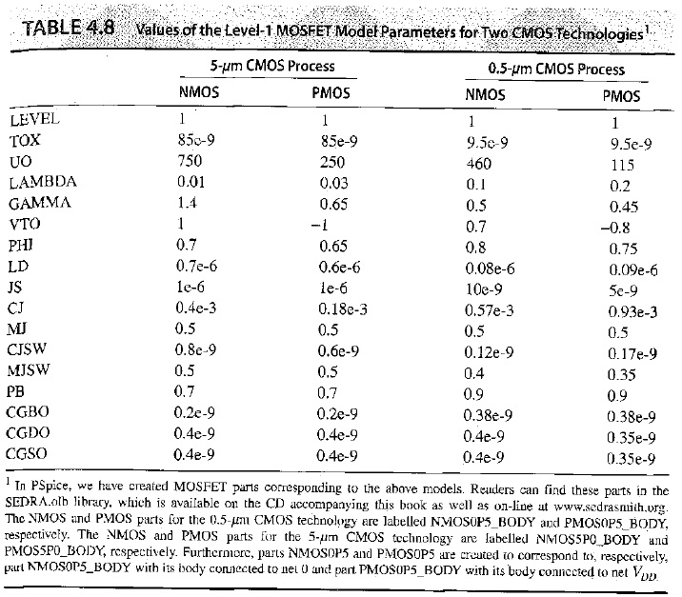
5 and 0,5 μm Techs. Example

Slide 3
Transistor Capacitance Parameters
Transistor Capacitance Parameters ?

Slide 4
Gate Capacitance Model
Polysilicon gate
Gate oxide
t
ox
n
+
L
n
+
Source
Drain
Cross section
W
n
+
n
+
L
Top view
As a simple plate model…

Slide 5
N-P Junction Capacitance
B
Al
A
SiO
2
p+
n+
p
-junction in an IC process
V_{A} < V_{B}:
Direct
V_{A} > V_{B}:
Reverse
A
Al
Cross-section of
pn
n
A
p
B
B
One-dimensional
diode symbol
representation

Slide 6
N-P Junction Capacitance

Slide 7
N-P Junction Capacitance
Transistors are usually reversely biased!!
(C_{j} < C_{j0})

Slide 8
Bottom Diffusion (Junction) Capacitance Model
At
Bottom
Source
W
(channel width)
Bottom
Channel
AS: Area of source
Ls
(Source or Drain Length)
Substrate
N
A

Slide 9
Side-wall Diffusion (Junction) Capacitance Model
By
Sides
W
(channel width)
Side wall
Source
Side wall
Side wall
PS: Perimeter of source
(the channel area is disconsidered !!)
Channel
Ls
(Source or Drain Length)
Substrate
N
A

Slide 10
Side-wall Diffusion (Junction) Capacitance Model
Computation of Cdb (for drain) is equivalent
trading AS and PS for AD and PD
W
(channel width)
Side wall
Source
Side wall
Side wall
PS: Perimeter of source
(the channel area is disconsidered !!)
Channel
Ls
(Source or Drain Length)
Substrate
N
A
Microelectronic Circuits - Fifth Edition Sedra/Smith
10

Slide 11
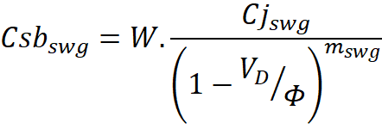
Side-wall Junction to Gate Capacitance Model (Level 53)
By Model of Level 53,
the channel is alço computed
W
(channel width)
Side wall
Source
Channel Area
Side wall
Side wall
Side wall to gate area
Ls
(Source or Drain Length)

Slide 12
Side-wall Junction to Gate Capacitance Model (Level 53)
W
(channel width)
Side wall
Source
Channel Area
Side wall
Side wall
Side wall to gate area
Ls
(Source or Drain Length)

Slide 13
Overlap Capacitance Models
Due to thermal steps after implant,
the drain and source areas move (lateral diffusion)
Gate oxide
t
ox
Polysilicon gate
n
+
Leff
n
+
Cross section
Source
Drain
W
n
+
L
d
Leff
L
d
n
+
L
L
b
Gate-bulk
Top view
overlap
Microelectronic Circuits - Fifth Edition Sedra/Smith
13

Slide 14
Overlap Capacitance Models
Gate oxide
t
ox
Polysilicon gate
n
+
Leff
n
+
Cross section
Source
Drain
W
n
+
L
d
Leff
L
d
n
+
L
L
b
Gate-bulk
Top view
overlap
Microelectronic Circuits - Fifth Edition Sedra/Smith
14

Slide 15
Overlap Capacitance Models
Gate oxide
t
ox
Polysilicon gate
n
+
Leff
n
+
Cross section
Source
Drain
W
n
+
L
d
Leff
L
d
n
+
Ld is included in C_{XXO} parameters
L
L
b
Gate-bulk
Top view
overlap
Leff= L-2.L_{d} (must be used in current equations if Ld is given)

Slide 16
Revisiting Gate Capacitance Model
Including lateral diffusion in the model
Polysilicon gate
Polysilicon gate
Source
Drain
Source
Drain
W
W
n
+
n
+
n
+
L
d
Leff
L
d
n
+
L
L
L
b
Gate-bulk
Top view
Top view
overlap
Leff instead of L

Slide 17
Revisiting Gate Capacitance Model
Polysilicon gate
Polysilicon gate
Source
Drain
Source
Drain
W
W
n
+
n
+
n
+
L
d
Leff
L
d
n
+
L
L
L
b
Gate-bulk
Top view
Top view
overlap
C_{ox} does not change- it depends on t_{ox}

