Slide 1
Certificate in EMI Skills Module 1 Part 4 Language for Lectures
Luciana Carvalho Fonseca & John Corbett

Slide 2
Session outcomes
To practise signalling different phases of a lecture
To focus on language for signposting
To practise language for presenting visuals
To practise use of cohesion, clarity, sounding interested, use of emphasis and pausing

Slide 3
Activity 1: Matching

Slide 4
Activity 1: Matching

Slide 5
Activity 2 Phrases in context

Slide 6
Activity 2 Phrases in context

Slide 7
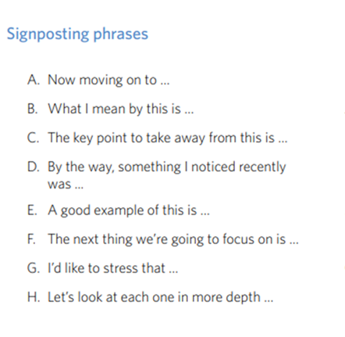
Activity 3
1. Write a short section from the middle of one of your own lectures, using at least 3 of the signposting expressions.
2. Read it aloud in groups of 3 but omit the signposting expression. Just nod when you would have said it.
3. Your partners must identify the missing word or phrase.

Slide 8
Wrapping up
Take-home messages:
a. Identifying a set of words and phrases that signal different phases of a lecture.
b. It is useful to practise these signals in your lectures.
Next: Using visuals

Slide 9
CAE Cert in EMI Skills EMI@USP
Next session: Signposting
& Using Visuals

