Slide 1
Designing, developing, and running (massive) open online courses
George Siemens, PhD
September 4, 2012
Presented to:
University of South Africa

Slide 2
What is a MOOC?

Slide 3
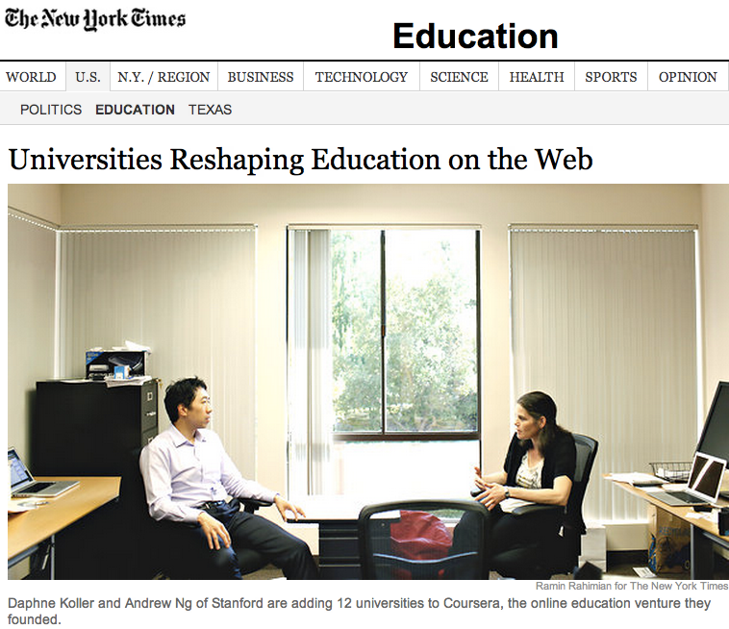
Notes:
http://www.nytimes.com/2012/07/17/education/consortium-of-colleges-takes-online-education-to-new-level.html?_r=2

Slide 4
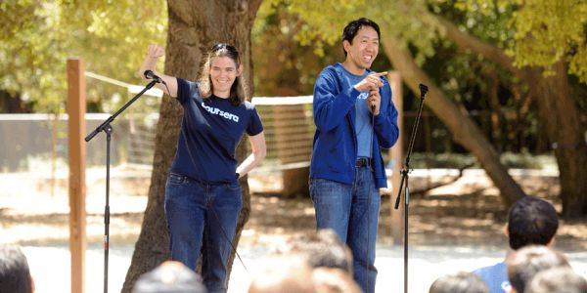
“I think this could be big the way Google was”
Image source: Noah Berger for The Chronicle
Notes:
http://chronicle.com/article/Coursera-Throws-a-Massive/133227

Slide 5
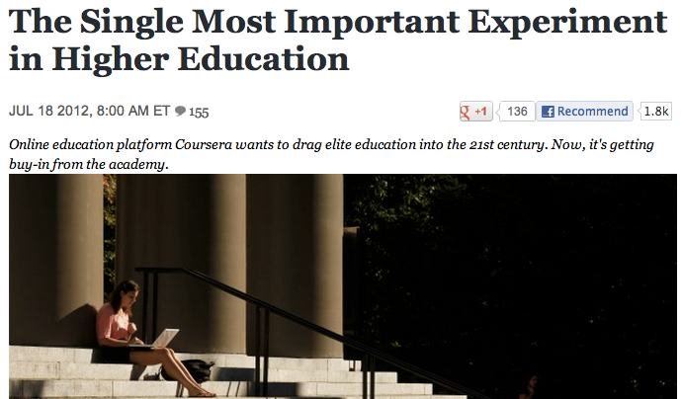
But the deals Coursera announced Tuesday may well prove to be an inflection point for online education, a sector that has traditionally been dominated by for-profit colleges known mostly for their noxious recruitment practices and poor results.
Notes:
http://www.theatlantic.com/business/archive/2012/07/the-single-most-important-experiment-in-higher-education/259953/

Slide 6
http://www.hybridpedagogy.com/Journal/files/MOOC_MOOC.html

Slide 7
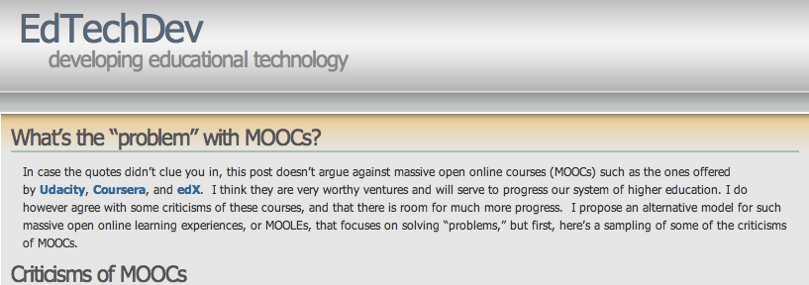
“Especially disturbing is that none of the major MOOC providers have hired anyone trained in instructional design, the learning sciences, educational technology, course design, or other educational specialties to help with the design of their courses. They are hiring a lot of programmers…”
http://edtechdev.wordpress.com/2012/05/04/whats-the-problem-with-moocs/

Slide 8
Defining MOOCs
Massive (maybe)
Open (sort of)
Online (yep)
Course (sort of)

Slide 9
A bit of (recent) history:
2007:
David Wiley: open wiki-based course
Alec Couros: Social media and Open Education
2008:
CCK08
Slew of other open courses
2011:
- Stanford AI births Coursera and Udacity

Slide 10
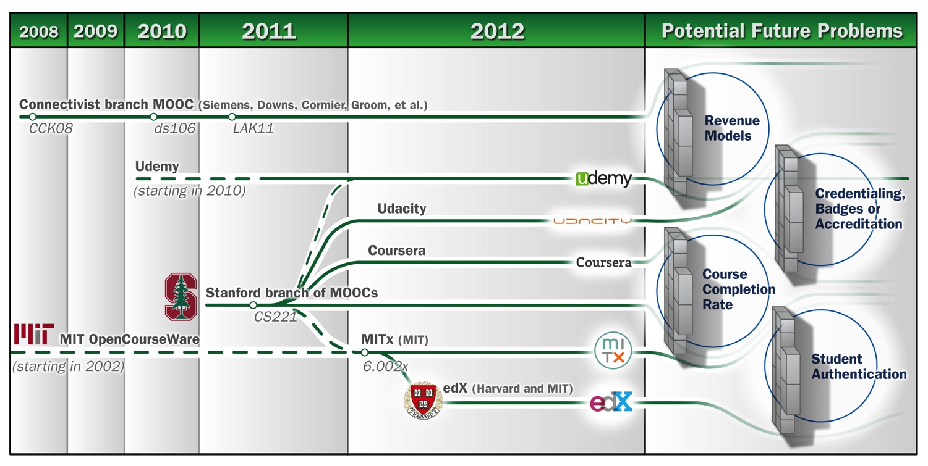
Phil Hill, 2012
Notes:
http://mfeldstein.com/four-barriers-that-moocs-must-overcome-to-become-sustainable-model/

Slide 11
Current landscape:
xMOOCs: Coursera, Edx
cMOOCs: DS106, CCK08/09/10/12

Slide 12
Coursera, edX:
Formal (traditional) course structure and flow
CCK:
Content as a starting point, learners expected to create/extend

Slide 13
Coursera/edX:
Traditional relationship between teacher/learner
Formal, structured teaching/content provision.
Learners expected to duplicate/master what they are taught

Slide 14
CCK-style MOOCs:
Changed relationship between teacher/learner
Distributed, chaotic, emergent.
Learners expected to create, grow, expand domain and share personal sensemaking through artifact-creation

Slide 15
Coursera/edX:
Centralized discussion forum support
CCK:
Distributed, often blog-based, learner-created forums and spaces

Slide 16
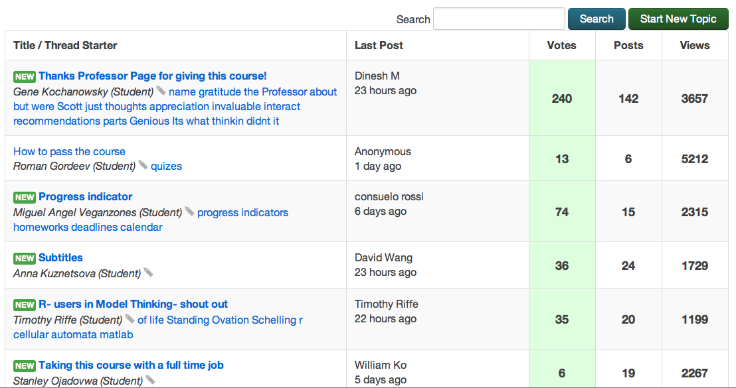

Slide 17
Learners generally complete some level of activity for formative and summative evaluation (quizzes, assignments, papers, create artifacts) in open online courses.
Evaluation is either automated (Coursera), instructor graded (CCK), or peer-commented (to some degree, all open courses)

Slide 18
cMOOCs:

Slide 19
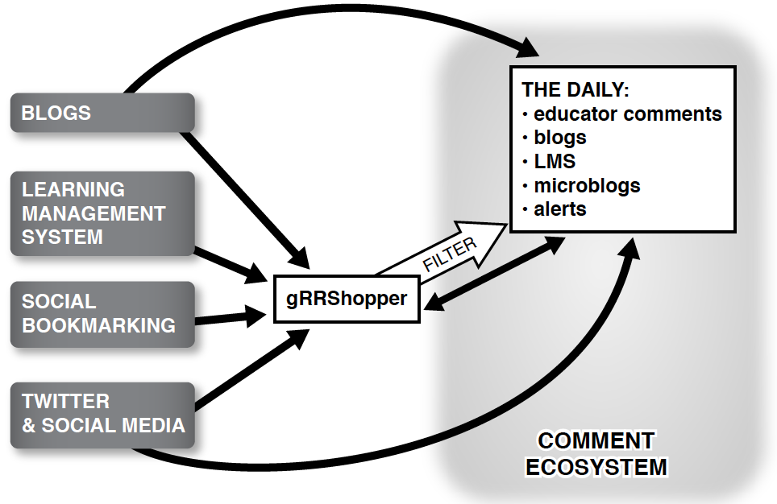

Slide 20
Content is fragmented (not confined to a course)
Knowledge is generative
Coherence is learner-formed, instructor guided
Distributed, multi-spaced interactions
Foster autonomous, self-regulated learners

Slide 21
Technology for running MOOCs is still underdeveloped

Slide 22
Need to have MOOCs from different parts of the world (export, not only import)

Slide 23
What happens in a MOOC?

Slide 24
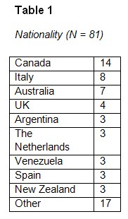
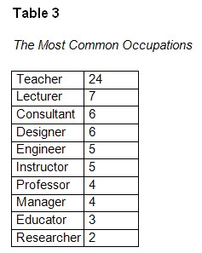
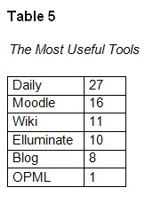
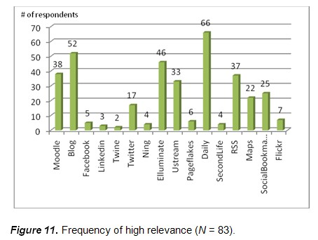
Fini, 2009
Notes:
http://www.irrodl.org/index.php/irrodl/article/view/643/1402

Slide 25
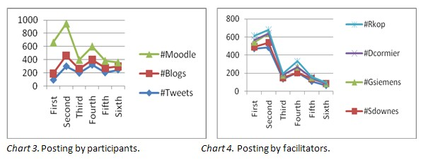
Kop, 2011
Notes:
http://www.irrodl.org/index.php/irrodl/article/view/882/1689

Slide 26
EduMOOC
Rodriguez, 2012
Notes:
http://www.eurodl.org/?article=516

Slide 27
How to plan and run a MOOC in 9 easy steps
Topic, audience
Find someone to teach with
Determine Content
Plan spaces of interaction
Plan interactions (live, asynch)
Plan *your* continued presence
Learner creation (activities)
Promote and share
Iterate and improve

Slide 28
1. Topic & Audience
Pick an area:
of personal interest and expertise
with appeal or demand for learning/discussion
what you already teach, just do it in the open
Who are you targeting?
students?
academics/peers?
anyone with a pulse?

Slide 29
2. Find someone to teach with
Never teach alone
Try a colleague form a different country, different region, or with different views
Bring in guest speakers, video interviews

Slide 30
3. Determine content
Use open articles if possible
Use multimedia resources (youtube, others)
Search conference recordings/proceedings
Use: video, interactive presentations, text, simulations
Leave room for learners to create/share
Treat content as a starting point for learning conversations, not as the exclusive intent of the course.

Slide 31
4. Plan spaces
Distributed spaces (tags)
Centralized (forums? Daily email?)
Decentralized format (blogs, social media, wherever)

Slide 32
5. Plan interactions
Synchronous (record so people in other time zones can view)
Asynchronous
Trails (Diigo)
Tags

Slide 33
6. Plan your continued presence
In an open course, you are not the central node, but you remain an important node
Be active in forums, blogs, twitter, email, whatever.
Don’t try and dominate the conversation. But be active.

Slide 34
7. Learner creations and activities
Learners should create stuff – i.e. artifacts of sensemaking
Promote the value of peer feedback

Slide 35
8. Get the word out: promotion and sharing
The usual routine: your students, colleagues, listservs, etc.
Get it out to your networks (Twitter, FB, conference presentations)

Slide 36
9. Iterate and Improve
If you’ve designed your course for fluidity, you will add/change as you go.
Listen to your course participants. They’ll let you know what to improve.
Blog your thoughts and reflections so others can temper your thinking

Slide 37
Set your expectations
Size doesn’t matter. If you have 15+ people, you have a course.
It will take more time that you can possibly imagine
It will be extremely rewarding
It will change how you view teaching/learning
You’ll find yourself saying things in faculty meetings that will scare your peers and administrators (like “courses are dead” or “let’s open up all our teaching”)

Slide 38
http://edfuture.net/
October 8-November 16, 2012

Slide 39
http://open.mooc.ca/
Starts September 10, 2012

Slide 40
http://lakconference.org

Slide 41
gsiemens @
gmail
Twitter
Skype
FB
Wherever
www.elearnspace.org
www.connectivism.ca
www.learninganalytics.net

