Slide 1
The Peloponnesian War and Tragedy

Slide 2
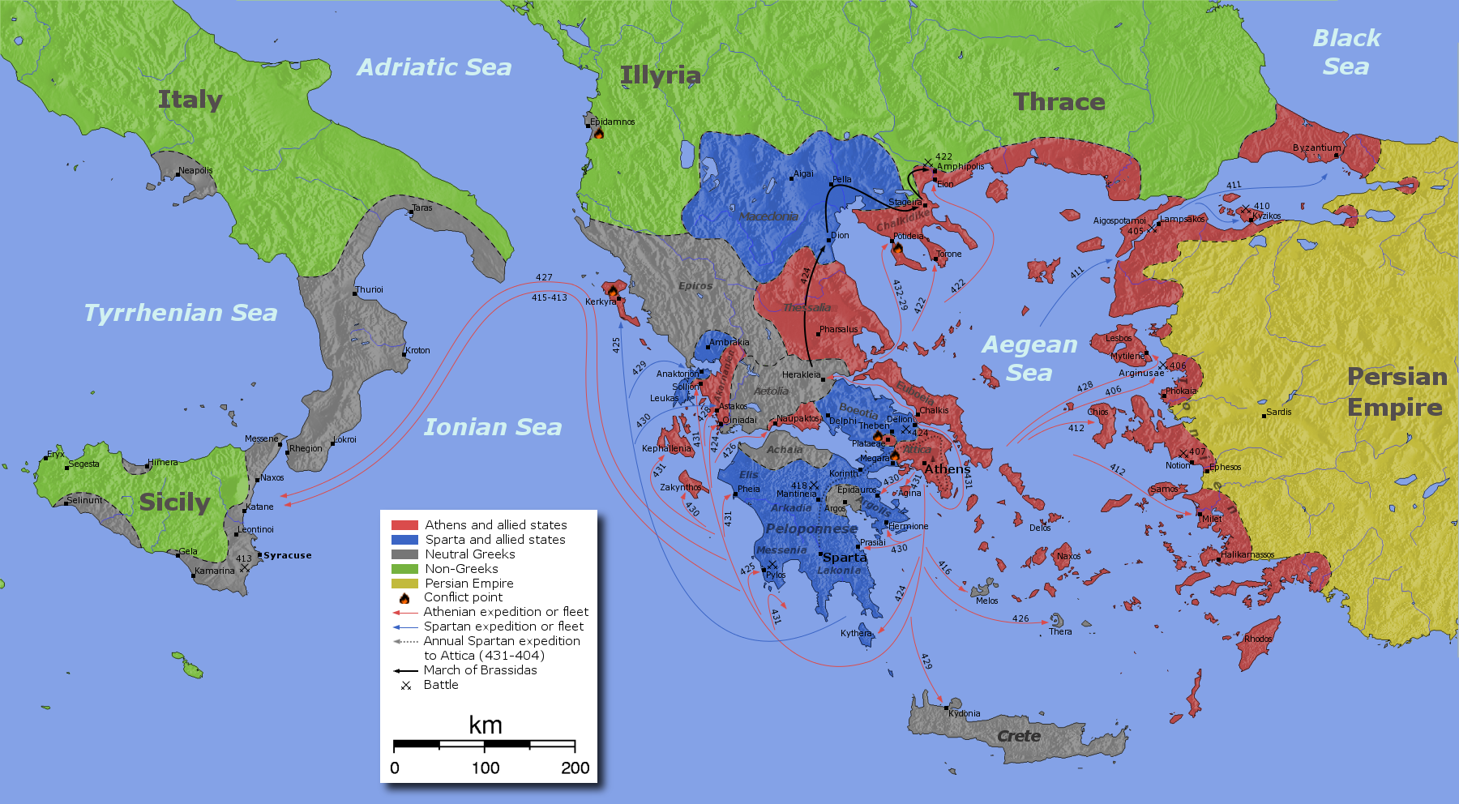
460 – 445 and 431 – 404 BCE
Main rivals: Athens vs Sparta (including the respective allies)

Slide 3
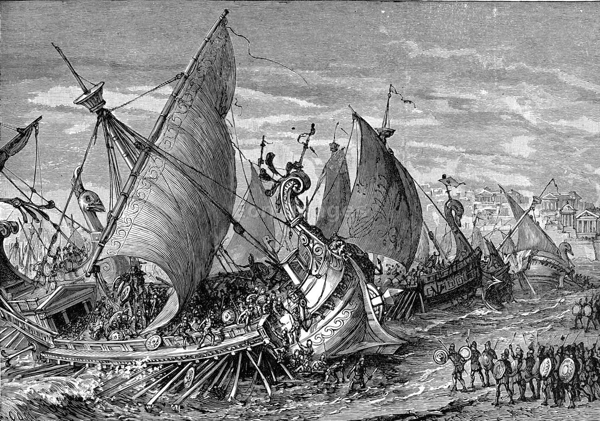
1st Peloponnesian War (ended with a truce in 445, called the Thirty Years‘ Treaty)
New hostilities arose in 433, when Athens allied itself with Corcyra (Corfu), a strategically important colony of Corinth
431: Thebes, a Spartan ally, attacked
Plateeia, an Athenian ally
Fighting: two periods of ten and
eleven years separated by a
truce of six years, The Truce of Nicias

Slide 4
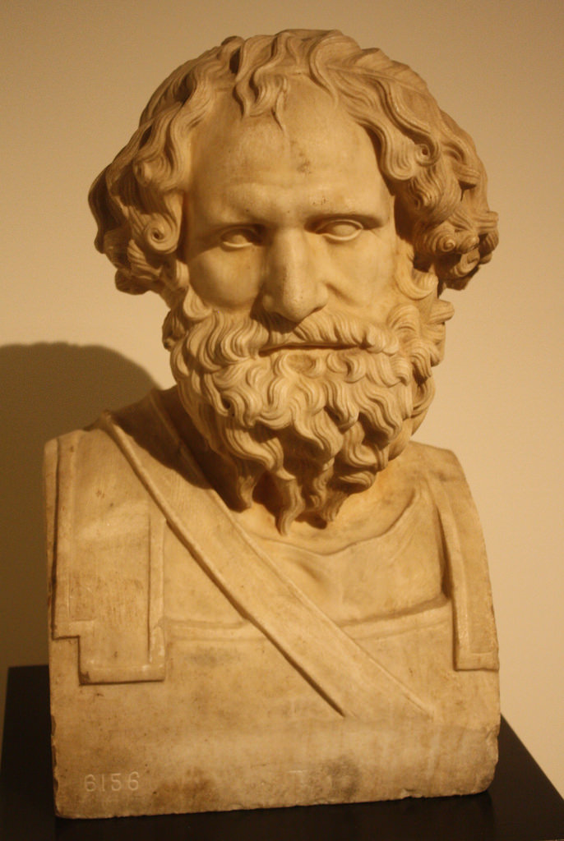
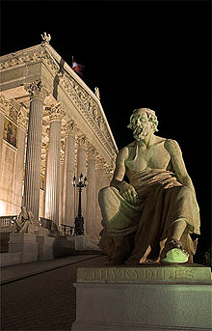
Pericles, fell victim to a plague in 429)
Archidamus II, King of Sparta (dies in 427)
Thucydides

Slide 5
The end …
413: Athenian invasion of Sicily failed
By 411: Athens itself is in turmoil – its democracy overthrown by oligarchs – the oligarchs are later replaced by the Regime of the Five Thousand
Athens, emboldened by several minor victories, rejected Spartan peace offers
Sparta sought an alliance with Persia
405: Athenian navy is destroyed at Aegospotami by Sparta‘s Lysander
Spartans cut off all food supplies to the city of Athens
404: surrender of Athens

Slide 6
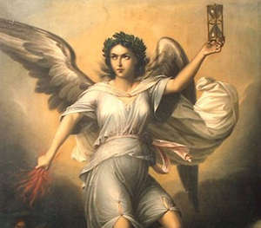
Lesson …
HYBRIS
(arrogance before the gods)
NEMESIS
(the remorseless goddess of revenge)

Slide 7
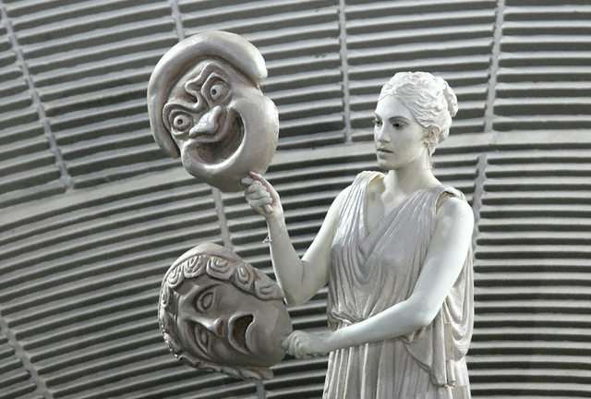
The downfall of the most culturally and politically advanced Greek city-state to annihiliation
Policy of aggression and arrogance
The rule of the strongest trumped any rule of law
Narrated by Thucydides,
Aeschylus, Sophocles, Euripides …

Slide 8
Questions for Groupwork
Describe the main narrative (event, characters, the framing of the different parties, etc.)!
Can you establish similarities between Thucydides‘s account of the Peloponnesian War and Euripides‘s The Trojan Women?
Why can we (or you) identify with these stories?

