Slide 1
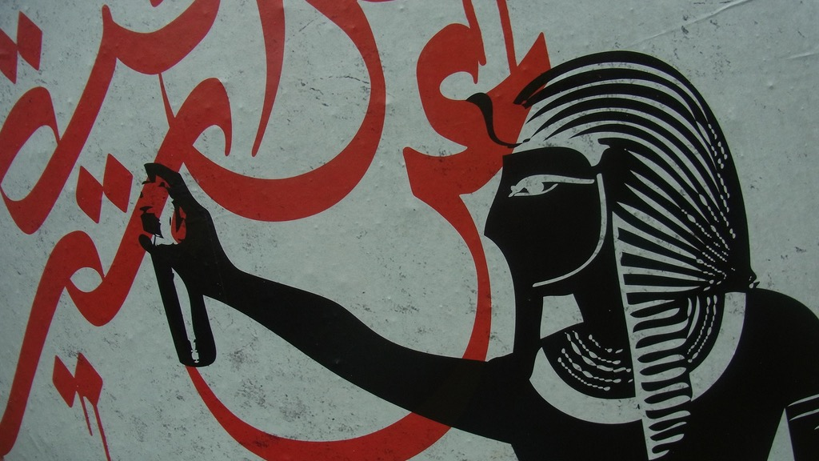
Major Themes in Contemporary Middle East
LECTURE 4.
GEOPOLITICS OF ENERGY

Slide 2
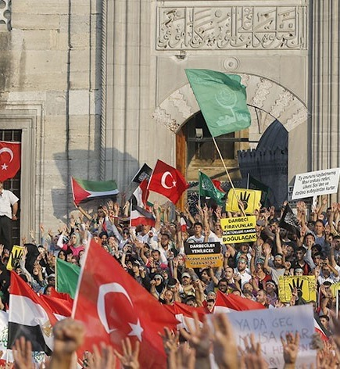
Summary of Lecture 3
Islam vs. Political Islam (Islamism)
Islam, politics and modernity
Reform in Islam: secularists, modernists and fundamentalists
“Islamic Revival”
Islamist actors: Islamic Republic of Iran, Muslim Brothers, Salafi jihadists
Islamism, governance and democracy
“Islamofascism” vs. “Islamophobia”

Slide 3
Are natural resources a curse or a blessing?
Does resource wealth prohibit democratisation?
What’s the impact of oil in the politics of Middle Eastern states?

Slide 4
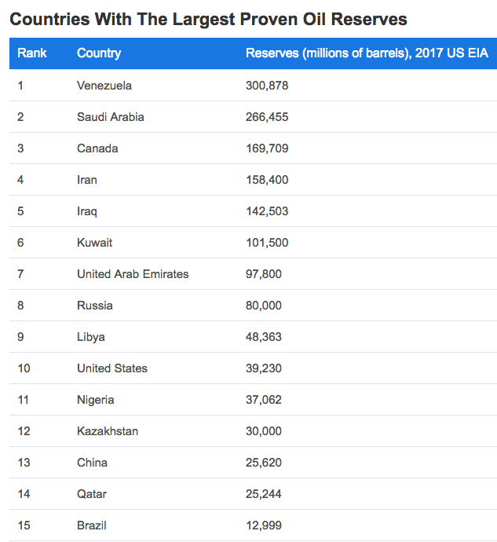
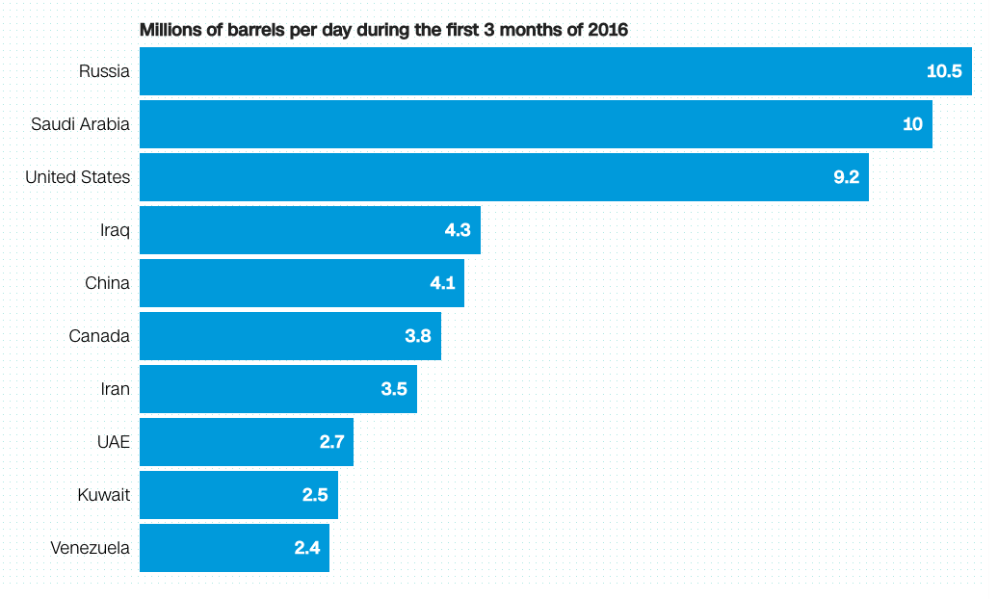
World’s top oil producers (2016)
cnn.com
US has topped the list in 2018
Venezuela sunk further down
worldatlas.com

Slide 5
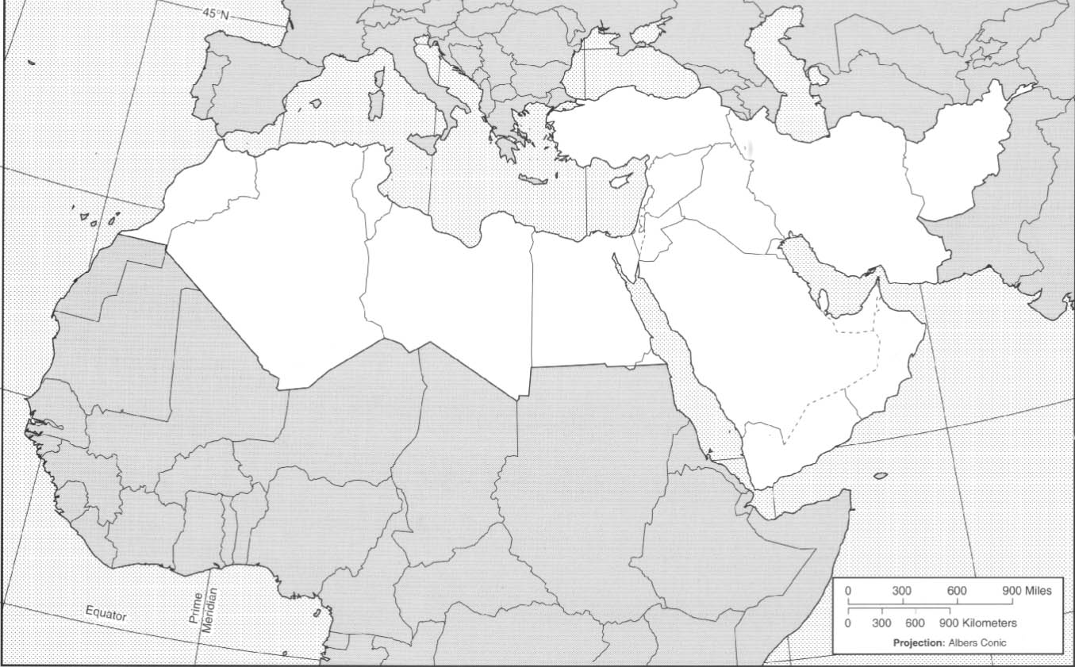
Oil Reserves
In recent decades, proven reserves…
In Middle East from 64 to 48%
In Latin America from 8 to 20%
In North America from 12 to 19%
5 Gulf countries (Saudi Arabia, Iraq, Iran, Kuwait, UAE) possess 46% of proven reserves
Gulf oil is cheap to excavate
Non-Oil Producing Historical Powers
Vs.
Oil-producing New Powers

Slide 6
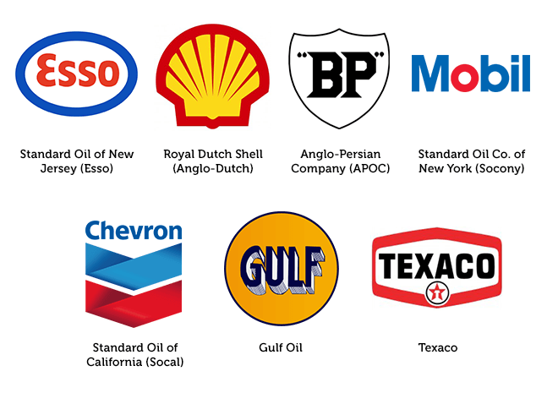
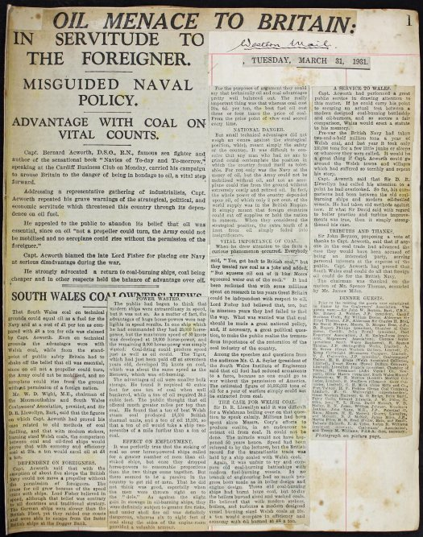
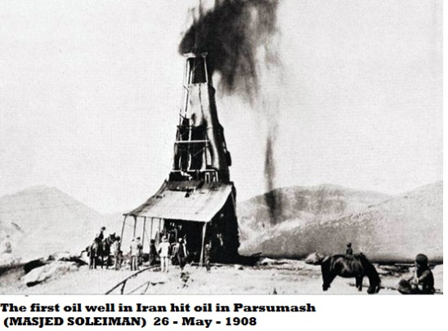
Geopolitics of Oil
Early 20th century
Oil discoveries on the Persian Gulf, Northern Iraq in early 1900s
Royal Navy switches from coal to oil in 1911
Britain:
Prevents Turkey from incorporating Mosul & Kirkuk (N. Iraq)
Separates Kuwait and Iraq
Stops Saudi expansion north (Kuwait/Iraq) and east (Gulf emirates)
Invades (1941) and organises a coup (1953) in Iran to protect its oil interests

Slide 7
Geopolitics of Oil
Early 20th century
1930 – 1960s oil controlled by major western oil companies
“Seven Sisters”
Nationalisation efforts from 1950s onwards
1951 CIA Report
“…oil is the most important single factor in the United States relations with the area.”
“…certain oil companies, in particular British companies, threaten stability in the Middle East through reactionary and out-moded policies...”
The policies of Anglo-Iranian Oil Company are regarded as highly unsatisfactory, and are responsible ... for the lowered Western prestige in that country.”

Slide 8
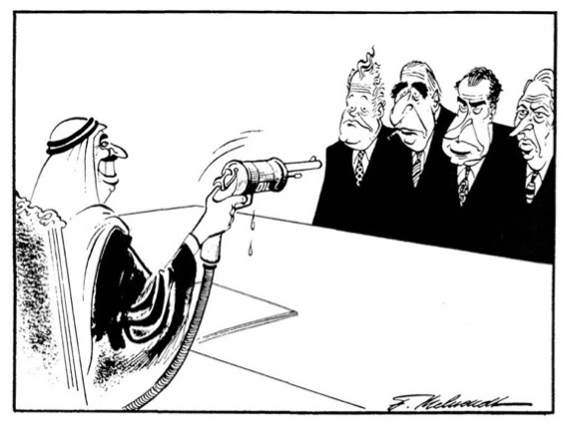
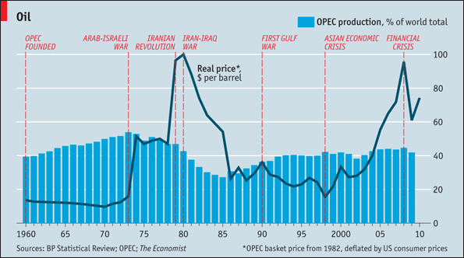
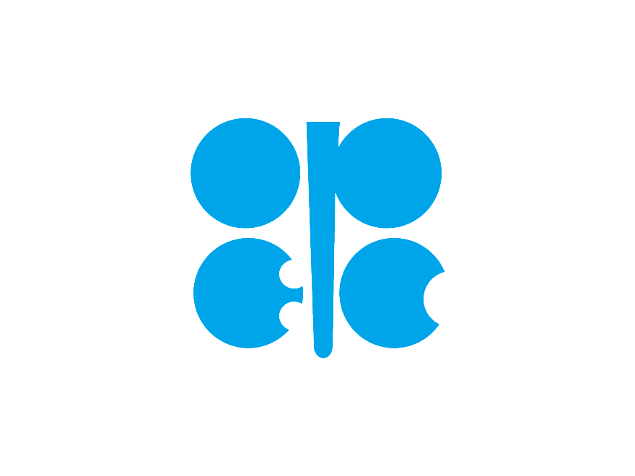
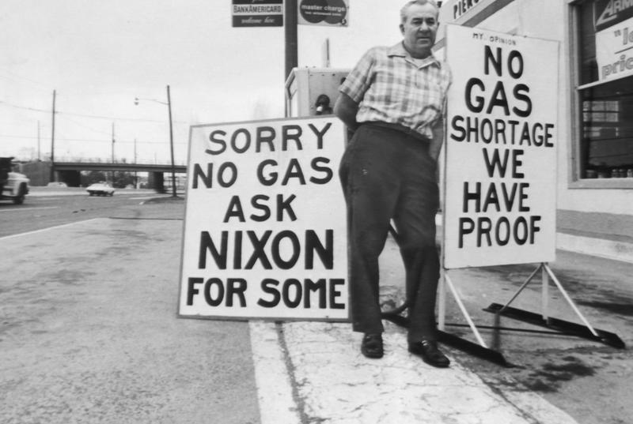
Geopolitics of Oil
Organisation of Petroleum Exporting Countries (OPEC)
Founded in 1960
Rose to prominence in the 70s
Two highs: 1973 – 85; 2003 – 14
Oil embargo of 1973--in response to Yom Kippur War: https://www.youtube.com/watch?v=VCLRlVxOH-Q
Fritz Behrendt 1973

Slide 9
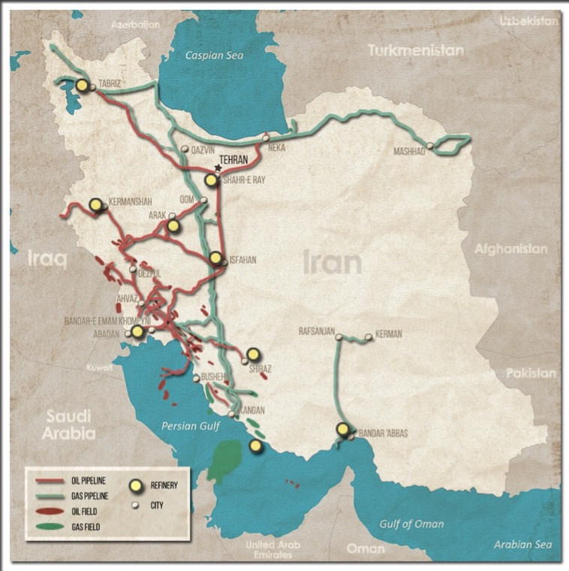
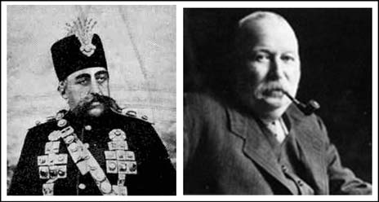
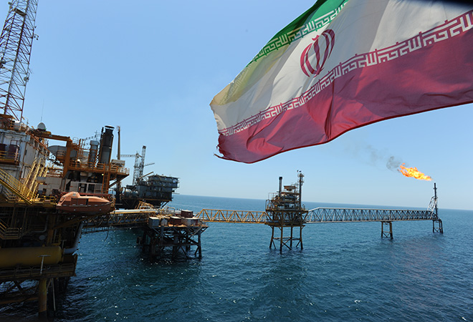
Producer Countries
Iran
D’Arcy Concession (1901)
Anglo-Persian Oil Company (renamed Anglo-Iranian in ‘35, BP in ‘54)
1933 Concession extended another 60 yrs
1941 Anglo-Soviet invasion
1951 Concession cancelled; AIOC nationalised
1953 MI6-CIA-backed coup
Shah major US ally, provider of oil
Windfall oil cash in 70s
major development projects + greater inequality, repression
1979 Revolution
Production falls in 1980s (war, sanctions)
Oil rent sustains the regime. Attempts at diversification by reformists
Rise of China provides alternative market

Slide 10
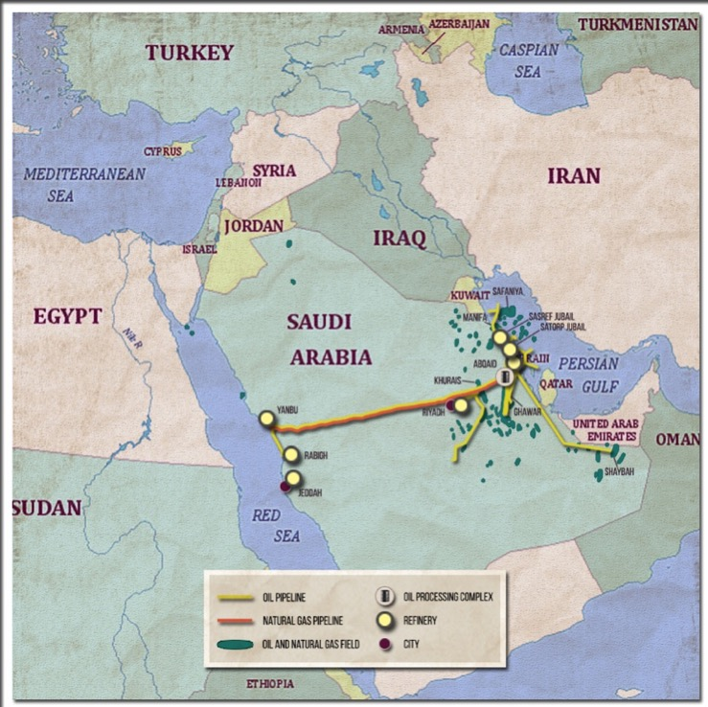
Producer Countries
Saudi Arabia
Oil discovered in 1938
Arabian American Oil Company (ARAMCO)
Roosevelt - Abdulaziz meeting 1945
US dependence on Saudi oil a pillar of bilateral relations
Petro-dollars major enabler of domestic stability and foreign policy
Most reserves in Shi’a dominated Eastern Province
Peak production 1980 (after Iranian revolution)
US dependence decreasing due to new technologies and discoveries → existential challenge for US-SA alliance
Roosevelt – Abdulaziz meeting
mondialisation.ca

Slide 11
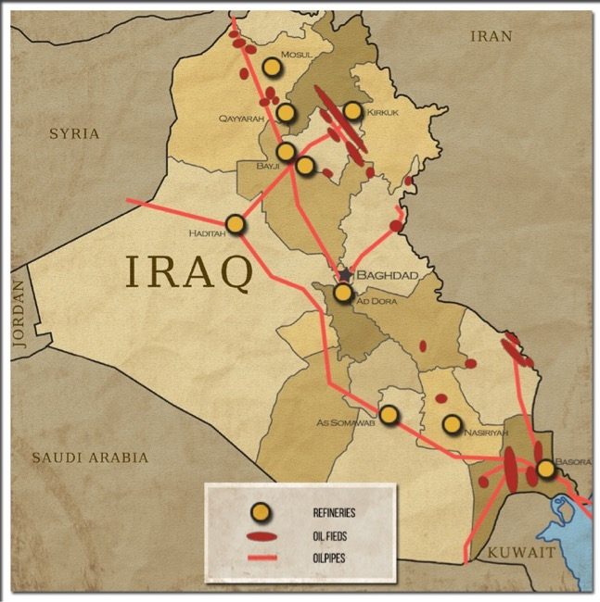
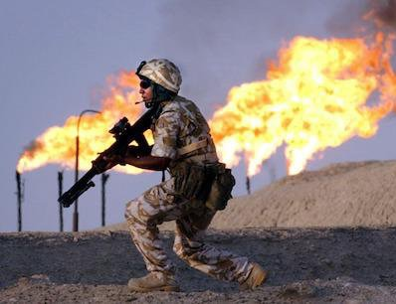
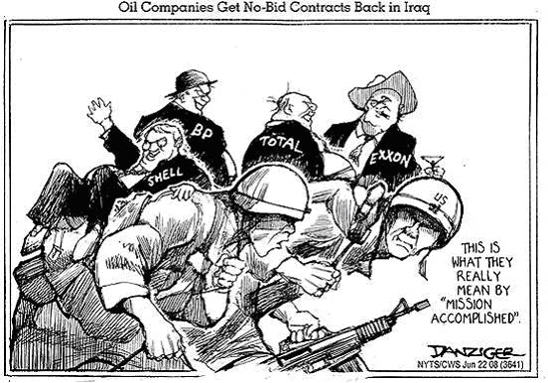
Producer Countries
Iraq
1927 oil discovered in Mosul
1929 British-controlled Iraq Petroleum Company (IPC) founded
1961: Iraq nationalises IPC
1970s: Oil cash sustains military build-up
1980s: Iraq supported by US, Gulf states against Iran
1990: Iraqi invasion of Kuwait, US invasion of Iraq → role of oil
2003 US invasion & 2005 Constitution allocates priority of oil affairs to provinces
Weakens Baghdad’s power
Autonomy for Kurdistan Regional Government (KRG)

Slide 12
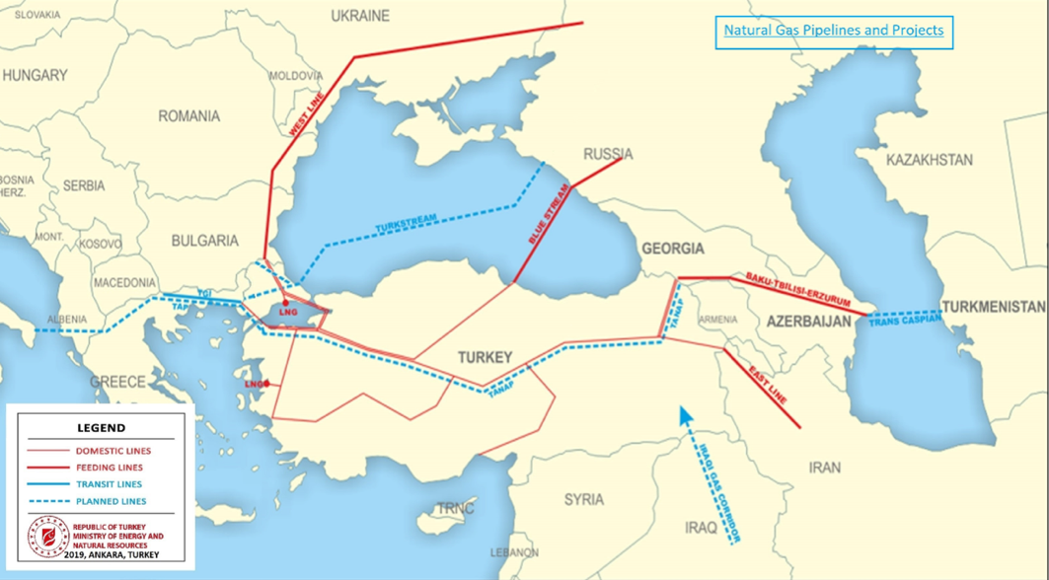
Transit Countries
Turkey
Resource-poor but benefits from being on major energy (oil & gas) transit routes
“Energy hub”
East-West; South-North routes
Geopolitical rivalry between the West and Russia
Nabucco Pipeline (cancelled in 2013)
TurkStream (in progress)

Slide 13
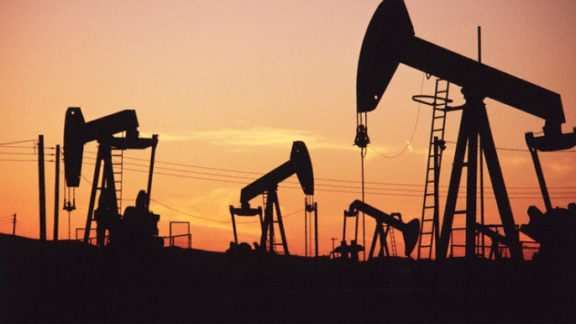
Rentier States

Slide 14
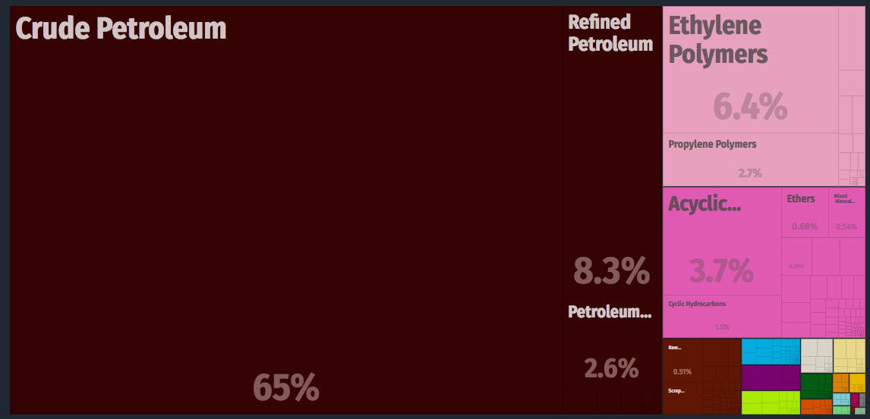
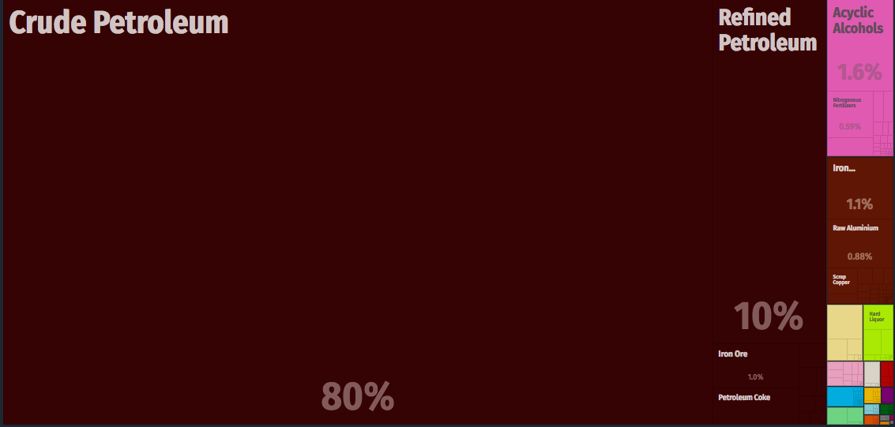
Rentier States
S. Arabia Exports 2017
What are they?
States whose income is derived from resource extraction
Economy depends to a large extent on one natural resource
“No taxation, No representation”
Rentierism is not conducive to democracy
Rentier states =/= Weak states
Venezuela Exports 2017
Hossein Mahdavy (1970) The Pattern and Problems of Economic Development in Rentier States: The Case of Iran
Hazem Beblawi (1987) The Rentier State in the Arab world
MIT Atlas of Economic Complexity atlas.media.mit.edu/

Slide 15
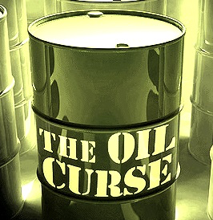
Rentier States
“The Dutch Disease”
Based on the discovery of natural gas in Groningen/Netherlands in 1959
Causal relationship between the increase in a specific economic sector and the decline of others
As revenues in the growing sector increase, the currency becomes stronger, and hence all other exports become too expensive.
All other sectors become less competitive.
Why is this relevant?
Very hard to diversify, once the disease sets in.
Danger of overdependence on a single product and hence vulnerability to market pressures (ex. Venezuela).
Resources are not always a blessing, indeed they can be a curse…

Slide 16
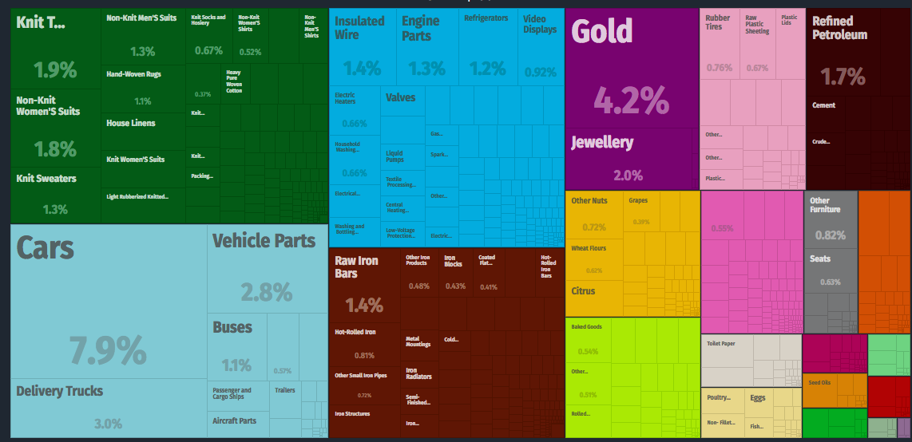
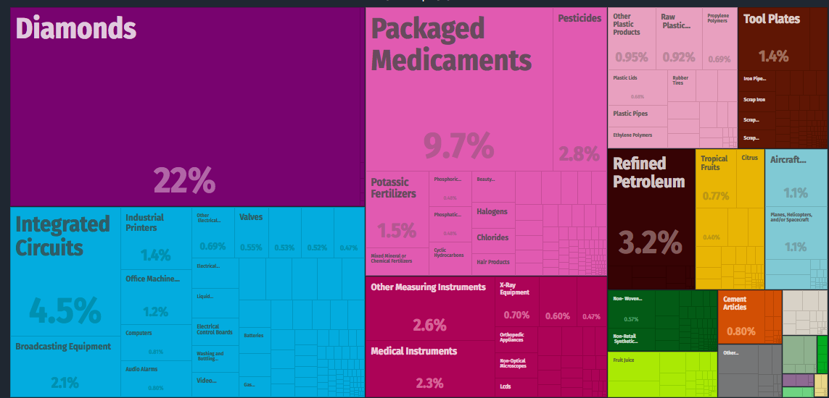
Rentier States
S. Arabia Exports 2017
Turkey Exports 2017
What are they?
States whose income is derived from resource extraction
Economy depends to a large extent on one natural resource
“No taxation, No representation”
Rentierism is not conducive to democracy
Rentier states =/= Weak states
Venezuela Exports 2017
Israel Exports 2017

Slide 17
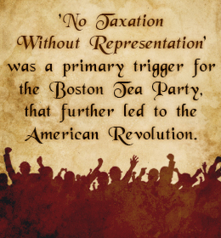
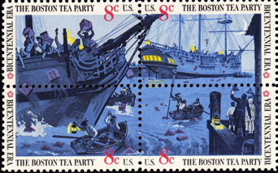
Rentier States
What are they?
States whose income is derived from resource extraction
Economy depends to a large extent on one natural resource
“No taxation, No representation”
Rentierism is not conducive to democracy
Rentier states =/= Weak states
In democracies, citizens finance the state by paying taxes. In return, they demand representation.
In rentier states, rulers do not need to tax the population, hence don’t owe them a right to representation.

Slide 18
Rentier States
What are they?
States whose income is derived from resource extraction
Economy depends to a large extent on one natural resource
“No taxation, No representation”
Rentierism is not conducive to democracy
Rentier states =/= Weak states
Resource wealth sustains thin layer of ruling elites and authoritarian structures
Democratic transitions in rentier states are likely to produce authoritarian governments.
“A democratically elected ruler will be tempted to turn authoritarian as soon as acquiring control of resource rent and the great power this gives him over society” (Luciani, p.119)
Rentier democracies
Norway, Netherlands
Rentier semi-democracies
Nigeria, Gabon, Iraq
Rentier full autocracies
Saudi Arabia, UAE, Qatar
Democratic institutions should be established before the resource arrives
Resource is not the only determinant of democracy
The record of many resource-poor countries is also problematic…
(ex. Syria, Egypt)

Slide 19
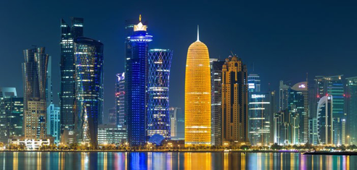
Rentier States
What are they?
States whose income is derived from resource extraction
Economy depends to a large extent on one natural resource
“No taxation, No representation”
Rentierism is not conducive to democracy
Rentier states =/= Weak states
Daron Acemoglu and James Robinson (2012) Why nations fail : the origins of power, prosperity and poverty
Skyline of Doha, Qatar

Slide 20
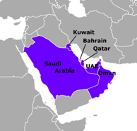
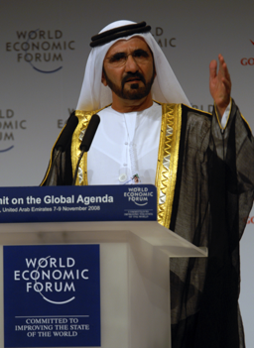
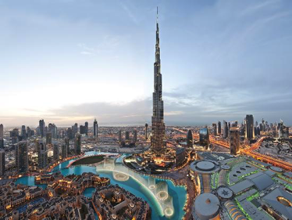
Rentier States
What are they?
States whose income is derived from resource extraction
Economy depends to a large extent on one natural resource
“No taxation, No representation”
Rentierism is not conducive to democracy
Rentier states =/= Weak states
Gulf Neo-Rentierism
Rulers “buy” consent by heavily investing in infrastructure and social welfare
Nurture diversified private sector that is open to international trade
Tribal ties: Ruling class is seen as legitimate by majority population
Small population helps
Mohammed bin Rashid Al Maktoum, Emir of Dubai
UAE exports 2017
Dubai Skyline

Slide 21
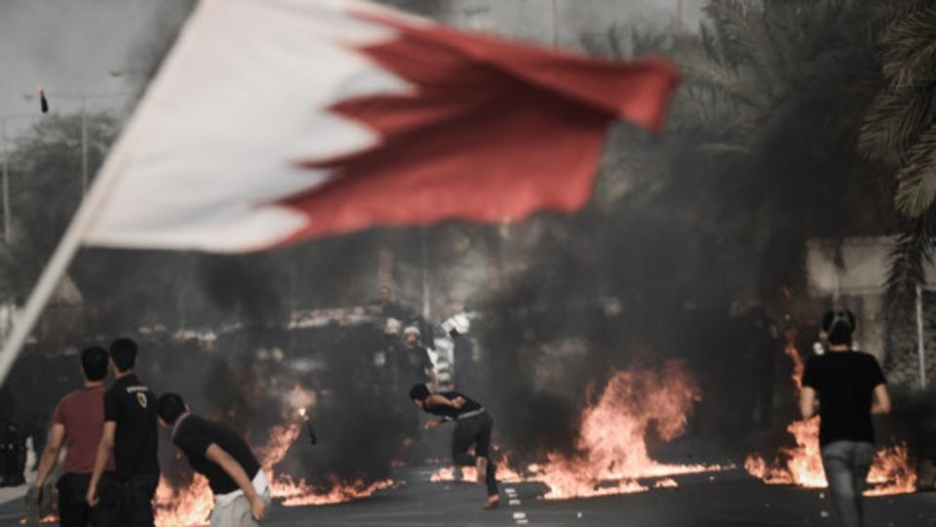
Rentier States
What are they?
States whose income is derived from resource extraction
Economy depends to a large extent on one natural resource
“No taxation, No representation”
Rentierism is not conducive to democracy
Rentier states =/= Weak states
Gulf Neo-Rentierism
Rulers “buy” consent by heavily investing in infrastructure and social welfare
Nurture diversified private sector that is open to international trade
Tribal ties: Ruling class is seen as legitimate by majority population
Small population helps
BUT… The “social contract” is fragile
Work force made up of migrant workers with very limited rights:
UAE (88%), Qatar (75%), Kuwait (74%)
Demand for liberties, inclusion by women, educated middle-classes
Ethnic/religious exclusion
Ex. Saudi Eastern Province, Bahrain

Slide 22
In summary…
Oil is a major factor in domestic and regional politics of the Middle East; BUT it doesn’t explain everything!
Non-Oil Producing Historical Powers Vs. Oil-producing New Powers
Resource wealth can be both a blessing and a curse
Rentierism and democracy do not go well together (unless democracy was there before the resource)
Rentier states do not have to be weak states

Slide 23
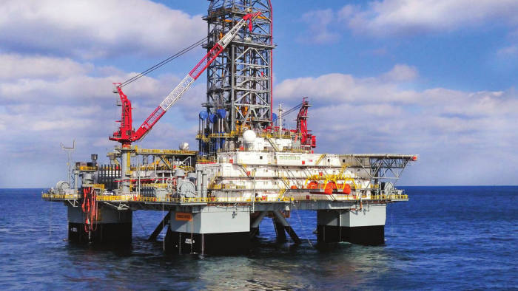
Homework
Answer in one paragraph and email me by Sunday 29 March.
“Why are oil prices falling so sharply, and how is this likely to impact the economies of producer countries in the region?”
Remember to cite any sources you use (news reports, statistics, etc.) in your answer.

Slide 24
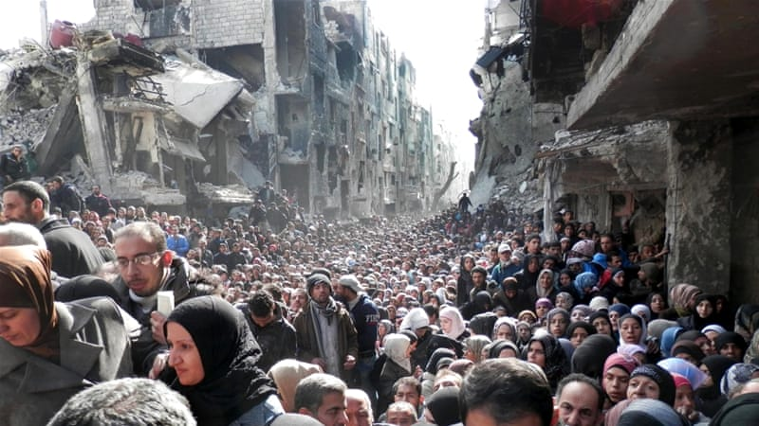
Lecture 5. Environment, Urbanisation & Migration

