Slide 1
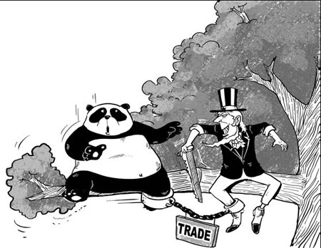
Back to Polanyi???
“Trade tensions will rise. In a world of deficient demand and excess savings, every country will try to acquire a greater share of global demand by exporting savings. This will be called trade protection, currency war, local content requirements, tariffs, and many other things, but these all amount to the same thing. It will be an attempt by each country to gain a greater share of global demand”(Pettis 2013, 192).

Slide 2
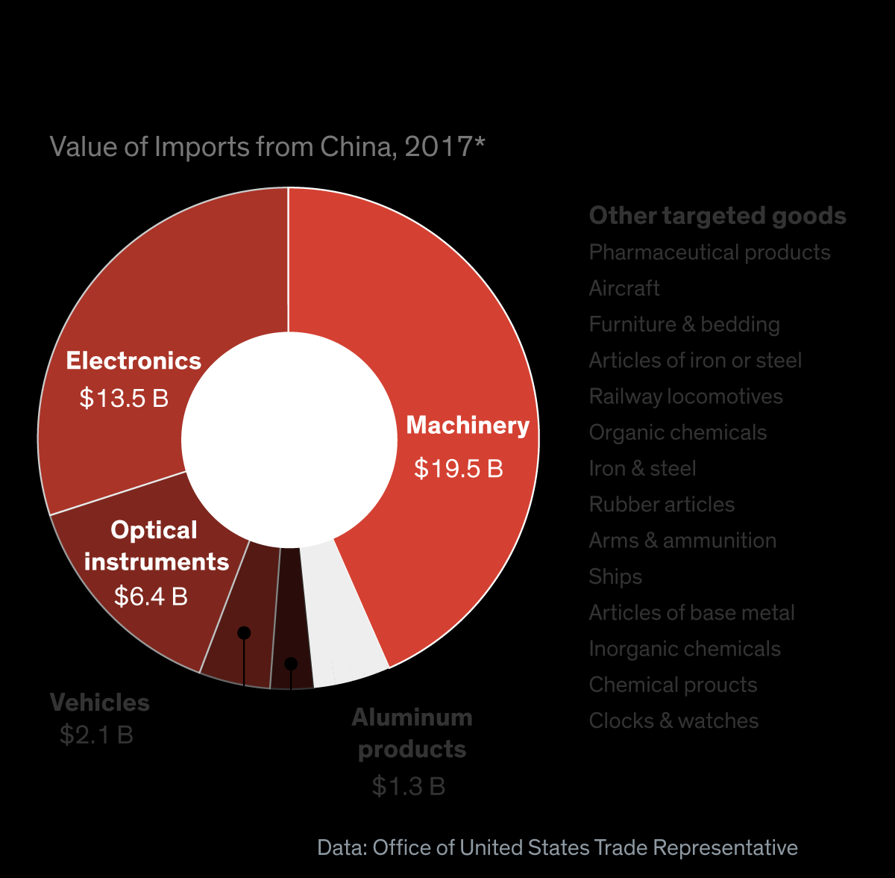

Slide 4
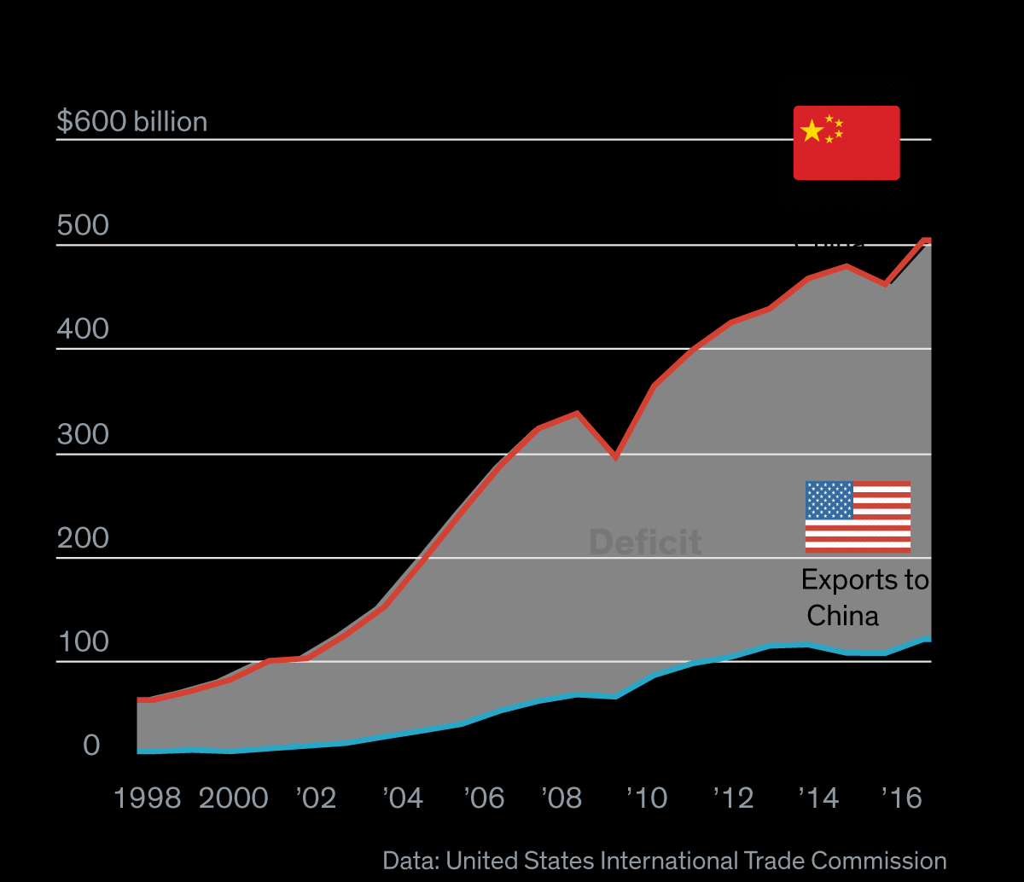

Slide 5
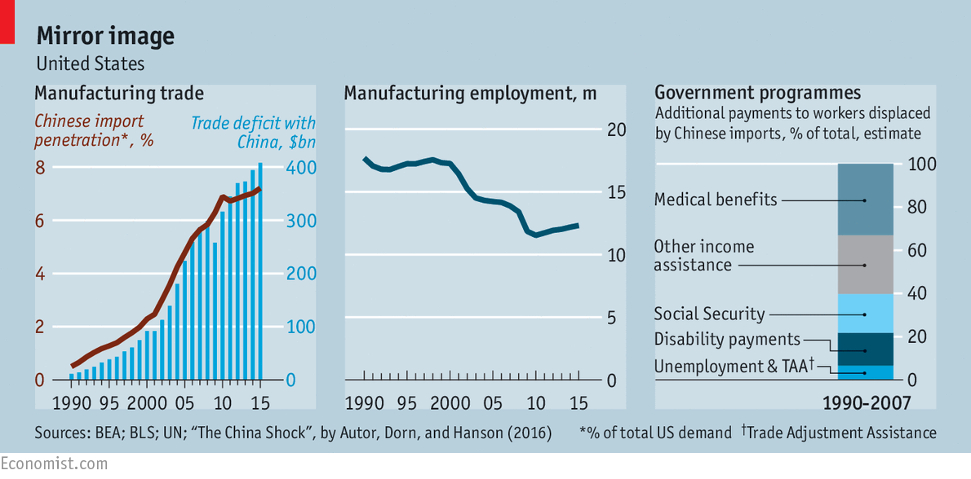
Back to Polanyi, but with a caveat...

Slide 6
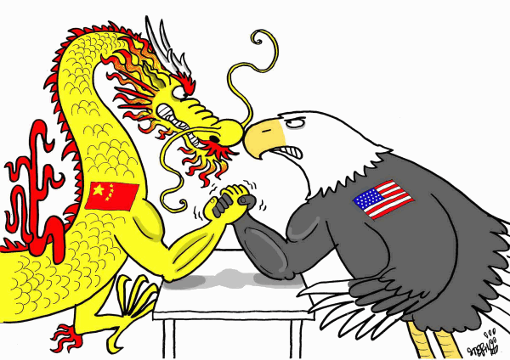
…not related to the international level…

Slide 7
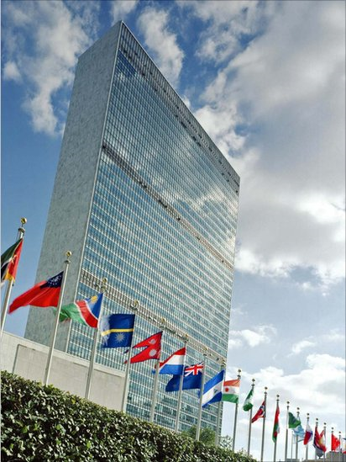
…although the global order is relevant
“When we talk about a liberal world order, we are speaking about the rules-based system of international trade and investment that has fuelled global growth in recent years” (Fukuyama 2016)
→ But its origins are found well before and demanded changes in the…

Slide 8
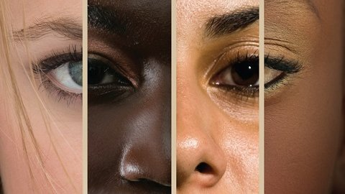
The domestic level matters: race and ethnicity

Slide 9
The Politics of Economic Nationalism
Class 9
The Rebirth of US White Nationalism
Dr. Vinícius Rodrigues Vieira (IRI-ISP)
17 October 2018

Slide 10
A new age of populist nationalism…
“We appear to be entering a new age of populist nationalism, in which the dominant liberal order that has constructed since the 1950s has come under attack from angry and energised democratic majorities. The risk of sliding into a world of competitive and equally angry nationalisms is huge, and if this happens it would mark as momentous a juncture as the fall to the Berlin Wall in 1989” (Fukuyama 2016).
→ … yet have nationalist tensions been sorted out under the so-called American-led international liberal order???

Slide 11
What meant to be American in the Post-War?
The end of the WASP mainstream???
Jews begun to be accepted in elite universities;
Mass education expands, particularly in the tertiary level (college);
Civil rights gain momentum

Slide 12
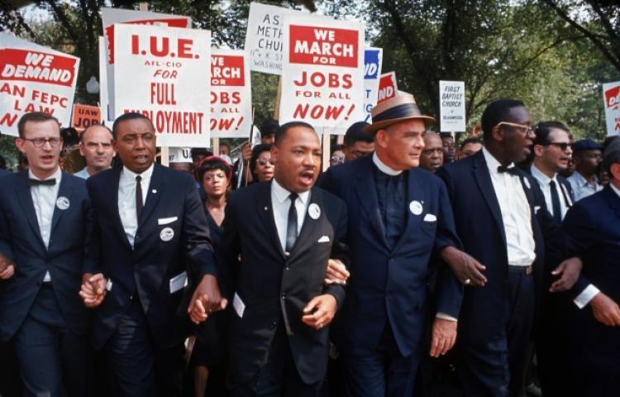

Slide 13
What meant to be American in the Post-War?
Mitigating the prominence of the WASP mainstream was a sine qua non condition for establishing and keeping the lead of the democratic-capitalist world during the Cold War.
Civil Rights Act (1964);
Voting Act (1965);
The Immigration and Naturalization Act (1965).

Slide 14
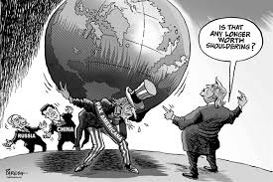
Has Trump destroyed everything???
"...a Trump presidency will signal the end of an era in which America symbolised democracy itself to people living under corrupt authoritarian governments around the world. American influence has always depended more on its 'soft power' rather than misguided projections of force such as the invasion of Iraq“ (Fukuyama 2016).

Slide 15
Quick Task
Discuss in pairs how the US had been behaving before Trump, since the end of the Cold War (1989)

Slide 16
Before Trump…
How was the hegemon behaving? The unilateral turn
Emphasis on unilateralism during Bush years (2001-2009);
Examples: non-signature of the Kyoto Protocol on Climate Change, the Rome Statute of the International Criminal Court (ICC);
That is, US was not following multilateral solutions
What has originated such an approach???

Slide 17
Before Trump…
Which are the incentives for multilateralism?
Legitimacy (hegemon can express its interests without looking authoritarian—or hegemonic);
Competition (US vs USSR during the Cold War) → but in the 1990s...

Slide 18
Before Trump…
Incentives for the erosion of multilateralism (and, thus, for using the strategies framed by the liberal order the US itself had created and sustained)...
Power (much more than Cold War allies, including Western Europe and Japan);
Legitimacy (without alternatives of power, there might be less incentives to portray cooperativeness);
Competition (US becomes the sole major military power) → Furthermore, in the 2000s...

Slide 19
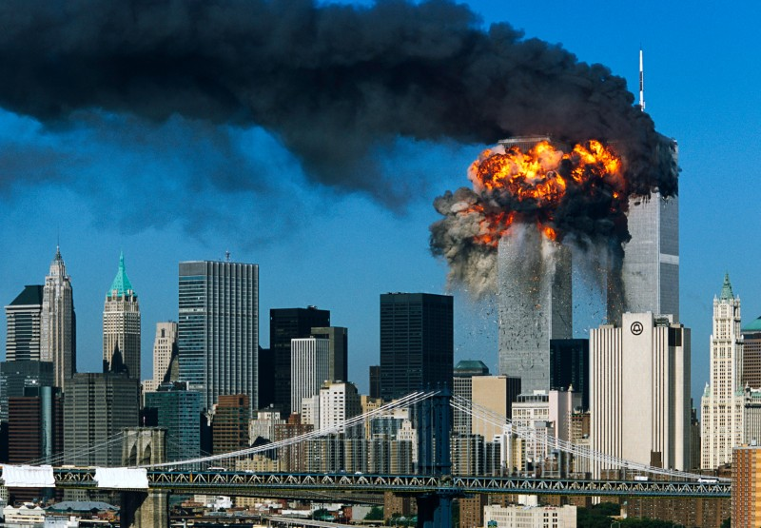
Before Trump…
Non-State Challenges to US power (Non-state)

Slide 20
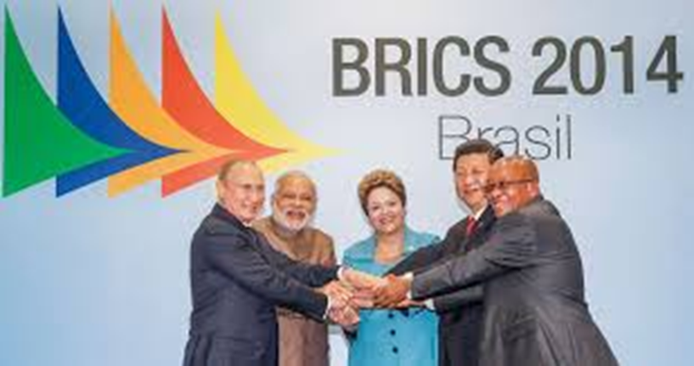
Before Trump…
State Challenges to US power
→ Are they ACTUAL challengers???

Slide 21
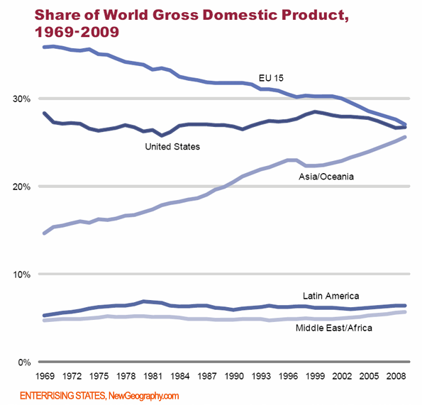
2 ) Which are the Emerging Powers?
b ) Definitions

Slide 22
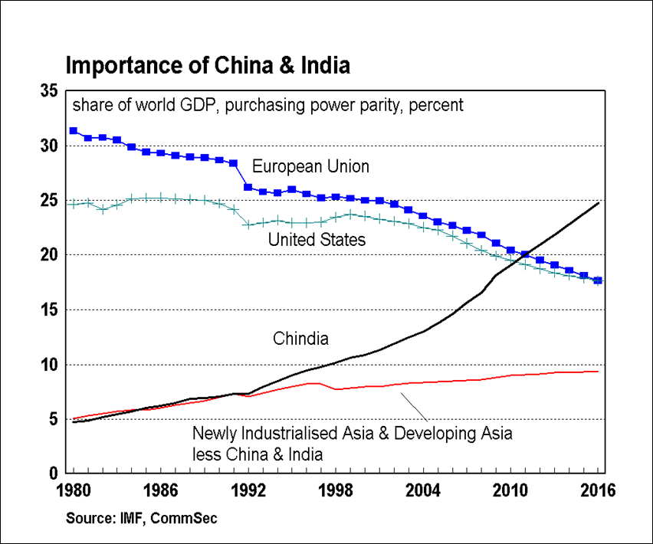
2 ) Which are the Emerging Powers?
b ) Definitions

Slide 23
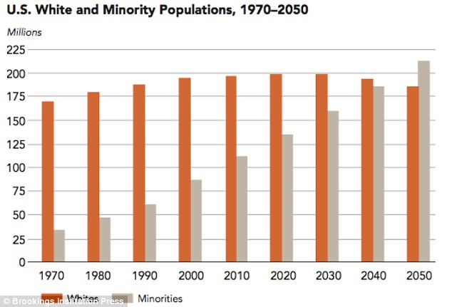

Slide 24
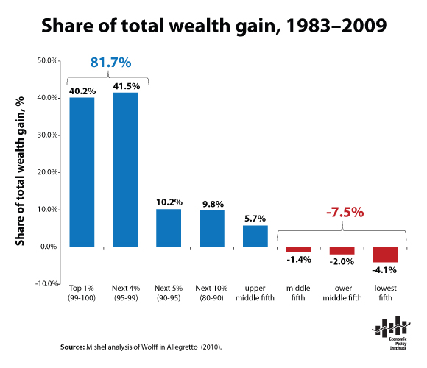
Class Divide Only???
"Social class, defined today by one's level of education, appears to have become the single most important social fracture in countless industrialised and emerging market countries. This, in turn, is driven directly by globalisation and the march of technology, which has been facilitated in turn by the liberal world order created largely by the US since 1945“(Fukuyama 2016).

Slide 25
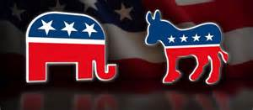
Mismatch in party politics
"The Republican party was dominated by corporate America and its allies who had profited handsomely from globalisation, while the Democratic party had become the party of identity politics: a coalition of women, African-Americans, Hispanics, environmentalists, and the LGBT community, that lost focus on economic issues“ (Fukuyama 2016).

Slide 26
Not only in the US (Burgoon 2009)
Measuring the Polanyian Backlash: the net autarky and net nationalist autarchy capture over lapping but potentially different aspects of political backlash, or rejection of internationalism and political liberalism, respectively.
Major Finding: Social Policy/Coverage reduces support to both net autarky (economic sufficiency) and net nationalist autarchy (nationalism that implies in less liberalism in politics).

Slide 27
Not only in the US (Burgoon 2009)

Slide 28
Not only in the US (Burgoon 2009)

Slide 29
Not only in the US (Burgoon 2009)

Slide 30
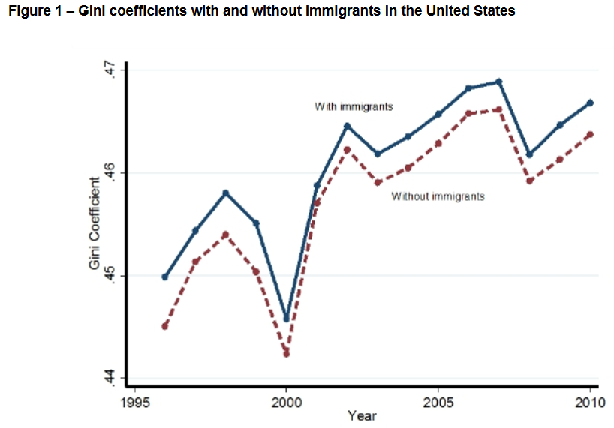
Rising Inequality → Association with Migrants
Source: http://blogs.lse.ac.uk/usappblog/2015/10/14/how-immigration-makes-income-inequality-worse-in-the-us/

Slide 31
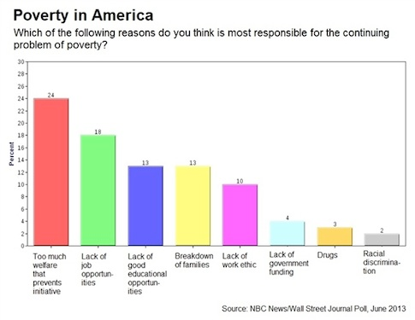
Rising Inequality → Undeserved Welfare

Slide 32
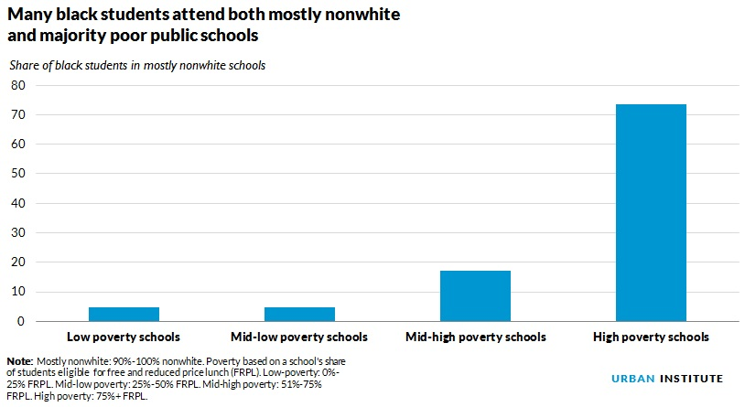
Rising Inequality → Poor Education

Slide 33
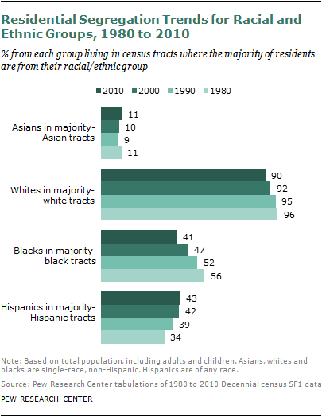
Rising Inequality → Racial Segregation

Slide 34
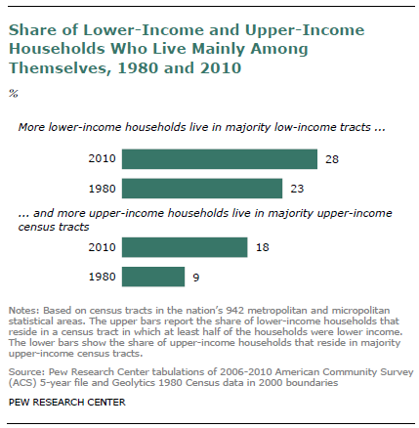
Rising Inequality → Class Segregation

Slide 35
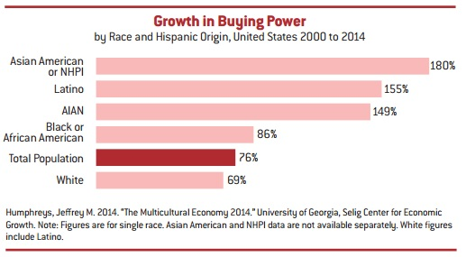
Rising Inequality → But Non-Whites Rise

Slide 36
How did the white working class react?
Prediction at the end of October 2016: "Presented here is more than a best-case scenario for the impact the white working class can have in support of Donald Trump. What this analysis makes plain is that even in the rosiest of scenarios, an extraordinary turnout of white working class voters, by itself, cannot produce a Trump victory. Thus, the 'hidden voter' theory appears to be highly overblown“ (Frey 2016).

