Slide 1
Exploration and Exploitation in Organizational Learning
James G. March
Source: Organization Science, 1991

Slide 2
Article overview
The article mainly studies the relationship between exploring new possibilities and exploiting old certainty in organizational learning.
Two scenarios
mutual learning between members of an organization and an organizational code
learning and competitive advantage in competition for primacy
Conclusion：In the process of adaptability, exploitation can gain benefits more quickly than exploration in the short-term, but in the long run it is kind of self-destruction.

Slide 3
Table of Contents
The Exploration/Exploitation Trade-Off
2. Mutual Learning in the Development of Knowledge
Knowledge and Ecologies of Competition
Little Models and Old Wisdom

Slide 4
Exploration and Exploitation
Exploration：Includes things like search, variability, risk taking, experimentation, play, flexibility, discovery, innovation
Exploitation：Includes things such as refining, selection, production, efficiency, completion, execution
PK
Exploration
Exploitation
Rare resources

Slide 5
1. The Exploration/Exploitation Trade-Off
Exploration and Exploitation in Theories of Organization
Organizational Behavior Theory
rational models of choice： gaining new information about alternatives (improving future returns) vs. using the information currently available (improve present returns)
theories of limited rationality: the most preferred alternative vs. target. (As long as it is higher than the target, you can stop the search.)
Organizational learning perspective
studies of organizational learning: refinement of an existing technology vs. invention of a new one
Organizational evolutionary perspective
evolutionary models of organizational forms and technologies：Variation vs. Selection.

Slide 6
The Vulnerbility of Exploration
Compared to returns from exploitation, returns from exploration are systematically less certain, more remote in time, and organizationally more distant from the locus of action and adaption.
Since long-run intlligence depends on sustaining a reasonable level of exploration, these tendencies to increase exploitation and reduce exploration make adaptive processes potentially self-destructive.

Slide 7
The Social Context of Organizational Learning
Mutual learning of an organization and the individuals in it.
procedures, norms,
rules, and form
learning from
socialized to
individuals
context of competition for primacy

Slide 8
2. Mutual Learning in the Development of Knowledge
Organizational learning and beliefs are disseminated to individuals in different ways: introduction, teaching, examples
Organization code to adapt to individual beliefs
Exploring and developing in joint learning is a constant game, such as long-term and short-term attention, individual knowledge and collective knowledge acquisition.

Slide 9
A Model of Mutual Learning：Development and diffusion of organization knowledge
The model has four main features:
1) There is an objective reality that exists independently of belief
2) At each time period, the individual and organizational code in the organization will receive beliefs about therealitys.
3) Individuals constantly correct their beliefs, so they are socialized within the organization and trained in the code.
4) The organization code should adapt to the individual beliefs, the beliefs of these individuals are more consistent with therealitys, not the code

Slide 10
A Model of Mutual Learning：Development and diffusion of organization knowledge
The initial conditions in this model include: a reality; an organization's code; an individual
Organizational code affects individual beliefs, and the same code is also influenced by beliefs; individual beliefs cannot directly influence the beliefs of other individuals, but indirectly through organizational code.

Slide 11
Basic Properties of the Model in a Closed System
There is also a common learning model in a closed system, with fixed organization and stable objective facts in the system.
Due to the established factual facts, the state of knowledge can be assessed in two ways at any time:
1) The proportion of facts can be calculated by organizing the code, which is the code knowledge level of this time period.
2) The factual proportion can be calculated from the individual beliefs, which is the average knowledge level of the individual in this time period.
These features can be summarized as follows: Every adjustment in beliefs helps to reduce the difference between individual and organizational code. Therefore, individual beliefs and code will become consistent over time

Slide 12
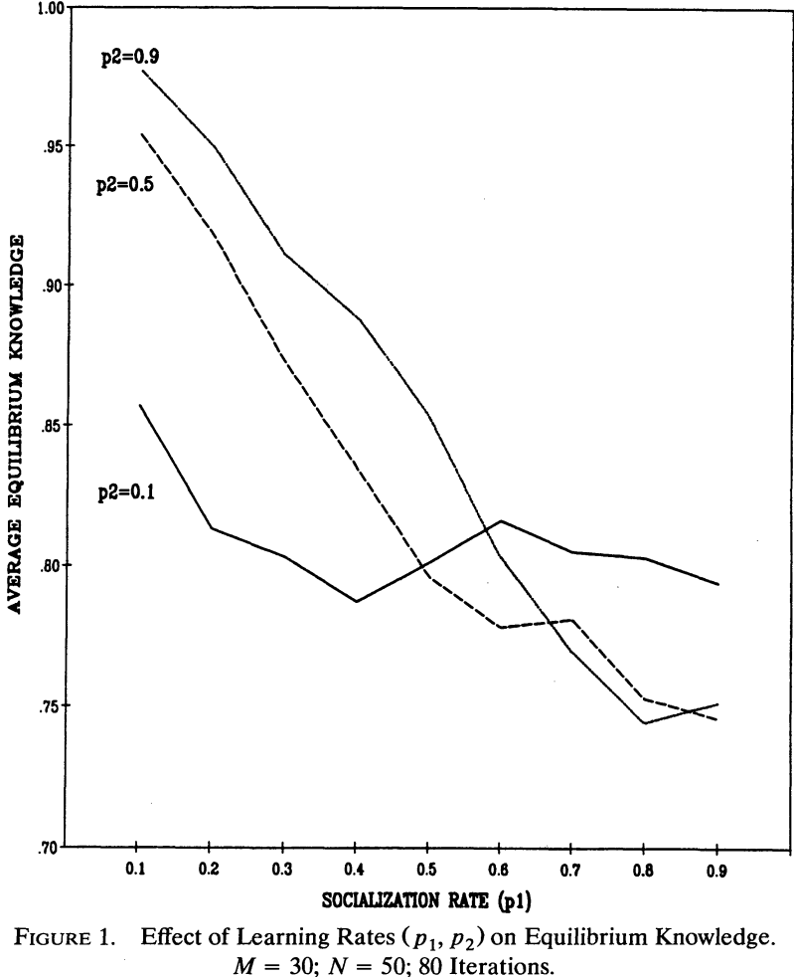
Effects of learning rates
P1= effectiveness of socialization
P2= effectiveness of learning by the code
The higher the learning rate, the earlier it will reach equilibrium.
The equilibrium level of knowledge is the interaction of two parameters
The result: slow socialization (lower p1) will make equilibrium knowledge faster than fast socialization

Slide 13
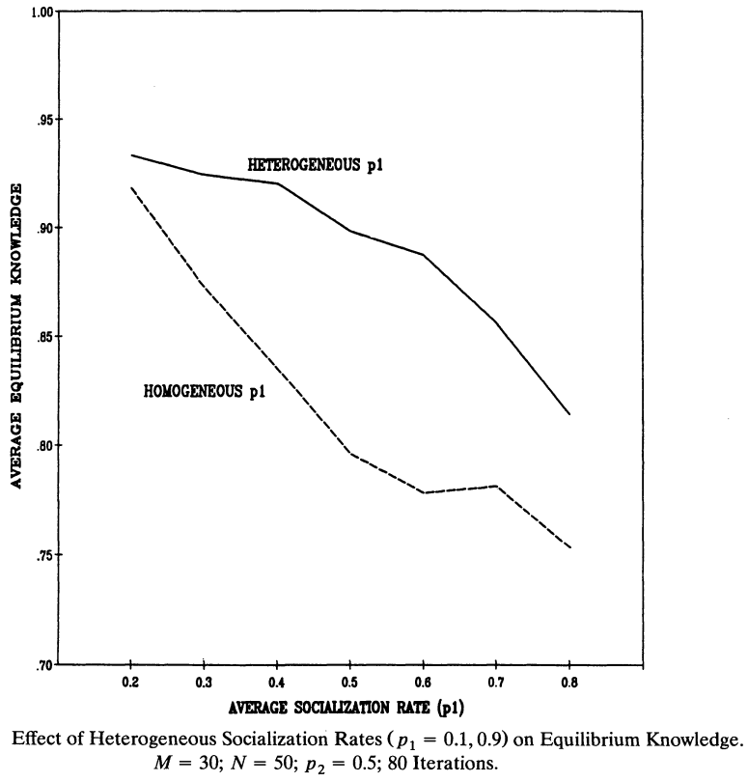
Effects of learning rate heterogeneity
P1= effectiveness of socialization
P2= effectiveness of learning by the code
The rapid learning of individuals in an organization has a beneficial effect on individual knowledge, but it is not good for the improvement of organizational knowledge. Therefore, in the long run, there should be fast learning (p=0.9) and slow learning (p=0.1) in the individual learning team. Two different types of individuals
As shown in the figure: the heterogeneous individual group has a higher average knowledge level than the homogenous individual group.

Slide 14
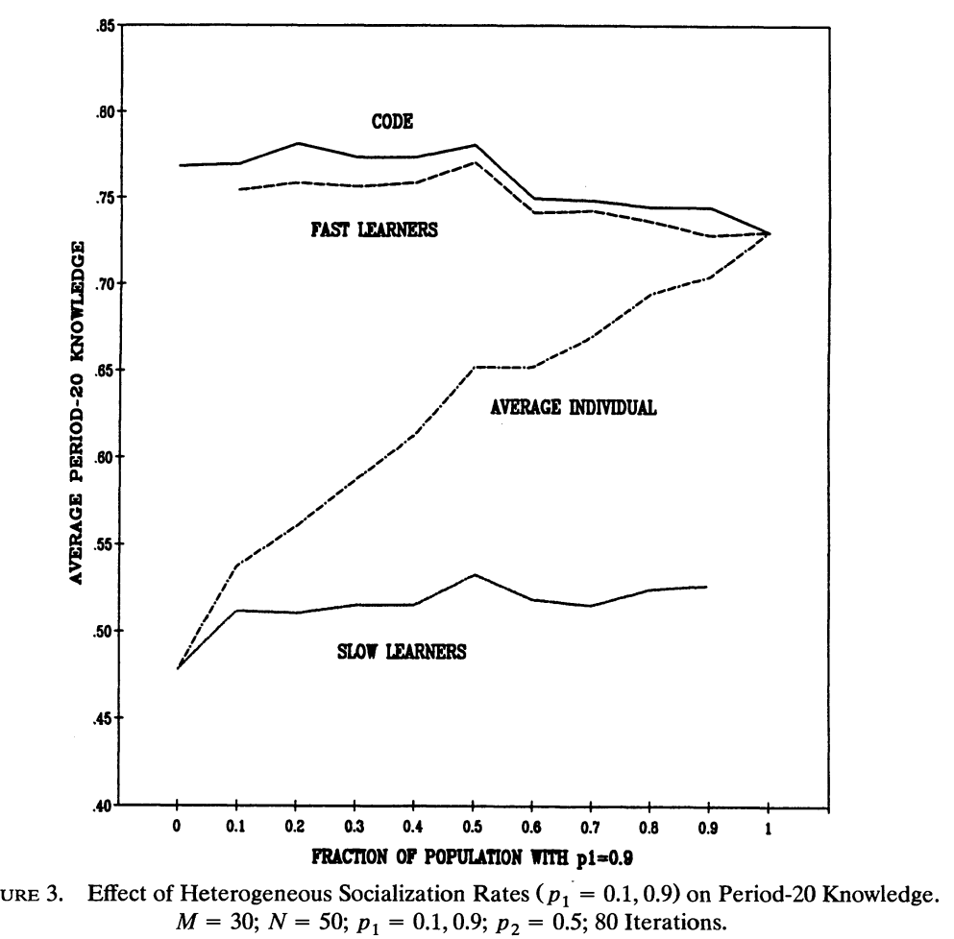
Effects of learning rate heterogeneity
P1= effectiveness of socialization
As shown in the figure, changes in the level of knowledge equilibrium of fast learners indicate that fast learners can acquire knowledge from the organization, provided that there are slow learners in the organization.
The results show that slow learners are an indispensable part of organizational learning, but in real life, slow learners are not part of being valued, whether in rewards or compensation, which leads to difficulties for slow learners.

Slide 15
Basic Properties of the Model in a More Open System
Consider personnel turnover
Consider environment turbulence

Slide 16
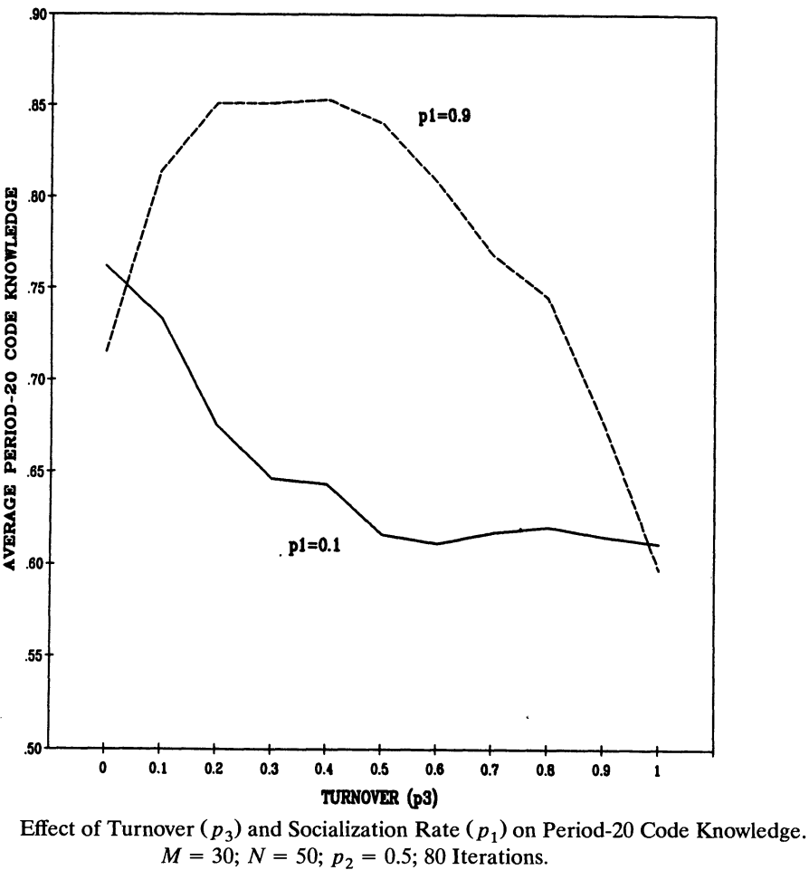
Effects of personnel turnover
P1= effectiveness of socialization
P3= turnover possibilities
The combination of slow learning and rapid turnover leads to inadequate exploit
Rapid socialization of individuals into the procedures and beliefs of an organization tends to reduce exploration. A modest level of turnover, by introducing less socialized people, increases exploration, and thereby improves aggregate knowledge

Slide 17
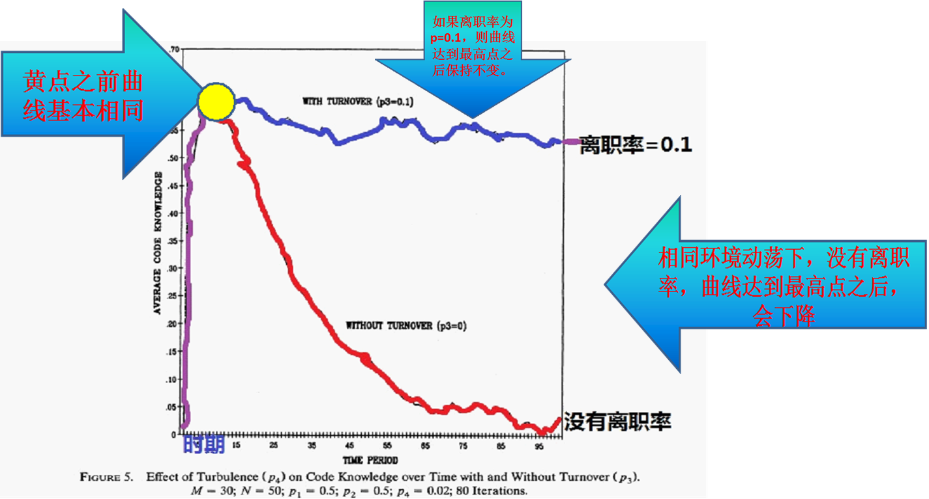
Effects of environment turbulence

Slide 18
3. Knowledge and Ecologies of Competition
4. 知识和生态学的竞争
In these ecologies of competition, the competitive consequences of learning by one organization depend on learning by other organizations.
Three elements：learning, performance, position
competitive advantage is affected by the accumulation of knowledge.

Slide 19
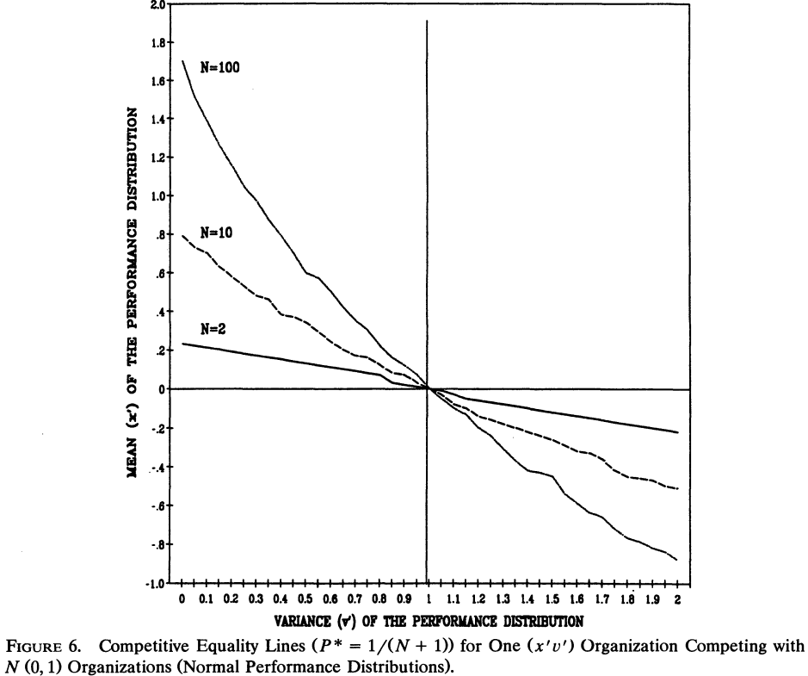
竞争以及相对绩效的重要性
in bilateral competition involving normal performance distributions, learning that increases the mean always pays off, and changes in the variance have no effect.
If N is greater than 1 (but finite), increases in either the mean or the variance have a positive effect on competitive advantage, and sufficiently large increases in either can offset decreases in the other.
The trade-off between increases in the mean and increases in the variance is strongly affected by N. As the number of competitors increases, the contribution of the variance to competitive advantage increases until at the limit, as N goes to infinity, the mean becomes irrelevant.
拥有竞争优势的区域
拥有竞争劣势的区域

Slide 20
Learning, Knowledge, and Competitive Advantage
Core: The impact of learning is reflected in the change in performance distribution
The study found
If learning increases the average and variance of a normal performance distribution, then learning will increase the competitive advantage in the first place.
Increases in the variance may compensate for decreases in the mean; decreases in the variance may nullify gains from increases in the mean.
Relative position is affected by variability, and increasingly so as the number of competitors increase

Slide 21
Competition for Relative Position and Strategic Action
It is quite possible to consider the average performance and performance reliability distribution as a strategic choice.
In the long run, they represent an organizational choice between learning input and access to existing possibilities, which is the central focus of this article.
In the short term, the choice of mean can be seen as a choice of effort or attention (from minimum to maximum). variations in the reliability of performance can be seen as choices of knowledge or risk that can be set willfully within the range of available Alternatives.

Slide 22
4. Little Models and Old Wisdom
Research questions: learning, analysis, imitation, regeneration, and technological change are the main factors that improve organizational performance and enhance competitive advantage. Each step involves a trade-off between exploration and development.
The existing debate is the choice between exploration and development under the influence of performance distribution and ecological interactions.
Results: 1) degrades organizational learning in a mutual learning situation; 2) The keyrealityor is the effect of knowledge on the right-hand tail of the performance distribution

Slide 23
Conclusion
The returns to fast learning are not all positive
Rapid socialization may hurt the socializers even as it helps the socialized
The development of knowledge may depend on maintaining an influx of the naive and ignorance
Competitive victory does not reliably go to the properly educated.

