Slide 1
Electrons do not orbit.
Electrons do not spin.
We don´t know were they are going.
We don´t know were they have been.
Anonymous

Slide 2
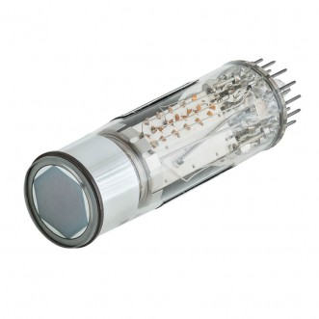
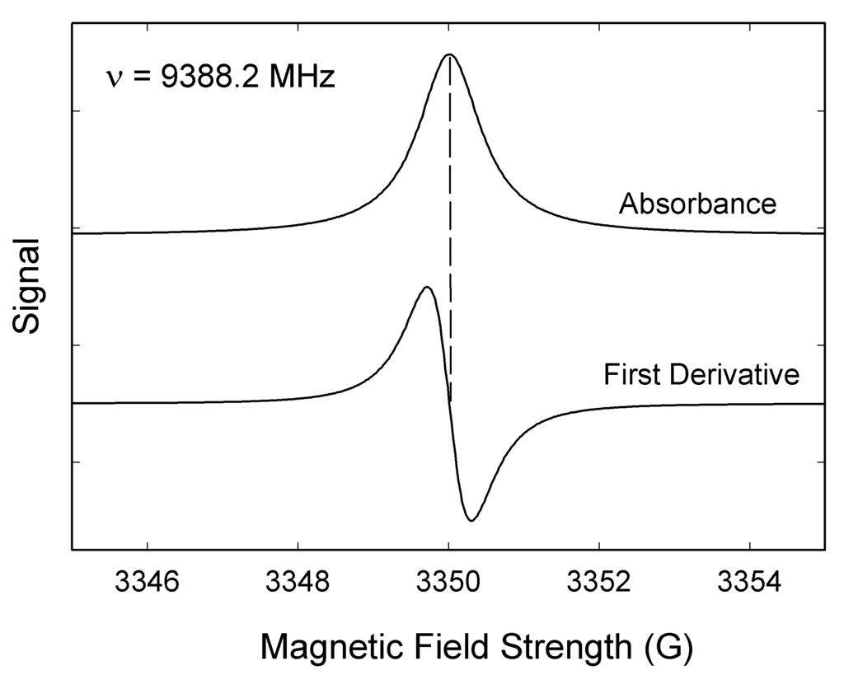
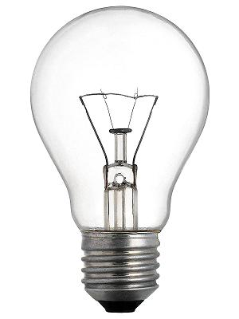
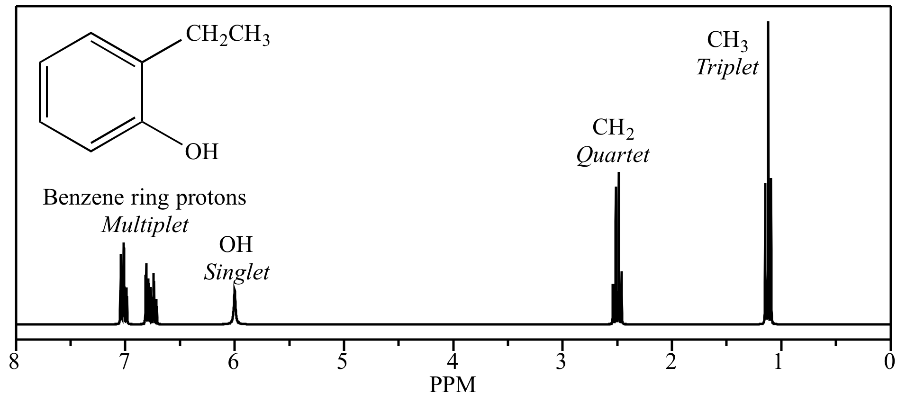
Ressonâncias Magnéticas
- Momentos magnéticos induzidos pela “rotação” de partículas, em níveis vibracionais moleculares;
Explorar transições em níveis energéticos, em função da presença de campos magnéticos externos fortes
Microondas ou rádio
Processamento
Solução
PMT
EPR
Fonte de luz
Hoje!
Detector
Amostra
NMR
Arranjo
Experimental
Preparo de
amostra
Processamento
de dados
Qualidade
do resultado
Acessível
Fácil
Fácil
Útil
$$Chemical shift: δ=\frac{υ_{sample}−υ_{reference}}{υ_{reference}}$$
Especializado
Muito difícil
Muito difícil
Melhor possível

Slide 3
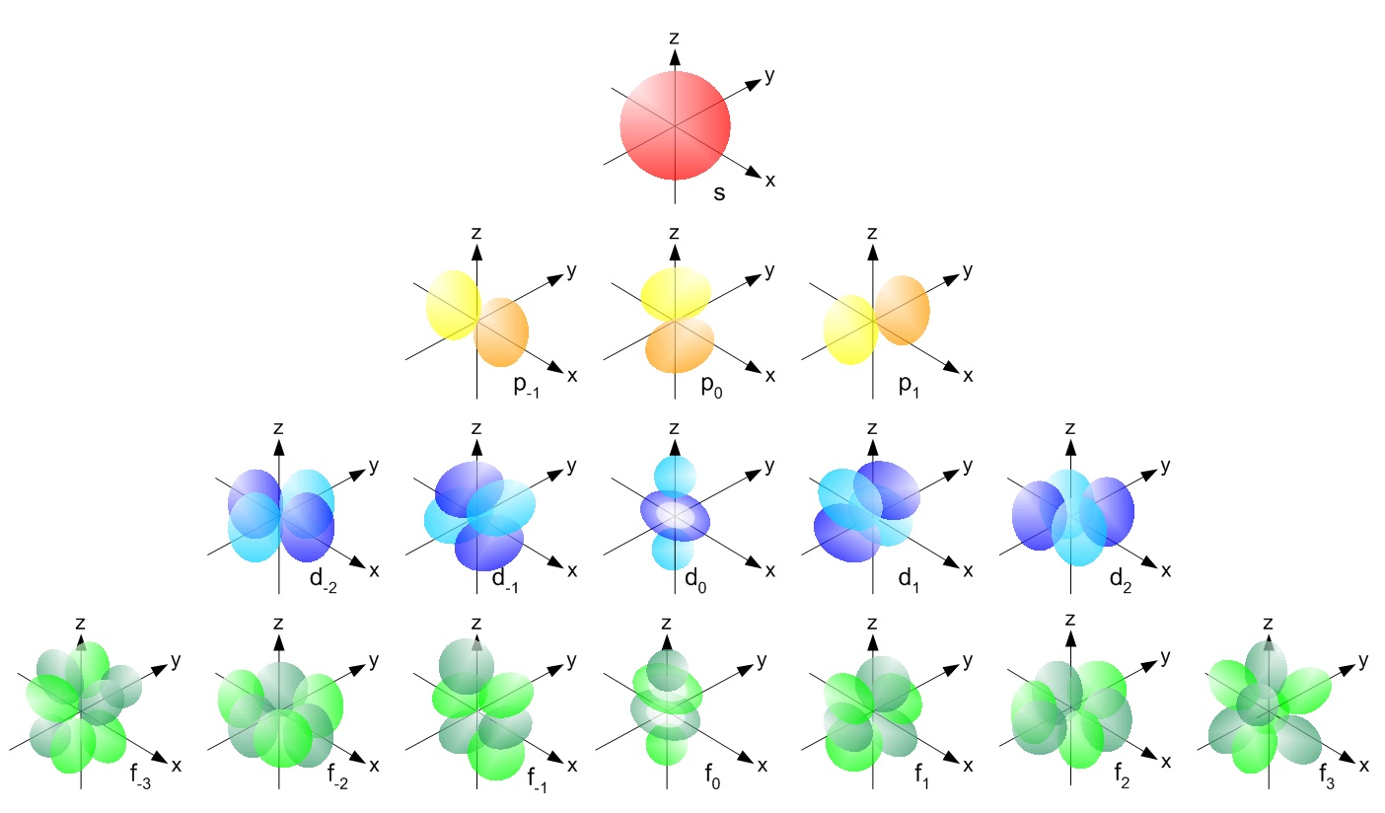
Electron configuration: finding a home for each electron
Principal quantum number (n): energy level (shell) occupied by electron; n = 1, 2, 3, 4, 5, 6, 7...
Angular momentum quantum number ($ℓ$): shape of the orbital(s) within the shell; (ℓ = 0, 1, 2,..., n − 1) of n
Magnetic quantum number (m_{ℓ}): orientation of an orbital around the nucleus; (from −ℓ to ℓ, in intergers);
Spin quantum number (s): projection of intrinsic angular momentum of electron (±½)
1s²
2s² 2p⁶
3s² 3p⁶ 3d¹⁰
4s² 4p⁶ 4d¹⁰ 4f¹⁴
5s² 5p⁶ 5d¹⁰ 5f¹⁴
6s² 6p⁶ 6d¹⁰ 6f¹⁴
7s² 7p⁶ 7d¹⁰ 7f¹⁴
ℓ = 0 (spherical), ℓ = 1 (principal), ℓ = 2 (diffuse), ℓ = 3 (fundamental)...
ℓ = 0
First p orbital(ℓ = 1) appear in the second shell (n = 2), the first d orbital (ℓ = 2) appear in the third shell (n = 3), and so on
ℓ = 1
ℓ = 2
ℓ = 3

Slide 4
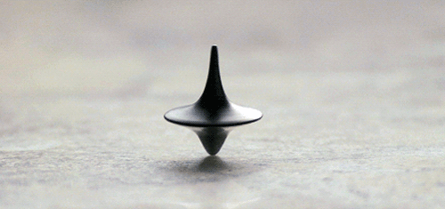
Classical model, e.g. Solar system, planets and moons
Spin angular momentum
Orbital angular momentum
$$\vec{L}= \vec{r}×\vec{p}$$
$\vec{L}$ or $\vec{S}$ always indicate the rotation axis
$$\vec{S}=I\vec{ω}$$
$$\vec{S}$$
$$\vec{L}$$
$$\vec{r}$$
$$m$$
$$\vec{v}$$
$$\vec{L}$$
$$\vec{S}$$
$$\vec{r}$$
$$m$$
No restrictions to the magnitude and direction of $\vec{L}$ or $\vec{S}$
$$\vec{v}$$

Slide 5
Quantum model, e.g. electron orbital
Magnitude and Direction are quantised
Principal quantum number (n): energy level (shell) occupied by electron; n = 1, 2, 3, 4, 5, 6, 7...
Angular momentum quantum number ($ℓ$): shape of the orbital(s) within the shell; (ℓ = 0, 1, 2,..., n − 1) of n
Magnetic quantum number (m_{ℓ}): orientation of an orbital around the nucleus; (from −ℓ to ℓ, in intergers);
Spin quantum number ($m_{s}$): projection of intrinsic angular momentum of electron (±½)
$$\left|\vec{L}\right|= ℏ\sqrt{ℓ(ℓ+1)}$$
ℓ = 0, $\left|\vec{L}\right|$=0
Angular momentum quantum number ($ℓ$) defines the quantisation of the magnitude of $\vec{L}$
$$ℓ=0,1,2,…, n−1$$
ℓ = 1, $\left|\vec{L}\right|$= $ℏ\sqrt{2}$
ℓ = 2, $\left|\vec{L}\right|$= $ℏ\sqrt{6}$
ℓ = 3, $\left|\vec{L}\right|$= $ℏ\sqrt{12}$

Slide 6
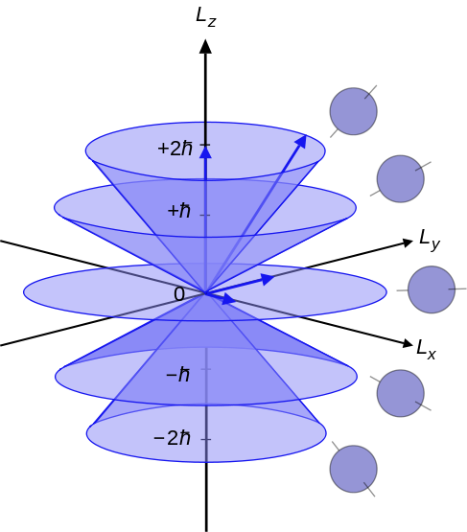
Quantum model, e.g. electron orbital
Magnitude and Direction are quantised
$$\vec{L}={\vec{L}}_{x}+{\vec{L}}_{y}+{\vec{L}}_{z}$$
Commutators ≠ 0
$$\left[{\vec{L}}_{x},{\vec{L}}_{y}\right]=iℏ{\vec{L}}_{z}$$
$$\left[{\vec{L}}_{y},{\vec{L}}_{z}\right]=iℏ{\vec{L}}_{x}$$
$$\left[{\vec{L}}_{z},{\vec{L}}_{x}\right]=iℏ{\vec{L}}_{y}$$
orbital d ($ℓ$=2), $\left|\vec{L}\right|$= $ℏ\sqrt{6}$
$m_{ℓ}$=2, $\left|{\vec{L}}_{z}\right|$= $+2ℏ$
${\vec{L}}_{z}$ is measured by convention
$m_{ℓ}$=1, $\left|{\vec{L}}_{z}\right|$= $+ℏ$
$$\hat{z}$$
$m_{ℓ}$=0, $\left|{\vec{L}}_{z}\right|$= $0$
$$\vec{L}$$
$$\left|{\vec{L}}_{z}\right|= m_{ℓ}ℏ$$
$m_{ℓ}$=-1, $\left|{\vec{L}}_{z}\right|$= $−ℏ$
$$\vec{L}$$
$$m_{ℓ}=−ℓ,…,ℓ$$
$m_{ℓ}$=-2, $\left|{\vec{L}}_{z}\right|$= $−2ℏ$
$$\vec{L}$$
$$\vec{L}$$
Magnetic quantum number (m_{ℓ}) defines the quantisation of the direction of $\vec{L}$, by conical sections

Slide 7
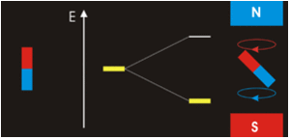
Electron (charged particle) orbital can be aproximated to a current loop
$${\vec{μ}}_{orb}$$
$${\vec{μ}}_{orb}=I\vec{A}=\frac{−e\vec{L}}{2m_{e}}$$
$\left|{\vec{μ}}_{orb}\right|$= $\frac{eℏ\sqrt{ℓ(ℓ+1)}}{2m_{e}}$
A
+
$$I$$
$$μ_{B}=\frac{eℏ}{2m_{e}}$$
$$\vec{r}$$
-
Bohr magneton
$$\vec{L}$$
Efeito Zeeman
A
+
$$I$$
$$\vec{r}$$
-
$${\vec{μ}}_{orb}$$

Slide 8
$$m_{ℓ}$$
$$m_{ℓ}$$
$$m_{ℓ}$$
Preferential sample orientation
Random sample orientation
$ℓ$=2
$ℓ$=1
$ℓ$=0

Slide 9
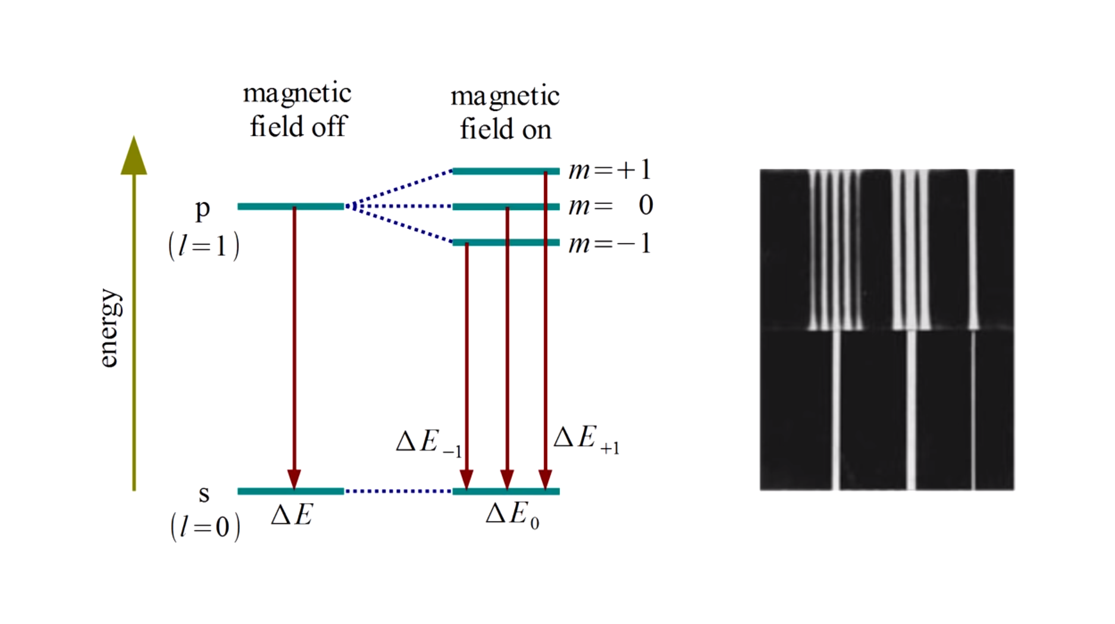

Slide 10
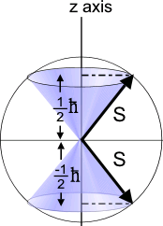
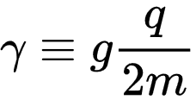
Quantum model, e.g. electron spin angular and magnetic momenta
Principal quantum number (n): energy level (shell) occupied by electron; n = 1, 2, 3, 4, 5, 6, 7...
Angular momentum quantum number ($ℓ$): shape of the orbital(s) within the shell; (ℓ = 0, 1, 2,..., n − 1) of n
Magnetic quantum number (m_{ℓ}): orientation of an orbital around the nucleus; (from −ℓ to ℓ, in intergers);
Spin quantum number ($m_{s}$): projection of intrinsic angular momentum of electron (±½)
Spin angular momentum
$$\left|\vec{S}\right|= ℏ\sqrt{s(s+1)}=\frac{\sqrt{3}}{2}ℏ$$
$$\vec{S}$$
$$s=\text{½}$$
Spin magnetic moment
Classical analogy, not entirely true (but it works)
g is g-factor = 2.0023…
$γ$ is gyromagnetic ratio
Electrons very likely do not spin around any axis!

Slide 11
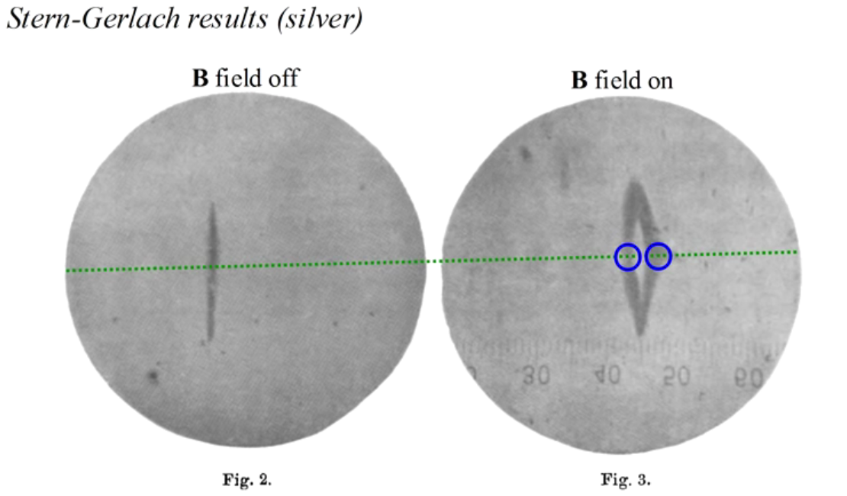
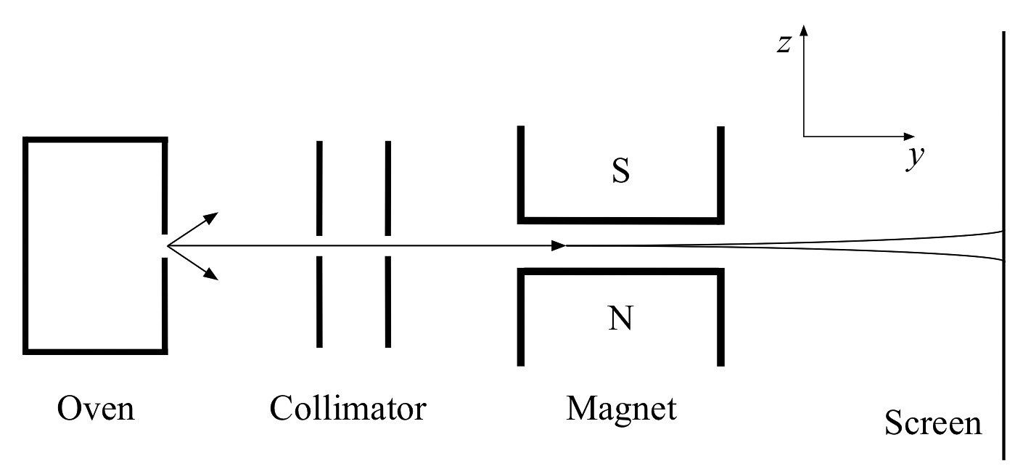
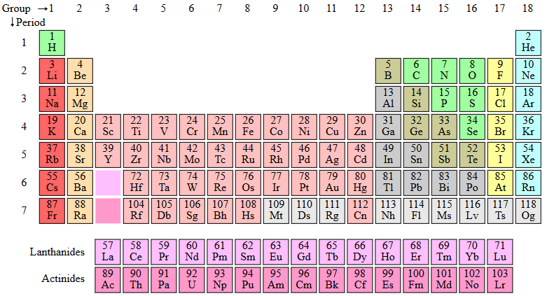
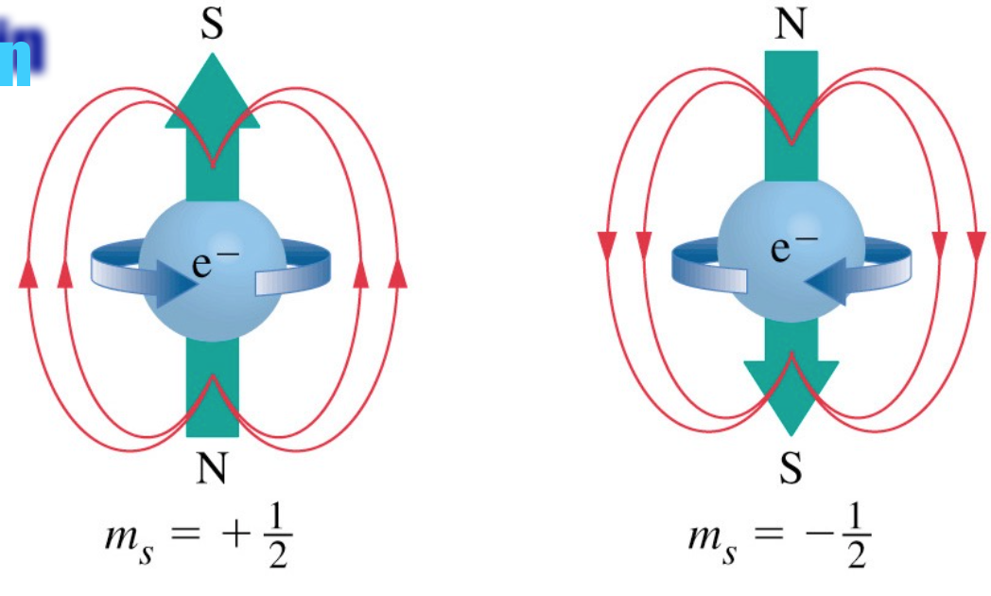
Proposição do “spin eletrônico” ou Momento angular intrínseco
Experimento de Stern-Gerlach, 1922
Ag⁴⁷ = [Kr] 4d¹⁰ 5s¹

Slide 12
Nuclear spin and angular momentum
(Nucleus is a collection of two kinds of particles)
$$\vec{I}$$
Parity effect: two protons or neutrons cancel each other for $\vec{I}$
+
+
+
+
$$\left|\vec{I}\right|= ℏ\sqrt{I(I+1)}$$
$$I=0,\frac{1}{2},1,\frac{3}{2}, …$$
Even-even nuclei: ${}_{6}^{12}{C,{}_{8}^{16}{O,…\left(I=0\right),\left|\vec{I}\right|=0}}$
Even-odd nuclei: ${}_{1}^{1}{H,{}_{7}^{15}{N,{}_{6}^{13}C…(I=\frac{1}{2}),\left|\vec{I}\right|=\frac{\sqrt{3}}{2}ℏ}}$
Odd-odd nuclei: ${}_{1}^{2}{H,{}_{7}^{14}{N…\left(I=1\right),\left|\vec{I}\right|=\sqrt{2}ℏ}}$
+
Magnetic moments of quarks combine to give the neutron its magnetic moment.
+
+
+
+
+
+
+
+
Atoms must have odd number of protons or neutrons, or both
+
+
+
+
+
+
However, you may want to work with isotopes
+
+
+
Protons and neutrons have spin 1/2
Spin é momento angular intrínseco: prótons nêutrons e elétrons provavelmente não giram

Slide 13
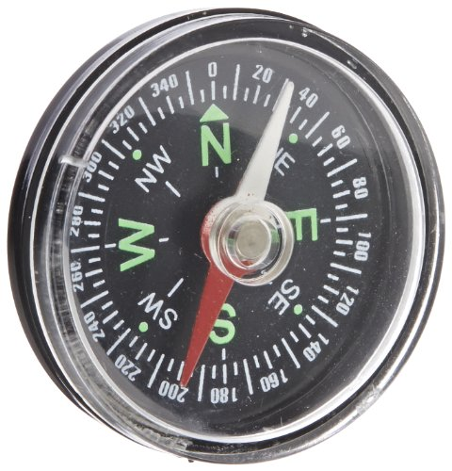
O(s) experimento(s): Momentos magnéticos na presença de campo magnético externo
Lorentz: $\vec{B}$ exerce força

Slide 14
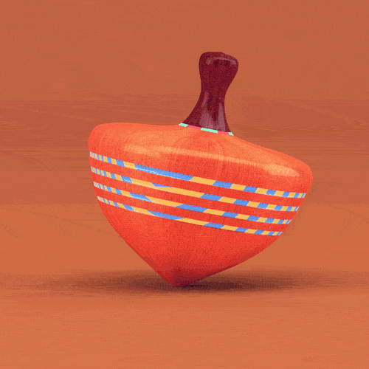
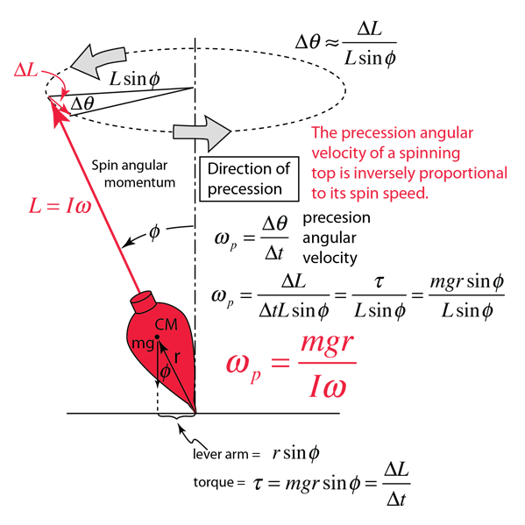
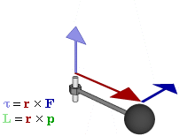
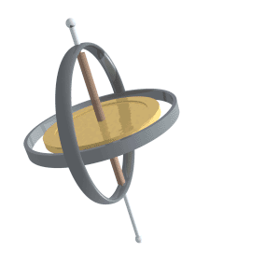
Torque-induced precession (gyroscopic precession)

Slide 15
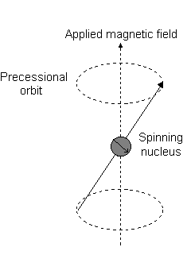
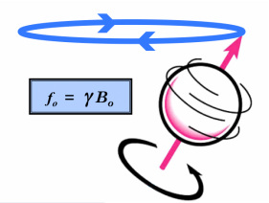
Torque-induced precession (gyroscopic precession)
Precession is a change in the orientation of the rotational axis of a rotating body.
$$ν=\frac{γB_{o}}{2π}$$
$\vec{ τ}=\vec{μ}×\vec{B}=γ\vec{I}×\vec{B}$ ou $γ\vec{S}×\vec{B}$

Slide 16
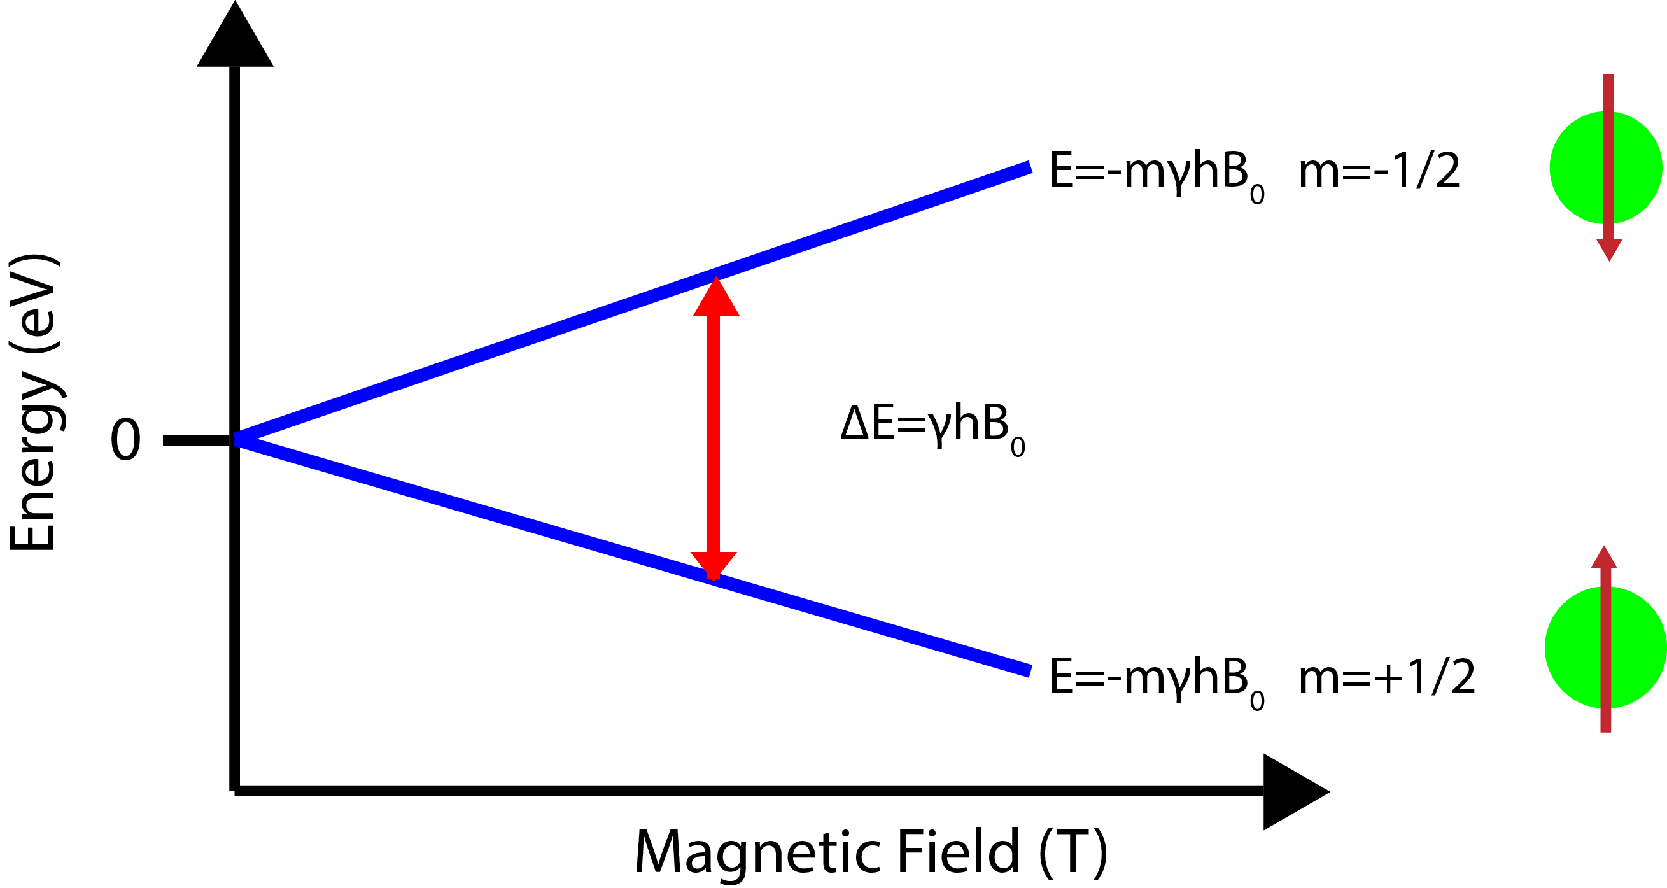
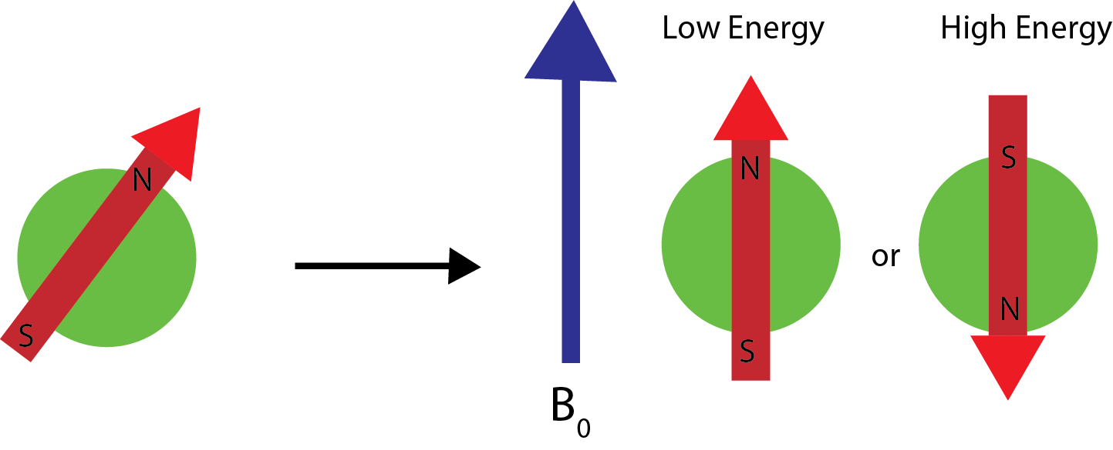
A aplicação do campo magnético externo alinha os momentos magnéticos a favor ou contra o campo.
Transições de Energia (Spin Flip)
$$E=\frac{1}{2}ℏγB_{o}$$
$$∆E=ℏγB_{o}$$
$$E=−\frac{1}{2}ℏγB_{o}$$
$$E=−m_{s}ℏγB_{o}$$
$$\frac{1}{2}ℏγB_{o}$$
A frequência de precessão é denominada frequência de Larmor, que é idêntica à frequência de transição.
$$E=hν$$
$$−\frac{1}{2}ℏγB_{o}$$
$ν=\frac{γB_{o}}{2π}$, $γ$ característico de protons, neutrons e electrons

Slide 17
B_{o}
EPR
ΔE=hν=g_{e}μ_{B}B₀
NMR
ΔE=hν=2μ_{p}B₀
$$μ_{P}=2.7928\frac{eℏ}{2m_{p}}$$
$$μ_{B}=\frac{eℏ}{2m_{e}}, g_{e}=2.0023$$
Condições: A (n + p) ímpar
H, ¹³C, ¹⁵N, ³¹P
Condições: paramagnetismo (elétrons não-pareados)

Slide 18
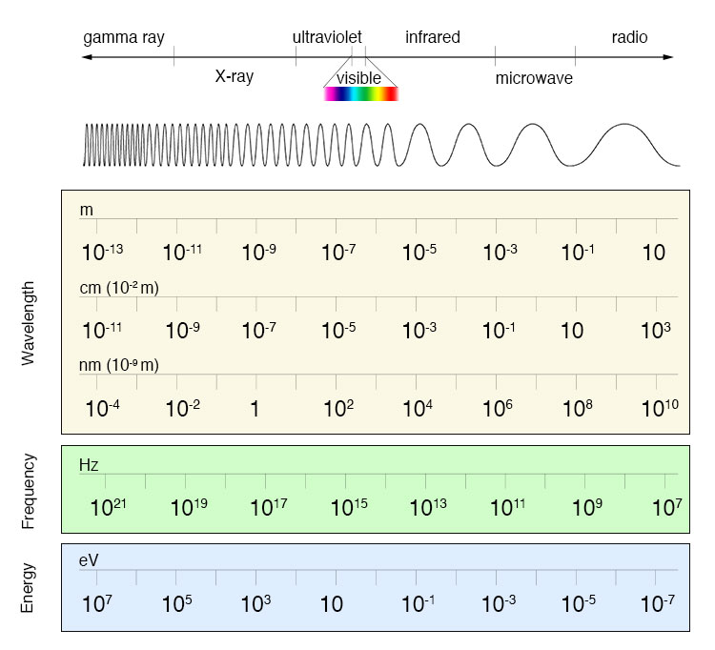
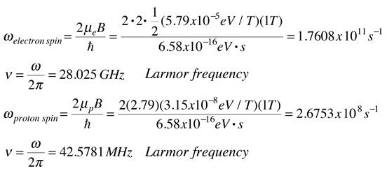
An example for magnetic field 1 Tesla follows:
Magnitude na superfície da Terra varia de 25 a 65 μT (0,25 a 0,65 Gauss).
$$ω_{e}=\frac{2μ_{e}B}{ℏ}$$
$$υ_{e}=\frac{ω_{e}}{2π}=28,025 GHz (Larmor frequency)$$
EPR
$$ω_{p}=\frac{2μ_{p}B}{ℏ}$$
$$υ_{p}=\frac{ω_{p}}{2π}=42,578 MHz (Larmor frequency)$$
NMR

