Slide 1
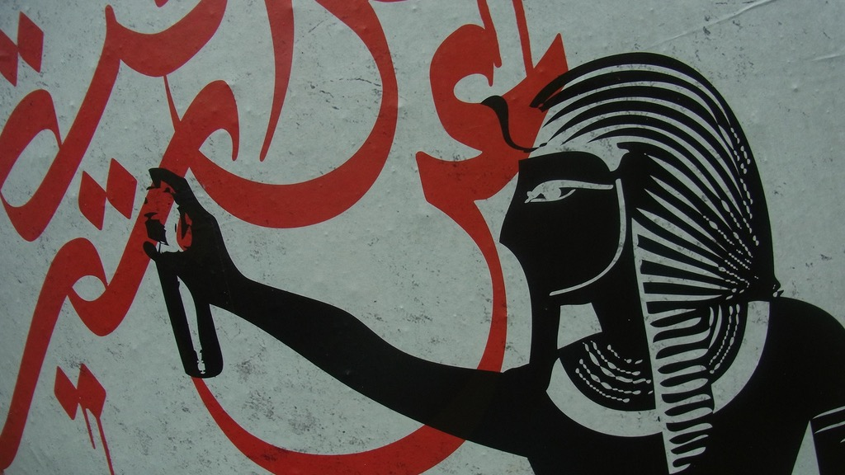
Major Themes in Contemporary Middle East
LECTURE 5.
Migration, Urbanisation & Environment

Slide 2
Why do people migrate?
What are the effects of migration for host & receiving countries?
What connects issues of migration, urbanisation and the environment in the 21st century?

Slide 3
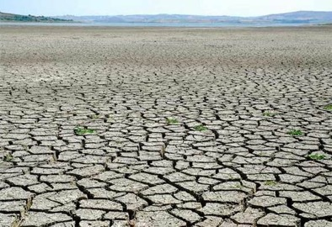
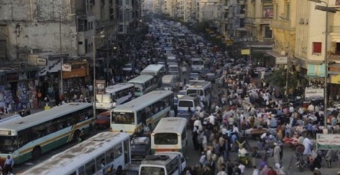
Migration
Environment
Urbanisation

Slide 4
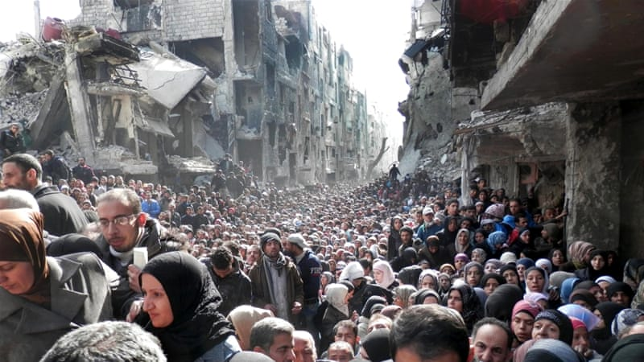
I. Migration

Slide 5
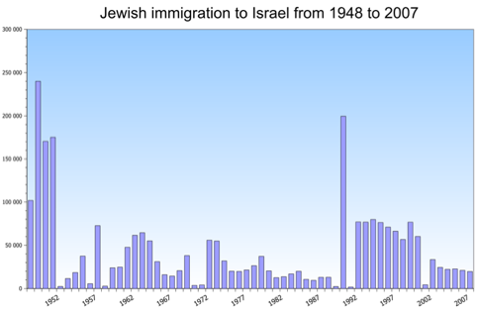
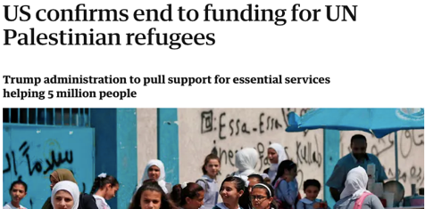
Migration in Middle East
At the turn of the 20th century
Displaced Muslims from Balkans, Caucasia into Ottoman Empire
Economic migration from O.E. to the West
WWI and the collapse of Ottoman Empire
Displacement through war, ethnic cleansing, population exchanges
Israel – Palestine
Waves of Jewish emigration to Palestine
Early 20th century
Post-1948
Post-1990
Palestinian refugees post-1948
5 million living outside of Palestine/Israel
70% of Jordan’s population of 9 million (2m in refugee camps)
UN Relief and Works Agency (UNRWA)
Guardian 31.08.18

Slide 6
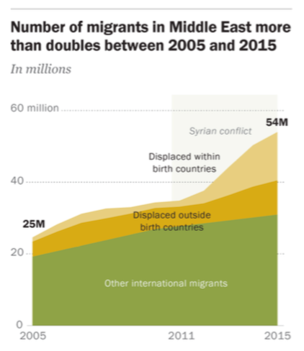
Migration in Middle East
21st century
Migrant population increased by 120% between 2006 and 2015
1 in 10 people in M.E. today are either international migrants or were forcibly displaced
Two major factors
Economic opportunity (40%) → non-displaced migrants
Conflict (60%) → displaced migrants

Slide 7
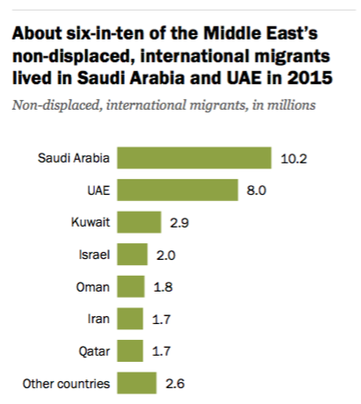
Migration in Middle East
1. Economic opportunity
Migration to resource-rich Gulf countries + Israel
Populations of Kuwait, Qatar, UAE majority migrant workers
Indications of job growth slowing down due to low oil prices; thousands of unemployed migrants across the Gulf.

Slide 8
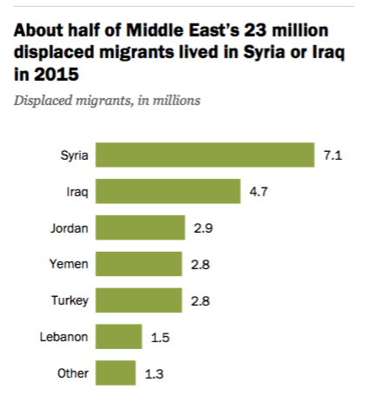
Migration in Middle East
2. Conflict
23m displaced migrants (40% of world migrant population)
59% of those are IDPs (almost all in Syria, Iraq and Yemen)
Migrants displaced across borders
Jordan
Lebanon (1.5m+ Syrians in 6m population)
Turkey (4m+ Syrian refugees)
Iran (2.5m, 1m registered, mostly Afghan)

Slide 9
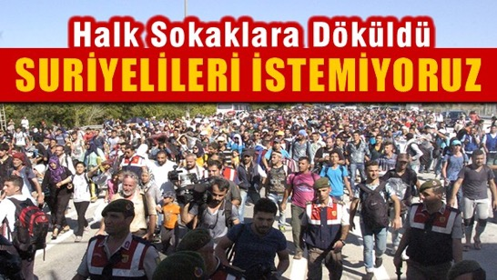
Migration in Middle East
“People poured to the streets: We don’t want the Syrians”
Ex. Syrian refugees in Turkey
Rising tensions, xenophobia, anti-Syrian sentiment (though less than in the West)
“Don’t want Syrian in my country”
“In recent years, Syrians wounded 4200 Turks, raped 600 Turkish women”

Slide 10
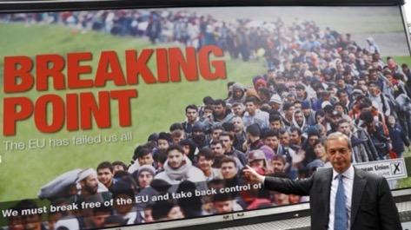
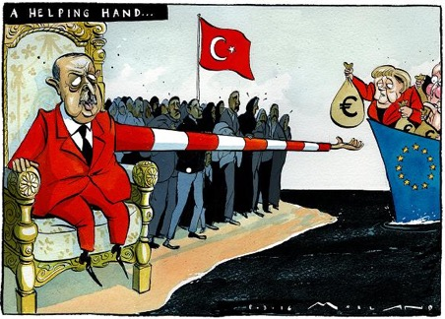
Migration in Middle East
Anti-refugee poster in Brexit 2016
Ex. Syrian refugees in Turkey
Rising tensions, xenophobia, anti-Syrian sentiment (though less than in the West)
Syrians as a political bargaining chip:
Turkey on the migration route
Fear of “Muslim invasion” in Europe
EU – Turkey refugee deal 2016
Turkey to stop refugee flow in turn for political and financial assistance
EU – TR refugee deal

Slide 11
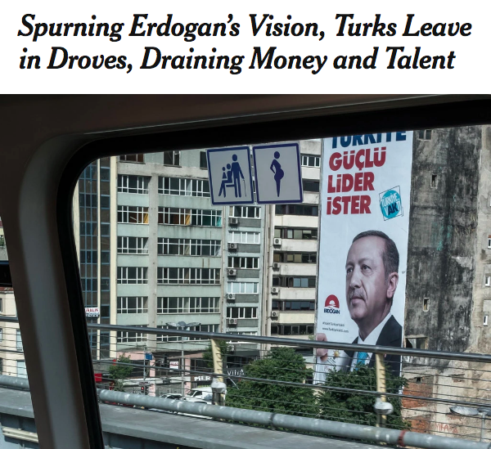
Migration in Middle East
Ex. Syrian refugees in Turkey
Rising tensions, xenophobia, anti-Syrian sentiment (though less than in the West)
Syrians as a political bargaining chip:
Turkey on the migration route
Fear of “Muslim invasion” in Europe
EU – Turkey refugee deal 2016
Turkey to stop refugee flow in turn for political and financial assistance
Turkish migration from Turkey since 2016 coup attempt
Upper & middle-class, educated, professional, intellectual, minority groups

Slide 12
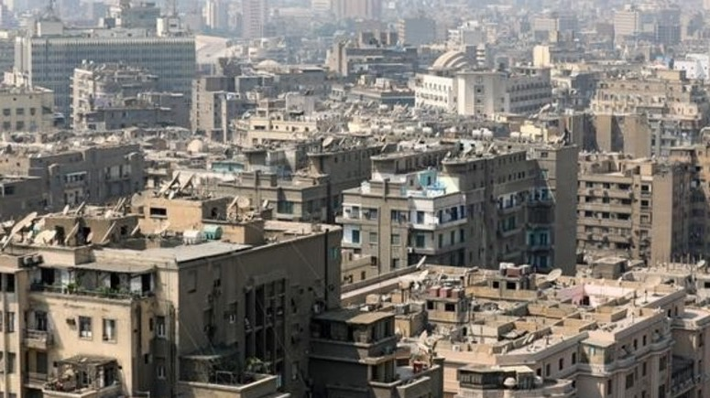
II. Urbanisation

Slide 13
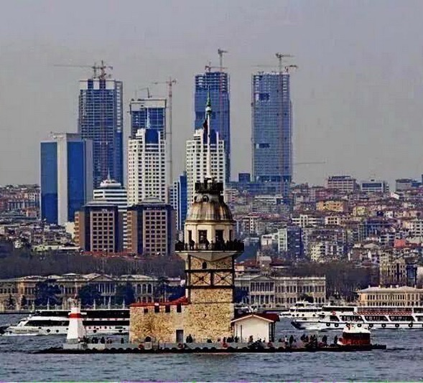
Urbanisation
Rural to urban migration
Concentration of economic activity in urban centres
Industrialisation + Service based economy
Population growth
Middle East…
Fastest growing urban populations for over 50+ years
Over 70% live in urban areas (in GDD, 85%)
“Global Cities”: Dubai, Istanbul, Doha
Megacities: Cairo, Istanbul, Tehran

Slide 14
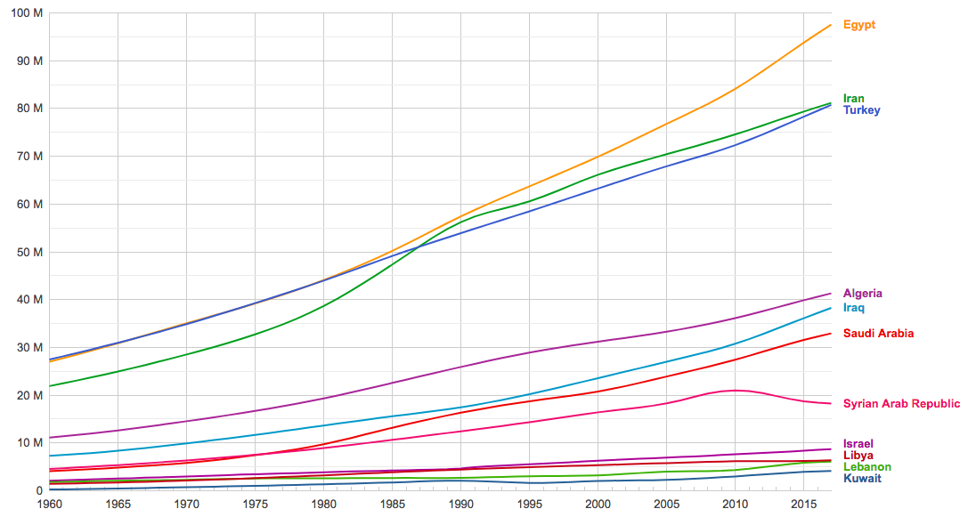
Population

Slide 15
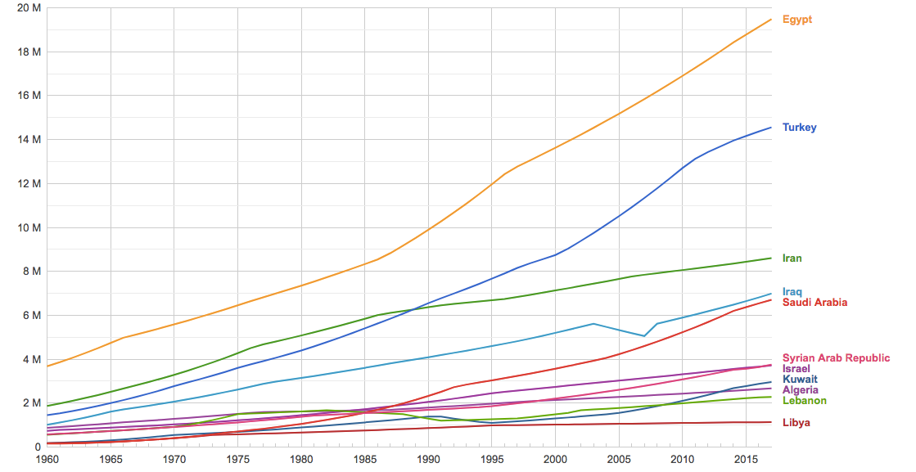
Population in largest city

Slide 16
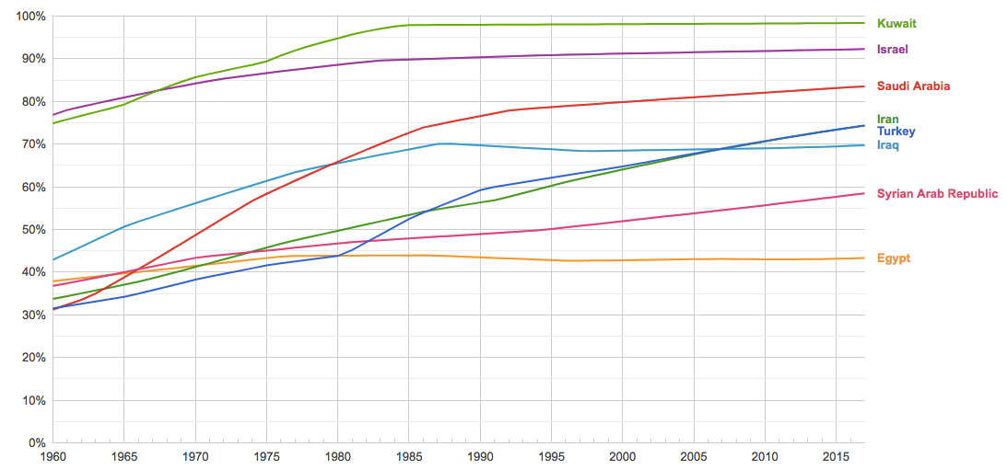
Population (% of total) - urban

Slide 17
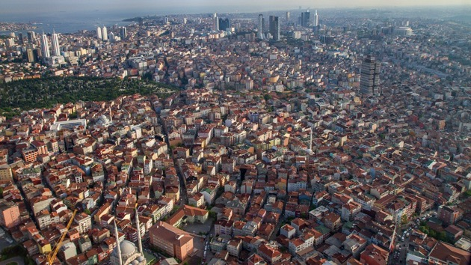
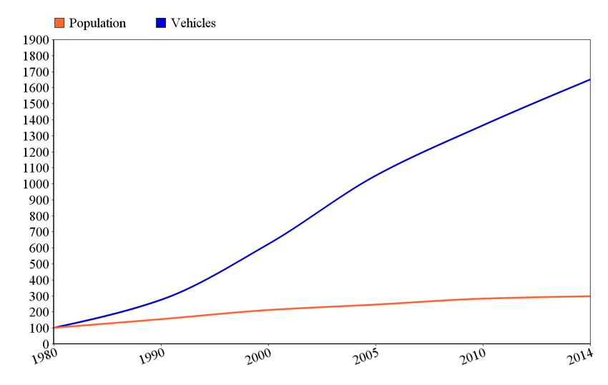
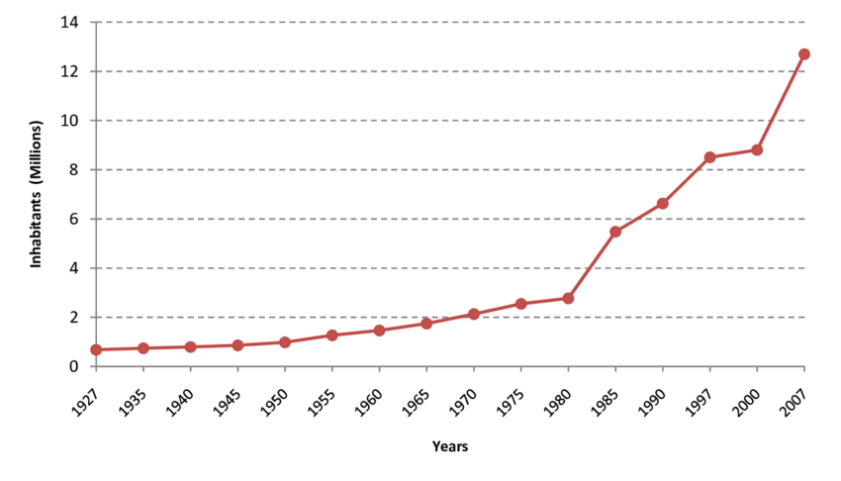
Istanbul
Population: 15 million
Registered vehicles: 4.1 million

Slide 18
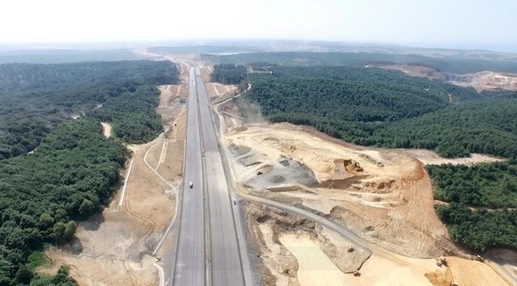
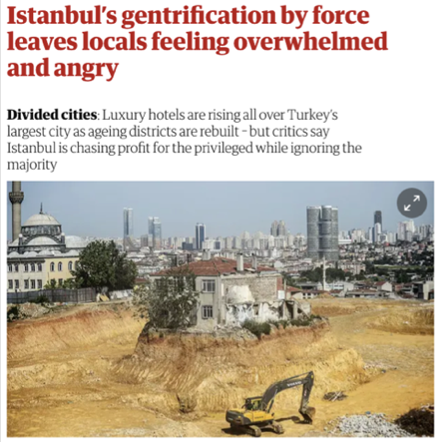
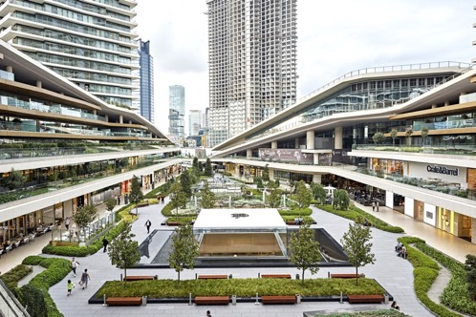
Urbanisation
The city as a site of implementation and resistance to neo-liberal developmentalism
Privatisation of public space
Commodification of public services
Gentrification & pushing the working class to the outskirts
Insecure employment
Construction-based growth: private residences and shopping malls
Energy intensive expansion

Slide 20
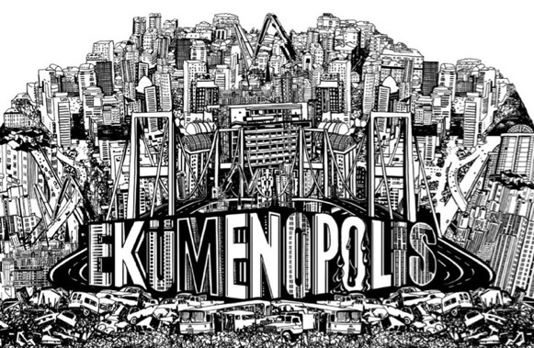
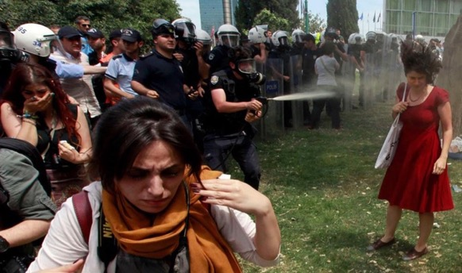
Urbanisation
The city as a site of implementation and resistance to neo-liberal developmentalism
Worst results when mixed with lack of accountability, corruption & clientelism
Protest and repression
Turkey & Brazil 2013
Ekumenopolis: The City Without Limits (2012)
https://www.youtube.com/watch?v=H9-bi32mwi8
https://www.youtube.com/watch?v=H-NS0QYUIQQ
Gezi Park protests 2013

Slide 21
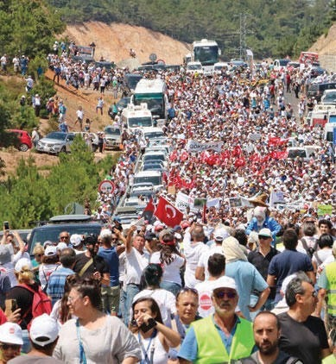
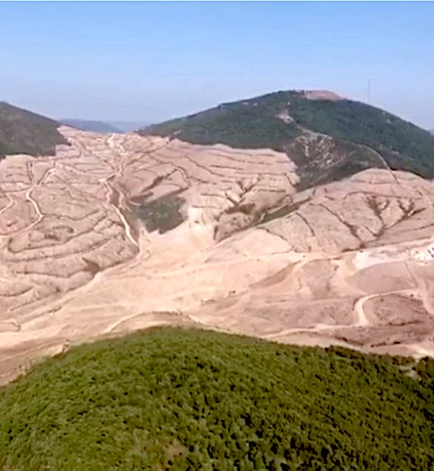

Slide 22
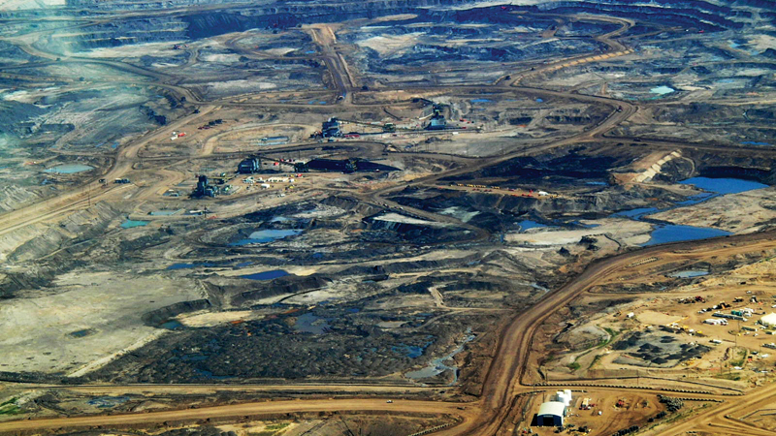
III. Environment

Slide 23
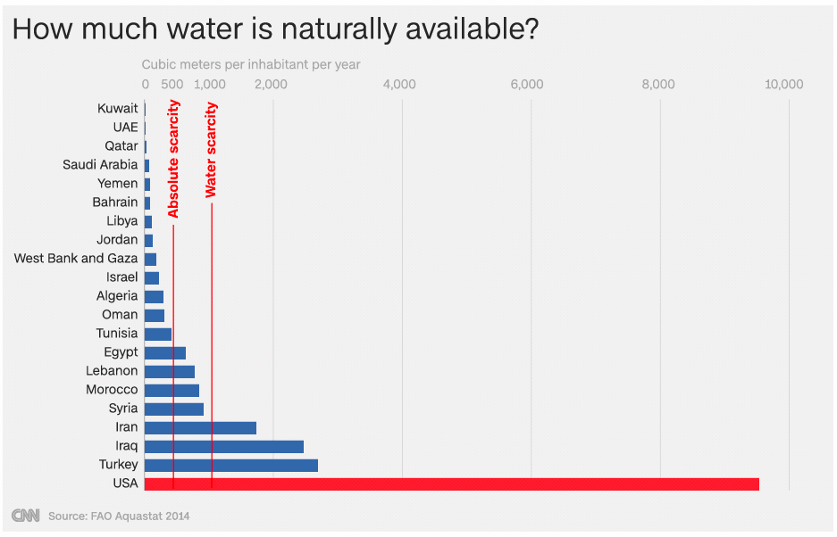
Water

Slide 24
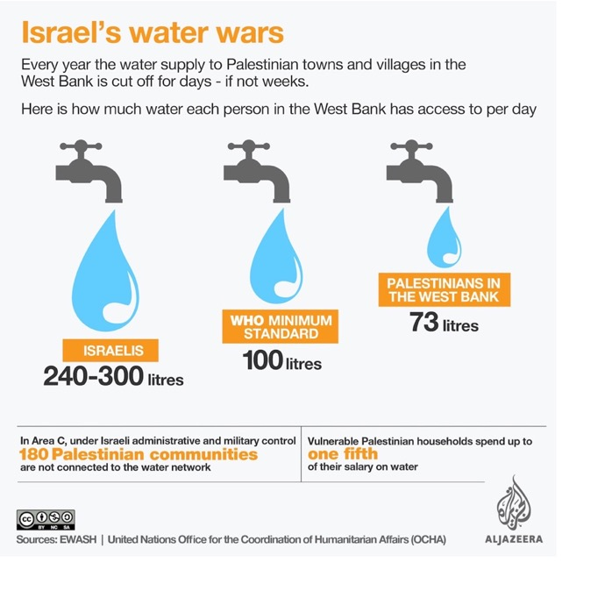
Water
A source of international conflict
Israel/Palestine
Israel has denied Palestinians access to the entire Lower Jordan River since 1967
80 to 85% of groundwater in the West Bank is used either by Israeli settlers or flows into Israel.

Slide 25
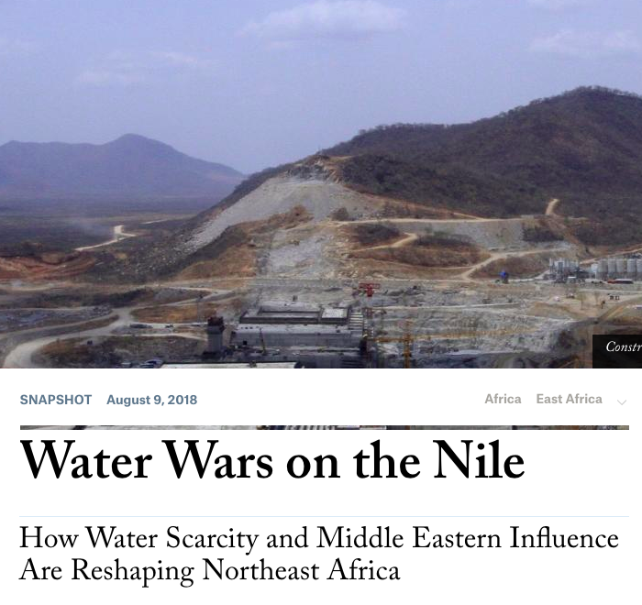
Water
A source of international conflict
Ethiopia/Sudan/Egypt/Saudi Arabia
Ethiopia’s Rennaissance Dam Project threatens Nile water supplies downstream in Egypt and can lead to conflict
Saudi Arabia, threatened with water shortages, looking to Africa for new resources
Foreign Affairs, 9.08.18

Slide 26
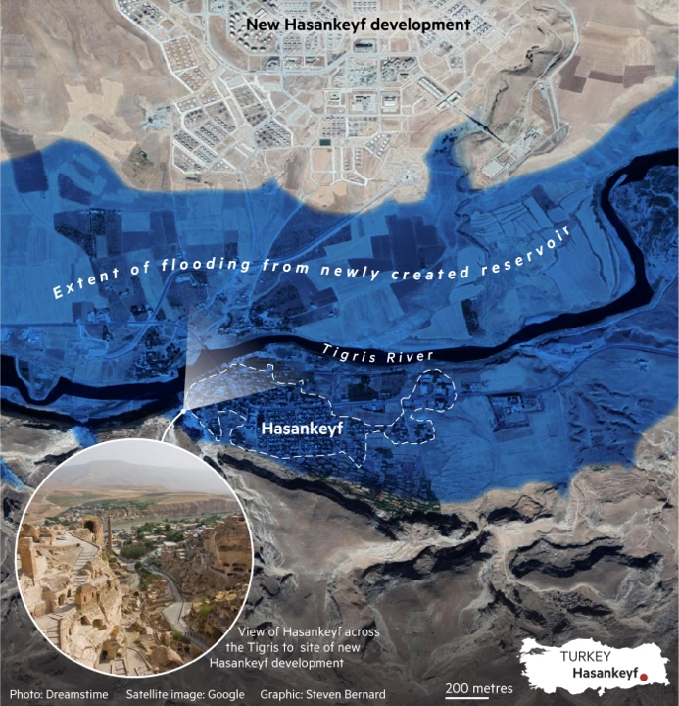
Water
A source of international conflict
Turkey/Syria/Iraq
Turkey’s dam projects on the Euphrates and Tigris rivers threatens water flow to Syria and Iraq
Turkey threatened to cut water to Syria in the 1990s
Iraq asked Turkey to stop filling the Ilisu Dam twice in recent years
Recommended reading: “Why water is a growing faultline between Turkey and Iraq”, FT, 4.7.18

Slide 27
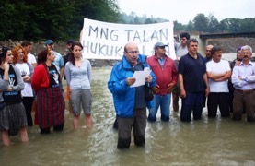
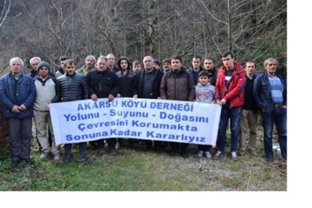
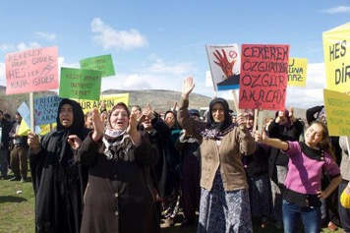
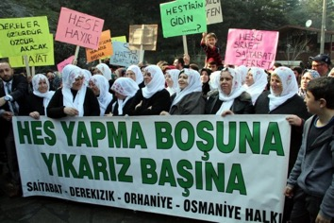
Water
A source of domestic conflict
Turkey
Hydroelectric dams… crucial for oil-poor economies BUT
Excessive damming threatens environment, sensitive ecologies, communities and cultural heritage
NatGeo brief on Ilisu Dam
Local protests against hydro construction in Turkey

Slide 28
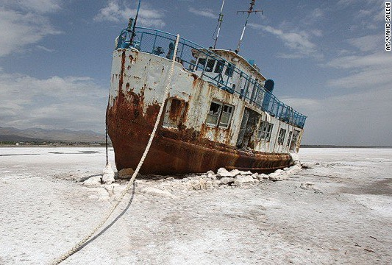
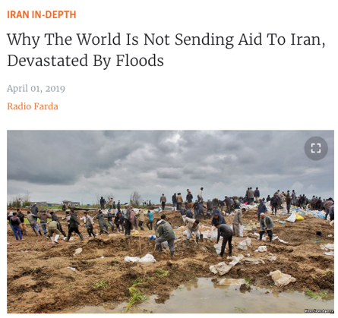
Water
A source of domestic conflict
Iran
Water shortages, in part result of climate change, in part excessive damming & mismanagement
Severe droughts force rural to urban migration
Hottest temperatures recorded: 53 Celsius!
“Climate refugees”
In 2018 → Massive protests across the country, mixed with socio-economic and political woes
And now → flash floods
Lake Urmiyah, once one of the largest salt lakes, is drying up

Slide 29
Climate Change
A cause of the Arab Spring?
”Threat multiplier” argument:
“The consequences of climate change are stressors that can ignite a volatile mix of underlying causes that erupt into revolution”
“Global warming may not have caused the Arab Spring, but it may have made it come earlier.”
Wheat shortages in China → bread prices in Egypt → Egyptian uprising
Severe drought → farmers to cities → Syrian uprising
Climate
Conflict
“Threat multiplier argument is tenuous, simplifying and depoliticising” – Jessica Barnes
Migration

Slide 30
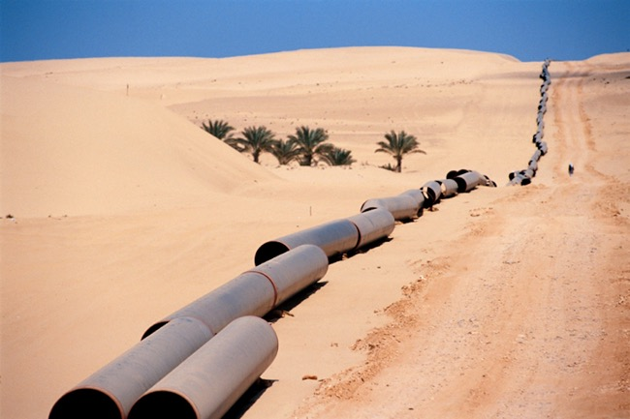
Homework
“What, in your opinion, is the most critical natural resource affecting stability in contemporary Middle East; and why?”
One paragraph
Due: Midnight, Monday 6 April

Slide 31
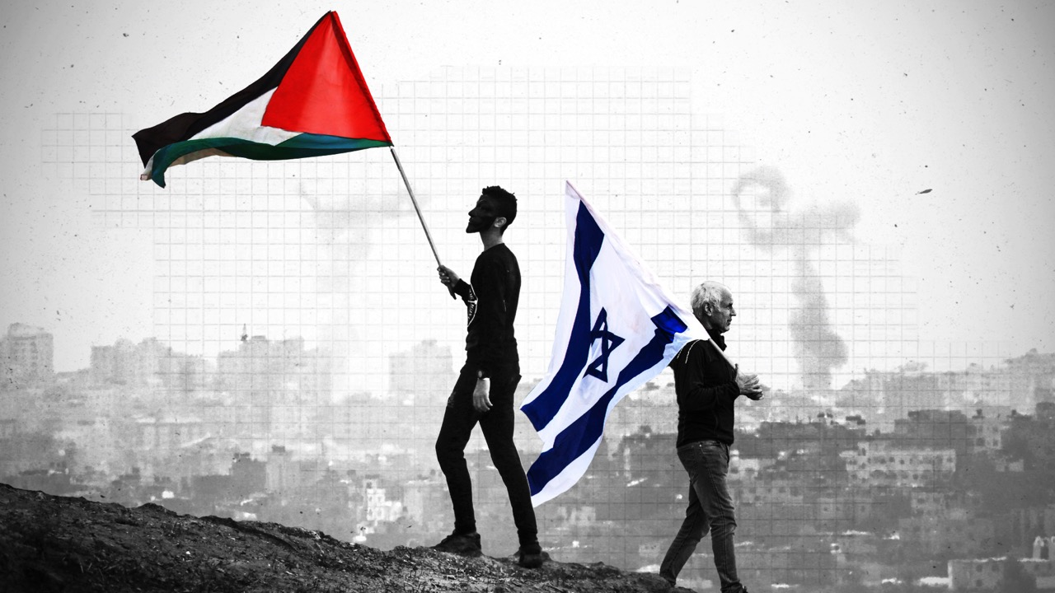
Lecture 6.
Israeli Palestinian Conflict

